Slide 1
Optimization in IoT
Chenna Keshava B S
C K Srinivasan

Slide 2
Introduction
Critical to applications across multiple domains
Examples:
Ecological Monitoring
Environmental Observations
Smart Homes
Smart Cities
Distributed AI On The Edge

Slide 3
Challenges in Large Scale IoT
Modelling
Organisation of Data
Effective Utilisation of Sensory Inputs and Devices
Communication in IoT
Deployment of IoT Apps

Slide 4
Literature Review of Important Research Papers

Slide 5
M2M optimization
Modelling the problem of Machine-to-Machine(M2M) Communication.
Traditionally the graph of sensors is used to find the Minimum Spanning Tree (MST).
The MST ensures that the cost of communication is the least.
The latest research trends explore the usage of Directed Acyclic Graph (DAG) to achieve the same goal.

Slide 6
CCN Traffic Optimization for IoT
CCN : Content-Centric Networking
CCN model for network optimisation
CCN has the merits of both hierarchical and data centric approaches.
Adaptation of CCN technology to Wireless Sensor Networks(WSN)

Slide 7
Architecture for Ubiquitous Computing
Generic architecture for ubiquitous computing applications.
Usage of micro electronic mechanical devices (MEMD).
Utility of Wireless Sensor Networks(WSN) in enabling Ubiquirous Computing

Slide 8
Collaboration in IoT
Collaboration for development of IoT Applications.
Management and integration of all dev processes of an IoT product
Helps in more diverse collaboration between people of wider technical expertise.

Slide 9
Generic Architecture for Distributed IoT Apps
Integrated architecture for IoT apps: Cloud, Gateways and Embedded Devices.
An distributed architecture similar to MVC model.
A single wholesome model for all the layers(not distinct for the 3 tiers).
Structured pedagogy for the study, training and research in IoT Applications.

Slide 10
Virtual Storage Systems
Iot storage to optimally use the free space on the embedded devices in the iot network.
Efficient usage of free space on all of the devices on the network.
Ensures maximal utilization of the free space.

Slide 11
Usage of IoT On The Edge
Keeping IoT devices on the edge.
Performing the computations near the consumer, instead of the Cloud
Advantages: Low Latency, Low Communication Overhead, Privacy, Security.
Example of Smart Hospital and Smart Railway System.

Slide 12
IoT in Manufacturing Supply Chain
Management of supply chain entirely using iot devices.
Usage of Data for Decision Making Process
Intelligent decisions using the latest data obtained from sensors.

Slide 13
IoT Based Smart Rehabilitation System
Rehabilitation of aged people
Usage of fewer humans for taking care of old-aged people
Average age of countries like Japan is well above 50
Using technology like IoT for nobl causes.

Slide 14
Overview of IoT
Smart City Project
Ensuring IoT integrates Sensors and Actuators
Data Collection at Sensor side
Decision Making at Actuators side using Real-Time Data.

Slide 15
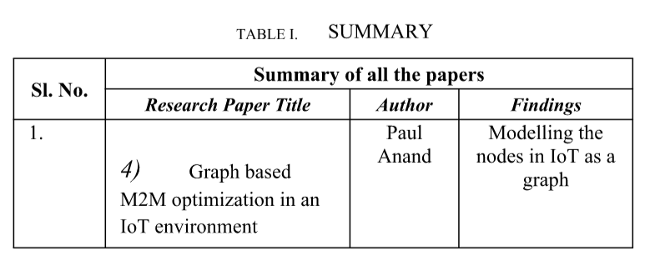
Discussion and Summary

Slide 16
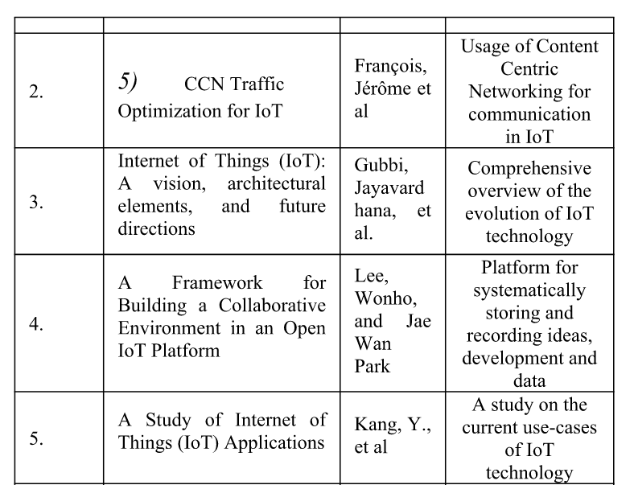

Slide 17
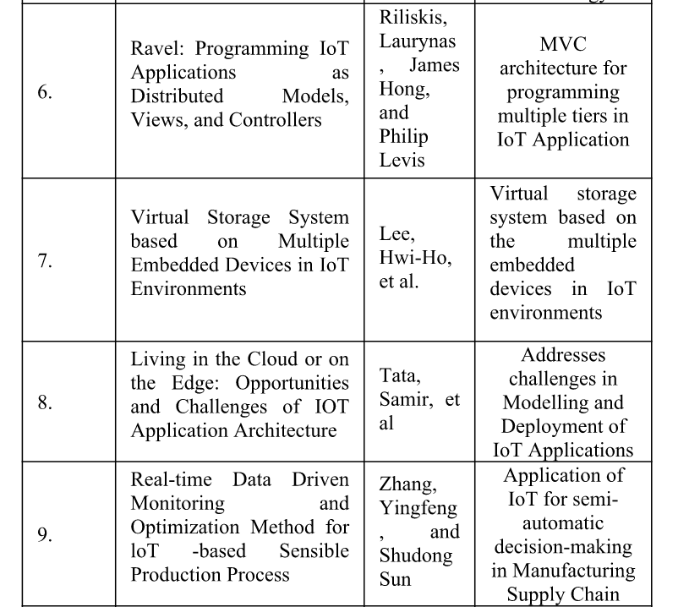

Slide 18
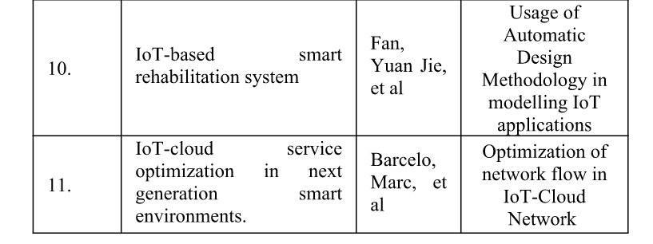
Summary

Slide 19
Conclusion
IoT has the potential to disrupt many of the critical fields empowering mankind. A critical aspect is to focus the research on the above-mentioned areas. Advancements in these areas can accelerate the percolation of IoT applications into all strata of the society.

Slide 20
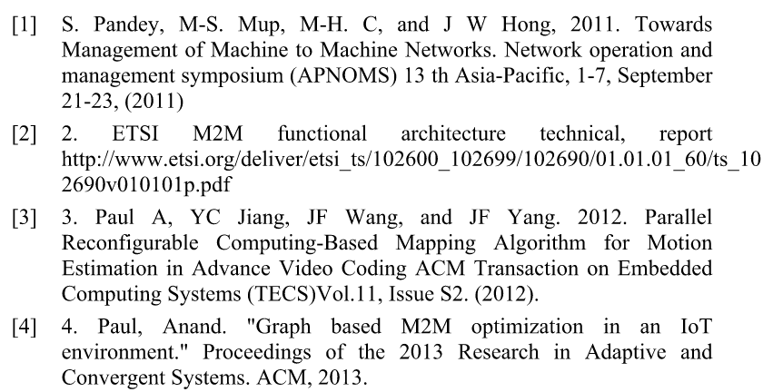
References

Slide 21
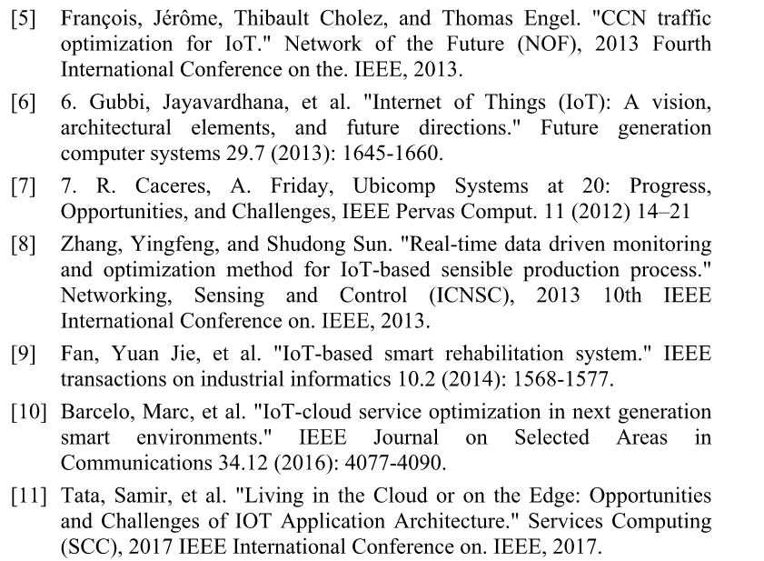

Slide 22
