Slide 1

A Project Review Meeting on College Canteen Token System
By
Member 1 Sai Saketh Vutharavalli roll 2520090055
Member 2 Burlla Chenna Malleshwar Reddy roll 2520030546
Team Number: 1
Under the guidance of
Dr. Nirmala Jyothi
Associate Professor
Department of Computer Science and Engineering
Koneru Lakshmaiah Education Foundation (Deemed to be University estd. u/s. 3 of the UGC Act, 1956) Off-Campus: Bachupally-Gandimaisamma Road, Bowrampet, Hyderabad, Telangana - 500 043. Phone No: 7815926816, www.klh.edu.in

Slide 2
Outline of the Presentation
Abstract
Introduction
Problem Statement
Project Flow Diagram
Objectives with Justification
Modules[Frontend web pages]
Expected Outcomes of the Proposed Work
Conclusion
References

Slide 3
Abstract
In today's fast-paced academic environment, long queues and manual order management in college canteens lead to significant time loss for students and operational inefficiencies for canteen staff. The College Canteen Token System is a web-based application designed to digitize and streamline the entire meal pre-ordering process within a college campus. The system allows students to browse the daily menu, apply dietary filters (vegetarian/non-vegetarian), place orders within defined daily limits, and complete a mock payment — all through an intuitive web interface. Upon successful order placement, a unique QR-coded token is generated for each student, which serves as a contactless pickup pass at the canteen counter. On the administrative side, canteen staff and administrators are provided with a dedicated panel to manage the menu, monitor incoming orders in real time, track daily revenue through a billing dashboard, and send notifications to students regarding order status. The application is built using Node.js and Express.js for the backend REST API, with HTML5, CSS3, and JavaScript powering the frontend. Data is persisted using LocalStorage, eliminating the need for complex database configuration. QR code generation is handled via the qrcode npm package, and all APIs are tested using Postman. This project demonstrates practical application of full-stack web development concepts including RESTful API design, modular frontend architecture, role-based access control, and real-time order management — making it a relevant and impactful solution to an everyday campus problem.

Slide 4
Introduction
The KLH college canteen serves hundreds of students daily during short break periods. Traditional
queue-based ordering causes significant time waste and operational challenges for canteen staff.
What is the Canteen Token System?
Students pre-order meals from their devices before break time
Receive a unique QR-coded token for contactless pickup at counter
Track real-time order status through in-app notifications
View past orders and payment history anytime
Admin Capabilities
Manage menu items and toggle daily availability
View and process incoming orders in real time
Access billing dashboard with revenue reports and stats

Slide 5
Problem Statement
KLH University students face the following challenges at the college canteen:
Long queues during short break periods (10-15 min) result in students missing meals
Manual order tracking leads to errors, missed orders, and wrong item delivery
Students have no prior visibility into daily menu availability or sold-out items
Cash handling at counter causes delays and is unhygienic in a post-pandemic setting
Canteen staff have no digital record of orders, leading to billing inaccuracies
No system exists to cap per-student orders, causing resource and food wastage
These issues directly impact student well-being, canteen efficiency, and academic punctuality.
A digital token-based pre-ordering system is the ideal solution for KLH campus.

Slide 6
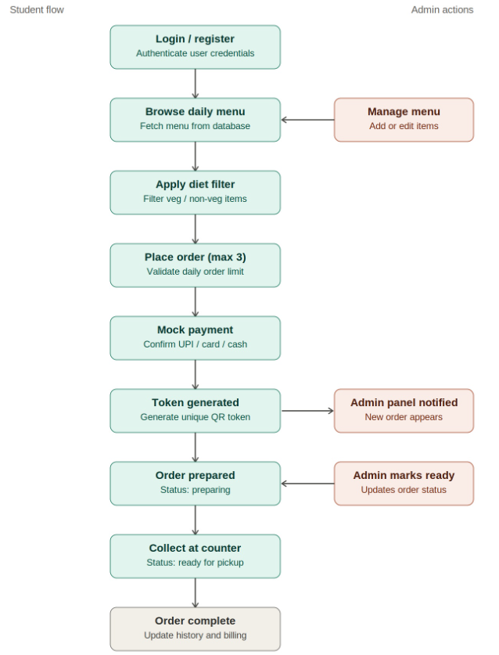
Project Flow Diagram

Slide 7
Objectives with Justification
Objective 1: Eliminate Queue Time
Allow students to pre-order meals online, removing the need to stand in canteen queues.
Objective 2: QR-Based Contactless Pickup
Generate a unique QR token per order enabling hygienic, fast, contactless collection.
Objective 3: Enforce Fair Daily Usage
Implement a daily cap of 3 orders per student to ensure fair distribution of meals.
Objective 4: Real-Time Admin Control
Provide canteen staff with a live dashboard to manage menu, orders, and revenue.
Objective 5: Dietary Preference Support
Allow students to filter menu by vegetarian or non-vegetarian preference easily.

Slide 8
Modules [Frontend web pages]
Module 1: Menu Display — Daily menu with veg/non-veg filters & availability badges
Module 2: Token Form — Order form with item selection, quantity control & special notes
Module 3: Dietary Filter — Filter menu items by vegetarian or non-vegetarian preference
Module 4: Daily Limit — Progress bar tracking 3-order daily cap per student
Module 5: Payment Mock — UPI / Debit Card / Cash at Counter with GST calculation
Module 6: Token QR Generation — Unique QR-coded token for contactless pickup
Module 7: Billing Dashboard — Revenue stats, category breakdown & transaction table
Module 8: Order History — Past orders filtered by student roll number
Module 9: Notifications — Real-time alerts for order status & canteen announcements
Module 10: Admin Panel — Manage menu, mark orders ready & configure settings

Slide 9

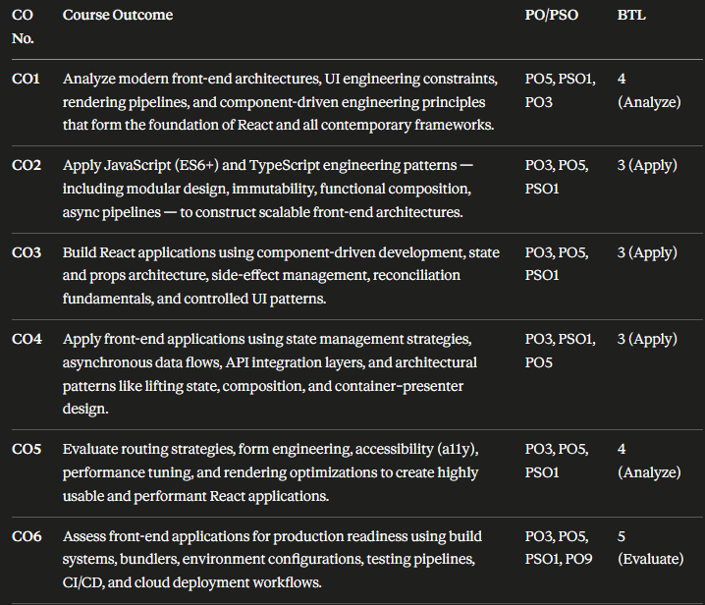
CO Mapping

Slide 10
Expected Outcomes of the Proposed Work
By the end of this project, the following outcomes are expected:
Students can pre-order meals and skip canteen queues entirely during break time
A QR-coded token system enables contactless, error-free order pickup at the counter
Canteen staff gain real-time visibility of all orders through the admin panel
Daily revenue, category-wise sales, and transaction history are tracked digitally
Per-student daily order limits reduce food wastage and ensure fair access to meals
Dietary preferences are respected through built-in veg/non-veg menu filtering
Students receive timely notifications when their order is ready for pickup
A working full-stack Node.js + Express.js REST API application is demonstrated
Overall Impact: Improved canteen efficiency, reduced student wait time, and a digitally
managed, hygienic meal ordering experience for the entire KLH campus.

Slide 11
Conclusion and Future Scope
Conclusion
The College Canteen Token System addresses the core problem of long queues and inefficient order management at KLH's canteen. By combining a student-friendly frontend with a robust Node.js backend and 10 well-defined modules, the application delivers a complete, practical, and deployable solution for the KLH campus environment.
Future Scope
Integration with real UPI/payment gateway (Razorpay / PayU)
MySQL database for persistent order and menu storage instead of LocalStorage
Mobile app version using React Native for easier student access
Facial recognition or RFID-based token verification at the counter
AI-based meal recommendation engine based on student order history

Slide 12
References
[1] Node.js Documentation — https://nodejs.org/en/docs
[2] Express.js Documentation — https://expressjs.com/
[3] MDN Web Docs: HTML5, CSS3, JavaScript — https://developer.mozilla.org
[4] qrcode npm Package — https://www.npmjs.com/package/qrcode
[5] Postman API Testing Tool — https://www.postman.com/
[6] KLH University Official Website — https://www.klh.edu.in
[7] Roy Fielding, Architectural Styles and the Design of Network-based Software
Architectures, University of California, Irvine, 2000.

Slide 13
Thank you

