Slide 1
AngularJS
The AngularJS players
$compile
$digest and $apply
Model View Whatever
Controller and $Scope
View and Templates
Models and Services
Routes

Slide 2
The Major ANGULaRJS Players
Who are the major players in AngularJS? How do they fit together?

Slide 3
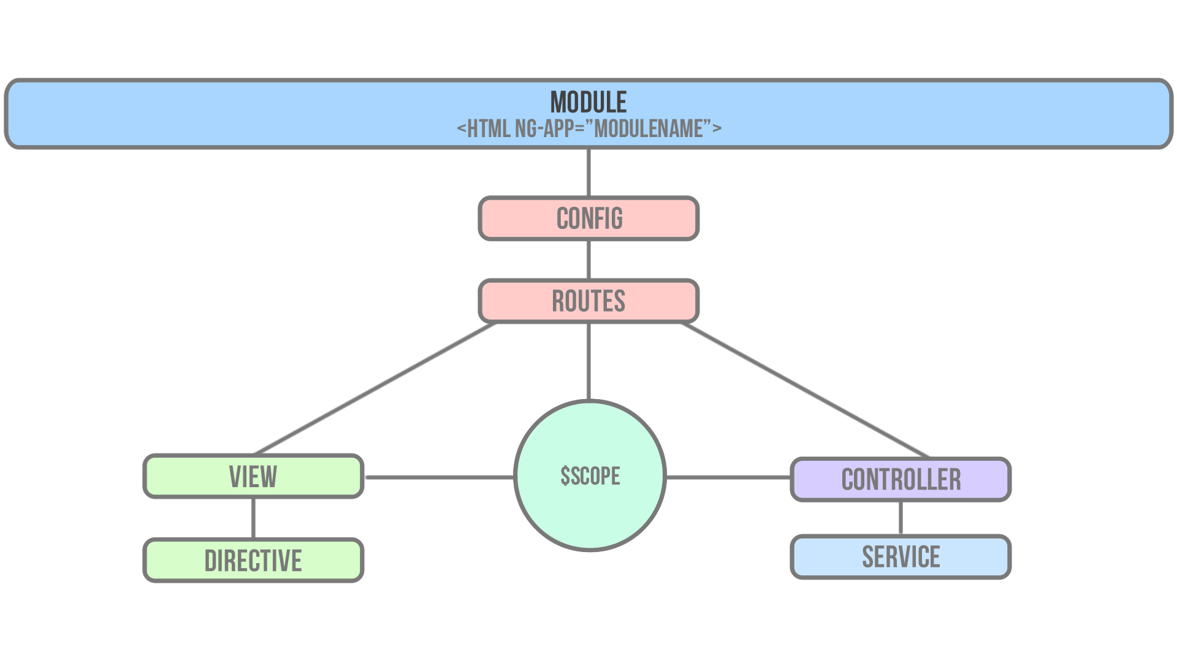

Slide 5
$Compile
$compile compiles DOM into a template function that can then be used to link scope and the View together

Slide 6
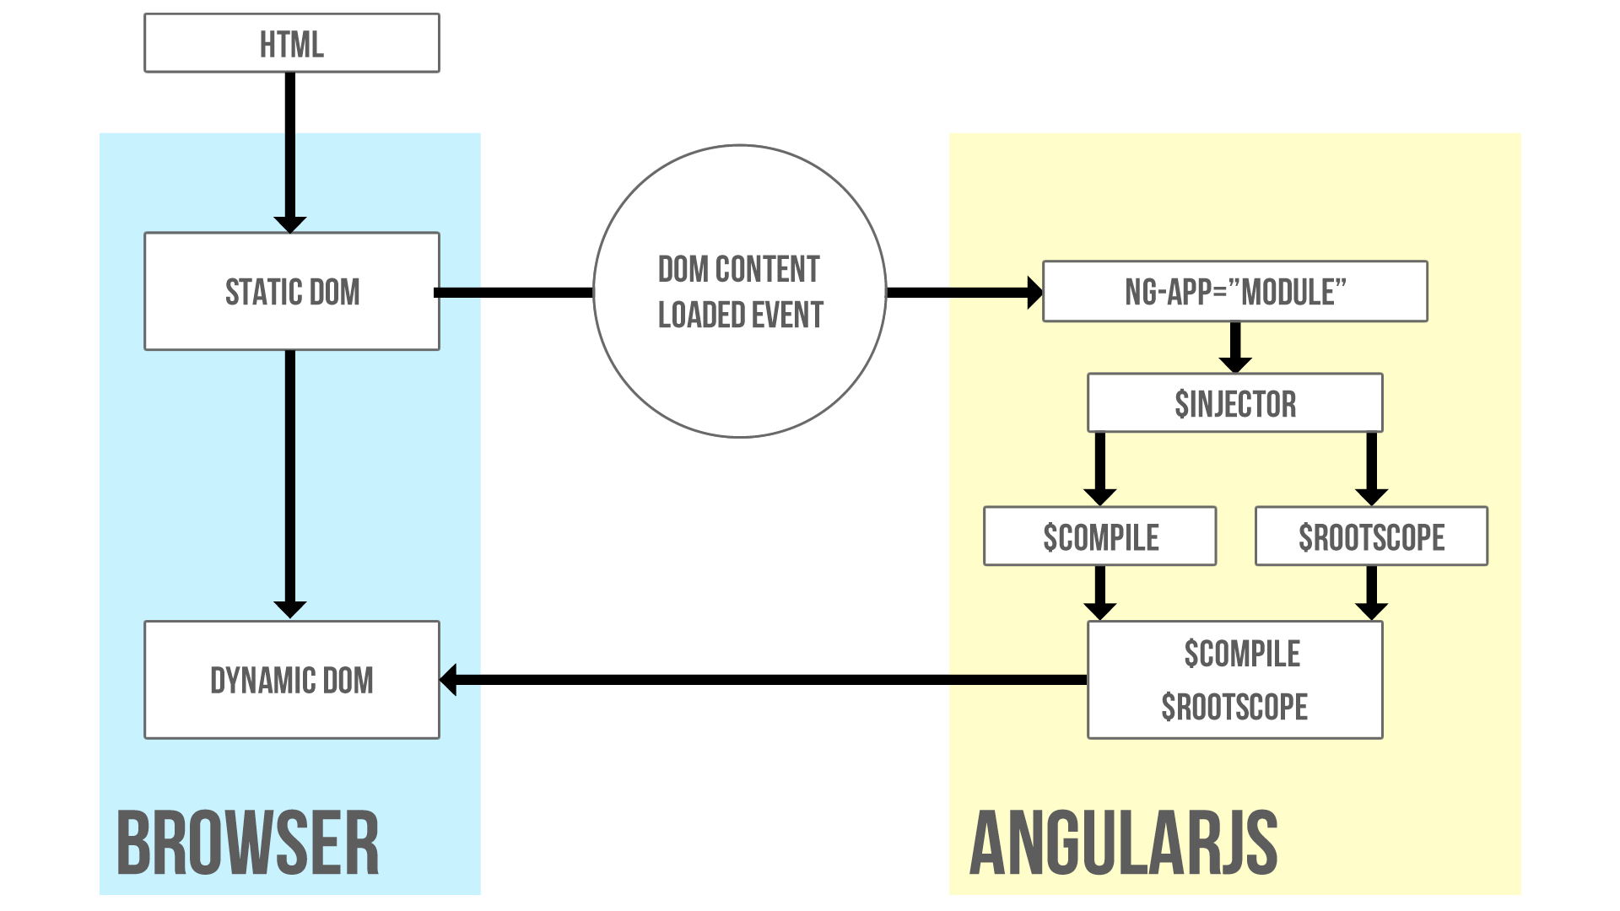

Slide 8
$DIGEst and $apply
$digest processes all of the watchers of the current scope
$apply() is used to notify that something has happened outside of the AngularJS domain
$apply forces a $digest cycle

Slide 9
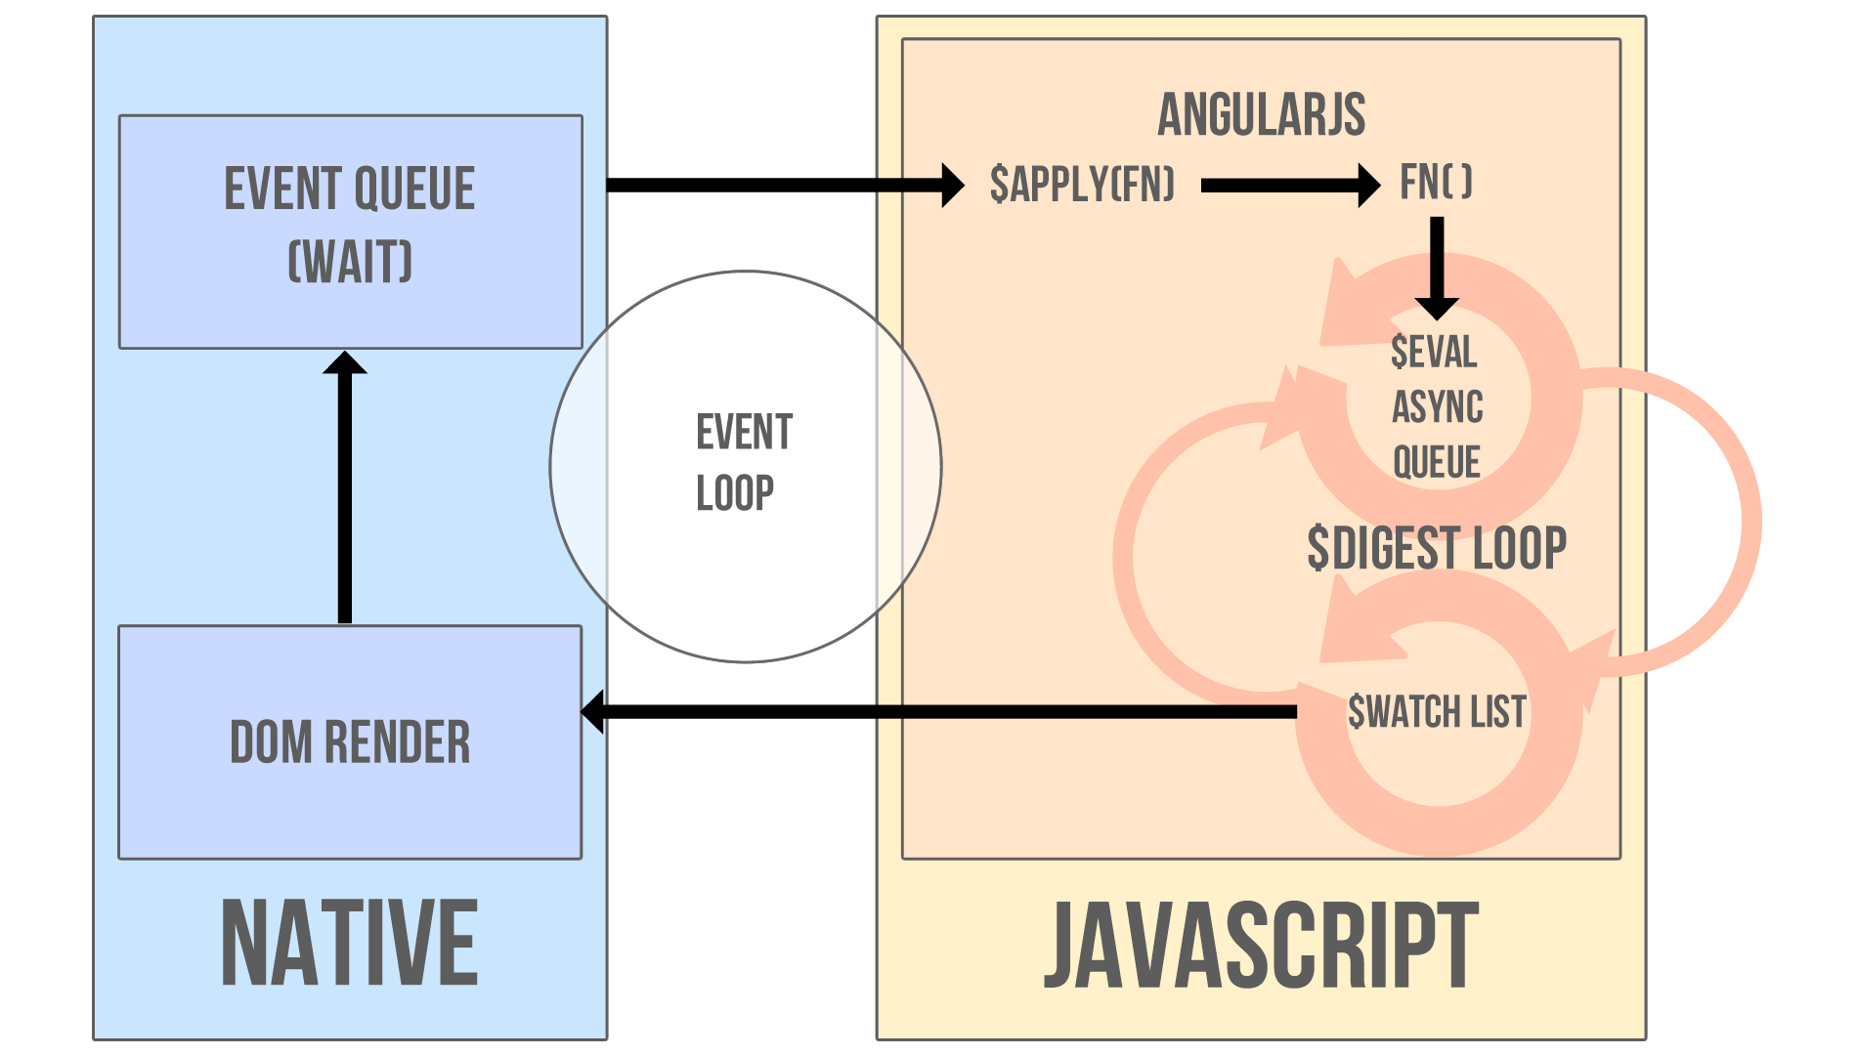

Slide 11
MVWhatever
Choose whichever pattern helps you be more productive

Slide 12
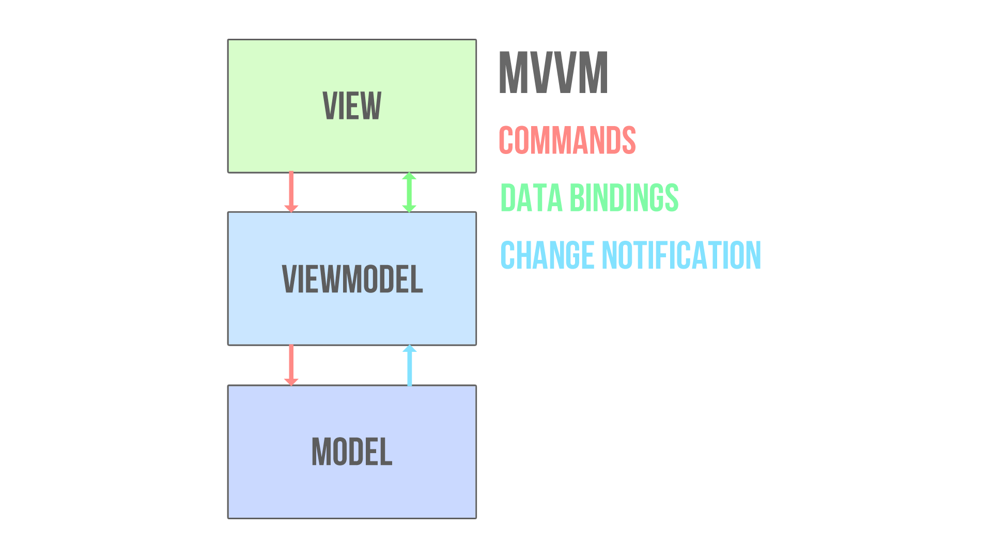

Slide 14
Controller and $Scope
$scope is the glue between the Controller and the View The Controller is responsible for constructing the model on
$scope and providing commands for the View to act upon
$scope provides context

Slide 15
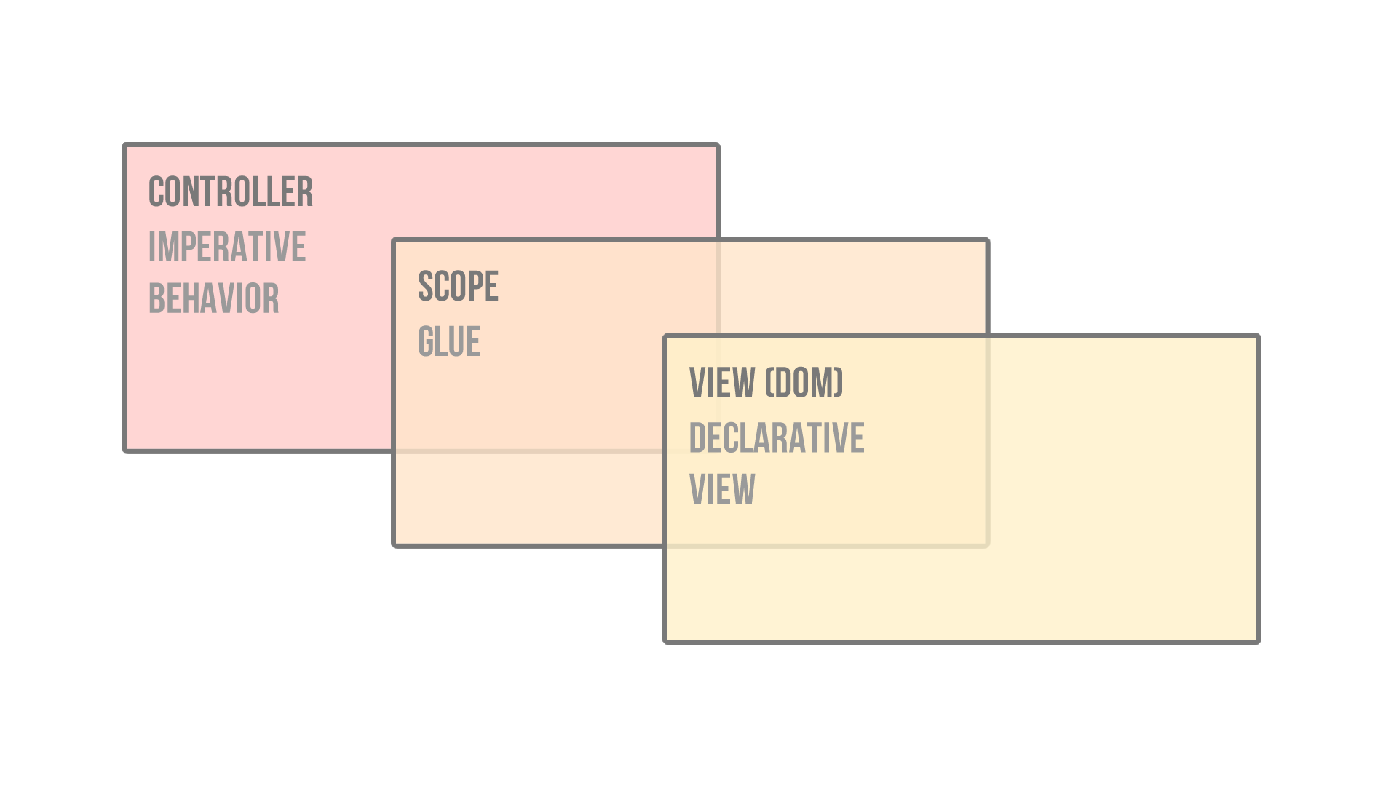

Slide 17
Best pRACTICEs
Controllers should...
Not know Anything about the view they control be small and focused
Should not talk to other controllers Should NOT own the domain model

Slide 19
VIEW and Template
The View is AngularJS compiled DOM
The View is the product of $compile merging the HTML template with $scope
DOM is no longer the single source of truth.

Slide 20
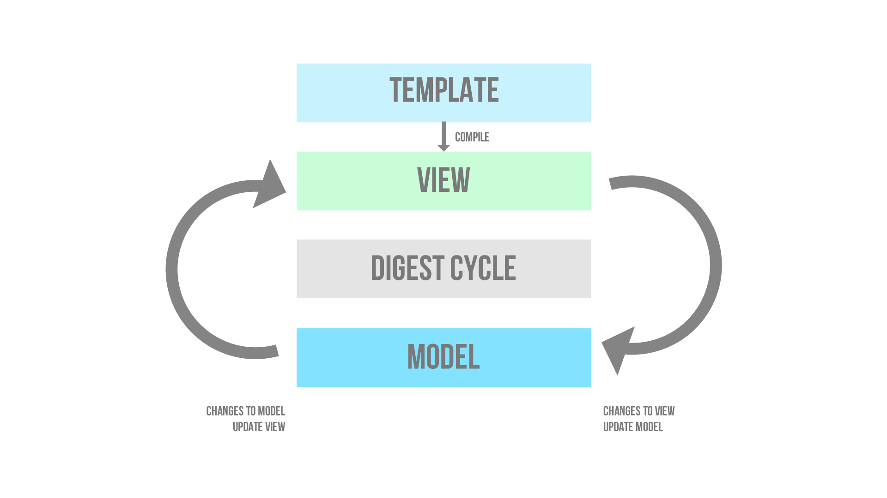

Slide 22
model and Services
Services carry out common tasks specific to the web application
Services are consumed via the AngularJS Dependency Injection subsystem
Services are application singletons Services are instantiated lazily

Slide 23
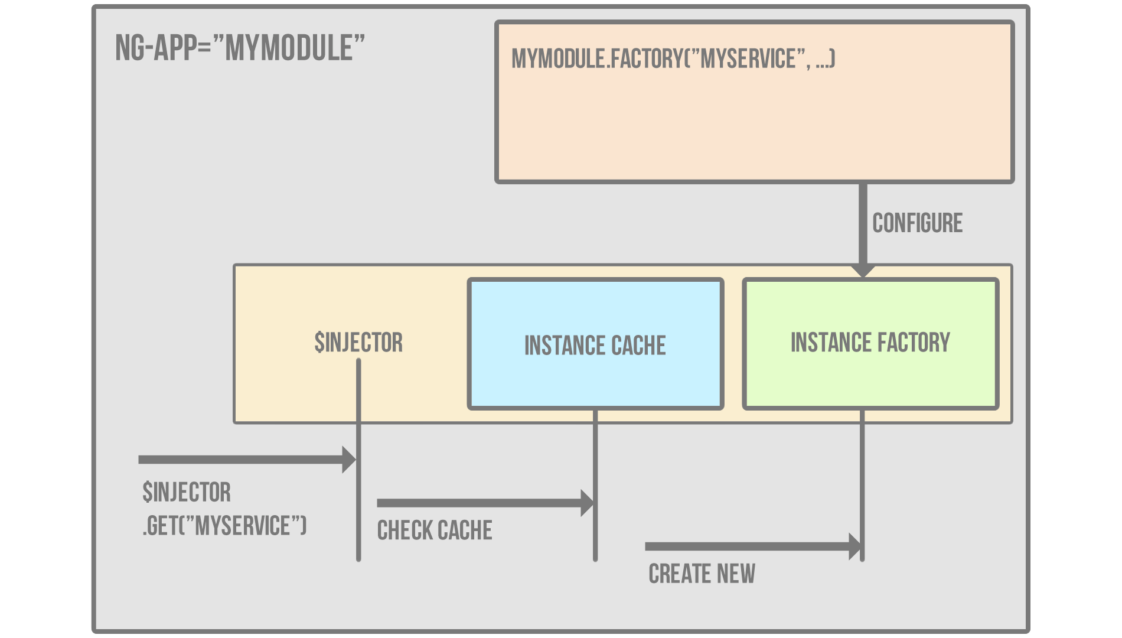

Slide 25
Routes
$route is used for deep linking URLs to Controllers and Views Define routes using $routeProvider
Typically used in conjunction with ngView directive and
$routeParams service

Slide 27
AngularJS Directive Basics
Directives as a DSL
The Simplified World View
Directive Definition Object
The Controller Function
The Link Function

Slide 29
Why A DSL?
People find DSLs valuable because a well-designed DSL can be much easier to program with than a
traditional library. This improves programmer
productivity, which is always valuable. In particular it
may also improve communication with domain experts,
which is an important tool for tackling one of the hardest problems in software development.
Martin Fowler

Slide 31
Fixed Languages are broken
[Without the ability to reprogram the language] programmers resort to repetitive, error-prone
workarounds. Literally millions of lines of code have been written to work around missing features in
programming languages.
Stuart Halloway

Slide 33
The simplified world view
Most simple directives consist of three things (or less)
Having a firm grasp on these three things will make advanced directives much more approachable

Slide 34
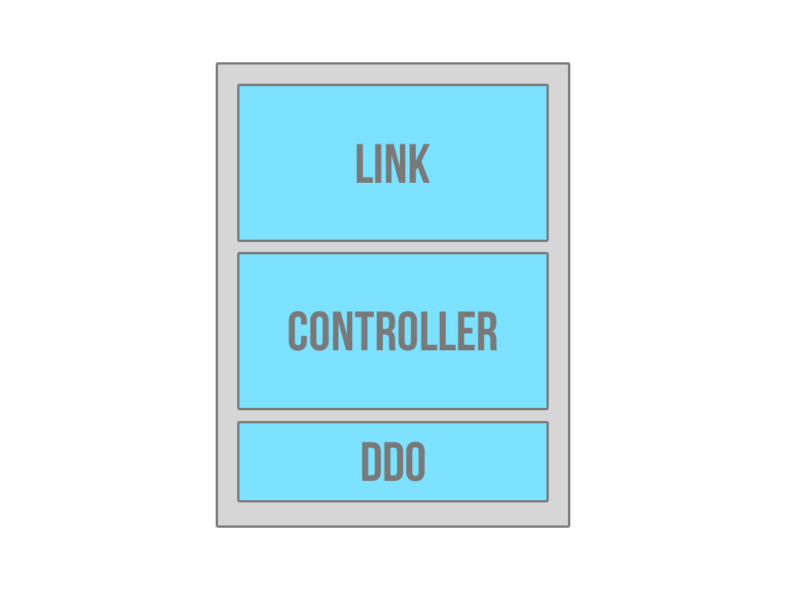

Slide 35
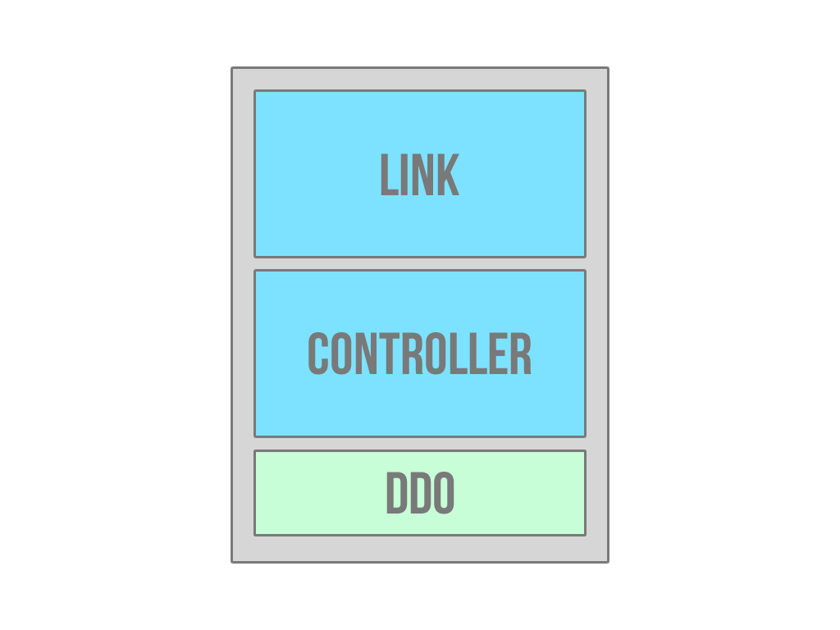

Slide 37
DirectIVE definition object
The Directive Definition Object (DDO) tells the compiler how a directive is supposed to be assembled
Common properties are the link function, controller function,
restrict, template and templateUrl

Slide 38
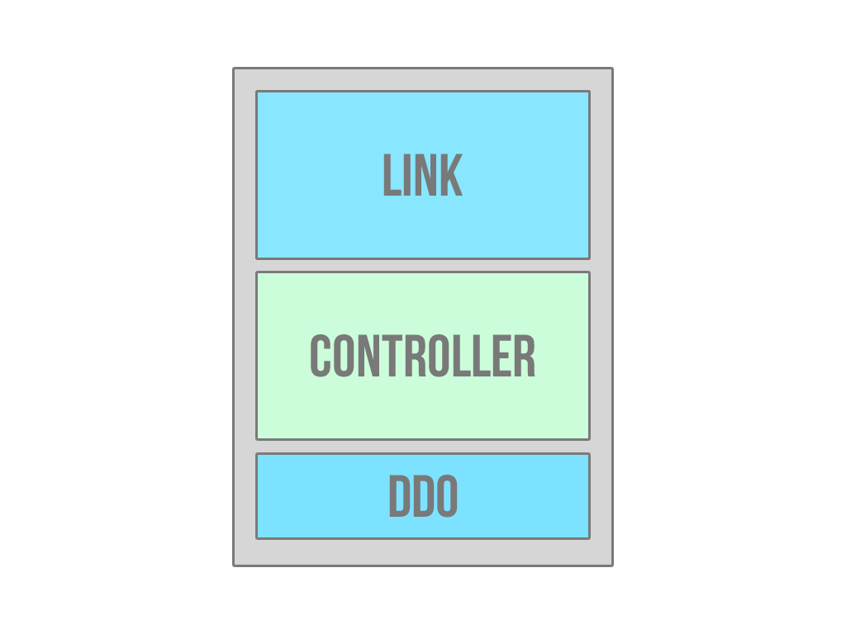

Slide 40
The controller function
The controller is constructed during the pre-linking phase Receives $scope which is the current scope for the element

Slide 41
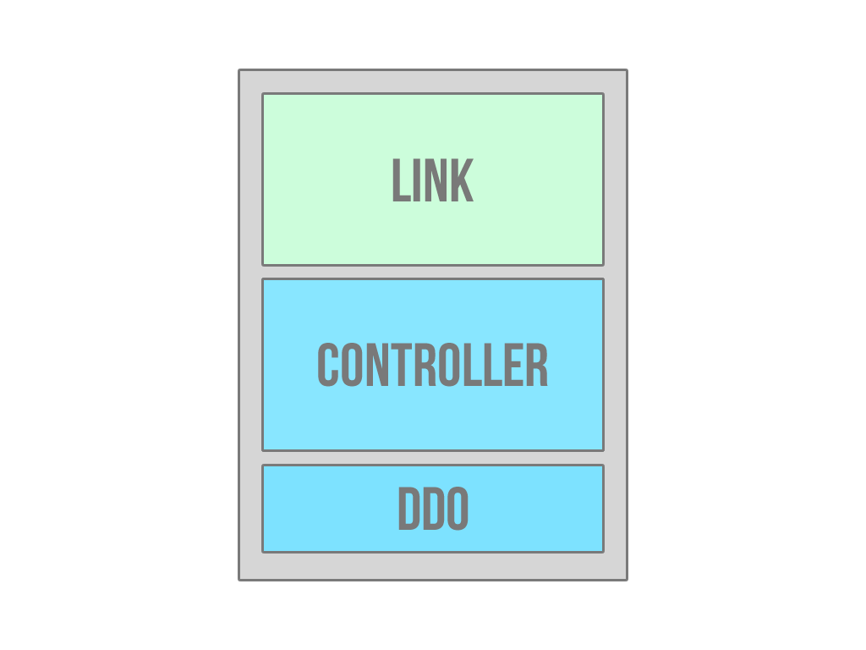

Slide 43
The link function
The link function is where DOM manipulation happens The link function comes with scope, element and attrs scope is the the same $scope in the controller function
element is a jQuery* instance of the DOM element the directive is declared on
attrs is a list of attributes declared on the element

Slide 45
Simple directive
Boards directive.

Slide 47
Simple directive with jquery
jQuery Transmit

Slide 49
SErver side Integration with AngularJS
REST and $HTTP
Promises
Real Time Communication

Slide 51
$httP
The $http service is a core Angular service that facilitates communication with the remote HTTP servers via the browser's XMLHttpRequest object or via JSONP.
The $http API is based on the deferred/promise APIs exposed by the $q service

Slide 53
$http Shortcut methods
$http.get
$http.head
$http.post
$http.put
$http.delete
$http.jsonp

Slide 55
Promises
The returned value of calling $http is a promise
You can use the then method to register callbacks These callbacks receive a single argument - an object
representing the response

Slide 57
Real time communication
Firebase.

Slide 59
E2e TESTING with AngularJS
The Environment
Unit Testing
E2E Testing

Slide 61
The environment
Karma is the current scenario runner Karma is testing framework agnostic
The easiest way to get up and running with Karma is with Yeoman

Slide 63
unit testing
Test isolated pieces or units of logic
We accomplish this with matchers and spies

Slide 65
Matchers
Expectations are built with the function expect which takes a value, called the actual. It is chained with a Matcher function, which takes the expected value.
expect(a).toBe(b); expect(a).not.toBe(null);

Slide 67
SPIES
Jasmine’s test doubles are called spies. A spy can stub any function and tracks calls to it and all arguments. There are special matchers for interacting with spies.
spyOn(mockUserService, 'userExists').andCallThrough(); scope.userExists();

Slide 69
e2e Testing
Used for simulating user interactions
You will write scenarios to describe behavior based on interactions
Scenarios consist of commands and expectations beforeEach runs before each it block
afterEach runs after each it block

Slide 71
Advanced AngularJS Directives
Isolated Scope
Compile
Transclusion
3rd Party Integration

Slide 73
Isolated Scope
Isolated scope does not prototypically inherit from its parent This prevents your directive from accidentally modifying data in the parent scope
This in a sense defines the API for the directive

Slide 75
Attribute Isolated Scope
Defined with an @ symbol
Binds a local scope property to the value of a DOM attribute The binding is uni-directional from parent to directive
The result is always a string because DOM attributes are strings

Slide 76
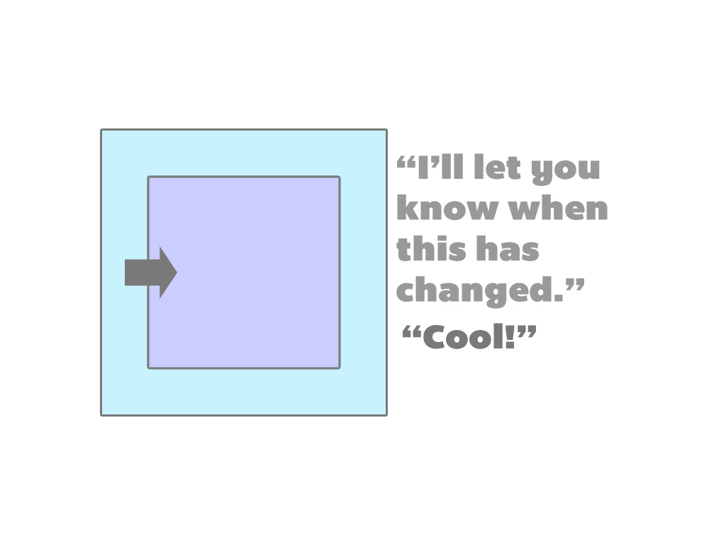

Slide 78
Binding Isolated Scope
Defined with an = symbol
Bi-directional binding between parent and directive You can define the binding as optional via =?
Optimal for dealing with objects and collections

Slide 79
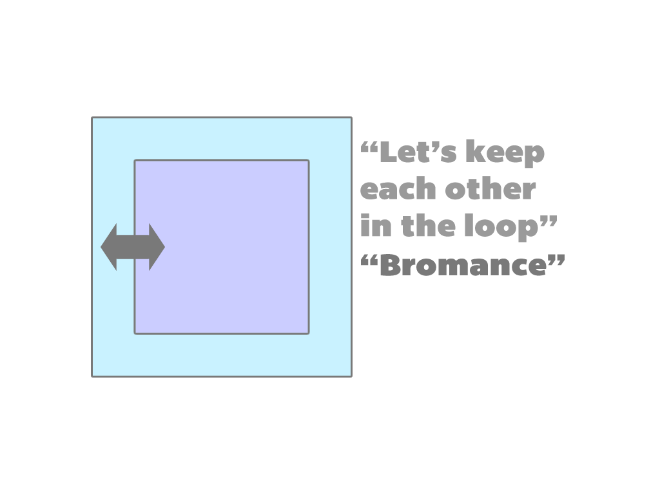

Slide 81
Expression Isolated Scope
Defined using an & symbol
Allows you to execute an expression on the parent scope To pass variables from child to parent expressions you must
use an object map

Slide 82
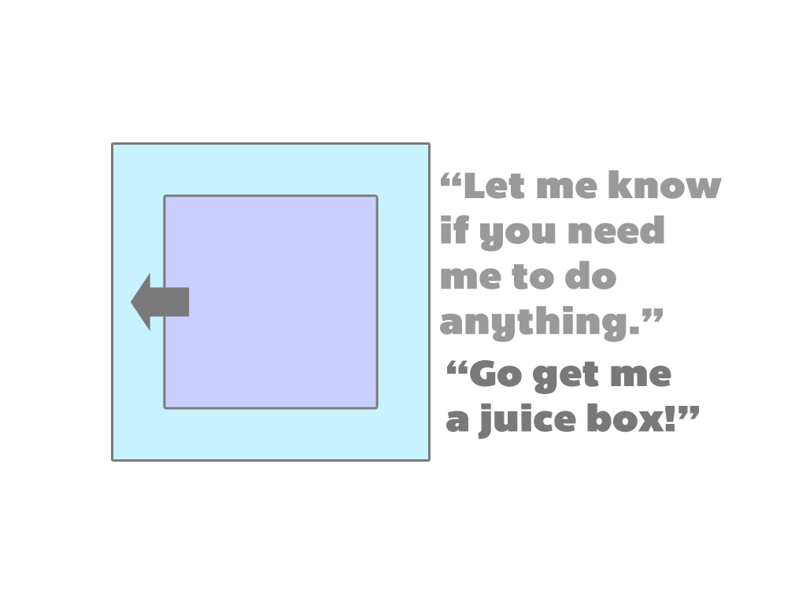

Slide 84
Transclusion
Compiles the contents of the element and makes it available to the directive
The transcluded contents are bound to the parent scope
The directive contents are bound to an isolate scope The two scopes are siblings
This is good for decorating an existing element with a directive without destroying it

Slide 85
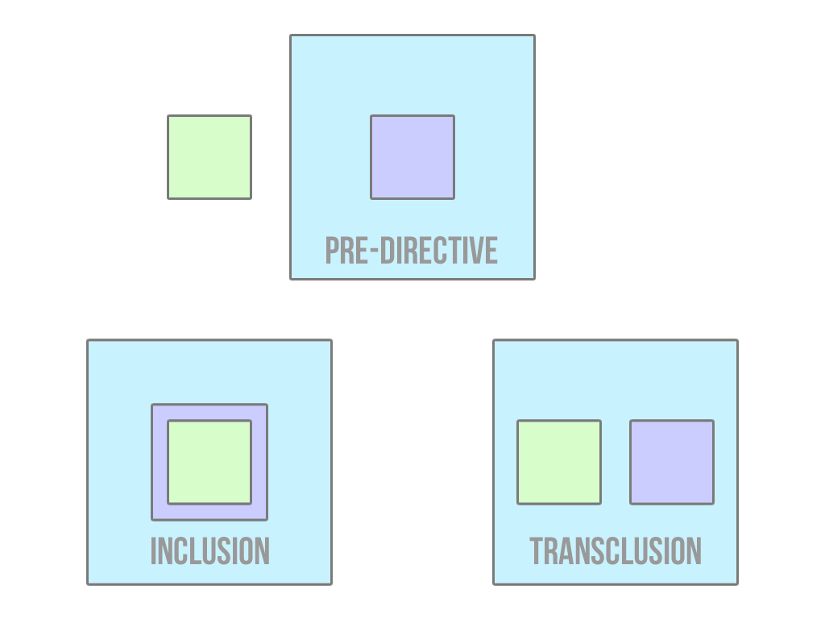

Slide 87
Compile
Responsible for transforming the template DOM

Slide 89
More 3rd party integration
Content pending.

Slide 91
AngularJS Animations
The Animation Naming Convention
CSS Transitions
CSS Animations
Javascript Animations

Slide 93
The animation Naming Convention
The pattern is [class][event][destination] and stack on each other
.repeat-item.ng-enter.ng-enter-active
.my-elm.ng-hide-add.ng-hide-add-active
.my-animation.CLASS-add.CLASS-add-active

Slide 95
CSS transitionS
The easiest and fastest way to attach animations Support by every browser except for IE9 and below
As long as the matching CSS class is present then AngularJS will pick up the animation

Slide 97
css Animations
More extensive than transitions
Supported by every browser except IE9 and below
Does not require the destination class styling aka -active class

Slide 99
Javascript Animations
Allows for more control over your animations Define your animations with the animation service Naming convention is still class based
Make sure to call the done() function when the animation is over

