Slide 1


Slide 2
What is a Service?
In AngularJS, a service is a function, or object, that is available for, and limited to, your AngularJS application.

Slide 3
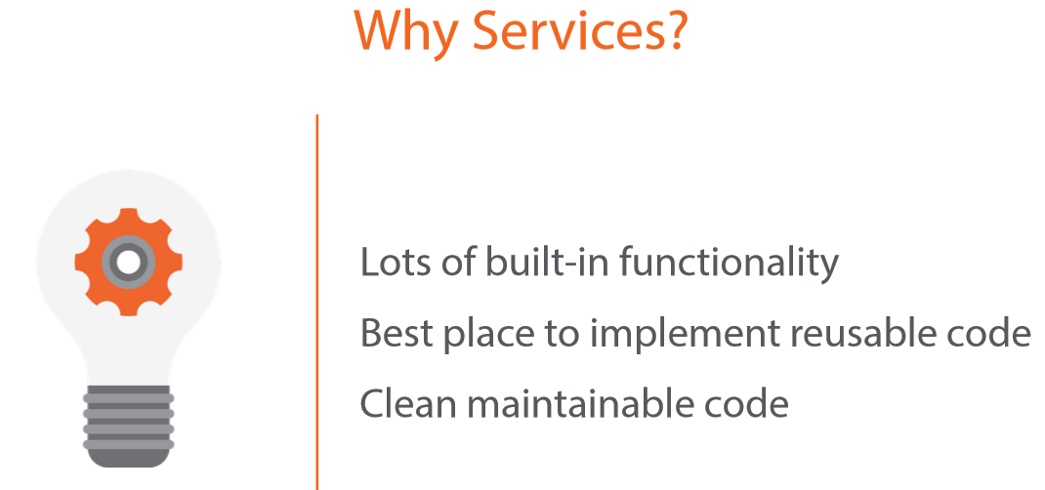

Slide 4
Built-In and Custom Services
Built-In Services
Custom Services

Slide 5
Built-In Services
$interpolate
$log
$rootScope
$window
$document
$rootElement
$route
$routeParams
$location
$httpBackend
$controller
$http
$resource
$anchorScroll
$cacheFactory
$compile
$parse
$locale
$timeout
$exceptionHandler
$filter
$cookieStore

Slide 6
DOM Services
$window
$document
$rootElement

Slide 7
Calling a Web Service
$http
$resource

Slide 8
$http.get("/api/products/")
.then(function(response) { vm.products = response.data;
});
$http
Built into Angular Core
Facilitates communication with a back-end service Asynchronous

Slide 9
REST
REpresentational State Transfer
Requests and responses involve the transfer of resources
Resources are identified with a URL
/api/products/
Requests utilize a standard set of HTTP verbs
GET | POST | PUT | DELETE
For more information: "REST Fundamentals"

Slide 10
function productResource($resource) { return $resource("/api/products/:id")
}
productResource.query(function(data) {
vm.products = data;
});
$resource
Separate Angular component: angular-resource
Abstraction on top of $http for calling RESTful services Requires less code

Slide 11
5 Service Flavors
provider()
factory()
service()
value()
constant()

Slide 12
$provide
$provide
provider
service

Slide 13








Slide 14
$provide.provider('books', function () {
this.$get = function () {
var appName = 'Book Logger';
return {
appName: appName
};
}
});
Using $provide.provider()
Call the “provider” function on the $provide service
Provider must define a “$get” function
Service is the object returned from the $get function
Configurable via the underlying provider

Slide 15
function factory(name, factoryFn, enforce) {
return provider(name, {
$get: enforce !== false ? enforceReturnValue(name, factoryFn) : factoryFn
});
}
Using $provide.factory()
Simpler version of provider when additional configuration is unnecessary
Registers a service factory function that will return a service instance

Slide 16
function service(name, constructor) {
return factory(name, ['$injector', function($injector) {
return $injector.instantiate(constructor);
}]);
}
Using $provide.service()
Calls factory function which calls provider function
Treats function it is passed as a constructor
Executes constructor function with “new” operator

Slide 17
Value and Constant Services
Value Services
Shorthand for factory with no parameters
Cannot be injected into a module configuration function
Constant Services
Simply registers service with injector, no factory/provider calls
Can be injected into a module configuration function

Slide 18


Dependency Annotations
Inform injector what services to inject
Use to support minimization
Three techniques available
Implicitly from function parameter names
Using $inject property annotation
Using inline array annotation

Slide 19

























Slide 20











Slide 21






▪
▪
▪

Slide 22











