Slide 1
EnergyFlux
Physics-Informed Solar Energy Platform with AI-Powered Grid Analytics
Stage 1: Commercial Behind-the-Meter PV + BESS + Power Flow
185 kWp Bifacial PV (LONGi LR6-72HBD-385M)
100 kW / 400 kWh BESS with TOU Dispatch
7-Bus 0.4kV Distribution Network — 17,518 Hourly Power Flow Runs
NVIDIA NIM ReAct Agent for Root Cause Analysis
Full REST API (FastAPI + Swagger UI)
Chennan Li, PhD, PE | github.com/chennanli/EnergyFlux

Slide 2
System Architecture — End-to-End Data Flow
Weather Data Open-Meteo API 17,518 hours
Irradiance Forecast NHITS 24h
PV Generation pvlib 4-Mode 775 MWh/yr
BESS Dispatch TOU-Aware 239 cycles/2yr
Power Flow pandapower 17,518 runs
AI Diagnosis NVIDIA NIM ReAct Agent
→
→
→
→
→
Network Topology — 0.4kV Commercial Distribution
BESS TOU Strategy (PG&E California)
Utility Grid (10kV) → Trafo 400kVA (10kV / 0.4kV) → LV Busbar ├── PV Plant (185 kWp bifacial, LONGi 385W, GCR=0.45) ····· 300m ├── BESS (100 kW / 400 kWh, TOU dispatch) ····················· 50m ├── Biotech Lab (50 kW base 24/7, +15 kW daytime) ··········· 200m ├── Office Building (30 kW weekday daytime) ···················· 150m └── EV Charging (50 kW weekday daytime — employees) ········· 250m
Off-Peak (9pm-8am): $0.10/kWh → Charge from grid
Mid-Peak (8am-4pm): $0.20/kWh → Charge from PV surplus
On-Peak (4pm-9pm): $0.35/kWh → Discharge to avoid import
Daily cycle: night charge → PV top-up → evening discharge
Result: 239 cycles / 2 years, 96 MWh charged
PV 4-Mode Comparison (annual energy)
Mode 1: Fixed tilt 20° — 663 MWh (baseline)
Mode 2: Tracker, no backtrack — 711 MWh (+7.2%, shading penalty)
Mode 3: Tracker + backtrack — 751 MWh (+13.4%)
Mode 4: Bifacial + backtrack — 775 MWh (+16.9%, used in power flow)

Slide 3
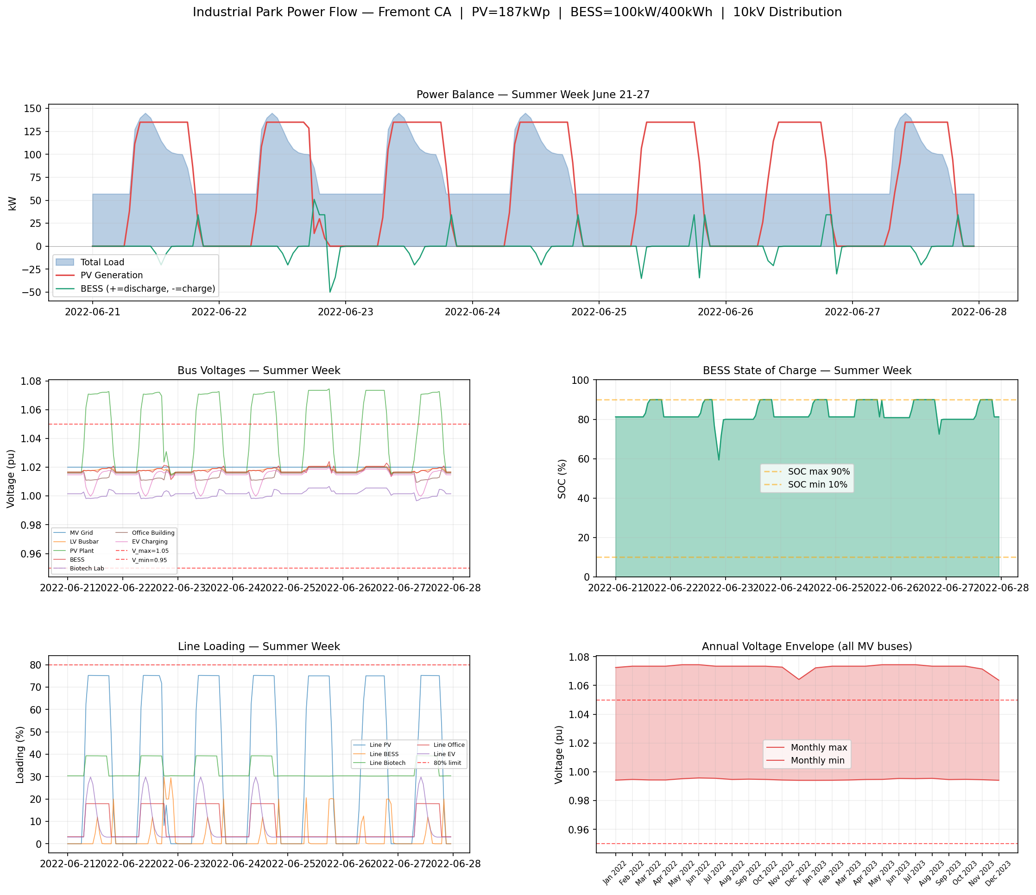
Power Flow Results — 17,518 Hourly Simulations (2 Years)
Key Findings
5,363 hours overvoltage (>1.05 pu)
= 31% of all hours, mostly weekends
Peak voltage: 1.074 pu at PV bus
(ANSI C84.1 limit: 1.05 pu)
Root cause: PV 135kW peak vs
weekend load 55kW → 80kW surplus
flows back through 300m cable
→ voltage rise at PV bus
Line loading: max 75% (safe)
No thermal overload risk
BESS absorbs surplus but
400kWh fills in ~5 hours
→ remaining surplus causes
overvoltage after BESS full
Insight: BESS placement matters more than sizing — co-locating BESS with PV (DC-coupled) reduces voltage rise at the source, not just at the busbar.

Slide 4
AI-Powered Root Cause Analysis + Roadmap
NVIDIA NIM ReAct Agent
REST API (FastAPI)
Model: Nemotron-Ultra-253B (via NVIDIA NIM API)
Framework: LangChain ReAct + FAISS RAG
4 Tools:
• query_weather() — real-time weather conditions
• query_pv_status() — PV generation vs expected
• query_powerflow() — bus voltages, line loading
• query_knowledge_base() — RAG over engineering docs
Demo scenario: Midday overvoltage at PV bus
Agent automatically:
1. Checks weather (clear sky, GHI=930 W/m²)
2. Checks PV output (135 kW, at capacity)
3. Checks BESS (SOC=90%, full)
4. Searches knowledge base
→ Diagnosis: PV surplus + full BESS → reverse flow
→ Actions: increase BESS, add reactive power support
GET /forecast — 24h GHI forecast
GET /generation — PV power (4 modes)
GET /powerflow — bus voltages, BESS, loads
GET /powerflow/summary — violation statistics
POST /diagnose — trigger RCA agent
Interactive Swagger UI at /docs
Roadmap
Stage 2: Chemical plant microgrid (TEP load)
→ 10kV industrial feeder, MW-scale PV + BESS
→ Pyomo LP optimal BESS dispatch
Stage 3: Data center + 115kV backbone
→ Multiple industrial loads on shared grid
Stage 4: Utility-scale 100MW solar farm
→ 115kV transmission, grid frequency response
Tech Stack: Python · pvlib · pandapower · NeuralForecast · LangChain · NVIDIA NIM · FAISS · FastAPI

