Slide 1
Bluetooth Low Energy Based CoAP Communication in IoT
---- CoAPNonIP: An Architecture Grants CoAP in WPAN

Slide 2
Content
Introduction
Problem Definition
Related Work
Architecture
Experiment
Future Work
Summary

Slide 3
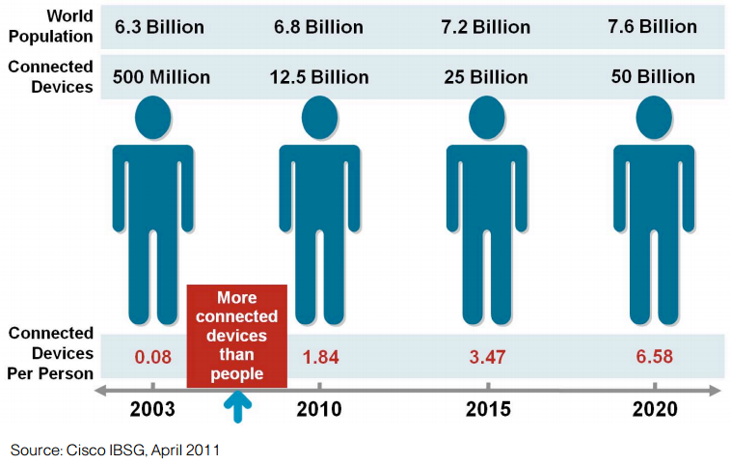
Introduction
1.IoT
IoT is connecting.
Figure 1 [1]: 4 steps towards CoAP

Slide 4
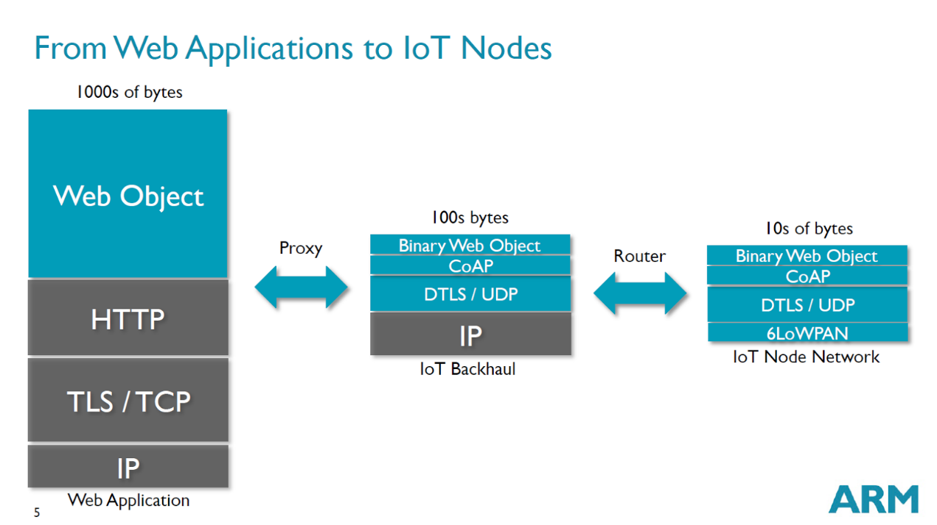
Introduction
2.CoAP
CoAP[2] is designed for constrained networks under the concept of IoT.
Figure 2 [3]: Using Context of CoAP
Notes:
CoAP is designed to easily interface with HTTP for integration with the Web while meeting specialized requirements such as
Constrained Application Protocol
CoAP is naturally RESTful
ARM(British multinational semiconductor and software design company )
//multicast support,
//very low overhead,
//simplicity for constrained environments.
//Payload size limited to 1024 bytes.
Multicast: send (data) across a computer network to several users at the same time.

Slide 5
Introduction
3.BLE
Notes:
Traditional Bluetooth use 20byte characteristics to transfer data. No format has been defined.

Slide 6
Problem Definition
1.Summary
Sine CoAP is a widely adopted HTTP like protocol. We want to explore the possibility of using CoAP in BLE
CoAP
Proxy
BLE based CoAP communication
Internet
HTTP Request
Sensor
Figure 4: Standard way of sending message
Notes:
We want to introduce CoAP in BLE to simplify the process of merge edge nodes (sensors) into IoT.

Slide 7
Problem Definition
2.Detail
Construct an architecture to supports data communication in sensor cloud.
Overcome limitations of BLE
Multiple app support on single device
Common interface
Notes:
sensor cloud ---- None-IP based environment

Slide 8
Related Work
1.6LoWPAN
In December 2014, Low-power IP(6LoWPAN[4]) is adopted by Bluetooth4.2 which provides another way to achieve CoAP in BLE.
Notes:
acronym[ak-ruh-nim] IPv6 over Low power Wireless Personal Area Networks.
Bluetooth 4.2. IoT capability(IP(6LoWPAN),
Security(LE Privacy 1.2 to prevent Bluetooth smart device being tracked by untrusted devices)
speed.

Slide 9
Related work
2.Alternative transports
Since 2013[6], CoRE working group maintains a Internet-Draft: CoAP Communication with Alternative Transports.
Notes:
It provides instructions and URI format for SMS, Websocket and TCP.
CoRE Working Group(Informational document) Internet-Draft

Slide 10
Architecture
CoAP over BLE
Figure 6 : Architecture overview
Notes:
Aims to make the CoAP been able to server one or more applications.

Slide 11
Architecture
2.Detail
Process Component
Message management
Application Layer
Interpret
Component
Interpret actions to lower level function call
Transport Layer
Communication
Component
BLE communication management
Figure 7 : Architecture Detail
Notes:
Architecture of CoAPNonIP

Slide 12
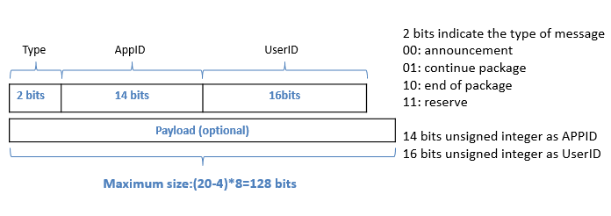
Architecture
3.Packet format
MTU(maximum transmission unit) of BLE is 23 by default and only 20 bytes are available to carry payload, we proposed a 20 bytes protocol to support proposed architecture.
Figure 8 : Packet format
Notes:
20 bytes available.
4 bytes header: 2+14+16=32 bits
Payload: 16 bytes
CoAP header: 4 bytes and 1 byte indicate payload. 1024 bytes for payload maximum
For first BLE packet we have 20-4-5=11 bytes to carry payload.

Slide 13
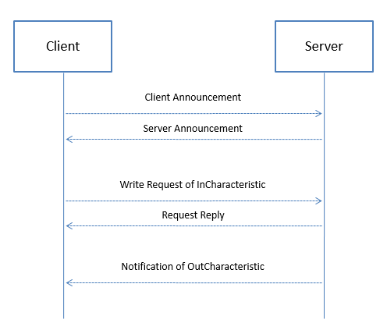
Architecture
4.Communication mechanism
Figure 9 : Communication mechanism
Notes:
Who searching nodes to connect with is Client.
Who waiting connection is Server.

Slide 14
Experiment
1.Experiment Setup:
We use two HTC Nexus 9 to do experiments.
Hardware | Details
OS | Android OS, v5.1.1(Lollipop)
CPU | Dual-core 2.3 GHz Denver
Memory | 16GB/2GB RAM
Bluetooth | v4.1, A2DP, apt-X
Table 1 :Experiment setup
Notes:
Two tablets

Slide 15
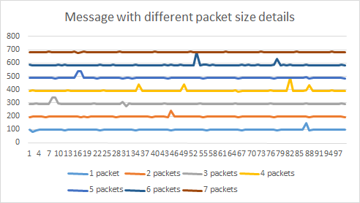
Experiment
2.Data Rate
Figure 11 : Experiment of data rate
Result: We have 10*20=200 byte/s data rate (1 BLE packet per 100ms).
Notes:
1.Start sample program scan and create connection between two devices.
2.Send CoAP message with payload 4 (1 packet), 12 (2 packets),28 (3 packets), 44 (4 packets), 60(5 packets), 76 (6 packets) and 92(7 packets) 100 times respectively (0 interval time).
3.Record receive time when received response from connected device.
4.Calculate transfer time according to time gap between message been received.

Slide 16
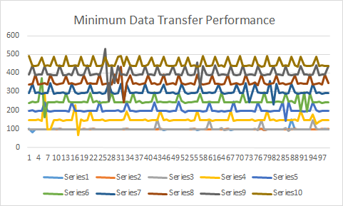
Experiment
3.Latency
Figure 12 : Experiment of latency
Result: Heartbeat-like pattern and random fluctuation
Notes:
Connection interval,
BLE
Start sample program scan and create connection between two devices.
Record received time at sender side
Send 4-bytesheader 100 times to remote device with 0,50,100,150,200,250,300,350,400,450ms interval respectively.
(because of data send queue, the first 3 lines are at 100ms)
Calculate transfer time according to time gap between message been received

Slide 17
Experiment
4.Performance with different distance
Figure 13 : Experiment of distance
Result: Performance only guaranteed within 10 meters
Notes:
Send 4 bytes header CoAP message and receive callback from remote device(100 times to calculate average) with different distance.
dotted line is tread.

Slide 18
Future Work
1. Improve performance.
2. Explore Solution for multi-node communication.
3. Implement other wireless protocols
Summary
We successfully implemented the proposed architecture in Android. Meanwhile, there is great room to improve our implementation.

Slide 19
Reference
[1]Barrett J, (2012, Oct 5). The Internet of Things.Youtube 2016.URL: https://www.youtube.com/watch?v=QaTIt1C5R-M
[2]Shelby, Z., Hartke, K., & Bormann, C. (2014). The Constrained Application Protocol (CoAP)(RFC 7252).
[3]Shelby, Z, (2014, April 30). CoAP: The Web of Things Protocol [Powerpoint slides]. Retrieved from http://www.slideshare.net/zdshelby/coap-tutorial
[4]Isomäki, M., Kerai, K., & Mutikainen, J (2011). Connecting BT-LE sensors to the Internet using Ipv6.
[5]Internet WG, (2014, Dec 16). Internet Protocol Support Profile
[6]Silverajan, B., & Savolainen, T. (2013). CoAP Communication with Alternative Transports. ID: draft-silverajan-core-coap-alternative-transports-01.

Slide 20
Thank you

