Slide 1
Bluetooth Low Energy Based CoAP Communication in IoT
---- CoAPNonIP: An Architecture Grants CoAP in WPAN
Notes:
The topic of my thesis is ********************

Slide 2
Content
Introduction
Problem Definition
Related Works
Architecture
Experiment
Conclusion
Future Works
Notes:
In term of content,
First, I will introduce the trend of IoT and the importance of CoAP.
Then, I will discuess related works before dive deep into architecture & experiment.
Last, I will make conclusion & discuss future works.

Slide 3
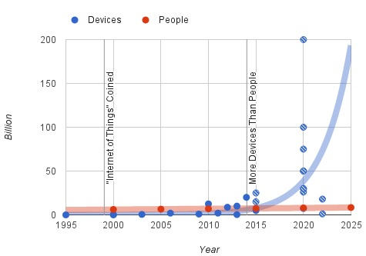
1 Introduction
1.1 Internet of Things (IoT)
Figure 1: Trend of devices vs people^{[1]}
Notes:
According to Howard in 2015, the number of devices in IoT has exceed the polulation of human being before 2015. And the most predictions expect the exponential growth will keep in the next 2 decades.

Slide 4
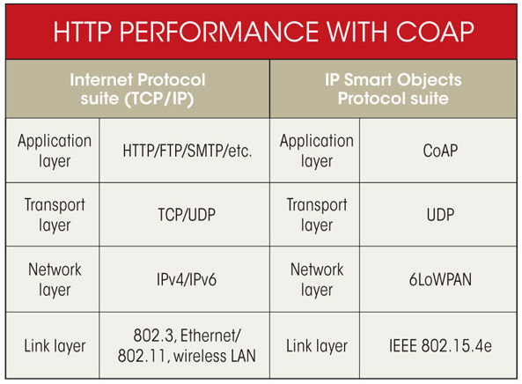
1 Introduction
1.2 Constrained Application Protocol (CoAP)
Figure 2: CoAP vs HTTP^{[2]}
Notes:
In terms of CoAP, CoAP is a light version of HTTP. It has inherent many characteristics from HTTP. Like http verbs and attributes of HTTP header.
By default it adopt the UDP in transport layer & 6lowpan in network layer.
The 6lowpan is an alternative of IPv6 in constrained networks.
IPv6 in low power wireless personal area networks.
//multicast support,
//very low overhead,
//simplicity for constrained environments.
//Payload size limited to 1024 bytes.
Constrained Application Protocol
Header compression, which compresses the 40-byte IPv6 and 8-byte UDP headers by assuming the usage of common fields.
Fragmentation and reassembly, as the data link of IEEE 802.15.4 with a frame length of max 127 bytes does not match the MTU of IPv6, which is 1280 bytes.
Stateless auto configuration, the process where devices inside the 6LoWPAN network automatically generate their own IPv6 address.
ARM(British multinational semiconductor and software design company )
Multicast: send (data) across a computer network to several users at the same time.

Slide 5



2 Problem Definition
2.1 Motivation
Send CoAP message through BLE
CoAP over IP
CoAP over IP
Sensor
Gateway
Server
CoAP over BLE ?
CoAP over IP
Sensor
Gateway
Server
Figure 3: Context of CoAP
Notes:
After review the characteristics of CoAP, I was thinking why we can’t make CoAP get ride of the constrains of IP protocols & make it works on wireless technology like BLE.

Slide 6
2 Problem Definition
2.2 Problem
How do we identify Non-IP based devices?
How do we overcome packet size limitation of BLE?
How do we serve multiple applications as a background service?
How do we provide a common interface to support different technologies?
Notes:
Goal 1. A general method to identify Non-IP based devices.
Goal 2. An architecture to support CoAP communication in BLE.
Goal 3. A background service to support multiple apps.
Goal 4. An interface to support other WPAN technologies.
After propoed those 4 questions I go to review relative works.

Slide 7
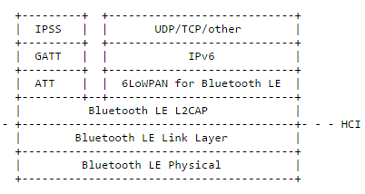
3 Related Works
3.1 In terms of IPv6 adoption
6LoWPAN is adopted by Bluetooth core specification V4.2^{[3]}.
Figure 4: IPv6 in BLE Stack^{[4]}
Notes:
In December 2014, IPv6 over Low power Wireless Personal Area Networks (6LoWPAN) is supported by BLE 4.2^{[3]}.
Isomaki
As shown in this chart besides the traditional “Generic Attribute Profile” protocol stacks. The new architecture of BLE adopt 6lowpan upon
The Logical Link Control and Adaptation.
In this way, by adding new hardware, the CoAP can be used in BLE.
It provides instructions and URI format for SMS, Websocket and TCP.
CoRE Working Group(Informational document) Internet-Draft
ATT (page 2160): "This specification defines the Attribute Protocol; a protocol for discovering, reading, and writing attributes on a peer device."
GATT (page 2207): "This specification defines the Generic Attribute Profile that describes a service framework using the Attribute Protocol for discovering services, and for reading and writing characteristic values on a peer device."

Slide 8
3 Related Works
3.2 In terms of getaway solutions
CoAP gateway for FS20 based home automation^{[5]}
CoAP gateway for DNP3.0 based automation system^{[6]}
CoAP gateway for bridging UPnP and ZigBee ^{[7]}
Notes:
Also, we see the CoAP are used as a gateway protocol between contained netoworks and the Internet. As shown here, Iisted three resent researches which are all using CoAP at the GateWay.
Also, CoAP gateways are used to make protocol translation between CoAP network and WPAN. Here I list three related researches.
Extended CoAP Codes to incorporate UPnP(Universal Plug and Play
) controls. Leave is issued by a sensor device when it leaves UPnP. Alive, Ping and CollectAll are for management of UPnP.
June 8,2016, JupiterMesh® Neighborhood Area Network (NAN) Announced
DNP3 (Distributed Network Protocol) is a set of communications protocols used between components in process automation systems. Its main use is in utilities such as electric and water companies. Usage in other industries is not common. It was developed for communications between various types of data acquisition and control equipment. It plays a crucial role in SCADA systems,

Slide 9
3 Related Works
3.3 Conclustion
No software solution supports CoAP communication in BLE netoworks.
Notes:
After review the use of CoAP in IoT. My conclusion is there is not software architecture for CoAP communication in BLE netowork.
Then, I turn to design the software solution.

Slide 10
4 Architecture
4.1 Overview
Process component
Application layer
Network layer
Communication component
Network component
Figure 5: Overview of the architectrue
Notes:
As you can see, in brief, the archictrue consists of application layer & network layer. The application layer provides data management & userfriendly interface to hide the detail implementation of network layer. And, it includes process compoennet & communication component.

Slide 11
4 Architecture
4.2 Application layer
Process component:
Processors
Senders
Communication component:
Broadcast
Search peers
Get nodes
Send data
Receive data
Notes:
As shown in the list
We have
Procesers to handle request & senders to send data.
In the communication component, 5 basic operations for a WPAN protocol are defined.

Slide 12
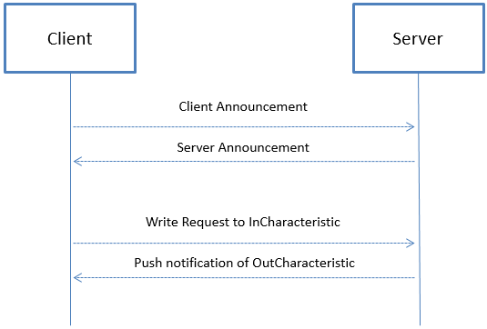
4 Architecture
4.3 Network layer – communication mechanism
Figure 6 : Communication mechanism
Notes:
In the network layer, there are two roles in communication. Servers are those who broadcast itself & client are those who try to find devices to connect with.

Slide 13
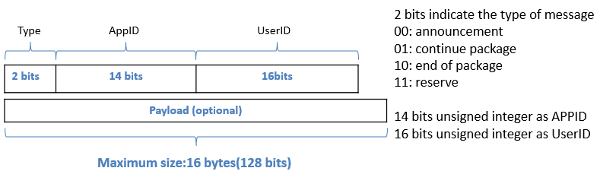
4 Architecture
4.3 Network layer – packet format
Figure 7 : Communication mechanism
Notes:
10min
Because of the packet size limitation of BLE & I proposed a protocol to support chop and assemble CoAP message.

Slide 14
5 Experiment
5.1 Experiment setup
Title | Goals
CoAP Header with interval | Test performance of sending CoAP header with different intervals.
Multiple packets | Test performance of sending different CoAP messages with different data size.
Round trip | Test performance of round trip
Multiple apps | Test performance of sending data from multiple apps
Table 1: Experiment setup
Notes:
After deigned the architecture, I implemented it and designed some experiments to test the perforamce of it.
As shown in the table.

Slide 15
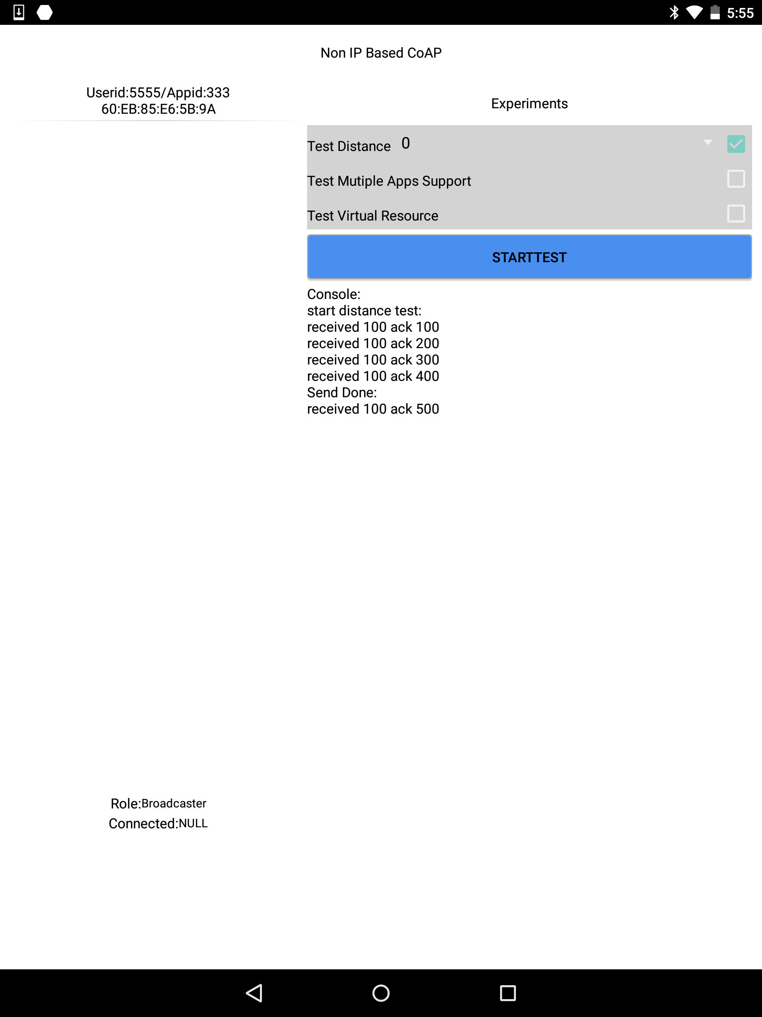
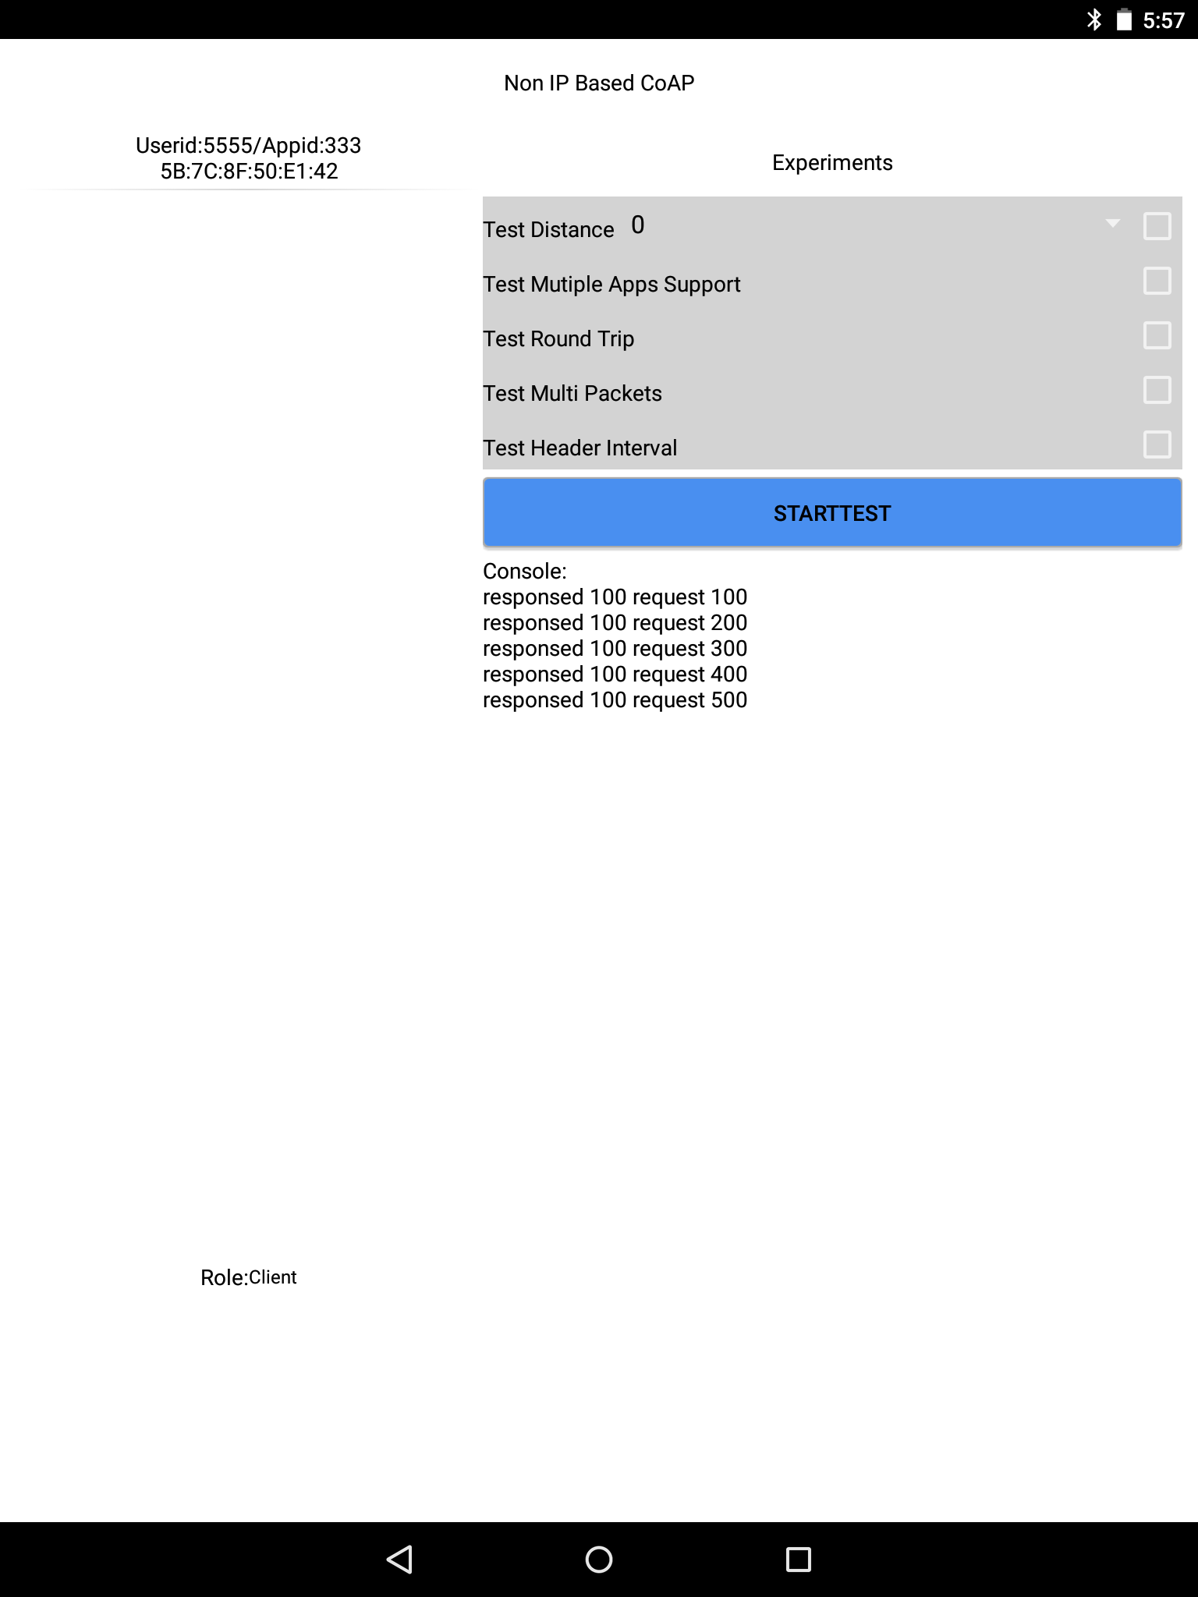
5 Experiment
5.1 Experiment setup
Figure 8: Two Nexus9 are running experiment program
Notes:
This is a picture of two nexus9 running the experiment program.
In order to do the experiment, I implemted the architecture in Andorid.
Both of the devices are running Android version 5 with Bluetooth v4.1
Dual-core 2.3 GHz Denver
16GB/2GB RAM
Bluetooth v4.1, A2DP, apt-X

Slide 16
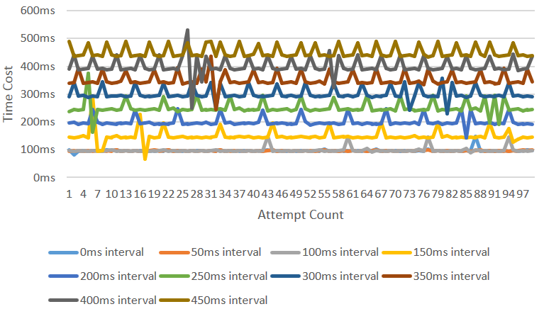
5 Experiment
5.2 Experiment 1: CoAP Header with interval
Figure 9: Results of sending headers with different interval
Notes:
the connection interval is the amount of time between two connection events. The device has a minimum and a maximum value for it. Which Android API does not provide.
// 1. The time cost of sending a BLE packet is around 100ms. (in android)
// 2. With the increase of interval the heart-beat like pattern appears more frequently. (Due to BLE’s strategies for saving energy)
// 3. There are some random fluctuation (Android’s BLE implementation)

Slide 17
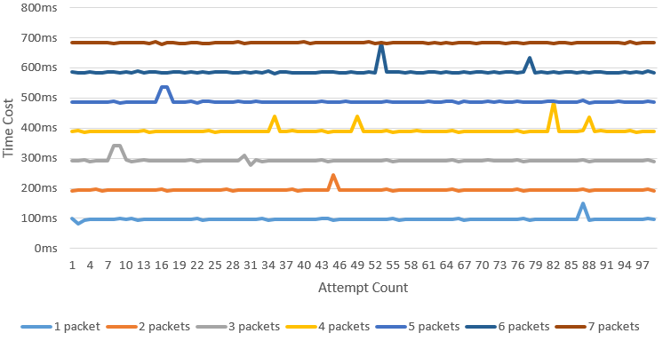
5 Experiment
5.3 Experiment 2: Multiple packets
Figure 10: Results of sending multiple packets
Notes:
The implementation used a synchronized way to exchange data.
As shown in the chart, when sending a long CoAP message, it may needs be chop into different BLE packets.
We can find heart beat like parrterns which are not obvious here. Also randon fluctuations are detected.

Slide 18
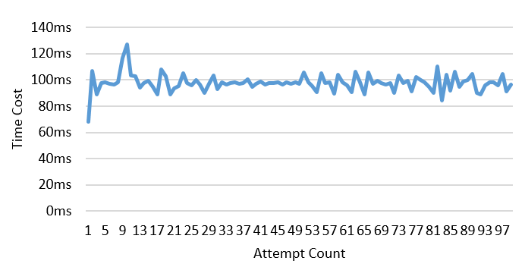
5 Experiment
5.4 Experiment 3: Round trip
Figure 11: 4-byte round trip
Notes:
From this experiment we find that the time cost of 4 bytes round trip are roughly the same as send data.
This is because we adopt reliable communication where each request will always wait for a acknowledgement.

Slide 19
5 Experiment
5.5 Experiment 4: Multiple apps
Figure 12: Result of multiple apps experiment
Notes:
In the fourth experiment, I tested the performance of the architecture when two apps try to send 100 times of 4 bytes coap header at the same time. As shown above, the red bar is the average send time of the trigger app which always faster than the major app because it start earlier.

Slide 20
5 Experiment
5.6 Conclusion
Data rate = 10 times * 20 bytes per packet * 8 bit per byte=1.6 kb/s.
Energy-saving mechanism of BLE influences the results.
Android’s implementation of BLE influences the results.
The single communication channel is a restriction.
Notes:
“Connection interval” can be any value between 7.5ms and 4s.
Kilobit per second asd
The data rate is 160 byte/s. due to wait ACK

Slide 21
6 Conclusion
The proposed architecture provides a software solution to enable CoAP communication in BLE.
The research results have been published by IEEE^{[8] [9]} in 2015.
Notes:
A general method to identify Non-IP based devices.
An architecture to support CoAP communication in BLE.
A background service to support multiple apps.
An interface to support other WPAN technologies.

Slide 22
7 Future Works
Data Rate
Availability
Cross-Platform
Underlying Technology
Security

Slide 23
References
[1] Howard, P. N. (2015, June 9). Sketching out the Internet of Things trendline. Retrieved 6 7, 2016, from http://www.brookings.edu/blogs/techtank/posts/2015/06/9-future-of-iot-part-2
[2] Sutaria, R., & Govindachari, R. (2013, May 1). Understanding The Internet Of Things. Retrieved June 13, 2016, from electronicdesign.com: http://electronicdesign.com/iot/understanding-internet-things
[3] SIG. (2014, December). BLUETOOTH ® CORE SPECIFICATION 4.2 FREQUENTLY ASKED QUESTIONS. Retrieved April 18, 2016, from bluetooth.org: https://www.bluetooth.org/ja-jp/Documents/Bluetooth4-2FAQ.pdf
[4] Isomaki, M., Nieminen, J., Gomez, C., Shelby, Z., Savolainen, T., & Patil, B. (2015, October). IPv6 over BLUETOOTH(R) Low Energy. Retrieved June 7, 2016, from ietf.org: https://tools.ietf.org/html/rfc7668
[5] Bergmann, O., Hillmann, K. T., & Gerdes, S. . (2012). A CoAP-gateway for smart homes. Computing, Networking and Communications (ICNC), 2012 International Conference on (pp. 446-450). Maui, HI: IEEE.
Notes:
[5] Bergmann, O., Hillmann, K. T., & Gerdes, S. , 2012
[6] Shin, I. J., Eom, D. S., & Song, B. K., 2015
[7] Mitsugi, J., Yonemura, S., Hada, H., & Inaba, T., 2011

Slide 24
References
[6] Shin, I. J., Eom, D. S., & Song, B. K. (2015). The CoAP-based M2M gateway for distribution automation system using DNP3.0 in smart grid environment. 2015 IEEE International Conference on Smart Grid Communications (SmartGridComm) (pp. 713-718). Miami, FL: IEEE.
[7] Mitsugi, J., Yonemura, S., Hada, H., & Inaba, T. (2011). Bridging UPnP and ZigBee with CoAP: Protocol and its Performance Evaluation. IoTSP '11 Proceedings of the workshop on Internet of Things and Service Platforms (p. 1). ACM.
[8] Chen, N., Li, X., & Deters, R. (2015). Collaboration & Mobile Cloud-Computing: Using CoAP to Enable Resource-Sharing between Clouds of Mobile Devices. 2015 IEEE Conference on Collaboration and Internet Computing (CIC) (pp. 119 - 124). Hangzhou: IEEE.
[9] Shi, H., Chen, N., & Deters, R. (2015). Combining Mobile and Fog Computing: Using CoAP to Link Mobile Device Clouds with Fog Computing. 2015 IEEE International Conference on Data Science and Data Intensive Systems (pp. 564 - 571). Sydney: IEEE.
Notes:
[5] Bergmann, O., Hillmann, K. T., & Gerdes, S. , 2012
[6] Shin, I. J., Eom, D. S., & Song, B. K., 2015
[7] Mitsugi, J., Yonemura, S., Hada, H., & Inaba, T., 2011

Slide 25
Thank you

Slide 26
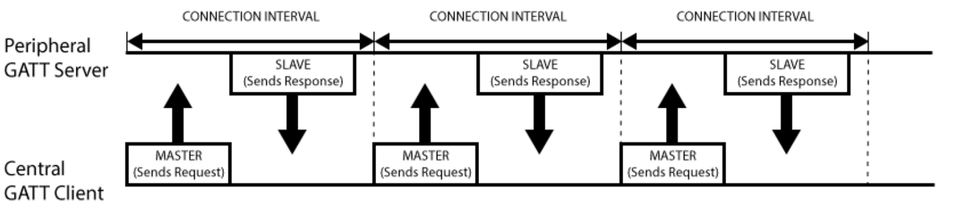
Extra
Connection interval: the connection interval is the amount of time between two connection events. The connInterval shall be a multiple of 1.25 ms in the range of 7.5 ms to 4.0 s. Different applications may require different connection intervals.[1]
Figure 1 connection interval example[2]
Notes:
Determines how often the Central will ask for data from the Peripheral. When the Peripheral requests an update, it supplies a maximum and a minimum wanted interval.
DEFAULT_DESIRED_MIN_CONN_INTERVAL 32; // 40ms
DEFAULT_DESIRED_MAX_CONN_INTERVAL 64; //80ms
Advertizer is the peripheral.
Over the air data rate 1 Mb/s
Application throughput 206 Kb/s

Slide 27
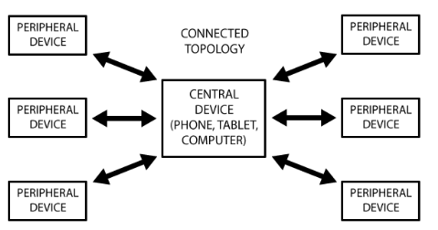
Extra
Figure 2 Peripheral [2]

Slide 28
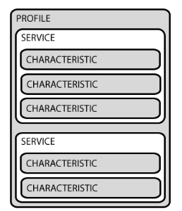
Extra
Figure 3 GATT explanation [2]

Slide 29
References
[1] SIG, Technical considerations for Bluetooth low energy application developers.last access at 2016.6.28 https://www.bluetooth.com/specifications/bluetooth-core-specification/technical-considerations
[2] adafruit, Introduction to Bluetooth Low Energy. Last access at 2016.6.28 https://learn.adafruit.com/introduction-to-bluetooth-low-energy/gatt

