Slide 1
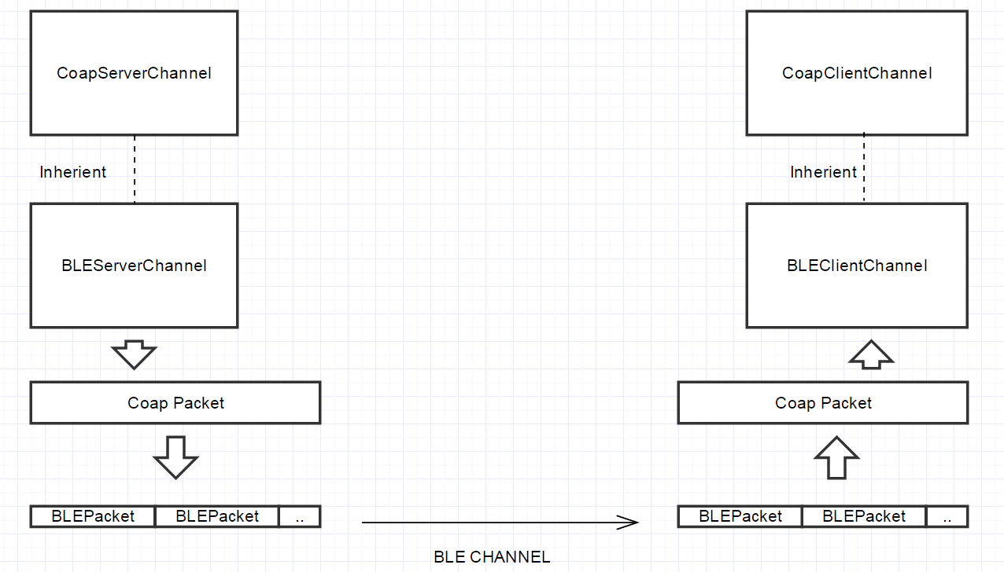

Slide 2



CoAP over IP
HTTP
Sensor
Gateway
Server
CoAP over BLE ?
HTTP
Sensor
Gateway
Server

Slide 3
SOAP Envelope
SOAP Header
Element | Required
Envelope | Yes
Header | No
Body | Yes
Fault | No
Header Message
SOAP Body
Body Message
Fault Message

Slide 4
Bit | 7 | 6 | 5 | 4 | 3 | 2 | 1 | 0
Byte1 | Packet Type |  |  |  | Flag
Byte2… | Remaining Length
Unknown Size | Optional Header
Unknown Size | Payload

Slide 5
APP1/User1
APP2/User1
CoAP Request
CoAP Request
BLE Server
BLE Service
BLE Client
BLE Server
APP1/User1
APP2/User1
BLE Server
CoAP Request
CoAP Request
BLE Service
BLE Client

Slide 6
App1
App2
Activity
Activity
NP2PChannel
NP2PChannel
Service Manager
Activity
NP2PC Service
NP2PChannel
NP2PClient
NP2PS Service
App1
App2
Activity
Activity
NP2PServer
NP2PChannel
NP2PChannel
NP2PC Service
NP2PClient

Slide 7
Client
Server
Client Announcement
Server Announcement
Write Request to InCharacteristic
Push notification of OutCharacteristic

Slide 8
2 bits indicate the type of message
00: announcement
01: continue package
10: end of package
11: reserve
14 bits unsigned integer as APPID
16 bits unsigned integer as UserID
Type
AppID
UserID
2 bits | 14 bits | 16bits
Payload (optional)
Maximum size:16 bytes(128 bits)

Slide 9
The BLE service (in BLE client) aims to support communications between multiple applications and multiple data providers (BLE server).
1. When discover advertising server, client need to know the type of BLE server for
automatically create communication channels
Solution: Set signal like “NP2P:Device1”as “manufactory data” when construct advertise data.
2. In the era of a single user with multiple access points, the communication channel should
independent from static identifier.
Solution: Adopt 4 bytes header in the 20bytes BLE packet.
2|14|16
2 bits indicate the type of message;
00: announcement
01: continue package
11: end of package
14 bits indicate APPID
16 bits indicate UserID
Announcement is a 4 bytes header payload;
It indicates a new instance of APP/User joined the communication.

Slide 10
BLE server
BLE Client
Request from UserID/APPID
ReplyToUserID

Slide 11
Developer Layer
Developer Layer: This layer is customized by developers.
Application Layer: Build a user friendly interface for CoAP communication, message queue management and multiple thread dispatcher.
Application Layer
Network Layer
Network Layer: Different implementations of wireless communication in Non IP environment

Slide 12
Process Component
Message Queue and
Data Processing
Application Layer
Communication Component
Implement common interface,
deliver data between network layer
and process compoenent.

Slide 13
Processors
Senders
Processor 1
Sender 1
Register message in CallBack inMap and Send it out
Is request?
Receiver
Y
Processor 2
Sender 2
Dispatcher
Dispatcher
N
Processor n
Sender n
Look Up Response CallBack Map to execute actions

Slide 14
Bandwidth Test
Repeat send 32bytes data 100 times (extra 8 bytes per frame)
Therefore we use 4000 bites/ time usage= bandwidth;
Time Span | Result
20s | 1.6kbps
19s | 1.684kbps
20s | 1.6kbps
19s | 1.684kbps
20s | 1.6kbps
19s | 1.684kbps
20s | 1.6kbps
19s | 1.684kbps
20s | 1.6kbps
20s | 1.6kbps
Average Time | Average Result
19.6s | 1.6336kbps

Slide 15
R1
VR
100
R2
VR
101
Request VR 100
Return VR 100
R1
VR
100
Device C
Request VR 100
Failed Return VR100 (timeout)
Request VR 100
Resource Container
Device D
Device A
R1
VR
101
R: Resource
VR: Virtual Resource
Device B

Slide 16
ads
BLE(GATT)
Proxy
CoAP
Internet
NFC(Byte array)
Proxy
CoAP
Current Solution to merge WAPN into CoAP network
BLE(CoAP)
Proxy
Internet
CoAP
NFC(CoAP)
Proposed Solution to merge WAPN into CoAP network

Slide 17
Application Layer (Process)
ads
Processors
Senders
Processor 1
Sender 1
Register CallBack inMap and Send out
Is request?
Receiver
Y
Processor 2
Sender 2
Dispatcher
Dispatcher
N
Processor n
Sender n
Look Up Response CallBack Map to execute actions

Slide 18
Begin
Create Instance of App
Have Service?
N
Start new service
Y
Create Connection
Communication
Connection Lost
Call end service
End

Slide 19
Begin
Create instance of CoAPRequest
Connection Available?
Y
Push request to sender queue
Send back to request sponsor device
Broadcast request to network layer
Call response handler in the hashmap
Connection Available?
Y
Send to remote device
End
Push request into processor queue
Resource available?
Y
Send response to sender queue

