Slide 1
Bluetooth Low Energy Based CoAP Communication in IoT
---- CoAPNonIP: An Architecture Grants CoAP in WPAN
Notes:
Introduction and background, including highlights (if any) from lit review (1-2 min.)
Research question (1 min.)
Research design and methods (5 min. max)
Data sources and selection Findings (10 min.) [this should be your main focus]
Recommendations/implications (2-5 min.)
Summary and conclusion (1-2 min.)
The topic of my thesis is ********************

Slide 2
Content
Introduction
Related Works
Problem Definition
Architecture
Experiment
Conclusion
Future Work
Notes:
In term of content, I will introduce the trend of IoT and the importance of CoAP. Then, I will go through some related works and define the problems. After that. I will dive deep in the architecture and experiments. Finally I will make conclusion and introduce the plan for future.

Slide 3
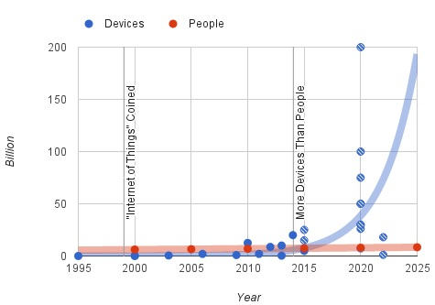
1 Introduction
1.1 Internet of Things (IoT)
Figure 1: Trend of devices vs people^{[1]}
Notes:
In recent years with the development of smart devices, the size of IoT has increased a lot. As shown in the chart, in 2015 the number of devices in IoT has exceed the population of human being. And most predictions believe the exponential growth will keep in the next 2 decades

Slide 4
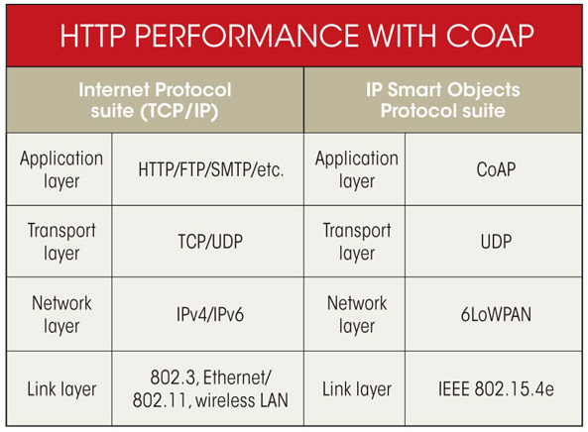
1 Introduction
1.2 Constrained Application Protocol (CoAP)
CoAP is designed for constrained networks under the context of IoT.
Figure 2: CoAP vs HTTP^{[2]}
Notes:
It has inherent many characteristics from HTTP. Like http verbs and attributes of HTTP header.
As shown above the CoAP is build up on UDP and the 6lowpan is always adopted as network layer protocol. It’s a lite version for IPv6
IPv6 in low power wireless personal area networks.
Constrained Application Protocol
Header compression, which compresses the 40-byte IPv6 and 8-byte UDP headers by assuming the usage of common fields.
Fragmentation and reassembly, as the data link of IEEE 802.15.4 with a frame length of max 127 bytes does not match the MTU of IPv6, which is 1280 bytes.
Stateless auto configuration, the process where devices inside the 6LoWPAN network automatically generate their own IPv6 address.
ARM(British multinational semiconductor and software design company )
//multicast support,
//very low overhead,
//simplicity for constrained environments.
//Payload size limited to 1024 bytes.
Multicast: send (data) across a computer network to several users at the same time.

Slide 5
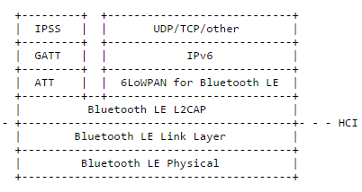
2 Related Works
2.1 In terms of IPv6 adoption
In December 2014, Pv6 over Low power Wireless Personal Area Networks (6LoWPAN) is supported by BLE 4.2^{[3]}.
Figure 3: IPv6 in BLE Stack^{[4]}
Notes:
For WPAN technologies, they can adopt CoAP by adding extra hardware to support IPv6 and UDP
It provides instructions and URI format for SMS, Websocket and TCP.
CoRE Working Group(Informational document) Internet-Draft
ATT (page 2160): "This specification defines the Attribute Protocol; a protocol for discovering, reading, and writing attributes on a peer device."
GATT (page 2207): "This specification defines the Generic Attribute Profile that describes a service framework using the Attribute Protocol for discovering services, and for reading and writing characteristic values on a peer device."

Slide 6
2 Related Works
2.2 In terms of getaway solutions
CoAP gateway for FS20 based home automation^{[5]}.
CoAP gateway for DNP3.0 based distribution automation system^{[6]}.
CoAP gateway for UPnP and ZigBee bridging^{[7]}.
Notes:
Also, CoAP gateways are used to make protocol translation between CoAP network and WPAN. Here I list three related researches. for FS20 based home automation: mapping FS20 device address to CoAP resource
June 8,2016, JupiterMesh® Neighborhood Area Network (NAN) Announced
DNP3 (Distributed Network Protocol) is a set of communications protocols used between components in process automation systems. Its main use is in utilities such as electric and water companies. Usage in other industries is not common. It was developed for communications between various types of data acquisition and control equipment. It plays a crucial role in SCADA systems,

Slide 7
3 Problem Definition
3.1 Proposed solution
Motivation: Why devices in WPAN can not directly send CoAP messages to each other without adding extra hardware layer or adopting protocol translation?
I purpose to make a software architecture to make CoAP works on existing communication protocols for WPAN such as BLE and NFC.
Meanwhile, BLE is used to explore how to overcome limitations of underline technologies.
Notes:
After evaluating relatived works, I was thinking we can not directly use CoAP in WPAN without adding hardware layer or adopting protocol translation
Therefore, I propose to build a software architecture to make

Slide 8
3 Problem Definition
3.2 Problem
How to identify Non-IP based devices?
How to overcome packet size limitation of BLE?
How to serve multiple applications as a background service?
How to provide a common interface to support different technologies?
Notes:
Goal 1. A general method to identify Non-IP based devices.
Goal 2. An architecture to support CoAP communication in BLE.
Goal 3. A background service to support multiple apps.
Goal 4. An interface to support other WPAN technologies.

Slide 9
4 Architecture
4.1 Overview
Application layer.
Network layer.
Notes:
Application layer consists of process component & communication component

Slide 10
4 Architecture
4.2 Application layer
Process component:
Processors
Senders
Communication component:
Broadcast
Search peers
Get nodes
Send data
Receive data
Notes:
Threads with dispatcher to handle request
Threads with dispatcher to send out request
Customized callback functions to handle responses.

Slide 11
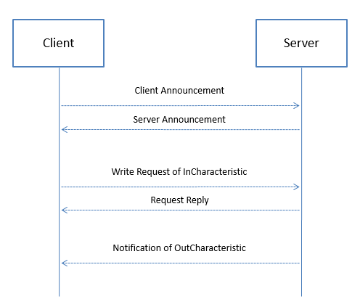
4 Architecture
4.3 Network layer – communication mechanism
Figure 4 : Communication mechanism

Slide 12
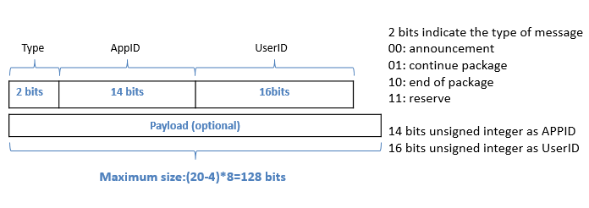
4 Architecture
4.3 Network layer – packet format
Figure 5 : Communication mechanism
Notes:
10min

Slide 13
5 Experiment
5.1 Experiment setup
Title | Goals
Minimum Data with Interval | Test performance of sending CoAP header with different intervals.
Multiple Packets | Test performance of sending different CoAP messages with different data size.
Round Trip | Test performance of round trip
Multiple Apps | Test performance of underlying service to support multiple apps
Table 1: Experiment setup

Slide 14
5 Experiment
5.1 Experiment setup
Hardware | Details
OS | Android OS, v5.1.1(Lollipop)
CPU | Dual-core 2.3 GHz Denver
Memory | 16GB/2GB RAM
Bluetooth | v4.1, A2DP, apt-X
Table 2: Device specification

Slide 15
5 Experiment
5.2 Experiment 1: Minimum data with interval
Figure 6: Results of sending headers with different interval
Notes:
the connection interval is the amount of time between two connection events. The device has a minimum and a maximum value for it. Which Android API does not provide.
// 1. The time cost of sending a BLE packet is around 100ms. (in android)
// 2. With the increase of interval the heart-beat like pattern appears more frequently. (Due to BLE’s strategies for saving energy)
// 3. There are some random fluctuation (Android’s BLE implementation)

Slide 16
5 Experiment
5.3 Experiment 2: Multiple packets
Figure 7: Results of sending multiple packets
Notes:
The implementation used a synchronized way to exchange data.

Slide 17
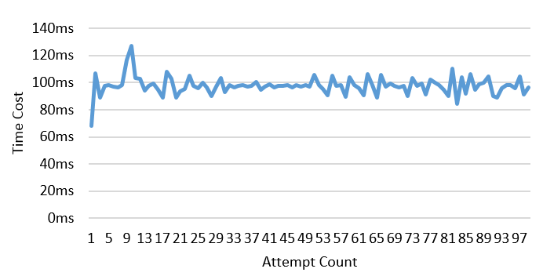
5 Experiment
5.4 Experiment 3: Round trip
Figure 8: 4-byte round trip
Notes:
The main limitation of communication is the time window of a data exchange event.

Slide 18
5 Experiment
5.5 Experiment 4: Multiple apps
Figure 9: Result of Multi-App Experiment

Slide 19
5 Experiment
5.6 Conclusion
The data rate is 160 byte/s.
The BLE’s save energy mechanisms influence the performance of sending data.
The performance of Android’s BLE implementation needs to be improved.
The competition in the message queue influences the received time of a message.
Notes:
“Connection interval” can be any value between 7.5ms and 4s.
The data rate is 160 byte/s. due to wait ACK

Slide 20
6 Conclusion
The proposed architecture provides a software solution to enable CoAP communication in WPAN.
The research results have been published by IEEE^{[8] [9]}.
Notes:
A general method to identify Non-IP based devices.
An architecture to support CoAP communication in BLE.
A background service to support multiple apps.
An interface to support other WPAN technologies.

Slide 21
7 Future works
Data Rate
Availability
Cross-Platform
Underlying Technology
Security

Slide 22
References
[1] Howard, P. N. (2015, June 9). Sketching out the Internet of Things trendline. Retrieved 6 7, 2016, from http://www.brookings.edu/blogs/techtank/posts/2015/06/9-future-of-iot-part-2
[2] Sutaria, R., & Govindachari, R. (2013, May 1). Understanding The Internet Of Things. Retrieved June 13, 2016, from electronicdesign.com: http://electronicdesign.com/iot/understanding-internet-things
[3] SIG. (2014, December). BLUETOOTH ® CORE SPECIFICATION 4.2 FREQUENTLY ASKED QUESTIONS. Retrieved April 18, 2016, from bluetooth.org: https://www.bluetooth.org/ja-jp/Documents/Bluetooth4-2FAQ.pdf
[4] Isomaki, M., Nieminen, J., Gomez, C., Shelby, Z., Savolainen, T., & Patil, B. (2015, October). IPv6 over BLUETOOTH(R) Low Energy. Retrieved June 7, 2016, from ietf.org: https://tools.ietf.org/html/rfc7668
[5] Bergmann, O., Hillmann, K. T., & Gerdes, S. . (2012). A CoAP-gateway for smart homes. Computing, Networking and Communications (ICNC), 2012 International Conference on (pp. 446-450). Maui, HI: IEEE.
Notes:
[5] Bergmann, O., Hillmann, K. T., & Gerdes, S. , 2012
[6] Shin, I. J., Eom, D. S., & Song, B. K., 2015
[7] Mitsugi, J., Yonemura, S., Hada, H., & Inaba, T., 2011

Slide 23
References
[6] Shin, I. J., Eom, D. S., & Song, B. K. (2015). The CoAP-based M2M gateway for distribution automation system using DNP3.0 in smart grid environment. 2015 IEEE International Conference on Smart Grid Communications (SmartGridComm) (pp. 713-718). Miami, FL: IEEE.
[7] Mitsugi, J., Yonemura, S., Hada, H., & Inaba, T. (2011). Bridging UPnP and ZigBee with CoAP: Protocol and its Performance Evaluation. IoTSP '11 Proceedings of the workshop on Internet of Things and Service Platforms (p. 1). ACM.
[8] Chen, N., Li, X., & Deters, R. (2015). Collaboration & Mobile Cloud-Computing: Using CoAP to Enable Resource-Sharing between Clouds of Mobile Devices. 2015 IEEE Conference on Collaboration and Internet Computing (CIC) (pp. 119 - 124). Hangzhou: IEEE.
[9] Shi, H., Chen, N., & Deters, R. (2015). Combining Mobile and Fog Computing: Using CoAP to Link Mobile Device Clouds with Fog Computing. 2015 IEEE International Conference on Data Science and Data Intensive Systems (pp. 564 - 571). Sydney: IEEE.
Notes:
[5] Bergmann, O., Hillmann, K. T., & Gerdes, S. , 2012
[6] Shin, I. J., Eom, D. S., & Song, B. K., 2015
[7] Mitsugi, J., Yonemura, S., Hada, H., & Inaba, T., 2011

Slide 24
Thank you

