Slide 1
BLE based CoAP communication in IoT
---- CoAPNonIP: An Architecture supports CoAP in BLE

Slide 2
Content
1.Background
2.Problems
3.Solutions
4.Architecture
5.Experiment
6.Summary

Slide 3
1.Background
1.1 IoT
IoT short for internet of things.
[1]The Internet of Things allows objects to be sensed and controlled remotely across existing network infrastructure

Slide 4
1.Background
1.1 IoT
According to Dr. John Barrett ’s[2] presentation in TED. There are 4 things we need to do:
Tagging an object.
Grant objects communication ability.
Grant sense to objects.
Remote control

Slide 5
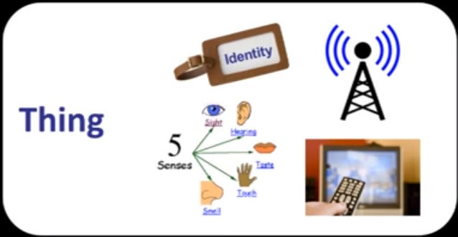
1.Background
1.1 IoT-extend 2
Figure 1[1]: 4 steps towards CoAP

Slide 6
1.Background
1.2 RESTful
REST stands for representational state transfer. RESTful is a style of communication.
RESTful style requires each available resource at server side can be visited through a consistent path (URI). Client can request different operations through standard HTTP verbs (e.g. POST, GET, PUT and DELETE).
Compared with SOAP, REST is more lightweight, flexible and controllable

Slide 7
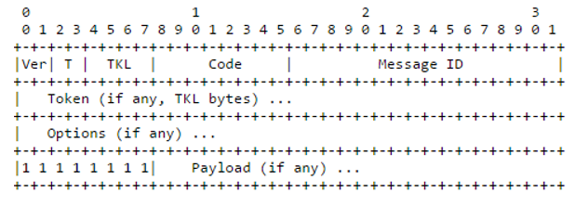
1.Background
1.3 CoAP
CoAP is short for Constrained protocol. It is a lite version of HTTP. CoAP has a four-bytes header which includes information of version, token, length of variable-length token field, message ID and code of message type.
Figure 2: CoAP format

Slide 8
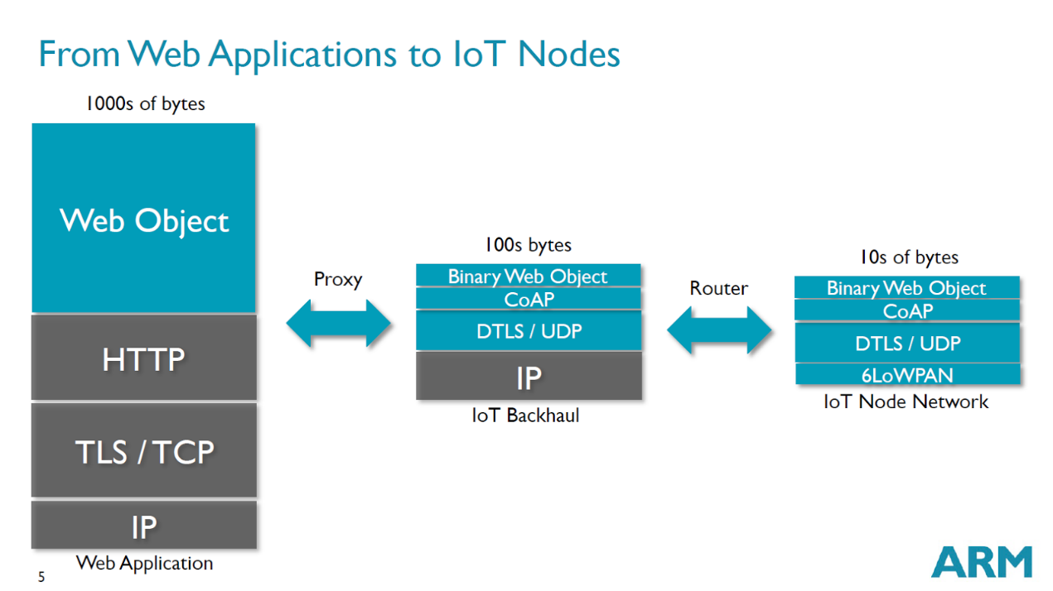
1.Background
1.3 CoAP
Figure 3: Context of CoAP

Slide 9
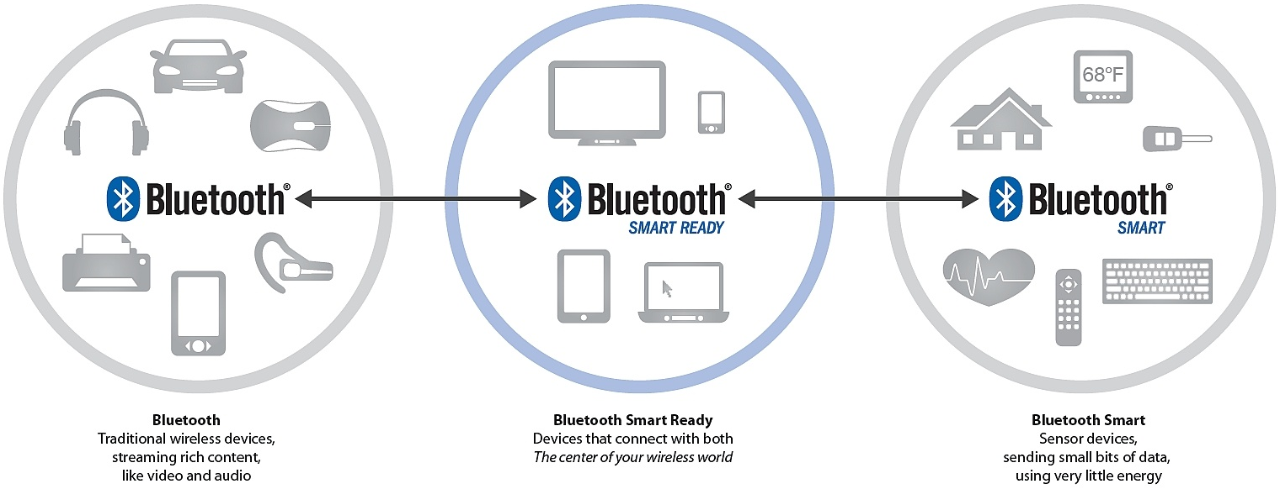
1.Background
1.3 BLE
Figure 4: Bluetooth and BLE

Slide 10
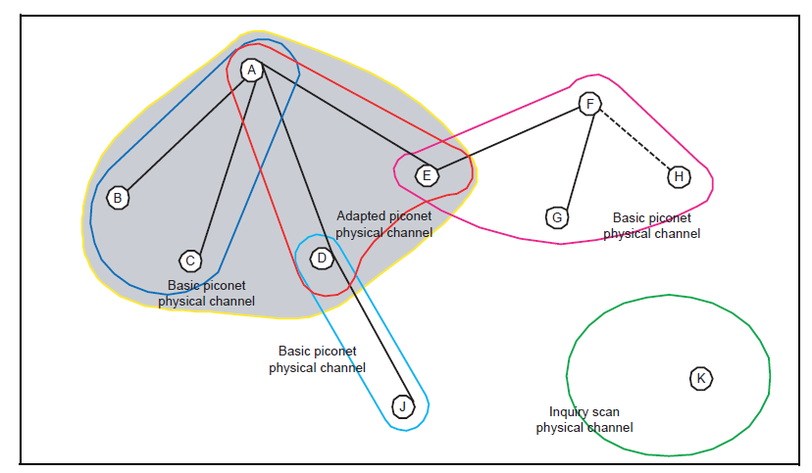
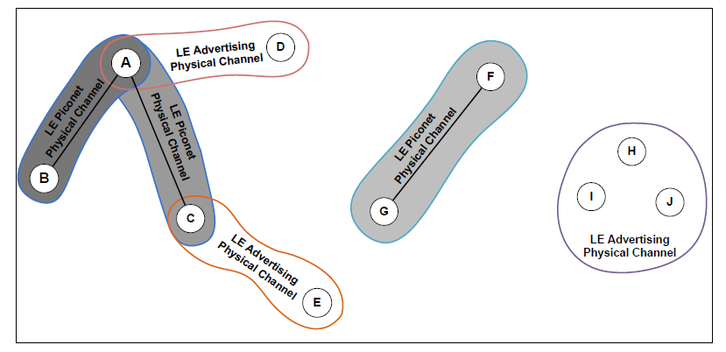
1.Background
1.3 Bluetooth vs BLE
Figure 5: Bluetooth vs BLE

Slide 11
2. Problems
How to build an architecture to support CoAP communication in BLE.
How to develop a software package to support developer to customize WPAN solutions for CoAP.
How to grant CoAP commutation capability to multiple applications in one physical device.
How to integrate data at center node.

Slide 12
3. Solutions
1. We proposed a CoAPNonIP architecture to support CoAP communication in BLE.
2. We separated the architecture into two layers: Application layer and Network layer to grant flexible to the architecture. In this way, communication control and underline communication details are separated.
3. Inspired by Apple’s iBeacon, we adopt USERID and APPID at Application layer to indicate app and its user. Those two ids help APPs to filter messages.
4. We introduced virtual resource concept to integrate data in a center node of sensors.

Slide 13
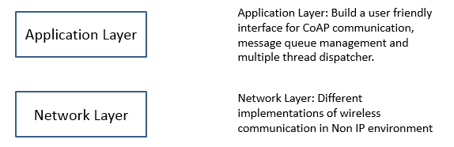
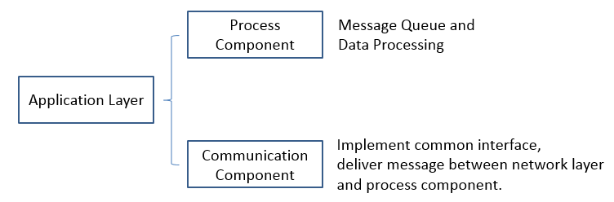
4. Architecture
4.1 Summary
Figure 5: Architecture summary

Slide 14
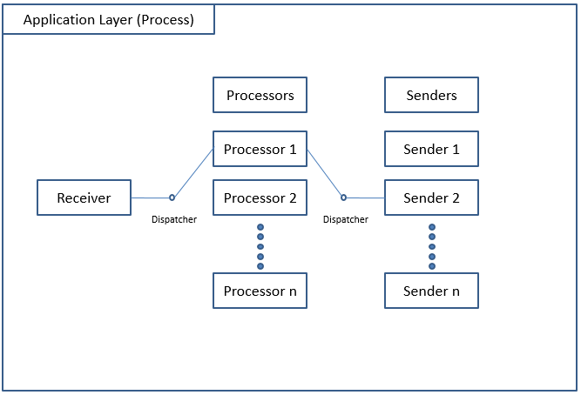
4. Architecture
4.2 Process component
Figure 6: Process component

Slide 15
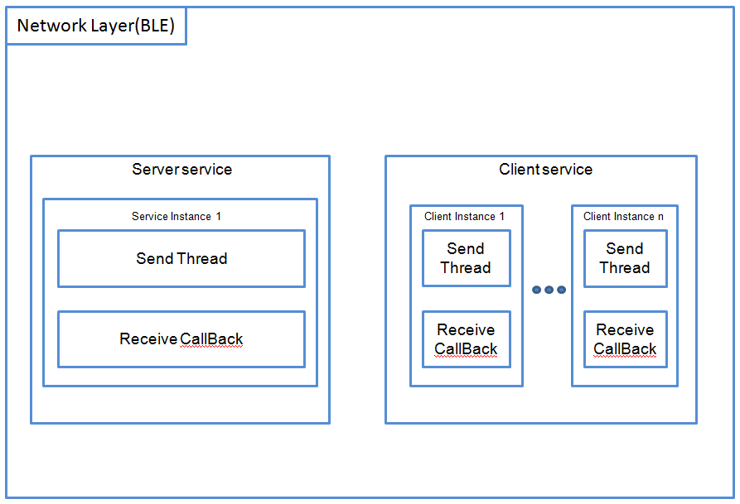
4. Architecture
4.3 Network layer
Figure 7: Network layer implementation of BLE

Slide 16
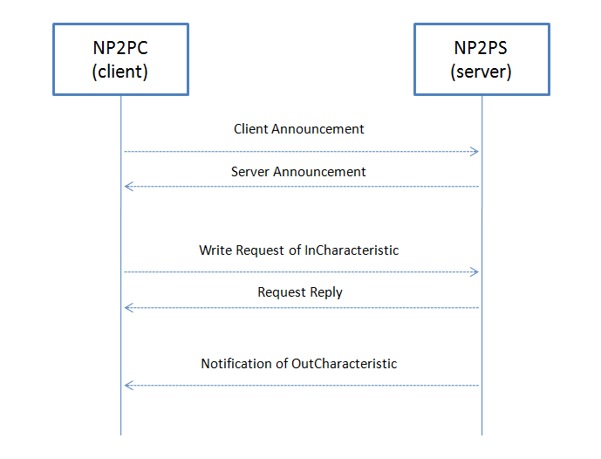
4. Architecture
4.4 Communication mechanism,
Figure 8: Communication mechanism

Slide 17
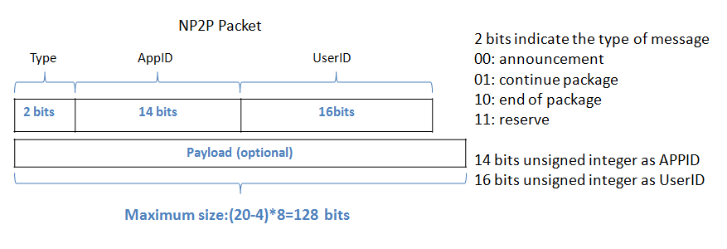
4. Architecture
4.5 Packet format
Since MTU(maximum transmission unit) is set to 23 by default and only 20 bytes are available to carry payload, we proposed a 20 bytes protocol in BLE implementation of CoAPNonIP.
Figure 9: Packet Size

Slide 18
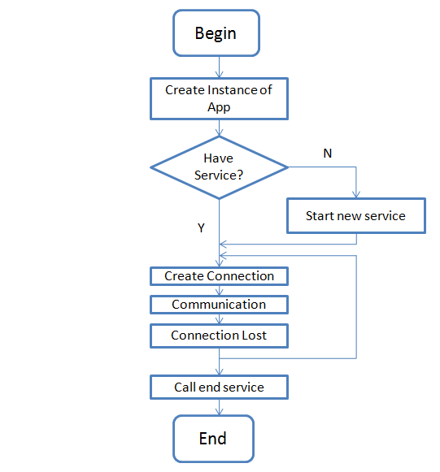
4. Architecture
4.6 Life cycle of network service
Figure 10: Life cycle of network service

Slide 19
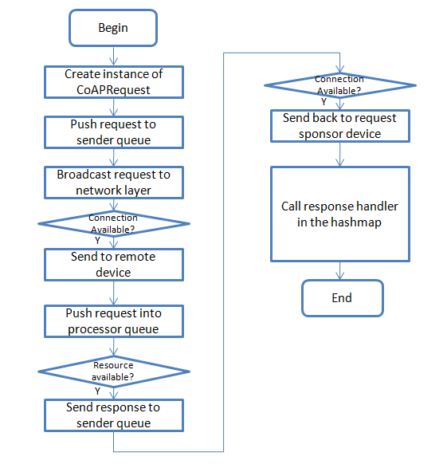
4. Architecture
4.7 Life cycle of a CoAP request
Figure 11: Life cycle of a CoAP request

Slide 20
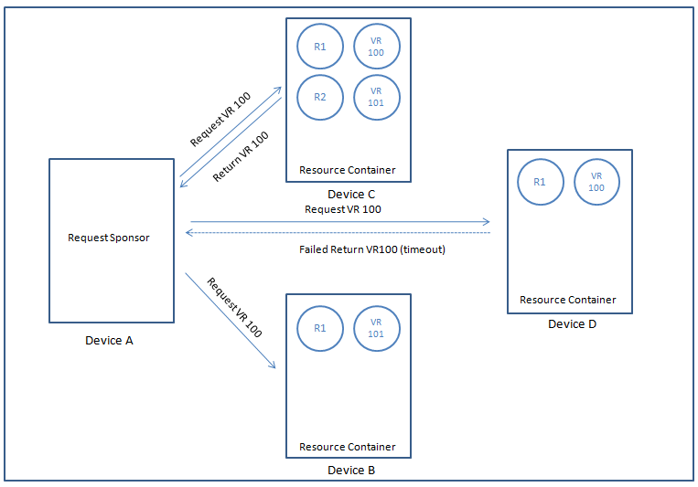
4. Architecture
4.8 Virtual Resource
Figure 12: Virtual Resource Mechanism

Slide 21
5. Experiment
5.1 Experiment Goals
Goals | Detail
Data Rate | Get one way data transfer performance.
Latency | Find out sources of latency
Round Trip | Find out round trip performance.

Slide 22
5. Experiment
5.2 Experiment setup
We use two HTC Nexus 9 to do experiments.
Hardware | Details
OS | Android OS, v5.1.1(Lollipop)
CPU | Dual-core 2.3 GHz Denver
Memory | 16GB/2GB RAM
Bluetooth | v4.1, A2DP, apt-X

Slide 23
5. Experiment
5.3 Data Rate
Experiment steps
1.Start sample program scan and create connection between two devices.
2.Send CoAP message with payload 4 (1 packet), 12 (2 packets),28 (3 packets), 44 (4 packets), 60(5 packets), 76 (6 packets) and 92(7 packets) 100 times respectively (0 interval time).
3.Record receive time when received response from connected device.
4.Calculate transfer time according to time gap between message been received.

Slide 24
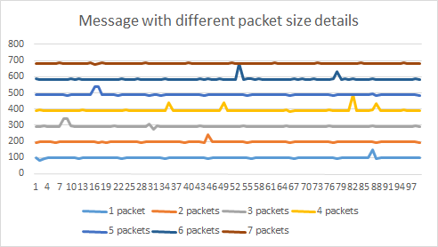
5. Experiment
5.3 Data Rate
Figure 13: Data rate experiment result
Experiment Result: We have 10*20=200 byte/s data rate.

Slide 25
5. Experiment
5.4 Latency
Experiment steps
Start sample program scan and create connection between two devices.
Send 4-bytesheader 100 times to remote device with 0,50,100,150,200,250,300,350,400,450ms interval respectively.
Record received time at sender side
Calculate transfer time according to time gap between message been received

Slide 26
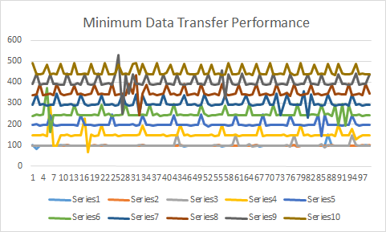
5. Experiment
5.4 Latency
Experiment Result:
1.”connection interval” determines how often a central will ask data from peripheral.
Most likely to be the reason of constant fluctuation (heartbeat-like pattern).
2. From time to time band performance may caused by the implementation of Android V5.0 (Lollipop)
Figure 14: Latency experiment result

Slide 27
5. Experiment
5.5 Round Trip
Experiment steps
Start sample program scan and create connection between two devices.
Send 4-bytes header 100 times (0 interval time).
Record received time at sender side (get 99 sets of data).
Calculate round trip time according to time gap between message been received.
Repeat three times.

Slide 28
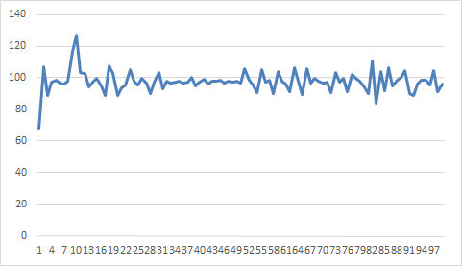
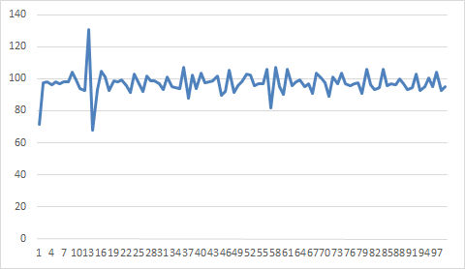
5. Experiment
5.5 Round Trip
Figure 15: Roundtrip result part 1
Figure 16: Roundtrip result part 2

Slide 29
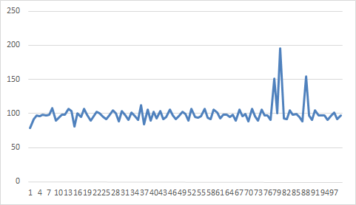
5. Experiment
5.5 Round Trip
Figure 17: Roundtrip result part 3
Experiment Result: Compared with one way data push round trip have more latency but the time consuming of it still around 100ms per packet.

Slide 30
6.Summary
We successfully implemented the proposed architecture in Android. According to results of experiments, we found several performance issues of the architecture. Although the development of Android’s solution for BLE may improve performance of our implementation, there is great room to improve our implementation.

Slide 31
References
[1] ITU, 31 January 2016 ,"Internet of Things Global Standards Initiative" . Retrieved from
http://www.itu.int/en/ITU-T/gsi/iot/Pages/default.aspx
[2] Dr. John Barrett, 5 October 2012,“The Internet of Things” . Retrieved from
https://www.youtube.com/watch?v=QaTIt1C5R-M

Slide 32
Thank you

