Slide 1
Bluetooth Low Energy Based CoAP Communication in IoT
---- CoAPNonIP: An Architecture Grants CoAP in WPAN

Slide 2
Content
Introduction
Problem Definition
Related Work
Architecture
Experiment
Future Work
Summary

Slide 3
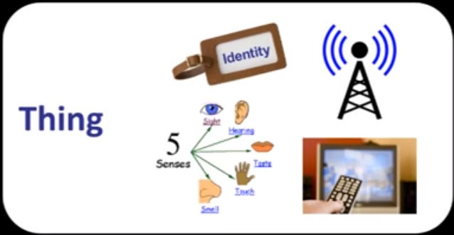
Introduction
1.IoT
IoT aims to make every physical object tangible in virtual world.
Figure 1 [1]: 4 steps towards CoAP
Notes:
The Internet of Things allows objects to be sensed and controlled remotely across existing network infrastructure.
According to Dr. John Barrett ’s presentation in TED[2012]. There are 4 things we need to do:
Tagging an object.
Grant objects communication ability.
Grant sense to objects.
Remote control
Dr. John Barrett is Head of Academic Studies at the Nimbus Centre for Embedded Systems Research at Cork Institute of Technology (CIT)

Slide 4
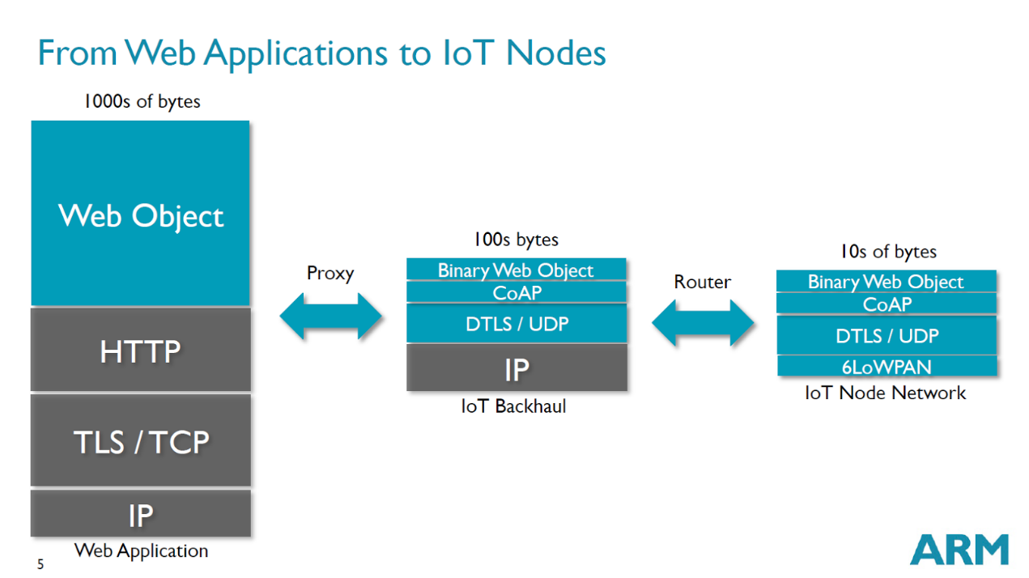
Introduction
2.CoAP
CoAP[2] is designed for constrained networks. It can easily be translated into HTTP while meeting multicast, low overhead and simplicity.
Figure 2 [3]: Using Context of CoAP
Notes:
CoAP is designed to easily interface with HTTP for integration with the Web while meeting specialized requirements such as
Constrained Application Protocol
CoAP is naturally RESTful
ARM(British multinational semiconductor and software design company )
//multicast support,
//very low overhead,
//simplicity for constrained environments.
//Payload size limited to 1024 bytes.
Multicast: send (data) across a computer network to several users at the same time.

Slide 5
Introduction
3.BLE
BLE is popular in constrained devices. However, it is not easily to merge it with existing Internet.
Proxy
Internet
BLE communication
HTTP Request
Sensor
Figure 3: Standard way of sending message
Notes:
Traditional Bluetooth use 20byte characteristics to transfer data. No format has been defined.

Slide 6
Problem Definition
1.Summary
Sine CoAP is a widely adopted HTTP like protocol. We want to explore the possibility of using CoAP in BLE
CoAP
Proxy
BLE based CoAP communication
Internet
HTTP Request
Sensor
Figure 4: Standard way of sending message
Notes:
We want to introduce CoAP in BLE to simplify the process of merge edge nodes (sensors) into IoT.

Slide 7
Problem Definition
2.Detail
Construct an architecture to achieve CoAP communication in BLE and supports customize WPAN solutions for CoAP.
Enable CoAP communication in multiple applications of one physical device.
Integrate same data from multiple devices at center node.
Notes:
The problem we facing are obvioius. The first thing is proposed an architecture. Then we need to make it be come an underline service to support multiple applications.
1. We proposed a CoAPNonIP architecture to support CoAP communication in BLE.
We separated the architecture into two layers: Application layer and Network layer to grant flexible to the architecture. In this way, communication control and underline communication details are separated.
2. Inspired by Apple’s iBeacon, we adopt USERID and APPID at Application layer to indicate app and its user. Those two ids help APPs to filter messages.
3. We introduced virtual resource concept to integrate data in a center node of sensors.

Slide 8
Related Work
1.6LoWPAN
In December 2014, Low-power IP(6LoWPAN[4]) is adopted by Bluetooth4.2 which provides another way to achieve CoAP in BLE.
Notes:
acronym[ak-ruh-nim] IPv6 over Low power Wireless Personal Area Networks.
Bluetooth 4.2. IoT capability(IP(6LoWPAN),
Security(LE Privacy 1.2 to prevent Bluetooth smart device being tracked by untrusted devices)
speed.

Slide 9
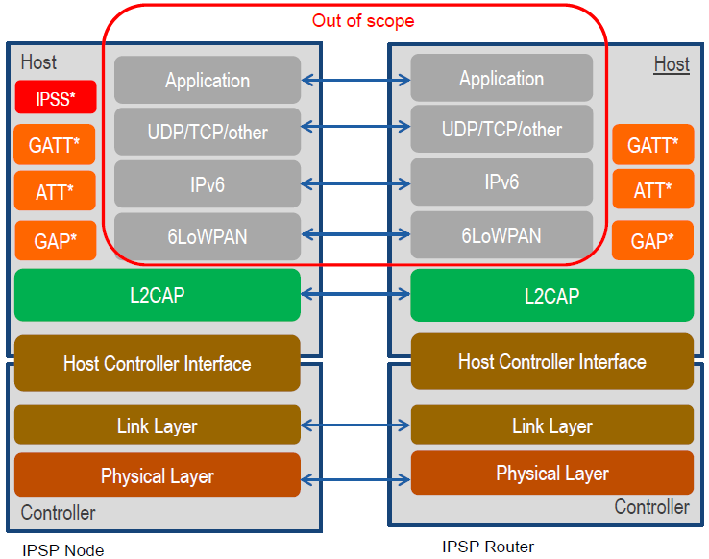
Related Work
1.6LoWPAN detail
Figure 5 [5]: IP Support Profile stack and IP stack
Notes:
GATT (Generic Attribute Profile)
The GATT server sends responses to requests and when configured, sends indication and notifications asynchronously to the GATT client when specified events occur on the GATT server
For a characteristic, there are three types of attributes property, value and descriptor
ATT (Attribute Protocol): "This specification defines the Attribute Protocol; a protocol for discovering, reading, and writing attributes on a peer device.“
GAP(General access protocol) defines various roles for devices, but the two key concepts to keep in mind are Central devices and Peripheral devices. it controls connections and advertising in Bluetooth
6LoWPAN encapsulate IPV6 header. (MTU size shall be 1280 or higher by adop 6lowpan)
The 6LoWPAN group has defined encapsulation and header compression mechanisms that allow IPv6 packets to be sent and received over IEEE 802.15.4 based networks.
//The fixed header of an IPv6 packet consists of its first 40 bytes (320 bits).
The 802.15.4(MAC and PHY) category was developed for low-data-rate monitor and control applications and extended-life low-power-consumption uses.
GATT is built on top of ATT and defines how higher level services are composed and the framework for operating on those services
GATT (page 2207): "This specification defines the Generic Attribute Profile that describes a service framework using the Attribute Protocol for discovering services, and for reading and writing characteristic values on a peer device."
The IPSP defines two roles – Node role and Router role.
The Router role is used for devices that can route IPv6 packets.
The Node role is used for devices that can only originate or consume IPv6 application packets. Additionally, the Node role has a special function in Bluetooth service discovery; an instance of the IPSS (Internet Protocol Support Service) that allows router devices to discover it (over GATT).

Slide 10
Related work
2.Alternative transports
Since 2013[6], CoRE working group maintains a Internet-Draft: CoAP Communication with Alternative Transports.
Notes:
It provides instructions and URI format for SMS, Websocket and TCP.
CoRE Working Group(Informational document) Internet-Draft

Slide 11
Architecture
1.Summary
CoAPNonIP
CoAPNonIP
CoAP request
BLE packets
CoAP request
Application
Application
BLE packets
CoAP response
CoAP response
BLE device
BLE device
Figure 6 : Architecture overview
Notes:
Aims to make the CoAP been able to server one or more applications.

Slide 12
Architecture
2.Detail
Process Component
Message management
Application Layer
Interpret
Component
Interpret actions to lower level function call
Transport Layer
Communication
Component
BLE communication management
Figure 7 : Architecture Detail
Notes:
Architecture of CoAPNonIP

Slide 13
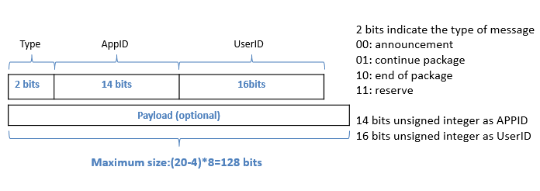
Architecture
3.Packet format
MTU(maximum transmission unit) of BLE is 23 by default and only 20 bytes are available to carry payload, we proposed a 20 bytes protocol to support proposed architecture.
Figure 8 : Packet format
Notes:
20 bytes available.
4 bytes header: 2+14+16=32 bits
Payload: 16 bytes
CoAP header: 4 bytes and 1 byte indicate payload. 1024 bytes for payload maximum
For first BLE packet we have 20-4-5=11 bytes to carry payload.

Slide 14
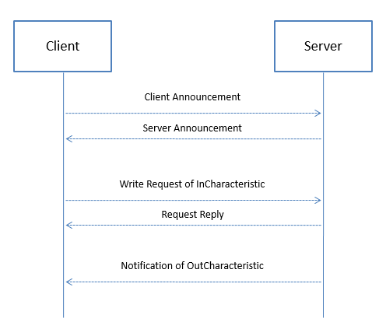
Architecture
4.Communication mechanism
Before data transfer, the architecture need to exchange announcement to get information of remote side.
Figure 9 : Communication mechanism
Notes:
Who searching nodes to connect with is Client.
Who waiting connection is Server.

Slide 15
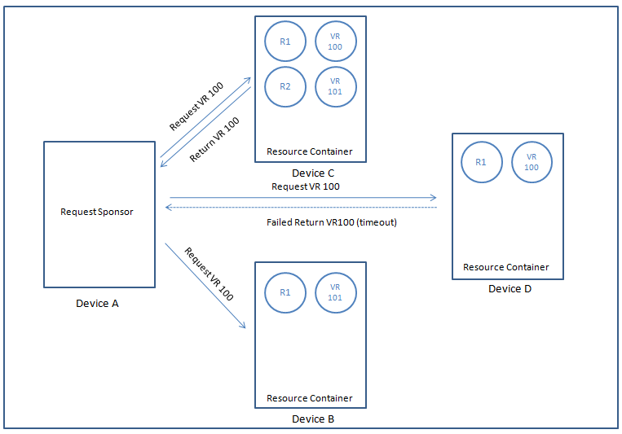
Architecture
5.Virtual resource
Figure 10 : Virtual resource
Notes:
Who searching nodes to connect with is Client.
Who waiting connection is Server.

Slide 16
Experiment
1.Experiment Setup:
We use two HTC Nexus 9 to do experiments.
Hardware | Details
OS | Android OS, v5.1.1(Lollipop)
CPU | Dual-core 2.3 GHz Denver
Memory | 16GB/2GB RAM
Bluetooth | v4.1, A2DP, apt-X
Table 1 :Experiment setup
Notes:
Two tablets

Slide 17
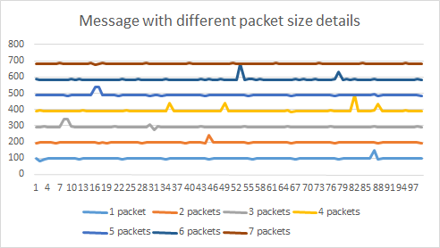
Experiment
2.Data Rate
Figure 11 : Experiment of data rate
Result: We have 10*20=200 byte/s data rate (1 BLE packet per 100ms).
Notes:
1.Start sample program scan and create connection between two devices.
2.Send CoAP message with payload 4 (1 packet), 12 (2 packets),28 (3 packets), 44 (4 packets), 60(5 packets), 76 (6 packets) and 92(7 packets) 100 times respectively (0 interval time).
3.Record receive time when received response from connected device.
4.Calculate transfer time according to time gap between message been received.

Slide 18
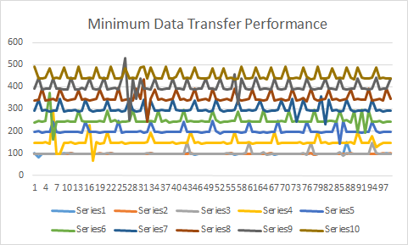
Experiment
3.Latency
Figure 12 : Experiment of latency
Result: Heartbeat-like pattern and random fluctuation
Notes:
Connection interval,
BLE
Start sample program scan and create connection between two devices.
Record received time at sender side
Send 4-bytesheader 100 times to remote device with 0,50,100,150,200,250,300,350,400,450ms interval respectively.
(because of data send queue, the first 3 lines are at 100ms)
Calculate transfer time according to time gap between message been received

Slide 19
Experiment
4.Performance with different distance
Figure 13 : Experiment of distance
Result: Performance only guaranteed within 10 meters
Notes:
Send 4 bytes header CoAP message and receive callback from remote device(100 times to calculate average) with different distance.
dotted line is tread.

Slide 20
Future Work
1. Improve performance.
2. Explore Solution for multi-node communication.
3. Implement other wireless protocols
Summary
We successfully implemented the proposed architecture in Android. Meanwhile, there is great room to improve our implementation.

Slide 21
Reference
[1]Barrett J, (2012, Oct 5). The Internet of Things.Youtube 2016.URL: https://www.youtube.com/watch?v=QaTIt1C5R-M
[2]Shelby, Z., Hartke, K., & Bormann, C. (2014). The Constrained Application Protocol (CoAP)(RFC 7252).
[3]Shelby, Z, (2014, April 30). CoAP: The Web of Things Protocol [Powerpoint slides]. Retrieved from http://www.slideshare.net/zdshelby/coap-tutorial
[4]Isomäki, M., Kerai, K., & Mutikainen, J (2011). Connecting BT-LE sensors to the Internet using Ipv6.
[5]Internet WG, (2014, Dec 16). Internet Protocol Support Profile
[6]Silverajan, B., & Savolainen, T. (2013). CoAP Communication with Alternative Transports. ID: draft-silverajan-core-coap-alternative-transports-01.

Slide 22
Thank you

