Slide 1
Model To Predict Price and Profit Of Residential Properties
Ch.V.Sarath Chandra

Slide 2

Use Cases Of Data Science In Real Estate
1
Risks reduction
2
Improved Customers Engagement
3
Accurate Appraisals
4
AI-Enabled Decision Making Process
5
Enhanced Marketing Strategy
6
Data- Driven Insurance

Slide 3




How To Improve Customer Engagement
Story-Time
Make a Connection
Support & Service
Social-media
In person
By web application
Leverage the power of storytelling to attract new followers and retain existing customers on your firm’s official social media accounts
As a brand, being present online is rarely enough to generate results. It also does not guarantee that visitors will reach out to your firm for real-estate services. Marketers working on behalf of real estate firms must first identify key customer pain points.
A collaborative, research-first approach to customer engagement can boost the bottom-line while also widening the customer base. Real estate firms must leverage digital tools in a way that captures and converts a prospective buyer into a lifelong customer.

Slide 4





Support and Services
Fundamentals
Keep clients informed
Create personal experiences
Empower potential clients
Provide actionable suggestions
Differentiate yourself from the competition

Slide 5





My Approach
Data
from kaggel
Data
from 99acers
Data cleaning
Detecting Outliers
ML & Stat
Validation

Slide 6
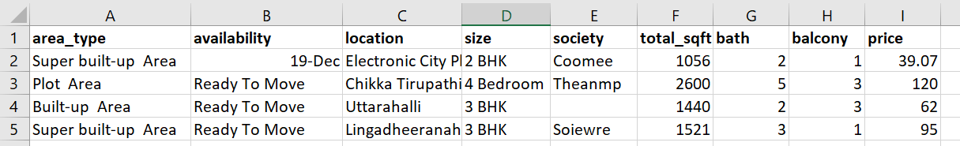
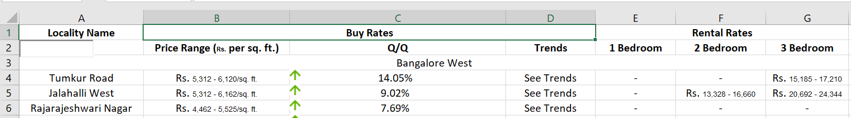
My Data set
From kaggel
https://www.kaggle.com/amitabhajoy/bengaluru-house-price-data
From 99acers
https://www.99acres.com/property-rates-and-price-trends-in-bangalore

Slide 7
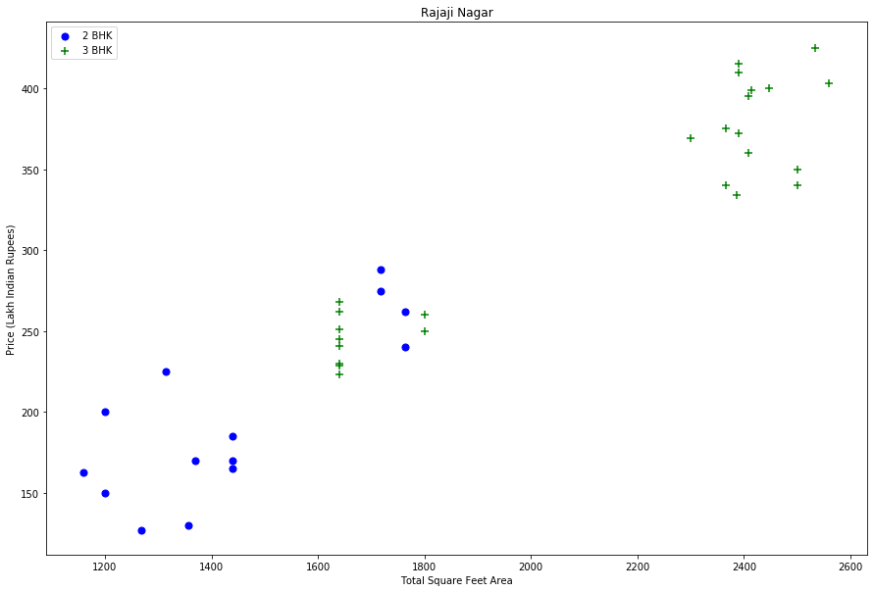
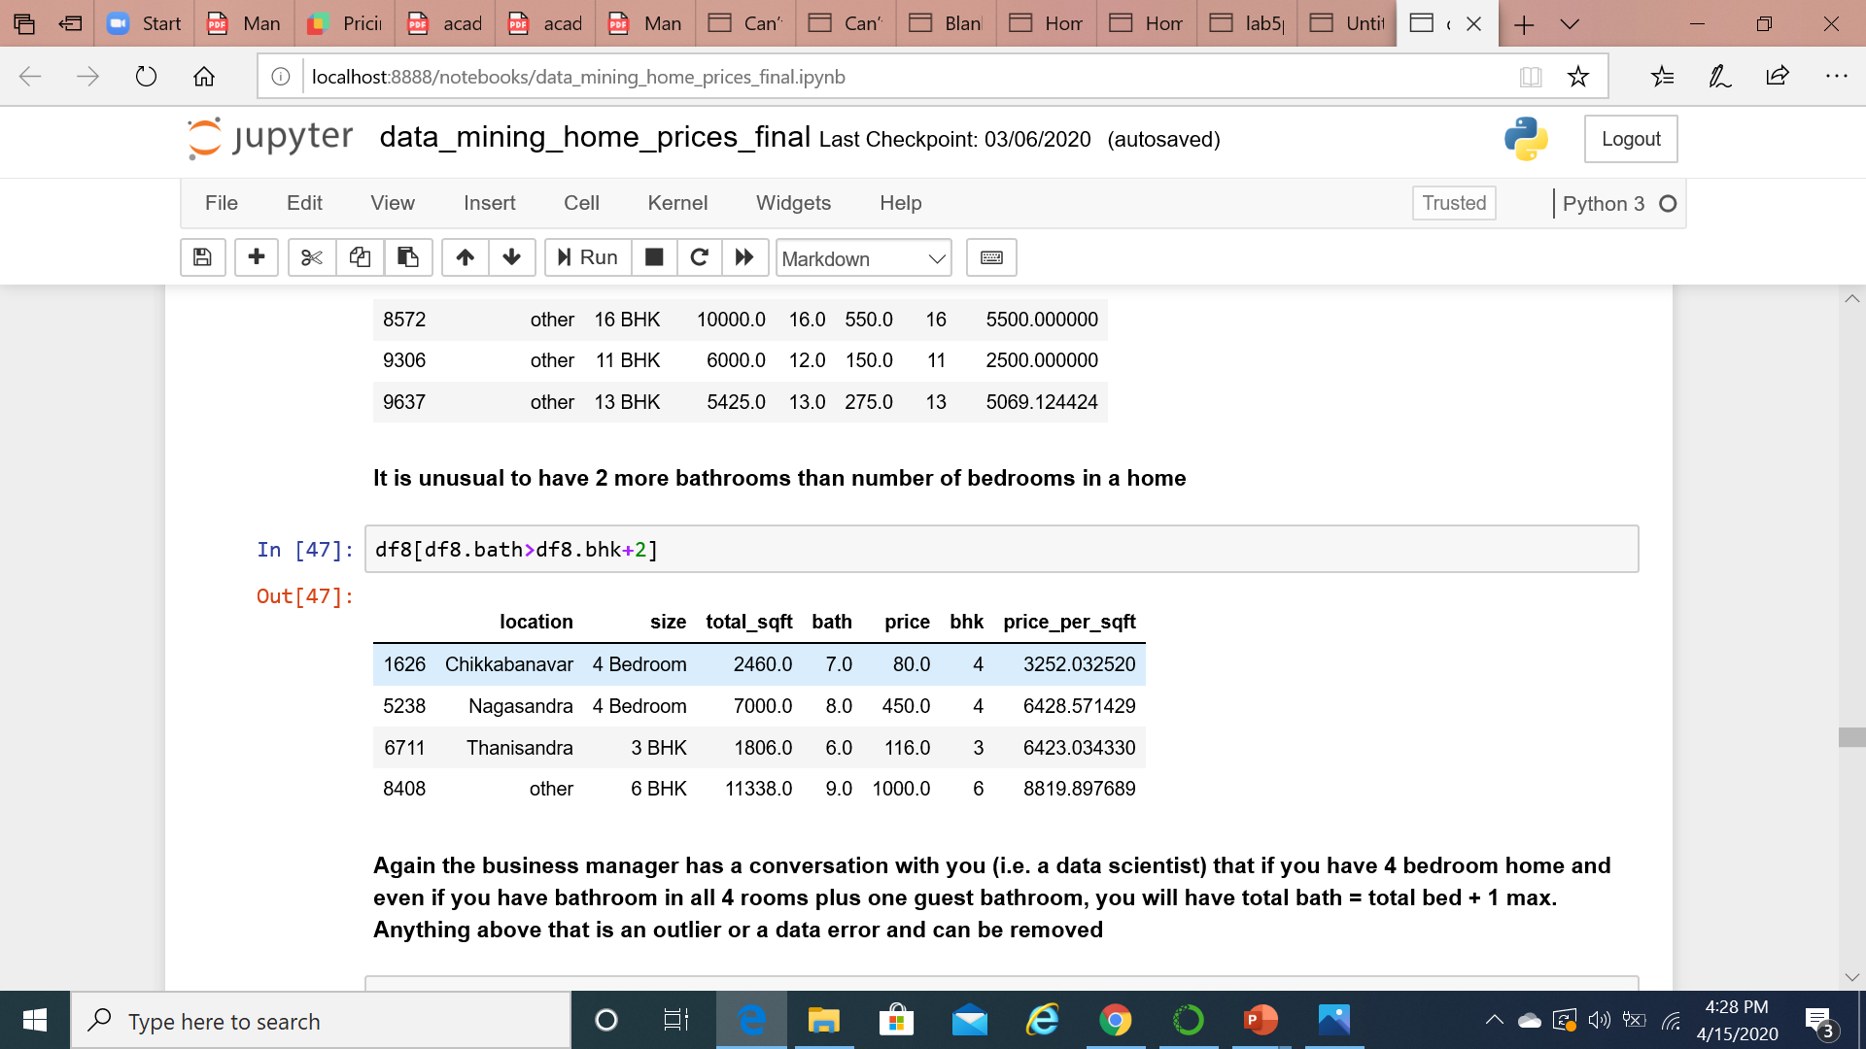
Detecting outliers
Two Bed room Vs three Bed room flat
No of Bath rooms Vs No of Bed rooms

Slide 8
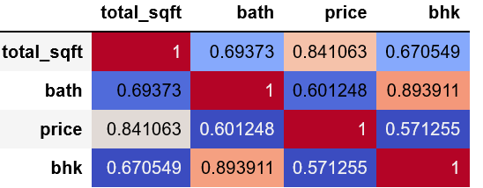

Correlation between the Attributes
>
0.5
Total_sqft
>
0.5
Bath
>
0.5
price
Bed room(bhk)
>
0.5

Slide 9

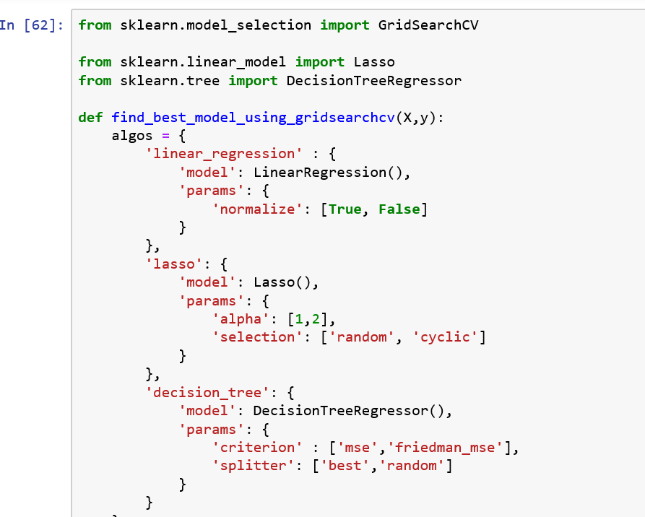
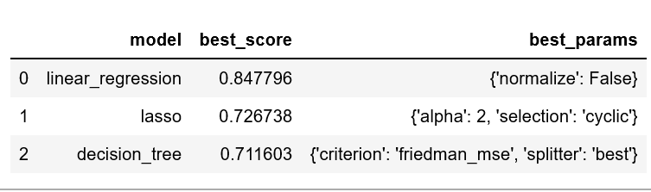
ML algorithm to find best statistical technique
Which is Optimal statistical technique
Results

Slide 10

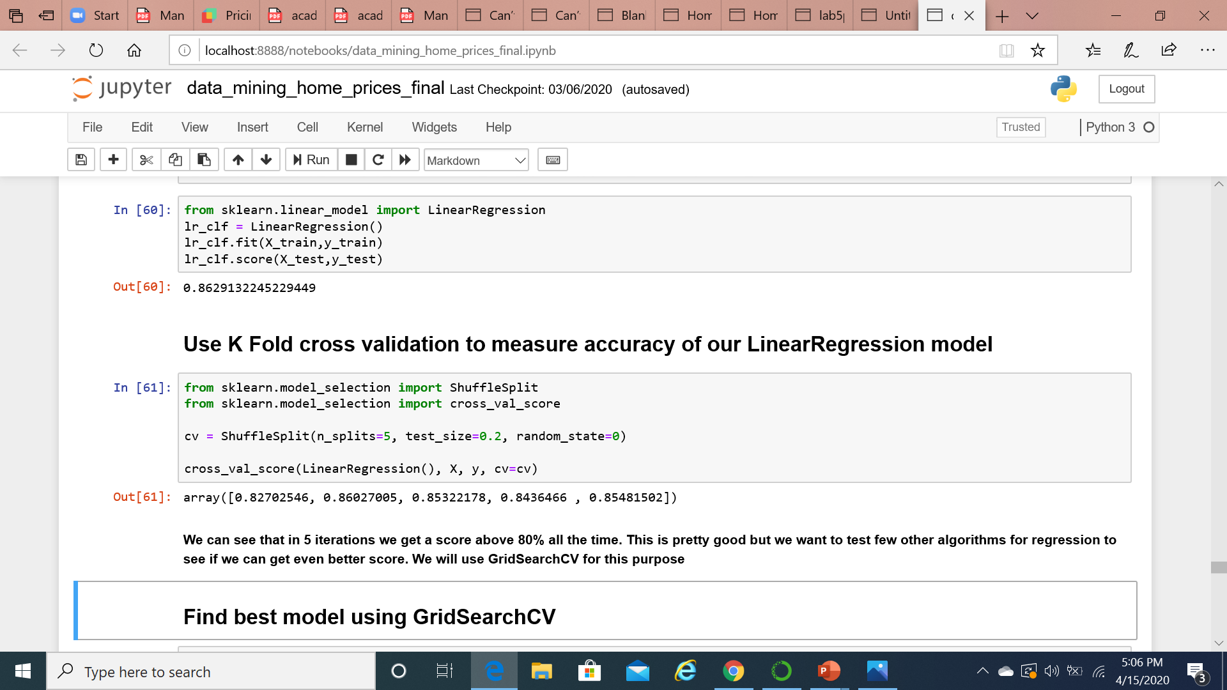
Validation !
K Fold Cross validation
Average > 80 %

Slide 11
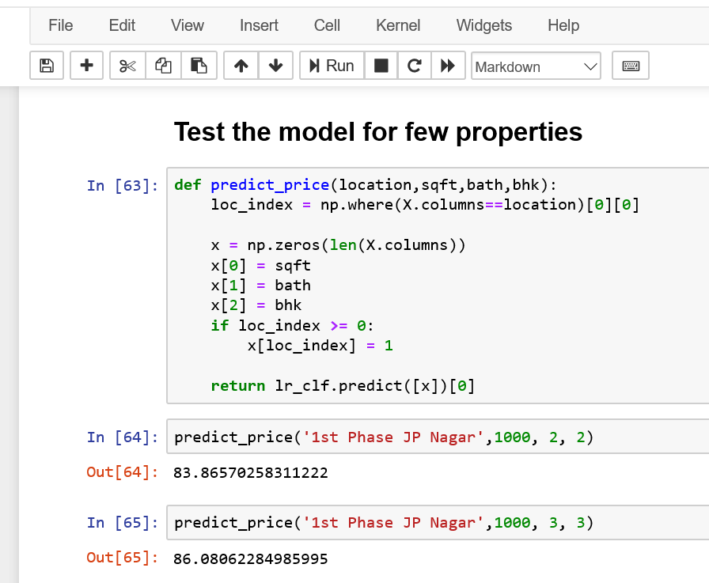

Testing Model

Slide 12
Thank You

