Slide 1

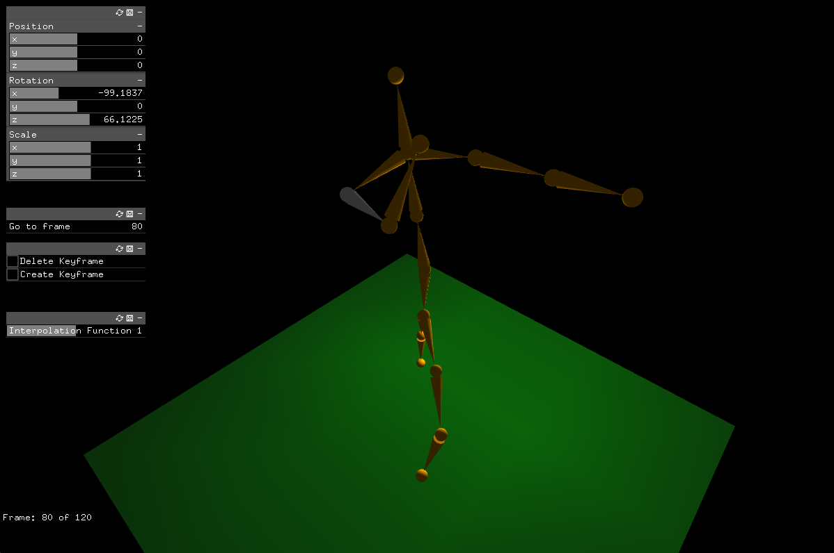
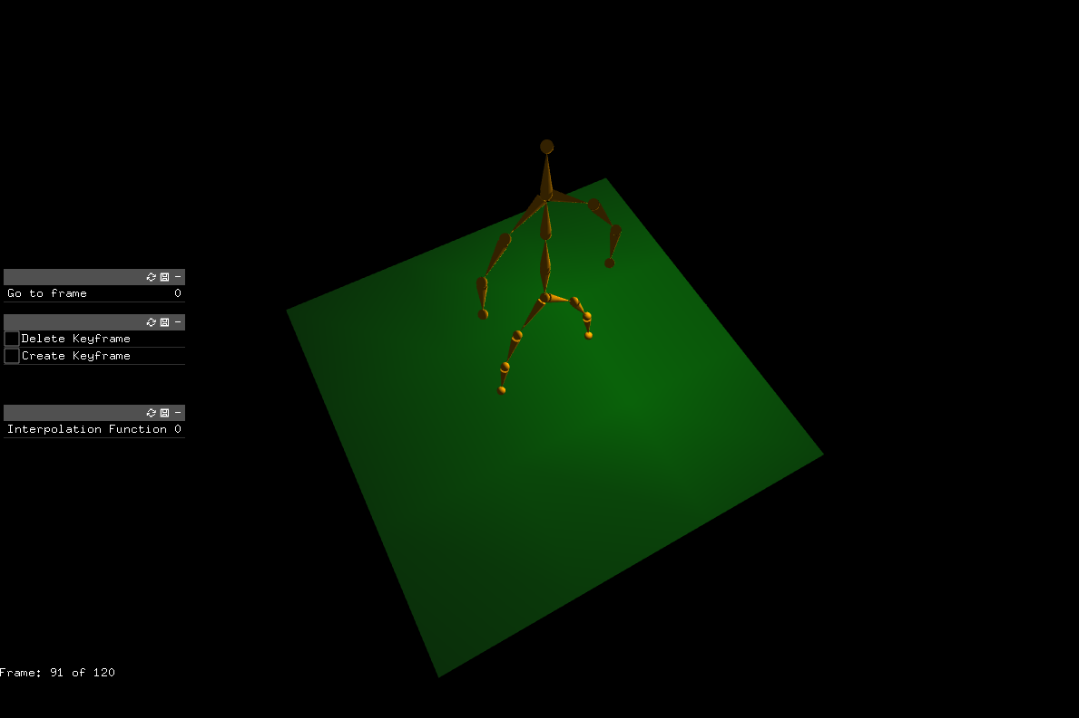
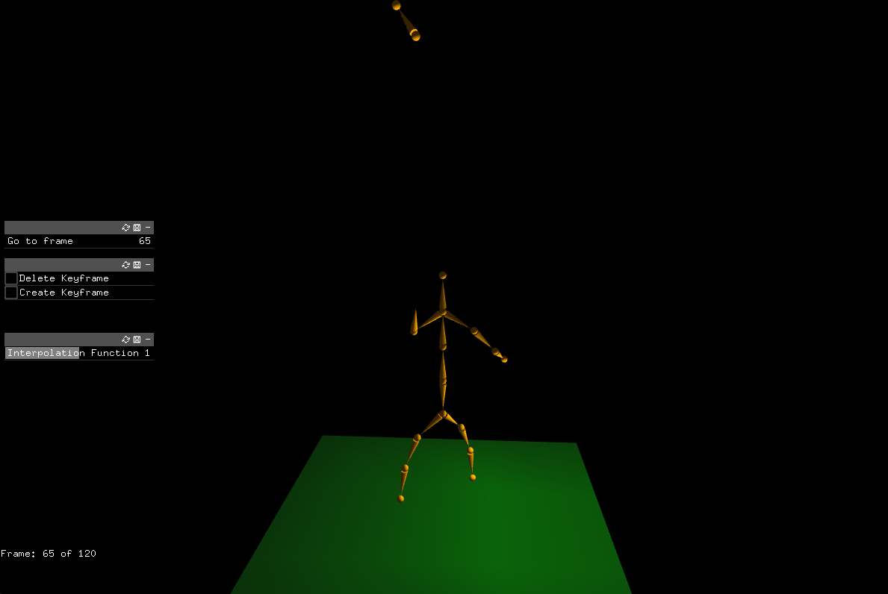
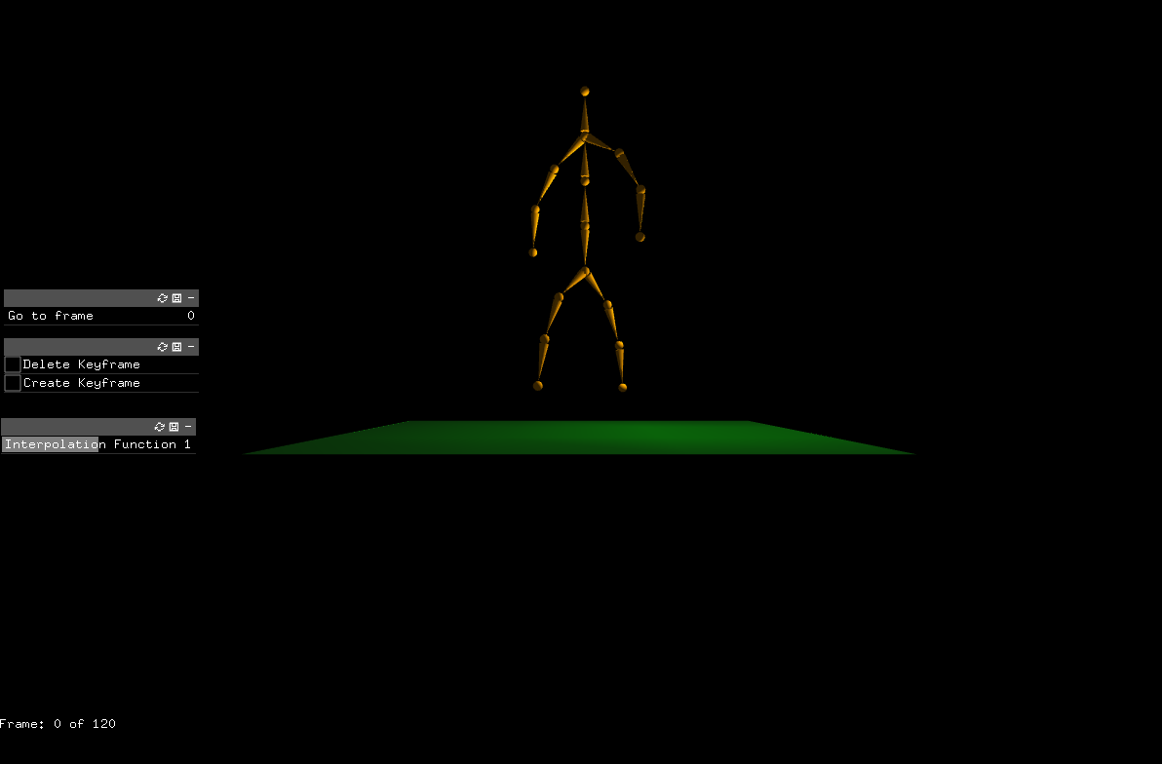
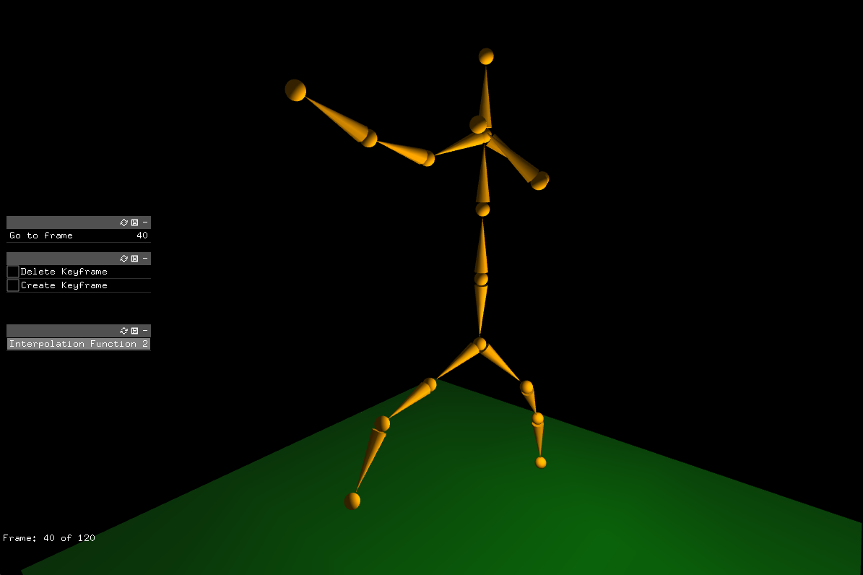
Computer Science Department
CS116A Final Project: Keyframing on Skeletons
Course Instructor: Kevin Smith
Austin Chen
Introduction
Methodology
Methodology
Analysis and Results
Keyframing is a very powerful tool for animation, allowing animators to set fewer frames and still be able to create a very smooth and realistic animation. Keyframing is a technique in which animators set frames that capture a scene’s current state, called “keyframes,” and uses an algorithm that creates interpolation frames between the keyframes to create a smooth animation.
Previous work in class included a skeleton builder for creating joint-based skeletons and a simple keyframer that was able to interpolate frames for a single object across two keyframes. My project seeks to expand on both works by adding keyframing support to the skeleton builder, as well as adding support for multiple keyframes.
The primary goal of this project is to create a keyframer that has sufficient functionality such that an animator could reasonably create a simple skeleton-based animation. The project should also be able to support multiple interpolation functions, as that is an important feature in making animations feel more realistic and varied.
the resulting value given by the interpolation value and mapping it to a vector between the two vectors that specify a transform for every object. This is done for the translation, rotation, and scaling vectors for each object, as this provides the most natural and intuitive transformations. An alternative strategy would be to apply the floating-point value to a transformation matrix, which should also theoretically produce smooth animations at the cost of being less predictable.
Implementation
The implementation consisted of three important parts: the storage of the scene states, the interpolation of the frames between two keyframes, and the animation system that feeds keyframes into the interpolation functions to receive interpolated frames. Object-Oriented programming was used extensively to make the keyframing system modular and extensible.
The storage of the scene states was split into two portions, one being the state of each object in the scene and the second being the state of the scene consisting of the object scenes. The state object consisted of a pointer to the object to be stored and three vectors, storing position, rotation, and scale. The scene state object stored a map of the pointers for each object to the states of the object for O(1) access time.
Interpolating the keyframes required interpolation functions, which were defined to be functions returning a float between 0 and 1 given the total number of frames in a keyframe sequence and the frame which the animation was at. Three interpolation functions were implemented, which were linear interpolation, ease interpolation, and cubic interpolation.
Finally, the system that fed keyframes to the interpolation function was designed to calculate the two keyframes surrounding a certain frame. The two keyframes were
then iterated over for every interpolation frame, with the transformation vectors for each object in both keyframes being used to calculate the interpolated transformation for the object. When a keyframe was reached, the next keyframe in the sequence was found to continue calculations.
Additional features included a Graphical User Interface to view and modify the transformation vectors of any selected object.
The keyframer was also tested with a different animation depicting the skeleton tossing up its hand as if it could be separated and reattached.
Methodology
Analysis and Results
Keyframing in General
Keyframing must take various keyframes containing the state of a scene and generate interpolation frames for the scenes that are assumed to have “occurred” in between. To do this, it is important to first develop a system that can store information about a scene state and later read it. This information must have quick access times as the state of the scene and its various objects will need to be fetched multiple times during an animation.
To calculate the interpolation frames, the keyframing software normally makes use of interpolation functions, which are functions that determine how far between two frames the animation is at a certain frame. In enterprise-quality keyframers, this interpolation function is usually customizable to a user-defined curve, but that is impractical for a shorter project. Instead, interpolation functions will be defined as functions that take a frame count and return a floating-point value between 0 and 1. This floating-point value will determine how far the animation is between the two keyframes set by the animator. Using this system allows one to easily define new interpolation functions as this provides a standardized method for doing so.
The actual interpolated frames are calculated by taking
Summary/Conclusions
Upon running the program, users are presented with any saved skeletons that were previously created, which they can quickly modify and animate. Users are given the option as various GUI sliders and buttons to change the interpolation function, the current frame, or the current keyframes. Users are also able to add or remove keyframes as needed.
Example
To demonstrate the effectiveness of the of the application, an animation was created with three keyframes to depict a skeleton punching twice with both its left and right “hands.”
Keyframing is a technique that enables animators to create fewer frames for their animations while still maintaining the smoothness of the animation. The project I have created allows users to test out keyframing on multiple joints and with multiple keyframes and interpolation functions.
The project is created in a way such that it can be easily extended and developed on top of due to its Objected-Oriented design.
Key References
[1] P. Dana, “III.5 - ISSUES AND TECHNIQUES FOR KEYFRAMING TRANSFORMATIONS,” in Graphics Gems III (IBM Version), D. Kirk, Ed., San Francisco: Morgan Kaufmann, 1992, pp. 121–123. doi: 10.1016/B978-0-08-050755-2.50035-X. [2] C. W. A. M. van Overveld, “A technique for motion specification in computer animation,” Vis. Comput., vol. 6, no. 2, pp. 106–116, Mar. 1990, doi: 10.1007/BF01901071.
Acknowledgements
This project was built on top of the Keyframing Lab and uses the interpolation functions displayed in that lab.

