Slide 1

Project Title -Seasonal Agriculture Performance Analysis 🌾📊
Student Name-CHENNUBOYINA SIVA SRUTHI
College Name-Seshadri Rao Gudlavalleru Engineering College
AICTE STU ID : STU6a68e4b35bda81785259187

Slide 2

PROBLEM STATEMENT
(Agricultural activities are influenced by seasonal variations in environmental conditions, farming practices, resource availability and market conditions. As a result, agricultural performance may differ from one season to another. However, raw agricultural data does not clearly explain how agricultural performance changes across seasons or what patterns can be observed in different seasonal conditions. The problem is to analyze the given agricultural dataset and investigate seasonal differences in agricultural performance by identifying meaningful patterns, trends, relationships and variations within the available data.

Slide 3
Project Description
This project analyzes agricultural activities across different seasons, regions, crops and farming conditions. The analysis covers crop production, yield, resource utilization, environmental conditions and economic performance. The data was prepared and analyzed to compare seasonal performance and identify meaningful variations. An interactive Power BI dashboard was developed with seasonal, environmental, resource, regional and economic analysis, along with a Farm-Level Drillthrough page for detailed investigation of individual farms.

Slide 4

WHO ARE THE END USERS?
• Farmers and farm managers
• Agricultural planners and decision-makers
• Agricultural analysts and researchers
• Resource and irrigation planners
• Stakeholders interested in seasonal agricultural performance

Slide 5

Technology Used
  • Python / Jupyter Notebook – data exploration and preparation
  • Pandas & NumPy – data handling and analysis
  • Matplotlib / Seaborn – exploratory visualization (where applicable)
  • Microsoft Power BI – interactive dashboard development
  • Power Query – data cleaning and transformation
  • DAX – analytical measures and KPI calculations

Slide 6
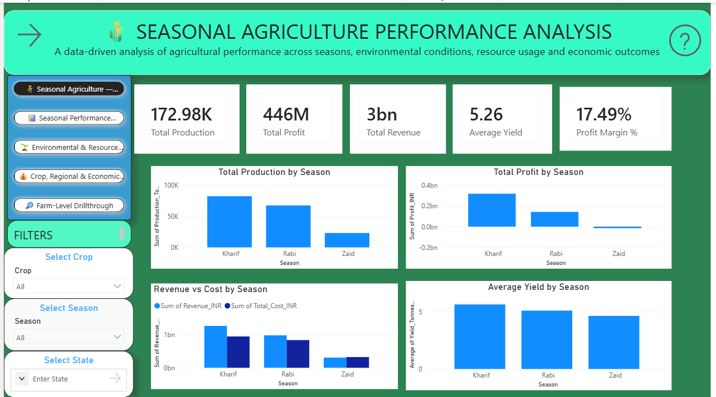
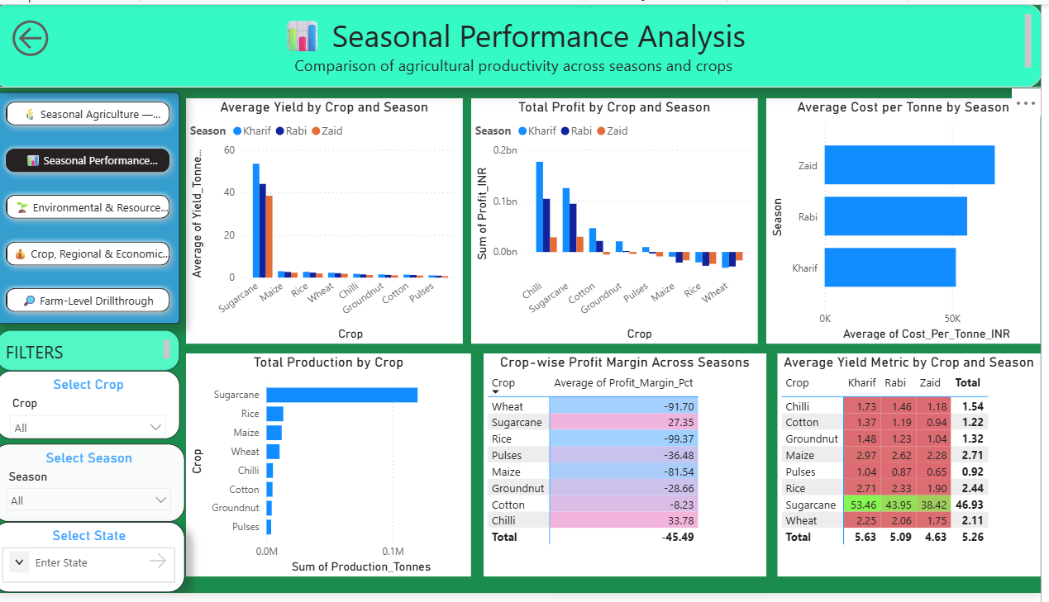
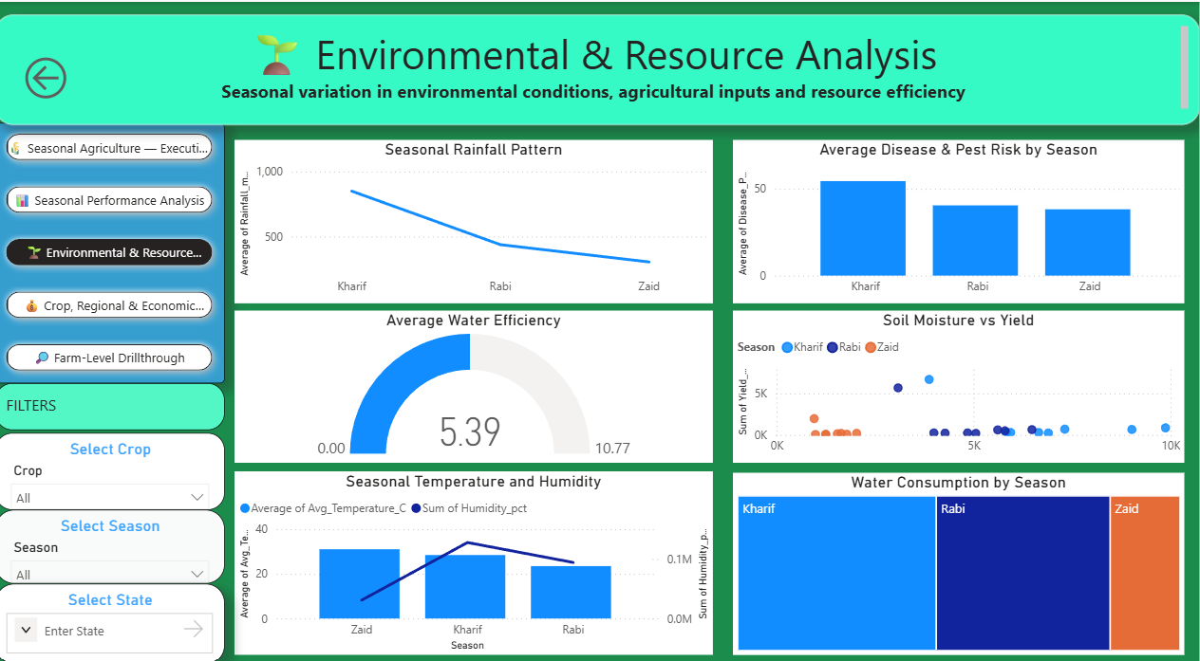
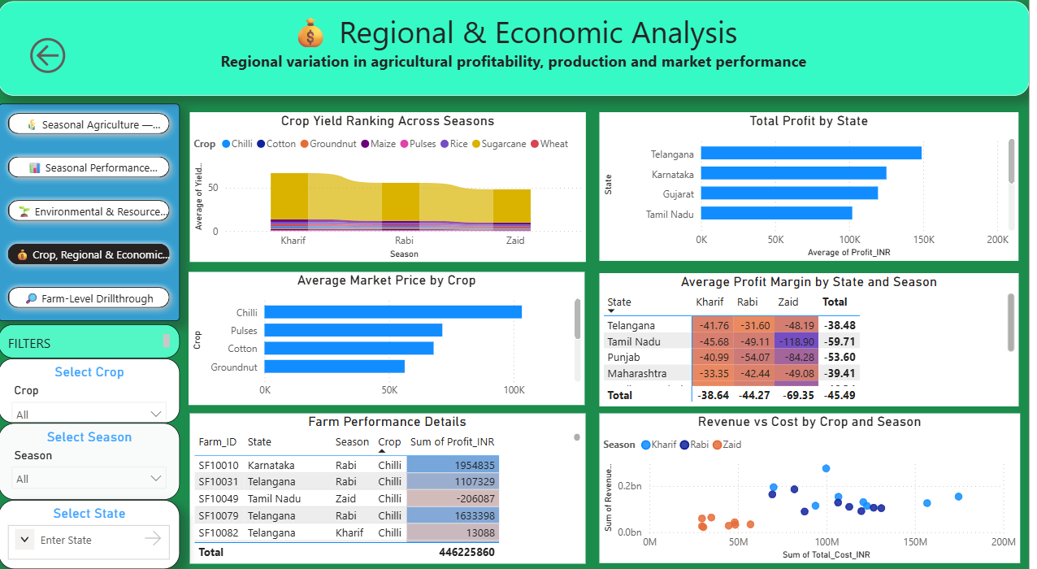
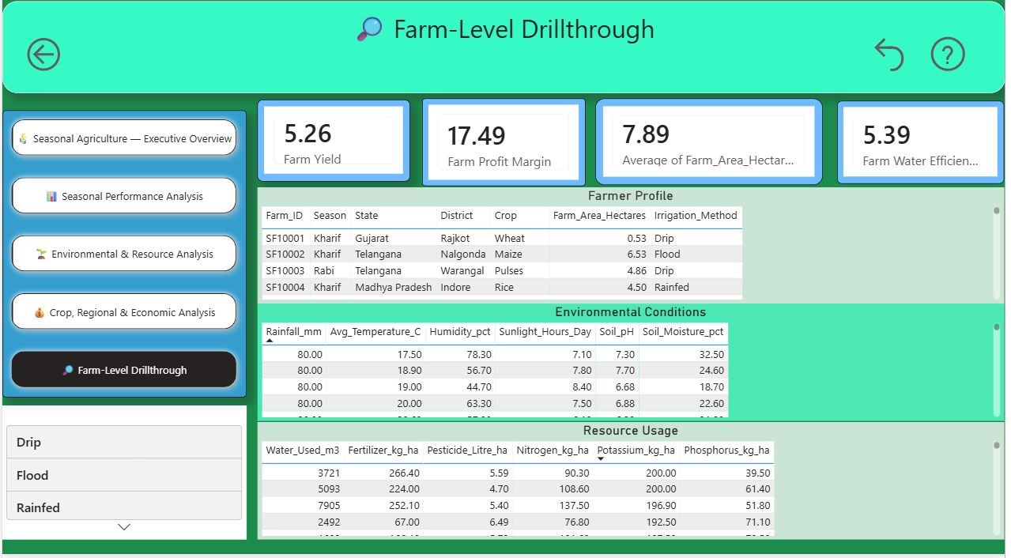
RESULTS

Slide 7
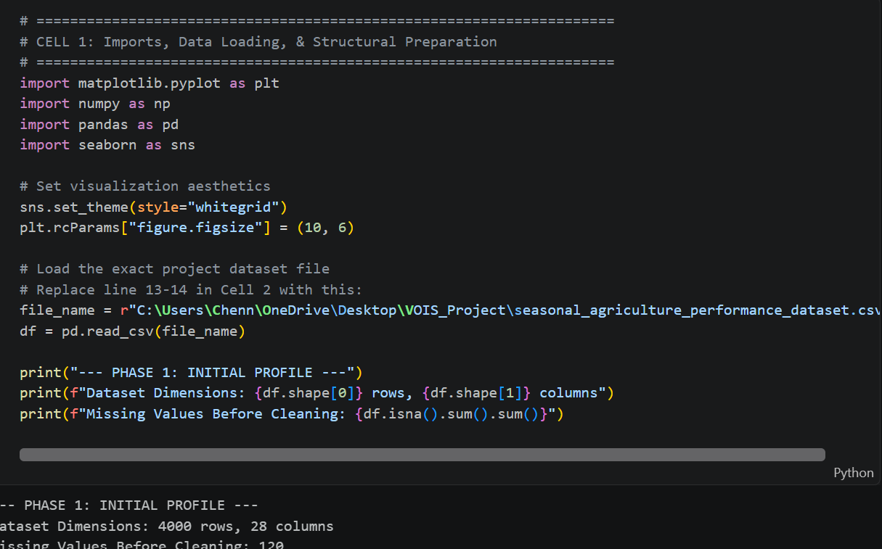
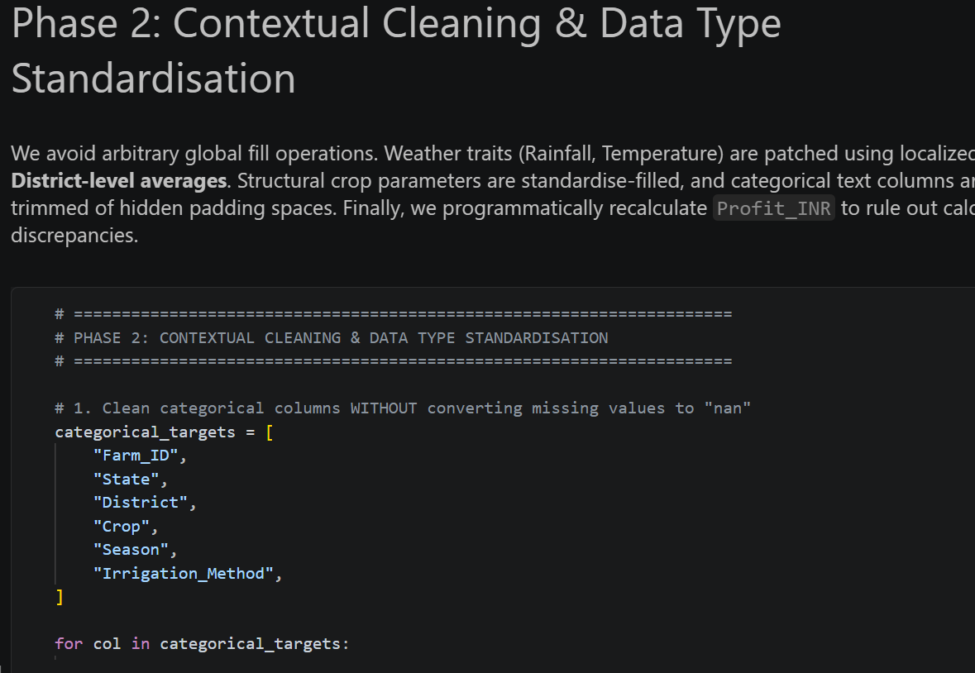
RESULTS
[Add screen shots of your code ]

Slide 8
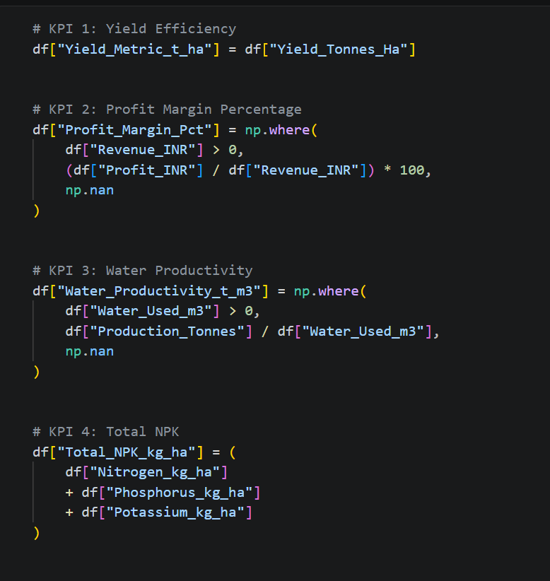
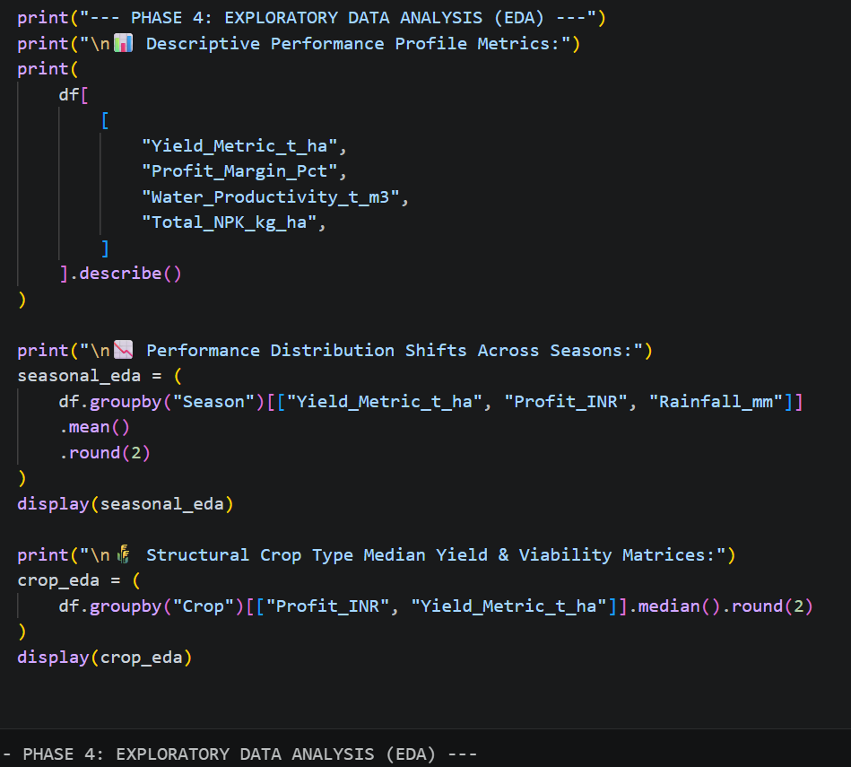
RESULTS
[Add screen shots of your code ]

Slide 9
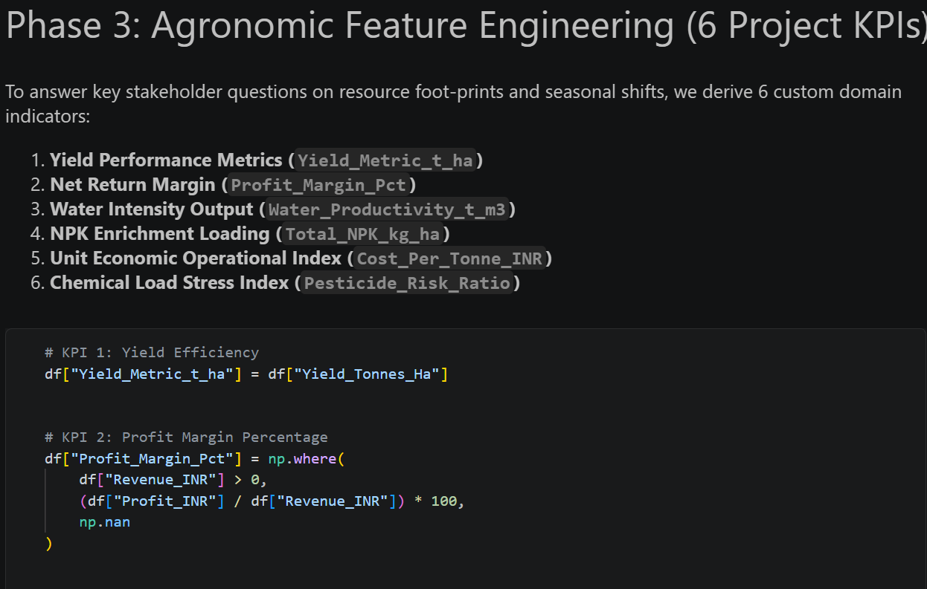
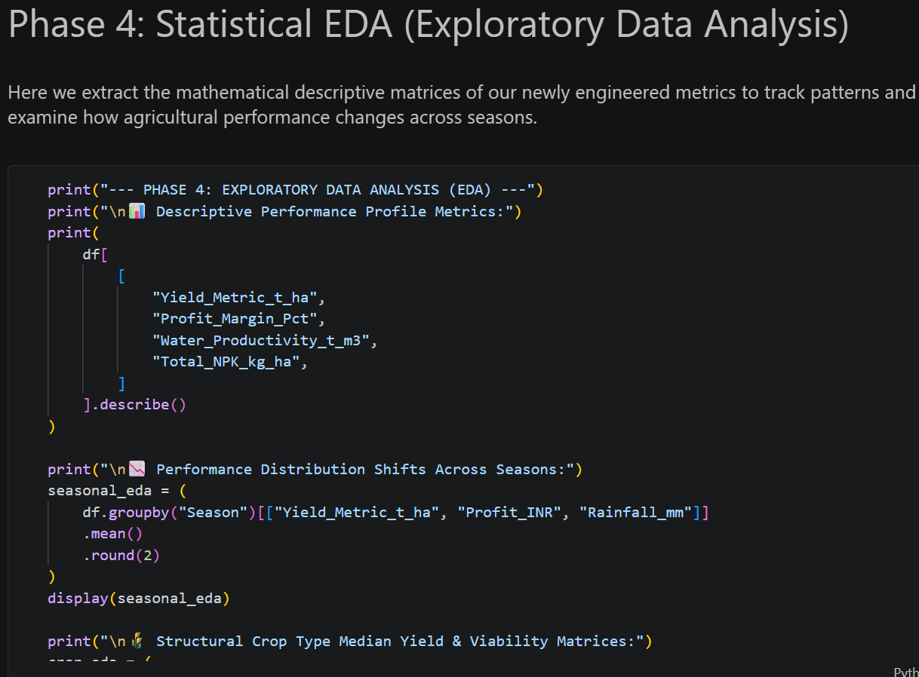
RESULTS
[Add screen shots of your code ]

Slide 10
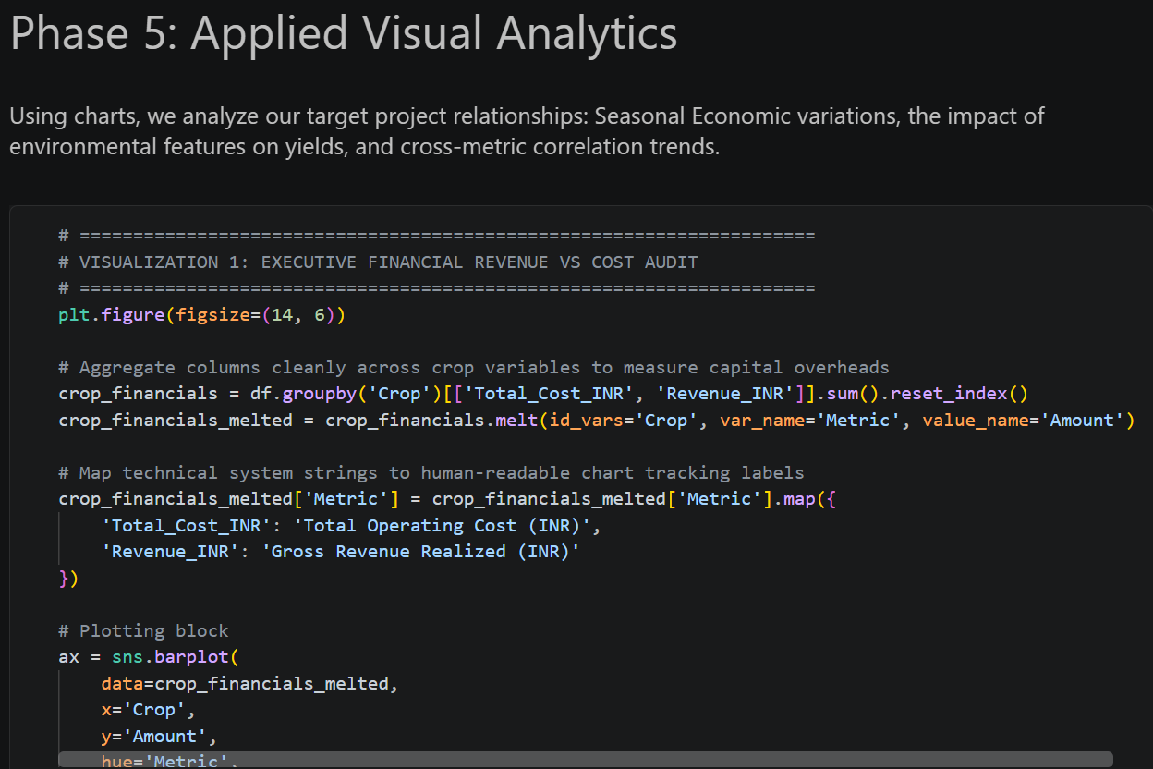
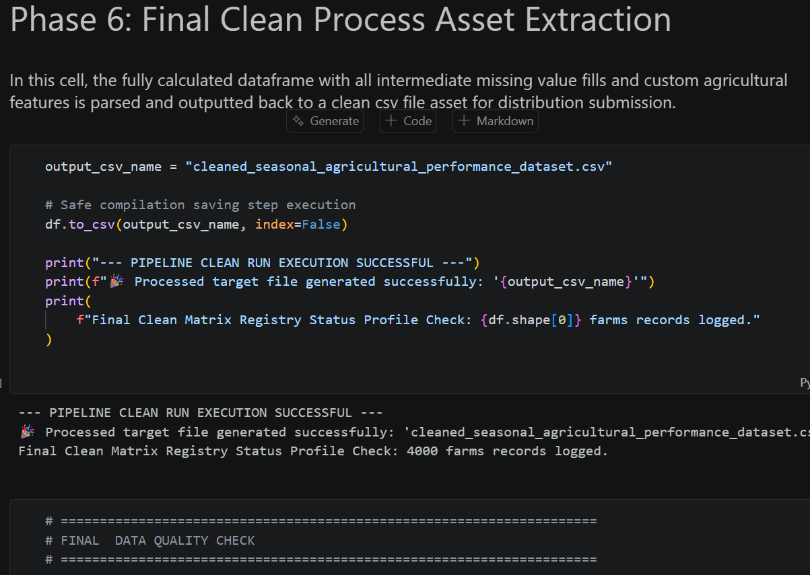
RESULTS
[Add screen shots of your code ]

Slide 11
Future scope
• Incorporate larger and more recent agricultural datasets.
• Add weather forecasts and real-time environmental data.
• Explore predictive models for yield and profitability forecasting.
• Develop early-warning indicators for resource and crop risks.
• Extend analysis to additional regions, crops and farming practices.
• Support scenario-based planning for seasonal agricultural decisions

Slide 12
GitHub Link
https://github.com/chennuboyinasivasruthi-ops/VOIS_Project

Slide 13
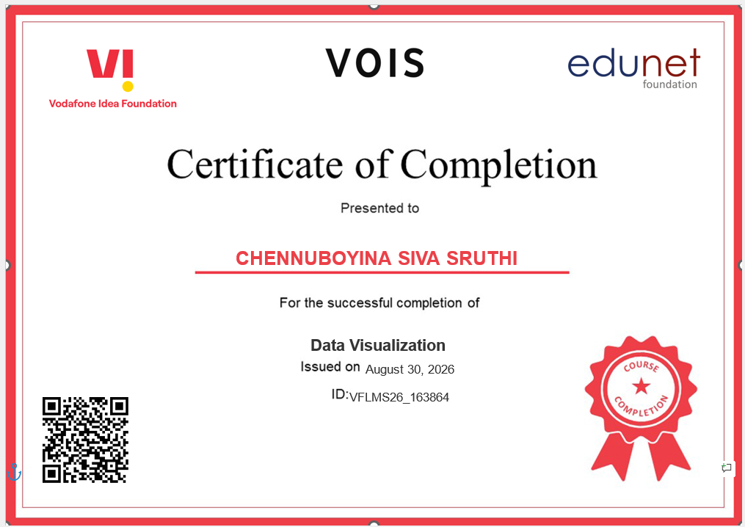
VOIS Course completion certificate -
Course name- Data Visualization

Slide 14
Thank you
.
.

