Slide 1


Slide 2
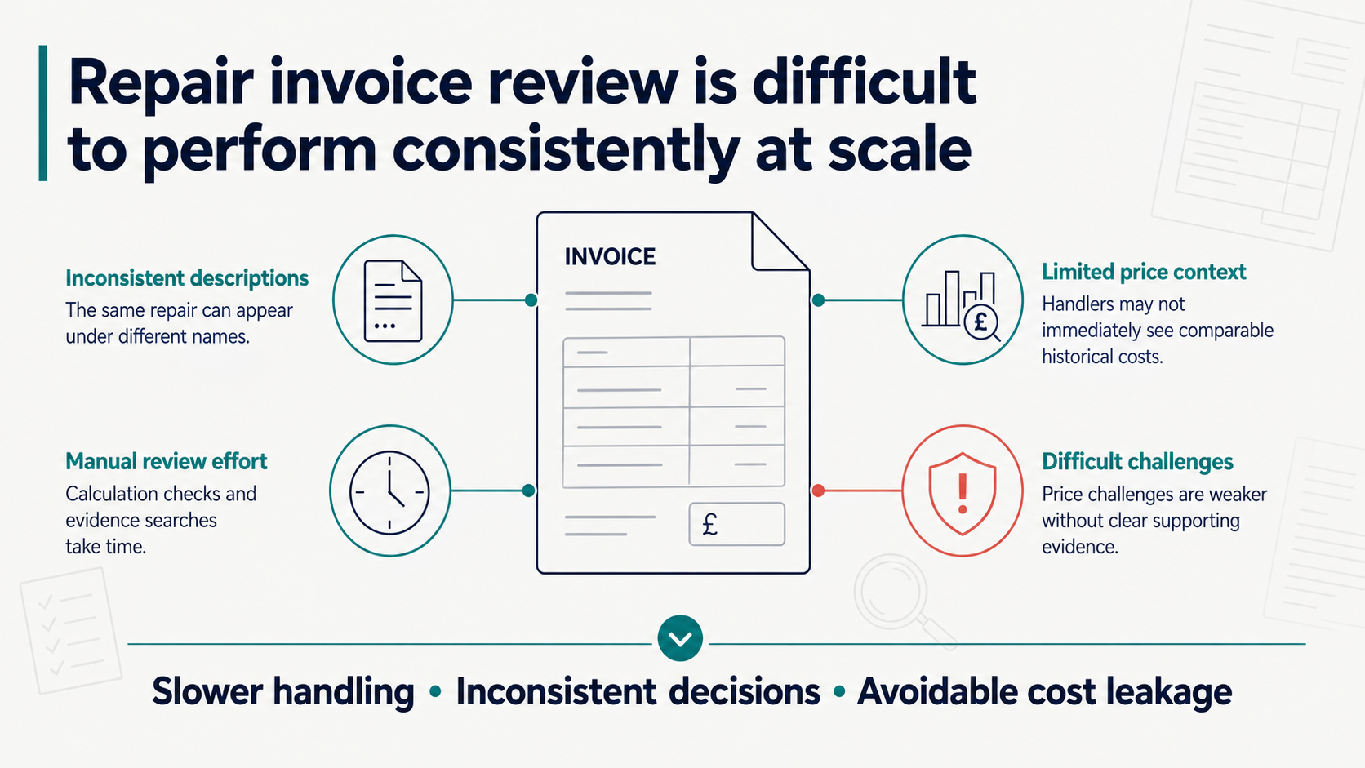

Slide 3
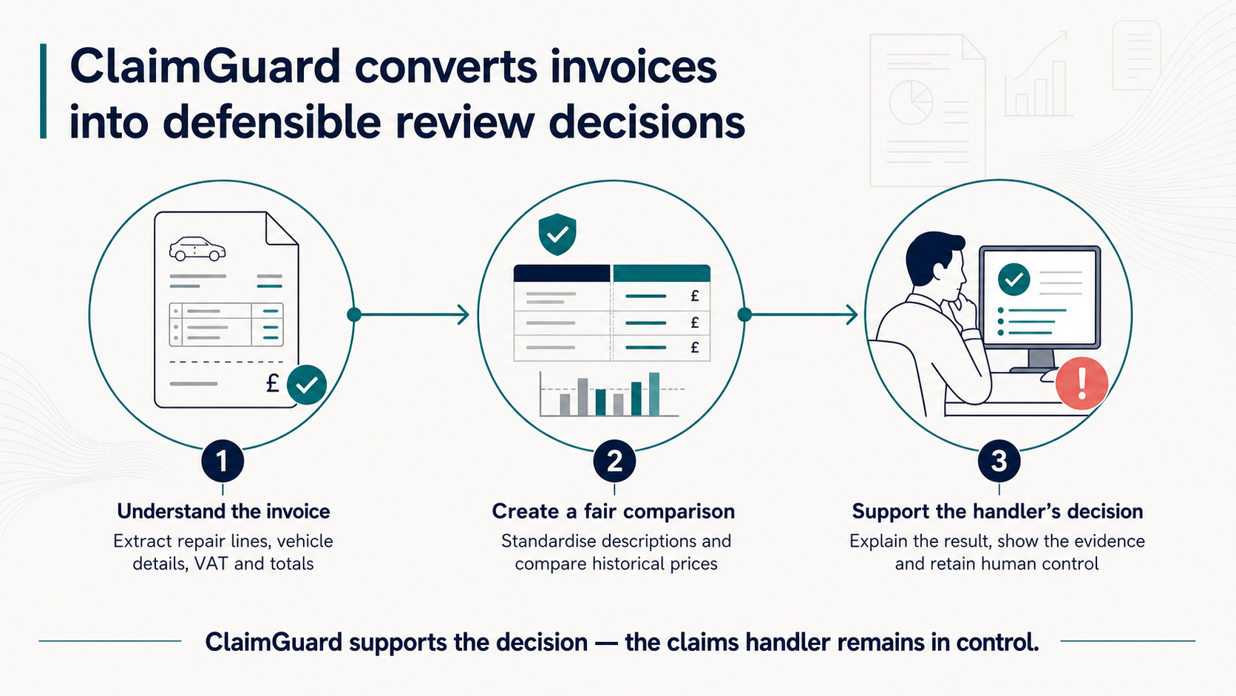

Slide 4
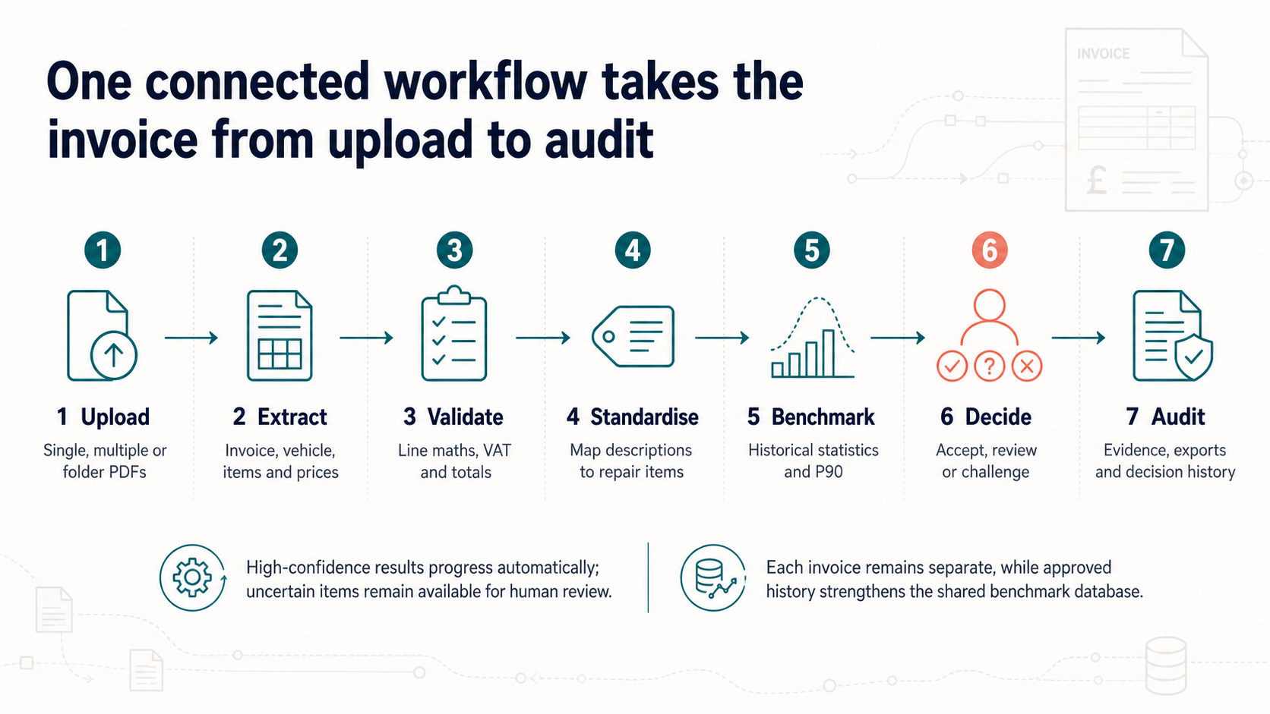

Slide 5
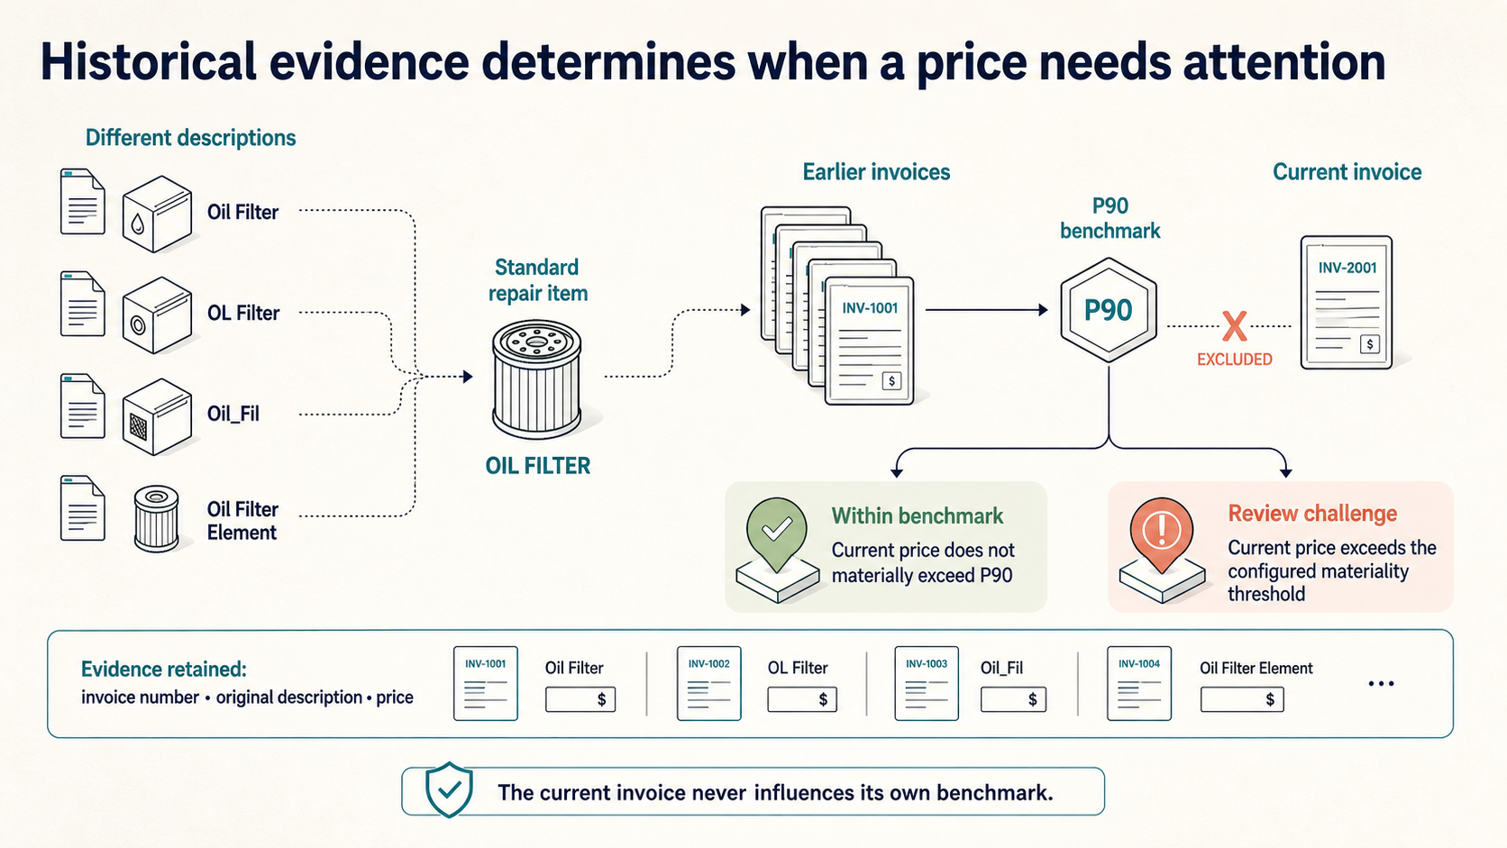

Slide 6
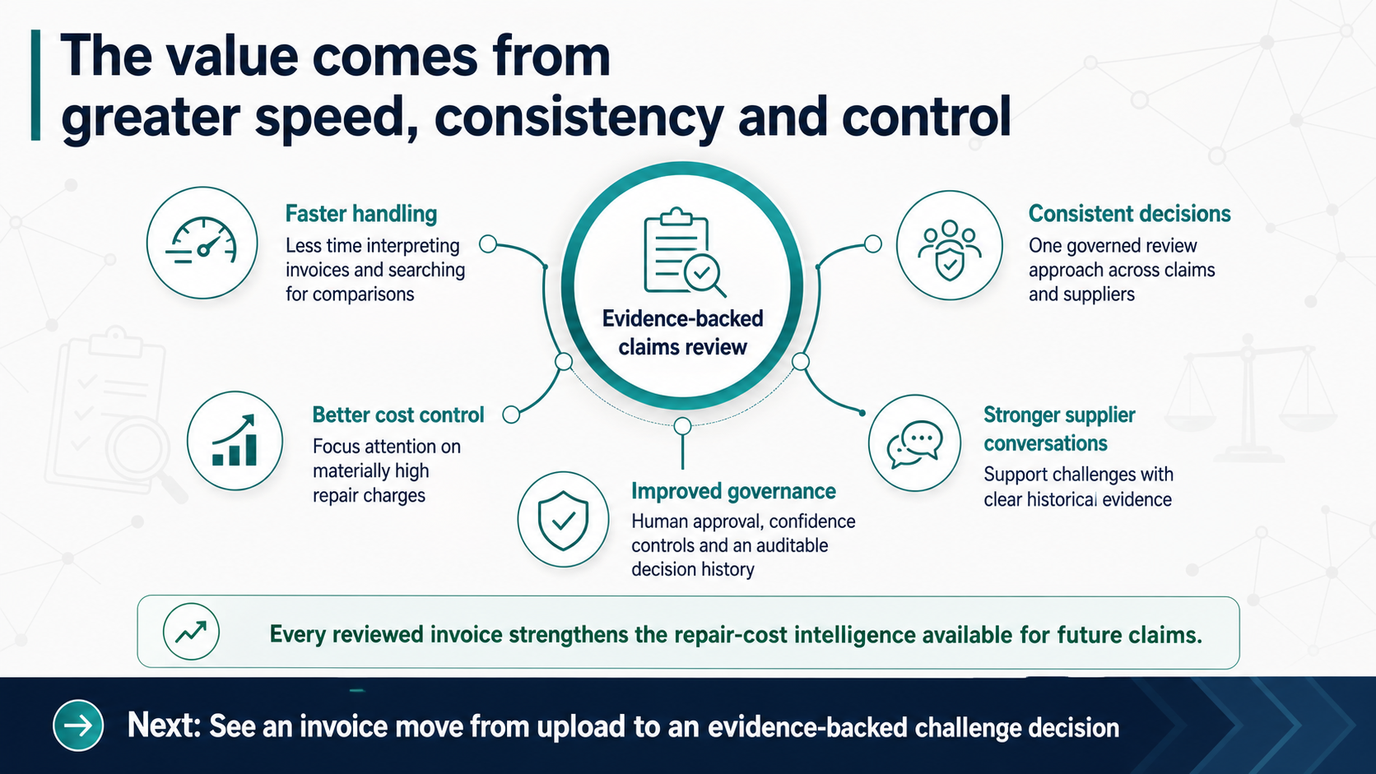

Slide 7
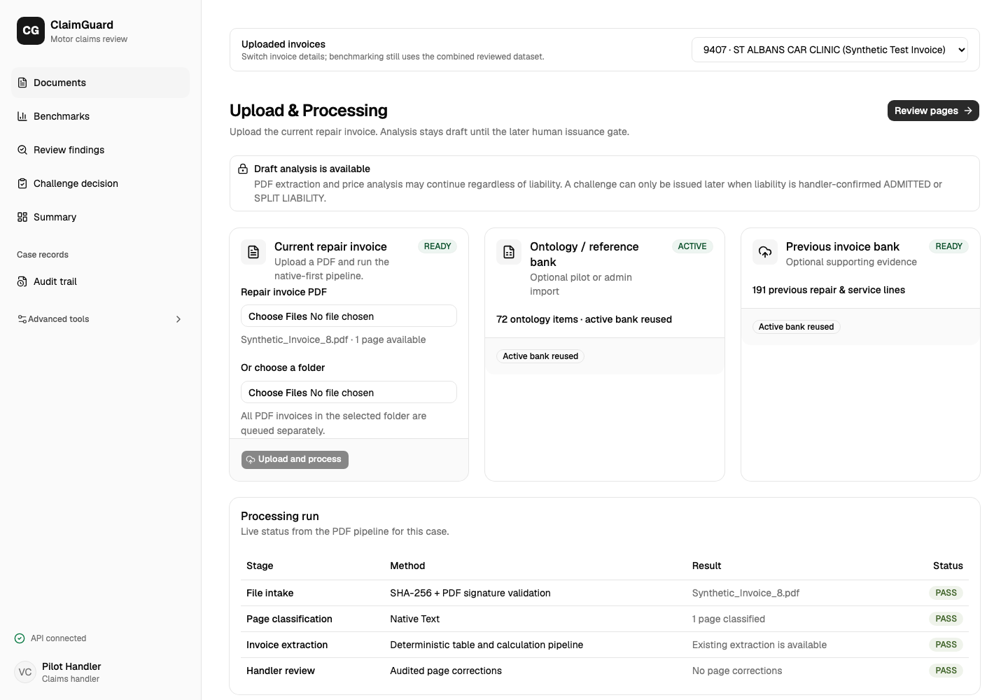
LIVE PRODUCT EVIDENCE
Upload once, review every invoice separately
Single, multiple and folder-based intake feed one governed review process.
01
Flexible intake
Upload one PDF, several PDFs or a complete invoice folder.
02
Separate records
Switch invoices without carrying over the wrong lines, prices or decisions.
03
Shared history
Approved observations strengthen the combined benchmark database.
Every invoice remains separate. The intelligence is shared.
7

Slide 8
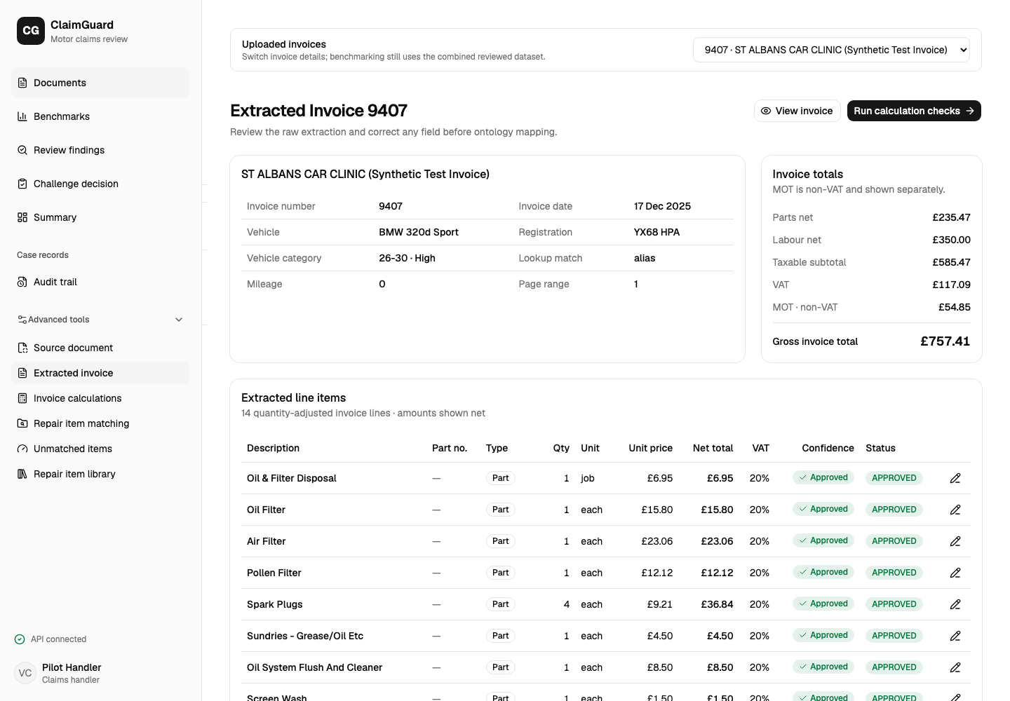
LIVE PRODUCT EVIDENCE
Every extracted value remains traceable
The selected invoice controls the visible vehicle, totals, line items and confidence states.
01
Structured invoice
Vehicle, registration, dates and totals are captured together.
02
Line-level visibility
Parts and service charges remain individually reviewable.
03
Confidence status
High-confidence fields already show a clear approved state.
The handler sees the selected invoice—not reused data.
8

Slide 9
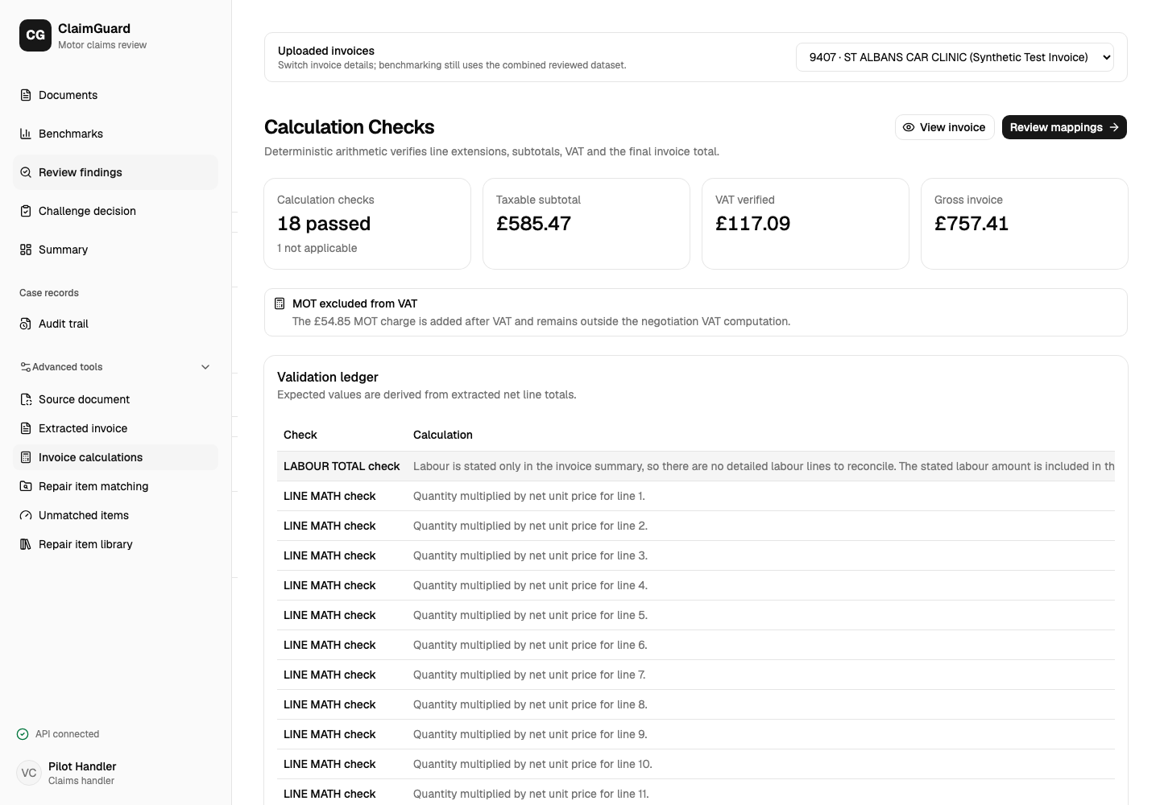
LIVE PRODUCT EVIDENCE
Calculations are verified before price review
Deterministic checks establish invoice integrity before historical comparison begins.
01
Arithmetic first
Quantity × unit price, subtotals and totals are checked consistently.
02
UK tax handling
MOT remains outside VAT and is shown separately.
03
Clear exceptions
Not-applicable checks are separated from genuine failures.
Invoice 9407: 18 passed, 0 calculation failures.
9

Slide 10
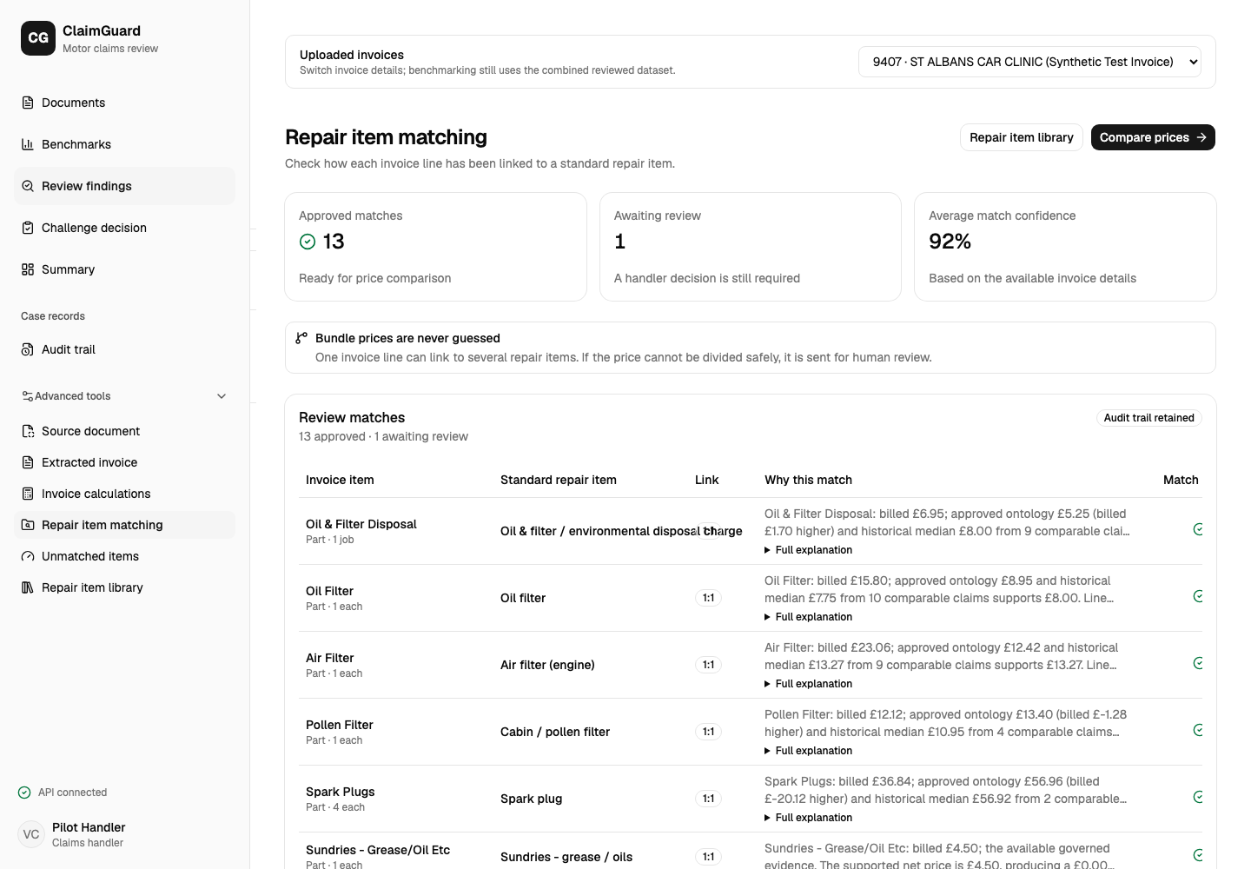
LIVE PRODUCT EVIDENCE
Different descriptions map to one repair item
Governed normalisation creates the consistent categories required for fair benchmarking.
01
Approved matches
High-confidence mappings are ready for price comparison.
02
Human review
The uncertain item stays visible for a handler decision.
03
No guessed bundles
Unsafe price allocations are never split automatically.
Consistent mapping is the foundation of fair comparison.
10

Slide 11
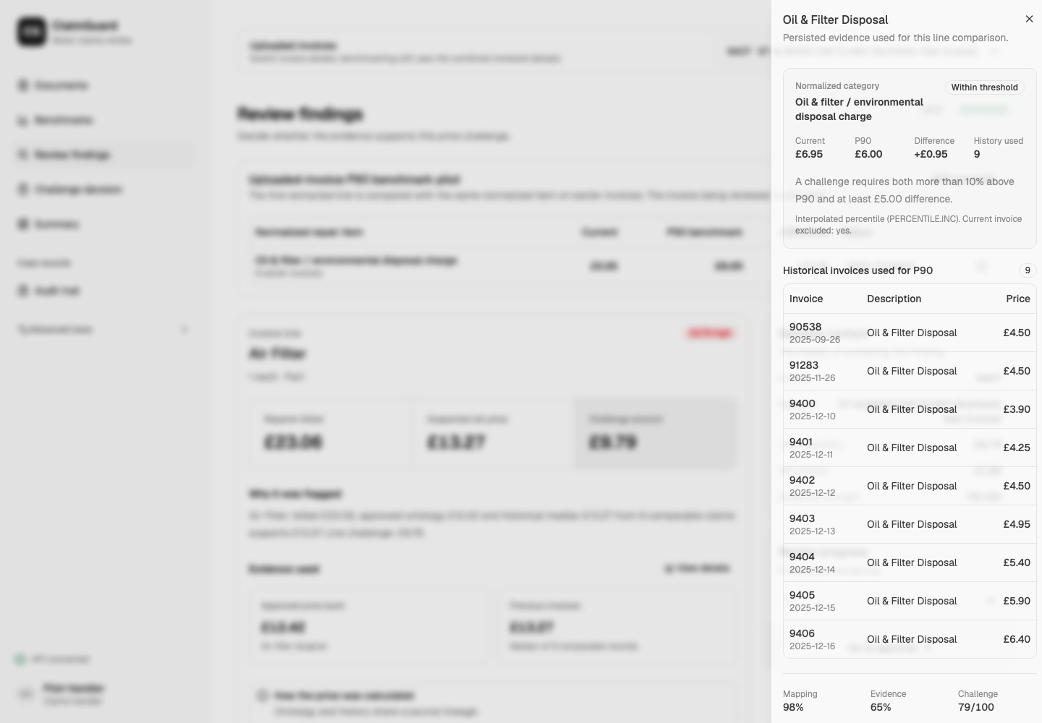
LIVE PRODUCT EVIDENCE
P90 decisions are backed by exact evidence
The benchmark can be traced to the earlier invoices used for the comparison.
01
Comparable history
Earlier prices are grouped under the same governed repair item.
02
Current excluded
The invoice being evaluated never influences its own P90.
03
Evidence on demand
Invoice number, date, description and price remain visible.
Transparent benchmark. Explainable recommendation.
11

Slide 12
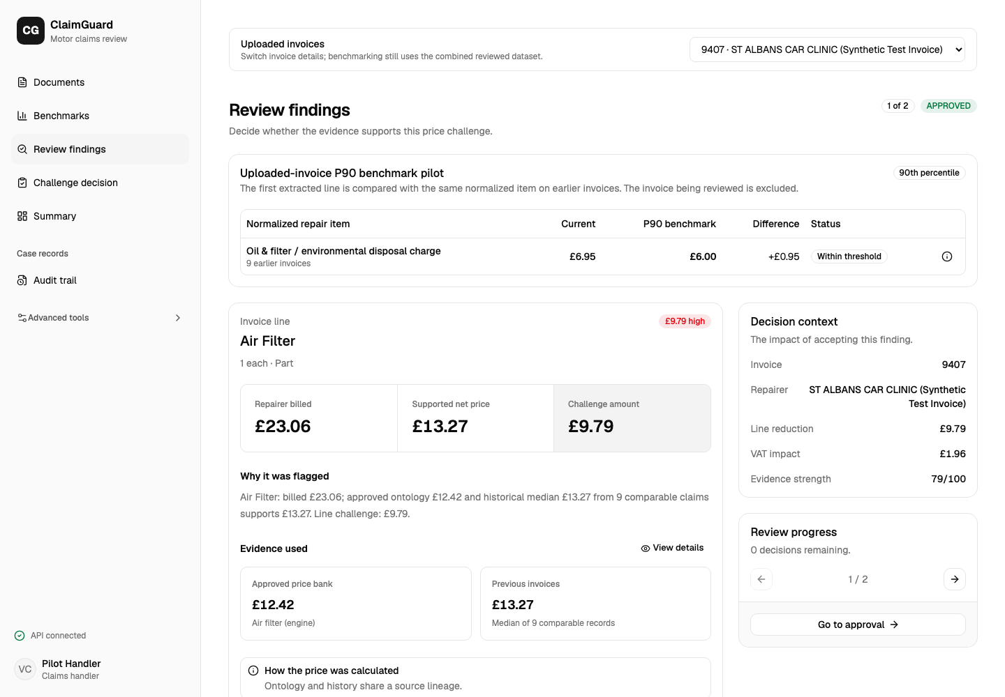
LIVE PRODUCT EVIDENCE
Every challenge explains the price difference
The handler sees the current charge, supported price, challenge amount and rationale together.
01
Repairer billed
£23.06 for the selected Air Filter line.
02
Supported net
£13.27 from governed and historical evidence.
03
Challenge amount
£9.79, with the evidence strength and VAT impact visible.
A review recommendation—not an irreversible automated decision.
12

Slide 13
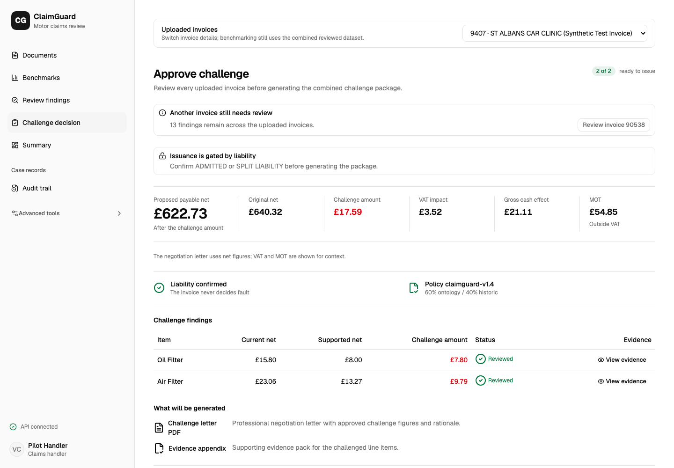
LIVE PRODUCT EVIDENCE
The handler makes the final decision
Reviewed lines are consolidated into one payable amount and a traceable evidence package.
01
Financial effect
£17.59 challenge amount and £21.11 gross cash effect.
02
Human approval
Liability and reviewed findings remain explicit issuance gates.
03
Auditable output
A challenge letter, evidence appendix and decision history are retained.
Faster review. Clear evidence. Human control.
13

