Slide 1
Unit IV Graph concepts
Scs1201 – advanced data structures
Semester iii / year ii

Slide 2
Syllabus
Minimum Spanning Tree
Kruskal’s Algorithm
Prim’s Algorithm
Sollin’s Algorithm
Shortest Path Algorithms
Dijkstra’s Algorithm
Bellman Ford
Floyd Warshall Algorithm

Slide 3
Minimum Spanning Tree
A tree T is a spanning tree of G if T is a spanning sub-graph of G.
Every spanning tree of a connected n-node graph G has (n-1) arcs.
Acyclic Tree.
The arcs belonging to a spanning tree are called tree arcs and the rest are called non-tree arcs.

Slide 4
Example – Undirected Graph
v₁
v₂
v₁
v₂
v₁
v₂
v₃
v₄
v₃
v₄
v₃
v₄
v₁
v₂
v₁
v₂
v₁
v₂
v₃
v₄
v₃
v₄
v₃
v₄

Slide 5
Example – Directed Graph
2
4
2
4
1
5
7
1
5
7
3
6
3
6

Slide 6
Applications
Designing Physical Systems (E.g. Pipeline)
Optimal Message Passing
Reducing Data Storage
Cluster Analysis
All Pairs minimax Path Problem

Slide 7
Minimum Cost Spanning Trees
The cost of a spanning tree of a weighted undirected graph is the sum of the costs of the edges in the spanning tree
A minimum cost spanning tree is a spanning tree of least cost
Select n-1 edges from a weighted graph of ‘n’ vertices with minimum cost

Slide 8
Algorithms
Kruskal’s Algorithm
Prim’s Algorithm
Sollin’s Algorithm

Slide 9
Greedy Strategy
An optimal solution is constructed in stages
At each stage, the best decision is made at this time
Since this decision cannot be changed later, it is ensured that the decision will result in a feasible solution
Typically, the selection of an item at each stage is based on a least cost or a highest profit criterion

Slide 10
Kruskal’s Approach
Build a minimum cost spanning tree T by adding edges to T one at a time
Select the edges for inclusion in T in the non-decreasing order of the cost
An edge is added to T if it does not form a cycle
Since G is connected and has n > 0 vertices, exactly n-1 edges will be selected

Slide 11
Example
0 5
2 3
1 6
1 2
3 6
3 4
4 6
4 5
0 1
10
12
14
0
0
28
10
1
1
16
14
16
6
2
18
5
5
6
2
24
25
18
22
4
12
4
22
3
3
24
25
28

Slide 12

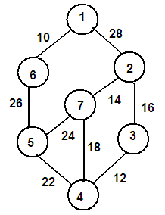

Kruskals Algorithm

Slide 14
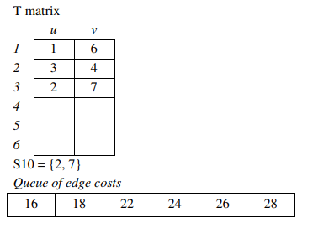
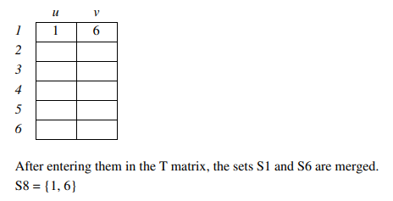
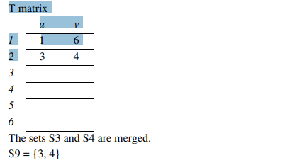
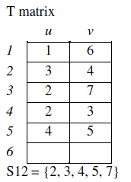

Slide 15
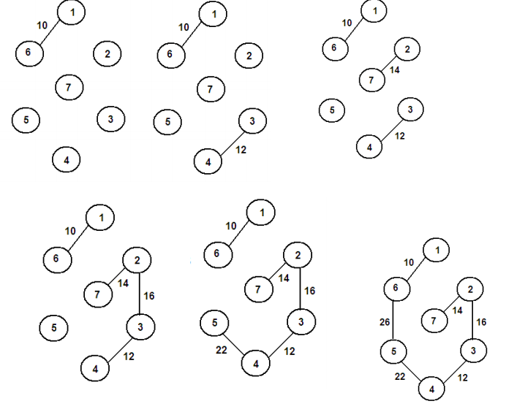

Slide 16
Contd…
0 5
2 3
1 6
1 2
3 6
3 4
4 6
4 5
0 1
10
12
0
0
14
0
3 6
+
10
1
1
cycle
10
10
1
16
14
5
6
2
5
6
2
18
5
6
2
4
12
12
22
4
4
3
3
3
24
25
28

Slide 17
Contd…
0 5
2 3
1 6
1 2
3 6
3 4
4 6
4 5
0 1
10
12
0
0
+
4 6
14
1
10
1
10
cycle
14
16
14
16
16
5
6
2
5
6
2
18
25
12
12
4
4
22
22
22
3
3
24
cost = 10 + 25 + 22 + 12 + 16 + 14
= 99
25
28

Slide 18
MST_Kruskal(G, W)
A ← Ø
for each vertex v ϵ V[G]
do MAKE_SET(v)
Sort the edges of E into non-decreasing order by weight w
do if find_set(u) ≠ find_set(v) then
A ← A u { (u, v) }
UNION(u, v)
Return A

Slide 19
Pseudocode
KRUSKAL(E, cost, n, t)
Construct a queue with edge costs such that they are in ascending order
i = 0, mincost = 0
while i < n – 1 and queue is not empty
Delete minimum cost edge (u, v) from queue
j = Find(u),
k = Find(v)
If j ≠ k
i = i + 1
t[i, 1] = u
t[i, 2] = v
minimum_cost = minimum_cost + cost[u, v]
mincost = mincost + cost[u, v]
Union(j, k)
End if
End while
If i ≠ n – 1
Print “Not a spanning tree”
Else
Return minimum_cost
End if
End KRUSKAL

Slide 20
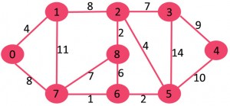
Example 2

Slide 21
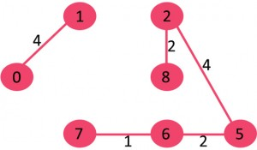
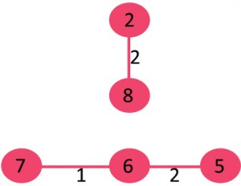
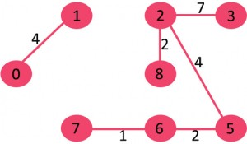

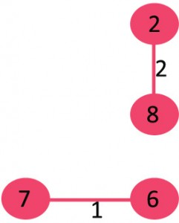
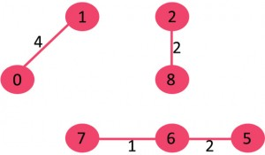
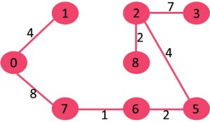
Solution

Slide 22
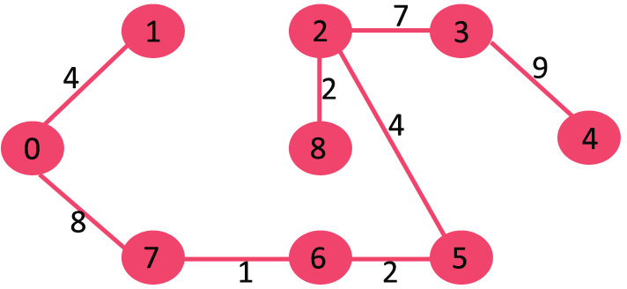
Minimum Cost Spanning Tree
cost = 4+ 8 + 1 + 2 + 2 + 4 + 7 + 9
= 37

Slide 23
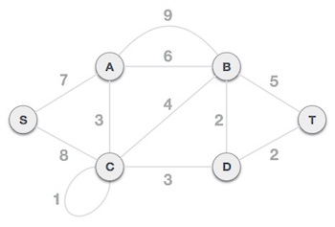
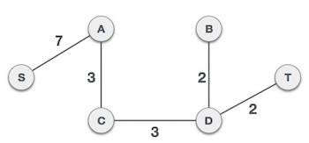
Example 3

Slide 24
Example 4
8
10
14
10
14
1
3
5
7
1
3
5
7
7
12
6
3
7
6
3
2
4
2
4
2
4
6
8
2
4
6
8
9

Slide 25
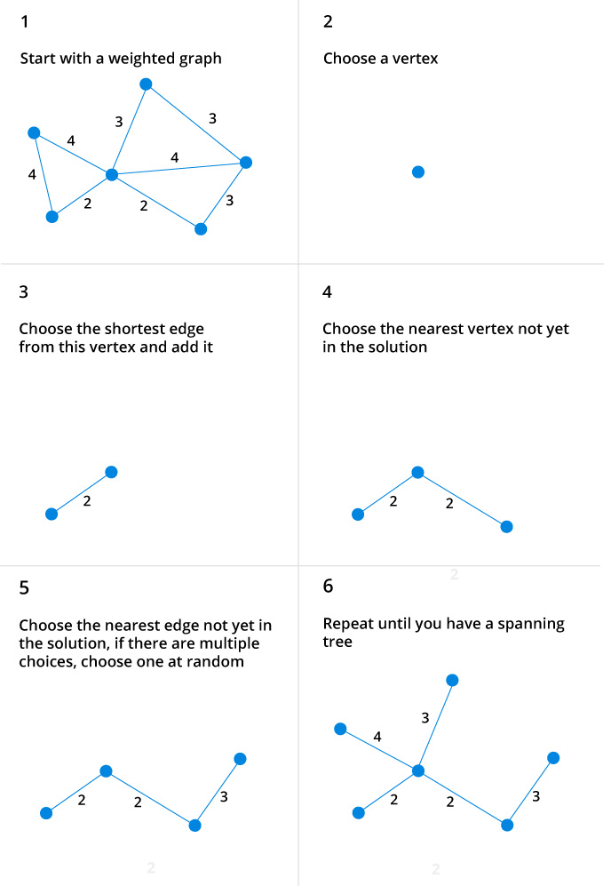
Example 5

Slide 26
Prim’s Algorithm
T = ;
U = { 1 }
while (U ≠ V)
let (u, v) be the lowest cost edge such that u ∈ U and v ∈ V – U
T = T ∪ {(u, v)}
U = U ∪ {v}

Slide 27
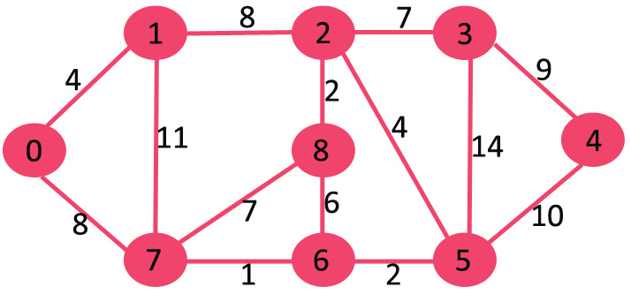

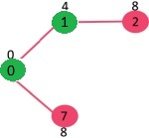
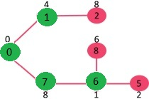
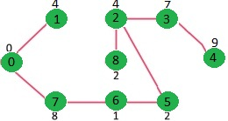
Example 1
Cost = 37
4 + 8 + 1 + 2 + 2 + 4 + 7 + 9

Slide 28
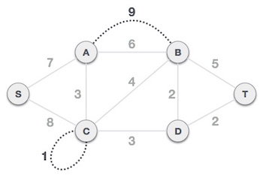
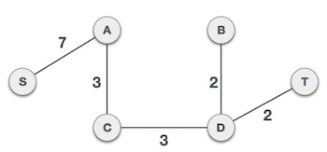
Example 2

Slide 29
Example 3
8
10
14
10
14
1
3
5
7
1
3
5
7
7
12
6
3
7
6
3
2
4
2
4
2
4
6
8
2
4
6
8
9

Slide 30
Example 4

Slide 31
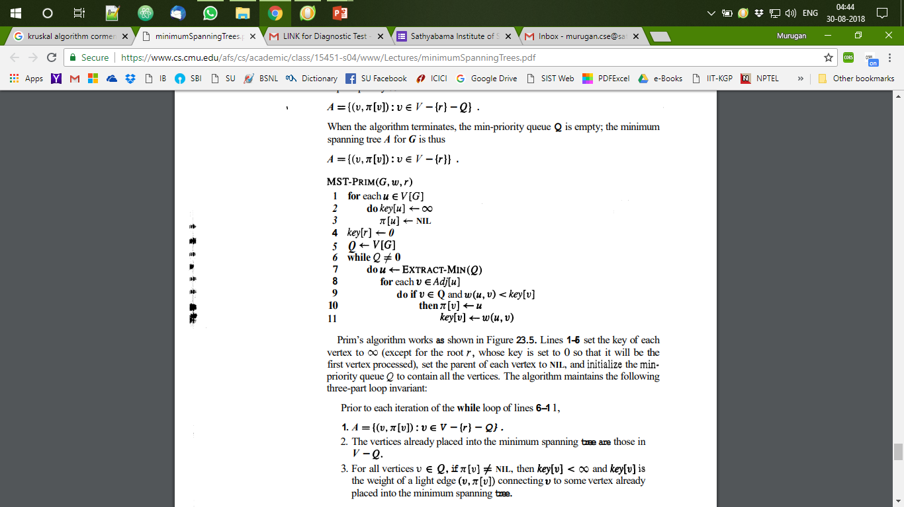
Prims Algorithm (Cormen)

Slide 32
Sollins Algorithm (or Boruvka)
1) Input is a connected, weighted and directed graph.
2) Initialize all vertices as individual components (or sets).
3) Initialize MST as empty.
4) While there are more than one components, do following for each component.
a) Find the closest weight edge that connects this component to any other component.
b) Add this closest edge to MST if not already added.
5) Return MST.

Slide 33
Example
Component Low Cost Edge
{0} 0-1
{1} 0-1
{2} 2-8
{3} 2-3
{4} 3-4
{5} 5-6
{6} 6-7
{7} 6-7
{8} 2-8

Slide 34
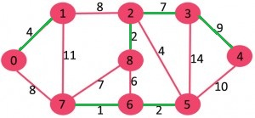
Low Cost Edges (Level 1)
{0-1, 2-8, 2-3, 3-4, 5-6, 6-7}

Slide 35
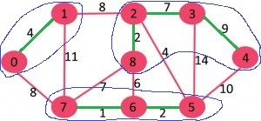
Level 2
{{0,1}, {2,3,4,8}, {5,6,7}}
Component Low Cost Edge
{0,1} 1-2 (or 0-7)
{2,3,4,8} 2-5
{5,6,7} 2-5

Slide 36
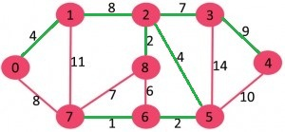
Level 3
{0-1, 2-8, 2-3, 3-4, 5-6, 6-7, 1-2, 2-5}

Slide 37
Example 2
0
28
10
1
14
16
5
6
2
24
25
18
12
4
22
3

Slide 38
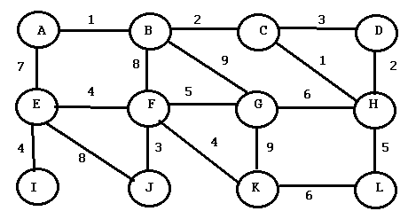
Problem – Minimum Cost Spanning Tree

Slide 39
SHORTEST PATH ALGORITHMS

Slide 40
Algorithms
Single Source Shortest Path
Dijkstras Algorithm
Bellman Ford Algorithm
All Pairs Shortest Path
Floyd Warshall

Slide 41
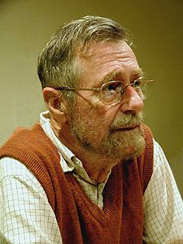
Edsger Wybe Dijkstra
- May 11, 1930 – August 6, 2002
- Received the 1972 A. M. Turing Award, widely considered the most prestigious award in computer science.
- The Schlumberger Centennial Chair of Computer Sciences at The University of Texas at Austin from 1984 until 2000
- Made a strong case against use of the GOTO statement in programming languages and helped lead to its deprecation.
- Known for his many essays on programming.

Slide 42
Dijkstra’s Algorithm
Solution to the single-source shortest path problem in graph theory.
Works on both directed and undirected graphs.
All edges must have nonnegative weights.
Approach: Greedy
Input: Weighted graph G={E,V} and source vertex v∈V, such that all edge weights are nonnegative
Output: Lengths of shortest paths from a given source vertex v∈V to all other vertices

Slide 43
Pseudocode
dist[s] ←0 (distance to source vertex is zero)
for all v ∈ V–{s}
do dist[v] ← ∞ (set all other distances to infinity)
S←∅ (S, the set of visited vertices is initially empty)
Q←V (Q, the queue initially contains all vertices)
while Q ≠ ∅ (while the queue is not empty)
do u ← mindistance(Q,dist) (select the element of Q with the min. distance)
S←S ∪ {u} (add u to list of visited vertices)
for all v ∈ neighbors[u]
do if dist[v] > dist[u] + w(u, v) (if new shortest path found)
then dist[v] ←dist[u] + w(u, v) (set new value of shortest path)
return dist

Slide 44
Example
∞
∞
Initialize
2
B
D
10
A | B | C | D | E
0 | ∞ | ∞ | ∞ | ∞
A
0
1
4
8
7
9
3
C
2
E
S={}
∞
∞

Slide 45
Visit A
10
∞
A | B | C | D | E
0 | ∞ | ∞ | ∞ | ∞
 | 10 | 3
B
2
D
10
0
A
1
4
8
7
9
3
S={A}
C
2
E
3
∞

Slide 46
Visit C
10
∞
A | B | C | D | E
0 | ∞ | ∞ | ∞ | ∞
 | 10 | 3
B
2
D
10
0
A
1
4
8
7
9
3
C
2
E
S={A, C}
3
∞

Slide 47
Start from C
A | B | C | D | E
0 | ∞ | ∞ | ∞ | ∞
 | 10 | 3
 | 7 |  | 11 | 5
7
11
B
2
D
10
0
A
1
4
8
7
9
3
C
2
E
S={A, C}
3
5

Slide 48
Visit E
A | B | C | D | E
0 | ∞ | ∞ | ∞ | ∞
 | 10 | 3
 | 7 |  | 11 | 5
7
11
B
2
D
10
0
A
1
4
8
7
9
3
C
2
E
S={A, C, E}
3
5

Slide 49
Start from E
A | B | C | D | E
0 | ∞ | ∞ | ∞ | ∞
 | 10 | 3
 | 7 |  | 11 | 5
 |  |  | 14
7
11
B
2
D
10
0
A
1
4
8
7
9
3
C
2
E
S={A, C, E}
3
5

Slide 50
Backtrack to C
A | B | C | D | E
0 | ∞ | ∞ | ∞ | ∞
 | 10 | 3
 | 7 |  | 11 | 5
 | 7 |  | 11
7
11
B
2
D
10
0
A
1
4
8
7
9
3
C
2
E
S={A, C, E}
3
5

Slide 51
Visit B
A | B | C | D | E
0 | ∞ | ∞ | ∞ | ∞
 | 10 | 3
 | 7 |  | 11 | 5
 | 7 |  | 11
7
11
B
2
D
10
0
A
1
4
8
7
9
3
C
2
E
S={A, C, E, B}
3
5

Slide 52
Start from B
A | B | C | D | E
0 | ∞ | ∞ | ∞ | ∞
 | 10 | 3
 | 7 |  | 11 | 5
 | 7 |  | 11
7
11
B
2
D
10
0
A
1
4
8
7
9
3
C
2
E
S={A, C, E, B}
3
5

Slide 53
Visit D
A | B | C | D | E
0 | ∞ | ∞ | ∞ | ∞
 | 10 | 3
 | 7 |  | 11 | 5
 | 7 |  | 9
7
9
B
2
D
10
0
A
1
4
8
7
9
3
C
2
E
S={A, C, E, B, D}
3
5

Slide 54
Problem – Source Vertex: B
B
2
D
10
A
1
4
8
7
9
3
C
2
E

Slide 55
Problem
Construct the Directed Graph for the given adjacency matrix. Consider 0 as the source vertex and find the shortest path using Dijkstra’s Algorithm.
 | 0 | 1 | 2 | 3 | 4 | 5 | 6 | 7
0 | 0 | 7 | 8 | 0 | 2 | 0 | 6 | 0
1 | 0 | 0 | 4 | 0 | 0 | 8 | 0 | 3
2 | 8 | 0 | 0 | 0 | 0 | 0 | 5 | 0
3 | 0 | 9 | 0 | 0 | 0 | 2 | 0 | 0
4 | 0 | 1 | 0 | 2 | 0 | 0 | 9 | 7
5 | 9 | 0 | 0 | 3 | 0 | 0 | 2 | 2
6 | 0 | 0 | 8 | 0 | 4 | 4 | 0 | 3
7 | 6 | 0 | 4 | 0 | 0 | 0 | 9 | 0

Slide 56
Bellman Ford Algorithm
Uses Relaxation to find Single Source Shortest Paths on directed graphs that may contain negative weight edges
Also detects negative weight cycles. (no solution)

Slide 57
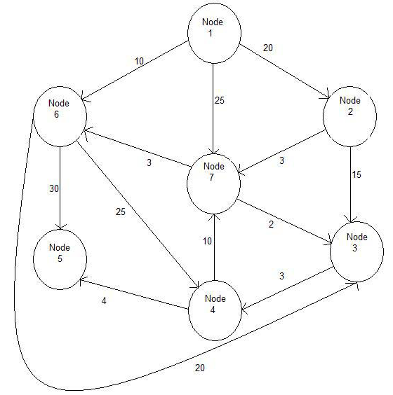
Exercise: Source Vertex : 1

Slide 58
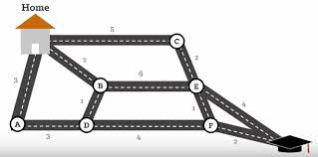
Exercise

Slide 59
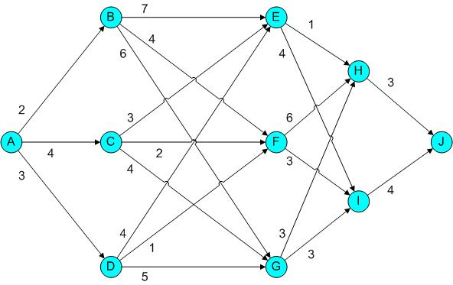
Exercise: Source Vertex: A

Slide 60
Algorithm
Bellman-Ford(G, w, s)
Initialize_Single_Source(G, s)
for i ← 1 to |V[G]| - 1
do for each edge (u,v) ∈ E[G]
do Relax(u, v, w)
for each edge (u, v) ∈ E[G]
do if d[v] > d[u] + w(u, v)
then return false
return true
Initialize_Single_Source(G,s)
for each vertex v ∈V[G]
do d[v] ← ∞
π[v] ← nil
d[s] ← 0
Relax(u, v, w)
if d[v] > d[u] + w(u, v)
then d[v] ← d[u] + w(u, v)
π[v] ← u

Slide 61
Initialize
 | 1 | 2 | 3 | 4 | 5
d | ∞ | ∞ | ∞ | ∞ | 0
π | / | / | / | / | /
2
3
1
4
3
(1,3)=6
(1,4)=3
(2,1)=3
(3,4)=2
(4,2)=1
(4,3)=1
(5,2)=4
(5,4)=2
5
1
6
2
4
1
3
2

Slide 62
Iteration I
 | 1 | 2 | 3 | 4 | 5
d | ∞ | 4 | ∞ | 2 | 0
π | / | 5 | / | 5 | /
2
3
1
4
3
(1,3)=6
(1,4)=3
(2,1)=3
(3,4)=2
(4,2)=1
(4,3)=1
(5,2)=4
(5,4)=2
5
1
6
2
4
1
3
2

Slide 63
Iteration II
 | 1 | 2 | 3 | 4 | 5
d | 7 | 3 | 3 | 2 | 0
π | 2 | 4 | 4 | 5 | /
2
3
1
4
3
(1,3)=6
(1,4)=3
(2,1)=3
(3,4)=2
(4,2)=1
(4,3)=1
(5,2)=4
(5,4)=2
5
1
6
2
4
1
3
2

Slide 64
Iteration III
 | 1 | 2 | 3 | 4 | 5
d | 6 | 3 | 3 | 2 | 0
π | 2 | 4 | 4 | 5 | /
2
3
1
4
3
(1,3)=6
(1,4)=3
(2,1)=3
(3,4)=2
(4,2)=1
(4,3)=1
(5,2)=4
(5,4)=2
5
1
6
2
4
1
3
2
No edges relaxes in Iteration 4.

Slide 65
Negative Weight Cycle Check
d[3] > d[1] + w(1, 3) ⇒ 3 > 6+6=12
d[4] > d[1] + w(1, 4) ⇒ 2 > 6+3=9
d[1] > d[2] + w(2, 1) ⇒ 6 > 3+3=6
d[4] > d[3] + w(3, 4) ⇒ 2 > 3+2=5
d[2] > d[4] + w(4, 2) ⇒ 3 > 2+1=3
d[3] > d[4] + w(4, 3) ⇒ 3 > 2+1=3
d[2] > d[5] + w(5, 2) ⇒ 3 > 0+4=4
d[4] > d[5] + w(5, 4) ⇒ 2 > 0+2=2

Slide 66
Problem
Construct the Directed Graph for the given adjacency matrix. Consider 0 as the source vertex and find the shortest path using Dijkstra’s and Bellman Ford Algorithm.
 | 0 | 1 | 2 | 3 | 4 | 5 | 6 | 7
0 | 0 | 7 | 8 | 0 | 2 | 0 | -6 | 0
1 | 0 | 0 | 4 | 0 | 0 | 8 | 0 | 3
2 | 8 | 0 | 0 | 0 | 0 | 0 | 5 | 0
3 | 0 | 9 | 0 | 0 | 0 | 2 | 0 | 0
4 | 0 | 1 | 0 | -2 | 0 | 0 | 9 | 7
5 | 9 | 0 | 0 | 3 | 0 | 0 | 2 | 2
6 | 0 | 0 | 8 | 0 | 4 | 4 | 0 | 3
7 | 6 | 0 | 4 | 0 | 0 | 0 | -9 | 0

Slide 67
Floyd-Warshall Algorithm
The Floyd-Warshall algorithm works based on a property of intermediate vertices of a shortest path.
An intermediate vertex for a path
p = <v₁, v₂, ..., v_{j}>
is any vertex other than v₁ or v_{j}.

Slide 68
Procedure
If the vertices of a graph G are indexed by {1, 2, ..., n}, then
consider a subset of vertices {1, 2, ..., k}.
Assume p is a minimum weight path from vertex i to vertex j whose intermediate vertices are drawn from the subset {1, 2, ..., k}.
If we consider vertex k on the path then either:
k is not an intermediate vertex of p
all intermediate vertices are in {1, 2, ..., k-1}
else
k is an intermediate vertex of p
Divide p at k giving two subpaths p₁ and p₂ giving v_{i} ↝ k ↝ v_{j}

Slide 69

Procedure
Define a quantity d^{(k)}_{ij} as the minimum weight of the path from vertex i to vertex j with intermediate vertices drawn from the set {1, 2, ..., k}
The above properties give the following recursive solution:

Slide 70
Predecessor Matrix (П)
П is a sequence of matrices П⁽⁰⁾, П⁽¹⁾, …,П^{(r)}
where П=П^{(r)} and П_{ij}^{(k)} defined to be the predecessor of vertex j on a shortest path from vertex i with all intermediate vertices in the set {1,2, …, k}.

Slide 71

Predecessor Matrix
Recursive formulation of П_{ij}^{(k)} when k = 0,
When k ≥ 1,

Slide 72
Algorithm
FLOYD-WARSHALL(W)
n = W.rows
2. D⁽⁰⁾ = W
3. Π⁽⁰⁾ = π⁽⁰⁾_{ij} = NIL if i=j or w_{ij} = ∞
4. Π⁽⁰⁾ = π⁽⁰⁾_{ij} = i if i≠j and w_{ij} < ∞
5. for k = 1 to n
6. let D^{(k)} = (d^{(k)}_{ij}) be a new nxn matrix
7. for i = 1 to n
8. for j = 1 to n
9. d^{k}_{ij} = min(d^{(k-1)}_{ij}, d^{(k-1)}_{ik} + d^{(k-1)}_{kj})
10. if d^{(k-1)}_{ij} ≤ d^{(k-1)}_{ik} + d^{(k-1)}_{kj}
11. π^{(k)}_{ij} = π^{(k-1)}_{ij}
12. else
13. π^{(k)}_{ij} = π^{(k-1)}_{kj}
14. return D^{(n)}

Slide 73
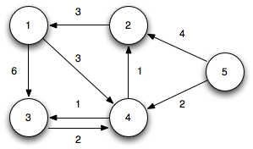
Example

Slide 74

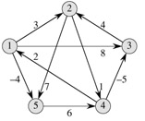

Example

Slide 75


Iteration 1

Slide 76


Iteration 2

Slide 77


Iteration 3

Slide 78


Iteration 4

Slide 79

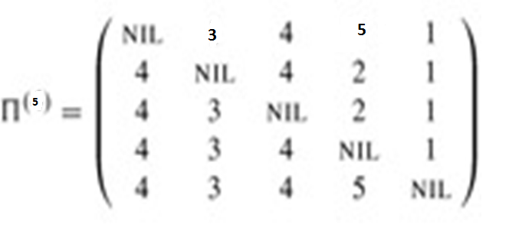
Iteration 5

Slide 80
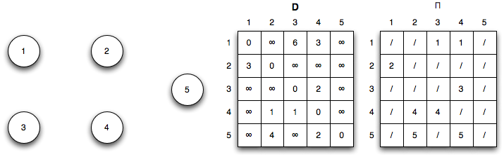
Initialization (k=0)

Slide 81
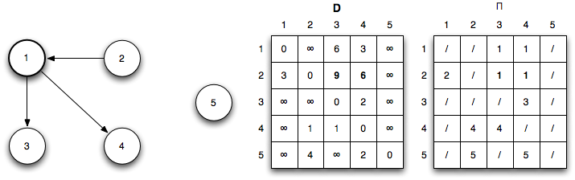
Iteration 1: k = 1
Shorter paths from 2 ↝ 3 and 2 ↝ 4 are found through vertex 1

Slide 82
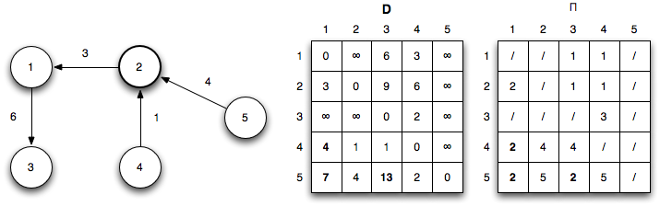
Iteration 2: k = 2
Shorter paths from 4 ↝ 1, 5 ↝ 1, and 5 ↝ 3 are found through vertex 2

Slide 83
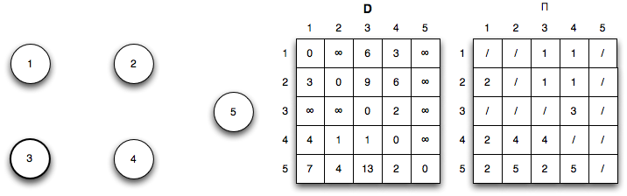
Iteration 2: k = 3
No shorter paths are found through vertex 3

Slide 84
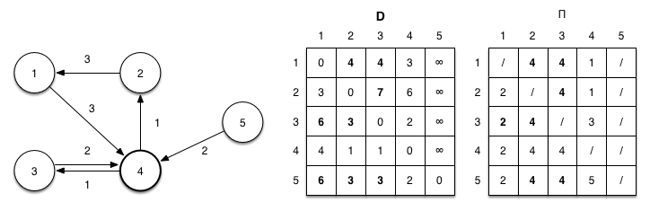
Iteration 2: k = 4
Shorter paths from the vertex 4 are:
1 ↝ 2, 1 ↝ 3, 2 ↝ 3, 3 ↝ 1, 3 ↝ 2, 5 ↝ 1, 5 ↝ 2, 5 ↝ 3, and 5 ↝ 4

Slide 85
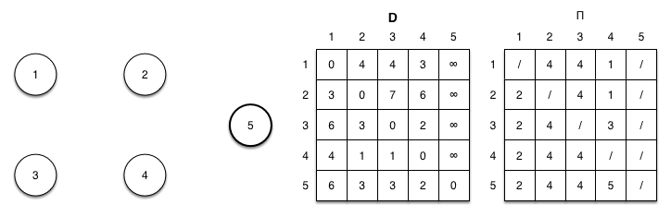
Iteration 2: k = 5
No shorter paths are found through vertex 5

Slide 86
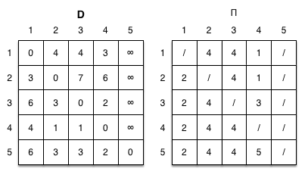
Shortest Path

