Slide 1
Torrent Scout
From Chip To Sequence
Chantal Roth

Slide 2
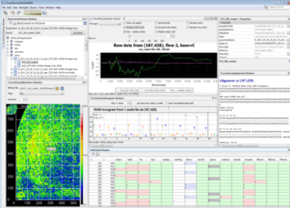
Content
Torrent Scout Overview
Torrent Scout Design
Torrent Scout Modules
Module Summary
Lookup System
Persistence/REST Client
Future Directions
Goals
Patterns
Next steps
NetBeans IDE
C/C++
PHP
IDE overview
Technical considerations
Installation
Raw data

Slide 3
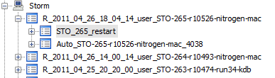
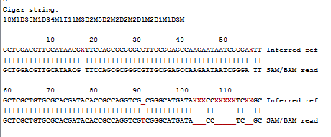

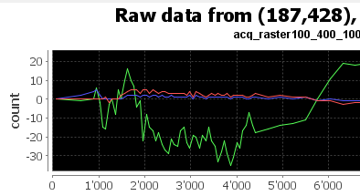
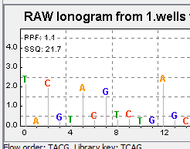
Torrent Scout Main Goals
Interactive, dynamic data viewing from Chip to Sequence
Open Source, platform independent
Modular, extensible

Slide 4
Torrent Scout Software Features
100% Java (no system dependent components)
Built with and based on NetBeans 7.0 development environment
Modular, loosely coupled extensible framework
Deployment with Java Webstart (automatic updates, deployment via Web)
Compiled and run via standard ant script

Slide 5
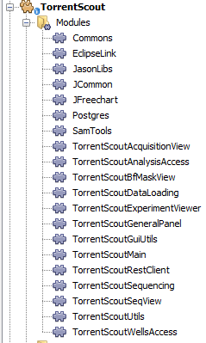
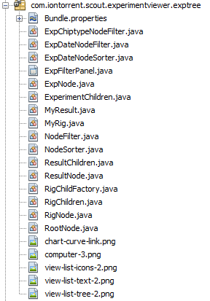
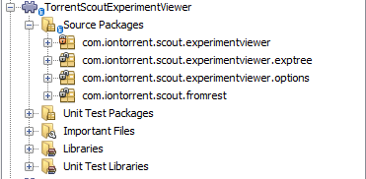
Suite -> Modules -> Package -> Source
Suite
Module/Component
Package

Slide 6

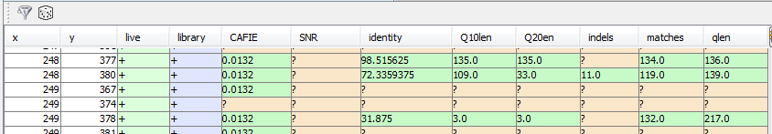
Module/Component Summary (1)
Db Explorer module: View experiment and results info via SQL or REST client
BfMask View module: Heat map of chip flags (such as bead, live, dud etc)
Table module: View chip flags and various scores (allows filtering and sorting)
Ionogram module: View raw and normalized ionogram (using 1.wells and .sff file)
Raw data module: View raw data from various *.dat files, computes nn bg subtraction etc

Slide 7

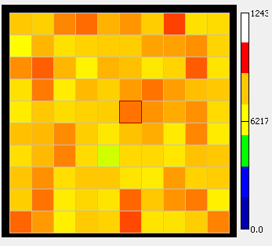
Module/Component Summary (2)
Alignment module: View alignment of read against template (using SAM/BAM file)
Scores heat map module: View various values such as SNR, CAFIE, % identity, Q20len etc as heatmap (based on Default.sam.parsed and wellStats.txt)
(Movie module) (Experimental: display raw values around a well as a “movie” )

Slide 8
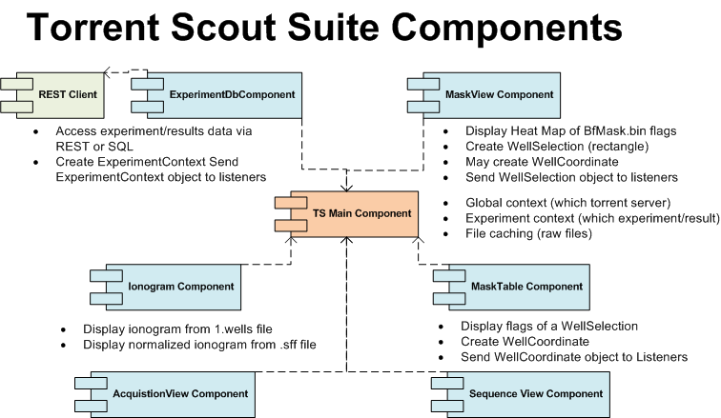
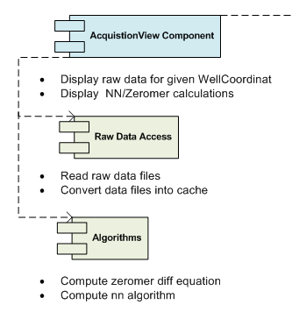
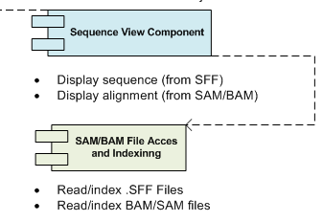

Slide 9
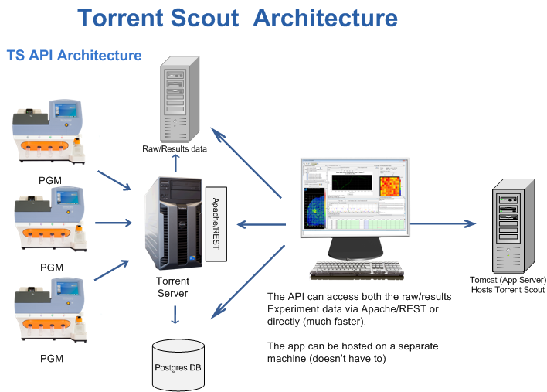
Torrent Scout Deployment Architecture
3. Access data
master.jnlp
1. Install or update
4. Plan B
2. Query DB

Slide 10
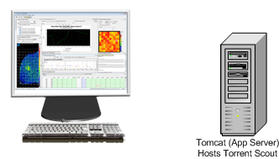
Installation Process
1. download master.jnlp from tomcat server
2. javaws checks if: a) master.jnlp is up to date b) if any component mentioned in master.jnlp needs to be updated
3. Update any missing/new components
4. Start Torrent Scout using settings specified in master.jnlp (memory, libraries etc)
1. master.jnlp
3. update

Slide 11


Running Torrent Scout
1. Directly on client machine:
2. Via VNC:
3. Via X-forwarding:
VNC
X

Slide 12
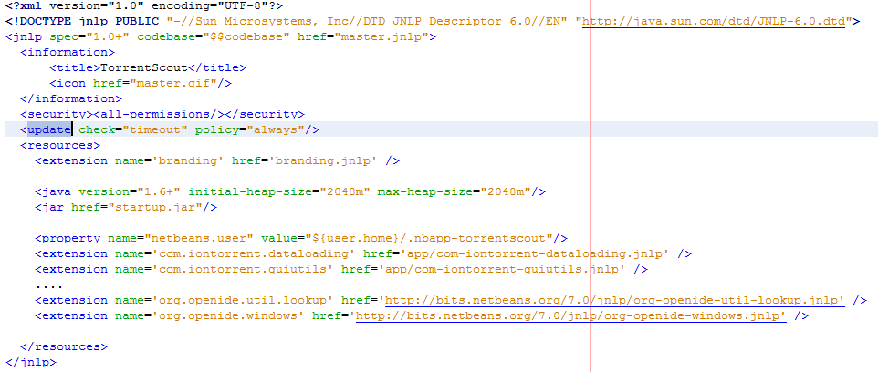
master.jnlp

Slide 13
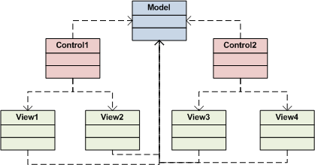
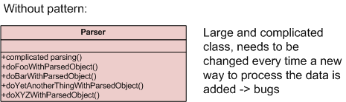
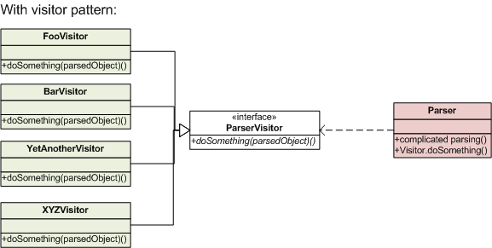
Patterns used
Factories (decoupling object creation from object use)
Model/View/Controller (letting multiple views use same data model)
Visitor pattern (e.g. processing parsed lines in classes separate from the parser)

Slide 14
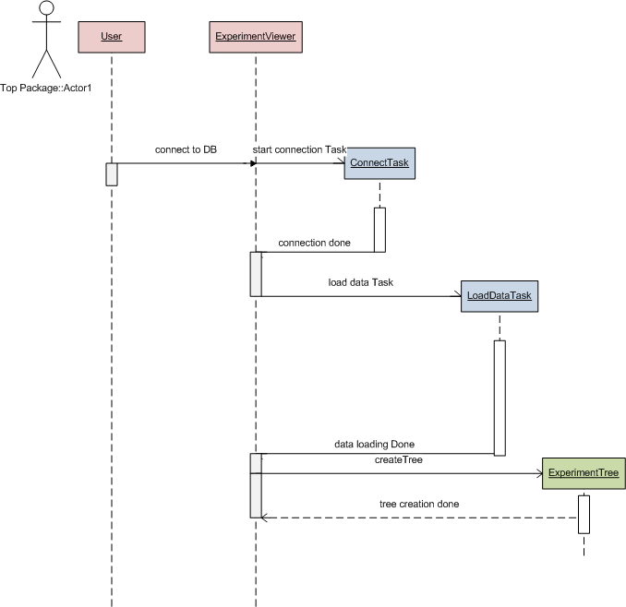
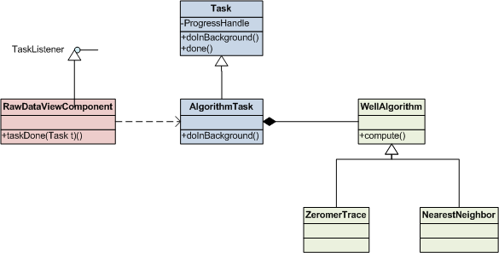
Command pattern example: Threading

Slide 15
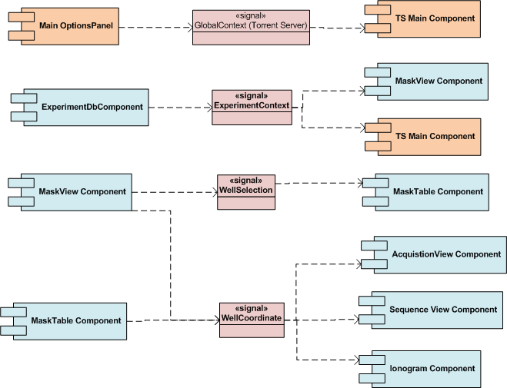
Observer pattern: Loose Coupling

Slide 16
Other patterns used
Object pools (reusing objects to save time and memory)
Singletons (making sure only one instance is used, such as global context or user preference manager)
Adaptors/Wrappers (decoupling, db -> REST)
Façade (hiding complexity, for instance for raw data access)
Lazy initialization (only creating objects or parts of it on demand to save time and memory) ( xy.get -> retrieve object from db)
…

Slide 17
NetBeans IDE Overview
Open Source Development Environment (similar to Eclipse)
Supports Java, C, C++, PHP, Groovy and Grails, SQL, HTML, CSS, Java Script, Ruby
Code completion, live parsing, refactoring, code templates etc
Code generation (persistence, get/set, via templates)
Includes debugger, profiler
Integration with Version Control (SVN, GIT, CVS etc)
Database integration (including code generation from DBs)
Build tools (Maven, Ant)
Java: Swing GUI Builder, Web apps, Deskop application development, Java EE, Web services, mobile embedded apps

Slide 18
Code generation example: Persistence
Automatic code generation for persistence with @Annotation tags and JAXB
No need to write any code or any classes (other than the query) to access a relational database
The (main) code need to query:

Slide 19
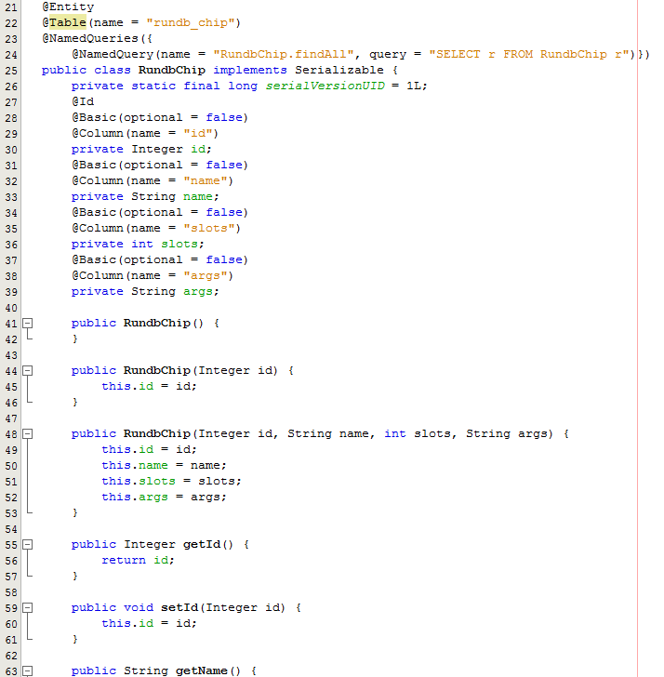
Example generated code: rundb_chip

Slide 20
Requirements to Run
Unix: use Sun Java 6 Webstart (not Open JDK)
Windows: use 64 bit machine and 64 bit Java (or use VNC to a unix box ☺)
At least 2GB RAM

