Slide 1
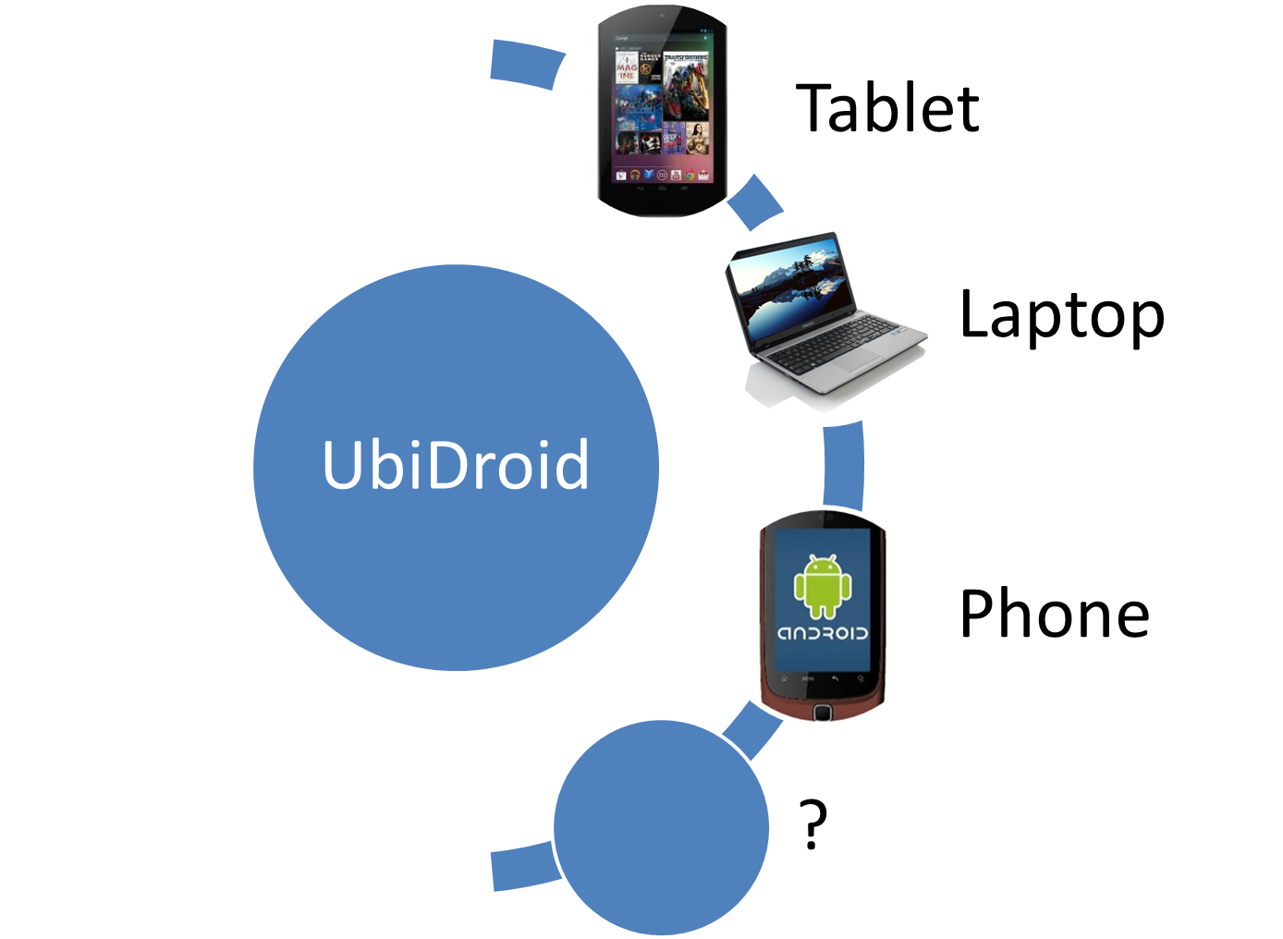


Slide 2
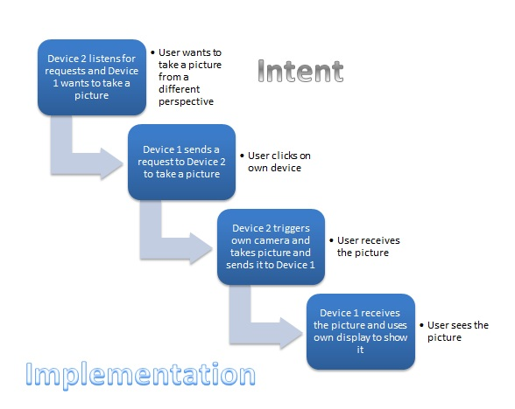

Slide 3
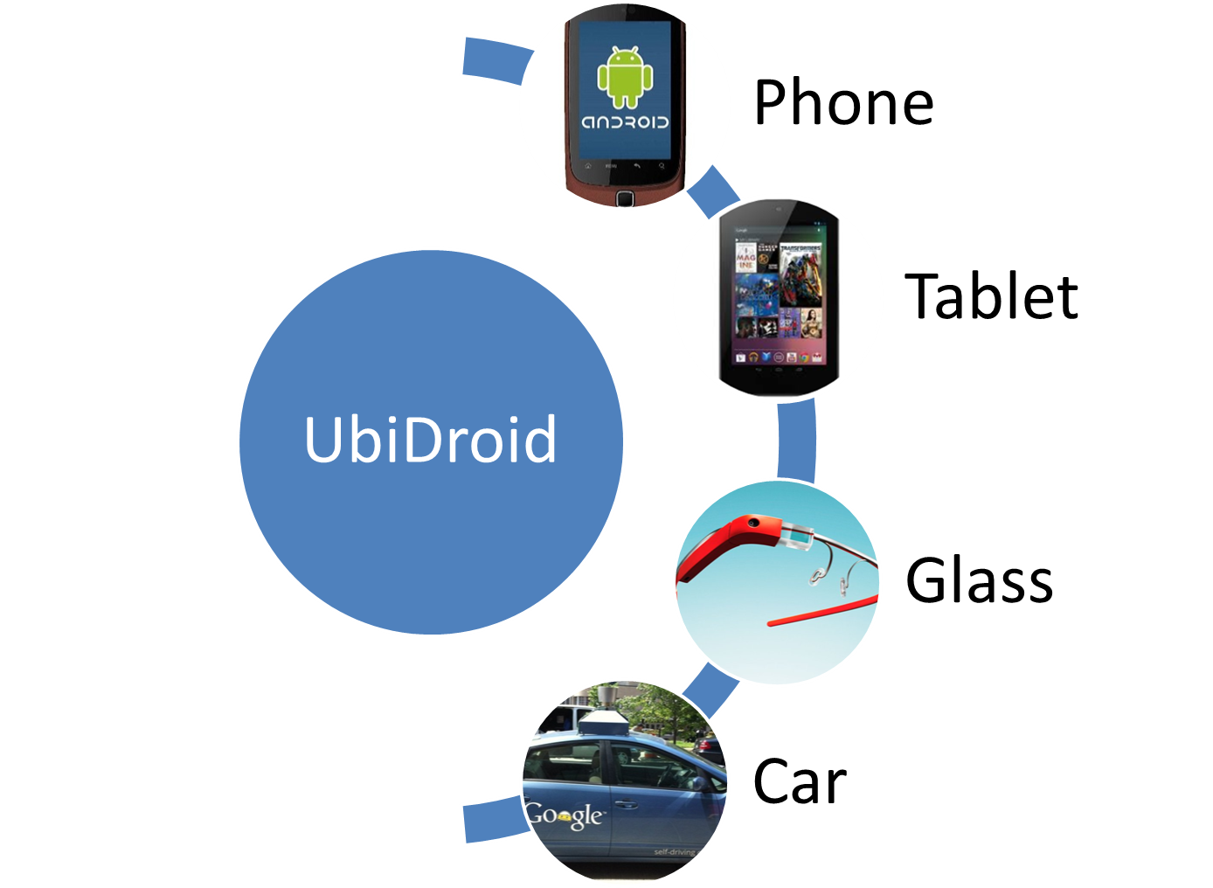


Slide 4
What is UbiDroid?
Android Framework/Infrastructure for cross device interactions
Provides API for application developers
Takes out complex system level implementation from app development

Slide 5

Implementation

