Slide 1
Speech Recognition
Maribeth Gandy
Notes:
Sources

Slide 2
What is speech?
Air generated by the lungs, flowing through the vocal tract, vibrating over the vocal cord, filtered by facial muscles, released out of the mouth and nose
Brain tells larynx (vocal cord) to oscillate
  Tightness of cord determines fundamental frequency
Air flow modified by tongue, teeth, lips and other facial muscles

Slide 3
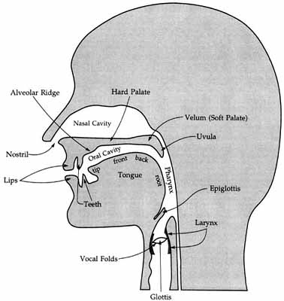
The Vocal Tract
http://www.youtube.com/watch?v=wR41CRbIjV4
http://www.youtube.com/watch?v=ajbcJiYhFKY

Slide 4
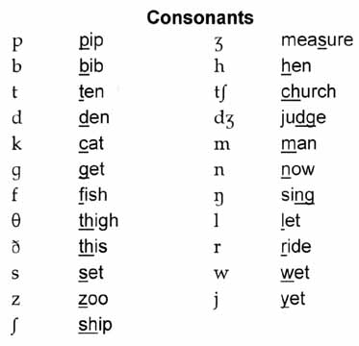
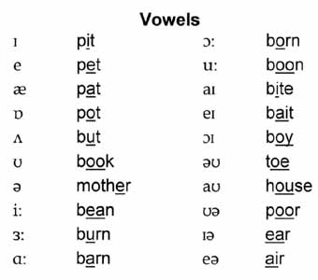
What is speech?
Speech made up of phoneme components
  Grouped by dialect
    English 44 phonemes
  Vowels
    produced with no obstruction to the air flow coming from the lungs
    Dipthongs
      “sum” vs “same”
  Consonants
    momentary interruption or obstruction of the air flow

Slide 5
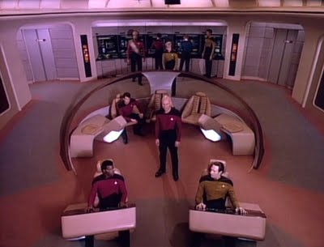
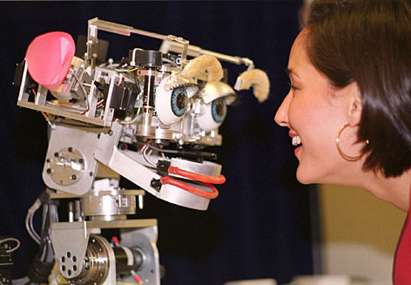
Domains and Applications
Traditional speech recognition
  Using speech for control
    natural interface to computer
    hands free interface
    automated information systems
    Humanoid communication

Slide 6
Domains and Applications
Recognizing streams of speech
  Transcription
    hands free typing
      Data entry
    transcription of notes, court proceedings, closed captioning etc.
      can be used for text search later
  contextual awareness
    May not involve recognizing individual words
    Intonation, emotion, number of speakers etc.

Slide 7
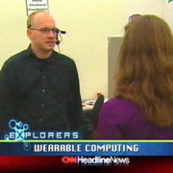
Domains and Applications
Speaker identification
  Security
  Personalization in systems
  Contextual awareness
Word spotting
  Security
  Creating metadata tags
  Searching media streams
  Contextual awareness

Slide 8
Speech Rec is Hard!
Why?
  Mondegreens
    Sylvia Wright, 1954
    mishearing (usually accidental) of a phrase in such a way that it acquires a new meaning
        “They have slain the Earl of Murray,
        And Lady Mondegreen” (…laid him on the green)
    Song lyrics
      “Excuse me while I kiss this guy”
    Appear in closed captioning

Slide 9
Why Speech Rec is Hard
Accents, language, dialects
Slang, lazy speech etc.
Vocabulary and proper names
Whispering, unvoiced speech
  Acoustically different
Context often necessary
  Content of previous speech
  Who is speaking
  Environment
  Cultural Expectations
  “Common Sense”
  Humans use visual information

Slide 10
Why Speech Rec is Hard
Noisy environments
  Multiple speakers
  Environmental sounds
Microphones
  In environment versus on person
  Quality
Natural language “understanding” is a whole separate issue
High recognition percentages seen with test data or in demos do not always translate in real life deployment
  http://www.youtube.com/watch?v=2Y_Jp6PxsSQ

Slide 11
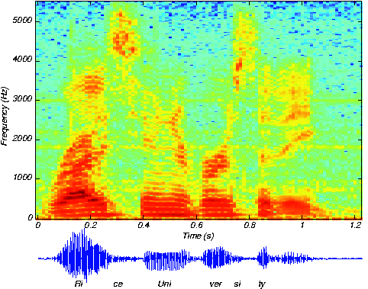
Standard Techniques
Simple speech recognition recipe
Find features, train up system with sample inputs and outputs. System learns how these features correspond to different phonemes and/or words.
  Find the beginning and end of the utterance.
  Filter the raw signal into frequency bands.
  Cut the utterance into a fixed number of segments.
  Average data for each band in each segment.
  Store this pattern with its name.
  Collect training set of about 3 repetitions of each pattern (word).
  Recognize unknown by comparing its pattern against all patterns in the training set and returning the name of the pattern closest to the unknown

Slide 12
Standard Techniques
Spectral analysis
Find phonemes (“How to wreck a nice beach”)
  but which word do they go with?
    Co-articulation
  Where to draw word boundaries
    Probabilistic segmentation

Slide 13
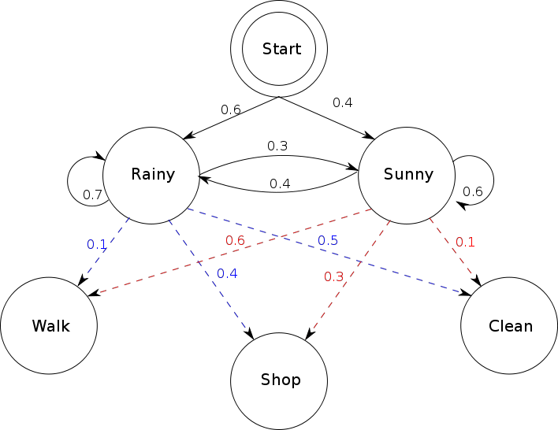
Standard Techniques
Pattern recognition techniques
  Dynamic Time Warping
  Hidden Markov Models
    www.cs.ubc.ca/~murphyk/Bayes/rabiner.pdf
  Supervised vs. unsupervised learning

Slide 14
Making Speech Rec Easier
Constrained vocabularies (tech support lines)
Noise cancellation mics or processing
Mic location and other techniques
  Headset
  Radar
  Contact microphones
Continuous recognition versus “push to talk”
Speaker dependent versus independent
Phonetic search
Semi manual process where error correction easy on part of user
“Wizard of Oz” interfaces
  Closed Captioning
  AR Façade
  If used for testing/evaluation, make sure to make it realistic

Slide 15
Is Speech the Ideal Interface?
  For years this has been seen as the best and final solution for all interfaces
  http://www.youtube.com/watch?v=v1uyQZNg2vE
  http://www.youtube.com/watch?v=NFKHAjHrc5A http://www.youtube.com/watch?v=0AQ_v5AcjmQ
  http://www.youtube.com/watch?v=1hZrfg2yWPo
  http://www.youtube.com/watch?v=plPkyyAIy3o

Slide 16
Speech as Interface
Good
  Accessible
  People will naturally adapt to interface shortcomings (talking slower, articulating)
  Easier to learn? Natural interfaces to automated systems
  Works well in ubicomp environments where no keyboards etc. or while people are mobile
  Secure?
  Makes it easier to search and/or tag media
  “Dual Purpose Speech”
    http://www.cc.gatech.edu/~thad/v/12_dps_uist2004_video.avi

Slide 17
Speech as Interface
Bad
  No privacy
  Possibly Embarrassing
  Disruptive to environment
  Does not always work well enough
  High cognitive load
  Temporal nature of sound results in longer waits?
  AR Façade
    http://www.youtube.com/watch?v=x__I1AbA7w0
    http://www.youtube.com/watch?v=W0JiON5um1o

Slide 18
Products & Libraries
IBM ViaVoice
Dragon Naturally Speaking
Microsoft Speech Server
CMU’s Sphinx
Libraries like HTK
Nexidia (phonetic search)
Variety of mobile services
  Nuance
  OpenStream
  Loquendo
Kinect
  http://www.youtube.com/watch?v=8Dz47H3WDGQ

