Slide 1
Recommender Systems: Content-based Systems & Collaborative Filtering
Note to other teachers and users of these slides: We would be delighted if you found this our material useful in giving your own lectures. Feel free to use these slides verbatim, or to modify them to fit your own needs. If you make use of a significant portion of these slides in your own lecture, please include this message, or a link to our web site: http://www.mmds.org

Slide 2
High Dimensional Data
High dim. data
Locality sensitive hashing
Clustering
Graph data
PageRank, SimRank
Community Detection
Infinite data
Filtering data streams
Web advertising
Dimensionality reduction
Spam Detection
Queries on streams
Machine learning
SVM
Decision Trees
Perceptron, kNN
Apps
Recommender systems
Association Rules
Duplicate document detection

Slide 3
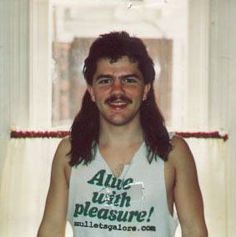
Example: Recommender Systems
Customer X
Buys Metallica CD
Buys Megadeth CD
Customer Y
Does search on Metallica
Recommender system suggests Megadeth from data collected about customer X

Slide 4










Recommendations
Examples:
Search
Recommendations
Items
Products, web sites, blogs, news items, …

Slide 5
From Scarcity to Abundance
Shelf space is a scarce commodity for traditional retailers
Also: TV networks, movie theaters,…
Web enables near-zero-cost dissemination of information about products
From scarcity to abundance
More choice necessitates better filters
Recommendation engines
How Into Thin Air made Touching the Void a bestseller: http://www.wired.com/wired/archive/12.10/tail.html
Notes:
In 1988, a British mountain climber named Joe Simpson wrote a book called Touching the Void, a harrowing account of near death in the Peruvian Andes. It got good reviews but, only a modest success, it was soon forgotten. Then, a decade later, a strange thing happened. Jon Krakauer wroteInto Thin Air, another book about a mountain-climbing tragedy, which became a publishing sensation. SuddenlyTouching the Void started to sell again.
Random House rushed out a new edition to keep up with demand. Booksellers began to promote it next to their Into Thin Air displays, and sales rose further. A revised paperback edition, which came out in January, spent 14 weeks on theNew York Times bestseller list. That same month, IFC Films released a docudrama of the story to critical acclaim. NowTouching the Void outsells Into Thin Air more than two to one.
What happened? In short, Amazon.com recommendations. The online bookseller's software noted patterns in buying behavior and suggested that readers who liked Into Thin Airwould also like Touching the Void. People took the suggestion, agreed wholeheartedly, wrote rhapsodic reviews. More sales, more algorithm-fueled recommendations, and the positive feedback loop kicked in.

Slide 6
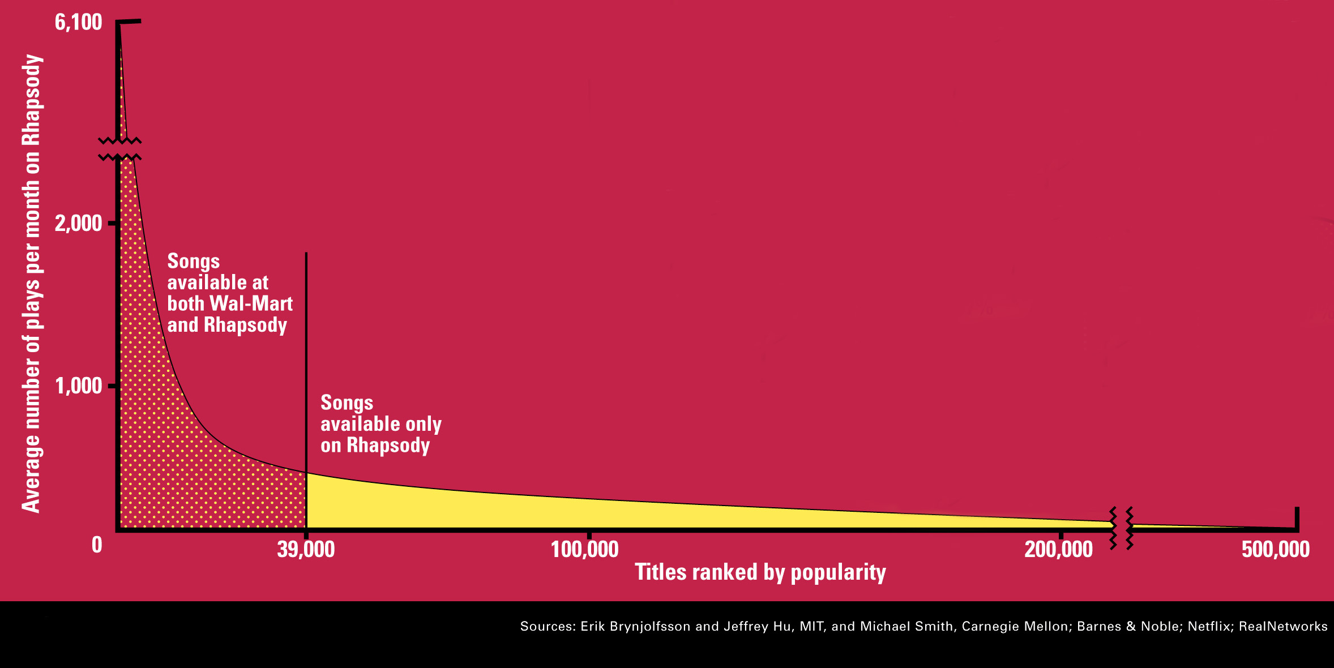
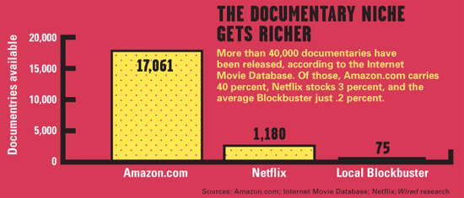
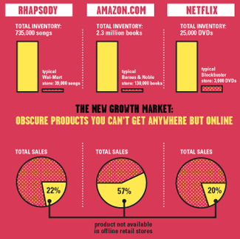
Sidenote: The Long Tail
Source: Chris Anderson (2004)

Slide 7
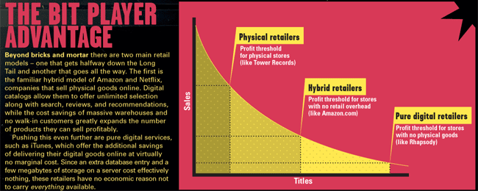
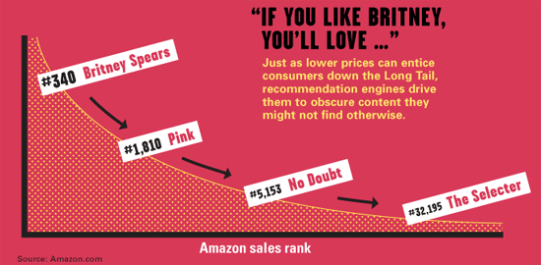
Physical vs. Online
Read http://www.wired.com/wired/archive/12.10/tail.html to learn more!

Slide 8
Types of Recommendations
Editorial and hand curated
List of favorites
Lists of “essential” items
Simple aggregates
Top 10, Most Popular, Recent Uploads
Tailored to individual users
Amazon, Netflix, …

Slide 9
Formal Model
X = set of Customers
S = set of Items
Utility function u: X × S → R
R = set of ratings
R is a totally ordered set
e.g., 0-5 stars, real number in [0,1]

Slide 10
Utility Matrix
Avatar
LOTR
Matrix
Pirates
Alice
Bob
Carol
David

Slide 11
Key Problems
(1) Gathering “known” ratings for matrix
How to collect the data in the utility matrix
(2) Extrapolate unknown ratings from the known ones
Mainly interested in high unknown ratings
We are not interested in knowing what you don’t like but what you like
(3) Evaluating extrapolation methods
How to measure success/performance of recommendation methods
Notes:
1.评分 豆瓣评分 IMDB
2.未知分数从已知的获得 然后进行推荐topk
3.如何评价推荐系统性能。

Slide 12
(1) Gathering Ratings
Explicit
Ask people to rate items
Doesn’t work well in practice – people can’t be bothered
Implicit
Learn ratings from user actions
E.g., purchase implies high rating
What about low ratings?
Notes:
外在方式 找人评
内在方式 从行为上学习，例如流量，例如购买量
问题在于高评分的有购买量可以评，低评分呢？

Slide 13
(2) Extrapolating Utilities
Key problem: Utility matrix U is sparse
Most people have not rated most items
Cold start:
New items have no ratings
New users have no history
Three approaches to recommender systems:
1) Content-based
2) Collaborative
3) Latent factor based
Notes:
冷启动问题
三种方法 基于内容的推荐 协同滤波 潜在因子分析

Slide 14
Content-based Recommender Systems

Slide 15
Content-based Recommendations
Main idea: Recommend items to customer x similar to previous items rated highly by x
Example:
Movie recommendations
Recommend movies with same actor(s), director, genre, …
Websites, blogs, news
Recommend other sites with “similar” content
Notes:
基于事物的特征项

Slide 16
Plan of Action
Item profiles
likes
build
recommend
match
Red
Circles
Triangles
User profile
Notes:
首先，要实现协同过滤，需要以下几个步骤
收集用户偏好
找到相似的用户或物品
计算推荐

Slide 17
Item Profiles
For each item, create an item profile
Profile is a set (vector) of features
Movies: author, title, actor, director,…
Text: Set of “important” words in document
How to pick important features?
Usual heuristic from text mining is TF-IDF (Term frequency * Inverse Doc Frequency)
Term … Feature
Document … Item

Slide 18
Learning a User Model
Creating a model of the user’s preference from the user history is a form of classification learning
The training data (i.e., user’s history) could be captured through explicit feedback (e.g., user rates items) or implicit observing of user’s interactions (e.g., user bought an item and later returned it is a sign of user doesn’t like the item)
Implicit method can collect large amount of data but could contains noise while data collected through explicit method is perfect but the amount collected could be limited

Slide 19
Learning a User Model
Next, a number of classification learning algorithms are reviewed
The main goal of these classification learning algorithms is to learn a function that model the user’s interests
Applying the function on a new item can give the probability that a user will like this item or a numeric value indicating the degree of interest in this item

Slide 20
Item Representation
Items stored in a database table
Structured data
Small number of attributes
Each item is described by the same set of attributes
Known set of values that the attributes may have
Straightforward to work with
User’s profile contains positive rating for 1001, 1002, 1003
Would the user be interested in say Oscars (French cuisine, table service)?
ID | Name | Cuisine | Service | Cost
1001 | Mike’s Pizza | Italian | Counter | Low
1002 | Chris’s Café | French | Table | Medium
1003 | Jacques Bistro | French | Table | High
Notes:
下节课。

Slide 21
Item Representation
Information about item could also be free text; e.g., text description or review of the restaurant, or news articles
Unstructured data
No attribute names with well-defined values
Natural language complexity
Same word with different meanings
Different words with same meaning
Need to impose structure on free text before it can be used in recommendation algorithm
Notes:
自然语言处理

Slide 22
Content-based Recommendation
For each item, create an item profile
Profile is a set (vector) of features
Movies: author, title, actor, director,…
Text: Set of “important” words in document
How to pick important features?
Usual heuristic from text mining is TF-IDF (Term frequency * Inverse Doc Frequency)
Term … Feature
Document … Item

Slide 23
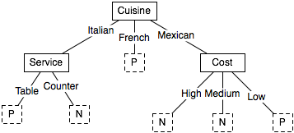
Decision Trees and Rule
Given the history of user’s interests as training data, build a decision tree which represents the user’s profile of interest
Will the user like an inexpensive Mexican restaurant?
Cuisine | Service | Cost | Rating
Italian | Counter | Low | Negative
French | Table | Med | Positive
French | Counter | Low | Positive
… | … | … | …

Slide 24
Decision Trees and Rule
Well-suited for structured data
In unstructured data, the number of attributes becomes too enormous and consequently, the tree becomes too large to provide sufficient performance
RIPPER: a rule induction algorithm based on the same principles but provide better performance in classifying text
Notes:
RIPPER is a rule induction algorithm closely related to decision trees that operates in a similar fashion to the recursive data partitioning approach described above. Despite the problematic inductive bias, however, RIPPER performs competitively with other state-of-the-art text classification algorithms. In part, the performance can be attributed to a sophisticated post-pruning algorithm that optimizes the fit of the induced rule set with respect to the training data as a whole. Furthermore, RIPPER supports multi-valued attributes, which leads to a natural representation for text classification tasks, i.e., the individual words of a text document can be represented as multiple feature values for a single feature. While this is essentially a representational convenience if rules are to be learned from unstructured text documents, the approach can lead to more powerful classifiers for semi-structured text documents. For example, the text contained in separate fields of an email message, such as sender, subject, and body text, can be represented as separate multi-valued features, which allows the algorithm to take advantage of the document’s structure in a natural fashion.

Slide 25
Nearest Neighbour Methods
Simply store all the training data in memory
To classify a new item, compare it to all stored items using a similarity function and determine the “nearest neighbour” or the k nearest neighbours.
The class or numeric score of the previously unseen item can then be derived from the class of the nearest neighbour.
Notes:
KNN不同CNN

Slide 26
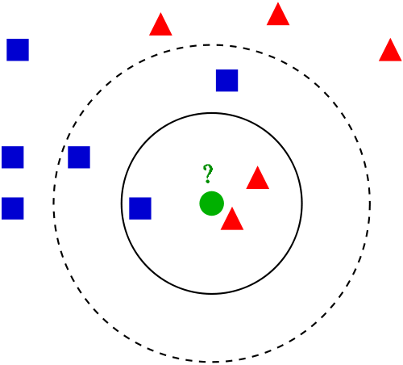
Nearest Neighbour Methods
unseen item needed to be classified
positive rated items
negative rated items
k = 3: negative
k = 5: positive

Slide 27
Nearest Neighbour Methods
The similarity function depends on the type of data
Structured data: Euclidean distance metric
Unstructured data (i.e., free text): cosine similarity function

Slide 28
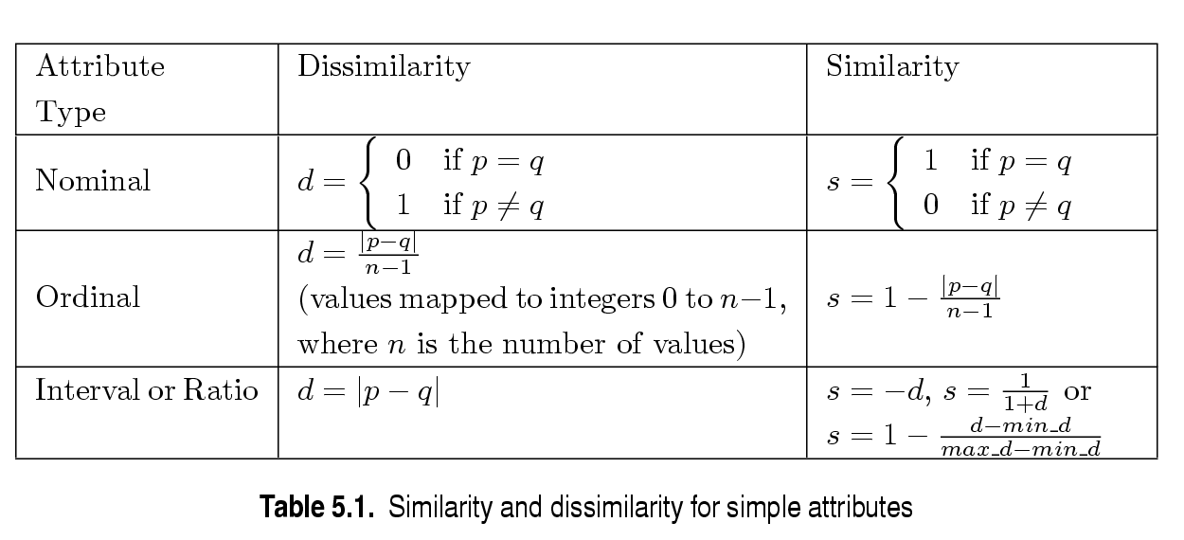
Similarity/Dissimilarity for Simple Attributes
p and q are the attribute values for two data objects.
Notes:
二进制、序列、比率

Slide 29
Euclidean Distance
Euclidean Distance
Where n is the number of dimensions (attributes) and p_{k} and q_{k} are, respectively, the k^{th} attributes (components) or data objects p and q.
Standardization is necessary, if scales differ.
Notes:
标准化必要性

Slide 30
Euclidean Distance
Distance Matrix
Notes:
Q：ED属于相似性还是相异性？

Slide 31
Minkowski Distance
Minkowski Distance is a generalization of Euclidean Distance
Where r is a parameter, n is the number of dimensions (attributes) and pk and qk are, respectively, the kth attributes (components) or data objects p and q.

Slide 32
Minkowski Distance: Examples
r = 1. City block (Manhattan, taxicab, L₁ norm) distance.
A common example of this is the Hamming distance, which is just the number of bits that are different between two binary vectors
r = 2. Euclidean distance
r → ∞. “supremum” (L_{max} norm, L∞ norm) distance.
This is the maximum difference between any component of the vectors
Do not confuse r with n, i.e., all these distances are defined for all numbers of dimensions.
Notes:
1范数曼哈顿距离
2范数欧式距离
无穷范数，最大值

Slide 33
Minkowski Distance
Distance Matrix

Slide 34
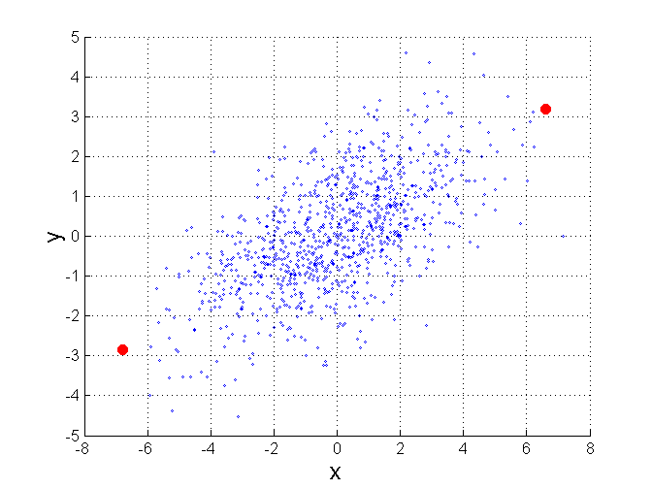
Mahalanobis Distance
Σ is the covariance matrix of the input data X
For red points, the Euclidean distance is 14.7, Mahalanobis distance is 6.
Notes:
协方差矩阵

Slide 35
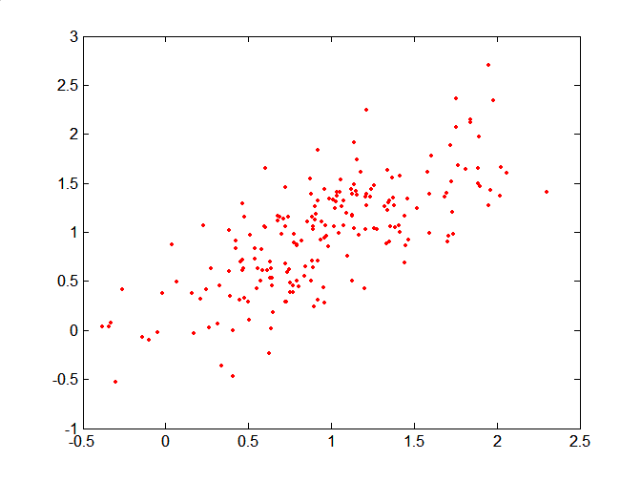
Mahalanobis Distance
Covariance Matrix:
C
B
A: (0.5, 0.5)
B: (0, 1)
C: (1.5, 1.5)
Mahal(A,B) = 5
Mahal(A,C) = 4
A

Slide 36
Common Properties of a Distance
Distances, such as the Euclidean distance, have some well known properties.
d(p, q) ≥ 0 for all p and q and d(p, q) = 0 only if p = q. (Positive definiteness)
d(p, q) = d(q, p) for all p and q. (Symmetry)
d(p, r) ≤ d(p, q) + d(q, r) for all points p, q, and r. (Triangle Inequality)
where d(p, q) is the distance (dissimilarity) between points (data objects), p and q.
A distance that satisfies these properties is a metric

Slide 37
Euclidean Distance Metric
Distance between A and B
Attributes which are not measured quantitatively need to be labeled by numbers representing their categories
Cuisine attribute: 1=Frech, 2=Italian, 3=Mexican.
Item | Attr. X | Attr. Y | Attr. Z
A | X_{A} | Y_{A} | Z_{A}
B | X_{B} | Y_{B} | Z_{B}

Slide 38
Cosine Similarity Function
Vector space model
An item or a document d is represented as a vector
w_{t,d} is the tf*idf weight of a term t in a document d
The similarity between two items can then be computed by the cosine of the angle between two vectors

Slide 39
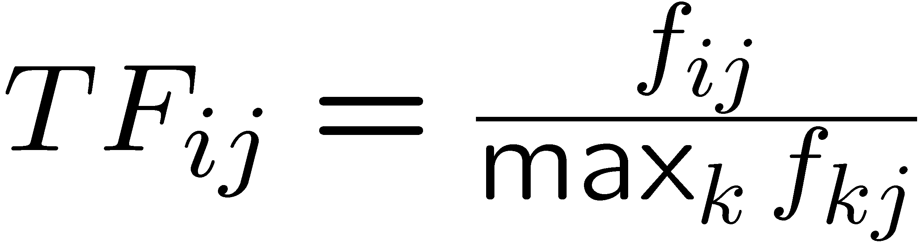
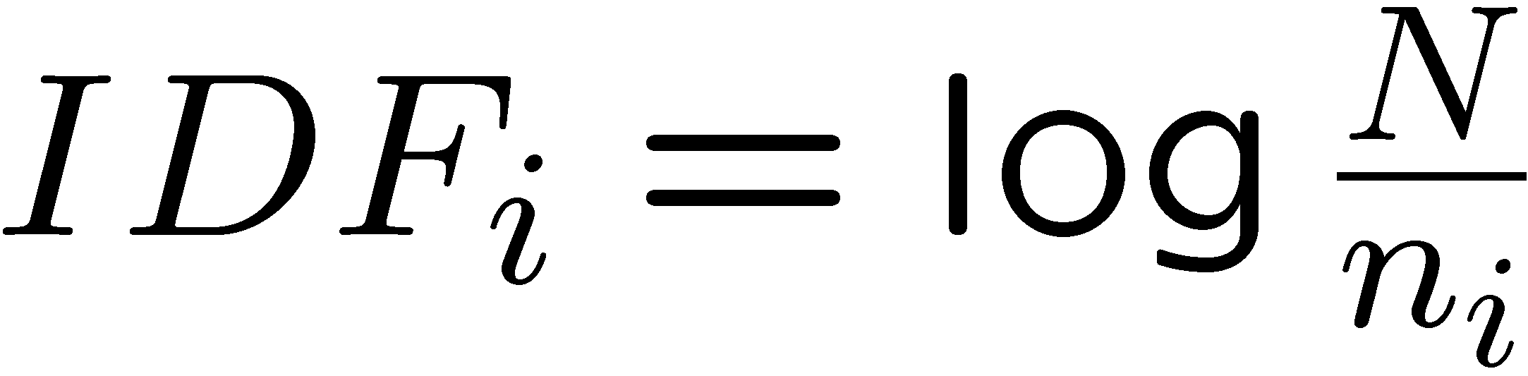
Sidenote: TF-IDF
f_{ij} = frequency of term (feature) i in doc (item) j
n_{i} = number of docs that mention term i
N = total number of docs
TF-IDF score: w_{ij} = TF_{ij} × IDF_{i}
Doc profile = set of words with highest TF-IDF scores, together with their scores
Note: we normalize TF to discount for “longer” documents
Notes:
TF-IDF是Term Frequency - Inverse Document Frequency的缩写，即“词频-逆文本频率”。它由两部分组成，TF和IDF。前面的TF也就是我们前面说到的词频，我们之前做的向量化也就是做了文本中各个词的出现频率统计，并作为文本特征，这个很好理解。关键是后面的这个IDF，即“逆文本频率”如何理解。我们讲到几乎所有文本都会出现的"to"其词频虽然高，但是重要性却应该比词频低的"China"和“Travel”要低。我们的IDF就是来帮助我们来反应这个词的重要性的，进而修正仅仅用词频表示的词特征值。概括来讲， IDF反应了一个词在所有文本中出现的频率，如果一个词在很多的文本中出现，那么它的IDF值应该低，比如上文中的“to”。而反过来如果一个词在比较少的文本中出现，那么它的IDF值应该高。

Slide 40
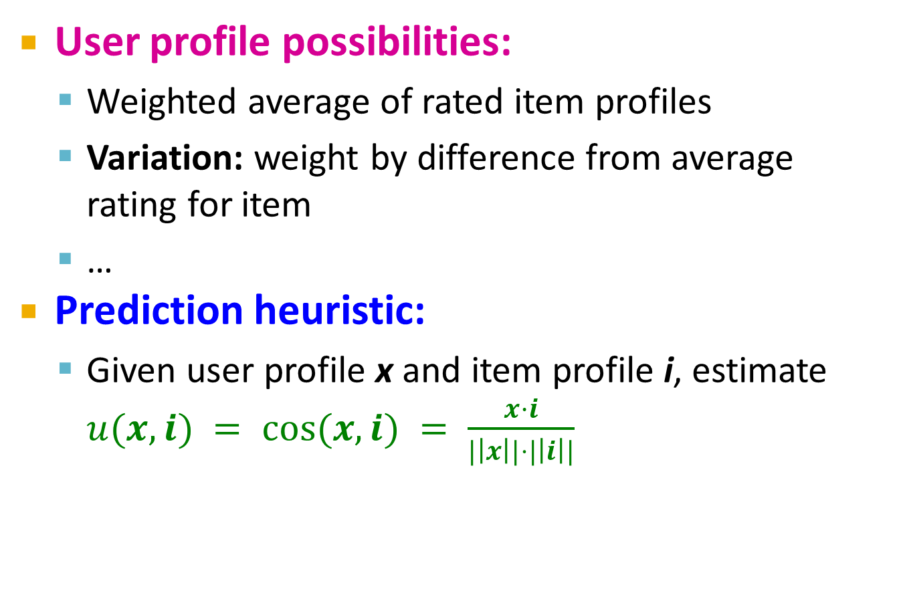
User Profiles and Prediction
User profile possibilities:
Weighted average of rated item profiles
Variation: weight by difference from average rating for item
…
Prediction heuristic:
Given user profile x and item profile i, estimate $u(x,i) = cos⁡(x,i) = \frac{x·i}{|\left|x\right||⋅|\left|i\right||}$
Notes:
Q: 推荐余弦值高的还是低的。。。
基于内容的推荐算法中余弦相似度的参考意义

Slide 41
Pros: Content-based Approach
+: No need for data on other users
No cold-start or sparsity problems
+: Able to recommend to users with unique tastes
+: Able to recommend new & unpopular items
No first-rater problem
+: Able to provide explanations
Can provide explanations of recommended items by listing content-features that caused an item to be recommended
Notes:
优势1与优势3，一个针对用户，一个针对对象，无需参照

Slide 42
Cons: Content-based Approach
–: Finding the appropriate features is hard
E.g., images, movies, music
–: Recommendations for new users
How to build a user profile?
–: Overspecialization
Never recommends items outside user’s content profile
People might have multiple interests
Unable to exploit quality judgments of other users
Notes:
1.Labeled
2. New users also meet cold start, or even frozen
Quality credit missing.

Slide 43
Collaborative Filtering
Harnessing quality judgments of other users

Slide 44
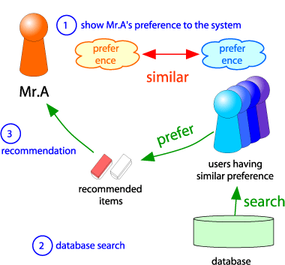
Collaborative Filtering
Consider user x
Find set N of other users whose ratings are “similar” to x’s ratings
Estimate x’s ratings based on ratings of users in N
x
N
Notes:
协同过滤一般是在海量的用户中发掘出一小部分和你品位（偏好）比较类似的，在协同过滤中，这些用户成为邻居，然后根据他们喜欢的其他东西组织成一个排序的目录作为推荐给你。对抗稀疏性。

Slide 45
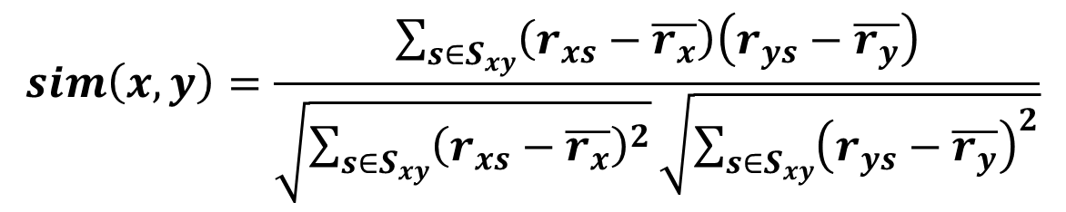
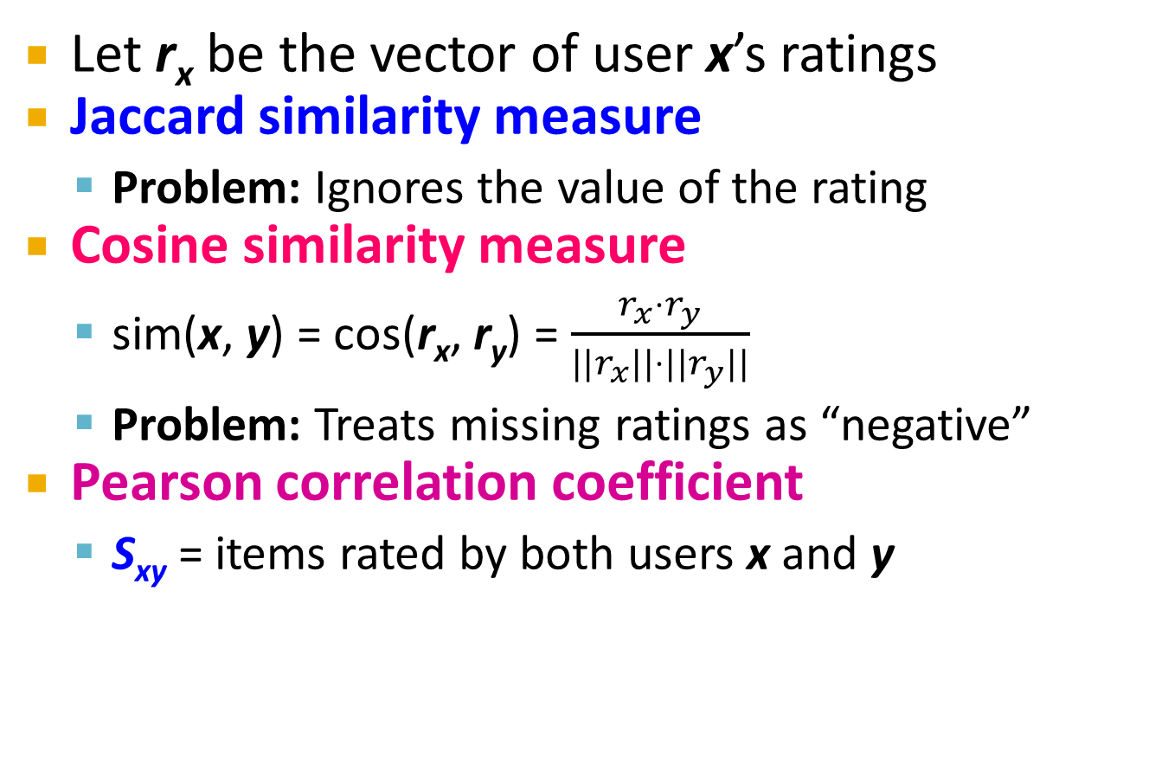
Finding “Similar” Users
r_{x} = [*, _, _, *, ***]
r_{y} = [*, _, **, **, _]
Let r_{x} be the vector of user x’s ratings
Jaccard similarity measure
Problem: Ignores the value of the rating
Cosine similarity measure
sim(x, y) = cos(r_{x}, r_{y}) = $\frac{r_{x}⋅r_{y}}{||r_{x}||⋅{||r}_{y}||}$
Problem: Treats missing ratings as “negative”
Pearson correlation coefficient
S_{xy} = items rated by both users x and y
r_{x}, r_{y} as sets:
r_{x} = {1, 4, 5}
r_{y} = {1, 3, 4}
r_{x}, r_{y} as points:
r_{x} = {1, 0, 0, 1, 3}
r_{y} = {1, 0, 2, 2, 0}
$$sim\left(x,y\right)=\frac{\sum_{s∈S_{xy}}{\left(r_{xs}−\overline{r_{x}}\right)\left(r_{ys}−\overline{r_{y}}\right)}}{\sqrt{\sum_{s∈S_{xy}}{{\left(r_{xs}−\overline{r_{x}}\right)}^{2}}}\sqrt{\sum_{s∈S_{xy}}{{\left(r_{ys}−\overline{r_{y}}\right)}^{2}}}}$$
r_{x}, r_{y} … avg. rating of x, y
Notes:
-- Jaccard is not appropriate as we want to consider weights
给定两个集合A,B，Jaccard 系数定义为A与B交集的大小与A与B并集的大小的比值
标准化处理

Slide 46
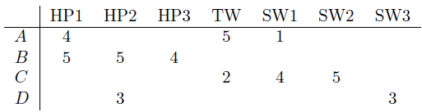
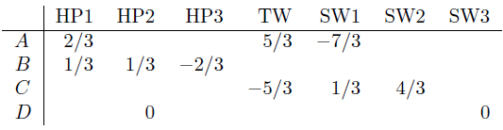

Similarity Metric
Cosine sim:
$$sim(x, y) = \frac{\sum_{i}{r_{xi}⋅r_{yi}}}{\sqrt{\sum_{i}{r_{xi}^{2}}}⋅\sqrt{\sum_{i}{r_{yi}^{2}}}}$$
Intuitively we want: sim(A, B) > sim(A, C)
Jaccard similarity: 1/5 < 2/4
Cosine similarity: 0.386 > 0.322
Considers missing ratings as “negative”
Solution: subtract the (row) mean
sim A,B vs. A,C:
0.092 > -0.559
Notice cosine sim. is correlation when data is centered at 0
Notes:
量化更清晰

Slide 47
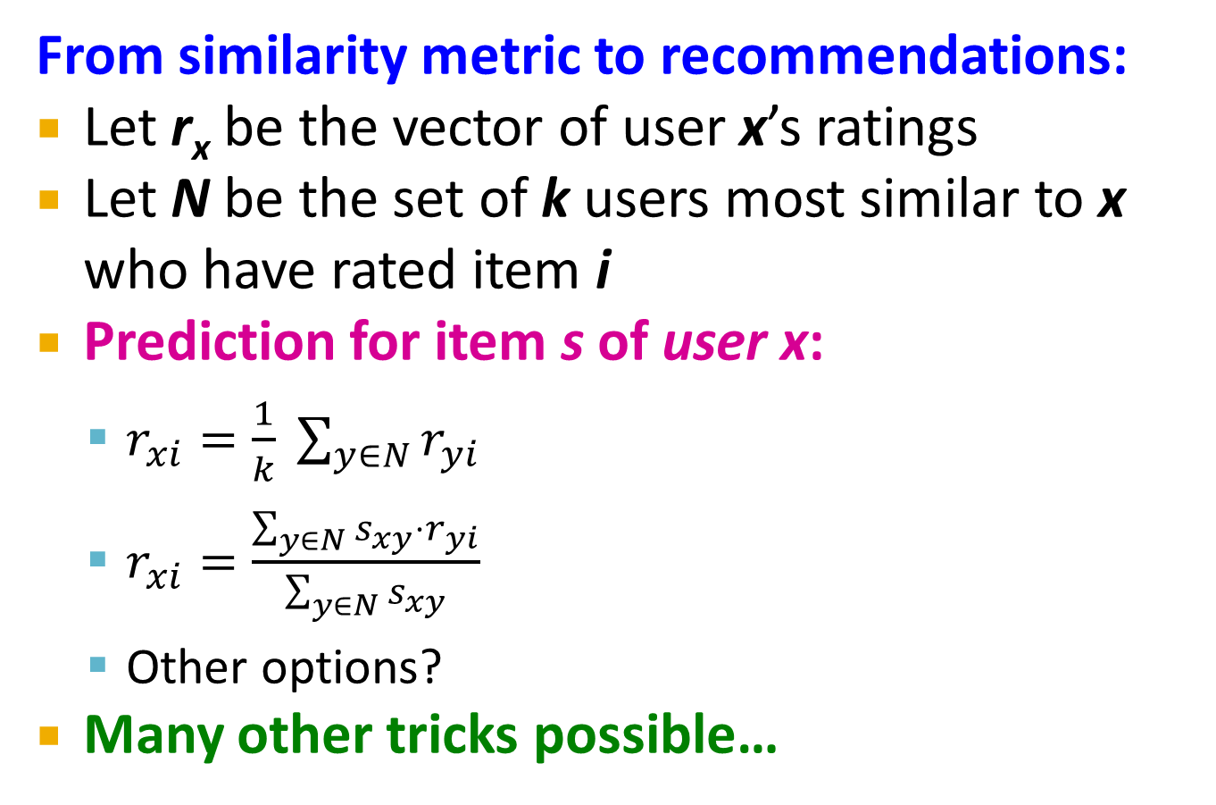
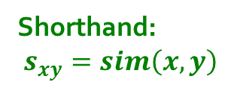
Rating Predictions
From similarity metric to recommendations:
Let r_{x} be the vector of user x’s ratings
Let N be the set of k users most similar to x who have rated item i
Prediction for item s of user x:
$r_{xi}=\frac{1}{k} \sum_{y∈N}{r_{yi}}$
$r_{xi}=\frac{\sum_{y∈N}{s_{xy}⋅r_{yi}}}{\sum_{y∈N}{s_{xy}}}$
Other options?
Many other tricks possible…
Shorthand: $s_{xy}=sim\left(x,y\right)$

Slide 48
Item-Item Collaborative Filtering
So far: User-user collaborative filtering
Another view: Item-item
For item i, find other similar items
Estimate rating for item i based on ratings for similar items
Can use same similarity metrics and prediction functions as in user-user model
s_{ij}… similarity of items i and j
r_{xj}…rating of user u on item j
N(i;x)… set items rated by x similar to i
Notes:
Top N similar

Slide 49
Item-Item CF (|N|=2)
users
12 | 11 | 10 | 9 | 8 | 7 | 6 | 5 | 4 | 3 | 2 | 1
 | 4 |  | 5 |  |  | 5 |  |  | 3 |  | 1 | 1
3 | 1 | 2 |  |  | 4 |  |  | 4 | 5 |  |  | 2
 | 5 | 3 | 4 |  | 3 |  | 2 | 1 |  | 4 | 2 | 3
 | 2 |  |  | 4 |  |  | 5 |  | 4 | 2 |  | 4
5 | 2 |  |  |  |  | 2 | 4 | 3 | 4 |  |  | 5
 | 4 |  |  | 2 |  |  | 3 |  | 3 |  | 1 | 6
movies
- unknown rating
- rating between 1 to 5

Slide 50
Item-Item CF (|N|=2)
users
12 | 11 | 10 | 9 | 8 | 7 | 6 | 5 | 4 | 3 | 2 | 1
 | 4 |  | 5 |  |  | 5 | ? |  | 3 |  | 1 | 1
3 | 1 | 2 |  |  | 4 |  |  | 4 | 5 |  |  | 2
 | 5 | 3 | 4 |  | 3 |  | 2 | 1 |  | 4 | 2 | 3
 | 2 |  |  | 4 |  |  | 5 |  | 4 | 2 |  | 4
5 | 2 |  |  |  |  | 2 | 4 | 3 | 4 |  |  | 5
 | 4 |  |  | 2 |  |  | 3 |  | 3 |  | 1 | 6
movies
- estimate rating of movie 1 by user 5

Slide 51
Item-Item CF (|N|=2)
users
12 | 11 | 10 | 9 | 8 | 7 | 6 | 5 | 4 | 3 | 2 | 1
 | 4 |  | 5 |  |  | 5 | ? |  | 3 |  | 1 | 1
3 | 1 | 2 |  |  | 4 |  |  | 4 | 5 |  |  | 2
 | 5 | 3 | 4 |  | 3 |  | 2 | 1 |  | 4 | 2 | 3
 | 2 |  |  | 4 |  |  | 5 |  | 4 | 2 |  | 4
5 | 2 |  |  |  |  | 2 | 4 | 3 | 4 |  |  | 5
 | 4 |  |  | 2 |  |  | 3 |  | 3 |  | 1 | 6
sim(1,m)
1.00
-0.18
0.41
-0.10
-0.31
0.59
movies
Neighbor selection: Identify movies similar to movie 1, rated by user 5
Here we use Pearson correlation as similarity:
1) Subtract mean rating m_{i} from each movie i m₁ = (1+3+5+5+4)/5 = 3.6 row 1: [-2.6, 0, -0.6, 0, 0, 1.4, 0, 0, 1.4, 0, 0.4, 0]
2) Compute cosine similarities between rows

Slide 52
Item-Item CF (|N|=2)
users
12 | 11 | 10 | 9 | 8 | 7 | 6 | 5 | 4 | 3 | 2 | 1
 | 4 |  | 5 |  |  | 5 | ? |  | 3 |  | 1 | 1
3 | 1 | 2 |  |  | 4 |  |  | 4 | 5 |  |  | 2
 | 5 | 3 | 4 |  | 3 |  | 2 | 1 |  | 4 | 2 | 3
 | 2 |  |  | 4 |  |  | 5 |  | 4 | 2 |  | 4
5 | 2 |  |  |  |  | 2 | 4 | 3 | 4 |  |  | 5
 | 4 |  |  | 2 |  |  | 3 |  | 3 |  | 1 | 6
sim(1,m)
1.00
-0.18
0.41
-0.10
-0.31
0.59
movies
Compute similarity weights: s_{1,3}=0.41, s_{1,6}=0.59

Slide 53
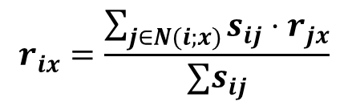
Item-Item CF (|N|=2)
users
12 | 11 | 10 | 9 | 8 | 7 | 6 | 5 | 4 | 3 | 2 | 1
 | 4 |  | 5 |  |  | 5 | 2.6 |  | 3 |  | 1 | 1
3 | 1 | 2 |  |  | 4 |  |  | 4 | 5 |  |  | 2
 | 5 | 3 | 4 |  | 3 |  | 2 | 1 |  | 4 | 2 | 3
 | 2 |  |  | 4 |  |  | 5 |  | 4 | 2 |  | 4
5 | 2 |  |  |  |  | 2 | 4 | 3 | 4 |  |  | 5
 | 4 |  |  | 2 |  |  | 3 |  | 3 |  | 1 | 6
movies
Predict by taking weighted average:
r_{1.5} = (0.41*2 + 0.59*3) / (0.41+0.59) = 2.6
$$r_{ix}=\frac{\sum_{j∈N(i;x)}{s_{ij}⋅r_{jx}}}{∑s_{ij}}$$

Slide 54

CF: Common Practice
Before:
Define similarity s_{ij} of items i and j
Select k nearest neighbors N(i; x)
Items most similar to i, that were rated by x
Estimate rating r_{xi} as the weighted average:
baseline estimate for r_{xi}
μ = overall mean movie rating
b_{x} = rating deviation of user x
= (avg. rating of user x) – μ
b_{i} = rating deviation of movie i
$$b_{xi}=μ+b_{x}+b_{i}$$

Slide 55
Item-Item vs. User-User
Avatar
LOTR
Matrix
Pirates
Alice
Bob
Carol
David
In practice, it has been observed that item-item often works better than user-user
Why? Items are simpler, users have multiple tastes
Notes:
第一种度量方法是从单个用户的角度度量，就是说给定一个用户，查看系统给出的推荐列表是否多样，也就是要比较推荐列表中的物品之间两两的相似度，不难想到，对这种度量方法，Item CF 的多样性显然不如 User CF 的好，因为 Item CF 的推荐就是和以前看的东西最相似的。 第二种度量方法是考虑系统的多样性，也被称为覆盖率 (Coverage)，它是指一个推荐系统是否能够提供给所有用户丰富的选择。在这种指标下，Item CF 的多样性要远远好于 User CF, 因为 User CF 总是倾向于推荐热门的，从另一个侧面看，也就是说，Item CF 的推荐有很好的新颖性，很擅长推荐长尾里的物品。所以，尽管大多数情况，Item CF 的精度略小于 User CF， 但如果考虑多样性，Item CF 却比 User CF 好很多。 如果你对推荐的多样性还心存疑惑，那么下面我们再举个实例看看 User CF 和 Item CF 的多样性到底有什么差别。首先，假设每个用户兴趣爱好都是广泛的，喜欢好几个领域的东西，不过每个用户肯定也有一个主要的领域，对这个领域会比其他领域更加关心。给定一个用户，假设他喜欢 3 个领域 A,B,C，A 是他喜欢的主要领域，这个时候我们来看 User CF 和 Item CF 倾向于做出什么推荐：如果用 User CF, 它会将 A,B,C 三个领域中比较热门的东西推荐给用户；而如果用 ItemCF，它会基本上只推荐 A 领域的东西给用户。所以我们看到因为 User CF 只推荐热门的，所以它在推荐长尾里项目方面的能力不足；而 Item CF 只推荐 A 领域给用户，这样他有限的推荐列表中就可能包含了一定数量的不热门的长尾物品，同时 Item CF 的推荐对这个用户而言，显然多样性不足。但是对整个系统而言，因为不同的用户的主要兴趣点不同，所以系统的覆盖率会比较好。
There is a difference in the typical behavior of users and items, as it
pertains to similarity. Intuitively, items tend to be classifiable in simple
terms. For example, music tends to belong to a single genre. It is impossi-
ble, e.g., for a piece of music to be both 60’s rock and 1700’s baroque. On
the other hand, there are individuals who like both 60’s rock and 1700’s
baroque, and who buy examples of both types of music.
The consequence is that it is easier to discover items that are similar because they belong
to the same genre, than it is to detect that two users are similar because
they prefer one genre in common, while each also likes some genres that
the other doesn’t care for.

Slide 56
Pros/Cons of Collaborative Filtering
+ Works for any kind of item
No feature selection needed
- Cold Start:
Need enough users in the system to find a match
- Sparsity:
The user/ratings matrix is sparse
Hard to find users that have rated the same items
- First rater:
Cannot recommend an item that has not been previously rated
New items, Esoteric items
- Popularity bias:
Cannot recommend items to someone with unique taste
Tends to recommend popular items

Slide 57
Hybrid Methods
Implement two or more different recommenders and combine predictions
Perhaps using a linear model
Add content-based methods to collaborative filtering
Item profiles for new item problem
Demographics to deal with new user problem

Slide 58
Remarks & Practical Tips
- Evaluation
- Error metrics
- Complexity / Speed

Slide 59
Evaluation
movies
1 | 3 | 4
 | 3 | 5 |  |  | 5
 |  | 4 | 5 |  | 5
 |  | 3
 |  | 3
2 |  |  | 2 |  | 2
 |  |  |  | 5
 | 2 | 1 |  |  | 1
 | 3 |  |  | 3
1
users

Slide 60
Evaluation
movies
1 | 3 | 4
 | 3 | 5 |  |  | 5
 |  | 4 | 5 |  | 5
 |  | 3
 |  | 3
2 |  |  | ? |  | ?
 |  |  |  | ?
 | 2 | 1 |  |  | ?
 | 3 |  |  | ?
1
users
Test Data Set

Slide 61
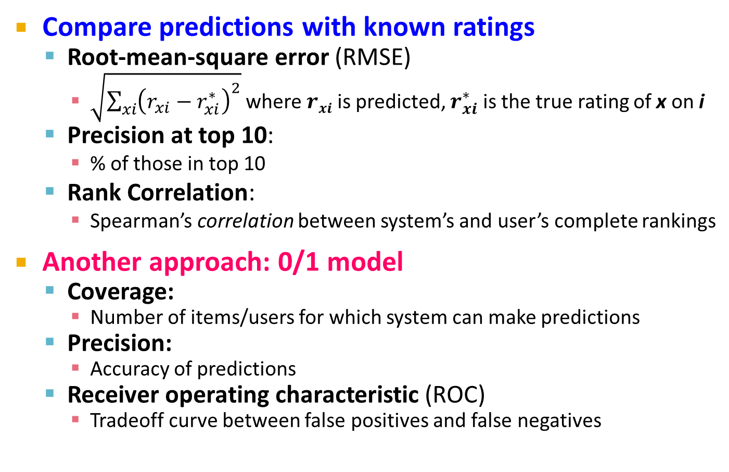
Evaluating Predictions
Compare predictions with known ratings
Root-mean-square error (RMSE)
$\sqrt{\sum_{xi}{{\left(r_{xi}−r_{xi}^{∗}\right)}^{2}}}$ where $rxi$ is predicted, $r_{xi}^{∗}$ is the true rating of x on i
Precision at top 10:
% of those in top 10
Rank Correlation:
Spearman’s correlation between system’s and user’s complete rankings
Another approach: 0/1 model
Coverage:
Number of items/users for which system can make predictions
Precision:
Accuracy of predictions
Receiver operating characteristic (ROC)
Tradeoff curve between false positives and false negatives

Slide 62
Problems with Error Measures
Narrow focus on accuracy sometimes misses the point
Prediction Diversity
Prediction Context
Order of predictions
In practice, we care only to predict high ratings:
RMSE might penalize a method that does well for high ratings and badly for others

Slide 63
Collaborative Filtering: Complexity
Expensive step is finding k most similar customers: O(|X|)
Too expensive to do at runtime
Could pre-compute
Naïve pre-computation takes time O(k ·|X|)
X … set of customers
We already know how to do this!
Near-neighbor search in high dimensions (LSH)
Clustering
Dimensionality reduction

Slide 64
Tip: Add Data
Leverage all the data
Don’t try to reduce data size in an effort to make fancy algorithms work
Simple methods on large data do best
Add more data
e.g., add IMDB data on genres
More data beats better algorithms
http://anand.typepad.com/datawocky/2008/03/more-data-usual.html

Slide 65
Quiz 1:
2
1

Slide 66
Quiz 1:
2
1

