Slide 1



Code Reviewer Recommendation in Tencent: Practice, Challenge and Direction
The 44th ACM/IEEE International Conference on Software Engineering (ICSE 2022)
Qiuyuan Chen^{1*}, Dezhen Kong^{1*}, Lingfeng Bao¹, Chenxing Sun², Xin Xia¹, Shanping Li¹
¹ Zhejiang University, Hangzhou, China
² Tencent, Shenzhen, China
* Work done while this author was an intern at Tencent.
Notes:
I am Qiuyuan Chen from Zhejiang University.
This work was collaborated with Gongfeng SAI Lab at Tencent

Slide 2







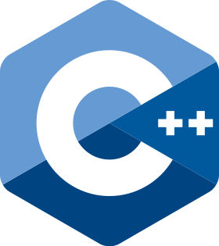


Motivation
Divided Organizations
Inner-source Practice
Who should review this code change?
A lot of Business at Tencent
~100k Employees
>70% codes are inner-sourced
A great many code changes
Code Review in a relatively small organization
Virtual organization across groups
Notes:
Tencent is a giant company.
It has six many organizations, and they are divided into small teams.
So in general, small groups do not need automatic reviewer recommendation. Because they are all familiar with each other.
And they can find an appropriate reviewer easily.
performing inner-source practice
Tencent established many virtual organizations across different groups.
That means developers comes from all over the company, and they are not limited by the divided teams.
In this environment, a great many code changes are submitted every day, every week, and every month.
On average there are about 10s of thousands of commits.

Slide 3






Background Workflow of Modern Code Review
At Tencent, developers use internal code review system “Gongfeng”,
like GitHub and Reviewboard.
At Tencent, reviewers are mainly designated by configuration files, or can be robots like Continuous Integration Tools.
2
3
5
4
6
¹ Fetch current code from main repository
² Make code changes and push them to CR system
³ Invite others to review code changes.
⁴ Give feedback.
⁵ Notify the submitter to improve the code changes
⁶ Merge code changes into main repository
1
Main Repository
Notes:
The best-performed approach, CN, reaches a score of 0.64, which means in about three in five (we can also treat it as a probabilistic) reviews, at least one reviewer could be actually recommended. In contrast, other approaches cannot reach even a half.

Slide 4
Background Workflow of Modern Code Review
At Tencent, developers use internal code review system “Gongfeng”,
like GitHub and Reviewboard.
At Tencent, reviewers are mainly designated by configuration files, or can be robots like Continuous Integration Tools.
2
3
5
4
6
¹ Fetch current code from main repository
² Make code changes and push them to CR system
³ Invite others to review code changes.
⁴ Give feedback.
⁵ Notify the submitter to improve the code changes
⁶ Merge code changes into main repository
1
Main Repository

Slide 5
Research Questions
RQ1: What is the effectiveness of code reviewer recommendation approaches on proprietary projects?
We investigate the performance of existing approaches on 10 proprietary projects.
RQ2: What are the perceptions and expectations of practitioners on code reviewer recommendation?
We interview 11 developers to get knowledge about their attitude towards reviewer recommendation systems.

Slide 6



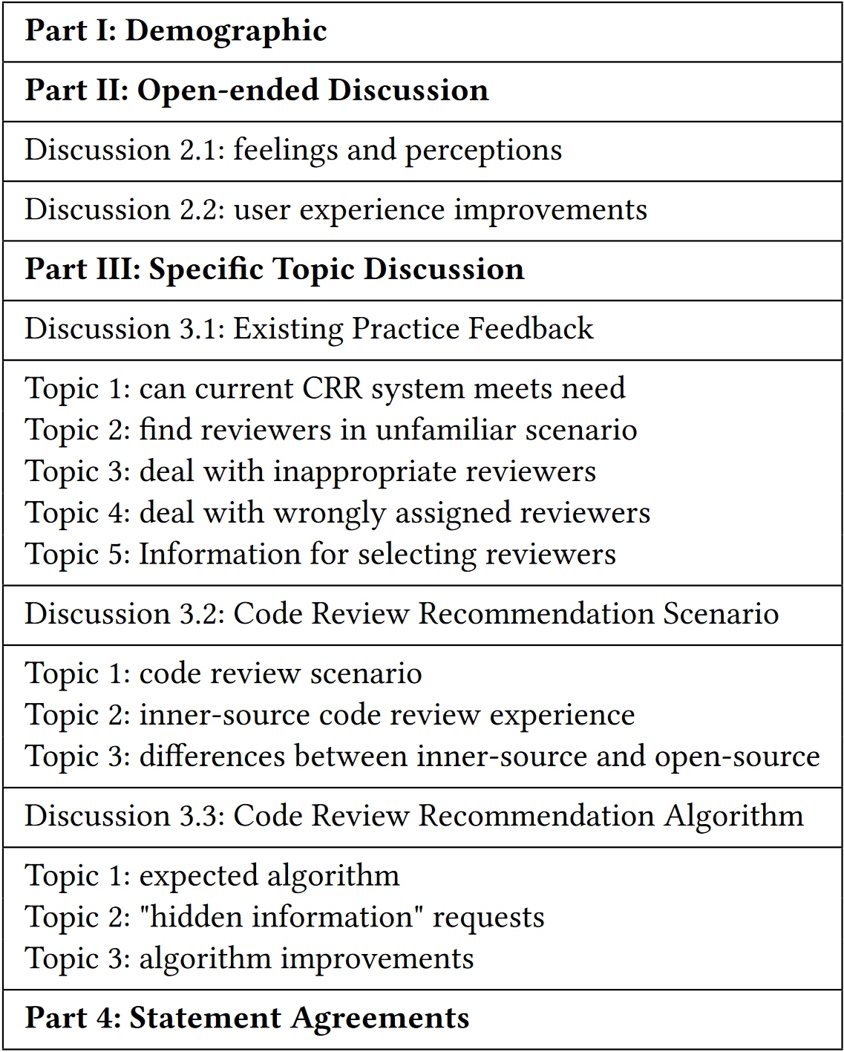








Research Methodology
Interview guide summarization
Code Repository
Analysis
Pilot Interview
Interview Analysis
CR History
Evaluation
Interview Guide*
Card Sorting
Data Extraction
Approach Selection
Semi-structured Interview
Transcription
Stage 1: for RQ1
Stage 2: for RQ2

Slide 7

Research Methodology
*Interview guide can be found on https://mfr.osf.io/render?url=https%3A%2F%2Fosf.io%2Fvcqpe%2Fdownload
Code Repository
Analysis
Pilot Interview
Interview Analysis
CR History
Evaluation
Interview Guide*
Card Sorting
Data Extraction
Approach Selection
Semi-structured Interview
Transcription
Stage 1: for RQ1
Stage 2: for RQ2

Slide 8
Research Questions
RQ1: What is the effectiveness of code reviewer recommendation approaches on proprietary projects?
We investigate the performance of existing approaches on 10 proprietary projects.
RQ2: What are the perceptions and expectations of practitioners on code reviewer recommendation?
We interview 11 developers to get knowledge about their attitude towards reviewer recommendation systems.

Slide 9
Research Methodology
*Interview guide can be found on https://mfr.osf.io/render?url=https%3A%2F%2Fosf.io%2Fvcqpe%2Fdownload
Code Repository
Analysis
Pilot Interview
Interview Analysis
CR History
Evaluation
Interview Guide*
Card Sorting
Data Extraction
Approach Selection
Semi-structured Interview
Transcription
Stage 1: for RQ1
Stage 2: for RQ2

Slide 10
RQ1 Results
Five Classic Code Reviewer Recommendation Approaches:
RevFinder：is an expertise-based approach that leverages file paths, assuming that the files located in close files may share similar functionality and are likely to be reviewed by reviewers with common experience.
TIE：uses multinomial Naive Bayes to measure the commit message’s textual content (i.e., commit message) similarity and a VSM-based approach to measure the file path similarity.
IR (VSM-based) ：vectorizes the PR’s description using VSM, calculates the textual similarities, and ranks the reviewers in the resolved PRs.
Comment Network (CN) ：is a recommender that ranks reviewers who share common interests with the contributors of target PR by mining historical comments traces and construct a comment network.
cHRev: considers the reviewing history (review number, review time). It counts the number of comments to the file as part of scores.

Slide 11
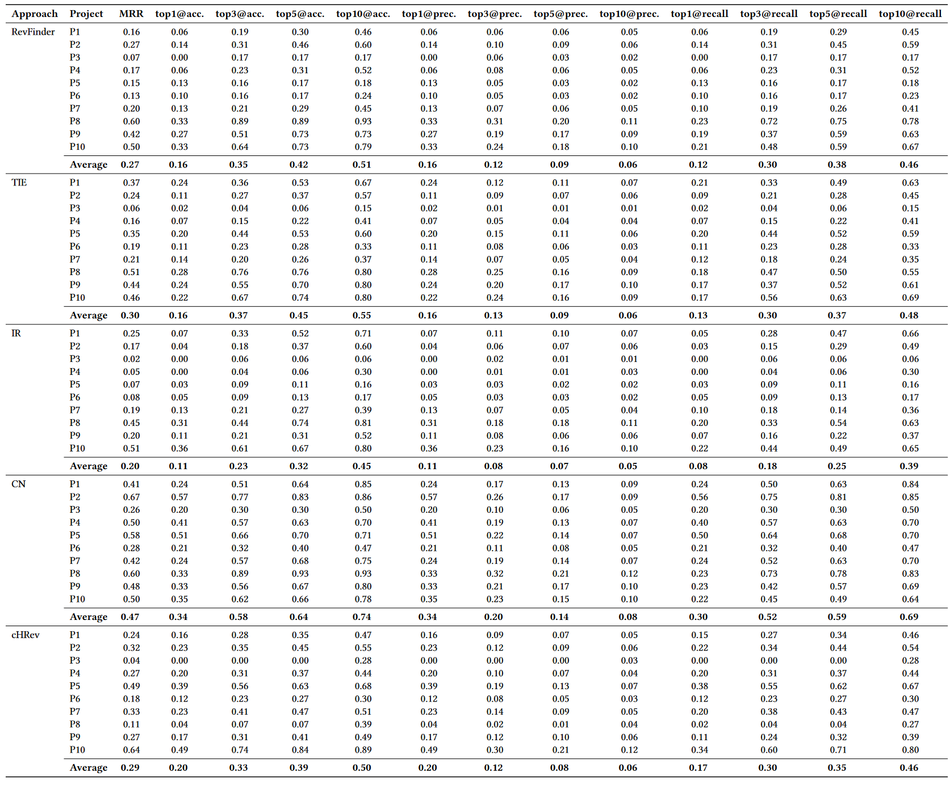
RQ1 Results
Finding 1: Existing approaches do not perform so well on 10 selected projects in Tencent as open-source projects.

Slide 12
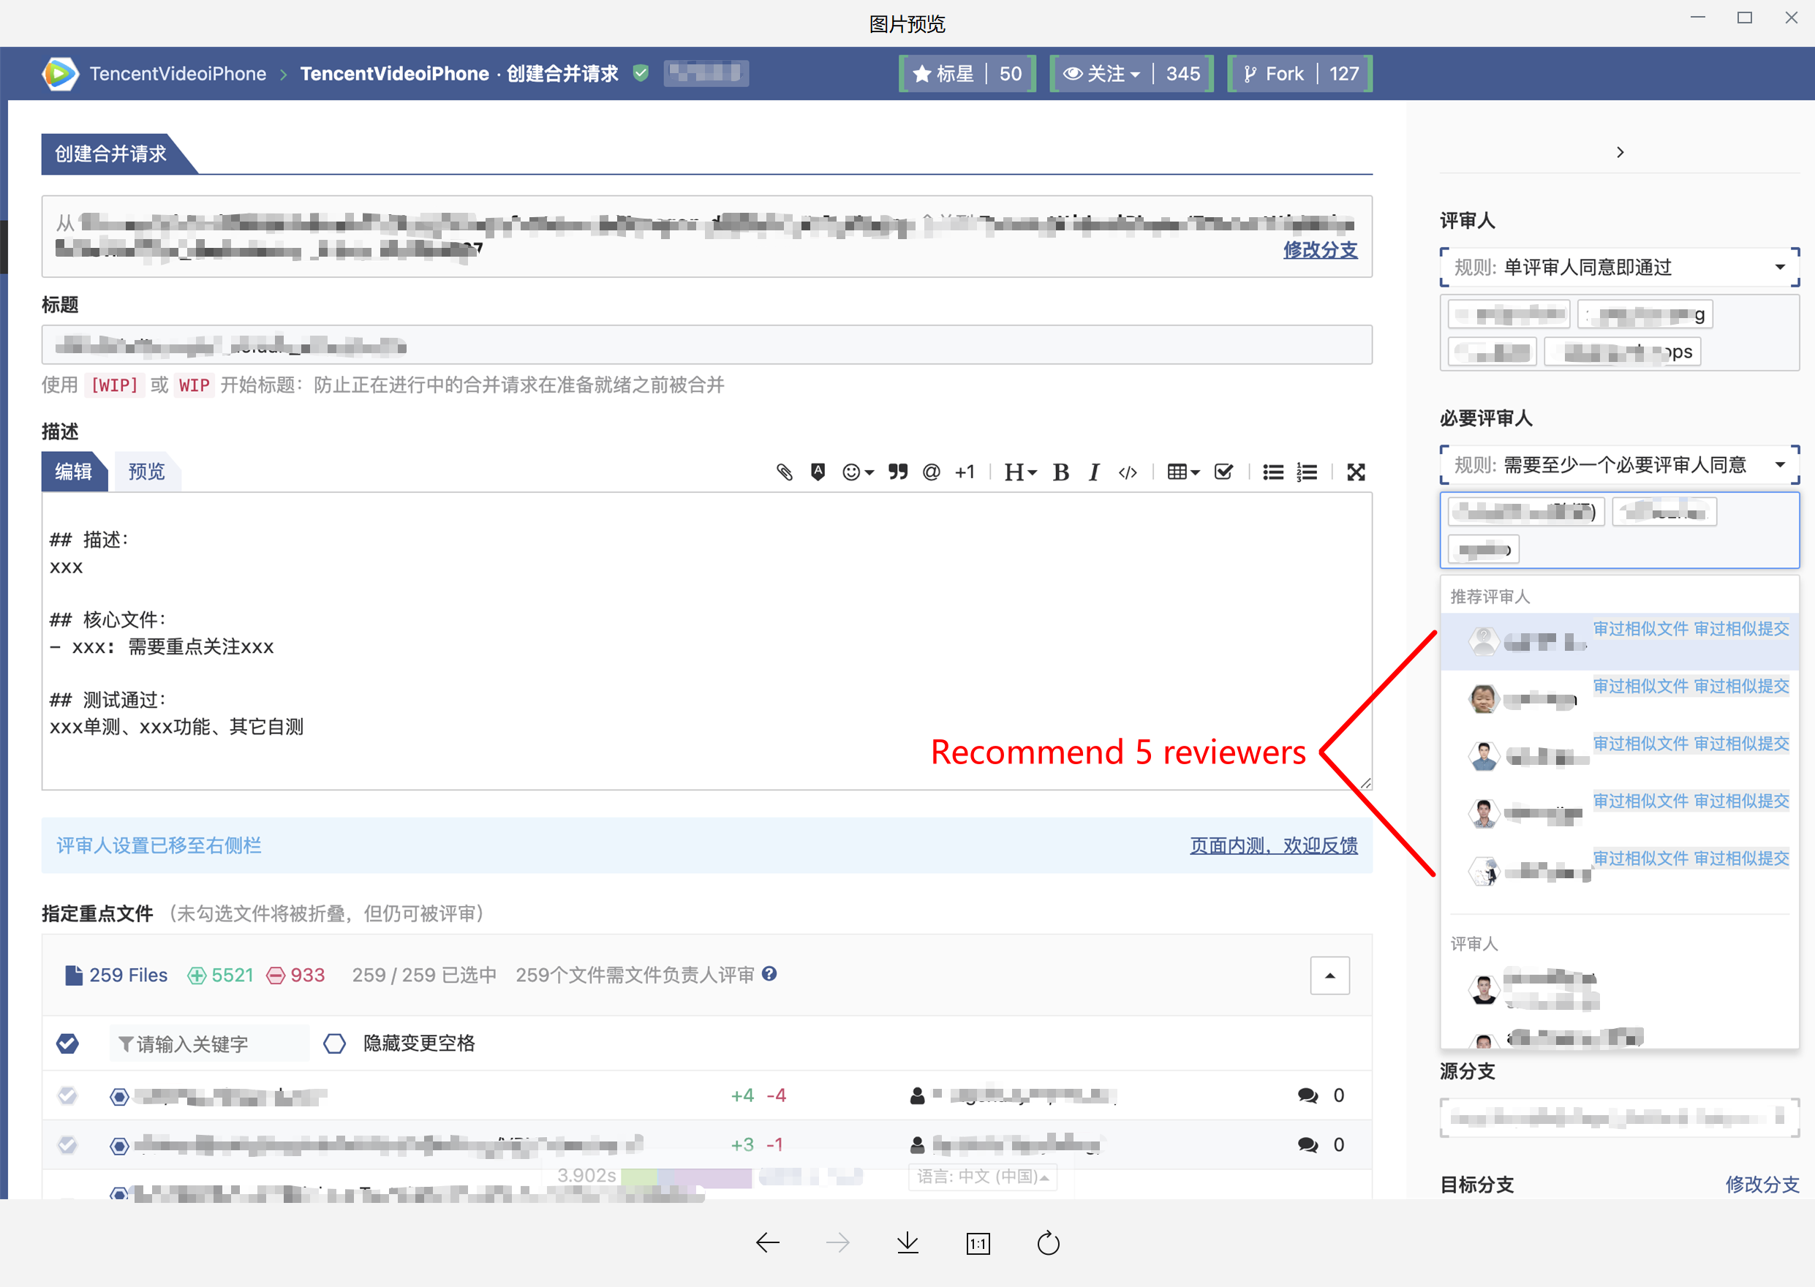
RQ1 Results
Finding 1: Existing approaches do not perform so well on 10 selected projects in Tencent as open-source projects.

Slide 13
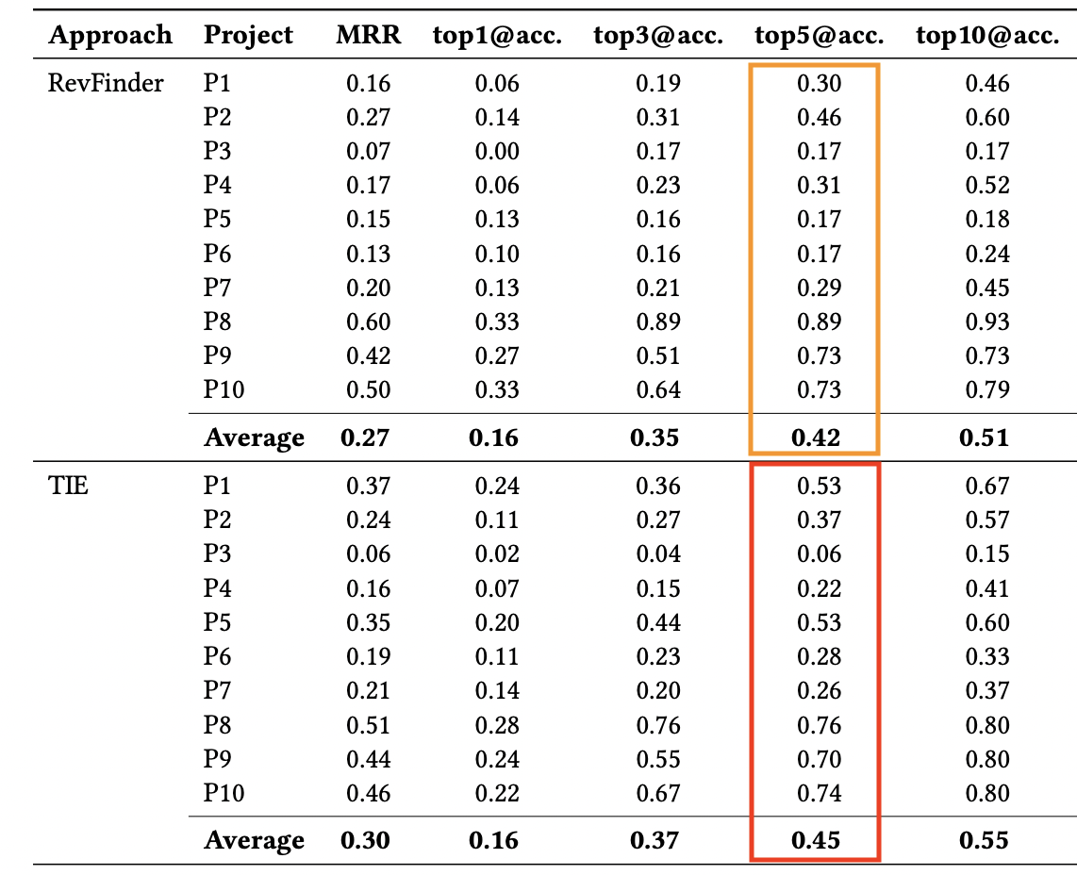
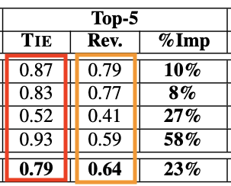
RQ1 Results
Finding 1: Existing approaches do not perform so well on 10 selected projects in Tencent as open-source projects.
Fig: Performance scores on Open-source projects
Fig: Performance scores on Proprietary projects
Notes:
The best-performed approach, CN, reaches a score of 0.64, which means in about three in five (we can also treat it as a probabilistic) reviews, at least one reviewer could be actually recommended. In contrast, other approaches cannot reach even a half.

Slide 14

RQ1 Results
Finding 2: Performance of an approach is subject to the characteristics of a project. Projects with dominant reviewers can get good performance.
Dominant Reviewer
(tech leader, senior developer…)
Beyond the Algorithm: it is easy to recommend a “correct reviewer”, but it is hard to Alleviate the Burden of Dominant Reviewer in practice.

Slide 15
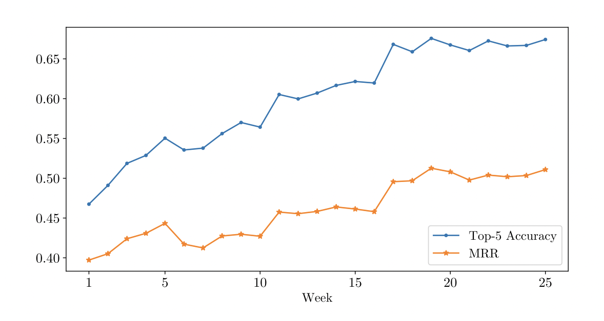
RQ1 Results
Finding 3: Cold start problem impact the existing approaches.
Code reviewer recommendation approaches suffer from Cold Start Problem and perform badly when initialized.
Fig: Average top-5 accuracy and MRR of Comment Network on ten proprietary projects in chronological order.
Notes:
横轴是是时间，单位是周
The horizontal axis is the time in weeks
The vertical axis is the performance

Slide 16
Research Questions
RQ1: What is the effectiveness of code reviewer recommendation approaches on proprietary projects?
We investigate the performance of existing approaches on 10 proprietary projects.
RQ2: What are the perceptions and expectations of practitioners on code reviewer recommendation?
We interview 11 developers to get knowledge about their attitude towards reviewer recommendation systems.

Slide 17
Research Methodology
*Interview guide can be found on https://mfr.osf.io/render?url=https%3A%2F%2Fosf.io%2Fvcqpe%2Fdownload
Code Repository
Analysis
Pilot Interview
Interview Analysis
CR History
Evaluation
Interview Guide*
Card Sorting
Data Extraction
Approach Selection
Semi-structured Interview
Transcription
Stage 1: for RQ1
Stage 2: for RQ2

Slide 18


RQ2 Results
Is configuration files still suitable?
Configuration Files
Too hard to maintain!
Not scalable!
Collaboration relationship often changes!
Many reasons, e.g., staff turnovers
Current Solution: using Configuration files to designate reviewers.
Developers
Implication: When the contributor-reviewer relationship is relatively stable, configuration-based recommendations support daily requirements of finding reviewers. However, the manual-maintained configuration cannot assure scalability, and its quality decays quickly.

Slide 19

RQ2 Results
Code Change #XXX has been submitted. Are you willing to review it?
I have received more than 100 review invitations!
I must ignore notifications and decide which to review by myself.
Implication: An excessive of invitation in the CRR system can cause “notification noise” for code reviewers, even invalidating the code review invitation process. Code reviewer recommendations should consider the issue and find a tradeoff between the recommendation size and the accuracy.

Slide 20

RQ2 Results
In most cases, the historical data-based recommendation approaches are useful.
Sometimes I need a senior partner, rather than recommendation results according to history data.
Implication: Even though practitioners are confident about the machine-learning-based CRR approaches, a practical CRR system should consider various situations and works in a non-invasive way.

Slide 21
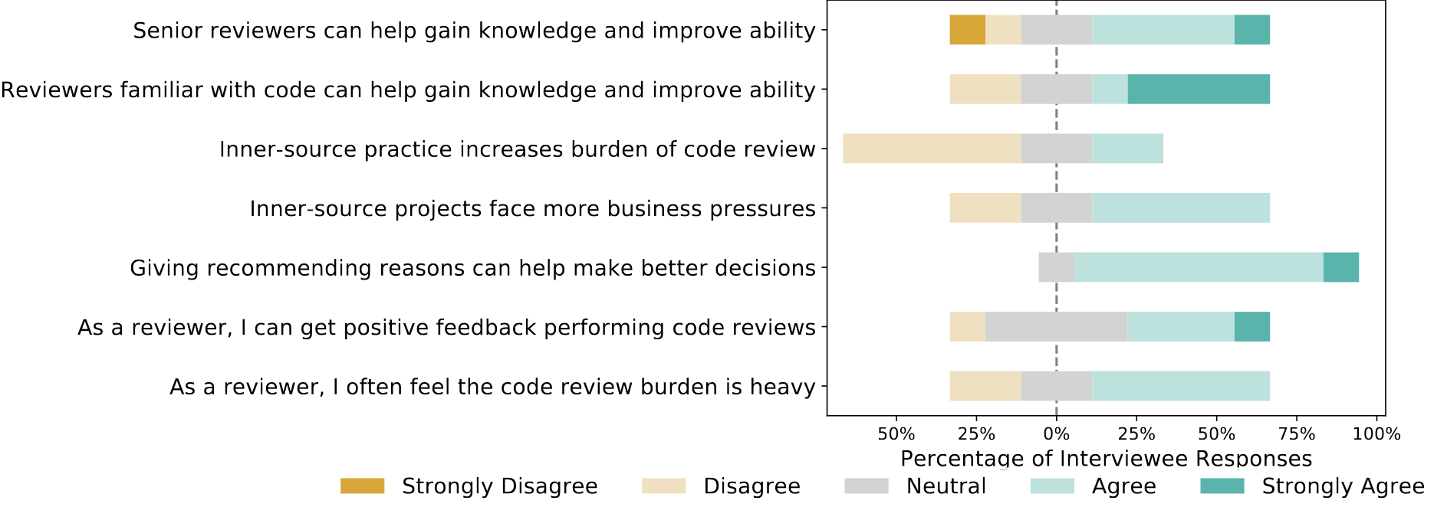
RQ2 Results
Implication: Recommendation systems should consider more factors in its working process and bridge the information gap between contributors and reviewers.

Slide 22

RQ2 Results
Recommendation systems should consider more factors, such as learning similar file paths and social network of reviewers.
Recommendation systems should help me know other developers’ skills and learn my feedback.
Implication: Recommendation systems should consider more factors in its working process and bridge the information gap between contributors and reviewers.

Slide 23
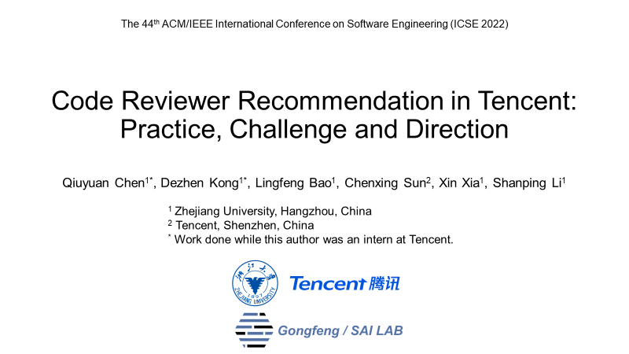
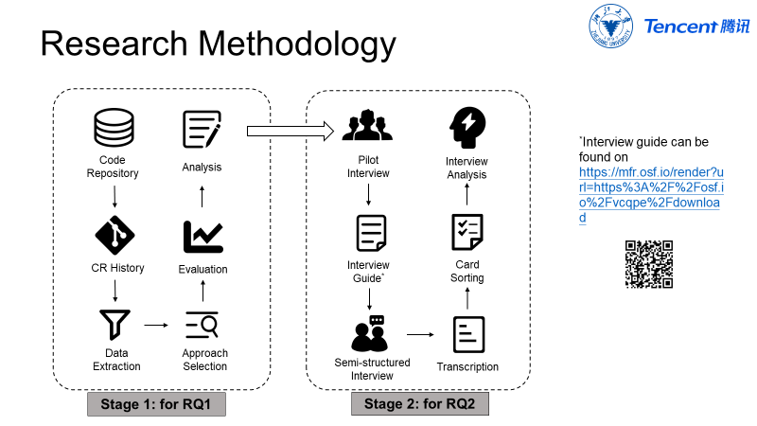
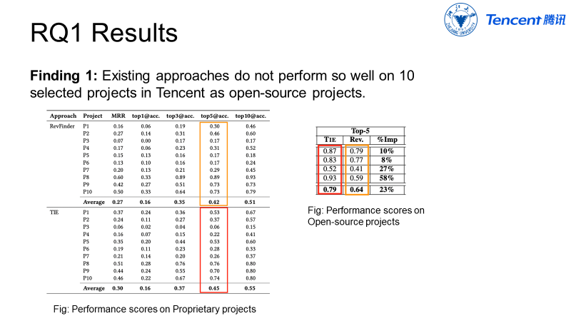
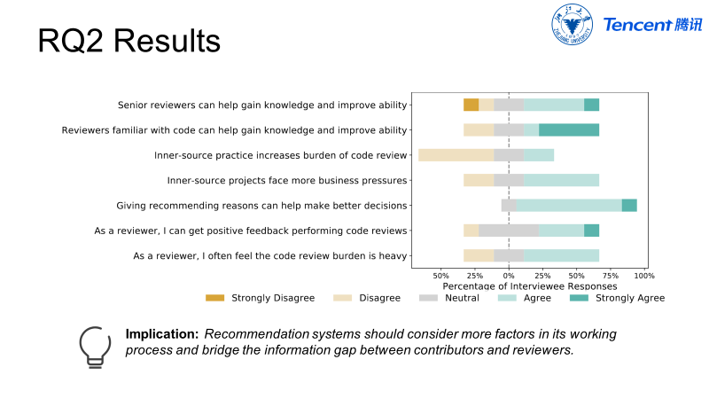
Thank you for listening!
For more details, please refer to our preprint at: www.chenqiuyuan.com.
Contact: chenqiuyuan@zju.edu.cn

