Slide 1
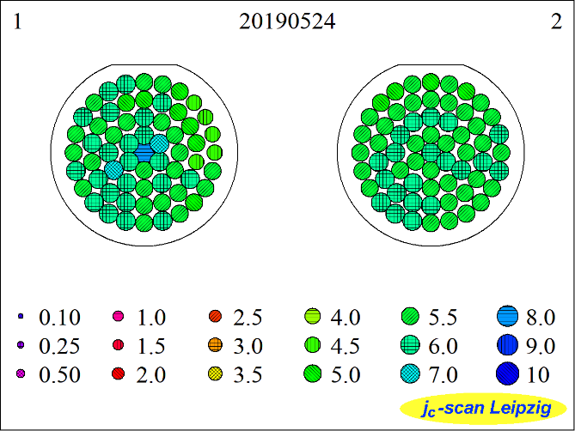
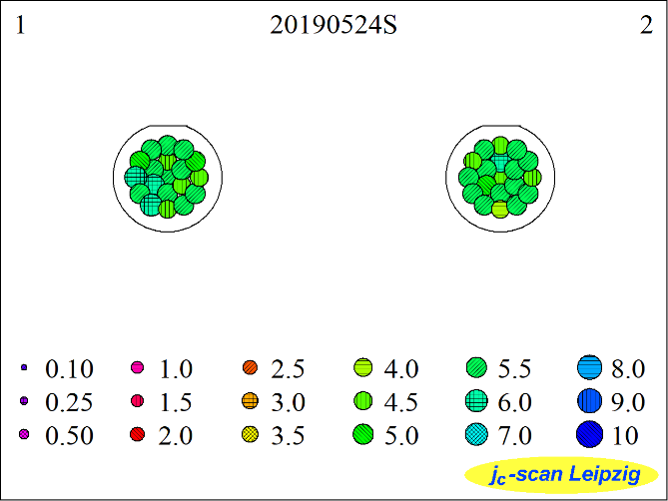
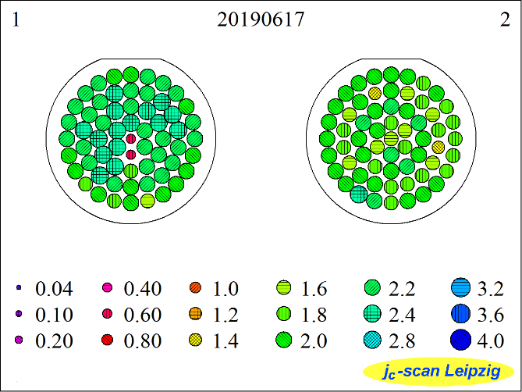
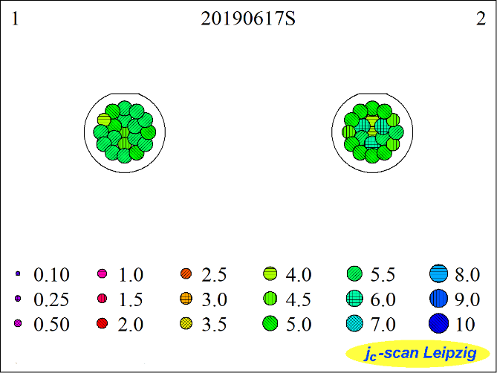
20190524(YBCO on 2-in. LAO)
20190524(YBCO on 10 mm * 10 mm LAO)
one turn
(placed on adject openings)
j_{c} (77K, 500nm) [MA/cm²]
j_{c} (77K, 500nm) [MA/cm²]
different turn with same condition
20190617(YBCO on 2-in. LAO)
20190617(YBCO on 10 mm * 10 mm LAO)
one turn
(placed on opposite openings)
j_{c} (77K, 500nm) [MA/cm²]
j_{c} (77K, 500nm) [MA/cm²]

