Slide 1

2-in. YBCO thin films
2-in YBCO film
2-in. YBCO thin films
0
0.5
1
1.5
2
Radius (cm)
0
0.5
1
1.5
2
2.5
Radius (cm)

Slide 2
Δω=0.507°
Δω=0.498°

Slide 3
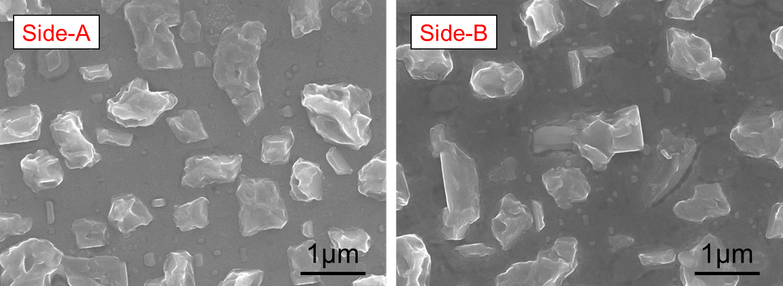

Slide 4
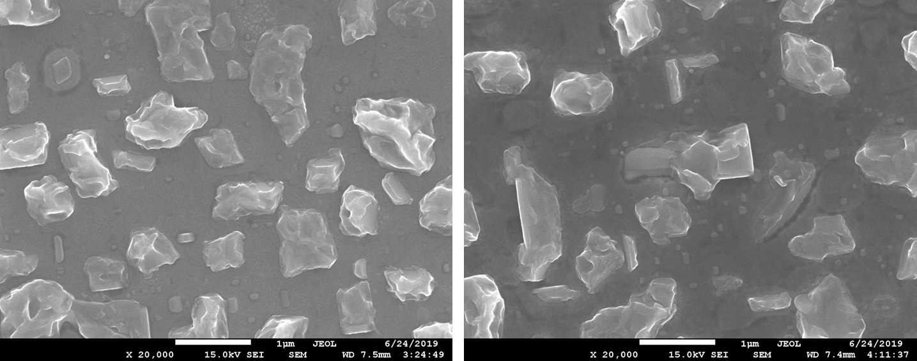
Side-A
Side-B
1μm
1μm

Slide 5
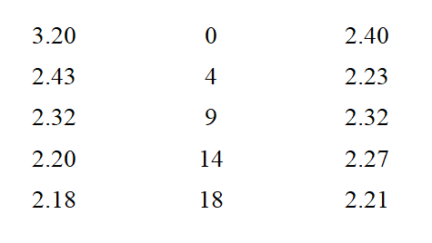
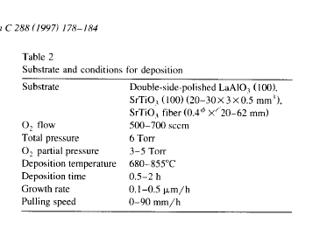

Slide 7
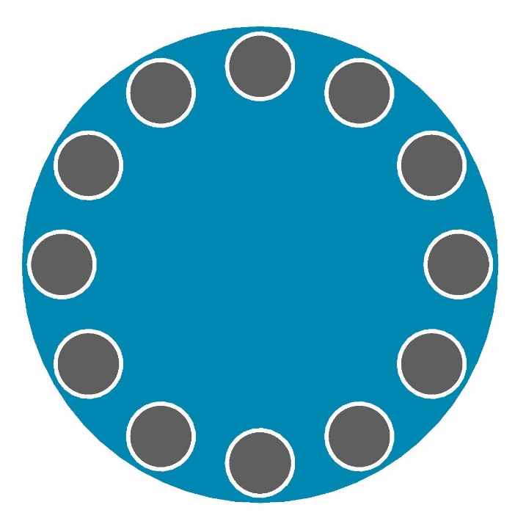
Opening
2-in. LAO Wafer

Slide 8

Linear Slits

Slide 9
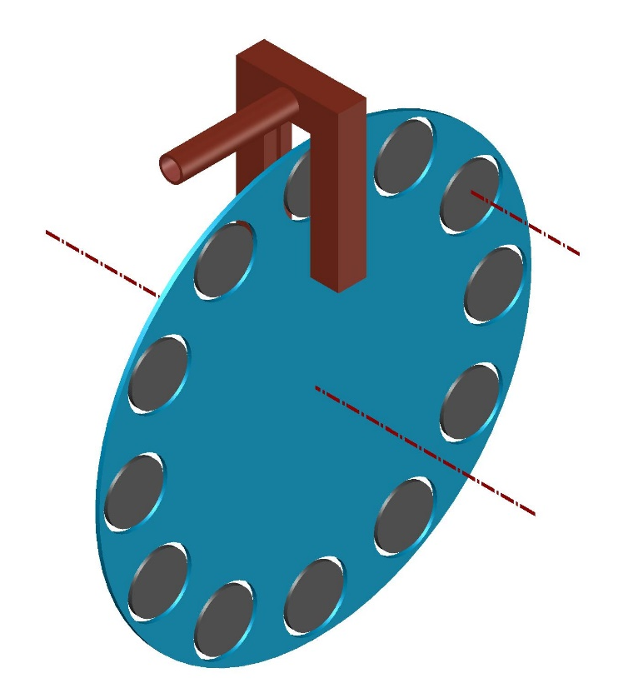
Self-Rotating
Rotating

Slide 10
