Slide 1
INFO 5731/020: Project presentation
Date of presentation: 05/09/23
Project title: Investigating the limitations of ChatGPT in natural language processing: Case study based on Twitter and Reddit
Instructor: Prof. Haihua Chen
Presented by: Group#04
Behara, Pavan Kumar
Muppuri, Karunakar
Phadke, Arti
Chenreddy, Joshnavi
Koppula, Sai Nithin Reddy

Slide 2
Table of contents
1. Introduction
2. Purpose of Analysis
3. Questions to be answered
4. Steps followed
5. Seed keyword selection & Data Collection
6. Data Cleaning
7. Data Preprocessing
9. Sentiment Analysis
10. Keyword Extraction
11. Entity Extraction
14. Conclusion
15. References
8. Data Analytics
13. Results
12. Topic Modelling
2

Slide 3

Introduction
About ChatGPT:
Artificial intelligence chatbot
Widespread applications in various languages, code writing & debugging, solving problems
Downsides of ChatGPT:
May give incorrect answers
Can be biased
May spread negative social sentiment
May fail at multitasking
Hence, it is important to look at the usefulness & shortcomings of ChatGPT
3

Slide 4
Purpose of Analysis
What is Sentiment Analysis?
Sentiment Analysis is computationally identifying & categorizing people’s opinions
Can indicate people’s feelings, views, opinions towards a topic
Why is it important to analyze these for ChatGPT?
To check the public’s opinion on usefulness of product/service, in this case, ChatGPT
Can help to comprehend users’ needs
Performed on textual, unstructured data
While ChatGPT is a breakthrough in AI inventions, there have been instances that its utility is questioned
For e.g., ChatGPT had been temporarily banned in Italy
Ban was over data privacy concerns
There have been 30+ countries in the world, that have banned ChatGPT
Concerns have been raised about plagiarism & ethical/data breaches
Can bring out important points about future course of actions
4

Slide 5
Questions to be answered
Find what users feel about ChatGPT
Whether they find ChatGPT useful or not
Divide the data into positive, negative, & neutral categories by sentiment analysis
Focus on the negative sentiments data collected and analyze the same to a deeper extent
Which phrases/words are specifically being discussed
Focus mainly on the negative tweets/reddit posts
Top topics being discussed about
Most frequent or most popular topics being talked about
5

Slide 6
Steps followed
Seed keyword
Topic & Keywords detection
Data collection
Data cleaning
Topic modelling
Results & conclusion
Keyword extraction
NLP sentiment analyzer models
Data preprocessing
Entity extraction
6

Slide 7
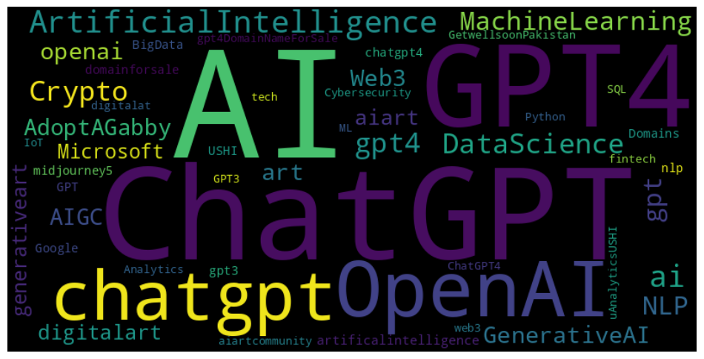
Seed keyword selection
Below wordcloud shows the data collected contains users talking the most about below hashtags
Hashtags that we focused on:
Below are some examples of tweets collected:
“Itâ€™s not the tokens, but whatâ€™s between them. Something magical is happening here. #AI #GPT3 #GPT4 #ChatGPT https://t.co/GIipOq7BpC”
OR
"How Can Business Owners Use Artificial Intelligence
Click the link to learn more!
#transcription #nlp #ai #gptâ€¦ https://t.co/0vClfS8gXM"
7

Slide 8
Data Collection
Used multiple sources: twitter tweets, reddit posts
Recent data collected within last 3 weeks
Collected 150K records including tweets, retweets, reddits, subreddits, comments etc.
Tweets data collection APIs used:
Tweepy
Snscrape
Selected query topics contained below keywords in various combinations in multiple runs of the code:
chatgpt, gpt4, openai, NLP, naturallanguageprocessing
limitation, drawback, disadvantage
Reddit data collection API used:
Python PRAW (Python Reddit API Wrapper) module to scrape data
Using Reddit App
8

Slide 9
Data Cleaning
Why is data cleaning important?
Unstructured data
Contains noise & garbage data
Can affect results of analysis
Ways to clean the data:
Lowercasing the data
Removing numbers
Removing extra spaces
Removing website addresses & HTML elements
Removing punctuations
Removing emojis using ASCII values
Using Python libraries & packages:
re: regex libraries
NLTK: Natural Language Toolkit
Corpus
tokenize
9

Slide 10
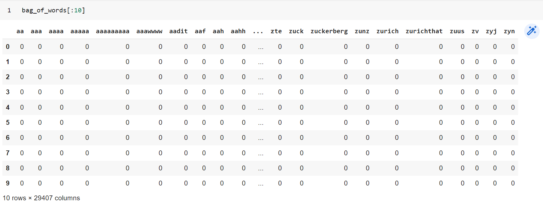
Data Preprocessing
Removing stopwords
English language
Removing low frequency words
Finding the Bag of Words (BoW)
Find bigrams, and trigrams
Finding the TF-IDF model (Term Frequency-Inverse Document Frequency)
Stemming & lemmatization
Bag of Words output:
10

Slide 11

Sentiment Analysis
- To determine if the overall meaning of the text is:
Positive
Neutral
Negative
Importance of Sentiment Analysis:
Analysis of large volume of data like customer emails, social media comments, reviews
Feelings expressed through opinions, appraisals, emotions, attitude towards a particular topic
Bring out subjective information & opinions
Includes steps like identify, extract, quantify and study the data
Example of Negative sentiment: from given tweets data -
“Top 5 limitations of Chat GPT: https://t.co/e4D3IsvFQ0 #ChatGPT #chatgptjp #chatgptomatic #chatgpt5â€¦ https://t.co/5ZL4qeKDSj“
11

Slide 12
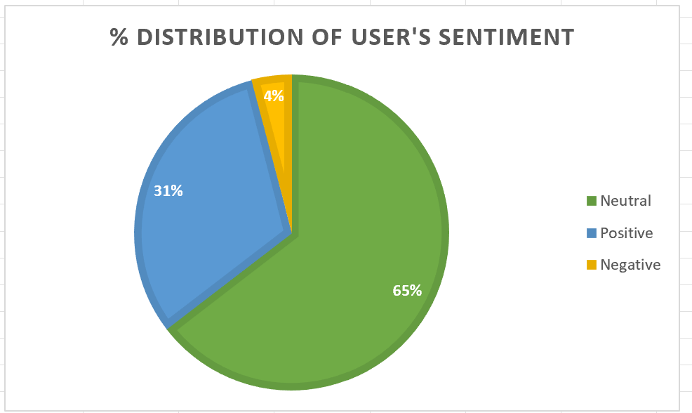
Sentiment Analysis
Results of running sentiment analysis on given data:
12

Slide 13
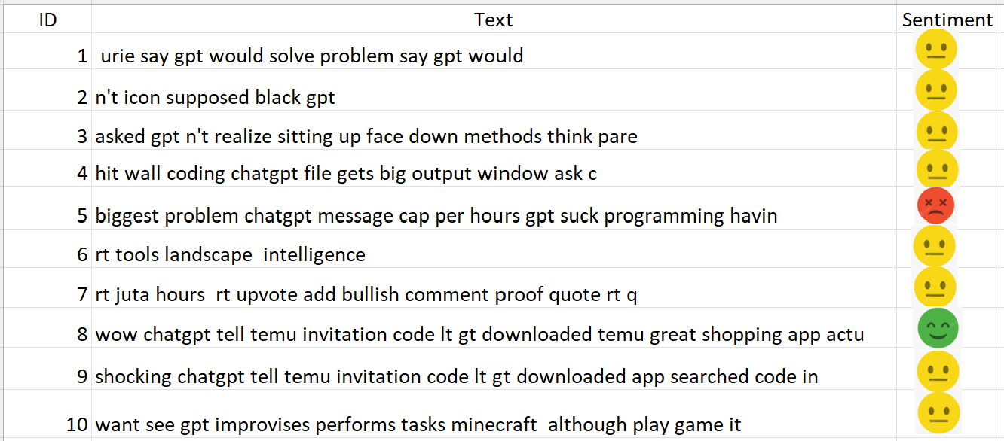
Sentiment Analysis findings
Sentiment Analysis models included the use of pre-trained models based on:
Huggingface Hub packages
VaderSentiment model
Model based on Huggingface package gave better results while VaderSentiment ran faster
Results were classified into 3 categories: positive (+1), neutral (0), negative (-1)
Below are some examples of neutral, negative & positive sentiments after running the models:
13

Slide 14

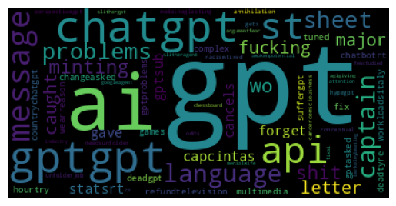
Keyword Extraction
Extracts most used & important words & expressions
Focus on the text with ‘negative’ sentiment
Model(s) used: KeyBert, Textrank (Summa), MultiRAKE
Extracted keywords/phrases, using bigrams, trigrams
Cosine score indicates the similarity score to find most similar documents
Frequencies of occurrences aren’t considered
Keywords Wordcloud:
14

Slide 15
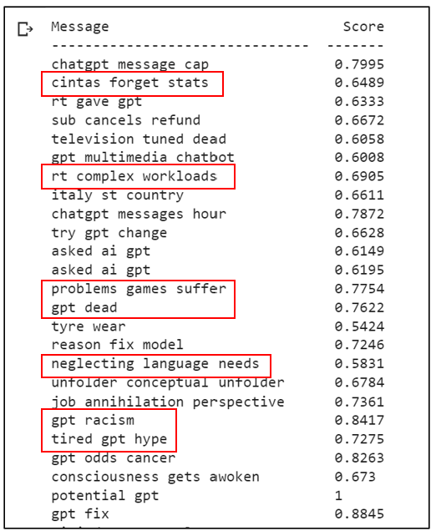
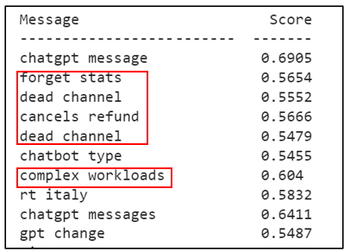
Keyword Extraction - output
KeyBert output:
Takeaways:
Negative text talks about problems of ChatGPT
Important negative sentiments are:
Forget
Dead channel
Complexity
Workload
Racism
Neglecting language needs
15

Slide 16
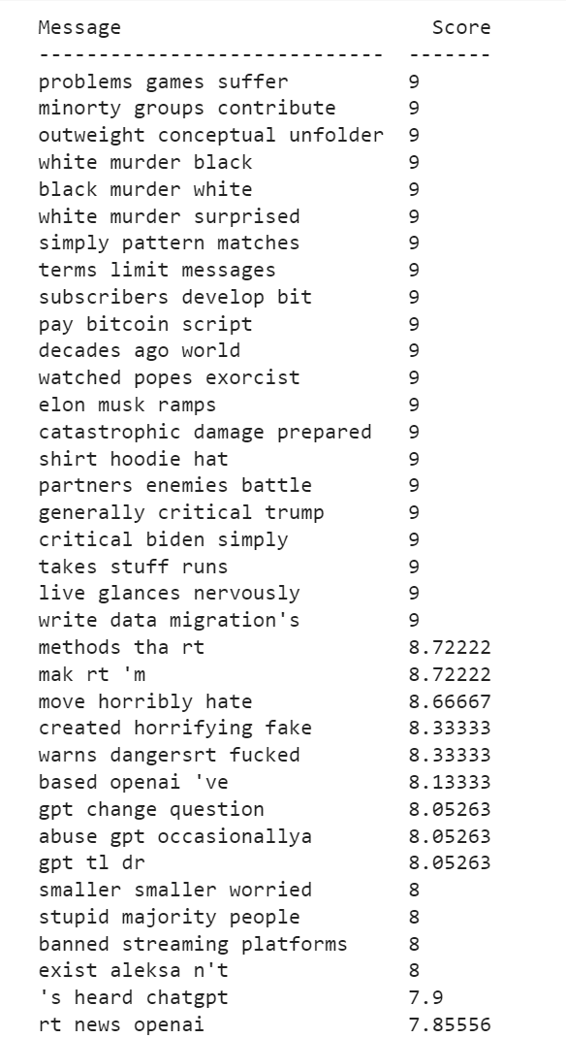
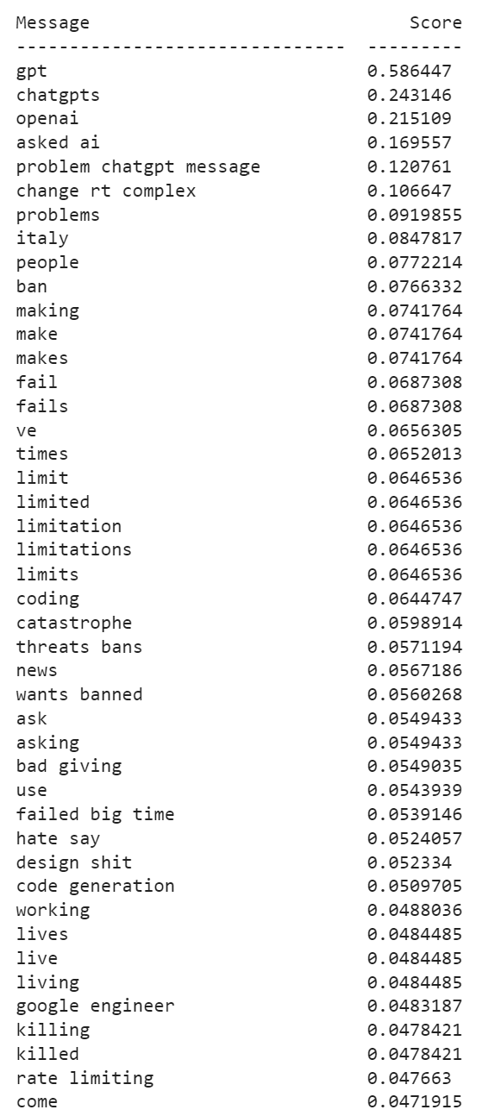
Keyword Extraction - output
Multilingual Rapid Automatic Keyword Extraction (RAKE) output
Textrank output:
Takeaways:
Negative text talks about problems of ChatGPT
Some severe negative sentiments are being indicated here:
Political topics
Racial topics
Global topics
Hate/violence speech
16

Slide 17

Entity Extraction
IE task: Extracts specific information & data from the text (entity recognition)
An example of important text topics/details identified from this dataset:
For example: related to location: Italy
EU privacy regulations
Ban & revocation of ban on chatgpt
openAI’s policy
Some tweets violate openAI’s privacy policy
generative chatgpt ban
Focus on the text with ‘negative’ sentiment
Model(s) used: spacy, displacy, NER
Extracted useful information like:
Locations: Italy, Berkeley, China,
Organizations: gpt, google, chatgpt, Washington law school
Date & Time: three decades ago,
Cardinal information: first (cyber attack)
17

Slide 18
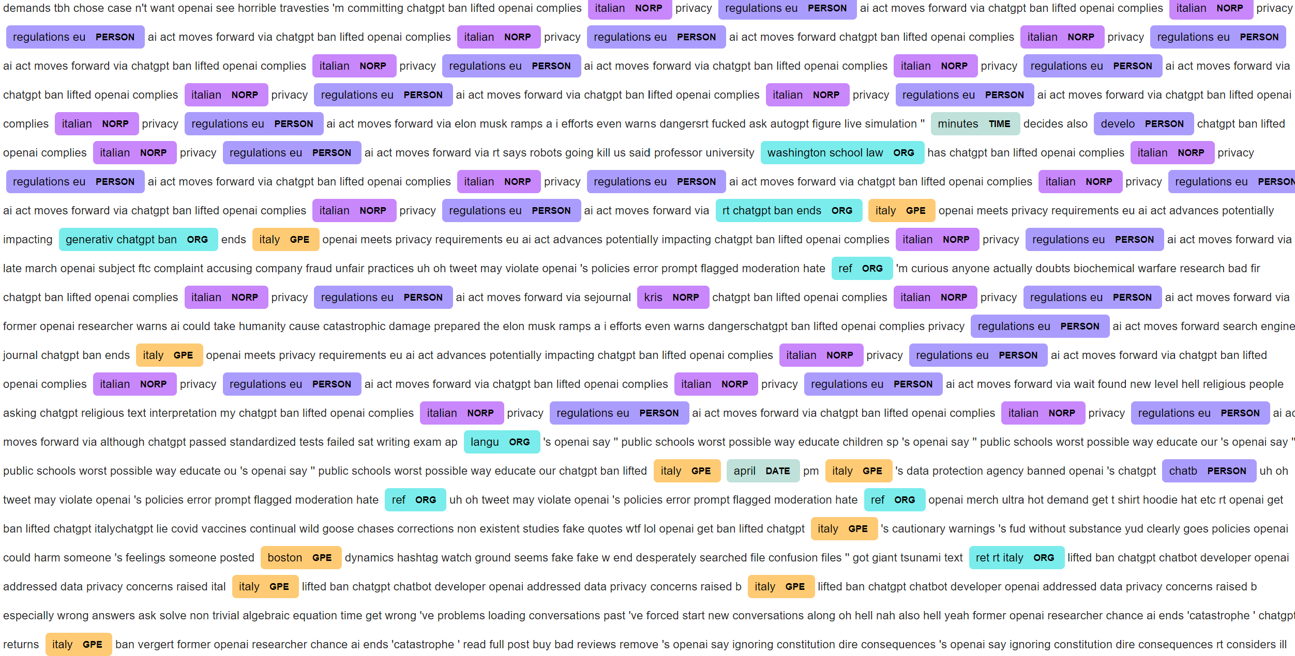
Entity Extraction - output
18

Slide 19
Topic modelling
Unsupervised learning method
Identified clusters and groups of similar words, expressions from a given text
Works without predefined text or training data
Methods used:
LSI model
LDA model
19

Slide 20
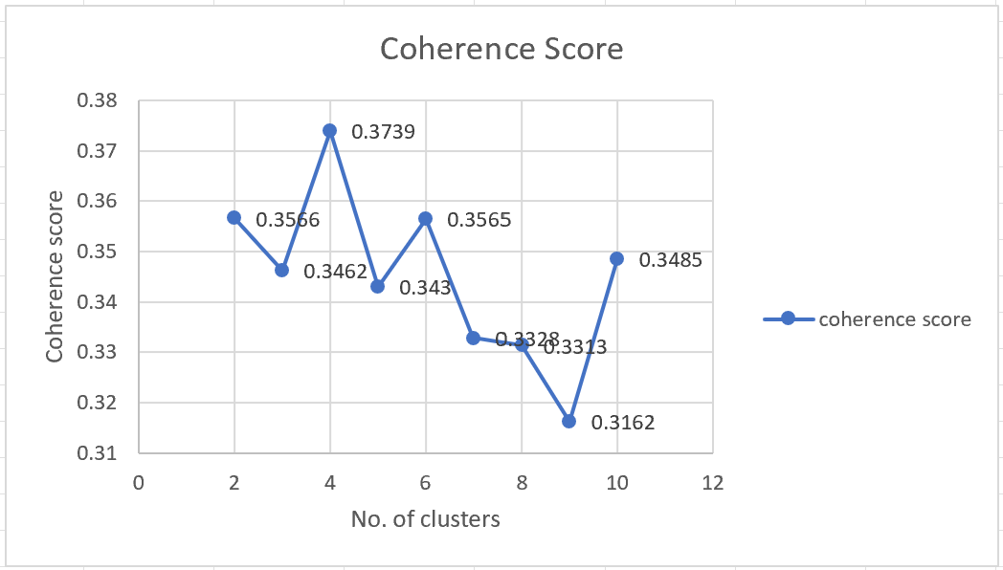
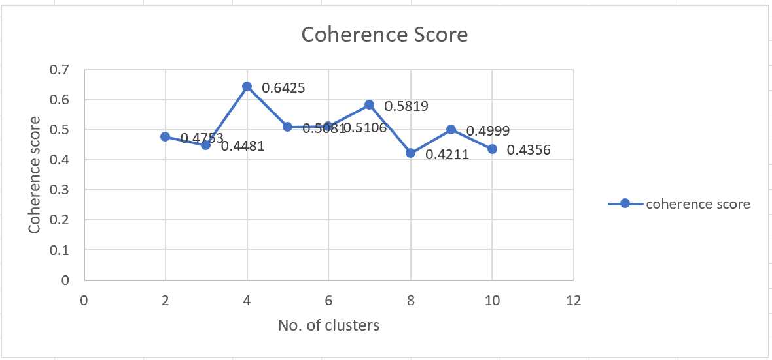
Topic modelling -output
LSI model
Selected the no. of clusters = 4 with maximum coherence score
Negative
sentiment
Topics details:
Topic 1: ban, privacy, regulation, act
Topic 2: error, flagged, violate, hate, act
Topic 3: regulations, act, ban
Topic 4: ban, eu, act
Vs.
Positive
sentiment
Topics details:
Topic 1: champions, web, social, league
Topic 2: fund, monetary, like, champions
Topic 3: connect, free, chat, gaming,
Topic 4: amazing, great, connect
20

Slide 21
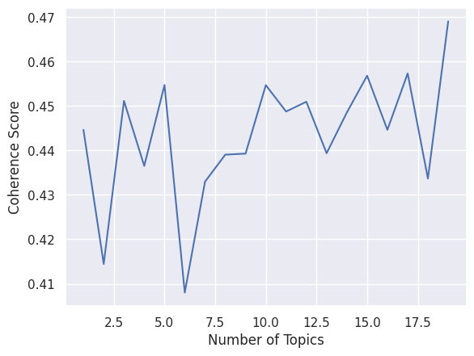
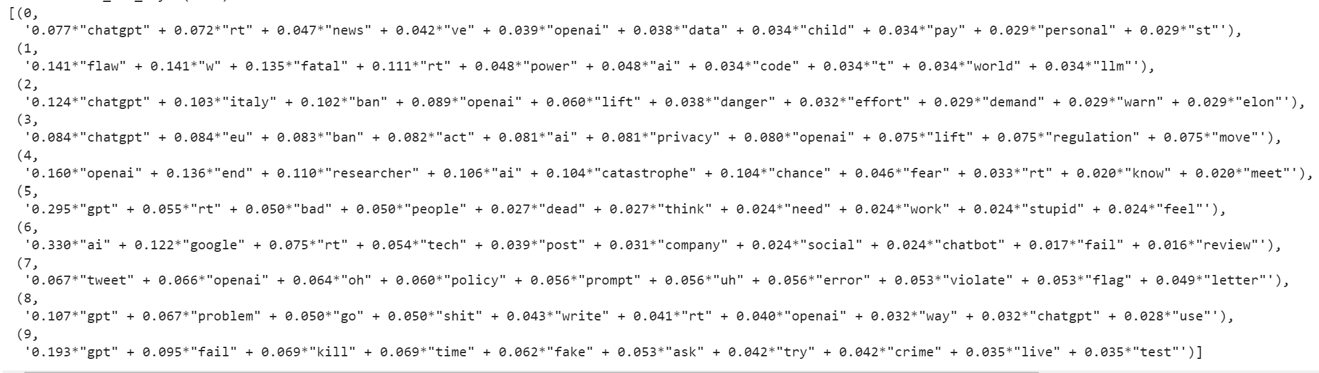
Topic modelling -output
LDA topic model
Topics details:
Topics details:
Topic 2: llm, flaw, code..
.
.
Topic 8: tweet, policy, violate, flag
Topic 9: problem
Topic 10: fake, crime, fail
21

Slide 22
Results
Response to the research questions:
1. Find what users feel about ChatGPT:
Findings:
From sentiment analysis:
4% of the data is tagged as negative sentiments, other data is neutral/positive
This indicates that overall sentiment from ChatGPT users is ‘non-negative’
2. Focus on the negative sentiments data collected and analyze the same to a deeper extent:
Findings:
From Keyword extraction & Entity extraction:
Negative sentiment talks about a variety of topics like complexity, workload, racism
Majority topics are around areas: political, racial, global topics, Hate/violence speech
3. Top topics being discussed about:
Findings:
From topic modelling & entity extraction output below are the top topics being discussed:
Positive topics: champions, web, social, league, fund, amazing, great, connect, free
Negative topics: ban, privacy, regulation, act, violate, hate, error, ban
22

Slide 23
Conclusion
We can conclude from this analysis that:
There is only 4% of the total data collected, which indicates negative sentiment about ChatGPT
Overall, the users feel positive or neutral about ChatGPT
The main topics being discussed about ChatGPT in negative sentiment are as below:
Forget
Dead channel
Complexity
Workload
Racism
Neglecting language needs
In a limited extent, there are users who are concerned about racism and other related impacts
Important topics that are being talked about related to ChatGPT can be roughly categorized into categories like privacy breach, act, regulation, rules, etc.
23

Slide 24
References
GitHub code location:
Data file: https://github.com/ArtiPhadke/Arti_INFO5731_Spring2023/blob/main/chatgpt_data_full.csv
https://github.com/ArtiPhadke/Arti_INFO5731_Spring2023/blob/main/sentiment_huggingface_INFO5731.ipynb
https://github.com/ArtiPhadke/Arti_INFO5731_Spring2023/blob/main/Keyword%2BNER%2Btopicmodel_code_INFO5731.ipynb
https://github.com/ArtiPhadke/Arti_INFO5731_Spring2023/blob/main/Preprocess%2BSentiment_INFO5731.ipynb
https://github.com/ArtiPhadke/Arti_INFO5731_Spring2023/blob/main/LSI_output_INFO5731.ipynb
https://github.com/ArtiPhadke/Arti_INFO5731_Spring2023/blob/main/Project_firstrun_INFO5731.ipynb
Lamsal, R., Harwood, A., & Read, M. R. (2022). Twitter conversations predict the daily confirmed COVID-19 cases. arXiv preprint arXiv:2206.10471.
Korkmaz, A. & Aktürk, C. & Talan, T. (2023). Analyzing the Users' Sentiments of ChatGPT Using Twitter Data. https://www.researchgate.net/publication/370552831_Analyzing_the_Users%27_Sentiments_of_ChatGPT_Using_Twitter_Data
Bukar, U., Sayeed, Md. S., Razak, S., Yogarayan, S., & Amodu, O. (2023). Text Analysis of Chatgpt as a Tool for Academic Progress or Exploitation. http://dx.doi.org/10.2139/ssrn.4381394
Susnjak, T. (2023). Applying BERT and ChatGPT for Sentiment Analysis of Lyme Disease in Scientific Literature. arXiv.org e-Print archive. https://arxiv.org/pdf/2302.06474.pdf
24

