Slide 1
CMSuggester: Method Change Suggestion to Complement Multi-entity Edits
Ye Wang¹, Na Meng¹, Hao Zhong²
¹Virgina Tech
²Shanghai Jiao Tong University

Slide 2
Problem Statement
To fix a bug, developers sometimes change multiple program locations
We consider program modification that changes multiple program entities as a multi-entity edit
An entity can be a class, a method, or a field
Consistently and completely applying multi-entity edits is tedious and error-prone
E.g. Developers need to change 3 locations, but only change 2 locations
Notes:
When maintaining software, developers sometimes change multiple program locations to fix a bug. Define multi-entity edits. In our research, we consider program modification that changes multiple program entities as a multi-entity edit. Specifically, an entity can be a class, a method, a field. E.g. Develpers need to change 3 locations, but they only change 2 locations, and forget the remaining one.

Slide 3
Related Work
Mining association rules from code change history
Zimmermann et al. [1], Ying et al. [2]
LSDiﬀ [3] infers systematic entity additions and deletions
E.g. “All classes implementing type A have method B deleted except class C”
Notes:
Existing tools provide limited support for applying such edits consistently. For example, Zimmermann and Ying separately built association rule mining tools. Those tools mine rules from code change history. But if there is no history records, these tools don’t work.
Given a code commit, LSDiff infers entity additions and deletions, but it doesn’t infer entity changes
LASE [4] infers program changes from similar example edits; it does not help if distinct edits should be co-applied to dissimilar methods.

Slide 4
When developers modify mutiple program locations for a maintenance task, can we suggest code changes for developers?
Notes:
Our goal is to investigate whether we can suggest code changes for developers, when they modify multiple program locations for one maintenance task

Slide 5
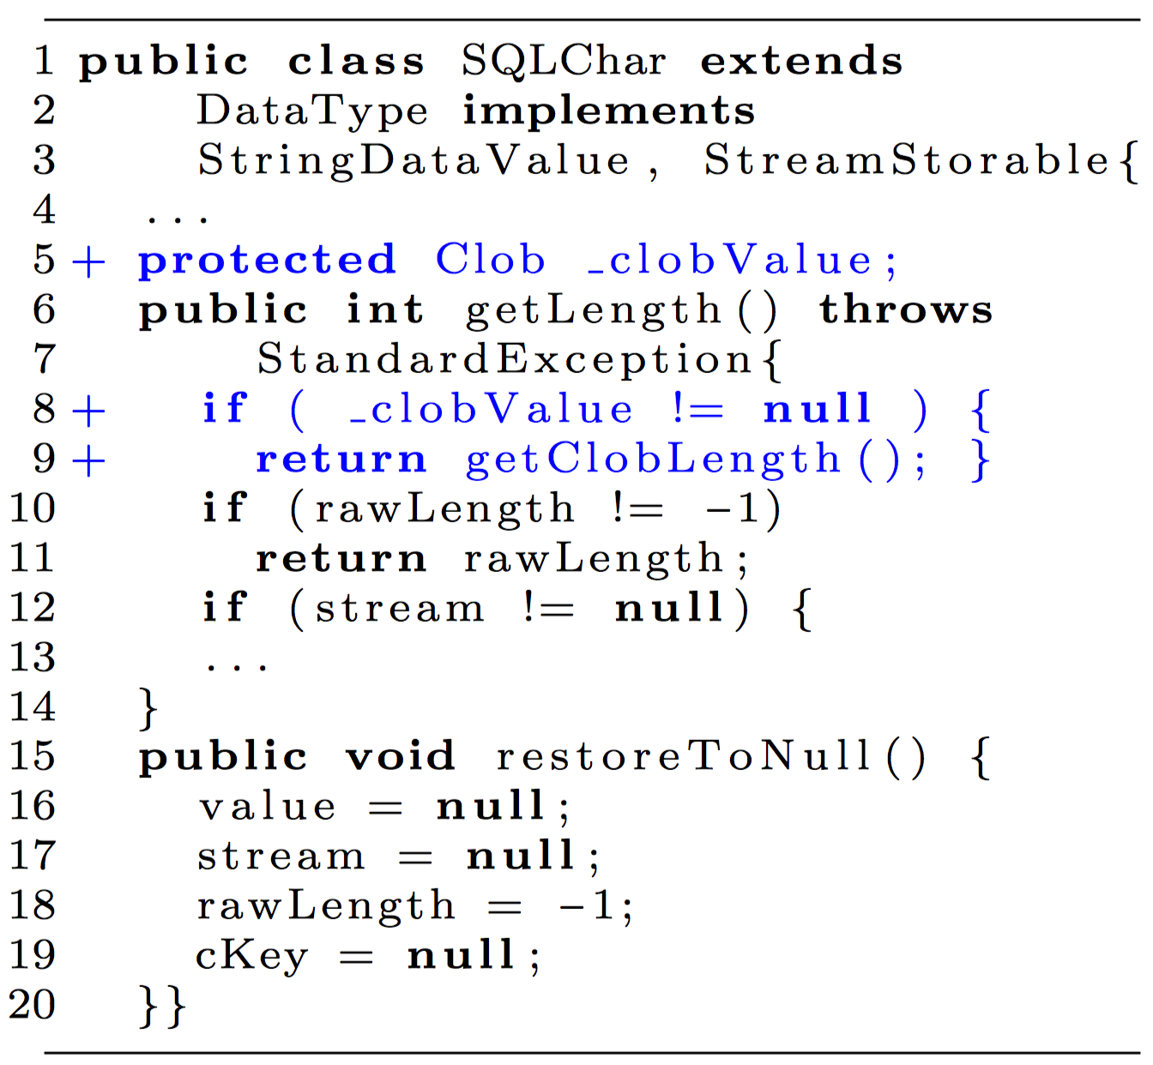
A Motivating Example
Derby-2201 required 1 field addition and 13 method changes, but only 12 methods were changed.
Developers missed the change in restoreToNull()
Notes:
To fix a bug, developers are expected to add a field and change 13 methods, but they only changed 12 methods at that time. This missed method change did not trigger any compilation error or test error, so it’s hard to find it. Finally this missing change was fixed two years later.
These two methods have different contexts. When developers apply the change in getLength(), they may ignore restoreToNull. But they still share some common accessed fields. We are curious whether we can use this characteristic.

Slide 6
Challenges
Methods have different contexts and different changes
Program modification logic is specific to individual projects

Slide 7
Methodology
We first conducted an empirical study to characterize how multi-entity changes are applied
We developed an approach to suggest complementary changes

Slide 8
Empirical Finding
Our prior work [5] shows that change patterns commonly exist in multi-entity edits.
E.g. *CM→AF is one of the most popular patterns.
We sampled 20 such commits to inspect the co-changed methods for any newly added ﬁeld.
In 15 of the 20 commits, the co-changed methods commonly access existing ﬁeld(s) before the edits are applied.
Notes:
Shorter. 20 commits containing the CM-AF pattern
Interestingly,...

Slide 9
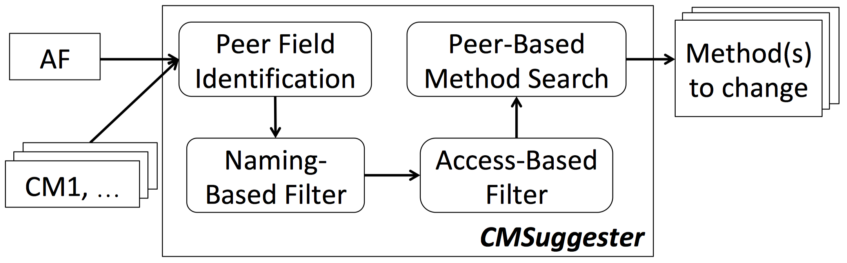
Overview of CMSuggester
Input from developers
CMSuggester suggests other methods to co-change for the new ﬁeld access.
Notes:
Input, Output
For each commit developers
By extracting the ﬁelds accessed by the given changed method(s), CMSuggester identiﬁes and recommends any unchanged method that also accesses those ﬁelds.
Peer Field Identiﬁcation
Peer ﬁelds: (1) declared in the same class as AF , and (2) accessed by a changed method that also access AF
Naming-Based Filtering
Constant ﬁelds, e.g. FLAG_SPARSE_ROW
Camel case fields, e.g. outputPrecision
Access-Based Filtering
3 access modes: read, write, read-write

Slide 10
Evaluation Data
 | Aries | Cassandra | Derby | Mahout | Total
# of commits | 10 | 45 | 42 | 9 | 106
# of 1A1C tasks | 39 | 172 | 151 | 46 | 408
# of 1A2C tasks | 9 | 237 | 168 | 12 | 426
# of 1A3C tasks | 4 | 379 | 366 | 8 | 757
1AnC: 1 added field + n changed method(s) used as input

Slide 11
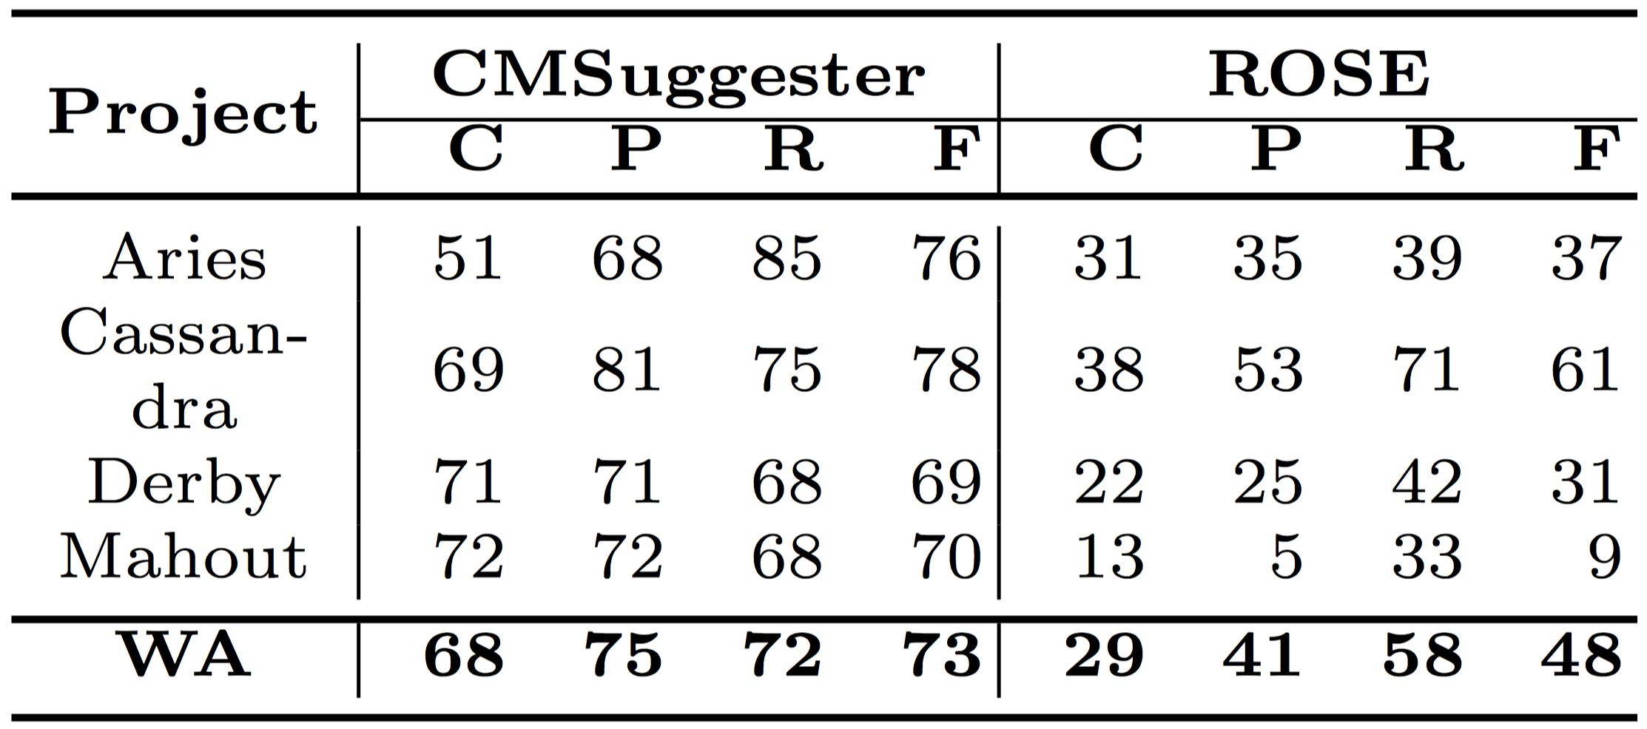
CMSuggester vs. ROSE for 1A1C tasks
CMSuggester outperformed ROSE in many 1A1C tasks
Notes:
This means that CMSuggester complements ROSE by inferring co-changes from methods’ common ﬁeld accesses instead of from the history.

Slide 12
Conclusion
CMSuggester is a novel approach that suggests complementary changes for multi-entity edits.
Instead of predicting changes based on version history, CMSuggester models the common ﬁeld accesses between methods for prediction.
CMSuggester outperforms ROSE when suggesting complementary changes for *CM→AF edits
Notes:
In the future, we also would explore other commonalities between co-changed methods to predict changes for multi-entity edits.

Slide 13
References
[1] Zimmermann, T., Weisgerber, P., Diehl, S., Zeller, A.: Mining version histories to guide software changes. In: Proc. ICSE. pp. 563–572 (2004)
[2] Ying, A.T.T., Murphy, G.C., Ng, R.T., Chu-Carroll, M.: Predicting source code changes by mining change history. IEEE Trans. Software Eng. 30(9), 574–586 (2004)
[3] Kim, M., Notkin, D.: Discovering and representing systematic code changes. In:Proc. ICSE. pp. 309–319 (2009)
[4] Meng, N., Kim, M., McKinley, K.: Lase: Locating and applying systematic edits.In: Proc. ICSE. pp. 502–511 (2013)
[5] Wang, Y., Meng, N., Zhong, H.: An empirical study of multi-entity changes in real bug ﬁxes. In: Proc. ICSME (2018)

Slide 14
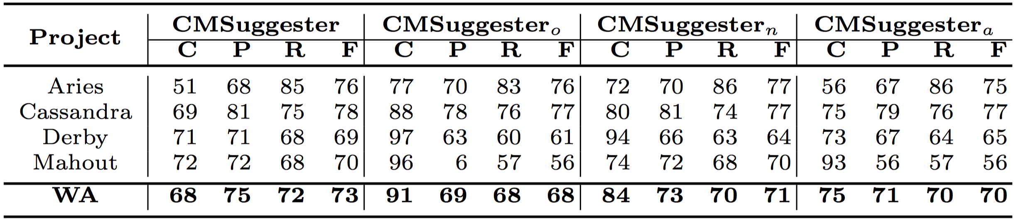
Sensitivity to Filter Settings
name ﬁlter ON
access ﬁlter ON
name ﬁlter OFF
access ﬁlter OFF
name ﬁlter ON
access ﬁlter OFF
name ﬁlter OFF
access ﬁlter ON
Both ﬁlters improves F-score at the cost of coverage. Especially, the naming-based ﬁlter achieved a better balance between F-score and coverage than the access-based ﬁlter.

Slide 15
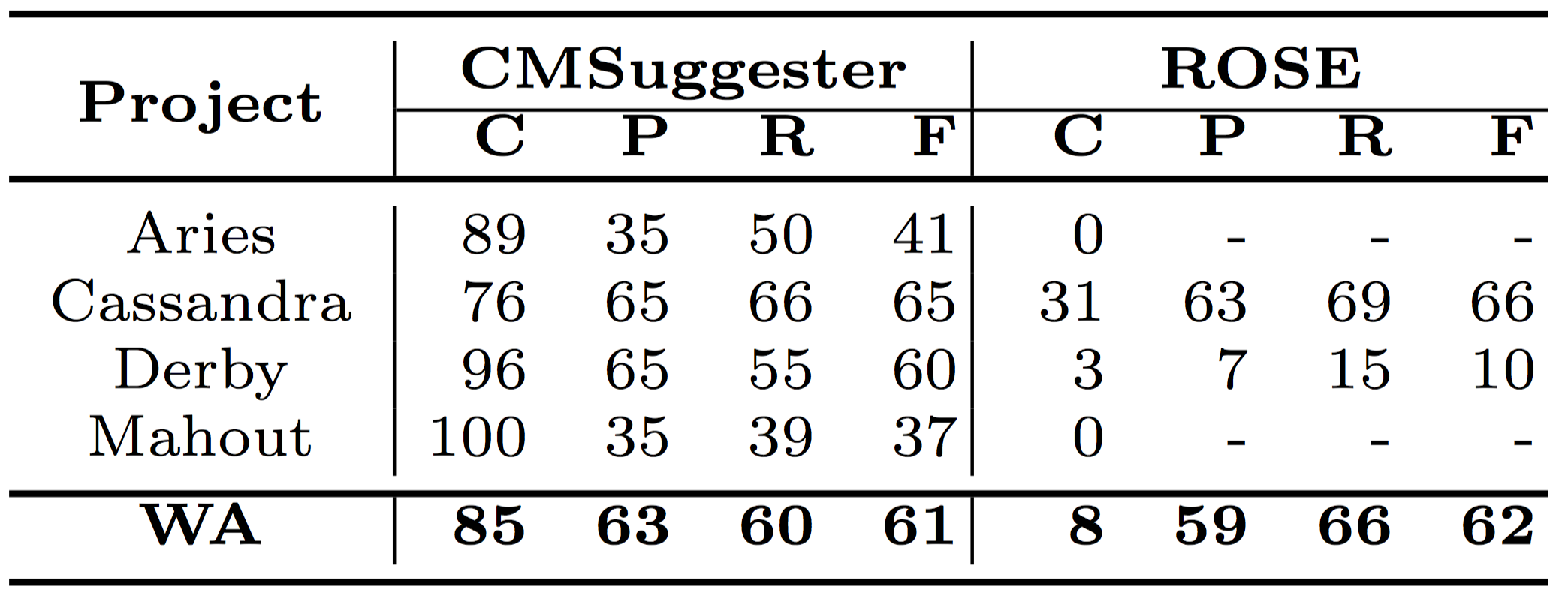
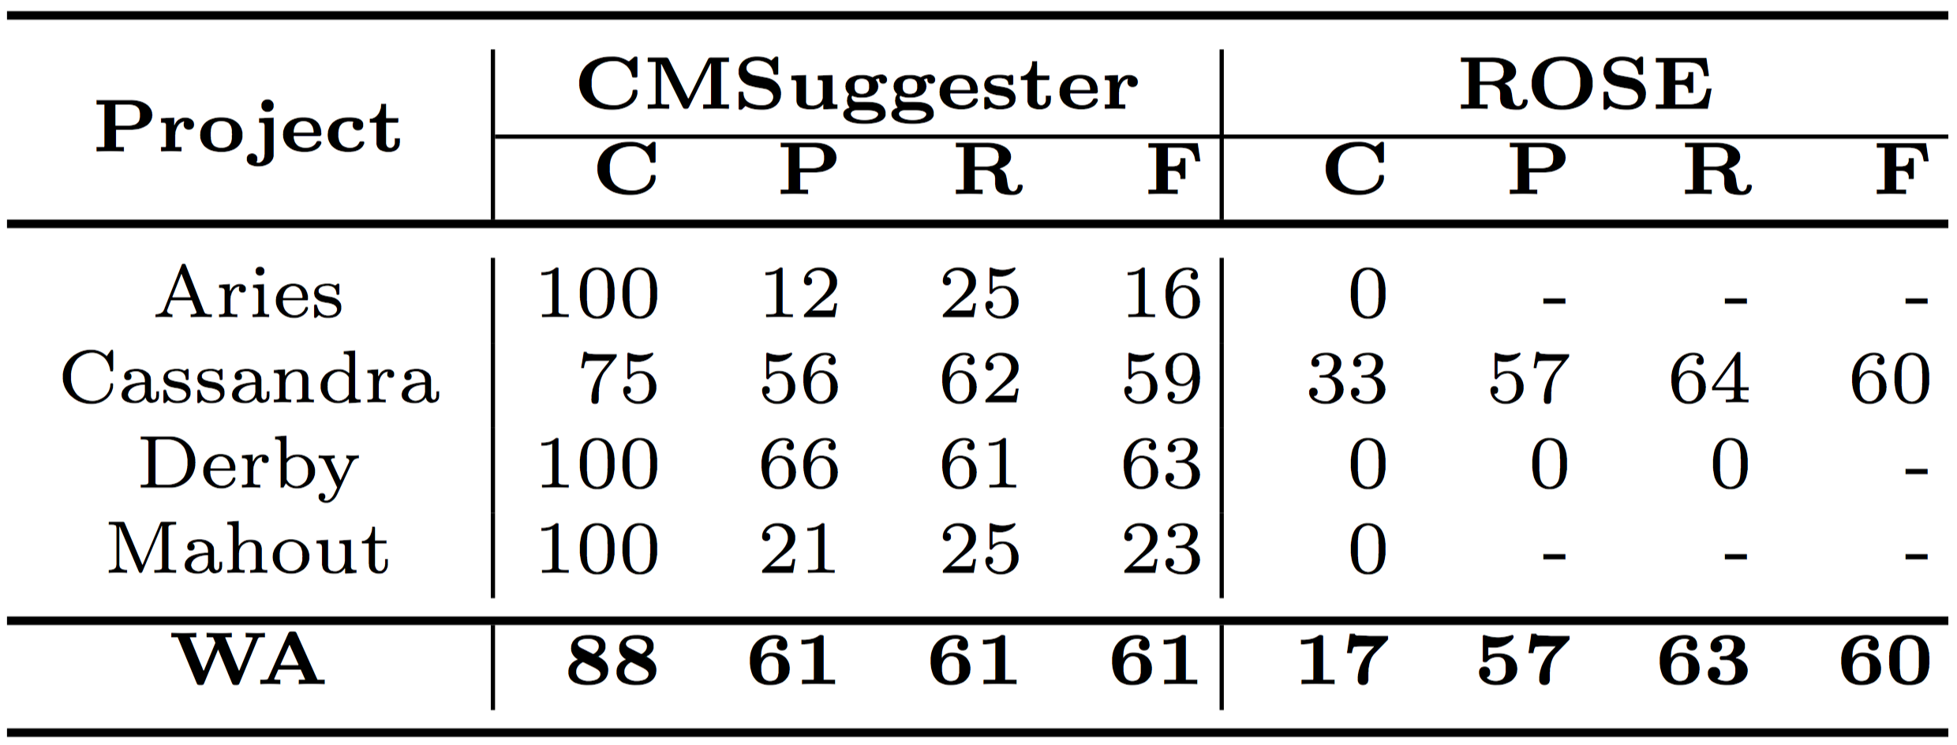
1A2C & 1A3C tasks
1 added field & 2 changed methods as input
1 added field & 3 changed methods as input
CMSuggester has better coverage and at least comparable accuracy

