Slide 1

An Empirical Study of Dynamic Types for Python Projects
Xinmeng Xia · Xincheng He · Yanyan Yan · Lei Xu · Baowen Xu
State Key Laboratory for Novel Software Technology , Nanjing University
Notes:
Good afternoon, everyone. I am Xia Xinmeng from Nanjing University. Today I will present our Empirical work of the Dynamic Types for open source Python projects.

Slide 2
Outline
Motivation
Empirical work
Discussion and Conclusion
Outline
Notes:
In the following, I will introduce the motivation, empirical work and conclusion of our work.

Slide 3
Motivation
Motivation
Notes:
First, it is the Motivation part.

Slide 4
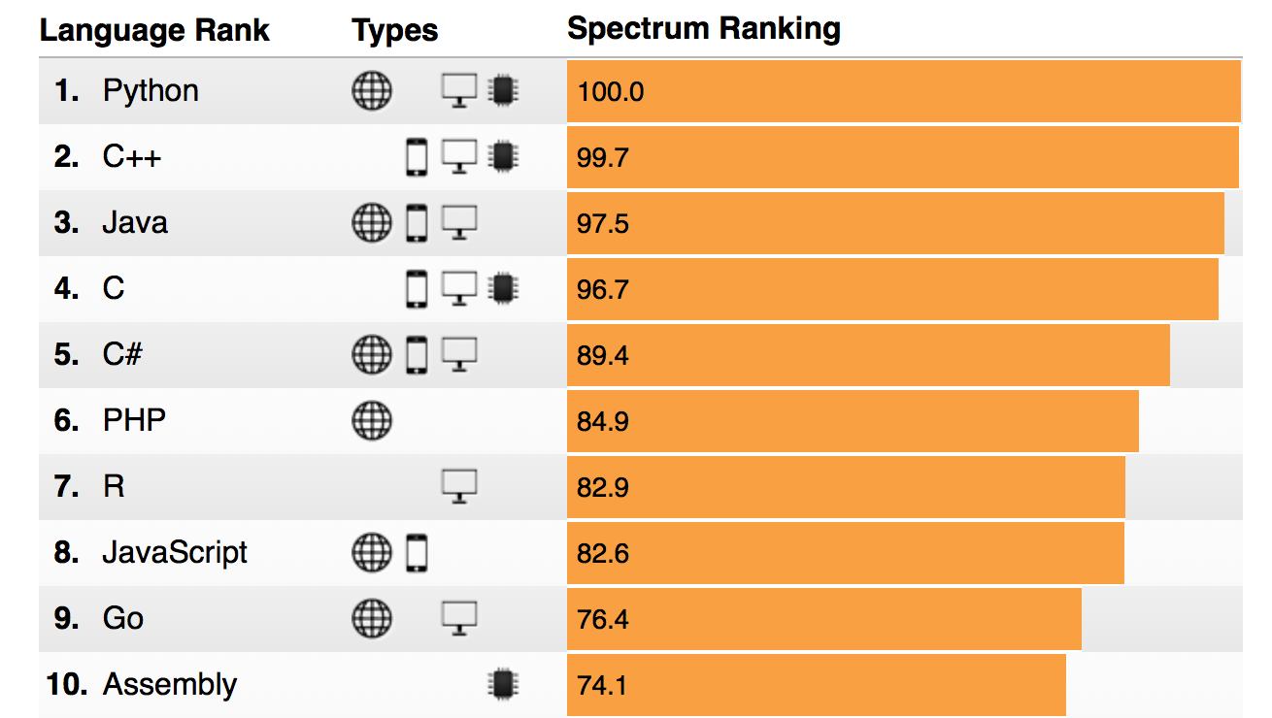
Python
A dynamically-typed programming language
Top 1 in 2018 IEEE Spectrum ranking
The ideal dynamic language :
Easy to learn
Convenient to use
Producing no bugs
Motivation
Notes:
Python is a dynamically-typed programming language and it is getting more and more popular.The popularity makes it important. An ideal dynamic language should contain the following feature: it’s easy to learn, it’s convenient to use and it produces no bugs.

Slide 5
Is Python really so ideal as designed?
Motivation
Notes:
Here comes the problem. Is Python really so ideal as designed?

Slide 6
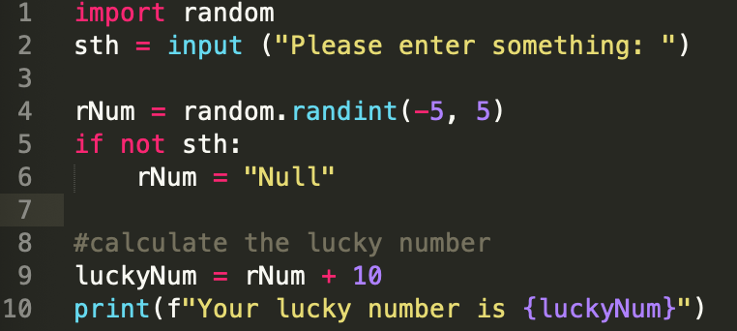
Example Analysis
A program to print the lucky number
Input1: A number, for example , “2”
Output1: Your lucky number is 3
Input2: Nothing
Output2: An error at line 9
" TypeError: must be str, not int''
Motivation
Notes:
Let me show you this example. This is a program to print the lucky number with an input. rNum is a variable. At line 4, it is assigned to a random integer number between -5 and 5. We have a if statement from line 5 to line 6. If nothing input, rNum will be assigned to a string “Null”. At line 9, we add rNum and 10 to calculate the luckynumber. If we input a number to the program, for example , “2”,the output will be the string “Lucky number is 3”. However, if nothing is input and we just press enter, an error will happen.

Slide 7
An error appears related to
dynamic types in Python!
Motivation
Notes:
An error appears related to dynamic types in Python!

Slide 8
Empirical work
Empirical work
Notes:
Now I will introduce our empirical work

Slide 9
In Our Work
Investigating the dynamic types in actual Python projects
Using a static tool to analyze the dynamic feature
Two RQs are put up to research the frequency and patterns of dynamic types.
RQ1: How often is the dynamic type applied in actual programming tasks of Python?
RQ2: What pattern is it when the type of a variable changes?
Empirical work
Notes:
What do we do in our work? we investigate the dynamic types in actual Python projects. We analyze the dynamic feature of a dynamic programming language with a static analysis tool. Two research questions are put up. RQ1 How often is the dynamic type applied in actual programming tasks of Python? This RQ is focus on the frequency of dynamic types. RQ2: What pattern is it when the type of a variable changes? This RQ is focus on the patterns of dynamic types.

Slide 10
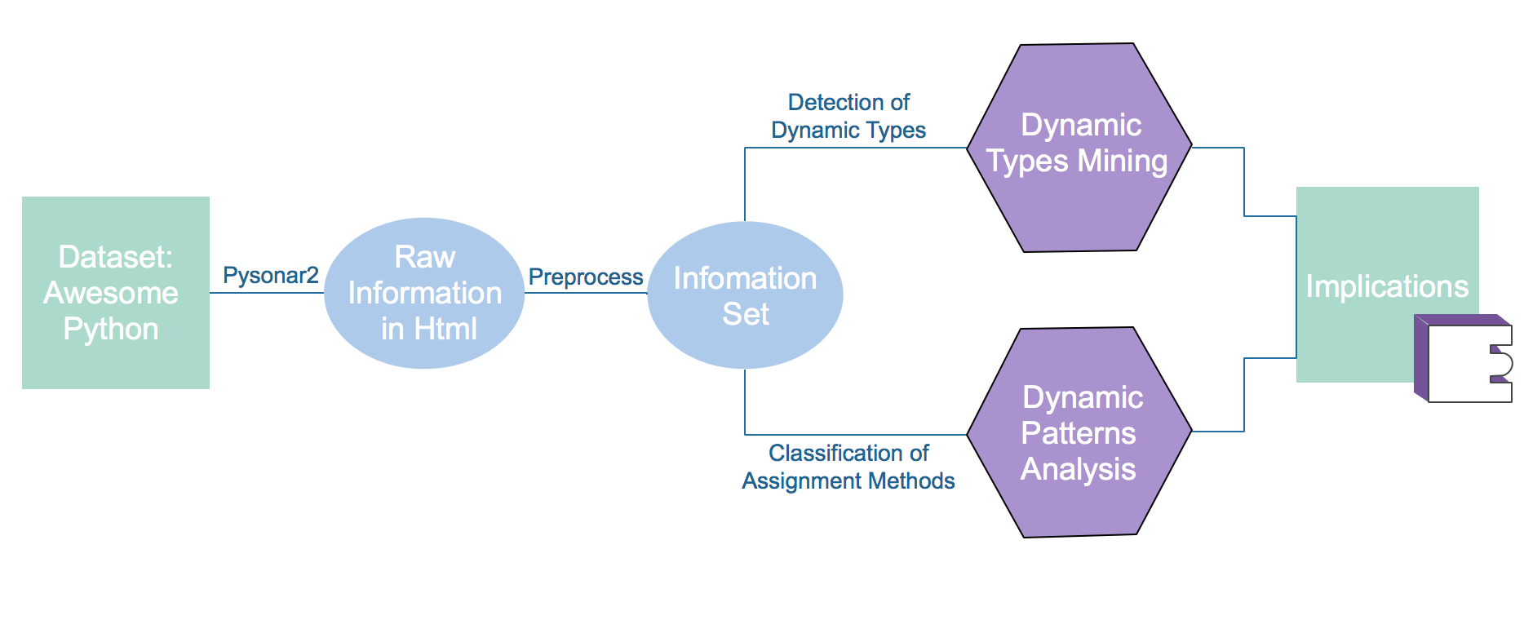
Overview
Empirical work
Notes:
This is the overview of our work. First, we collect the dataset Awesome Python, then we use the analysis tool pysonar2 analyze these python source files. We extract the information we need from the result of pysonar2 and store them in csv files. Next, we make a mining of dynamic types and analyze the dynamic patterns. Finally, we give the implications for the design of Python and analysis tool. We will discuss each part in the following in detail.

Slide 11
Dataset
Awesome Python
Awesome frameworks, libraries, software and resources of Python
81 categories (459 projects in total)
Large and balanced
Lines of Code
Number of Files
Description of Dataset
Empirical work
Notes:
For the dataset, we collect Awesome Python from GitHub and other website. Awesome Python contains awesome frameworks, libraries, software and resources of Python. There are 81 categories in these dataset. This figure depicts the statistic data including the number of files, lines of codes in each category. Most category have a number less than 25,000 files and 1,000 lines of code.

Slide 12
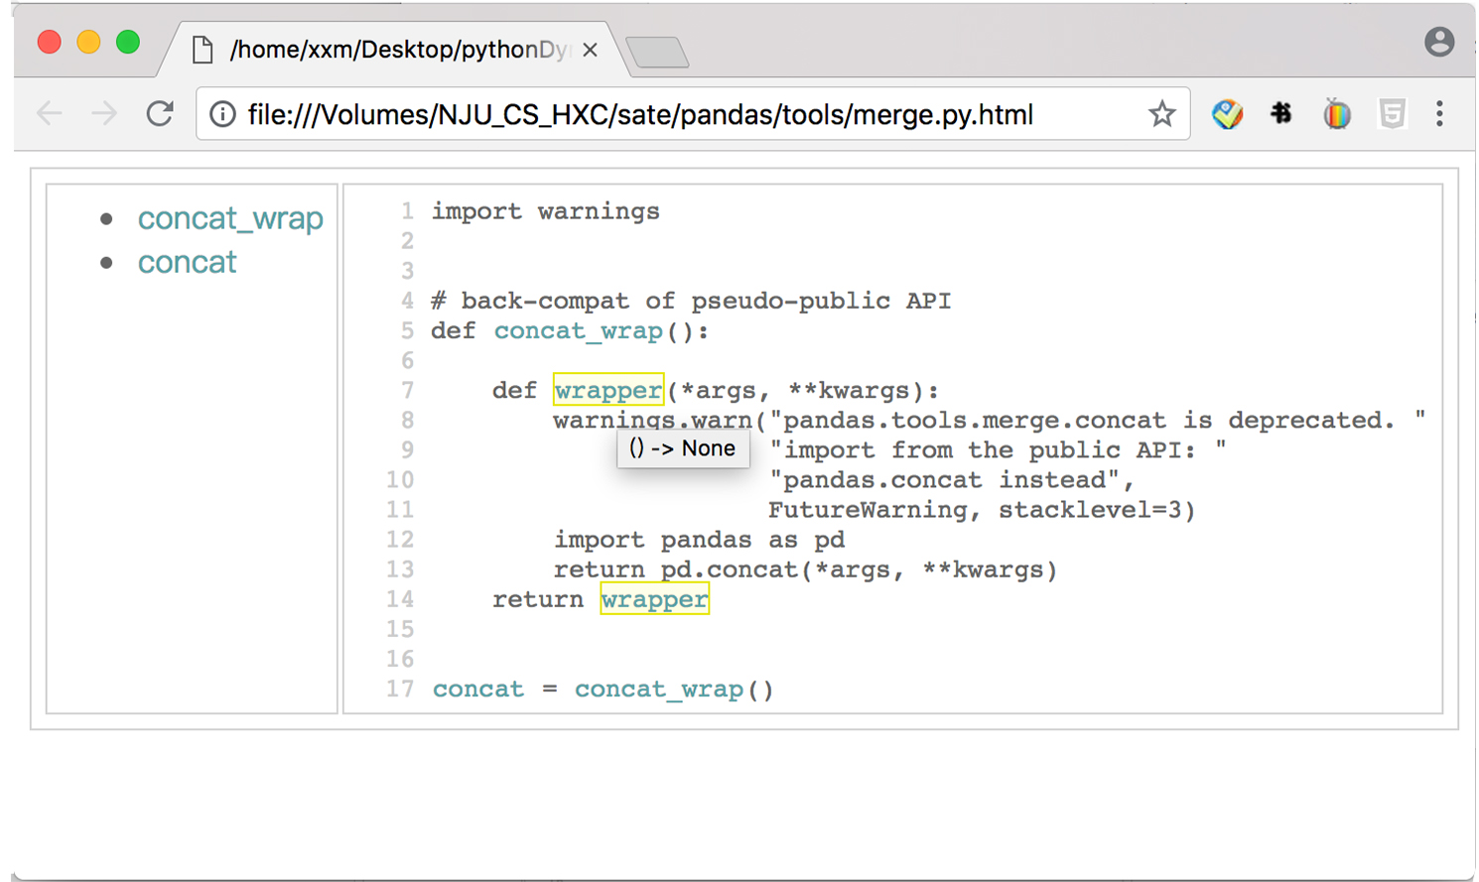
Data Extraction and Preprocess
A static analysis tool: Pysonar2
A type inferencer for Python
Initially developed by Yinwang of Google
Empirical work
Notes:
Next we use a static analysis tool,pysonar2, to extract the necessary information. Pysonar2 is a type inference tool with high accuracy. It’s Initially developed by Yinwang of Google

Slide 13
Data Extraction and Preprocess
Identifier information: stored in seven-tuples
(category, name, line number , absolute path, absolute scope, content, type)
E.g. for the identifier “rNum”, the seven-tuple is
(variable, rNum, 4, “/Users/xxm/Desktop/test.py”, “/Users/xxm/Desktop/test.py/rNum”, “rNum = random.randint(-5,5)”, int)
Python Files
Pysonar2
Seven- tuples
Regular Expression
Empirical work
Notes:
The necessary identifier information is stored in seven-tuples. A seven-tuple include the category of the identifiers such as class, variable, name of identifiers such as getID,rNum,the line number of the identifier, absolute path, absolute scope, content of the line assigning the identifier such as getID = 5 and its type such as int , string. For example, this is an information tuple of variable“ rNum” in above example. It is a variable with a name rNum, at the line 4. What we do in this step is extract the seven tuples for each identifier in these files

Slide 14
RQ1: How often is the dynamic type applied in actual programming tasks of Python?
Recognizing Dynamic Types
Absolute Scope
Identical
Absolute Path
Name
Identifier1
Identifier2
lType1
Type2
Different
Content2
Content2
Category1
Category2
Line Number1
Line Number2
Example
Identical or Different
Empirical work
Notes:
The first research question is to analyze the frequency of dynamic type. So how could we recognize the dynamic types in the python source code. We propose an approach to recognize the dynamic types by comparing the seven-tuples between 2 identifiers. Considering the two variables rNum at line4 and line6, they share the the same name, scope, path ,but they own different types and contents. The type in line4 is int, in line6 is string. So we say rNum have the dynamic type

Slide 15
RQ1: How often is the dynamic type applied in actual programming tasks of Python?
6.9% of identifiers involve dynamic type and 13.4% of identifiers are not sure whether they involve dynamic type. Most identifiers(79.7%) do not involve dynamic type.
Most dynamic type ( 58.9% ) for identifiers in Python programs appears between variable names and variable names.
Identifiers with Dynamic Type
Empirical work
Notes:
Here is our statistic result. v means variable, f means function,c means class, p means function parameter. We investigate the frequency of these identifiers with identical names but different type. The result shows few identifiers involve dynamic type. From this figure, we can know that Most dynamic type in Python programs appears between variable names and variable names.

Slide 16
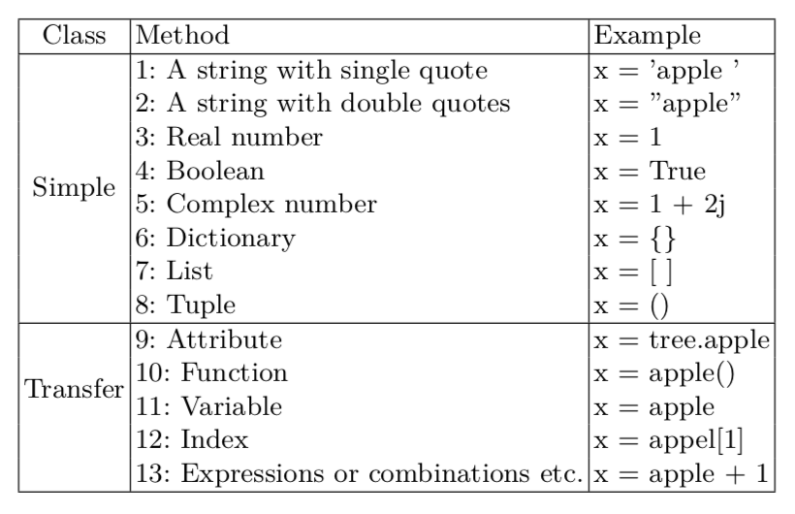
RQ2: What pattern is it when the type of a variable changes?
Assignment Model
Empirical work
Notes:
The second RQ aims to analyze the pattern of the dynamic type. We define the assignment model which contains all assignment methods for a variable. As we can see from the table, the assignment methods is divided into two category. Simple and Transfer. Simple assignment methods include assignments of string, real number, Boolean number, list ,dictionary and so on. Transfer assignment methods include assignment of functions, index, expression and so on.

Slide 17
RQ2: What pattern is it when the type of a variable changes?
Function assignments and expression assignments are probably the major ways to lead to dynamic type.
Dynamic type appears mainly inside “Transfer” methods.
Dynamic Changes Of Assignment Methods
Empirical work
Notes:
After defining our assignment methods, we calculate the number of the identifiers with identical names and different assignment methods. The result shows in this heatmap. The deeper the color is, the larger the number is. From the figure, we can see that Function assignments and expression assignments are probably the major ways to lead to dynamic type and Dynamic type appears mainly inside “Transfer” methods.

Slide 18
Discussion and Conclusion
Discussion and Conclusion
Notes:
Finally, I will discuss our results and conclude our work.

Slide 19
Implications
Design of Python
Dynamic type should be restricted regarding to the frequency of use.
Naming space of Python can probably be optimized.
Design of analysis tool
For the type inference tools of Python, combining assignment methods information into the tools may help improve its accuracy.
Discussion and Conclusion
Notes:
The findings of shows few identifiers involve dynamic type. So maybe it is better to restrict the use of dynamic type, for example, adding some using limit for the type of Python. Besides, Naming space of Python can probably be optimized to avoid duplicated name between different categories of identifiers such as function and variable. This may be a potential threat to program validity. For the design of analysis tool. We may combine assignment methods information into the tools which may help improve its accuracy.

Slide 20
Conclusion
An Empirical Study of Dynamic Types for Python Projects
Investigating the frequency of the dynamic types in actual programming tasks of Python
Investigating the patterns for the change of the type of a variable
What’s in the paper:
An approach is proposed to use static tool to analyze the dynamic feature
Results shows little identifier involves dynamic type and dynamic type appears mainly inside “Transfer” methods
Implications are given to improve the design of Python and its analysis tools from our findings
Discussion and Conclusion
Notes:
In the end, let me conclude the contribution of this study. We make an Empirical Study of Dynamic Types for Python Projects. We investigate the frequency of the dynamic types in actual programming tasks of Python and investigate the patterns for the change of the type of a variable. In the paper, An approach is proposed to use static tool to analyze the dynamic feature. Results shows little identifier involves dynamic type and dynamic type appears mainly inside “Transfer” methods. Implications are given to improve the design of Python and its analysis tools from our findings

Slide 21
Thanks for your listening !
Q&A
xiaxm@smail.nju.edu.cn
Notes:
Thank you for your listening ! Any question?

