Slide 1

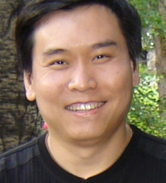





API Method Recommendation without Worrying About the Task-API Knowledge Gap
Qiao Huang, Xin Xia, Zhenchang Xing, David Lo and Xinyu Wang
Notes:
大家下午好，我叫黄乔，来自浙江大学，今天我的报告分两块，第一块是介绍我们发表在今年ASE会议上的一篇关于API推荐的论文，第二块是想结合我读博期间发表的其他几篇论文，和大家分享做研究过程中我总结的成功失败的经验教训。

Slide 2
Background
Too many APIs in a large library
Java SE 8 API, 4K classes, 31K methods
A practical scenario
I have a programming task
I don’t even know which API is worth for investigation
Notes:
首先介绍一下研究背景，

Slide 3
Problem Definition
Input: programming task described in natural language
How to initialize all values in an array to false?
Output: API recommendation result
API: Arrays.fill()
API Document: Assigns the specified boolean value to each element of the specified array of booleans
Notes:
首先介绍一下问题定义，BIKER接受的输入是用自然语言描述的编程任务，比如Java如何将数组所有元素初始化为false？输出是相关API的推荐结果，比如这个例子下会优先推荐Arrays这个类下面的fill方法
要解决这个问题，一个直接的做法是，利用信息检索算法，直接从API文档中根据API功能描述与用户查询语句的文本相似度来检索出合适的API。比如在这个例子里，arrays.fill的文档描述和查询语句很明显是语义相似的，但表达语义的具体用词会有所区别，比如问题说的是initialize初始化，文档里说的是assign赋值，类似的还有value和element，false和boolean的对应，这种问题我们已经有比较成熟的解决方案，就是用基于神经网络的word embedding，具体技术我就不详细介绍了，总之我们把一个大的语料库交给word embedding训练之后，就可以捕捉到false和boolean是语义相似的词语，从而进一步得出这个查询语句跟API文档描述是语义相似的。

Slide 4
Challenge: Task-API Knowledge Gap
How to check whether a class exists?
Wrong API: org.omg.CORBA.Object.is_a (score = 0.669)
Checks whether this object is an instance of a class that implements the given interface
Correct API: java.lang.Class.forName (score = 0.377)
Returns the Class object associated with the class with the given string name
API-Doc describes functionality and structure, but lacks concepts or purposes
Notes:
但是，直接从API文档中检索API，还有一个更难的问题，就是任务描述与API文档之间的知识鸿沟
从这个例子可以看出，API文档重点描述的是API的结构信息与基本功能，而查询语句中涉及到的核心概念或者任务目标往往是API文档所缺失的，这个我们就把它叫做知识鸿沟

Slide 5

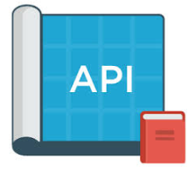




How Developers Search for APIs?
API 1
API 2
Query
…
API 3
…
API n
Similar Questions
Candidate APIs
Notes:
BIKER的设计灵感来自于程序员的真实搜索行为，我们通过调查问卷发现，程序员在搜索API的时候，优先选择不是直接查文档，而是通过搜索引擎，比如Google来查找答案。大多数情况下，Google的第一个搜索结果往往是一组Stack Overflow上与它的查询比较相似的问题链接，当然，Google也会提供一些其他的信息源，比如技术博客。总的来说，Stack Overflow是程序员浏览最多的信息源，有些程序员甚至绕过google直接在SO上面搜索。通过浏览这些相似问题下的讨论，可以找到一些候选API，然后再通过查阅文档，进一步确定API的使用场景是否能满足自己的需求。

Slide 6

Overall Framework of Our Approach
API-Related Questions
BIKER: Bi-Information source based KnowledgE Recommendation
Similarity Scores
Top-K Similar Questions
Candidate APIs
Query
Code Snippets from SO Posts
Results
Title of Similar Questions
Ranking List of APIs
Official API description
Notes:
基于以上发现，我们设计了一套模拟程序员搜索行为的API推荐算法。首先我们从Stack Overflow的官方数据集里抽取出跟Java API相关的问题，这里所说的API相关问题是指这个问题的最佳答案里有明确提到Java API。我们总共提取了大约12万个API问题作为知识库，当用户输入查询语句后，我们通过信息检索算法抽取出K个相似的API搜索问题，这里我们用到了word embedding技术来解决同义词问题。我们通过手工分析发现，开发者在答案里提到一个重要的API的时候，通常会用HTML标签高亮或者用超链接link到对应的API文档地址，因此我们可以利用正则表达式等手段从每个问题的答案里抽取出一系列候选API。接下来我们需要计算每个API与query之间的相关度，这里我们既考虑了一个API在多个问题里出现的频率，也考虑了API本身的文档描述与用户查询的文本相似度，得到这个ranking list之后，我们就可以直接把结果返回给用户了。
人机交互问题，算法不是百分之百准确的，1. 不能确定top-1是否准确，2. 只有API函数名，不知道用法
因此，为了提升推荐结果的可解释性，帮助程序员更快更准地找到合适的API，我们在API推荐结果的基础上，

Slide 7
An Example of API Summary
Query: Run linux command in java code
Top-1 API: java.lang.Runtime.exec
Doc: Executes the specified string command in a separate process
Similar Questions
1. Run cmd commands through java
2. use cmd commands in java program
3. Unable to execute Unix command through Java code
Code Snippets
1. Process p = Runtime.getRuntime().exec(command);
2. Runtime.exec( -whatever cmd command you need to execute- )

Slide 8
Baselines
RACK (Rahman et al., SANER 2016)
Using SO posts to build a keyword-API mapping database
DeepAPI (Gu et al., FSE 2016)
Based on deep neural network (seq2seq)
Training with annotated API sequences from code repositories.
Notes:
We compare our approach with 2 baselines. The first baseline is RACK, proposed by Rahman et al., in SANER. They used SO posts to build a keyword-API mapping database but they didn’t leverage API document. Besides their approach only supports API recommendation at class-level. For example, given the query how to initialize all values in an array to false, the class-level only recommends the class Arrays, while method-level would recommend Arrays.fill. They also published a testing dataset including 150 questions selected from Java tutorial sites, and this dataset is also used for evaluation in our paper.
The second baseline is DeepAPI, proposed by Gu et al., in FSE. Their approach is based on seq2seq model, a kind of deep neural network, and the model is trained with a large number of annotated API sequences from code repositories. The model receives a natural language query and outputs a sequence of API methods.

Slide 9
Evaluation Results
Quantitative Analysis
Improve MRR and MAP by at least 50%
Training time 36min and 2.8s to process each query
User Study
28 Java developers, 4 groups, 10 questions
Improve correctness by 11% and completion time by 28%

Slide 10
Conclusion
We studied developers’ API search behavior
We proposed an automated approach to recommend APIs by incorporating both SO posts and API-Doc
Our quantitative evaluation and user study demonstrated the effectiveness of our approach
Future work: tool implementation, extension for more PLs
Code: https://github.com/tkdsheep/BIKER-ASE2018
Notes:
As a conclusion, in this paper, we first XXX
Inspired by this study, we proposed XXX
Finally, our XXX
In future work, we plan to implement our approach as an automated tool in the form of a plugin for a web browser of IDE, we also plan to extend our approach to support more programming languages.

Slide 11
Part2: Sharing My Research Experience

Slide 12
Identify Self-Admitted Technical Debt (SATD) Using Text Mining
IEEE Transactions on Reliability, Reject
SATD is used as an excuse for presenting text mining
EMSE, Major Revision
What’s the top-k Features?
Can we update training data?
Implications?
Notes:
TR：并没有进一步挖掘SATD的特点，也不知道这个分类在实际应用中有啥用？
EMSE运气比较好，给了一轮大修的机会，评审的意见超级多，rebuttal letter我写了30多页word文档才搞定所有意见。在修改过程中，可以明显感受到评审非常nice，他们意见虽然多，但每一条都是在帮助我改进论文。
让我印象比较深的有这么几条意见：第一条是考虑到我用了feature selection技术，评审就让我展示一下到底哪些关键词是SATD comment里面经常出现的，从而就可以针对程序员写SATD comment的pattern做一些讨论。
第二条是让我加一些关于implication的讨论，比如我们的研究对学术界和工业界有哪些启发，能带来什么价值，等等。
第三条是关于一个实际应用场景的讨论，假设我们的算法做成工具部署了，那么随着项目的不断发展，会有很多新的SATD comment被识别出来，如果把这些新的数据补充到我们的训练数据里，对模型又会有什么影响？

Slide 13
Which Packages Would be Affected by This Bug Report?
SANER 2017, Reject
Many small issues about writing
No discussion about bug localization
MSR 2017, Reject
Strong Accept, Weak Accept, Reject, Avg Score 0.7
Top-10 packages, really useful?
ISSRE 2017, Accept
Rebuttal letter in 500 words
Notes:
这篇论文也是我刚开始读博时完成的一篇论文，主要提出了一种多分类算法，根据一个bug report的内容来预测哪些package受到这个bug的影响。这篇论文在创新性上有所欠缺，第一个版本投的SANER直接被拒，主要是实验设计和论文写作存在许多小问题，另一块就是缺少和bug localization相关论文的对比。
根据这些意见，我把论文大修之后改投MSR，三个评审有一个reject，一个weak accept和一个strong accept，然后我是那一年MSR所有论文里唯一一篇拿到一个strong accept仍然被拒的论文。原因就是PC meeting讨论的时候，给reject的那个评审一直强调我们这篇论文的contribution不够明显，另外一个致命缺陷就是我们评估算法的时候是根据top-5和top-10的推荐结果来评估的。Reviewer就问，在真实应用场景下，为什么不关注top-1的结果，我们推荐5个甚至10个package真的有用吗？会不会反而是浪费时间，增加负担？
我很感激MSR的评审，给了我很大的启发，TODO
最后我们根据MSR评审的意见做了一些修改之后改投ISSRE会议，这个会议是有rebuttal的，

Slide 14
Automating Intention Mining
ASE 2017, Reject
It's not useful to have sentences classified
Pick a specific SE task and evaluate how your work affects the task.
TSE, Major Revision
Provide more qualitative analysis
Clarify the data collection process
Notes:
ASE 优点：手工标注了大量数据，改进了intention分类，实验数据详实
缺点：蹭热点，问题本身不够有创新性，是incremental work

Slide 15



Supervised vs Unsupervised Model for Effort Aware Just-In-Time Defect Prediction
100 changes (10 are defective), 1000 LOC modified in total
Prediction model
Rank by score
Inspect in order
200 LOC modified in total (i.e., inspect 20% LOC)
40 changes inspected
4 defective changes found
Recall = 4 / 10 = 0.4, the higher recall, the better

Slide 16
Summary
Which one is more important? Nail or Hammer?
How can developers benefit from our work? How to prove it?
Why does our approach perform better? What’s the weakness?
Is there any other issues when applying our work in real application?
Notes:
是否过度追逐复杂的深度学习算法，而忽略了对软件工程问题本身的思考

Slide 17
Thank you!
Notes:
That’s all of my presentation today, thank you!

Slide 18
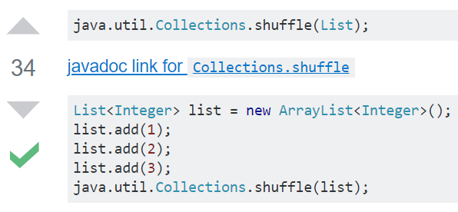
Heuristic Rules to Detect Candidate APIs
How to generate a random permutation in Java?
String in HTML tag ⟨code⟩ that matches an API name
Hyperlink to Official API documentation

Slide 19
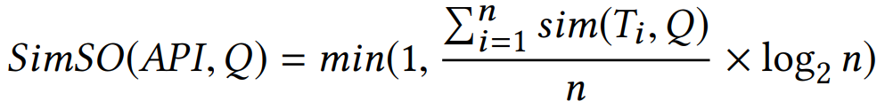
Similarity Scores between Query and API
SimSO: Based on StackOverflow posts
SimDoc: Based on API documentation
Calculating text sim between query and API description
The formula is based on Ye et al.’s work in ICSE 2016
Ye, Xin, et al. "From word embeddings to document similarities for improved information retrieval in software engineering." Proceedings of the 38th international conference on software engineering. ACM, 2016.
Text sim between query and question title
There are n questions that mentioned this API

Slide 20
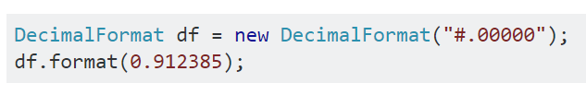
Heuristic Rules to Extract Code Snippets
LOC <= 5 (for simplicity)
Contains both the API’s class name and method name
For example: DecimalFormat.format
Ranked by their corresponding questions’ sim scores
class name
method name

Slide 21

Data Collection
1.3 Million Java Questions
Text Corpus
126K API-Related Questions
Knowledge Base
4K Classes
31K Methods
API contained in
accepted answer
Score >= 5
413 Questions for Testing
1K Questions
469 Questions
Remove unqualified questions
Further checking
Notes:
Before presenting the experiment, here I introduce how we collect our dataset.
We first xtract more than 1 million java-tagged questions from Stack Overflow. The textual content in these questions would be used as a text corpus for training word embedding.
Then we extract more than 100K questions that contains API entities in their answers. These questions would be used as our knowledge base for similar question retrieval. This knowledge base also contains the description of all Java API classes and methods extracted from Oracle’s Java API documentation.
Next, to build a testing dataset for evaluation, we select the API-related questions that are voted by at least 5 developers and their accepted answers should contain API entity. In this way, we get about 3K questions and we randomly select 1K of them. Then we manually check the title of each question and remove unqualified questions that are not seeking for an API to solve a programming task. In this way, we get 469 questions. Finally, we further check the answers of these questions to label the ground-truth API and further remove a small number of unqualified questions.
In this way, we got 413 questions for testing and these questions along with their duplicate questions are not included in our knowledge base.

Slide 22
Ten Questions in User Study
Resolving ip-address of a hostname?
How to make a list thread-safe for serialization?
Remove trailing zeros from double?
How to check whether a class exists?
Is there any way to find os name using java?
Java Fastest way to read through text file with 2 million lines?
Check if a class is subclass of another class in Java?
How to generate a random permutation in Java?
How to initialize all the elements of an array to any specific value in java?
How to round a number to n decimal places in Java?

Slide 23
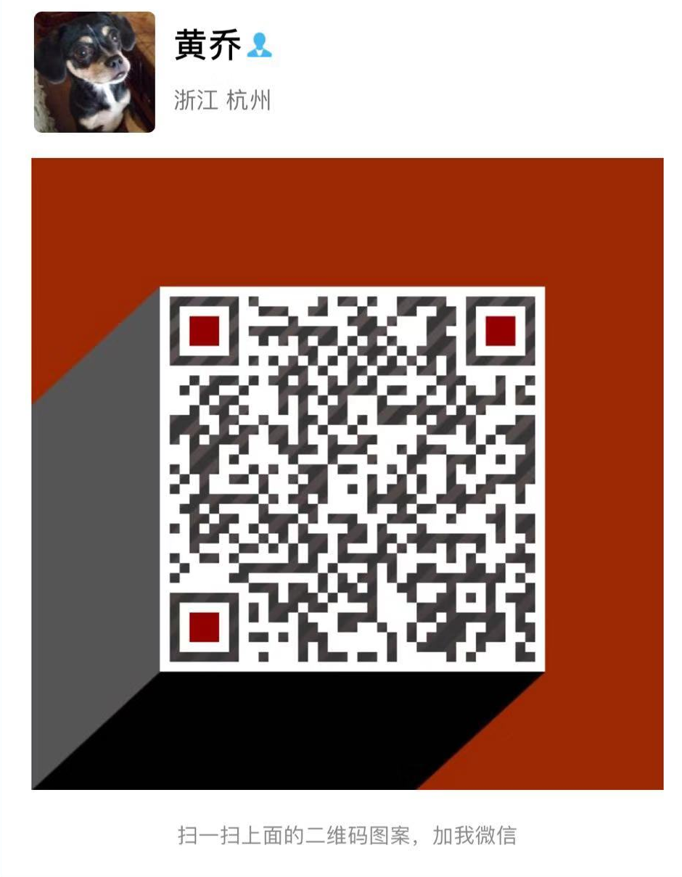
WeChat

