Slide 1
Chen Zhenpeng
I am a Ph.D. student in the Software Engineering Institute, Peking University
I am advised by Prof. Hong Mei and Prof. Xuanzhe Liu
Research interest
User behavior mining and profiling
Sentiment analysis
Homepage: https://chenzhenpeng18.github.io

Slide 2



Through a Gender Lens: Learning Usage Patterns of Emojis from Large-Scale Android Users
Zhenpeng Chen, Xuan Lu, Wei Ai, Huoran Li,
Qiaozhu Mei, Xuanzhe Liu
WWW 2018

Slide 3
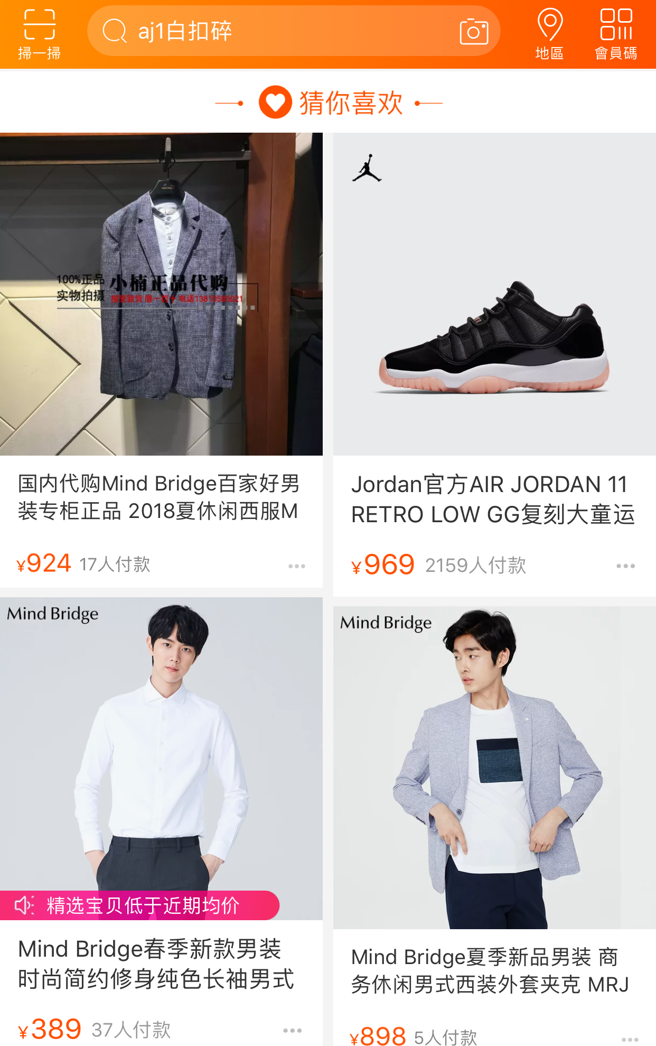
Why Genders?
Provide gender-customized service and improve service quality
Guess what you like
Shopping experience
Precision marketing
HOT TOPICS
Gender difference
Gender inference

Slide 4
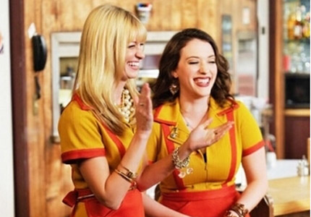
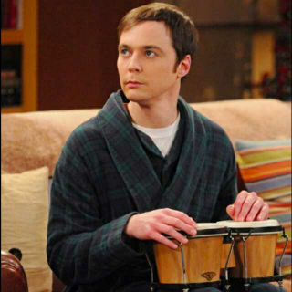
F2F Communication
More emotional

Slide 5
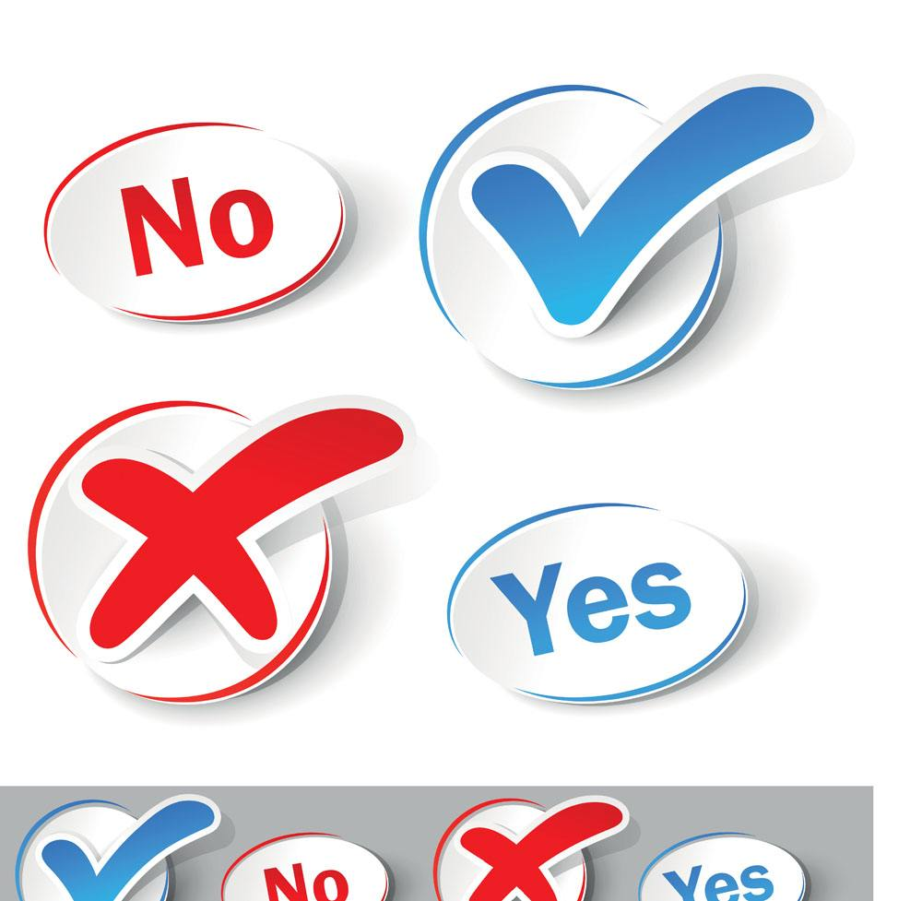


Online Communication
Facial Expressions
Body Languages
?
Differences in Emoji Usage?

Slide 6
Research Questions
Do female and male users have significant differences in emoji usage?
If yes, is such a difference sufficient for a machine learning algorithm to infer gender of users purely based on their emoji usage?

Slide 7
Data Collection
Kika Keyboard
Data set
134,419 anonymized users
401 million messages
Dec 4, 2016 – Feb 27, 2017
Gender limited to female and male
183 countries and 58 languages

Slide 8
Who Tend to Use More Emojis?
The percentage of messages containing emojis
Females: 7.96%, males: 7.02% (p-value<<0.01)
0.708
0.561

Slide 9
Do They Prefer Different Emojis?
Similarity in frequently used emojis
Differences still exist
3.2%
< 3%

Slide 10
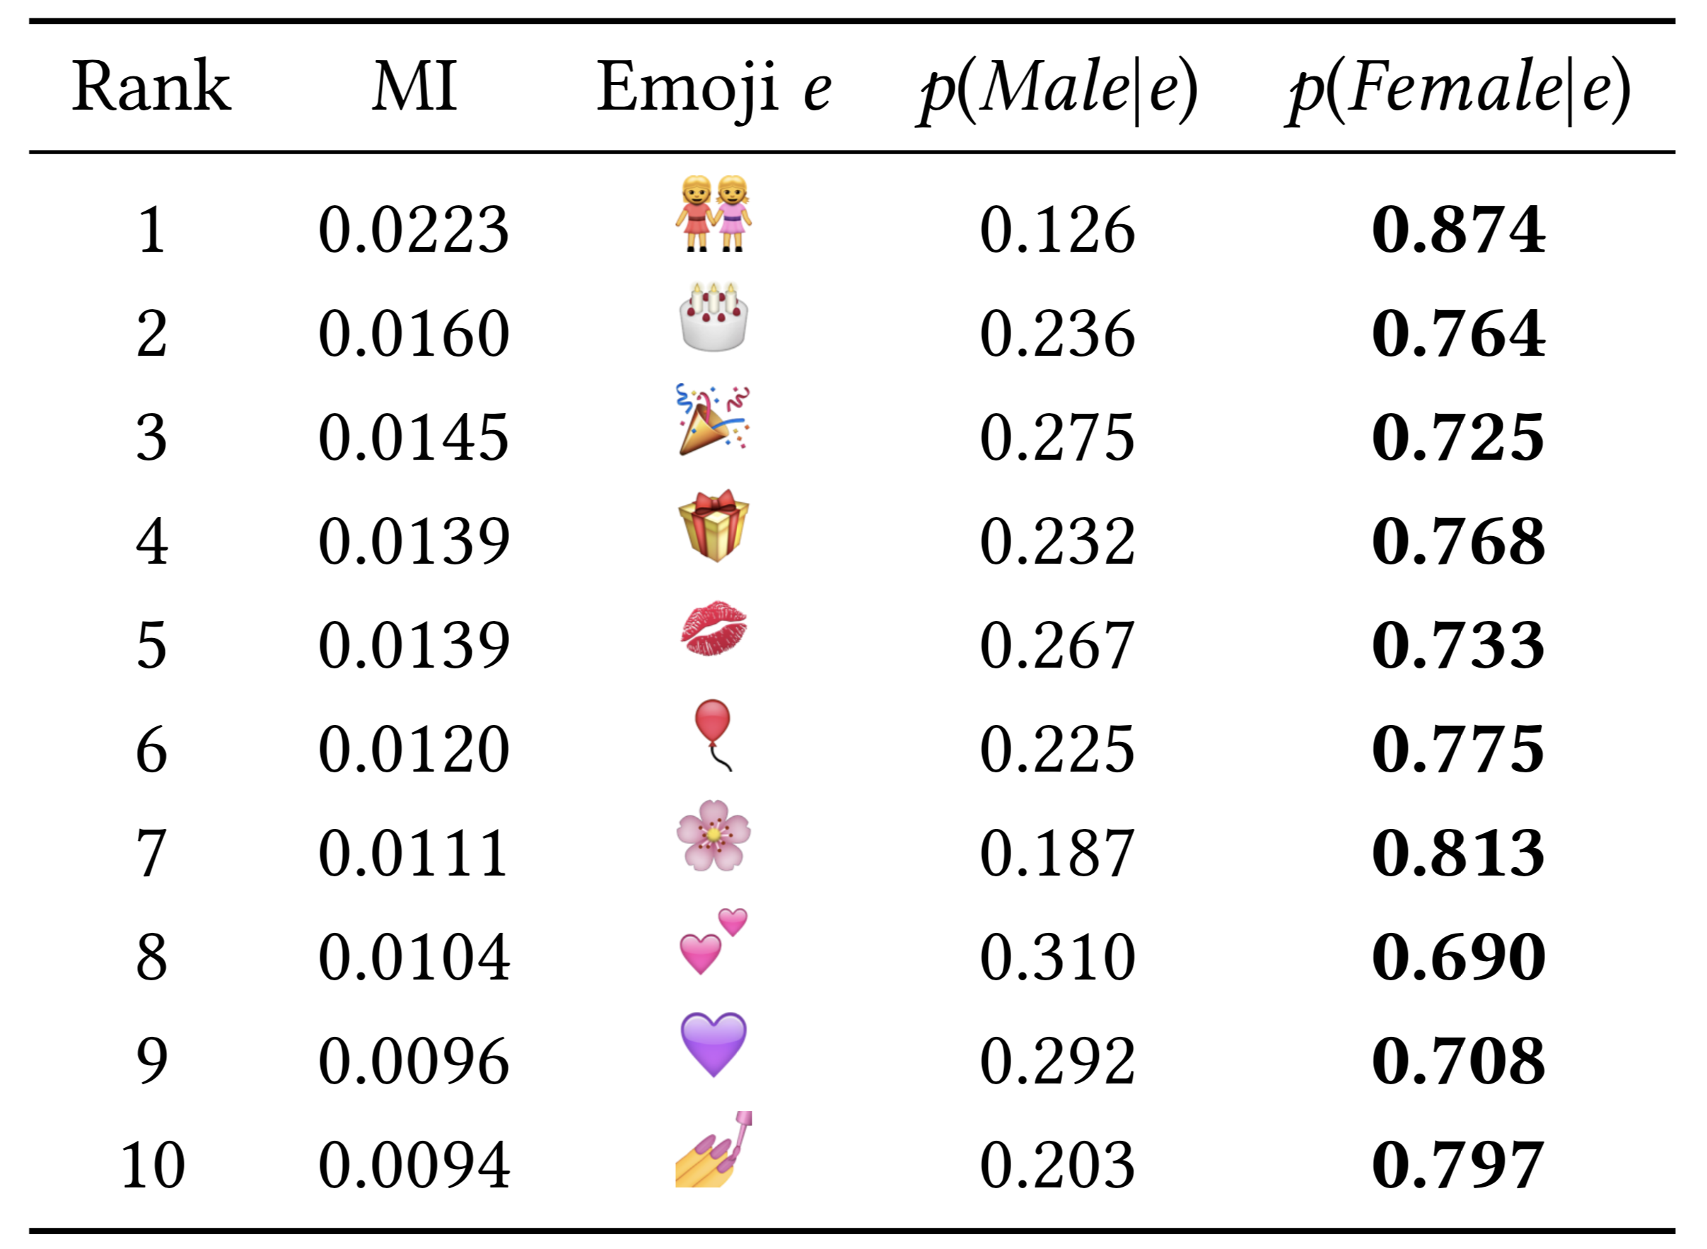
Are There Distinguishing Emojis?
Mutual information (MI)
The mutual dependence between the usage of a certain emoji and the genders
Higher MI means more informative
“Male” emojis
⚽️ 🚬 ♂

Slide 11
Do They Differ in Sentiment Expression?
Females are likely to be more emotional
Expressing sentiment is the main function of emojis
Emoji sentiment polarity measured by LIWC using official annotations
Usage proportion of emotional emojis
 | Female | Male | p-value
Positive | 50.87% | 50.25% | <<0.01
Negative | 10.11% | 9.42% | <<0.01

Slide 12
Findings
Gender differences in emoji usage
Usage frequency: females tend to use more emojis
Emoji preferences: females more prefer fancy emojis
Sentiment expression: females tend to use more emotional emojis
Sufficient to Infer Gender?

Slide 13

Additional Advantages
I will attend the exciting Web Conference at 8 a.m. 😍 You can contact me that time! ☺️ ☺️ My phone number is 15655555555
Popular across the world
Emojis rather than texts
Generalizable to languages
Alleviate privacy risk

Slide 14

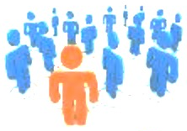
Workflow of Gender Inference
self-reported gender
FeatureN
Feature2
Gender
Feature1
Ridge
RF
Features of a new user
GBC
Input
FeatureN
SVC
Prediction Model
Training Users
Extract & Synthesize
……
……
Classification
Feature2
Machine Learning Models
Predicting
Feature1
Gender
Emoji-usage Features
Training & Learning
Prediction
Formulation
3
1
2

Slide 15
Workflow of Gender Inference
self-reported gender
FeatureN
Feature2
Gender
Feature1
Ridge
RF
Features of a new user
GBC
Input
FeatureN
SVC
Prediction Model
Training Users
Extract & Synthesize
……
……
Classification
Feature2
Machine Learning Models
Predicting
Feature1
Gender
Emoji-usage Features
Training & Learning
Prediction
Formulation
3
1
2

Slide 16
Workflow of Gender Inference
self-reported gender
FeatureN
Feature2
Gender
Feature1
Ridge
RF
Features of a new user
GBC
Input
FeatureN
SVC
Prediction Model
Training Users
Extract & Synthesize
……
……
Classification
Feature2
Machine Learning Models
Predicting
Feature1
Gender
Emoji-usage Features
Training & Learning
Prediction
Formulation
3
1
2

Slide 17
Experiment Setup
39,372 users with at least
100 emoji-messages
Total
Randomly selected
31,872 users
The rest
7,500 users
Train
Test

Slide 18
Emoji-Usage Features
1,370 features from 3 dimensions
Emoji Frequency
The proportion of emoji messages
The average number of emojis in one message
……

Slide 19
Emoji-Usage Features
1,370 from 3 dimensions
Emoji Frequency
Emoji Preferences
The usage proportion of each emoji to all emojis

Slide 20
Emoji-Usage Features
1,370 from 3 dimensions
Emoji Frequency
Emoji Preference
Sentiment Expression
The proportion of positive/negative emojis in total emoji usage
The proportion of messages containing positive/negative emojis
……

Slide 21
Machine Learning Algorithms
Linear Model
Ridge Classifier (Ridge)
Tree Model
Random Forest Classifier (RF)
Gradient Boosting Classifier (GBC)
SVM Model
Support Vector Classifier (SVC)

Slide 22
Metrics and Baseline
Gender distribution in test set as naïve baselines
65.3% females and 34.7% males
Accuracy
Overall performance
Precision of Females / Males
(Precision_F / Precision_M)
Performance on females and males

Slide 23
Results
All the four algorithms outperform the baseline
Gradient boosting classifier performs the best

Slide 24
Results
All the four algorithms outperform the baseline
Gradient boosting classifier performs the best
Encouraging performance
High accuracy
Balanced performance on females and males
 | Accuracy | Precision_F | Precision_M
GBC | 81.1% | 82.6% | 77.5%
Baseline | 65.3% | 65.3% | 34.7%

Slide 25
Comparable with Text-Based Model
Comparing to [Sap et al. , 2014]
Proposed for English
Unigram frequency as features
 | Accuracy | Precision_F | Precision_M
Emoji Model | 73.6% | 73.8% | 72.8%
Text Model | 71.8% | 70.6% | 87.7%
Maarten Sap et al. 2014. “Developing age and gender predictive lexica over social media”. In Proceedings of the 2014 Conference on Empirical Methods in Natural Language Processing.

Slide 26
Generalization: Text Model
Models We Need
Performance
I am so excited to attend TheWebConf 😊😊
English Model
👍
私はTheWebConfに参加することに非常に興奮しています😊😊
Japanese Model
👎
Je suis tellement excitée d‘assister au TheWebConf😊😊
French Model
👎
Indonesian Model
Saya sangat bersemangat untuk menghadiri TheWebConf😊😊
👎

Slide 27
Generalization: Emoji Model
I am so excited to attend TheWebConf 😊😊
私はTheWebConfに参加することに非常に興奮しています😊😊
🗣 One Fits All ！
Je suis tellement excitée d‘assister au TheWebConf😊😊
Saya sangat bersemangat untuk menghadiri TheWebConf😊😊

Slide 28
Representative Languages
10 non-English languages with the most users
Indo-European
Spanish, Portuguese, French, Italian, German
Austronesian
Tagalog, Indonesian, Malay
Afro-Asiatic
Arabic
Tai-Kadai
Thai

Slide 29
Performance on Different Language users
Our model significantly outperforms the baseline on all the 10 language users
Italian Users
 | Accuracy | Precision_F | Precision_M
GBC | 84.1% | 86.3% | 79.3%
Baseline | 66.1% | 66.1% | 33.9%

Slide 30

Performance on Different Language users
Our model significantly outperforms the baseline on all the 10 language users
Arabic Users
 | Accuracy | Precision_F | Precision_M
GBC | 76.4% | 69.0% | 85.4%
Baseline | 55.5% | 44.5% | 55.5%
Culture effects
Stricter self-censored online behaviors

Slide 31
Lower Privacy Risk
Text Model
Emoji Model
numbers
http
I will attend the exciting Web Conference at 8 a.m. 😍 You can contact me that time! ☺️ ☺️ My phone number is 15655555555
$
names
dates
@yahoo.com
time

Slide 32
Limitations of This Study
We consider only females and males
We focus on only users of Kika Keyboard
We focus on only Android users
Different emoji renderings across platforms give rise to different emoji usages

Slide 33
Take-Away
Significant gender differences in emoji usage
Usage frequency: females tend to use more emojis
Emoji preferences: females more prefer fancy emojis
Sentiment expression: females tend to use more emotional emojis
Sufficient to infer gender
Comparable performance with text-based model
Generalizable to languages
Low privacy risk

