Slide 1




SATD Detector: A Text-Mining-Based Self-Admitted Technical Debt Detection Tool
Zhongxin Liu¹, Qiao Huang¹, Xin Xia², Emad Shihab³, David Lo⁴ and Shanping Li¹
¹Zhejiang University, China
²Monash University, Australia
³Concordia University, Canada
⁴Singapore Management University, Singapore
Notes:
浙江大学博士生 刘忠鑫

Slide 2



What is Technical Debt (TD) ?
Hardcode
perf problem
Deadline is close.
小刘 is in a rush to implement some features
Bad practices in 小刘 ’s code
Technical debt is introduced in the software.

Slide 3



Self-Admitted Technical Debt (SATD)
Admitted by 小刘 himself
Recorded in source code comments
// Need some format checking here

Slide 4

Identify SATD Comments?
Most previous studies use the 62 patterns summarized by Potdar et al. (ICSME 2014)
Summarizing patterns require manual effort.
Low recall
Difficult to extract all potential patterns
temporary crutch
todo
remove me before production
fix this crap

Slide 5
Our Previous Work
Proposed a text-mining-based approach to identify SATD comments. (EMSE)
Automatic identification
Better performance

Slide 6






Framework of Our Approach
Information Gain, 10%
Source Projects
New Comments
Feature Selection
Training
Classifiers Voting
Preprocessing
Tokenization
Stop-word Removal
Stemming
Prediction Results
Raw Features
Features
Sub-classifiers
Model Building Phase
Naïve Bayes Multinomial
Prediction Phase

Slide 7
SATD Detector
A tool that can automatically detect SATD comments using our text-mining-based approach.
Back-end: a Java library
Front-end: an Eclipse plugin

Slide 8
The Java Library
https://github.com/Tbabm/SATDDetector-Core
Implements our text-mining-based approach
Embedded a pre-trained text mining model
Can be integrated in current dev tools.
Users can also using their own data to train the model

Slide 9
Demonstration

Slide 10
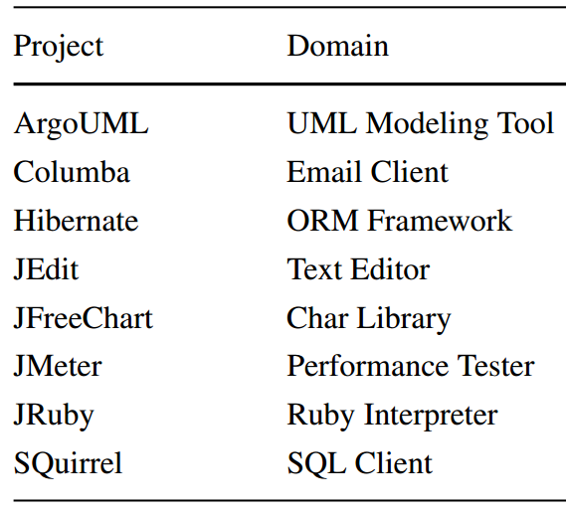
Data Statistics
8 open source projects (Java)
Manually analyzing 4k comments on average for each project
% of SATD comments is around 4% ~ 21%
Vocabulary size varies from 2k to 4k

Slide 11

Evaluation Results
Metrics | Ours | Pattern | NBM | bestSub | NLP
Precision | 0.756 | 0.770 | 0.354 | 0.537 | 0.547
Recall | 0.733 | 0.069 | 0.717 | 0.718 | 0.623
F1-score | 0.737 | 0.123 | 0.465 | 0.591 | 0.576
Improv. F1 | - | 499% | 58% | 25% | 28%
More than 90% of SATD comments are not identified by patterns
Our approach outperforms other baselines by a substantial margin

Slide 12
Conclusion
We implement a tool, which can automatically identify SATD comments and manage them in an IDE.
Our tool can be integrated into other development tools easily.
Our tool can find more SATD comments with a high precision.

Slide 13
Thanks!
Notes:
Thanks for your listening!

Slide 14
Questions?

