Slide 1
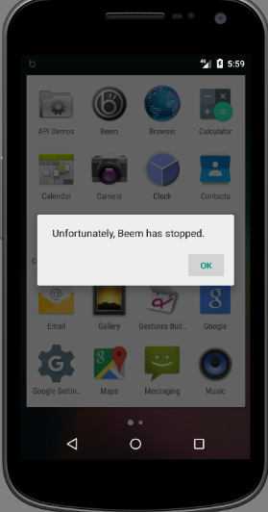

Repairing crashes in Android Apps 安卓应用的程序崩溃修复
Shin Hwei Tan* | Zhen Dong^ | Xiang Gao^ | Abhik Roychoudhury^
Southern University of Science and Technology* National University of Singapore^

Slide 2





南方科技大学智能软工组
姚新 系主任
研究方向 : 神经计算、演化计算、
机器学习、大数据分析、自适应优化等
张煜群
研究方向 : 软件工程、服务计算
刘烨庞
研究方向 : 软件测试和分析，
移动计算和软件安全
陈馨慧 （Shin Hwei Tan）
研究方向 : 自动程序修复、 软件测试、基于搜索的软件工程

Slide 3
Repair & Synthesis for Android apps
Repairing crashes in Android apps [ICSE 2018]
Android Testing via Synthetic Symbolic Execution [ASE 2018]
path constraint
App
Library
φ
Symbolic domain
Concrete domain

Slide 4
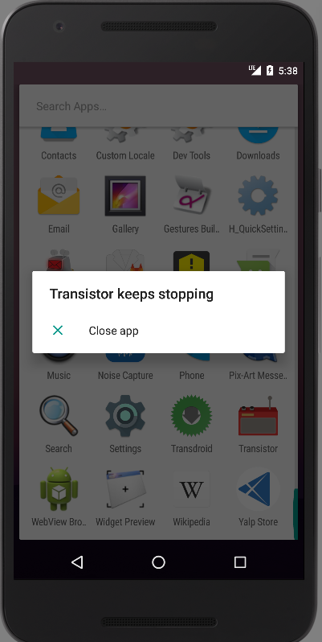
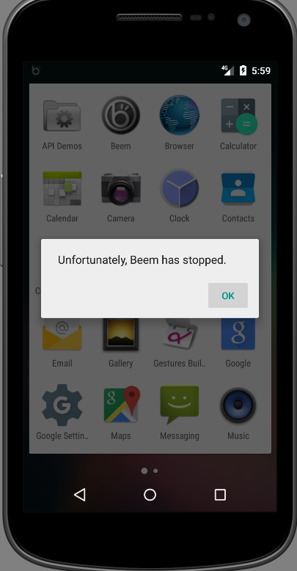

Android Repair System
Criteria for Android repair system:
Could be used by any smartphone user
Doesn’t require source code
No prior knowledge of Android app
No prior experience of running tests

Slide 5
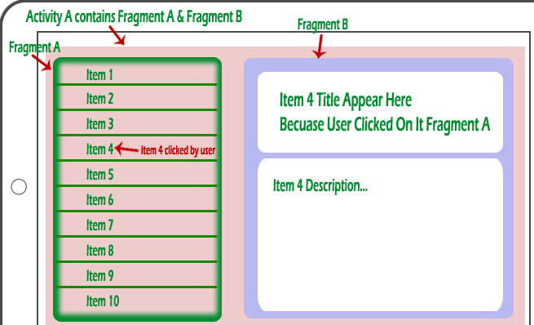
Background: Activity/Fragment
Item 4 Title Appear Here
Because User Click On Fragment A
Notes:
Each fragment can be modified independently of the host activity
(activity containing the fragment) by performing a set of changes

Slide 6
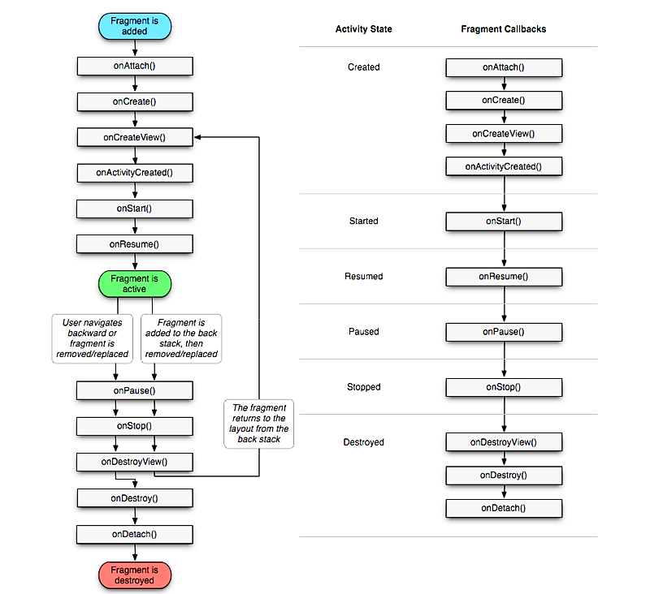
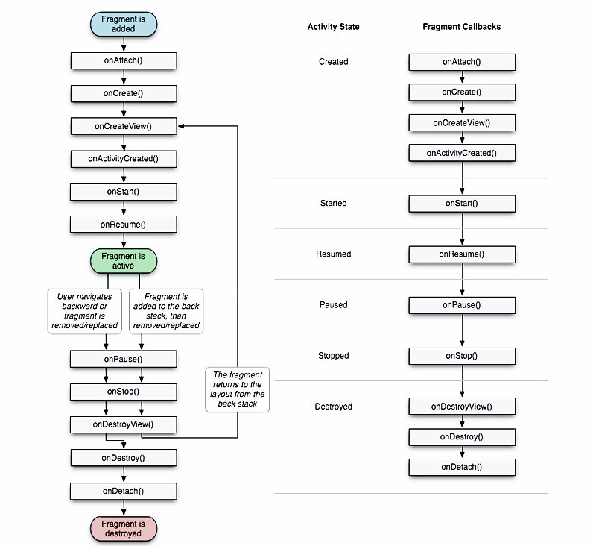
Complexity of Android Activity/Fragment Lifecycle
Activity State
Fragment Callbacks
Created
Started
Resumed
Paused
Stopped
Destroyed
Notes:
Each method represents a lifecycle callback, a method that gets called given a change of state. Lifecycle transition obeys certain principles. For
instance, an activity with the paused state could move to the resumed state or
the stopped state, or may be killed by the Android system to free up RAM.
A fragment is a portion of user interface or a behavior that can be put in
an Activity. Each fragment can be modified independently of the host activity
(activity containing the fragment) by performing a set of changes. For a fragment,
it goes through more states than an Activity from being launched to the active

Slide 7
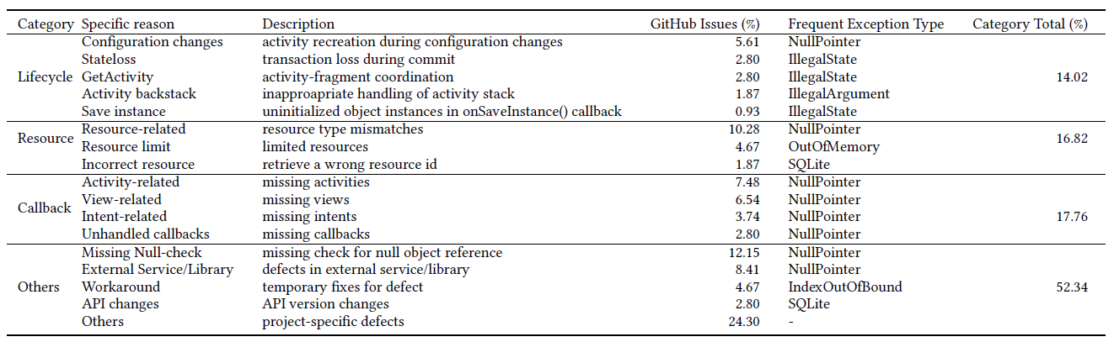
What lead to crashes in Android apps?
Common root causes of crashes in apps:
Lifecycle-related (14.02%)
Resource-related (16.82%)
Workaround: 4.67 %
Most common exceptions
NullPointerException (40.19%)
IllegalStateException (7.48%)
Could be automatically repaired

Slide 8
Lifecycle-aware Repair Operators
Operator | Description
S1: GetActivity-check | Insert a condition to check whether the activity containing the fragment has been created.
S2: Retain object | Store object and load it when configuration changes
S3: Replace resource id | Replace resource id with another id of same type.
S4: Replace method | Replace the current method call with another method call with similar name and compatible parameter types.
S5: Replace cast | Replace the current type cast with another compatible type.
S6: Move stmt | Removes a statement and add it to another location.
S7: Null-check | Insert condition to check if a given object is null.
S8: Try-catch | Insert try-catch blocks for the given exception.

Slide 9
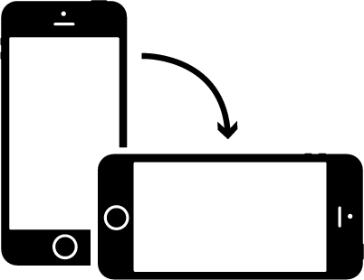
Lifecycle-aware Repair Operator: Retain stateful object
Activity re-created:
onDestroy()→onCreate()
public void onCreate(Bundle savedInstanceState) {…
+ setRetainInstance(true);// retain this fragment
}
// new field for saving the object
+ private static Option saveOption;
public View onCreateView(LayoutInflater inflater,
ViewGroup container, Bundle savedInstanceState) {
// saving and loading the object
+ if(option!=null){
+ saveOption = option;
+ }else{
+ option = saveOption;
+ }
 switch (option.getButtonStyle()){
1
2
3

Slide 10




Android Apps Repair System (Droix)
Droix
Buggy APK
Mutant
Logs
Bug locations
Log analyzer
Mutant generator
Decompiler
Bug report
UI sequence
Test checker
Operators
Violations
Evaluator
Code checker
Violations
Fixed APK
Selector
APKs
Mutants pool

Slide 11
Android Apps Repair System (Droix)
Droix
Buggy APK
Mutant
Logs
Fault locations
Log analyzer
Mutant generator
Decompiler
Bug report
UI sequence
Test checker
Operators
Violations
Evaluator
Code checker
Violations
Fixed APK
Selector
APKs
Mutants pool

Slide 12
Code-level & Test-level Properties in Droix
Level | Type | Description
Code-level | Well-formedness | Compilable and structural type of program matches with the context of selected operator.
 | Bug hazard | Transformation violates Java exception-handling best practices.
 | Exception Type | Transformation matches given exception type.
Test-level (Android-specific) | Lifecycle | Event transition matches with the activity/fragment lifecycle model.
 | Activity-Fragment | Interaction between a fragment and its parent activity matches the activity-fragment coordination model
 | Commit | Commit of fragment’s transactions in allowed states.
Bug hazard: “What not to do when handling exception?”
Similar concepts as anti-patterns [FSE’16]

Slide 13
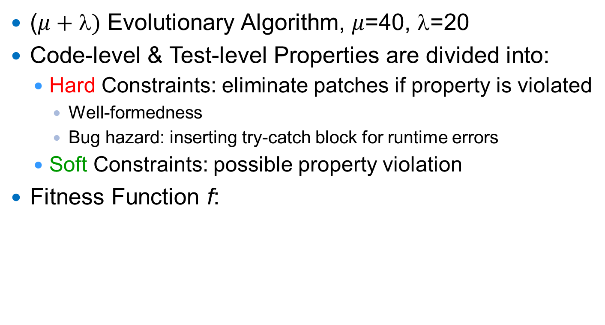
Searching for Patches
($μ+)$ Evolutionary Algorithm, $μ$=40, $$=20
Code-level & Test-level Properties are divided into:
Hard Constraints: eliminate patches if property is violated
Well-formedness
Bug hazard: inserting try-catch block for runtime errors
Soft Constraints: possible property violation
Fitness Function f:
f = Minimize # of violations for soft constraints
Notes:
Error represents an unrecoverable condition which should not be handled

Slide 14
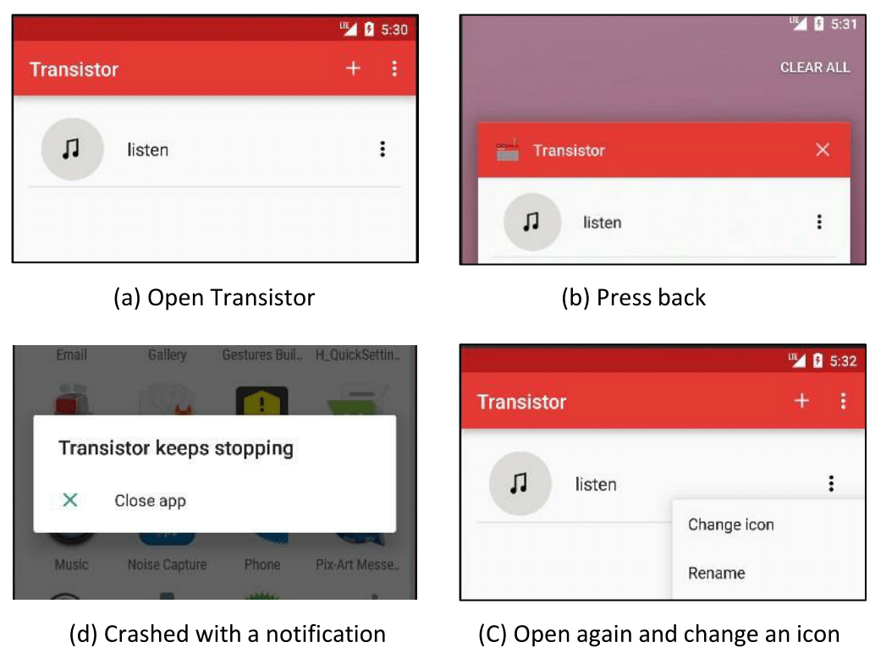
Example: Transistor
FATAL EXCEPTION: MAIN
PROCESS: ORG.Y20K.TRANSISTOR, PID: 2416
JAVA.LANG.ILLEGALSTATEEXCEPTION:
FRAGMENT MAINACTIVITYFRAGMENT{82E1BEC}
NOT ATTACHED TO ACTIVITY
Fragment is detached from the previous activity during app termination & should be attached to new activity in the restarting app.

Slide 15
Example: Transistor
Developer’s patch
- startActivityForResult ( pickImageIntent , REQUEST_LOAD_IMAGE);
+ mActivity.startActivityForResult ( pickImageIntent , REQUEST_LOAD_IMAGE);
Reuse old activity (mActivity)
Droix’s patch
+ if ( getActivity() !=null )
startActivityForResult ( pickImageIntent , REQUEST_LOAD_IMAGE);
Check if activity containing the fragment has been created.

Slide 16

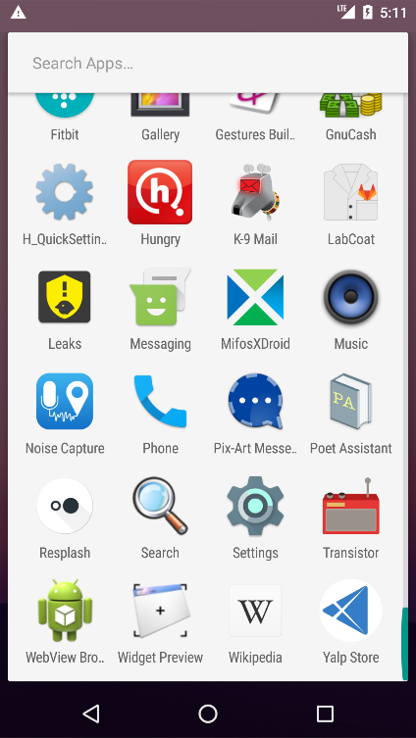
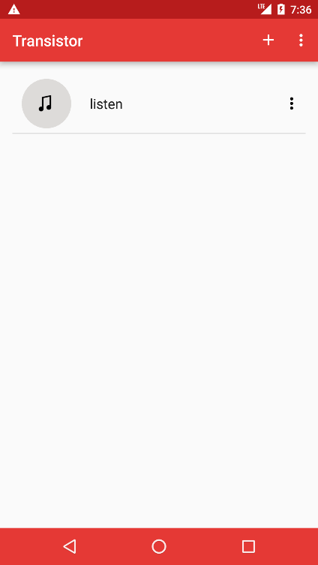
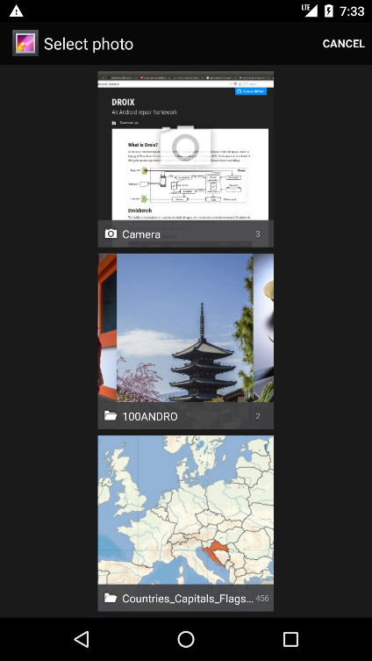


Which patch is better?
Patch generated by Droix
Patch crafted by human
<17minutes to fix
2 days to fix
Resolved 9 months later

Slide 17






Empirical Evaluation of Droix
Benchmark: Droixbench
Evaluation results
Repaired 15 crashes, 3 incorrect
Comparing with developer’s repair
1 better
7 syntactic equivalent
1 semantic equivalent
3 UI-behavior equivalent
Fdroid
PoetAssistant
K-9 Mail
......
AnkiDroid
ConnectBot
24 crashes in 15 mobile apps

Slide 18

Android Testing via Synthetic
Symbolic Execution
Xiang Gao | Shin Hwei Tan | Zhen Dong | Abhik Roychoudhury

Slide 19

Challenges in symbolically executing framework oriented programs
Device-dependent (IoT, android)
Cannot be executed outside certain device/emulator
Unavailable system or third-party libraries
framework-base programs
Complex and large libraries
Path explosion
Quickly involved platform
Library models should be continually updated

Slide 20
Existing solutions
Incomplete Modelling e.g. JPF-android
Manage whole execution in real system stack e.g. Instrumentation-based strategy
Pre-defined Library Model
Software
Software
System software stack
Actual Device
We propose a strategy between the in-vitro and in-vivo approaches for handling complex libraries.

Slide 21


Constraints loss due to concrete execution
path constraint
App
Library
φ
Path constraint loss occurs when symbolic variables pass through the library boundary.
Symbolic domain
Concrete domain
Program Synthesis
On-demand synthesize a model to simulate the
behaviour of library and rebuild the lost path constraints.

Slide 22

Basic idea of SynthesiSE
App code
Symbolic analysis
Third-party libraries
program synthesis
System libraries
Concrete analysis
concrete
execution
Symbolically analysing application without modelling
Symbolically executing application code and selectively concrete executing libraries
Recovering the loss constraints by program synthesis

Slide 23
Program synthesis
Generated in the iterative refinement process
Input-output pairs
Path constraints
Program synthesizer
Synthesized expression
A set of ordered component, e.g. arithmetic, control-flow, array-access
Expression to simulate the relation between inputs and output
Second-order constraint solver
Components

Slide 24
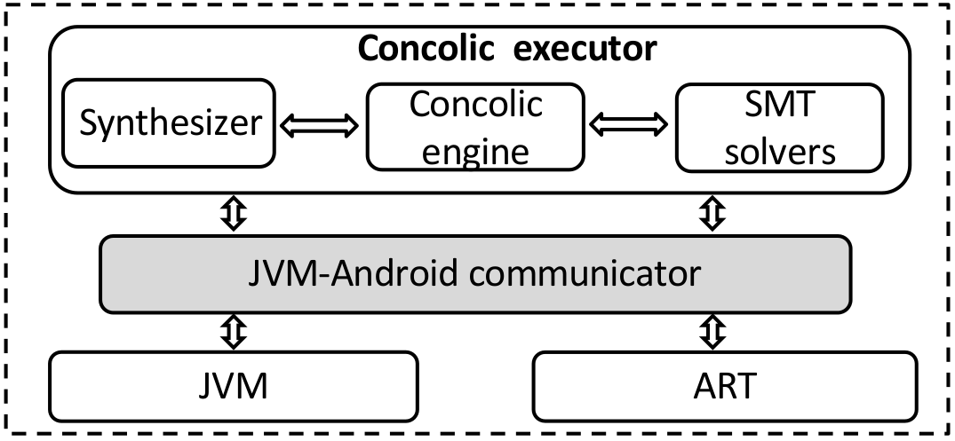
Architecture
Reuse existing symbolic execution framework designed for Java Program
Execute Android program in real devices/emulators
Automatically synthesize model to simulate the behaviours of Android library

Slide 25
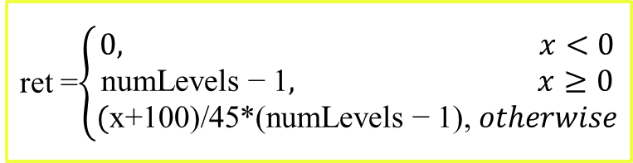
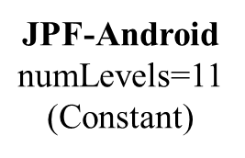
Results – Synthesized expression
Android Library
1 expression is correct
6 expressions are conditional correct
3 expression are both conditional and context-specific correct
2 cases without expression (object comparison)
public int calculateSigLev(int rssi, int numLevels ) {
if ( rssi <= MIN RSSI ) {
return 0 ;
} else if ( rssi >= MAX RSSI ) {
return numLevels − 1 ;
} else {
//MAX=-55, MIN=-100
float inputRange = (MAX − MIN) ;
float outputRange = ( numLevels − 1 ) ;
return int((rssi-MIN)*outputRange/inputRange) ;
}}
Example
Synthesized expression
JPF-Android
$\text{numLevels}$=11
(Constant)
ret =$\left\{\begin{aligned}0, x<0 \\ \text{numLevels}\text{ − 1}, x≥0 \\ \text{(}\text{x}\text{+100)/45∗(}\text{numLevels}\text{ − 1),} otherwise\end{aligned}\right.$
ret = 0.18*x1+18

Slide 26
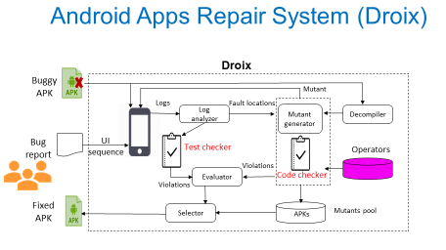
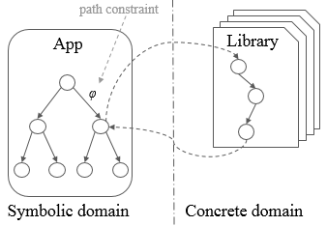
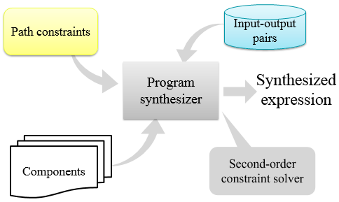

Conclusion

