Slide 1

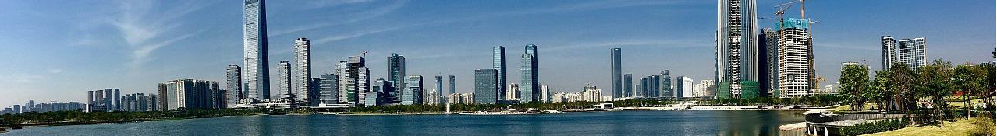
Divide and conquer: A feasible way towards practical APR tools
NASAC2018 第十七届全国软件与应用学术会议 2018.11.24
Hao Zhong
Shanghai Jiao Tong University

Slide 2
Hao Zhong (钟浩)
Code synchronization/migration
ICSE2010, FASE2013, ICPC2016.
Documentation errors
FASE2011, OOPSLA2013.
Concurrency bugs
ASE 2015, ASE 2016.
Mining specifications
ECOOP2009, ASE2009, ICSE2012, TSE2018.
Bug signature/detection
ASE2017
Program repair
ICSE 2015, EMSE 2018 (ICSE2018), SANER 2018, JSS 2018.

Slide 3
The criticism
M. Monperrus. A critical review of “automatic patch generation learned from human-written patches”: Essay on the problem statement and the evaluation of automatic software repair. In Proc. 36th ICSE, pages 234–242, 2014.
Y. Qi, X. Mao, Y. Lei, Z. Dai, and C. Wang. The strength of random search on automated program repair. In ICSE, pages 254–265, 2014
Qi, Z., Long, F., Achour, S., & Rinard, M. An analysis of patch plausibility and correctness for generate-and-validate patch generation systems. In Proc. ISSTA, pages. 24-36, 2015

Slide 4
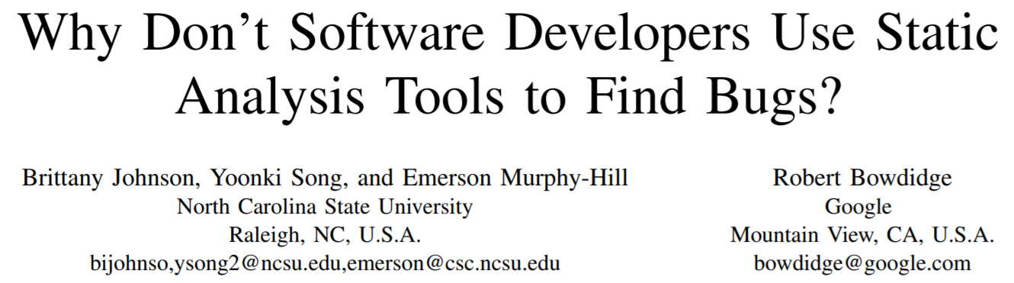
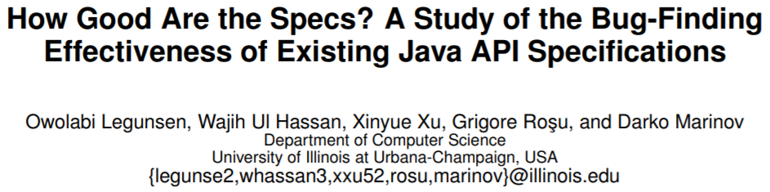
The criticism on other research field
Some
ICSE2013
80% false alarms are reasonable
ASE2016

Slide 5
Our empirical study at ICSE 2015
An empirical study on real bug fixes
Hao Zhong and Zhengdong Su
In Proc. International Conference on Software Engineering (ICSE), pages 913-923, 2015.
Research Questions
RQ1. To what extent are bugs localized?
RQ2. How complicated is it to fix bugs?
RQ3. What operators are essential for fixing bugs?
RQ4. What is the importance of API knowledge to fix bugs?
RQ5. What kinds of files are necessary to be modified to fix bugs?
RQ6. How many files are necessary to be added or deleted to fix bugs?

Slide 6

The potential of APR
Hao Zhong and Na Meng. An empirical study on using hints from past fixes. In Proc. International Conference on Software Engineering (ICSE), pages 144-145, 2017.

Slide 7
The potential of APR
APRs have the potential of repair 20% bugs
Concurrency bugs account for about 5% bugs
Ziyi Lin, Darko Marinov, Hao Zhong, Yuting Chen, and Jianjun Zhao. JaConTeBe: A benchmark suite of real-world Java concurrency bugs. In Proc. ASE, pages 178-198, 2015.
Ziyi Lin, Hao Zhong, Yuting Chen, and Jianjun Zhao. LockPeeker: detecting latent locks in Java APIs. In Proc. International Conference on Automated Software Engineering (ASE), pages 368-378, 2016.

Slide 8
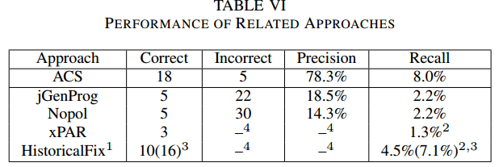
How difficult is APR?
APR tools are still far from realizing their potential
Yingfei Xiong,Jie Wang,Runfa Yan,Jiachen Zhang,Shi Han,Gang Huang,Lu Zhang.Precise Condition Synthesis for Program Repair. Proc. ICSE 2017

Slide 9
Why is APR so difficult?
Towards reusing hints from past fixes -An exploratory study on thousands of real samples
Hao Zhong and Na Meng
Empirical Software Engineering, 23(5), pages 2521-2549, 2018. Accepted by ICSE 2018 as a journal first paper.
Bug fix
Delta graphs
Redundancy
With Grapa, we use WALA to build SDGs from bug fixes, and compare them to build delta graphs.
We compare delta graphs with six overlap strategies.
No splitting
All modifications
Hao Zhong and Xiaoyin Wang. Boosting complete-code tool for partial program. In Proc. International Conference on Automated Software Engineering (ASE), pages 671-681, 2017.

Slide 10
Subjects
Name | Fix | LOC | File
aries | 442 | 492,349 | 2,423
cassandra | 2,463 | 9,683,554 | 19,918
derby | 2,392 | 17,601,539 | 26,359
mahout | 438 | 538,277 | 3,712
total | 5,735 | 28,315,719 | 52,412
In-project
OP1: How many fixes can be constructed from past fixes?
OP2: How creative is a bug fix?
OP3: What are the challenges when preparing the repository of bug fixes?
Cross-project
OP4: What is the potential to learn from other projects?

Slide 11
Major findings
Finding 1. In total, if an repair approach only reuses the contents, the structure changes, or name changes from past fixes of only one past fix, at most 2.1%, 12.5%, and 3.8% new bugs can be thus constructed.
Finding 2. In total, if a repair approach combines multiple fixes and reuses the contents, the structure changes, or name changes, at most 3.2%, 41.3%, and 9.8% new bugs can be thus constructed.
Finding 4. A fix typically has both recurring edits and creative edits.
…

Slide 12
Divide and conquer
Mining repair model for exception-related bug
Hao Zhong and Hong Mei
The Journal of Systems & Software, 141, pages 16-31, 2018.
NullPointerException
AssertionFailedError
bugs
SQLException
Exception-related bugs
AssertionError
…

Slide 13
Baseline
M. Martinez and M. Monperrus. Mining software repair models for reasoning on the search space of automated program fixing. Empirical Software Engineering, 20(1):176–205, 2013.
past fix
changedistiller
repair action
miner
repair shape
generator
repair model
bug

Slide 14
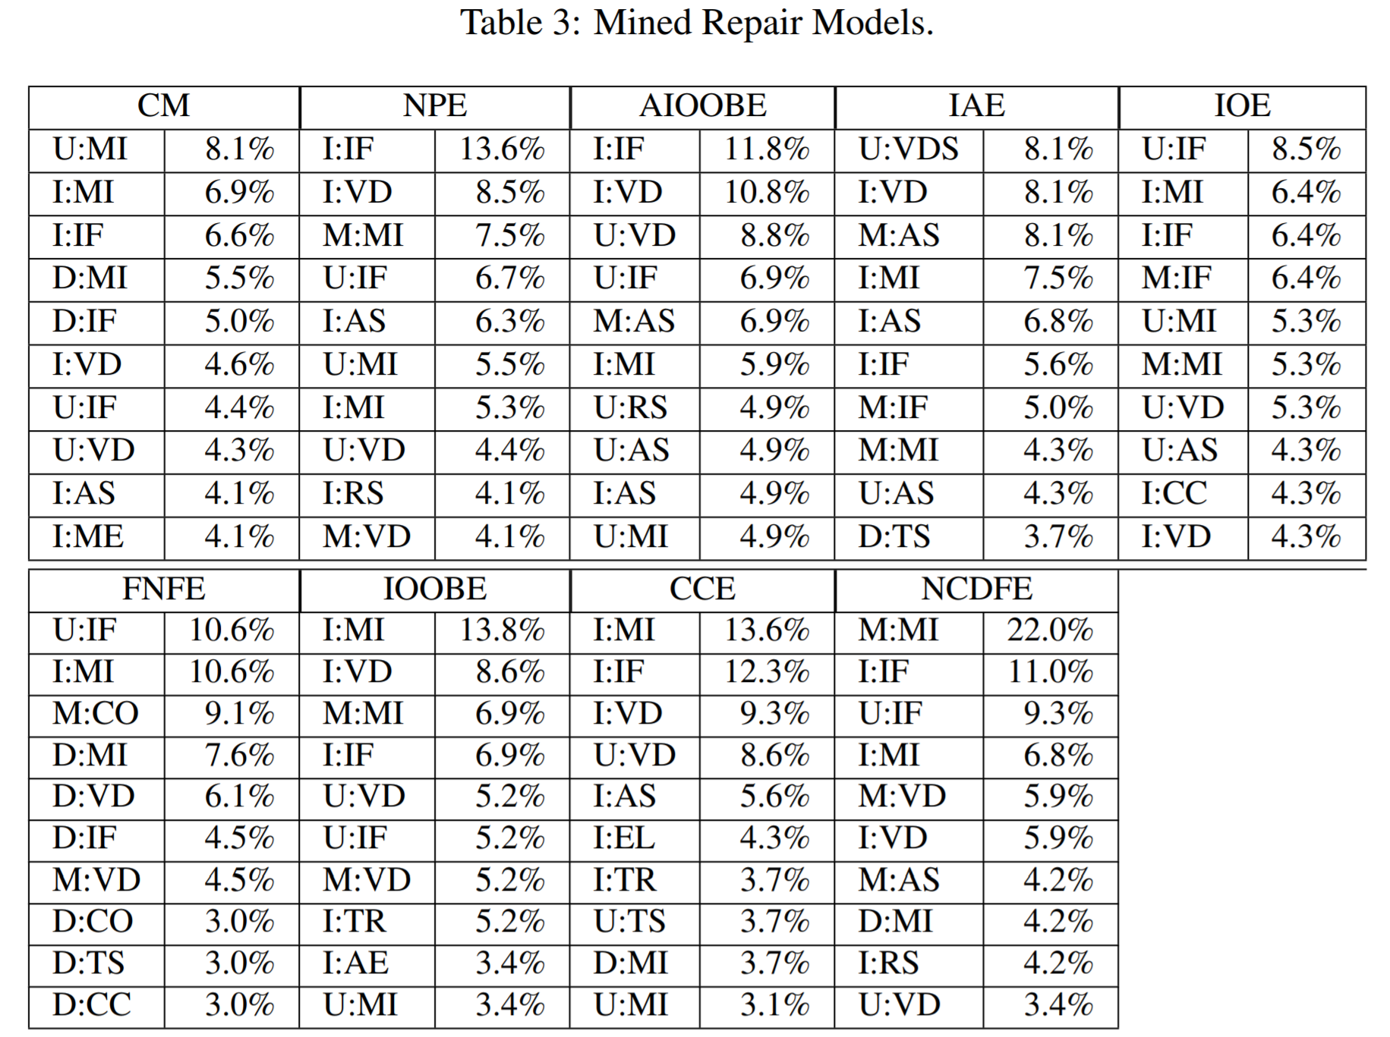
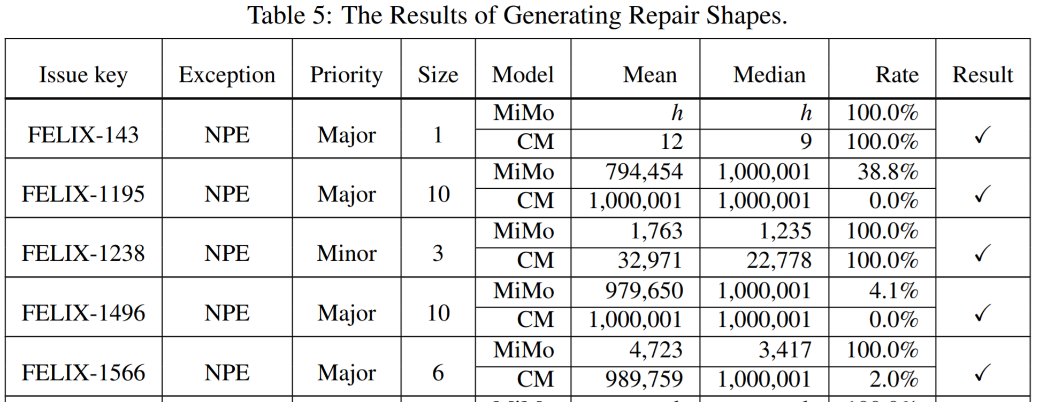
Repair model

Slide 15


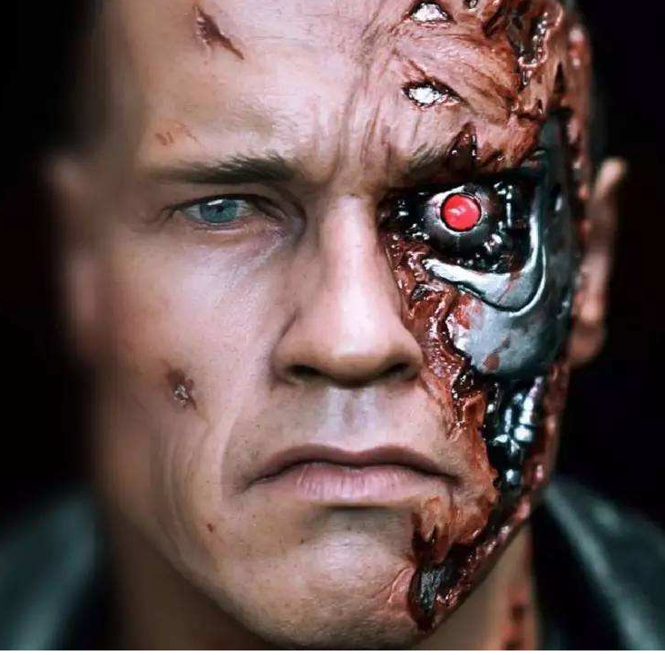




AI in fictions

Slide 16
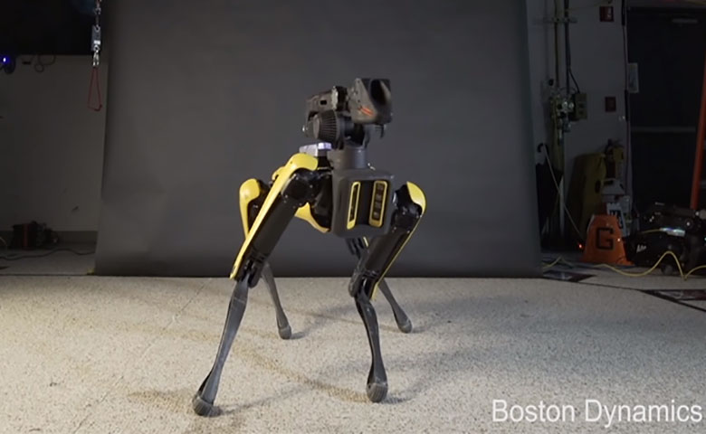
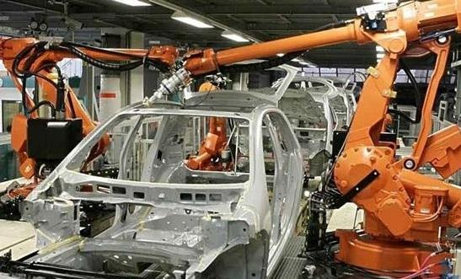
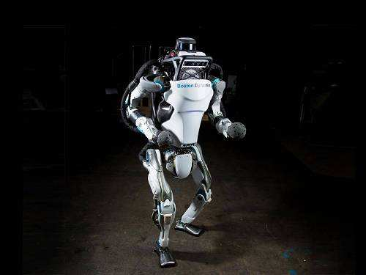
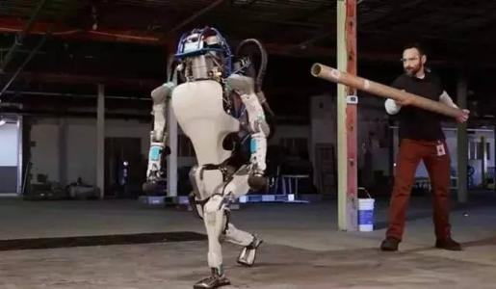
Hardware

Slide 17



Software?
Automatic program repair
Automatic program synthesis

Slide 18



Underestimated?
Software
scale
Hardware
time

Slide 19
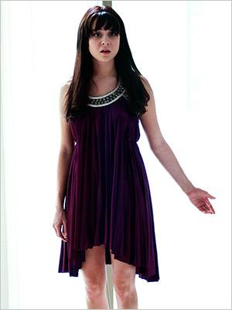
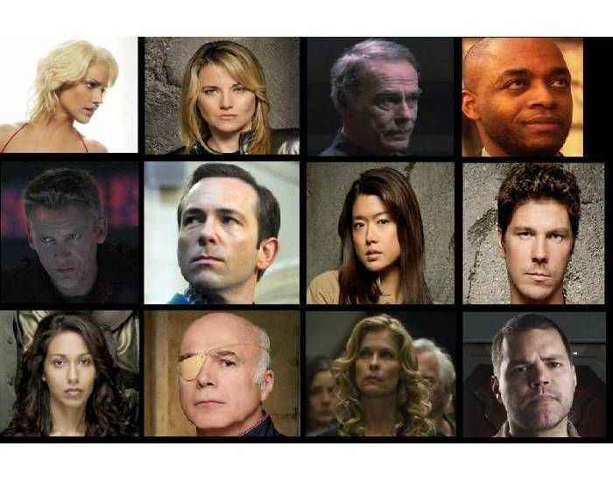

What is AI?

Slide 20


What is AI?

Slide 21
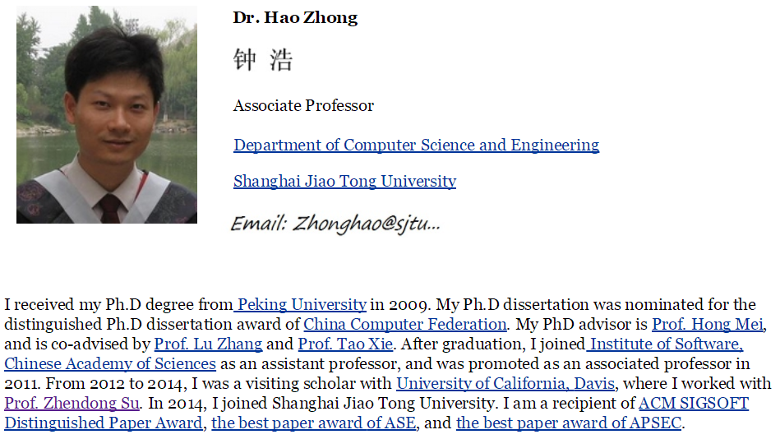

Please contact me if you are a self-motivated student

