Slide 1




An Empirical Study on Crash Recovery Bugs in Large-Scale Distributed Systems
Yu Gao, Wensheng Dou, Feng Qin, Chushu Gao, Dong Wang, Jun Wei, Ruirui Huang, Li Zhou, Yongming Wu
Institute of Software,
Chinese Academy of Sciences
University of Chinese Academy of Sciences
The Ohio State University
Alibaba Group
Notes:
Hi! My name is Yu Gao, from University of Chinese Academy of sciences, Today I will talk about our empirical study on crash recovery bugs in large-scale distributed systems. 介绍大规模分布式系统对节点失效恢复相关缺陷的实证研究工作

Slide 2

















Large-scale distributed systems
Notes:
随着越来越多的数据与计算从本地往云端迁移，大规模分布式系统逐步在大型互联网公司中得到了广泛使用，并且成为云计算、大数据应用以及其他现代应用的基础设施。因此，高可靠性和高可用性在大规模分布式系统显得尤为重要。

Slide 3





Node crashes are inevitable!
Large-scale distributed systems are commonly built on thousands of commodity machines (nodes)
Power failure
Hardware failure
Software failure
Notes:
大规模分布式系统由数量众多的计算节点组成，运行不同的复杂协议。
这些系统中的计算节点可能面临断电、硬件错误、软件错误等异常情况，这些异常行为将导致计算结点出现节点失效（Node crash）。虽然单个计算结点失效概率较低，但是当计算结点数量庞大之后，节点失效发生的概率就会很高

Slide 4
Node crashes are common!
Machine failures in 29-day Google trace log [1]
(12,583 distinct machines)
2.4% machines per day!
# Events
Day
[1] M. Mesbahi et al., Cloud Dependability Analysis: Characterizing Google Cluster Infrastructure Reliability, ICWR 2017.
Notes:
一项对google集群中超过12000台机器所做的研究表明，平均每天大约会有2.4%的机器发生失效

Slide 5

Basic crash recovery process
Automated crash recovery must be a first-class operation of distributed systems [1]
In-memory state
Node 1
Node 2
Serving
Persistent
state
Crash detection
Crash handling
Local recovery
In-memory state
Reboot detection
Remote synchronization
Reboot handling
[1] B. Cooper et al., Benchmarking Cloud Serving Systems with YCSB, SoCC 2010.
Notes:
为了应对节点失效，开发者在分布式系统中引入了各种复杂的节点失效恢复机制
比如在一个基本的失效恢复过程中，一个正常对外提供服务的节点，node1会对重要数据进行备份。当节点1发生crash之后，其余相关的节点，如节点2会检测到该节点失效，并做相应的失效处理。当节点1重新启动之后，它首先通过备份进行本地恢复，然后与集群中的其他节点进行远程同步。同时，节点2会检测到节点1的重启，做相应的重启处理。最后整个集群重新进入到一个一致性状态。

Slide 6





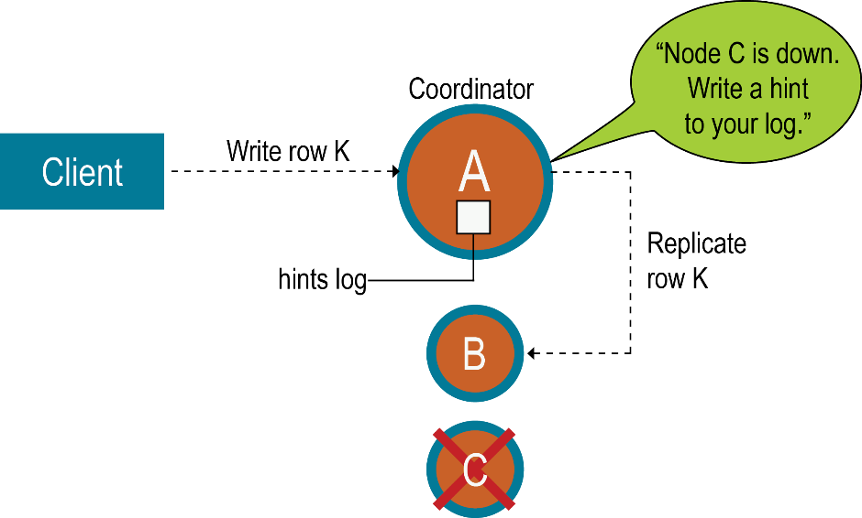


Various crash recovery mechanisms
Backing up
Data synchronization
Failover
Region Server
Region
Put
Memstore
WAL
Ack
HDFS Data Node
Write-ahead logging in HBase
Hinted handoffs in Cassandra
Notes:
在分布式系统中有各种格样的失效恢复机制，如备份、数据同步、故障转移等等。不同的系统又可能具有特别的失效恢复机制，如Hbase中的write-ahead logging，cassandra中的hinted handoffs 等

Slide 7

Crash recovery bugs (CR bugs)
Crash recovery processes can have bugs!
Backing up
Data synchronization
Failover
Region Server
Region
Put
Memstore
WAL
Ack
HDFS Data Node
Write-ahead logging in HBase
Hinted handoffs in Cassandra
Notes:
然而这些节点失效恢复机制及其实现中可能存在错误，从而引入错综复杂的节点失效恢复相关缺陷（Crash recovery bugs），导致严重的后果

Slide 8

A real-world crash recovery bug
zookeeper fails to start because of inconsistent epoch
https://issues.apache.org/jira/browse/ZOOKEEPER-1653
Follower
Leader
①
NEWLEADER
②
Take snapshot
Snapshot
case Leader.NEWLEADER:
zk.takeSnapshot();
self.setCurrentEpoch(newEpoch);
…
③
Write current epoch
currentEpoch
if (epochOfZxid > currentEpoch){
// Stop itself
}
Fail to start!
Notes:
比如一个真实的zookeeper当中的节点失效恢复缺陷如图所示：
当follower节点收到来自leader节点的newleader消息之后，它首先把当前内存数据写入snapshot文件中，接着把current epoch数据写入另外一个文件。
但是开发者在设计和实现系统的过程中没有预想到在这两个I/O写中间可能发生一个节点失效，这个意料之外的节点失效会导致follower节点在重启之后用于恢复的数据存在不一致，最终导致follower节点无法启动。

Slide 9
Understanding CR bugs is important!
Empirical bug studies in distributed systems
Cloud bug study [1]
Distributed concurrency bugs [2]
Timeout issues [3]
Existing CR bug detection – Treat a distributed system as a black/grey box
Model checking [4]
Crash injection [5]
Not for CR bugs!
Lack of deep understanding of CR bugs!
[1] H. Gunawi et al., What Bugs Live in the Cloud? A Study of 3000+ Issues in Cloud Systems, SoCC 2014.
[2] T. Leesatapornwongsa et al., TaxDC: A Taxonomy of Non-Deterministic Concurrency Bugs in Datacenter Distributed Systems, ASPLOS 2016.
[3] T. Dai et al., Understanding Real-World Timeout Problems in Cloud Server Systems, IC2E 2018.
[4] T. Leesatapornwongsa et al., 2014. SAMC: Semantic-Aware Model Checking for Fast Discovery of Deep Bugs in Cloud Systems, OSDI 2014.
[5] H. Gunawi et al., FATE and DESTINI: A Framework for Cloud Recovery Testing, NSDI 2011.
Notes:
现有的分布式系统中的缺陷实证研究工作都不解析节点失效恢复相关缺陷
而大多数的缺陷检测工具把分布式系统看做是一个黑盒或灰盒，他们在检测缺陷时不关心在何种系统状态下注入节点失效可能会导致节点失效恢复相关缺陷，在缺陷检测中缺乏对节点失效恢复相关缺陷的深入理解
因此对分布式系统中节点失效恢复相关缺陷做一个综合性实证研究十分必要

Slide 10



CREB: study on Crash REcovery Bugs
103 CR bugs
4 varied distributed systems
Bugs reported during 2011-2014
We carefully study each bug
Inspect comments, patches and source code
Write down all steps to reproduce
Coordination | Computing framework | Storage | Storage
Master/slave based on leader election | Master/slave | Master/slave | Peer-to-peer
Notes:
在我们的工作中，我们对4个开源分布式系统中103个节点失效恢复相关缺陷做了研究。这四个分布式系统可以代表不同类型的分布式系统，并且包含2中常见的系统架构模型：master/slave 模型和peer-to-peer模型。针对每个缺陷，我们通过研究开发者之间的讨论，缺陷补丁，系统源码，以及重现部分缺陷来深入分析和理解缺陷，同时我们也会记录所有重现缺陷的步骤。

Slide 11

Research questions
RQ1: Root cause
What are the root causes for CR bugs?
RQ2: Triggering condition
How is a CR bug triggered?
RQ3: Bug impact
What impacts do CR bugs have?
RQ4: Fixing
How do developers fix CR bugs?
Notes:
我们的研究问题是：造成节点失效恢复相关缺陷的根本原因是什么？此类缺陷如何被触发？此类缺陷具有何种影响？开发者在现实世界中如何修复此类缺陷？

Slide 12
RQ1: Root cause
Notes:
首先我将要介绍缺陷根因

Slide 13
RQ1: Root cause
Notes:
根据我们的研究，节点失效恢复相关缺陷可能由不正确的备份，不正确的节点失效、重启检测，不正确的状态识别，不正确的状态恢复，以及并发所造成。接下来，我将逐一对他们进行介绍。

Slide 14
RQ1: Root cause
Observer
Leader
Root cause
Incorrect backup
Startup
No backup
Ex:ZOOKEEPER-1552
Notes:
首先是不正确的备份。
Click: 第一种情况是缺少备份
Click: 我会用一个zookeeper中的例子来进行解释

Slide 15
RQ1: Root cause
Observer
Leader
Root cause
Incorrect backup
“Snapshot of current
in-memory data”
Snapshot
Take snapshot
Snapshot
Startup
No backup
Ex:ZOOKEEPER-1552
Notes:
在启动阶段，一个observer节点首先把来自leader的snapshot数据应用到内存中，
Click: 接着把该数据持久化到本地磁盘中

Slide 16
RQ1: Root cause
Observer
Leader
Root cause
Incorrect backup
“Snapshot of current
in-memory data”
Snapshot
Take snapshot
Snapshot
No backup
Serving
“Commit TXN_i”
TXN_i
Ex:ZOOKEEPER-1552
Notes:
当observer进入正常服务阶段后，
Click: 所有来自leader的事务都只被应用到内存中而没有进行备份

Slide 17
RQ1: Root cause
Observer
Leader
Root cause
Incorrect backup
“Snapshot of current
in-memory data”
Snapshot
Take snapshot
Snapshot
No backup
Serving
“Commit TXN_i”
TXN_i
.
.
.
“Commit TXN_n”
TXN_n
Huge in-memory data!
“Snapshot of current
in-memory data”
Take a long time for recovery!
Ex:ZOOKEEPER-1552
Notes:
运行一段时间之后，zookeeper集群内存数据变得十分巨大
Click: 当observer节点在此时被重新启动后
Click: 它必须从leader节点接收一个十分巨大的snapshot文件来进行数据同步
Click: 这将发费很长时间，造成了性能下降

Slide 18



RQ1: Root cause
Root cause
Incorrect backup
N
No backup
Data
Data
Backup
Implication:
Important data should be backed up in all cases
Inconsistency about whether data are backed up indicates CR bugs
Notes:
在我们的研究中
Click: 重要的数据在一些程序路径中被正确地备份
Click: 而在其余一些路径中则没有被备份，从而引发了节点失效恢复相关缺陷
Click: 这表明重要的数据在所有程序路径下都应该被备份，数据是否被备份的不一致性有可能导致节点失效恢复相关缺陷
Important data should be backed up in all cases
and Inconsistency about whether data are backed up indicates CR bugs

Slide 19
RQ1: Root cause
Root cause
Incorrect backup
RM
AM1
Finish job X successfully
No backup
Incorrect backup management
Premature removal of backups
RM: ResourceManager
AM: ApplicationMaster
Ex: MAPREDUCE-5476
Notes:
第二种不正确备份的情形是不正确的备份管理
Click: 比如备份的过早移除
Click: 在这个mapreduce的例子当中，一个application master节点 AM1在成功完成工作X之后

Slide 20
RQ1: Root cause
Root cause
Incorrect backup
RM
AM1
Finish job X successfully
Delete staging directory
“Unregister to RM”
No backup
Incorrect backup management
Premature removal of backups
RM: ResourceManager
AM: ApplicationMaster
Ex: MAPREDUCE-5476
Notes:
首先删除了工作X的临时目录，
Click: 接着向rm节点发送消息进行注销工作X。

Slide 21

RQ1: Root cause
Root cause
Incorrect backup
RM
AM1
Finish job X successfully
Delete staging directory
“Unregister to RM”
No backup
Incorrect backup management
Premature removal of backups
Stop itself
RM: ResourceManager
AM: ApplicationMaster
Ex: MAPREDUCE-5476
Notes:
在收到注销消息之前，rm节点发生crash

Slide 22
RQ1: Root cause
Root cause
Incorrect backup
RM
AM1
Finish job X successfully
Delete staging directory
“Unregister to RM”
No backup
Incorrect backup management
Premature removal of backups
Stop itself
AM2
Try to recover job X
Fail the job since staging dir has been already cleaned!
RM: ResourceManager
AM: ApplicationMaster
Ex: MAPREDUCE-5476
Notes:
当rm节点被重新启动后
Click: 它重启了另外一个节点AM2来恢复工作X
Click: 然而当am2节点试图恢复工作时
Click: 由于工作X的临时目录已经被移除，它错误地把工作X的结果置为失败

Slide 23
RQ1: Root cause
Create backups
Create backups
Root cause
Incorrect backup
Backups
Backups
Period of use
Period of use
No backup
Clean backups
Incorrect backup management
Backups
Premature removal of backups
Clean backups
Backups
Notes:
如图所示，备份只有在不再被使用时才可以被删除，过早移除备份有可能会使某项任务无法被正确恢复

Slide 24
RQ1: Root cause
Root cause
Incorrect backup
No backup
Incorrect backup management
Premature removal of backups
Implication:
Backups should be managed properly
Incorrect backup lifecycle indicates CR bugs
Incorrect backup updates
Backups are not updated in an atomic way
Update logic is incorrectly implemented
Notes:
不正确的备份管理还包括不正确的备份更新，具体讨论可以在我们的论文中找到。
Click:
综上，备份应当被恰当地管理，不正确的备份生命周期可能会引发节点失效恢复相关缺陷

Slide 25
RQ1: Root cause
Root cause
Incorrect backup
Incorrect crash / reboot detection
No crash detection
Do not perceive a dead node
Unaware crash within timeout
No crash recovery can be applied
Notes:
接下来，我将介绍不正确的节点失效或节点重启检测
Click: 第一种情形是缺少节点失效检测
Click: 其中包含3中可能的情况

Slide 26

RQ1: Root cause
Root cause
Incorrect backup
Incorrect crash / reboot detection
AM
RM
TA
“heartbeat”
No crash detection
Do not perceive a dead node
Unaware crash within timeout
No crash recovery can be applied
RM: ResourceManager
AM: ApplicationMaster
TA: TaskAttempt
Ex: MAPREDUCE-3228
Notes:
让我们来看一个mapreduce当中由没有感知到一个死亡节点所引发的节点失效恢复相关缺陷
Click: 在这个例子中，rm节点和ta节点被部署到同一台物理机器上。am节点向ta节点发送心跳消息

Slide 27

RQ1: Root cause
Root cause
Incorrect backup
Incorrect crash / reboot detection
AM
RM
TA
“heartbeat”
“heartbeat”
“Stop the task container!”
No crash detection
Hang!
Do not perceive a dead node
Unaware crash within timeout
No crash recovery can be applied
RM: ResourceManager
AM: ApplicationMaster
TA: TaskAttempt
Ex: MAPREDUCE-3228
Notes:
在收到心跳消息之前，整台物理机器发生了崩溃，使得rm节点和ta节点同时崩溃
Click: 超时之后，am节点检测到ta节点发生了crash，并且向rm节点发送消息请求停止ta节点所在的任务容器。
Click: 但是am节点没有意识到rm节点也发生了crash，从而挂起等待rm节点的响应

Slide 28
RQ1: Root cause
Root cause
Incorrect backup
Incorrect crash / reboot detection
HM
RS1
RS2
Crash recovery is disabled
“Assign ROOT”
“Succ”
“Assign META”
No crash detection
Untimely crash / reboot detection
“Access ROOT”
No crash recovery can be applied
“Succ”
HM: HBase Master
RS: Region Server
Ex: HBASE-5918
Notes:
另外两种情形是不及时的节点失效或节点重启检测，以及没有运行相应的失效恢复过程。
Click: 比如这个hbase的例子所示的缺陷由没有运行相应的失效恢复过程所引发
Click: 在HM节点的启动过程中，对region server节点的节点失效恢复机制不可用。
Click: HM节点首先把root region分派给节点rs1
Click: 接着试图把meta region分派给节点rs2. 在分派meta region的过程中需要访问到root region。

Slide 29
RQ1: Root cause
Root cause
Incorrect backup
Incorrect crash / reboot detection
HM
RS1
RS2
Crash recovery is disabled
Detect RS1’s crash, but no recovery can be applied
“Assign ROOT”
“Succ”
“Assign META”
No crash detection
Untimely crash / reboot detection
Hang!
“Access ROOT”
No crash recovery can be applied
“Succ”
HM: HBase Master
RS: Region Server
Ex: HBASE-5918
Notes:
如果rs1节点在root region被成功分派之后发生crash
click: 那么该节点失效会被hm节点成功检测到，但是相应的失效恢复过程却由于失效恢复机制在此时不可用而无法运行。
Click: 最后导致集群一直在等待一个可用的root region来完成对meta region的分派。
Click

Slide 30
RQ1: Root cause
Root cause
Incorrect backup
Incorrect crash / reboot detection
No crash detection
Untimely crash / reboot detection
Implication:
Crashes and reboots can happen at any time
Missing/untimely crash/reboot detection indicates CR bugs
Notes:
这些例子表明节点失效和节点重启在任何时间都有可能发生，缺少节点失效或重启检测，以及不及时的节点失效或重启检测可能会导致节点失效恢复相关缺陷

Slide 31
RQ1: Root cause
Root cause
Incorrect backup
Incorrect crash / reboot detection
Incorrect state identification
Consider wrong states as correct
Miss the correct states
Incorrect data parser logic
Notes:
接下来，我将介绍不正确的状态识别。这里包含3中情形

Slide 32
RQ1: Root cause
Root cause
Incorrect backup
Incorrect crash / reboot detection
Incorrect state identification
N1
N2
“Vote for me?”
“Yes”
Consider wrong states as correct
Miss the correct states
Incorrect data parser logic
Ex: ZOOKEEPER-975
Notes:
我将用一个zookeeper中的例子来解释把一个错误状态看做正确状态的情形
Click: 一个zookeeper节点N1试图选举它自己为新的leader节点
Click: 在收到节点n2的响应消息之前，节点n1被重新启动
Click:

Slide 33
RQ1: Root cause
Root cause
Incorrect backup
Incorrect crash / reboot detection
Incorrect state identification
N1
N2
“Vote for me?”
“Yes”
Take the stale message
Go in LEADING state
Consider wrong states as correct
Performance degradation!
Miss the correct states
Incorrect data parser logic
Ex: ZOOKEEPER-975
Notes:
之后它错误的接受了n2节点的旧的选举消息
Click: 进入了leading状态。然而在n1节点发生crash之后，另外一个节点已经被选举为新的leader，N1运行了一次不必要的leader选举过程，从而造成了性能下降

Slide 34
RQ1: Root cause
Root cause
Incorrect backup
Incorrect crash / reboot detection
Incorrect state identification
Implication:
Inconsistencies between states before crash and identified states after crash may indicate CR bugs
Consider wrong states as correct
Miss the correct states
Incorrect data parser logic
Notes:
这表明节点失效前的状态，与发生节点失效后所识别到的状态之间的不一致性可能会引发节点失效恢复相关缺陷

Slide 35
RQ1: Root cause
Root cause
Incorrect backup
Incorrect crash / reboot detection
Incorrect state identification
Incorrect state recovery
N1
N2
“Message”
Modify in-memory state
v
Leftover of N1!
Incorrect handling of leftovers
No handling of leftovers
• Untimely handling of leftovers
Notes:
接下来我将介绍不正确的状态恢复
Click: 当一个节点发生失效后，它可能会在别的节点上留下一些旧的信息，我们把这些旧的信息成为crash节点的遗留物。这些遗留物应该被后续的恢复过程妥善处理。然而，一个有趣的发现是，由不正确的状态恢复所引发的缺陷大约有一半都由没有对失效节点的遗留物进行处理所导致的

Slide 36
RQ1: Root cause
Root cause
Incorrect backup
Incorrect crash / reboot detection
Incorrect state identification
Incorrect state recovery
TA1
AM
“CommitPending”
if(commitAttempt == null){
commitAttempt = attemptID;
} else { … }
“startCommit”
“doneCommit”
Incorrect handling of leftovers
No handling of leftovers
• Untimely handling of leftovers
AM: ApplicationMaster
TA: TaskAttempt
Ex: MAPREDUCE-3858
Notes:
Click: 比如在这个mapreduce缺陷中，ta1节点试图提交一个任务，并把它的attemptID保存在am节点端
Click:

Slide 37
RQ1: Root cause
Root cause
Incorrect backup
Incorrect crash / reboot detection
Incorrect state identification
Incorrect state recovery
TA1
AM
Leftover of TA1!
“CommitPending”
If(commitAttempt == null){
commitAttempt = attemptID;
} else { … }
“startCommit”
“doneCommit”
TA2
“CommitPending”
“Kill”
Incorrect handling of leftovers
Task remains unfinished!
No handling of leftovers
• Untimely handling of leftovers
AM: ApplicationMaster
TA: TaskAttempt
Ex: MAPREDUCE-3858
Notes:
在任务提交期间，ta1节点发生了crash
Click: 那么保存在am节点上的attemptid成为了ta1节点的遗留物
Click: 在超时之后，AM节点重启了另外一个task attempt， ta2来完成该项任务
Click: 当ta2节点试图提交任务是
Click: 由于一个attemptID已经存在在rm端
Click: ta2节点提交任务失败，最终导致该项任务一直处于未完成状态

Slide 38
RQ1: Root cause
Root cause
Incorrect backup
Incorrect crash / reboot detection
Incorrect state identification
Incorrect state recovery
Implication:
Unhandled leftovers of a crash node indicates CR bugs
Incorrect handling of leftovers
No handling of leftovers
• Untimely handling of leftovers
Notes:
这表明我们可以通过检测未被处理的失效节点遗留物来检测节点失效恢复相关缺陷

Slide 39
RQ2: Triggering condition
Notes:
接下来让我们来看一下节点失效恢复缺陷是如何被触发的

Slide 40
RQ2: Triggering condition
Triggering condition
# of nodes
Implication:
We can detect CR bugs in a small cluster, rather than a large cluster
Almost all (97%) CR bugs involve 4 nodes or fewer
Notes:
根据我们的研究，几乎所有的节点失效恢复相关缺陷都只涉及到不多于4个的计算节点
Click: 因此我们可以通过一个小的分布式集群来检测节点失效恢复相关缺陷

Slide 41
RQ2: Triggering condition
Triggering condition
# of nodes
# of crashes
No more than three crashes can trigger almost all (99%) CR bugs
Notes:
另外不多于3个的节点失效可以触发几乎所有的缺陷

Slide 42
RQ2: Triggering condition
Triggering condition
# of nodes
# of crashes
# of reboots
A combination of no more than 3 crashes and no more than 1 reboot can trigger 87% of the bugs.
Implication:
We can test distributed systems by injecting a small number of crashes and reboots
No more than one reboot can trigger 87% of CR bugs
36% of bugs do not need to inject any reboot
Notes:
不多于1个的节点重启可以触发87%的缺陷。其中36%的缺陷无需注入任何节点重启。
Click: 而通过不超过3个的节点失效以及不多于1个的节点重启可以触发87%的缺陷
Click: 因此，我们可以通过注入少量的节点失效和重启来触发节点失效恢复相关缺陷，测试分布式系统

Slide 43
RQ3: Bug impact
Notes:
接下来我将简要的介绍节点失效恢复相关缺陷的影响

Slide 44
RQ3: Bug impact
38% of CR bugs cause downtimes of the cluster or nodes
18% in CBS [1]
17% in TaxDC [2]
Fatal failures
[1] H. Gunawi et al., What Bugs Live in the Cloud? A Study of 3000+ Issues in Cloud Systems, SoCC 2014.
[2] T. Leesatapornwongsa et al., TaxDC: A Taxonomy of Non-Deterministic Concurrency Bugs in Datacenter Distributed Systems, ASPLOS 2016.
Notes:
节点失效恢复相关缺陷可能会带来5中影响，包括集群无服务，节点不可访问，数据相关的失败，性能下降，以及操作失败
Click: 其中，我们把集群无服务和节点不可访问看做是致命失败
Click: 与分布式系统中另外两个缺陷实证研究工作相比较，节点失效恢复相关缺陷更容易导致致命缺陷，因此我们应该对此类缺陷多加关注

Slide 45
RQ4: Fixing
Notes:
接下来，我将介绍缺陷修复

Slide 46
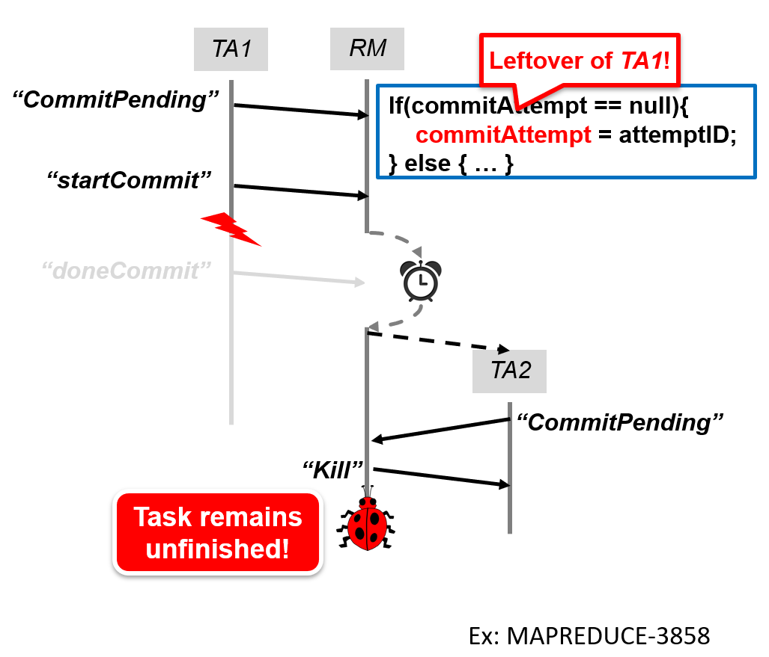

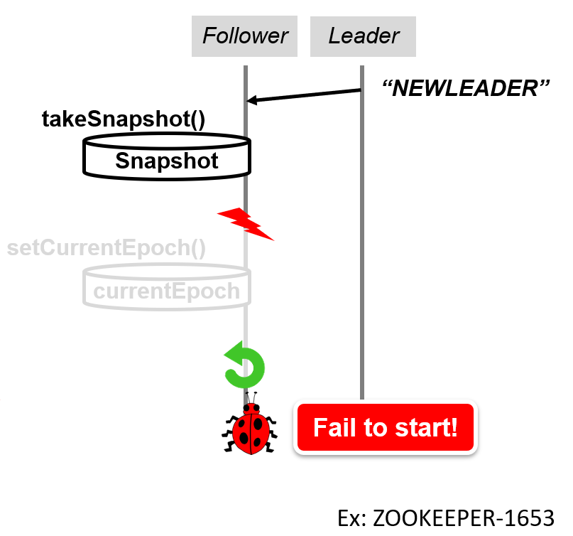
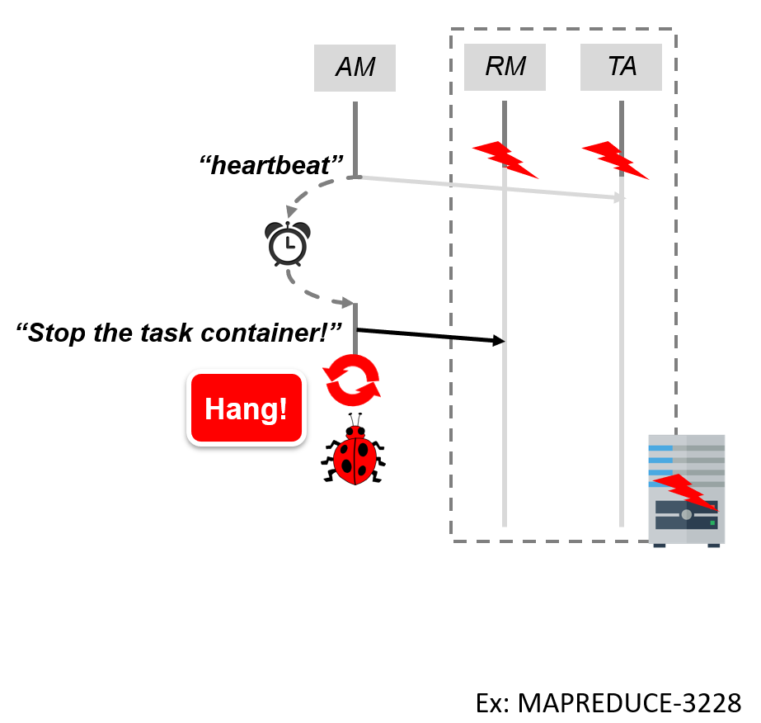
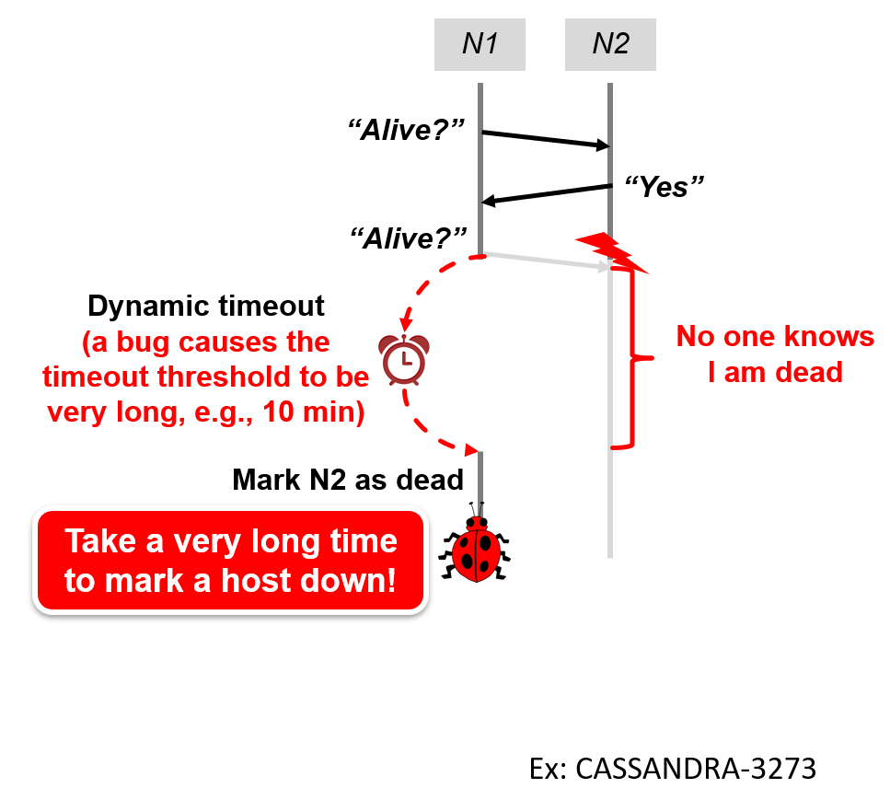
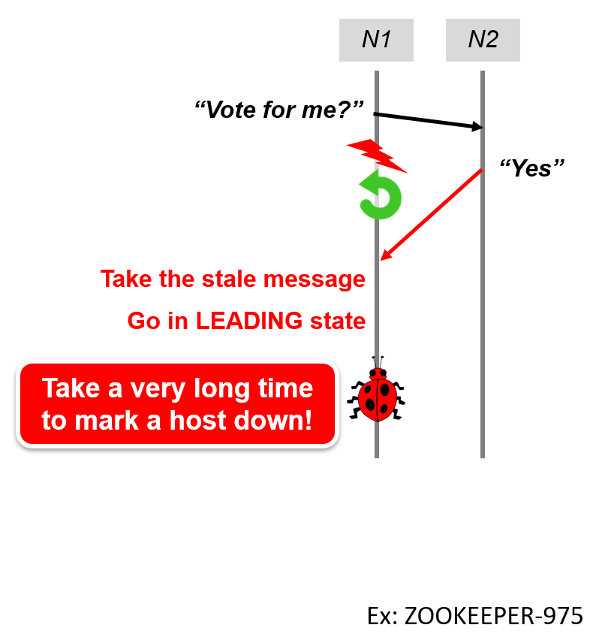
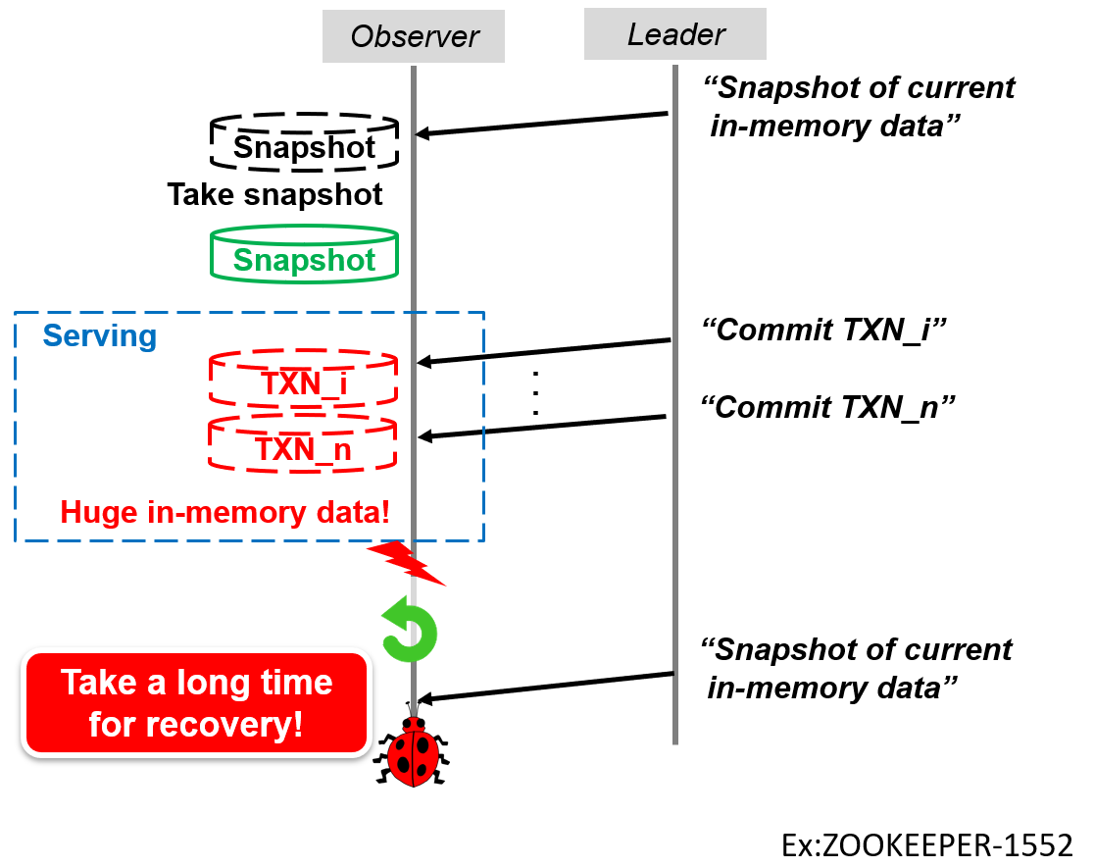
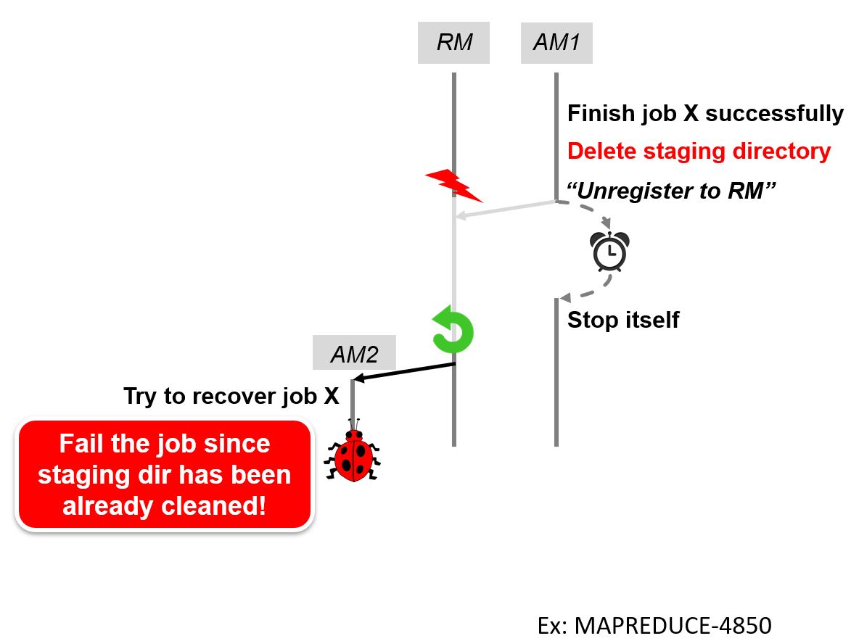
RQ4: Bug fix patterns
No clear fix patterns
Root cause oriented
System-specific
Clean leftover
Detect unexpected crash
Fix dynamic timeout strategy
Add timeout
Delay backup removal
Ignore stale message
Add backing up
Notes:
由于节点失效恢复相关缺陷的修复与缺陷的根因以及系统高度相关，我们还没有发现明确地修复模式
Click: 比如我们之前提到的缺陷例子由各种各样的修复方法所修复。例如由不正确备份所导致的缺陷通过增加备份机制被修复，由缺少节点失效检测所导致的缺陷由增加超时机制所修复等等。

Slide 47

RQ4: Incomplete fixes
Reduce the possibility of bug occurrence
JobTracker
“Submit job”
submitJob()
Job info
.
.
.
initJob()
Job token
Ex: MAPREDUCE-5169
Notes:
但是我们发现开发者对此类缺陷的修复可能并不完美
例如在这个mapreduce的例子中，在收到客户的一个提交工作的消息之后
Click: jobTracker节点首先在 submitJob() 方法中生成了job info文件
Click: 一段时间后，jobtracker节点接着在initJob() 方法中生成了job token文件

Slide 48

RQ4: Incomplete fixes
Reduce the possibility of bug occurrence
JobTracker
JobTracker
“Submit job”
“Submit job”
submitJob()
submitJob()
Job info
Job info
Job token
.
.
.
initJob()
Job token
Fail to recover without jobToken!
Ex: MAPREDUCE-5169
Notes:
在这两个I/O写中间有可能会发生节点失效
Click: 这会导致jobtracker节点在重启后由于无法找到job token文件而无法正确恢复该工作
Click
Click: 整个缺陷是通过把这两个I/O写操作放到同一个方法submitjob中来修复的
Click

Slide 49
RQ4: Incomplete fixes
Reduce the possibility of bug occurrence
JobTracker
JobTracker
“Submit job”
“Submit job”
submitJob()
submitJob()
Job info
Job info
Job token
.
.
.
initJob()
Job token
Fail to recover without jobToken!
Ex: MAPREDUCE-5169
Notes:
虽然这个修复使得在这两个I/O写中间发生crash的几率减少了，节点失效依然可能在这个小的时间间隔中发生，再次触发缺陷。该修复只是减少了缺陷发生的几率。

Slide 50
RQ4: Incomplete fixes
12% of CR bugs have incomplete fixes
Reduce bug occurrence probability
Introduce new bugs
Omit cases
Implication:
CR bug verification is necessary
We can detect new CR bugs in fixes
Notes:
根据我们的研究，大约12%的修复都是不完整的，包括只是减少了缺陷发生的概率，引入新的缺陷，以及忽略了某些触发缺陷的情形。
Click: 这表明节点失效恢复相关缺陷的验证十分必要，我们可以在缺陷修复中检测新的节点失效恢复相关缺陷

Slide 51
More lessons
Bug detection
Backup-guided bug detection
Crash/reboot detection analysis
State inconsistency guided detection
Concurrency analysis in crash recovery bugs
Bug fix oriented detection
Testing of distributed systems
Crash/reboot injection strategy
More discussions can be found in our paper!
Notes:
我们的发现表明未来我们可以设计基于缺陷模式检测此类缺陷的缺陷检测方法，可以设计新的分布式系统测试方法，以及设计新的节点失效及节点重启注入策略。在我们的论文中可以找到更多相关的讨论。
我们已经发现了一些缺陷模式，如缺少节点失效检测、缺少备份等，可以帮助我们设计新的缺陷检测方法，目前我们正在基于一些缺陷模式，实现相应的错误检测工具，也在设计新的节点失效和节点重启注入机制，选取更倾向于产生错误的系统注入点来加速缺陷的暴露。

Slide 52
Conclusion
Inadequate crash recovery mechanisms and their incorrect implementations could introduce CR bugs
We perform a comprehensive study on 103 CR bugs in 4 distributed systems, and obtain many interesting findings
These findings found in our study can help open up new directions to combat crash recovery bugs
http://www.tcse.cn/~wsdou/project/CREB/
Notes:
综上，不正确的节点失效恢复机制及其实现可能引入节点失效恢复相关缺陷，我们通过对4个开源系统中103个节点失效恢复相关缺陷的深入研究，得到了许多有趣的发现，可以帮助我们发现新的应对此类缺陷的研究方向。我们在网页上提供公开数据集供后续研究使用。

Slide 53

THANK YOU!
http://www.tcse.cn/~gaoyu15/
Notes:
Thanks for your attention.
I’m ready to take questions

Slide 54
Bug selection
We start our study based on CBS [1]
3,655 vital cloud issues reported during 2011~2014, from six distributed systems
Select CR bugs
Select issues that have available fixes, clear descriptions, and related to crash recovery
Keep an issue as a CR bug if crashes or restarts are an essential condition for the issue, and we can completely understand it
[1] H. Gunawi et al., What Bugs Live in the Cloud? A Study of 3000+ Issues in Cloud Systems, SoCC 2014.
Notes:
We start our study from an existing cloud bug study database, CBS

Slide 55
Threats to validity
Only study CR bugs reported during 2011~2014 from 4 distributed systems
These 4 systems are widely used and cover a diverse set of architectures, and our studied bugs are representative
Our study aims to have a deep understanding of CR bugs rather than getting statistical conclusions
Exclude bugs without clear descriptions and fixes
Maintain the accuracy of our study results
Notes:
These 4 systems are widely used and cover a diverse set of architectures. Their mechanisms for combating crashes are also commonly used by other systems.

Slide 56
How significant are crash recovery bugs?
We start our study based on CBS [1]
3,655 vital cloud issues
8.2% of bugs in CBS are crash-related
44% of our studied crash recovery bugs were not marked as crash-related in CBS
CBS
CREB
[1] H. Gunawi et al., What Bugs Live in the Cloud? A Study of 3000+ Issues in Cloud Systems, SoCC 2014.
Notes:
We start our study from an existing cloud bug study database, CBS
The actual number of crash recovery bugs in CBS could be more than 103.

Slide 57
How significant are crash recovery bugs?
Our studied crash recovery bugs cause more severe consequences
38% of CR bugs cause fatal failures, while 18% of bugs in CBS [1] and 17% of bugs in TaxDC [2] do so
[1] H. Gunawi et al., What Bugs Live in the Cloud? A Study of 3000+ Issues in Cloud Systems, SoCC 2014.
[2] T. Leesatapornwongsa et al., TaxDC: A Taxonomy of Non-Deterministic Concurrency Bugs in Datacenter Distributed Systems, ASPLOS 2016.
Notes:
We start our study from an existing cloud bug study database, CBS

Slide 58
Bug distribution
Notes:
The distributions of the number of the studied bugs in four target systems are relatively even.

Slide 59
Root causes

Slide 60
Crashes on/during recovery
The crash/reboot handling process crashes(7 bugs)
Another node crashes during the recovery process (8 bugs)
A
A
B
A
B
B-recover
Concurrency!

Slide 61
CR bugs caused by concurrency
Concurrency in one recovery process (5 bugs)
Concurrency between two recovery processes (4 bugs)
Concurrency between a recovery process and a normal execution (13 bugs)

Slide 62



Triggering condition – crash/reboot triggering window
The timing of crashes / reboots is important for reproducing crash recovery bugs
…
Another nodes are at certain state
The cluster is at a consistent global state
The node is at certain state
31%
Easy
52%
Moderate
17%
Difficult
For a reboot:
…
After the crash or after a fixed time
Current cluster is at certain state
86%
Easy
14%
Difficult

