Slide 1

Control Flow-Guided SMT Solving for Program Verification
Jianhui Chen, Fei He
School of Software, Tsinghua University
NASAC 2018, November 23 - 25, Shenzhen University

Slide 2
Outline
Why?
Motivations
How?
Approach
What?
Evaluation

Slide 3
Satisfiability Modulo Theory
Satisﬁability Modulo Theories (SMT) is a decision problem for formulas in some combination of ﬁrst-order background theories.
A wide range of applications in verification, static analysis, constraint solving, test case generation, and computer security.
Many efficient SMT solvers, e.g., Z3, MathSAT, CVC4, Yices, etc.

Slide 4
SMT-based Program Verifier
Verifier
SMT Formula
Solver
Parser
SMT Encoder
A satisfied model / Unsat
General-purpose solver, unaware of application-specific information
Notes:
Very roughly, an smt-based analyzer can be considered as consisting of two parts: parser, and smt encoder.
The program analysis problem is encoded as a (or a series of) SMT equations, and then solved by the off-the-shelf solvers.
In this way, we avoid the low-level computation details when develop a program analyzer. And it greatly promote the rapid progress of program analysis in recent years.
However, there approach has also a drawback! – that is, the smt solver is usually general-purpose ones, the domain-specific information of the problems will not be sufficiently utilized.

Slide 5
Example
false
if(c0)
x=1;y=1;
else
if(c1)
x=2;y=2;
else
x=3;y=3;
assert(x==y);
if(c0)
true
false
if(c1)
true
x=1;
y=1;
x=2;
y=2;
x=3;
y=3;
assert(x==y);
Program
CFG

Slide 6
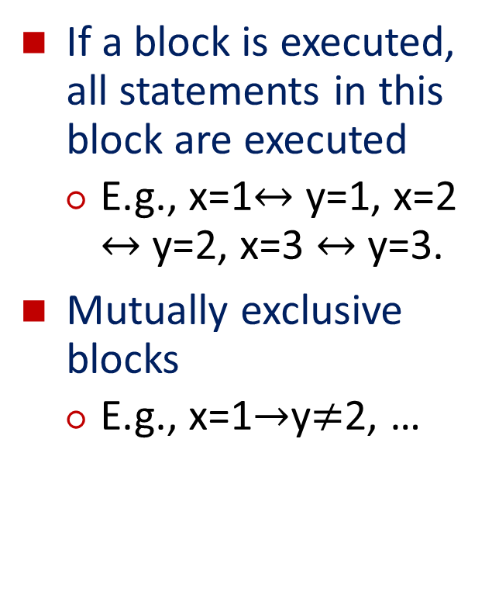
Control-Flow Information
If a block is executed, all statements in this block are executed
E.g., x=1$↔$ y=1, x=2 $↔$ y=2, x=3 $↔$ y=3.
Mutually exclusive blocks
E.g., x=1$→$y$≠$2, …
false
if(c0)
true
false
if(c1)
true
x=1;
y=1;
x=2;
y=2;
x=3;
y=3;
assert(x==y);
CFG

Slide 7
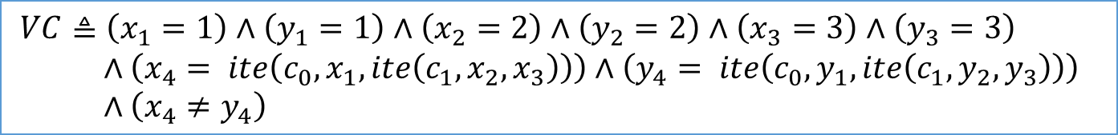
SMT Encoding
if(c0)
x1=1;y1=1;
else
if(c1)
x2=2;y2=2;
else
x3=3;y3=3;
x4=ite(c0,x1,ite(c1,x2,x3));
y4=ite(c0,y1,ite(c1,y2,y3));
assert(x4==y4);
if(c0)
x=1;y=1;
else
if(c1)
x=2;y=2;
else
x=3;y=3;
assert(x==y);
Program
SSA
$VC≜\left(x_{1}=1\right)∧\left(y_{1}=1\right)∧\left(x_{2}=2\right)∧\left(y_{2}=2\right)∧\left(x_{3}=3\right)∧\left(y_{3}=3\right)$
$∧\left(x_{4}= ite\left(c_{0},x_{1},ite\left(c_{1},x_{2},x_{3}\right)\right)\right)∧\left(y_{4}= ite\left(c_{0},y_{1},ite\left(c_{1},y_{2},y_{3}\right)\right)\right)$
$∧\left(x_{4}≠y_{4}\right)$
Verification Condition

Slide 8
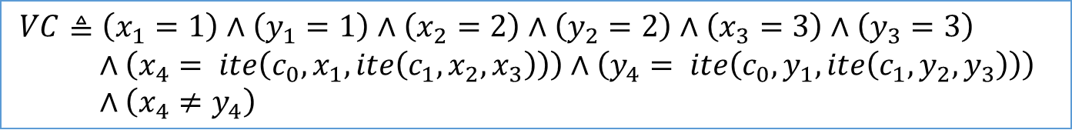
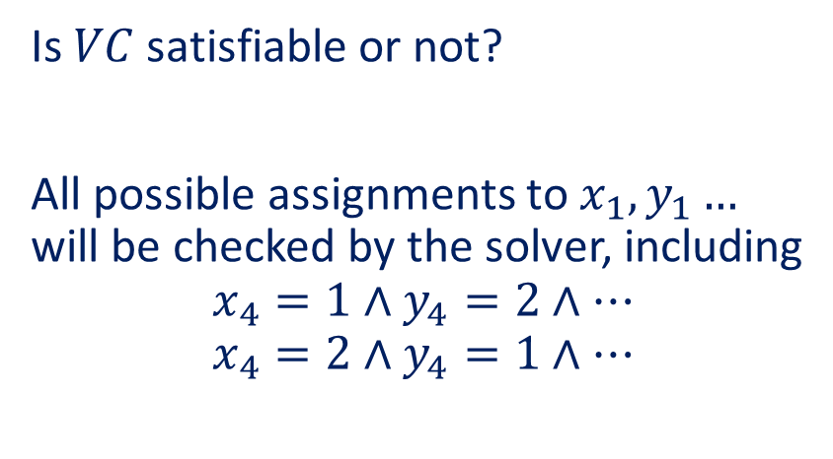
Checking VC
$VC≜\left(x_{1}=1\right)∧\left(y_{1}=1\right)∧\left(x_{2}=2\right)∧\left(y_{2}=2\right)∧\left(x_{3}=3\right)∧\left(y_{3}=3\right)$
$∧\left(x_{4}= ite\left(c_{0},x_{1},ite\left(c_{1},x_{2},x_{3}\right)\right)\right)∧\left(y_{4}= ite\left(c_{0},y_{1},ite\left(c_{1},y_{2},y_{3}\right)\right)\right)$
$∧\left(x_{4}≠y_{4}\right)$
Is $VC$ satisfiable or not?
All possible assignments to $x_{1},y_{1}…$ will be checked by the solver, including
$$x_{4}=1∧y_{4}=2∧…$$
$$x_{4}=2∧y_{4}=1∧…$$
false
if(c0)
true
false
if(c1)
true
x=1;
y=1;
x=2;
y=2;
x=3;
y=3;
assert(x==y);
Control-Flow is Neglected
by SMT solvers

Slide 9
Motivations
Application-specific information is neglected by the SMT solvers
Control-flow is very useful information
Can we utilize the control-flow information in the SMT solving?

Slide 10
Outline
Why?
Motivations
How?
Approach
What?
Evaluation

Slide 11
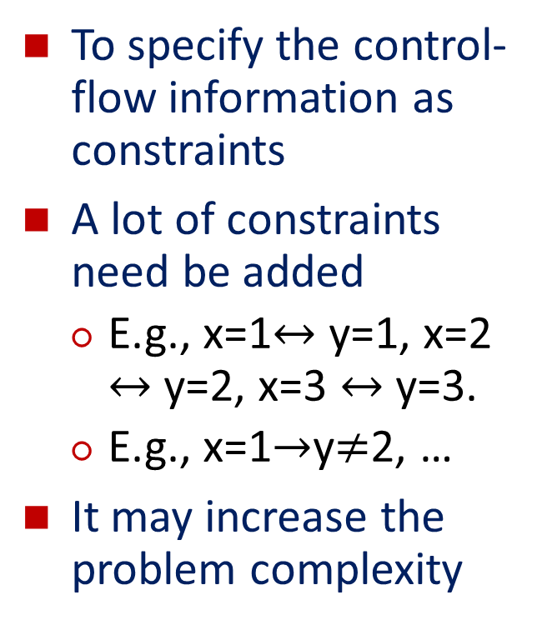
A Direct Idea
To specify the control-flow information as constraints
A lot of constraints need be added
E.g., x=1$↔$ y=1, x=2 $↔$ y=2, x=3 $↔$ y=3.
E.g., x=1$→$y$≠$2, …
It may increase the problem complexity
false
if(c0)
true
false
if(c1)
true
x=1;
y=1;
x=2;
y=2;
x=3;
y=3;
assert(x==y);
CFG

Slide 12


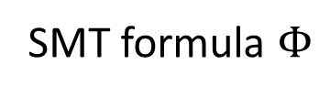

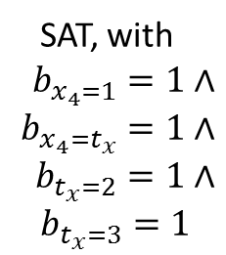

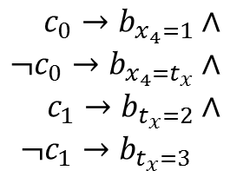
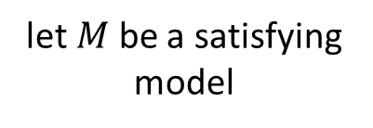
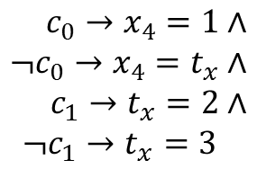


SMT Solving
SMT formula $Φ$
add a T-conflict clause to $Φ$
$M$ is $T$-unsat
SAT Solver
Theory Solver
$ℬ\left(Φ\right)$ is unsat
$ℬ\left(Φ\right)$ is sat
$M$ is $T$-sat
let $M$ be a satisfying model
UNSAT
SAT
$$c_{0}→x_{4}=1∧$$
$$¬c_{0}→x_{4}=t_{x}∧$$
$$c_{1}→t_{x}=2∧$$
$$¬c_{1}→t_{x}=3$$
Boolean
abstraction
$$c_{0}→b_{x_{4}=1}∧$$
$$¬c_{0}→b_{x_{4}=t_{x}}∧$$
$$c_{1}→b_{t_{x}=2}∧$$
$$¬c_{1}→b_{t_{x}=3}$$
SAT, with $$b_{x_{4}=1}=1∧$$
$$b_{x_{4}=t_{x}}=1∧$$
$$b_{t_{x}=2}=1∧$$
$$b_{t_{x}=3}=1$$
$T$-unsat

Slide 13
DPLL(T)
Input: An SMT formula Φ
Output: SAT or UNSAT
1: while true do
2: if !propagate_and_check() then
3: if level == 0 then
4: return UNSAT;
5: else resolve_conflict();
6: if !decide() then return SAT;
The branching heuristic chooses a variable and assigns a truth value to it.

Slide 14
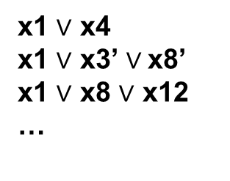
SMT solving is essentially a DFS
choose a variable and decide its value
x1 $∨$ x4
x1 $∨$ x3’ $∨$x8’
x1 $∨$ x8 $∨$ x12
…
x1
propagate x4=1
1
0
x3
propagate x8=0,x12=1
x2
x7
DPLL(T)
IDEA: Use control flow to guide the search process

Slide 15
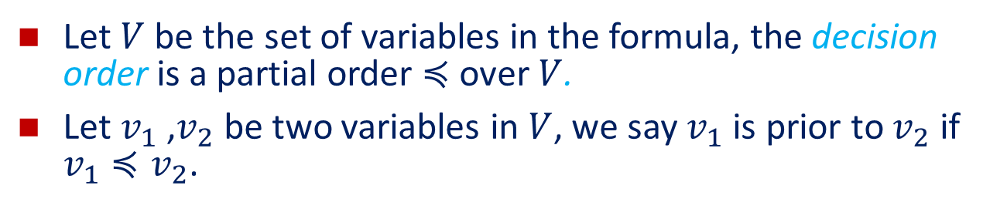
Guided SMT Solving
Verifier
Formula + Dec. Order
Solver
A satisfied model / Unsat
Let $V$ be the set of variables in the formula, the decision order is a partial order $≼$ over $V$.
Let $v_{1}$ ,$v_{2}$ be two variables in $V$, we say $v_{1}$ is prior to $v_{2}$ if $v_{1}≼v_{2}$.

Slide 16
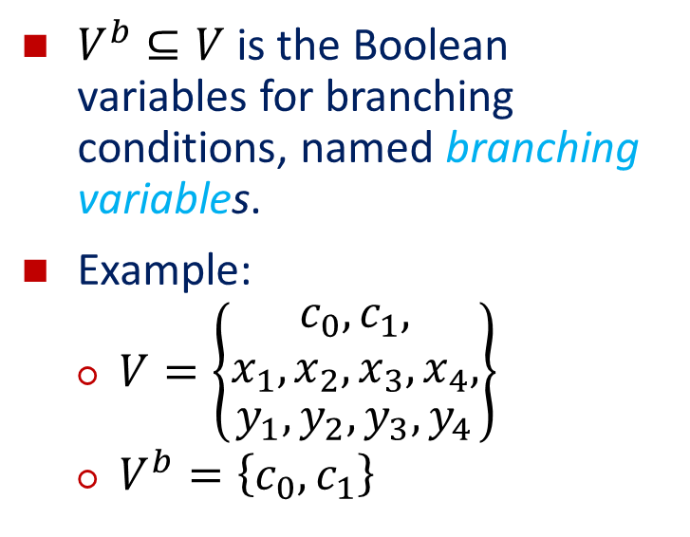
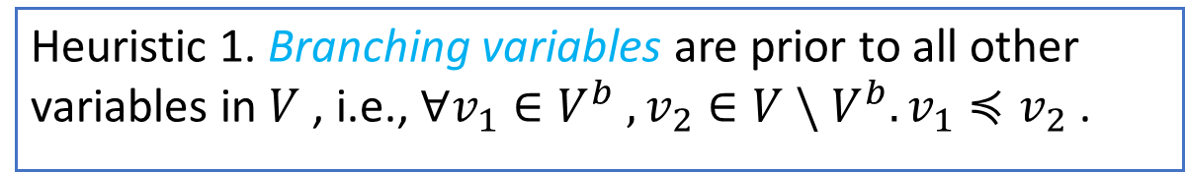
Heuristic 1
$V^{b}⊆V$ is the Boolean variables for branching conditions, named branching variables.
Example:
$V=\left\{\begin{aligned}\begin{aligned}c_{0},c_{1}, \\ x_{1},x_{2},x_{3},x_{4},\end{aligned} \\ y_{1},y_{2},y_{3},y_{4}\end{aligned}\right\}$
$V^{b}=\left\{c_{0},c_{1}\right\}$
false
if(c0)
true
false
if(c1)
true
x=1;
y=1;
x=2;
y=2;
x=3;
y=3;
assert(x==y);
Heuristic 1. Branching variables are prior to all other variables in $V$ , i.e., $∀v_{1}∈V^{b} ,v_{2}∈V \backslash V^{b}.v_{1}≼v_{2}$ .

Slide 17
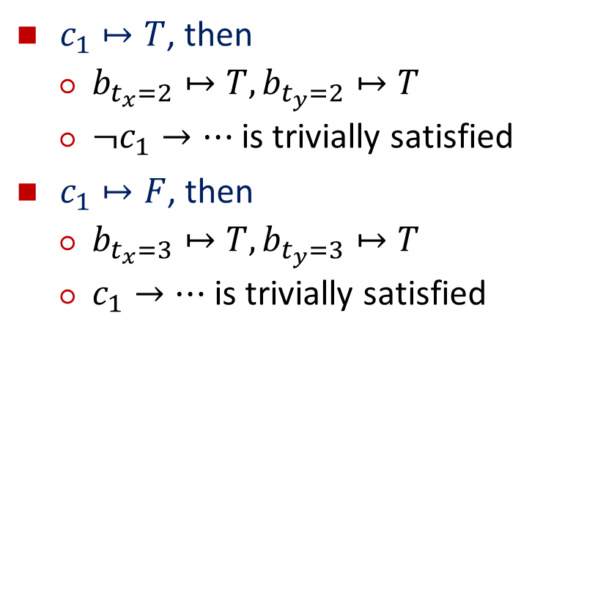
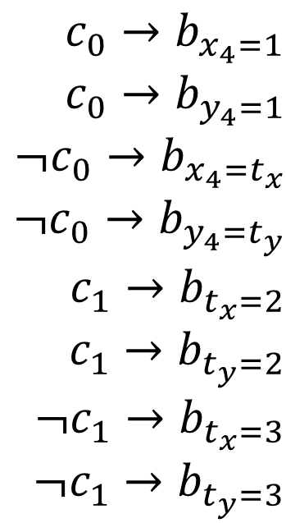
Example
$c_{1}↦T$, then
$b_{t_{x}=2}↦T,b_{t_{y}=2}↦T$
$¬c_{1}→…$ is trivially satisfied
$c_{1}↦F$, then
$b_{t_{x}=3}↦T,b_{t_{y}=3}↦T$
$c_{1}→…$ is trivially satisfied
$$c_{0}→b_{x_{4}=1}$$
$$c_{0}→b_{y_{4}=1}$$
$$¬c_{0}→b_{x_{4}=t_{x}}$$
$$¬c_{0}→b_{y_{4}=t_{y}}$$
$$c_{1}→b_{t_{x}=2}$$
$$c_{1}→b_{t_{y}=2}$$
$$¬c_{1}→b_{t_{x}=3}$$
$$¬c_{1}→b_{t_{y}=3}$$

Slide 18
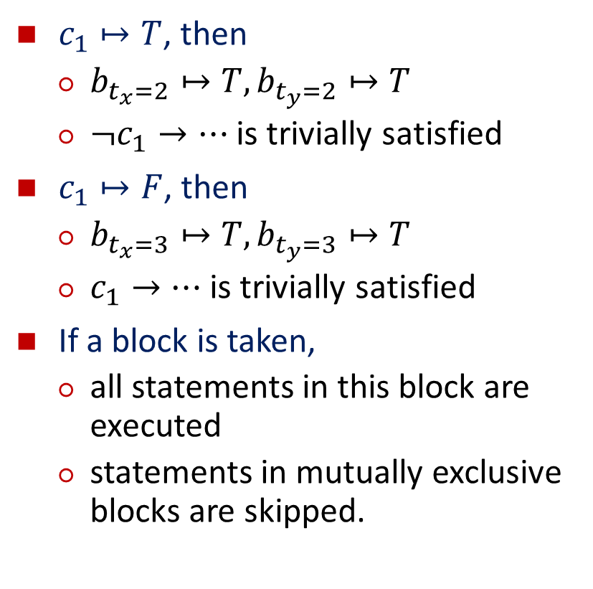
Example
$c_{1}↦T$, then
$b_{t_{x}=2}↦T,b_{t_{y}=2}↦T$
$¬c_{1}→…$ is trivially satisfied
$c_{1}↦F$, then
$b_{t_{x}=3}↦T,b_{t_{y}=3}↦T$
$c_{1}→…$ is trivially satisfied
If a block is taken,
all statements in this block are executed
statements in mutually exclusive blocks are skipped.
false
if(c0)
true
false
if(c1)
true
x=1;
y=1;
x=2;
y=2;
x=3;
y=3;
assert(x==y);

Slide 19
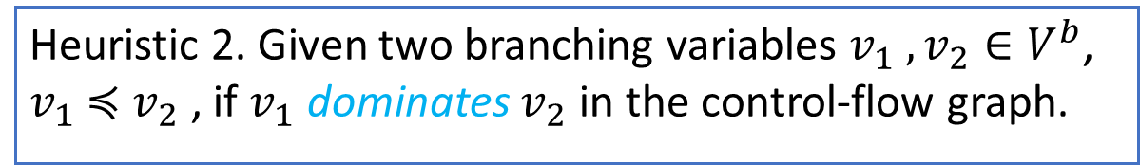
Heuristic 2
false
if(c0)
true
false
if(c1)
true
x=1;
y=1;
x=2;
y=2;
x=3;
y=3;
assert(x==y);
Heuristic 2. Given two branching variables $v_{1} ,v_{2}∈V^{b}$, $v_{1}$ $≼$ $v_{2}$ , if $v_{1}$ dominates $v_{2}$ in the control-flow graph.

Slide 20

Branching Graph
false
if(c0)
true
false
if(c1)
false
c0
true
x=1;
y=1;
x=2;
y=2;
x=3;
y=3;
true
c1
true
false
assert(x==y);
Branching Graph
CFG
$$c_{0}≼c_{1}$$

Slide 21
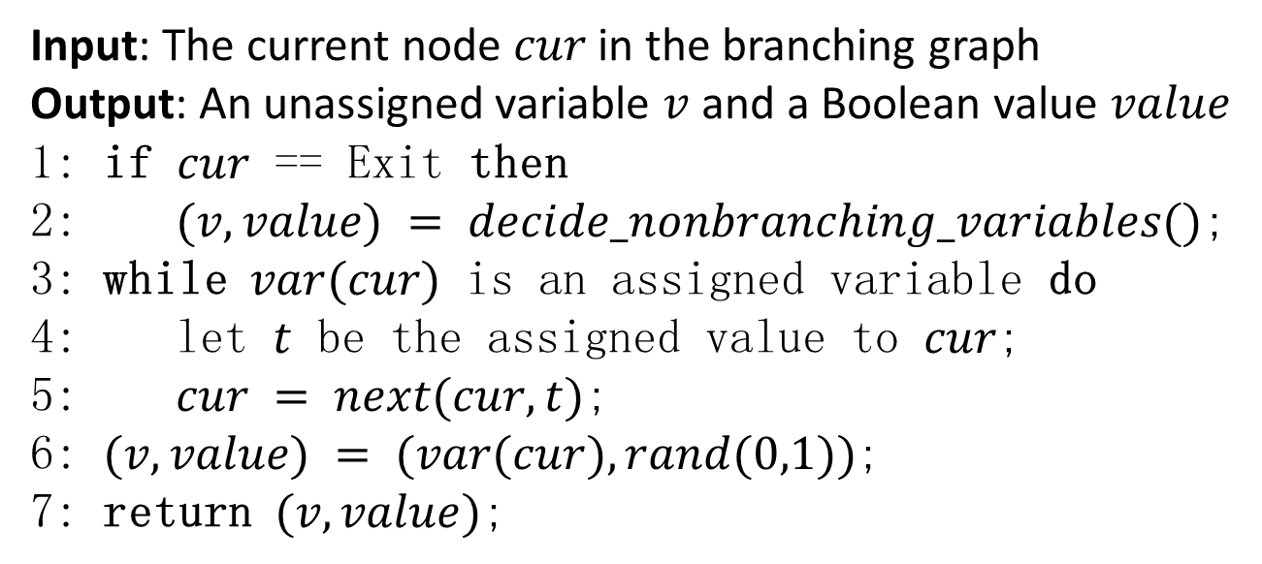
Enhanced decide()
Input: The current node $cur$ in the branching graph
Output: An unassigned variable $v$ and a Boolean value $value$
1: if $cur$ == Exit then
2: $(v,value) = decide_nonbranching_variables()$;
3: while $var(cur)$ is an assigned variable do
4: let $t$ be the assigned value to $cur$;
5: $cur = next(cur,t)$;
6: $(v,value) = (var(cur), rand(0,1))$;
7: return $(v,value)$;

Slide 22

Example
$$c_{0}→b_{x_{4}=1}$$
$$c_{0}→b_{y_{4}=1}$$
$$¬c_{0}→b_{x_{4}=t_{x}}$$
$$¬c_{0}→b_{y_{4}=t_{y}}$$
$$c_{1}→b_{t_{x}=2}$$
$$c_{1}→b_{t_{y}=2}$$
$$¬c_{1}→b_{t_{x}=3}$$
$$¬c_{1}→b_{t_{y}=3}$$
$c_{0}↦F$, propagates $b_{x_{4}=t_{x}}↦T,b_{y_{4}=t_{y}}↦T$
then, we choose $c_{1}$ and (randomly) decide its value
false
c0
true
c1
true
false

Slide 23
More in the paper
Details of the algorithms
An enhanced CNF conversion algorithm
Please read our paper …

Slide 24
Outline
Why?
Motivations
How?
Approach
What?
Evaluation

Slide 25
Implementation
Program
+
Property
SMT formula with
decision order
SMT Solver
Order
Parser
Enhanced CNF
Conversion
guide
Analysis
Frontend
Core Solver
Satisfiability result
Order inferring
and encoding

Slide 26
Evaluation
1411 SMT instances generated from SV-COMP’17 benchmarks.
948 SMT instances solved by DPLL(T) tactic.
314 instances are satisfiable and 634 ones are unsatisfiable.
The largest SMT files occupy hundreds of MBs.
The baseline is Z3 with the default activity-based branching heuristic.

Slide 27
Experimental Results
Sub | CPU Time /s |  |  | Score Time /s
 | Z3 | Z3+ | Lift | Z3 | Z3+ | Lift
sat | 34573 | 8135 | 4.25 | 16573 | 2016 | 8.22
unsat | 25994 | 19619 | 1.32 | 12794 | 9567 | 1.33
all | 60568 | 27754 | 2.18 | 29368 | 8803 | 3.34
all benchmarks
satisfiable benchmarks

Slide 28
Conclusion & Future work
A novel approach for utilizing control-flow knowledge in SMT solving
lightweight, and
take full advantage of the built-in features of SMT solvers
An enhanced CNF conversion procedure, with which
the control-flow information is kept in the CNF formulas
Experiments results show promising performance of our approach.

Slide 29
Thanks!
Question?

