Slide 1







Automatic and Accurate Expansion of Abbreviations in Parameters
姜艳杰
刘辉
朱佳琪
张路

Slide 2


1
Problem
Abbreviation
Prioritized dictionaries
1
Part One
2
Related Work
Terms from source code
Terms from comments
Matching
Abbreviation dictionary
3
Approach
Domain specific dictionary
Expansion
Generic English dictionary
4
Evaluation
5
Conclusion

Slide 3

1
Part One
Problem

Slide 4
Problem
70%
Identifiers account for 70% of source code in terms of characters.

Slide 5
Problem
Abbreviations are widely used in identifiers.
devt
TargetEle
et
keyEvt
BridgeCtx
aci

Slide 6

Problem
Program Comprehension
Concept location
Software Clustering
IR-based software maintenance
…

Slide 7
2
Part One
Related Work

Slide 8

Generic Dictionary
street
stream
string
strip
str
...
strict
struggle
stranger

Slide 9

Abbreviation Dictionary
Constructed
manually
Time Consuming
A Small Part of Abbreviation
Tedious
Different Meaning

Slide 10
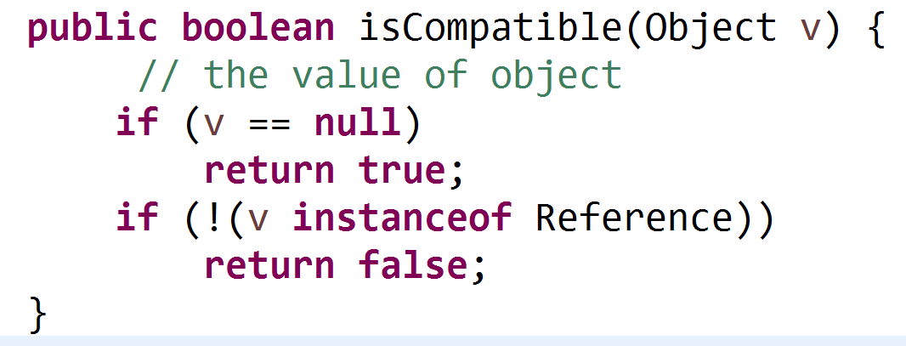

Comments
Rarely write comments
Rarely can be found

Slide 11
Based on Source Code
Enclosing Class
Abbr
Expr
Enclosing Method
Enclosing Project

Slide 12
State-of-the-Art
Rely heavily on dictionaries
Rarely exploit the specific context of identifiers

Slide 13
3
Part One
Approach

Slide 14
Inspiring
Formal parameter
Actual parameter
Node item(int i)
Node obj = nodelist.item(index)
Location(BridgeContext context)
location = new Location(bridgeCtx)
getComputedStyle(Element e,
int property)

Slide 15




Inspiring
Abbreviations
parameter

Slide 16
Inspiring
Corresponding formal
(or actual) parameter
Abbreviations in parameter names
Type of the enclosing parameter

Slide 17
Approach
Source Code
Parameters & Context
Abbreviations & Context
Abbreviations & Full Terms
Extract Parameters
Extract Abbreviations
Expand Abbreviations

Slide 18
Searching for expansion
Searching for expansion in ParameterName
succeed
fail
Searching for expansion in ParameterType
succeed
Return Expansion
fail
succeed
Searching for expansion in Dictionary
fail
Terminate

Slide 19
Heuristics
The search is based on a sequence of heuristics in order.
Acronym
Prefix
Dropped-Letters

Slide 20
H1: Acronym
tf
TransformerFactory
transformer
factory

Slide 21
H2:Prefix
ex
ception
ex
ex

Slide 22
H3:Dropped-Letters
x
x
C
e
t
ctx
C
on
t
t

Slide 23
Resolution of Conflicting Expansions
public void subscriber(Subscriber s)
{
//…
}
m.subscriber(stringObserver);
Source.subscriber(subscriber);
Single.toFlowable().subscriber(subscriber);
s
subscriber

Slide 24
Recursive Expansion
Abbreviation | Expansion
t
Abbreviation | Expansion
temp | temporary
temporary
temp

Slide 25
4
Part One
Evaluation

Slide 26
Subject Project
Project | LOC | Domain | Application/ Library | Number of Functions
Retrofit | 21,557 | Network | Library | 1,012
CheckStyle | 384,906 | Source code Analysis | Application | 17,123
PDFsam | 33,485 | Office | Application | 2,107
Bootique | 14,600 | Virtual Machine | Library | 926
DB-Manager | 1,992 | Database | Application | 182

Slide 27
Subject Project
Project | LOC | Domain | Application/ Library | Number of Functions
Batik | 302,731 | Graphics | Library | 23,447
Maven | 137,438 | Software Management | Application | 8,906
FileBot | 40,728 | Multimedia | Application | 3,116
Protecle | 19,843 | Security | Application | 3,074

Slide 28

Process
sample abbreviations
Expansion by proposed approach
Expansion by software developers
True/False

Slide 29
RQ1: Abbreviations in parameters
36.74%

Slide 30
RQ2: Where are the full terms
28% from parameter names
37% from parameter type

Slide 31
RQ3: Compared against State-of-the-Art-Approach
Ours
Ours
Linsen
Linsen

Slide 32
RQ4: Impact of Abbreviations' Length
precision (Ours)
recall (Ours)
Precision/recall (Linsen)

Slide 33
RQ5: Influence of the Heuristics
recall
recall
recall
recall
precision
precision

Slide 34
RQ6: Scalability
Size of Projects(LOC)

Slide 35
5
Part One
Conclusion

Slide 36
Conclusion
A significant percentage of abbreviation appear in parameter name.
An accurate approach to expand abbreviations.

Slide 37

THANKS
BEIJING INSTITUTE OF TECHNOLOGY
PEKING UNIVERSITY

