Slide 1
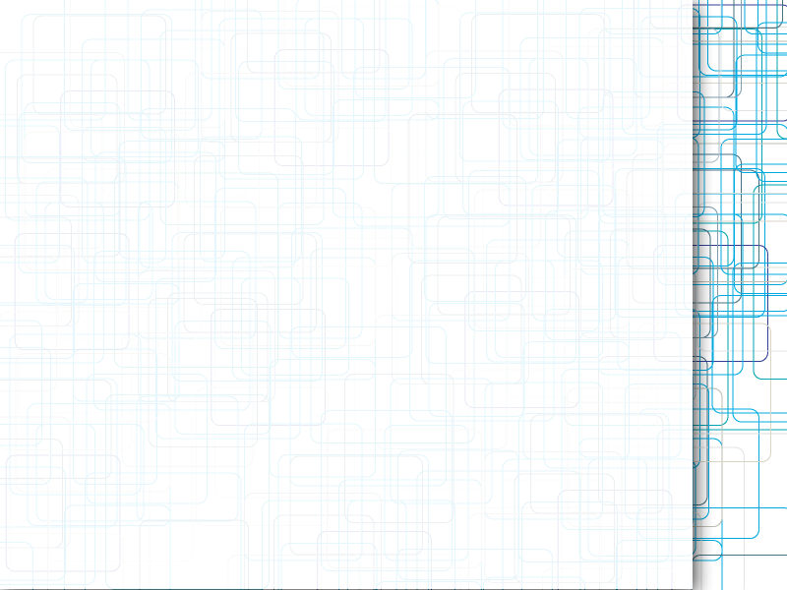
Building high-level features using large-scale unsupervised learning

Slide 2
1. GOAL
Unlabeled images
10 million
Wild dataset & ImageNet
37,000 example
Accuracy 17.9%

Slide 3
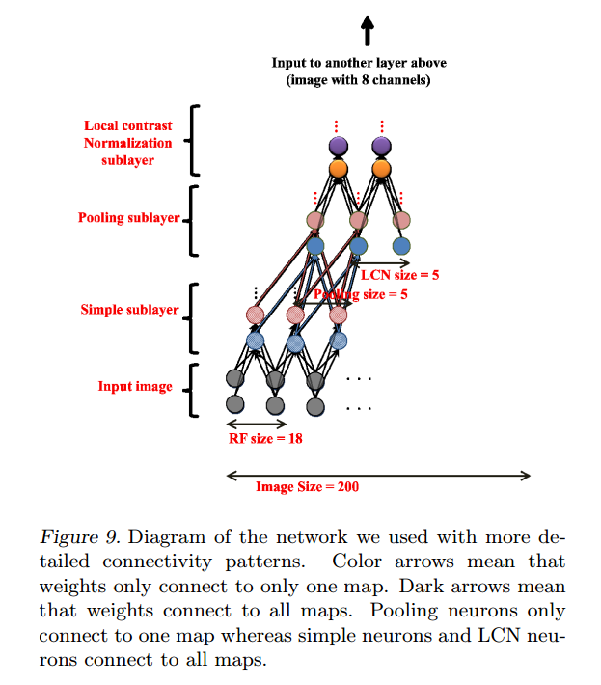
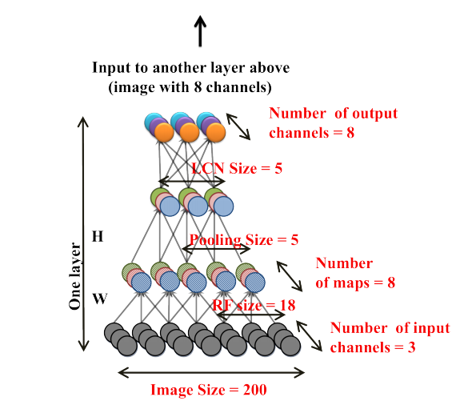
2. Architecture

Slide 4

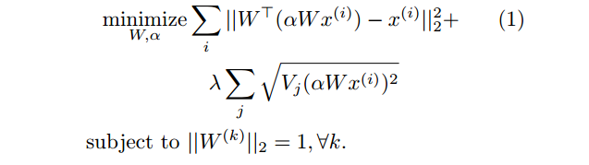
3. Filtering And Pooling
After two layer，part of the output is：
（1）
Adding reconstitution cost：
（2）

Slide 5

4. Local Contrast Normalization
Subtractive normalization:
Divisive normalization（c = 0.01）:

Slide 6

5. Optimization
Optimization problem:
Deriving gradients:

