Slide 1

Independent Components
Analysis

Slide 2
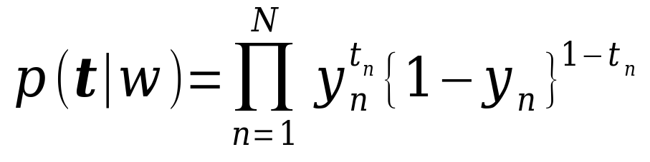
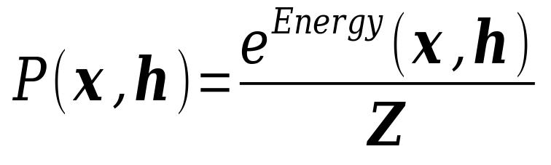
1.discriminative model and generative model
MLP:
RBM:

Slide 3
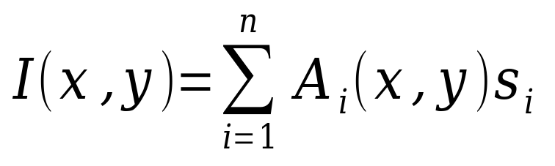
2.Principal component analysis(PCA)
Goal: using orthogonal transformation to convert the high-dimensional data to low-dimensional linearly uncorrelated variables.
I(x,y) is the image pixels of one patch. Assume n equals to the number of pixels.
x,y means the pixel position.
Each I(x,y) is the linear weighted sum of features.

Slide 4
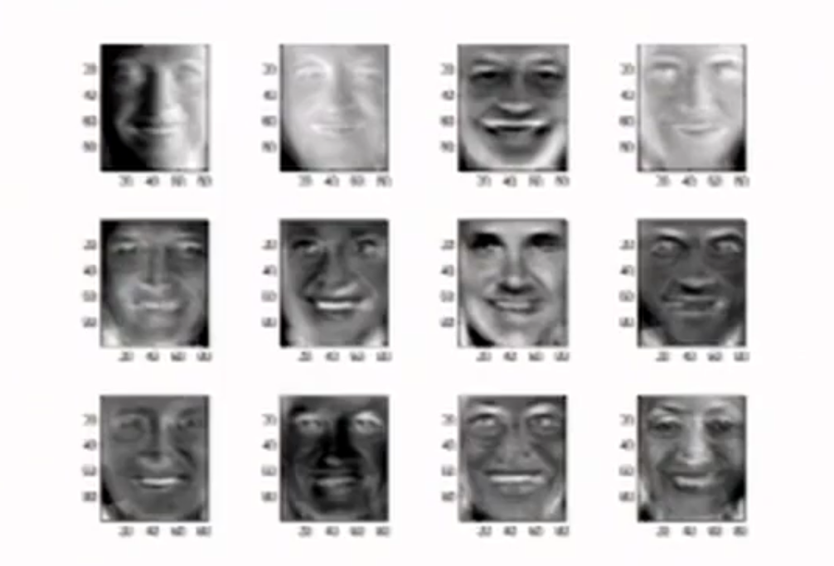
2.PCA

Slide 5
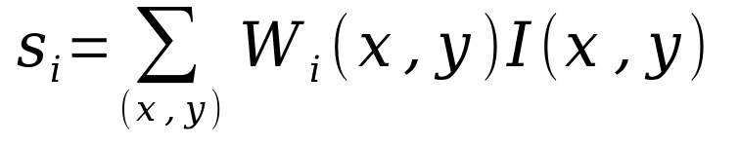

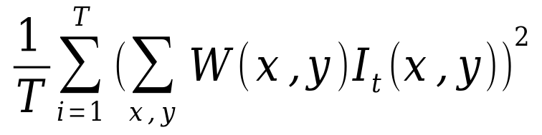
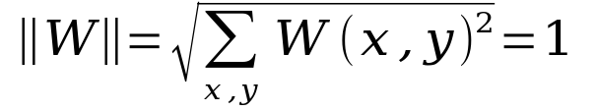
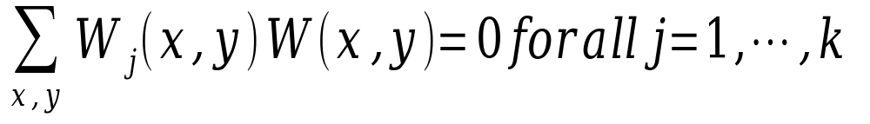
2.PCA
si is the projection of I(x,y)
maximize
same to maximize
constraints:

Slide 6
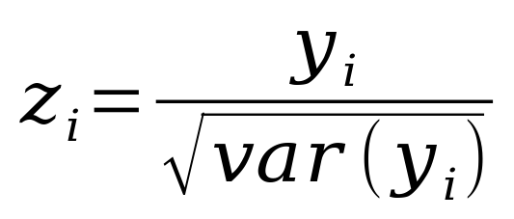
3.Preprocessing
1.remove the DC component
2.compute the principal components
3.retain n first principal components
4.Whitening the principal components
The preprocessed vector denoted by z.

Slide 7
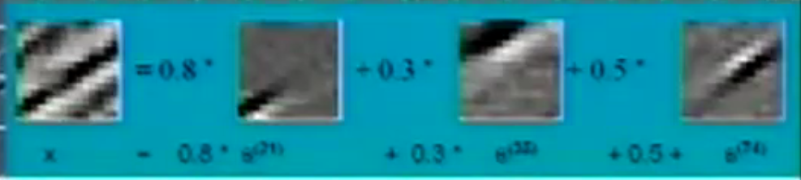
4.Independent Components
Analysis
Goal: Separating the some unknown latent and independent variables of the input.
eg. sound signal
In the image system is the si.

Slide 8
4.ICA
Three assumption:
1.si are statistically independent
2.si are non-gaussian
3.the linear system defined by Ai is invertible

Slide 9
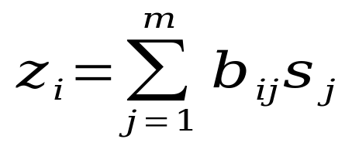
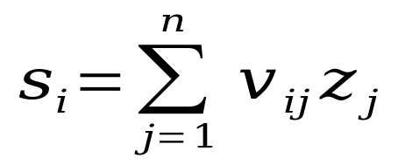
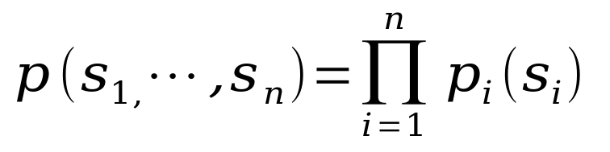
4.ICA
After preprocessing, we get zi
Transformation:
Assume we know the probability density functions of si:

Slide 10
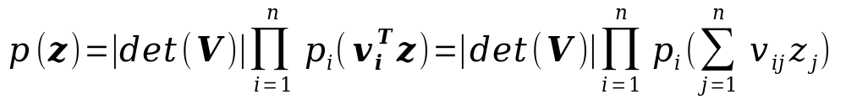
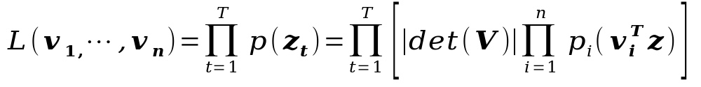
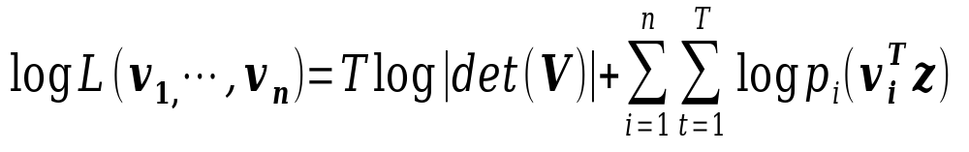
4.ICA
Then the probability density functions of zi is:
For T times of observations,likelihood is
Get the logarithm

Slide 11
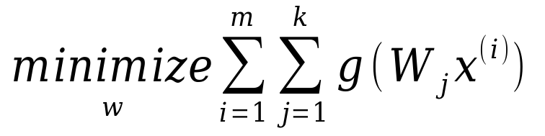

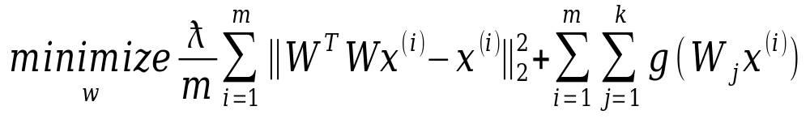
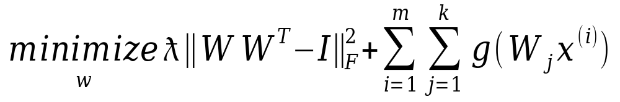
5.R(reconstruction)ICA
Two drawbacks: difficult to learn overcomplete features and sensitive to whitening
ICA: subject to
RICA:

Slide 12
5.several questions
Why we need white the component?
What is the specific process to solve the principal component?
The proof of two lemma?

