Slide 1
PROJECT LIGHTNING TALK:
Atlantis:
Terraform Pull Request Automation
for Cloud Native Teams
Rui Chen · Atlantis Maintainer
Shanghai, China · September 8, 2026
Notes:
Target: 0:00–0:20 (20 seconds) Spoken words: 34 Cue: Define Atlantis before introducing the workflow. Hi, I'm Rui, an Atlantis maintainer. Atlantis is an open-source service that runs Terraform and OpenTofu plans and applies from pull requests. The idea is simple: code review should include the infrastructure execution result. Transition: Advance after the final sentence. Emergency cuts: None; retain this slide’s narration. Reference notes (not spoken): See sources.md for factual references.

Slide 2
PLAN → REVIEW → APPLY
The pull request becomes the workflow.
Webhook · apply request
Pull request
Atlantis
Code + plan review
Plan + apply results
PR orchestration
Configured requirements
Results stay with
the pull request.
Terraform / OpenTofu
Providers · state · infrastructure
02
Notes:
Target: 0:20–1:10 (50 seconds) Spoken words: 76 Cue: Trace the loop once; distinguish orchestration from provider/state execution. Many teams already automate infrastructure. Atlantis brings planning, review, execution, and results into one workflow. A developer opens a pull request. The Git host sends a webhook; Atlantis runs Terraform or OpenTofu and posts the plan back. The team reviews the code and plan together. An authorized engineer requests atlantis apply. Atlantis checks configured requirements, executes the change, and reports the result in the pull request. The infrastructure tooling still uses your providers and state backend. Transition: Advance after the final sentence. Emergency cuts: None; retain this slide’s narration. Reference notes (not spoken): C01/C05/C06: Atlantis orchestrates VCS interaction, affected-project workflows, command requirements and reporting. Terraform/OpenTofu handles provider APIs and remote state/backend operations. The diagram combines plan and apply result arrows; they are separate events.

Slide 3
ENGINEER EXPERIENCE
One change. One PR conversation.
infra: resize production database
Atlantis
Plan: 0 to add, 1 to change, 0 to destroy
Reviewer
Approved
Rui
atlantis apply
Atlantis
Apply complete.
Illustrative PR · approval requirement configured · apply before merge
03
Notes:
Target: 1:10–1:50 (40 seconds) Spoken words: 62 Cue: Explain the engineer experience; do not repeat the architecture. Here is one database capacity change. The summary says zero to add, one to change, zero to destroy. Small does not mean safe: the reviewer reads the full plan and considers operational impact. The plan becomes review context attached to the code change. If execution fails, the team can correct the change in the same pull request. This example applies before merging. Transition: Advance after the final sentence. Emergency cuts: If execution fails, the team can correct the change in the same pull request. Reference notes (not spoken): See sources.md for factual references.

Slide 4
PLATFORM TEAMS
Shared review. Controlled execution.
Collaborative
Developers propose
Controlled
Platform rules govern execution
Visible
Plan + result beside the code
04
Notes:
Target: 1:50–2:15 (25 seconds) Spoken words: 38 Cue: Three outcomes; centralized execution is not a security guarantee. Platform teams get visibility, control, and collaboration. Plans and results sit beside code. Credentials and execution are centralized; configured requirements and locking coordinate changes. Developers propose; platform rules govern execution. Centralization still needs careful permissions and trusted repositories. Transition: Advance after the final sentence. Emergency cuts: None; retain this slide’s narration. Reference notes (not spoken): C18: Provider credentials are supplied to the Atlantis execution environment; this does not assert that all developer credentials disappear. Repo/server configuration controls requirements. Atlantis locks a directory/workspace across PRs; this is separate from Terraform state locking. Plan execution also needs trusted repositories and restricted permissions.

Slide 5
CORE INTEGRATIONS
Connect Git to your infrastructure tools.
Git providers
Atlantis
IaC execution
GitHub · GitLab
PR orchestration
Terraform / OpenTofu
Purpose-built infrastructure PR automation
05
Notes:
Target: 2:15–2:40 (25 seconds) Spoken words: 36 Cue: Point to the flow; do not read the host list. Atlantis connects your Git provider to IaC execution. You can build pieces in generic CI; Atlantis packages projects, plans, applies, locking, and VCS interaction into one service. Custom workflows extend execution, including tools such as Terragrunt. Transition: Advance after the final sentence. Emergency cuts: Custom workflows extend execution, including tools such as Terragrunt. Reference notes (not spoken): P01–P03/C04/C18: Current hosts: GitHub, GitLab, Bitbucket Cloud and Server, Azure DevOps, Gitea and compatible forks such as Forgejo. Examples on screen are not exhaustive. Terraform and OpenTofu are selectable distributions. Terragrunt requires its binary and custom workflow commands; it is not a peer provider. Project discovery/planning, apply coordination, locking and VCS comments are purpose-built behaviors, not capabilities exclusive to Atlantis.

Slide 6
WORKFLOW EXTENSIONS
Extend the pull-request review.
Policy
e.g. Conftest
Plan
Review
Review input
Added context
Cost
e.g. Infracost
Custom workflows compose your own tooling.
06
Notes:
Target: 2:40–3:00 (20 seconds) Spoken words: 32 Cue: Policy and cost are separate, optional review inputs. Platform teams compose tooling through custom workflows. Policy and cost are examples: Conftest checks the plan; Infracost adds cost context. These are configured extensions, not checks that every Atlantis installation automatically runs. Transition: Advance after the final sentence. Emergency cuts: None; retain this slide’s narration. Reference notes (not spoken): P04/P05/P07: Examples, not an exhaustive ecosystem: Conftest policy evaluation and Infracost cost estimation. Custom workflow run steps invoke external tools. Server-side pre/post workflow hooks support surrounding scripts; unlike workflow output, hooks do not automatically post their output as PR comments. Pre-hook errors do not block workflows by default; fail-on-pre-workflow-hook-error changes that behavior. Infracost integration requires configured tooling/hooks or workflow steps; it is not enabled by installing Atlantis. Custom validation or notification scripts are possible mechanisms, not bundled products.

Slide 7
DEPLOYMENT MODELS
Atlantis is self-hosted.
Kubernetes is optional.
Atlantis service
Kubernetes
Container
Server / VM
Official Helm chart
Official image
Atlantis binary
07
Notes:
Target: 3:00–3:20 (20 seconds) Spoken words: 34 Cue: Hosting choice does not determine provider support. Atlantis is self-hosted: use Helm, a container, or a server binary. Kubernetes is optional. Running Atlantis on Kubernetes does not limit it to managing Kubernetes; Terraform and OpenTofu providers determine the infrastructure being managed. Transition: Advance after the final sentence. Emergency cuts: None; retain this slide’s narration. Reference notes (not spoken): P06: Official Helm chart, official container image and Go binary deployment. Hosting is distinct from Terraform/OpenTofu provider targets. No cloud-provider compatibility list is implied.

Slide 8
ATLANTIS USER SURVEY · 2024 · N=354
Multiple stacks. One PR workflow.
354
GIT
GitHub leads · GitLab sizeable
survey responses
IaC
Terraform dominant
About half also use Terragrunt
Official results: runatlantis.io/blog
08
Notes:
Target: 3:20–3:50 (30 seconds) Spoken words: 43 Cue: Say the year; point to the official survey blog. The project's twenty twenty-four survey received three hundred fifty-four responses. GitHub led, with sizeable GitLab usage. Terraform dominated; about half also used Terragrunt, and OpenTofu was gaining ground. Kubernetes and AWS were common deployment environments. These are historical community responses, not market share. Transition: Advance after the final sentence. Emergency cuts: None; retain this slide’s narration. Reference notes (not spoken): S01–S05: Official 2024 survey: 354 responses, not organizations or market share. GitHub most common; sizeable GitLab, then Bitbucket/others. Terraform dominant; about half additionally use Terragrunt; OpenTofu gaining ground. Kubernetes and/or AWS common. Published Markdown links WebP chart images, with no raw numeric table or downloadable dataset; no chart estimates used. Visible examples summarize breadth; complete qualitative findings remain here.

Slide 9
PROJECT DIRECTION
Toward Atlantis 1.0.0
A clearer compatibility contract
Breaking changes
Major version
Planning discussion · not released
Draft proposal #5296 · release tracking #2496
09
Notes:
Target: 3:50–4:05 (15 seconds) Spoken words: 29 Cue: Keep project direction brief and explicitly provisional. The draft one point zero proposal clarifies the compatibility contract: breaking changes would require major versions. It signals stability and backwards compatibility. This is planning, not a release announcement. Transition: Advance after the final sentence. Emergency cuts: None; retain this slide’s narration. Reference notes (not spoken): R01: Draft PR #5296 says 1.0 is not expected to differ from a usual 0.x feature release; it signals stability/backwards compatibility. Proposed semantics: bug fixes patch, features minor, backwards-incompatible changes major. Server settings, repo config, API and core execution behavior are examples of compatibility boundaries. Draft and unmerged; no release date promised.

Slide 10
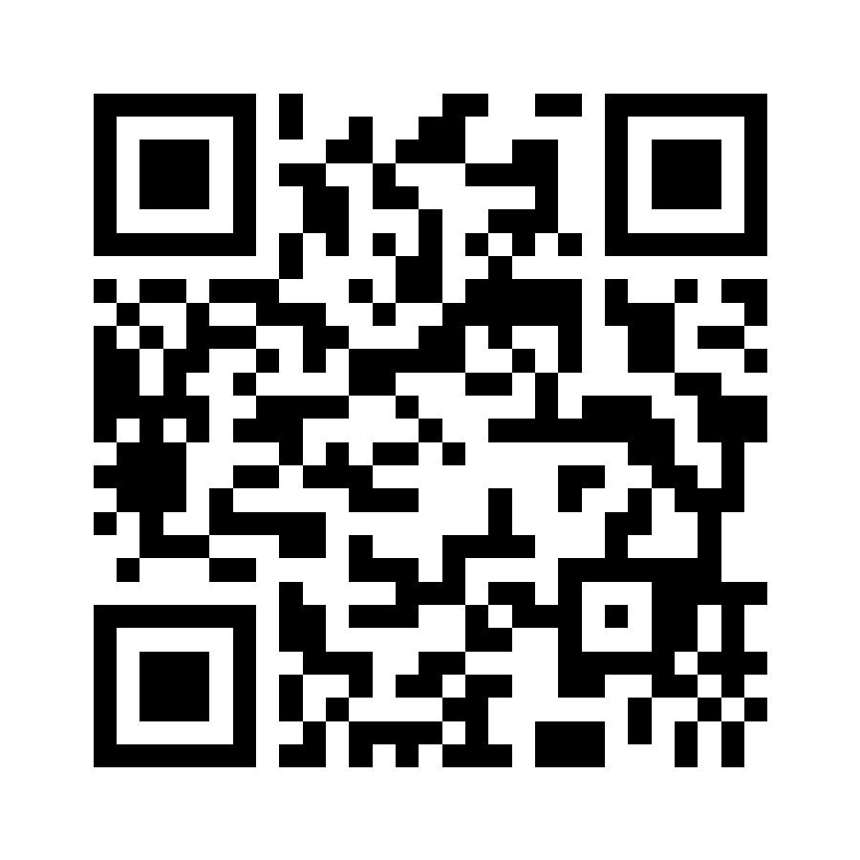
OPEN SOURCE · CNCF SANDBOX · APACHE 2.0
Infrastructure is code.
Plan it.
Review it.
Apply it.
GET STARTED
runatlantis.io/docs
SOURCE
github.com/
runatlantis/atlantis
COMMUNITY
Biweekly · Wed 16:00 UTC
From the pull request.
Agenda / notes + add to calendar
Project Pavilion · T-10 · Tue 10:30–14:30
10
Notes:
Target: 4:05–4:30 (25 seconds) Spoken words: 42 Cue: Point to discovery links, then hold the final slide. Learn more at runatlantis dot io, explore the code on GitHub, and join the CNCF community. Find Atlantis at Project Pavilion, table T-ten, in Grand Ballroom One on Tuesday. Infrastructure is code. Plan it. Review it. Apply it. From the pull request. Transition: Hold the closing slide. Emergency cuts: None; retain this slide’s narration. Reference notes (not spoken): E03: Project Pavilion T-10, Tuesday September 8, 10:30–14:30, Grand Ballroom I. The slot extends into afternoon. This does not promise Rui is continuously present during the whole pavilion slot. Community meetings: every two weeks on Wednesday at 16:00 UTC. Official agenda/notes and calendar access: https://docs.google.com/document/d/1EzseHmT4Zarj-_7MO8ud5mHByIJGIHS7JdoNNK9ZckU/edit (verified against the public document and official v0.37.0 release announcement).

