Slide 1

FDM Mobile Analysis
An Analysis of Market Performance and Key Drivers from October to December 2019
Data Sources:
- Sales Performance Data: Weekly volumes by price bracket.
- Pricing & Offer Data: Daily/weekly tariffs with 40+ KPIs.

Slide 2
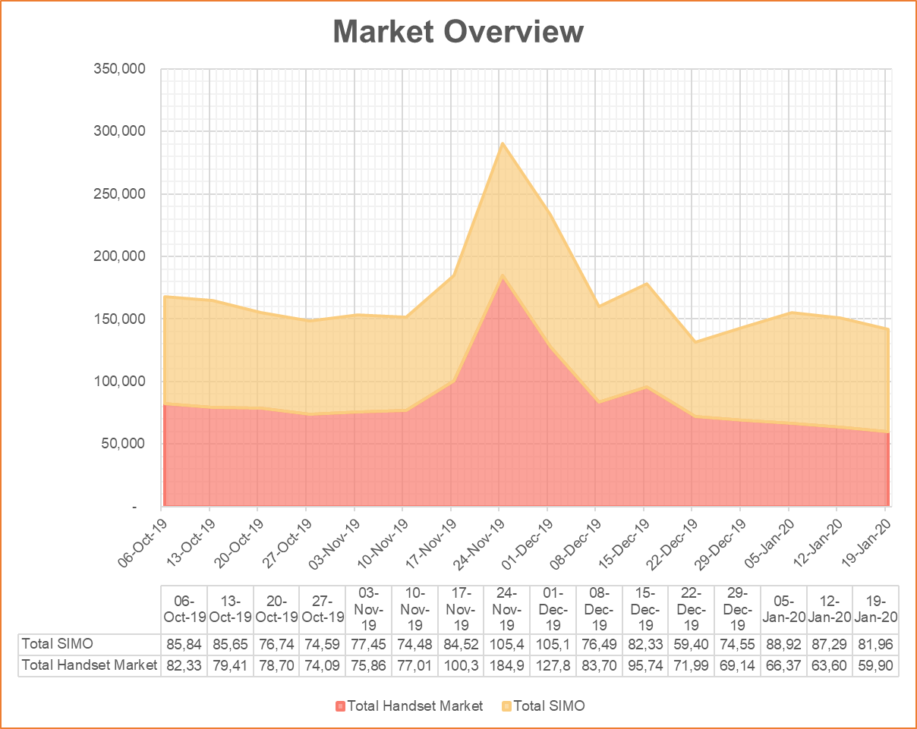
Sales Performance Insights
Key Insights:
- November Sales Spike: Driven by handset sales in the 30-39.9 cost range, likely influenced by Black Friday promotions.
Black Friday Sale boosted performance…
Key Insights:
- Early January Sales Recovery: SIMO plans in the 0-9.9 cost range, influenced by Boxing Day / New Year promotions
Notes:
624b0185-2f36-42c6-9562-52b62bd1a8b7.source.default.zh-Hans

Slide 3
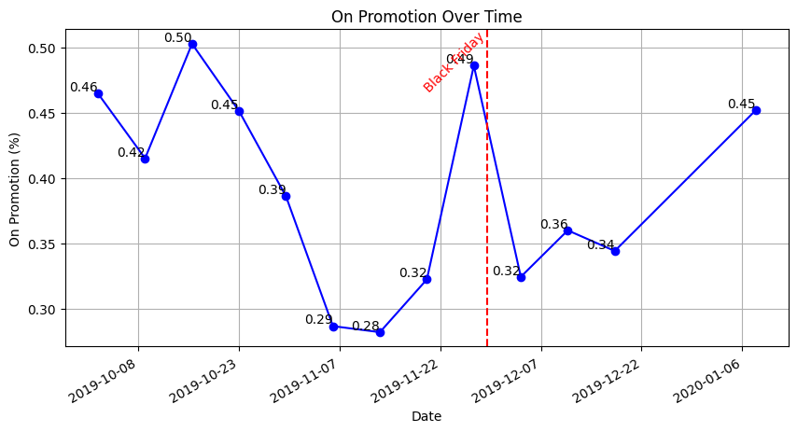
Impact of Promotions
Increase in promotions during sales peaks
Proportion of Promoted Products:
49%
Significant rise in promoted products from mid-November leading to Black Friday.
Increased from 28% to 49% during the time.
Different Network Promotion Strategies
14 companies
Varying strategies with BT maintaining high promotions and Giffgaff significantly increasing during sales periods.
Click here to see different companies promotion strategy: output2.png
Notes:
098ba12a-60e2-4716-9af0-eaef08ae26a8.source.default.zh-Hans

Slide 4
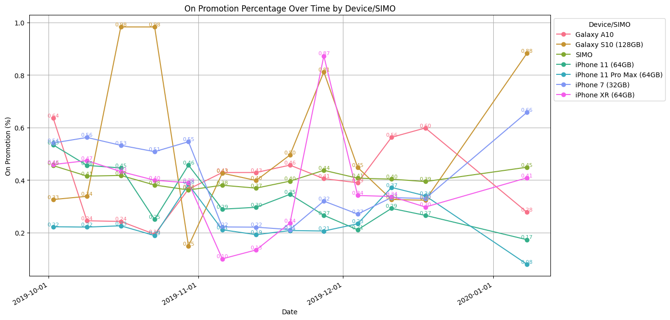
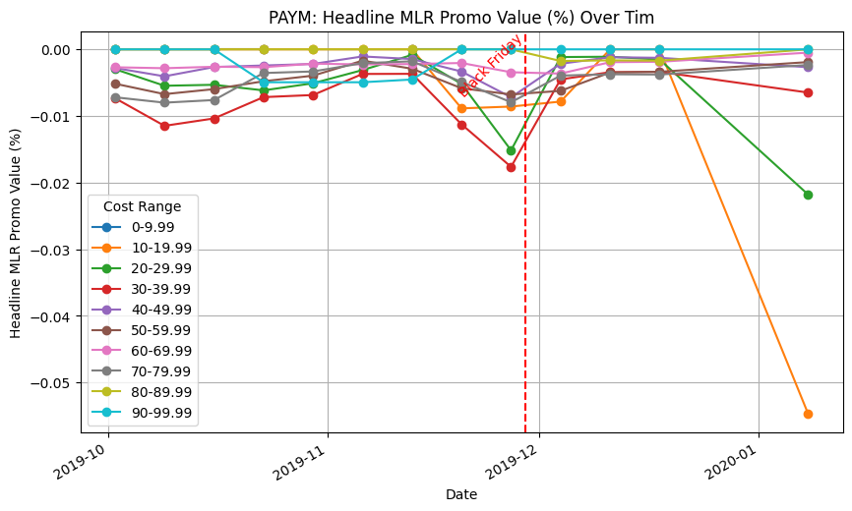
Other Observations
“Galaxy S10” “iPhone XR”
Which Device Matters
During the Black Friday Sale season, among all devices, 87% "Galaxy S10" and 81% "iPhone XR (64GB)" deals had promotions, potentially pushed the sales performance.
Some cost ranges have better deals
During the Black Friday Sale season, PAYM products price range in "20-29.9" or "30-39.9" has the highest headline MLP promo %. This explains the peak in figure: "Handset Market Zoom-in" "20-29.9" and "30-39.9" increase in sale.
Promo
%
Notes:
098ba12a-60e2-4716-9af0-eaef08ae26a8.source.default.zh-Hans

Slide 5
Key Takeaways & Recommendations
Summary:
- High sales driven by targeted promotions and strategic pricing.
Recommendations:
- Maintain robust promotions during key sales periods.
- Black Friday and holiday promotions were critical.
- Tailor strategies to specific devices and customer segments for maximum impact.

