Slide 1

41091
Data Systems
Implementation of ETL pipeline
using Python

Slide 2
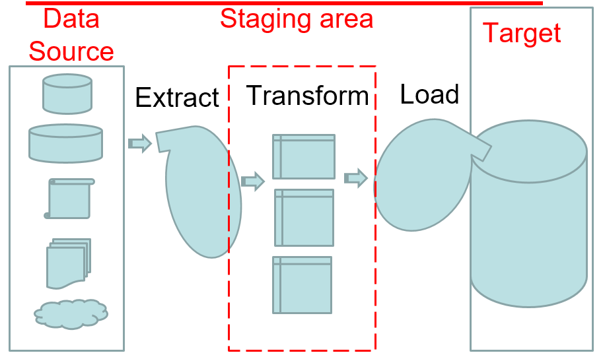
ETL
ETL - Extract, Transform, and Load
Data flow: [Data source] -> [Staging area] -> [Data warehouse].
Cleaning and reformating data before loading into data warehouse.
Notes:
The five critical differences of ETL vs ELT:
ETL is the Extract, Transform, and Load process for data. ELT is Extract, Load, and Transform process for data.
In ETL, data moves from the data source to staging into the data warehouse.
ELT leverages the data warehouse to do basic transformations. There is no need for data staging.
ETL can help with data privacy and compliance by cleaning sensitive and secure data even before loading into the data warehouse.
ETL can perform sophisticated data transformations and can be more cost-effective than ELT.

Slide 3
Project example - ETL
Use Python
Extract data from
xls file (Technicians daily work log book)
Xml file (Invoices )
MySQL tables (staff, jobs, payment, …)
Streaming data (Weather web site)
Where: your data lake
Transform data by
Clean extracted data
Add missing data
Transform data to the data structure in the data warehouse
Where: your staging area
Load the data to the Fact Table in
your Data Warehouse
When: scheduled time
( 11pm every day)
DW

Slide 4
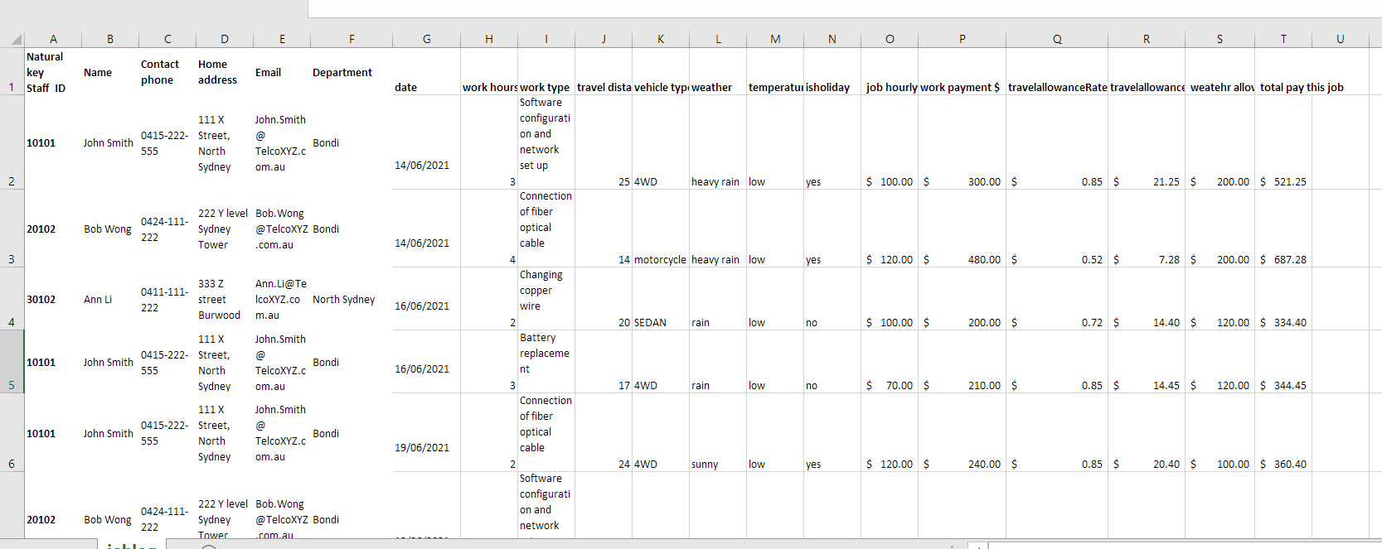
Example 1 - Extract data from excel file

Slide 5
Step 1 : ----
Description
Python code
The Python code and MySQL are developed by Teaching Assistant Shougang Chen.

Slide 6
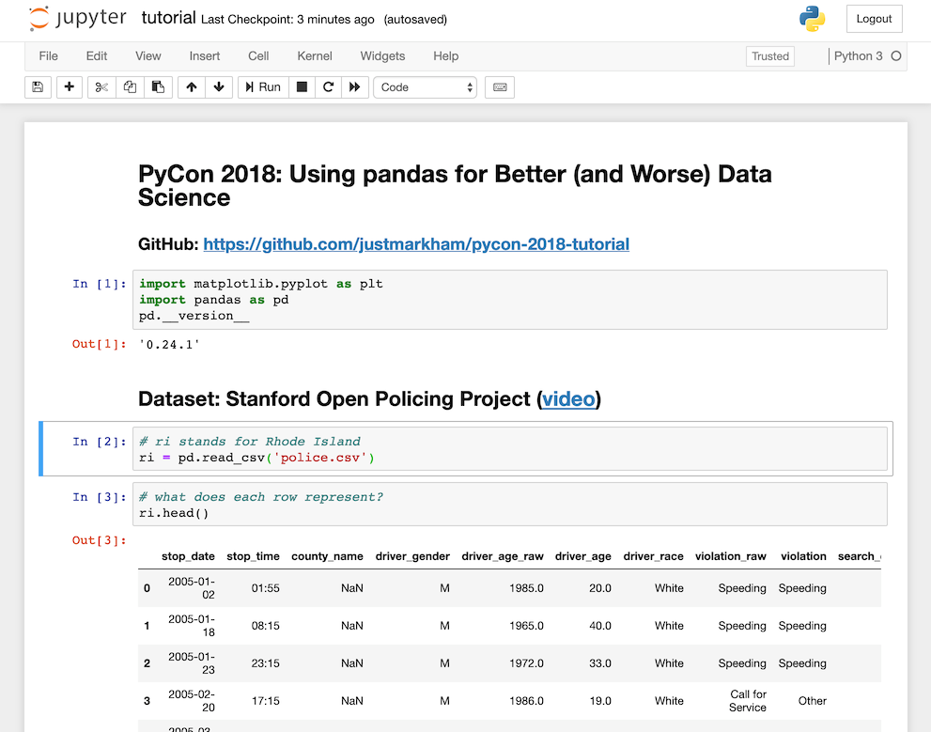
Step 1- Results Screenshot
The Python code and MySQL are developed by Teaching Assistant Shougang Chen.

Slide 7
Step 2 : ----
Description
Python code
The Python code and MySQL are developed by Teaching Assistant Shougang Chen.

Slide 8
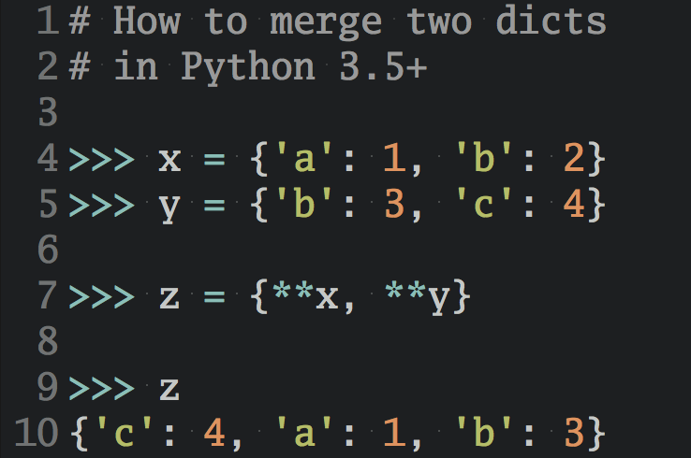
Step 2 Results - Screenshot
Screenshot
The Python code and MySQL are developed by Teaching Assistant Shougang Chen.

Slide 9
Step 3 : ----
Description
Python code
The Python code and MySQL are developed by Teaching Assistant Shougang Chen.

Slide 10
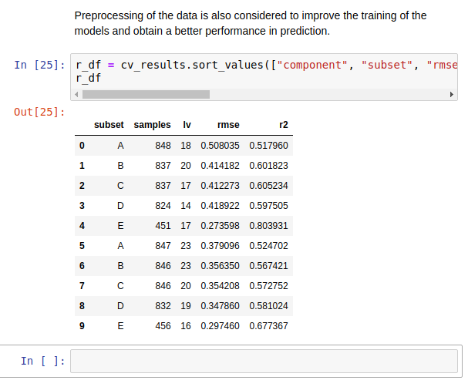
Step 3 results
Screenshot
The Python code and MySQL are developed by Teaching Assistant Shougang Chen.

Slide 11
Step 4 : ----
Description
Python code
The Python code and MySQL are developed by Teaching Assistant Shougang Chen.

Slide 12
Step 4 results
Screenshot
The Python code and MySQL are developed by Teaching Assistant Shougang Chen.

Slide 13
The Python code and MySQL are developed by Teaching Assistant Shougang Chen.

