Slide 1
Words Embedding Word2Vec vs Glove
Chen Sheiner, Shay Shemesh
Aug 2022

Slide 2
Overview
Introduction
Word2vec
Glove
Past work
Method
Future work

Slide 3
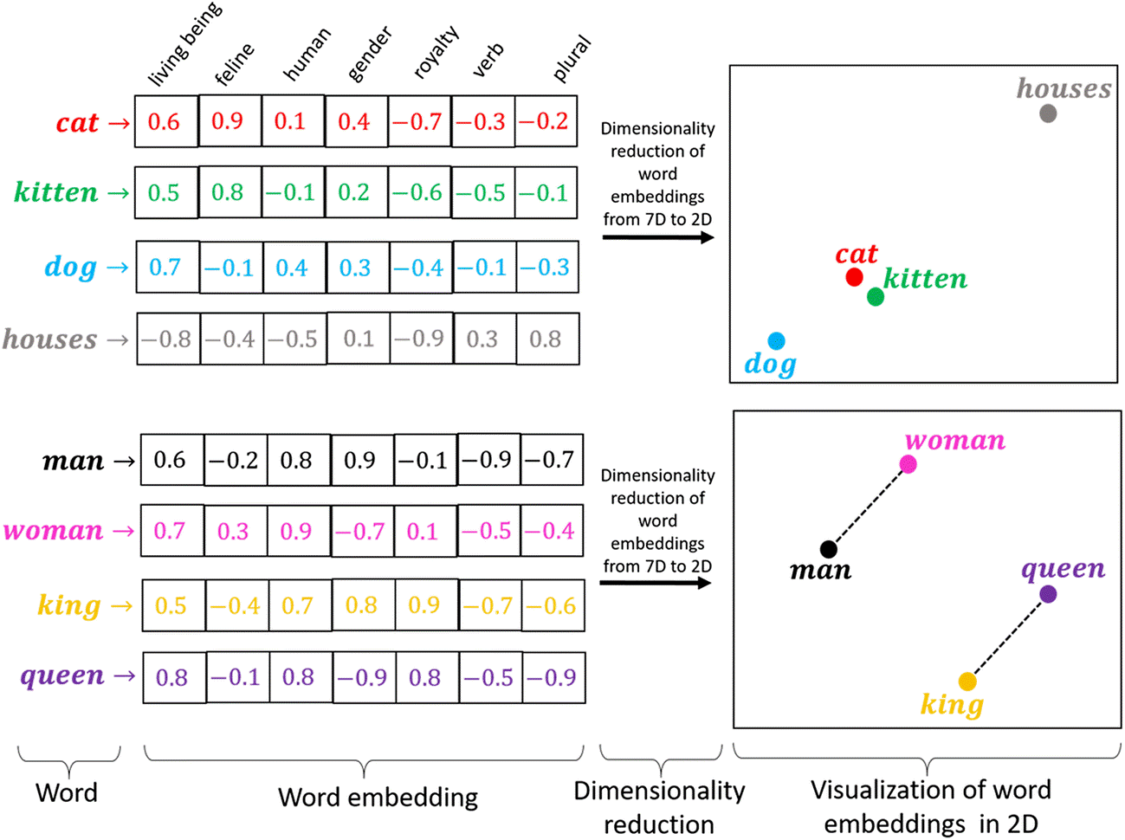
Introduction
The vector representation of words, of size n.
Similar words have similar vector values
Helps convert NLP problems to regular ML and DL
“You shall know a word by the company it keeps!”
— Page 11, “A synopsis of linguistic theory 1930-1955“, in Studies in Linguistic Analysis 1930-1955, 1962.

Slide 4
Word2Vec
Developed by Tomas Mikolov, et al. at Google in 2013
Low space and time complexity
Relies on local usage context

Slide 5
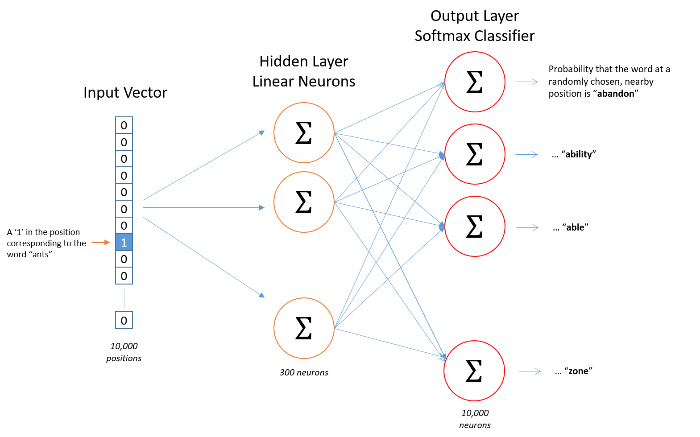
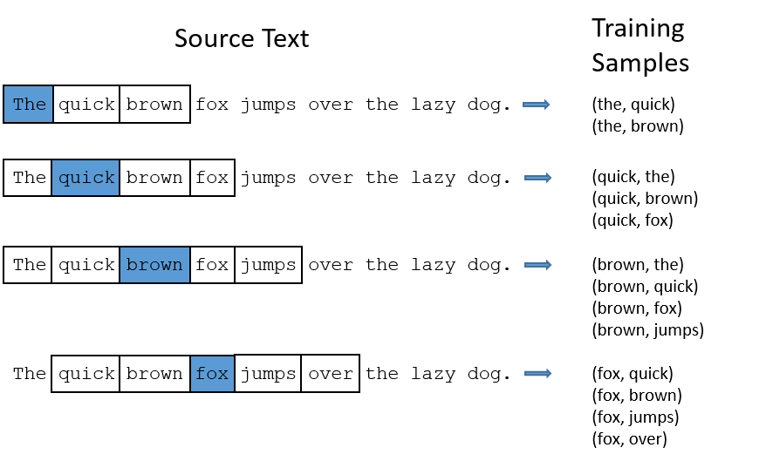
Word2Vec

Slide 6
Glove
Developed by Tomas Mikolov, et al. at Google in 2013
Low space and time complexity
Relies on local usage context
This is the hyperparameter of this model

Slide 7

Past work – “Comparing word2vec and GloVe for Automatic Measurement of MWE Compositionality”
Hypothesis
Multiword expressions word vector are like its components word vectors
Datasets
SIMP20=simple Wikipedia dataset of 2020
EN20_10P= 10% of all Wikipedia dataset from 2020
Categories (the true labels were created by humans)
 | F_ENC | R_ENC | MC_VPC | D_ADJN | MC_VN
meaning | nominal | noun | Verb-particle | Adjective-noun | Verb-object
size | 1042 compounds | 90 compounds | 116 pairs | 135 compounds | 638 pairs
Ex. | Greenhouse gas | Ivory tower | Lie down | Blue chip | Take root
Pickard, T. (2020, December). Comparing word2vec and glove for automatic measurement of MWE compositionality. In Proceedings of the Joint Workshop on Multiword Expressions and Electronic Lexicons

Slide 8
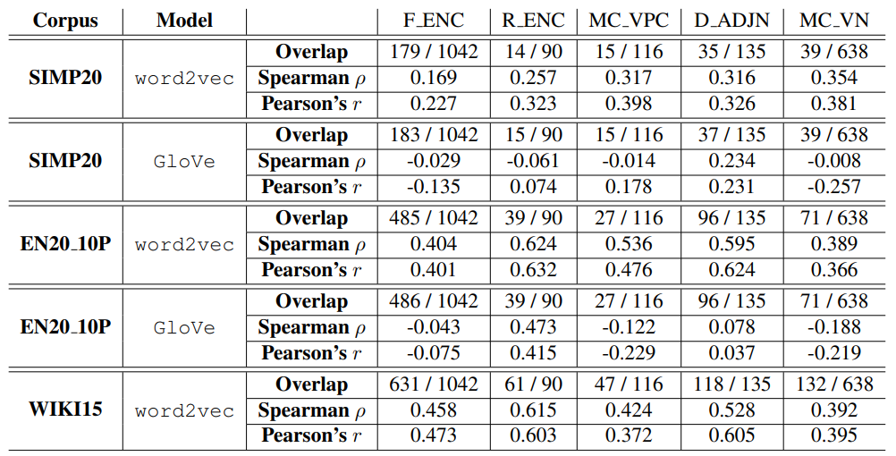
Past work – “Comparing word2vec and GloVe for Automatic Measurement of MWE Compositionality”
Pickard, T. (2020, December). Comparing word2vec and glove for automatic measurement of MWE compositionality. In Proceedings of the Joint Workshop on Multiword Expressions and Electronic Lexicons

Slide 9
Future work
Training Word2Vec and GloVe on Datasets
Saving various models at specific epoch number and time trained
Compering similar models' accuracy on matching test datasets
Visualization of results

Slide 10

Questions?

