Slide 1
Words Embedding Word2Vec vs Glove
Chen Sheiner,
Shay Shemesh
Aug 2022

Slide 2
Overview
Introduction
Word2vec
Glove
Past work
Method
Future work

Slide 3
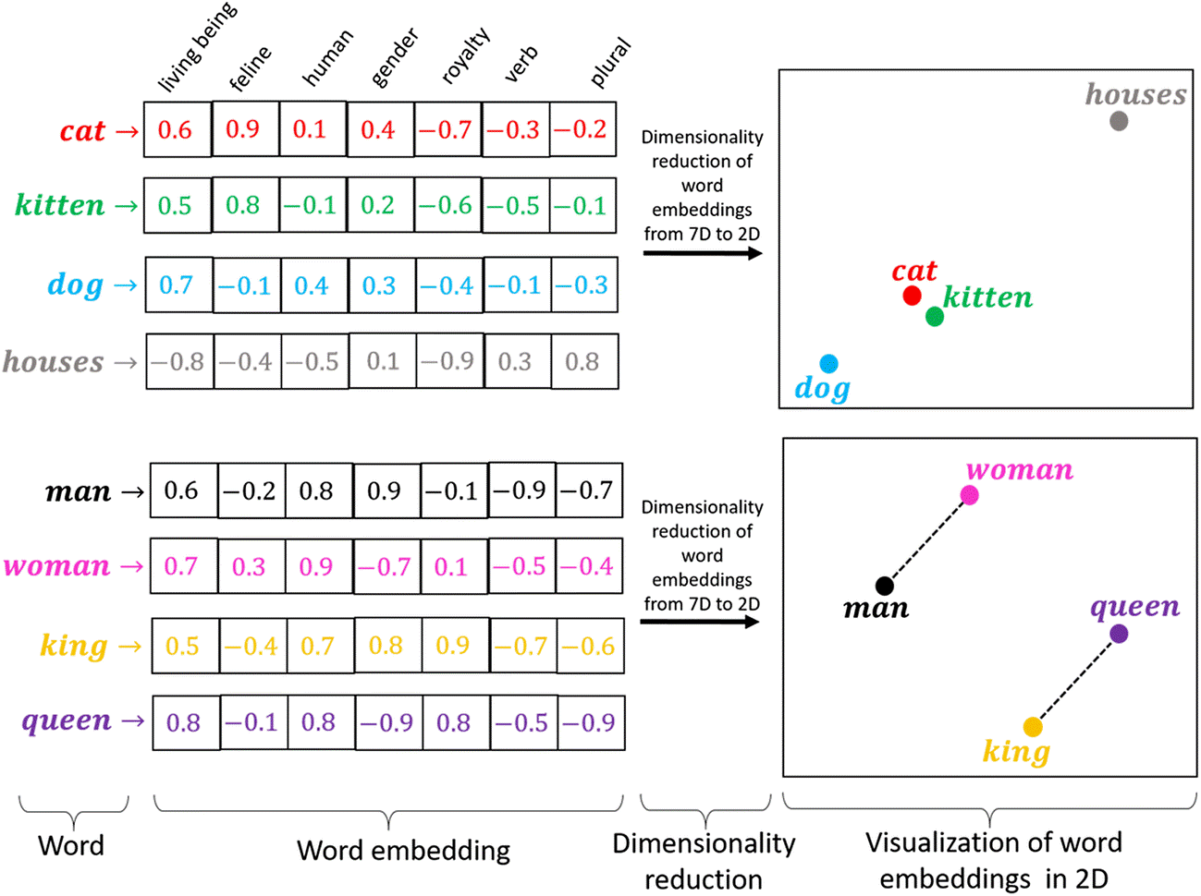
Introduction
The vector representation of words, of size n.
Similar words have similar vector values
Helps convert NLP problems to regular ML and DL
“You shall know a word by the company it keeps!”
— Page 11, “A synopsis of linguistic theory 1930-1955“, in Studies in Linguistic Analysis 1930-1955, 1962.

Slide 4
Word2Vec
Developed by Tomas Mikolov, et al. at Google in 2013
Low space and time complexity
Relies on local usage context
This is the hyperparameter of this model

Slide 5
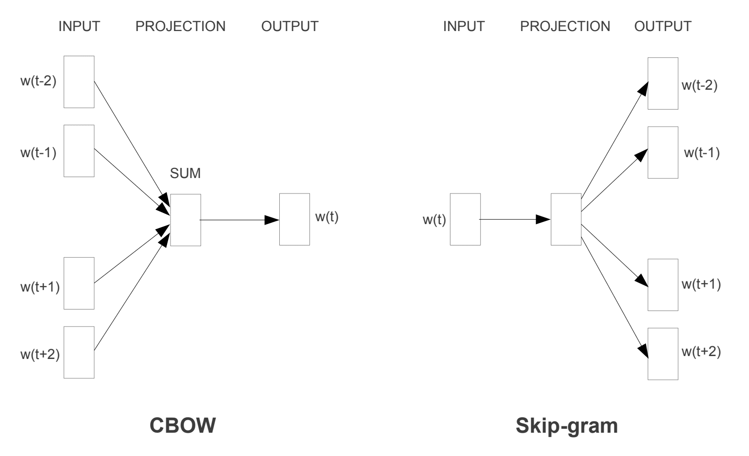
Continuous Bag-of-Words vs Skip-Gram

Slide 6
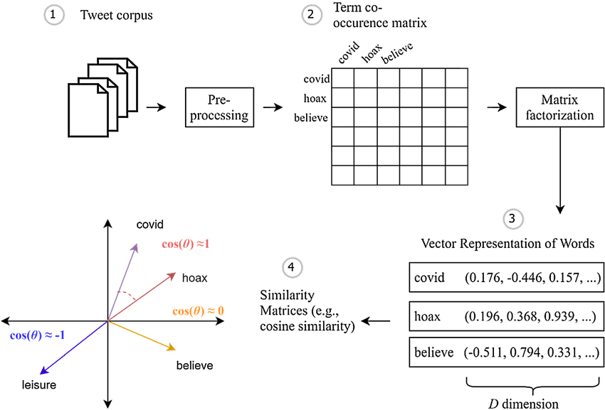
GloVe
GloVe: Global Vectors for Word Representation, 2014.
developed by Pennington, et al. at Stanford,2014
word co-occurrence matrix using statistics across the whole text corpus

Slide 7
Past work comperision
????
Ravanelli, M., & Bengio, Y. (2018, December). Speaker recognition from raw waveform with sincnet. In 2018 IEEE Spoken Language Technology Workshop (SLT)

Slide 8
Method
Using these 2 databases , train models of Word2Vec and GloVe
Harvard USPTO Patent Dataset
???
The models will have some checkpoints for fair compersion:
Same epoch trained
Same Time trained

Slide 9
Method
Compering the models based on same epoch/time trained on these test respectively:
U.S. Patent Phrase to Phrase Matching
????

Slide 10
Future work
Initial results
Hyperparameter tuning via cross validation
Create visualization of the results

Slide 11
Questions?

