Slide 1
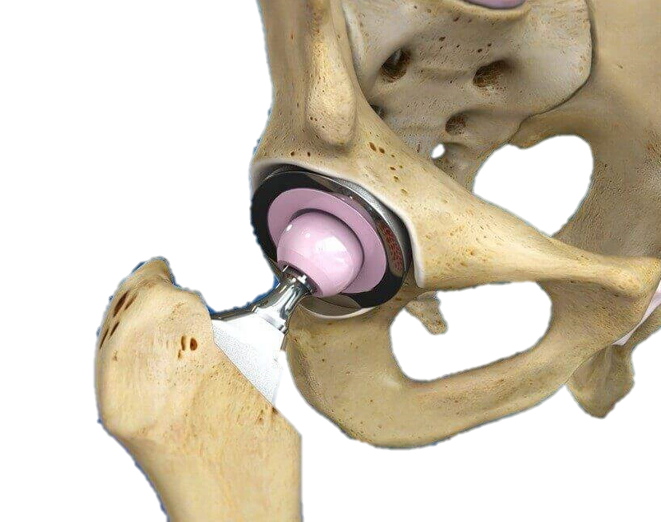
Surgeon Identification in Cementless Hip Replacement using SincNet
Chen Sheiner, Eden Moran, Shay Shemesh
Aug 2022

Slide 2

Overview
Introduction
Hypothesis
Speaker identification
Data set
SincNet
Future work

Slide 3
Introduction
The ultimate goal - identify the last hit of the last broach
Assumption - different surgeons yield different patterns of operation sounds
Leading idea - pre classifying types of surgeons might drastically improve accuracy of last hit identification

Slide 4
Hypothesis
Different surgeons exhibit different acoustic features during the surgery
It is possible to differentiate between them regardless to the specific broach size used

Slide 5
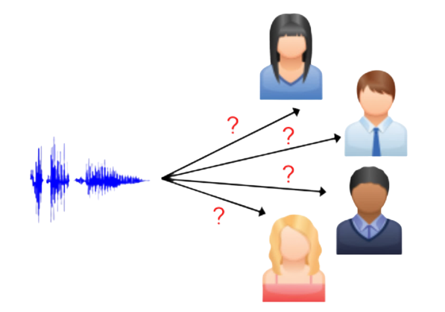
Speaker Identification
Similarities between:
Speaker identification Surgeon identification
Why:
Sentence Broach recording
Syllable Hit sound
Pitch Hit frequency
Speak amplitude Hit amplitude

Slide 6
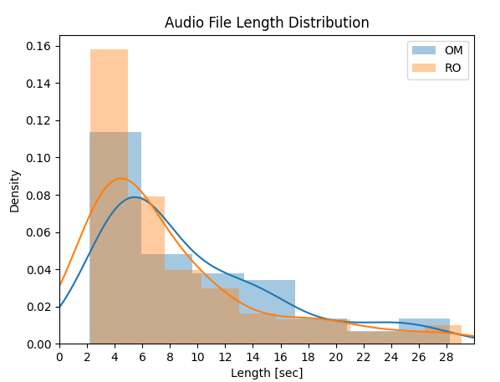
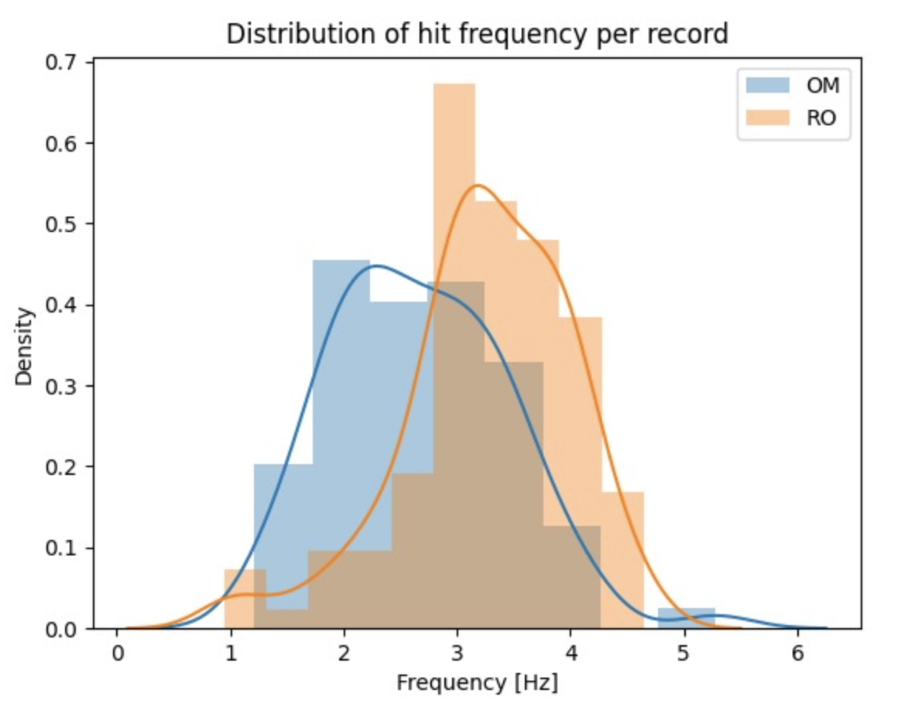
Data
Original: 275 audio files, 3 surgeons
Data preparation rules:
Drop stem and cerclage audio files
Drop audio files of the surgeon “AM”
not sufficient data
Drop lower 10% quantile of the data
enable filter length value
Drop 5% of longest audio file
lower the variance of the data by dropping outliers
Surgeon | Number of Operations | Number of Audio Files | Mean Length of Files
OM | 12 (42.86%) | 78 (40.84%) | 9.531
RO | 16 (57.14%) | 113 (59.16%) | 8.177
Total | 28 | 191 | 8.73

Slide 7
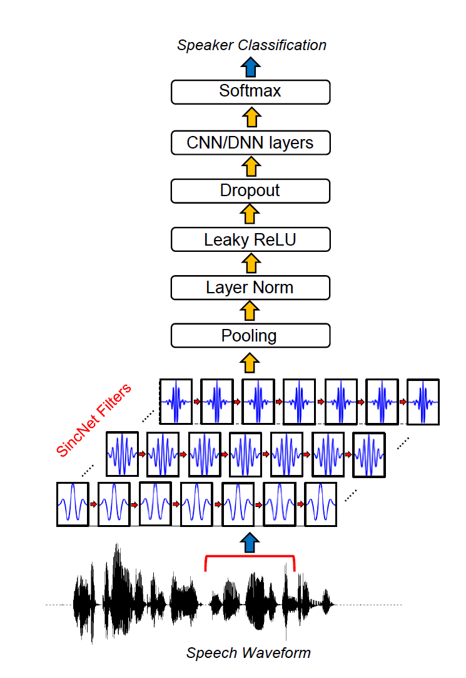
SincNet
Modified CNN
Meaningful first layer
Band pass filter (freq) by sinc functions (time)
Regular CNN Pipeline
Ravanelli, M., & Bengio, Y. (2018, December). Speaker recognition from raw waveform with sincnet. In 2018 IEEE Spoken Language Technology Workshop (SLT)

Slide 8
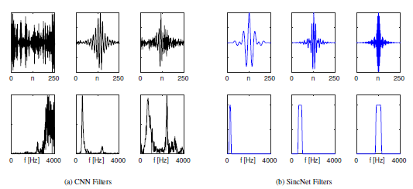
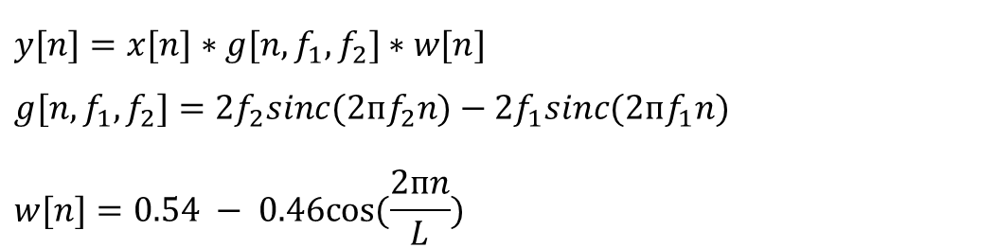
SincNet vs CNN
$$y[n]=x[n]∗g[n,f_{1},f_{2}]∗w[n]$$
$$g[n,f_{1},f_{2}]=2f_{2}sinc(2пf_{2}n)−2f_{1}sinc(2пf_{1}n)$$
$$w[n]=0.54 − 0.46cos⁡(\frac{2пn}{L})$$
Ravanelli, M., & Bengio, Y. (2018, December). Speaker recognition from raw waveform with sincnet. In 2018 IEEE Spoken Language Technology Workshop (SLT)

Slide 9
Future work
Initial results
Hyperparameter tuning via cross validation
Data filtering rules – maximizing number of samples with small data variance
Split long audio files with long silence periods
Up sampling the data of the third surgeon (“AM”)

Slide 10

Questions?

