Slide 1
Words Embedding Word2Vec vs Glove
Chen Sheiner,
Shay Shemesh
Aug 2022

Slide 2
Overview
Introduction
Word2vec
Glove
Past work
Method
Future work

Slide 3
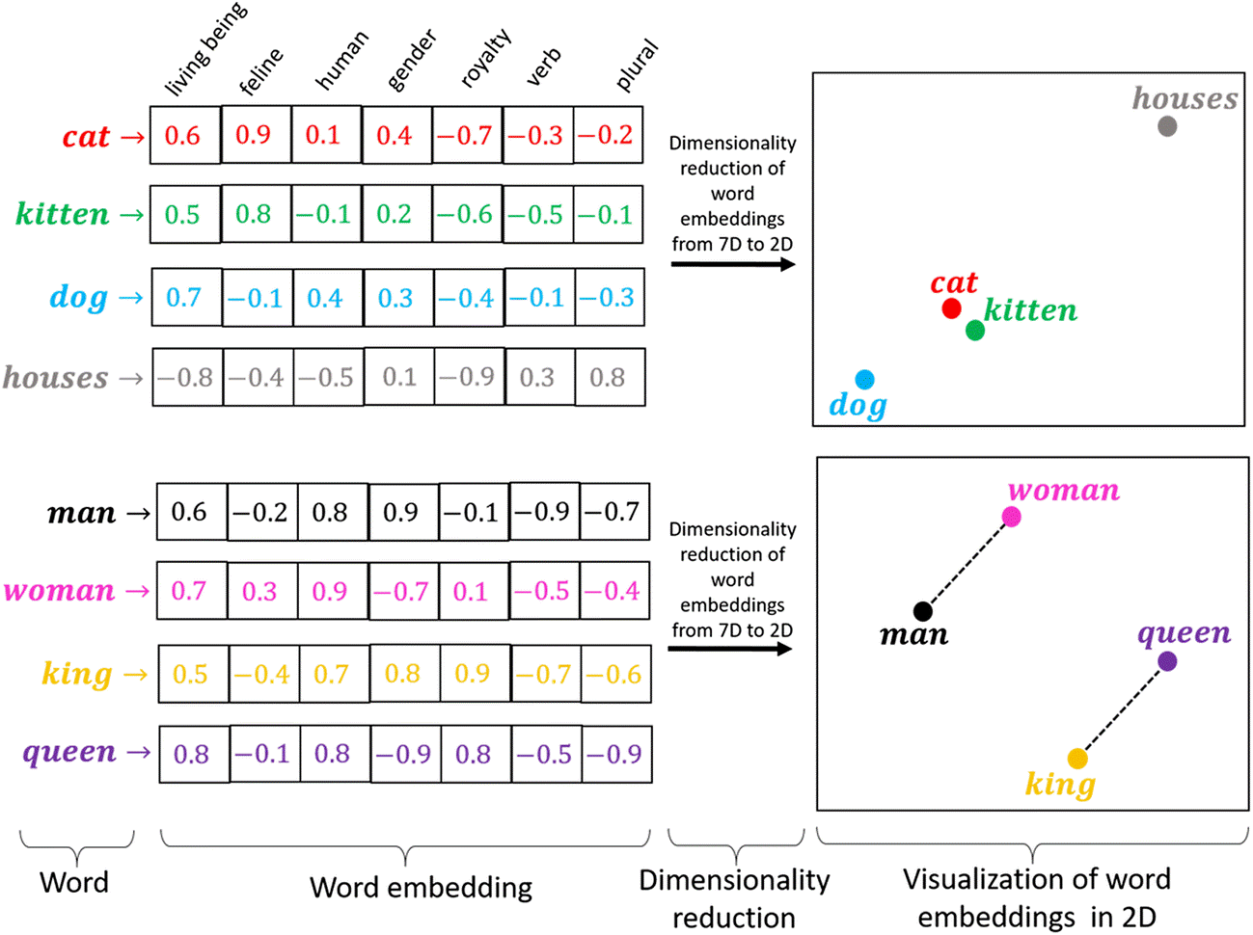
Introduction
The vector representation of words, of size n.
Similar words have similar vector values
Helps convert NLP problems to regular ML and DL
“You shall know a word by the company it keeps!”
— Page 11, “A synopsis of linguistic theory 1930-1955“, in Studies in Linguistic Analysis 1930-1955, 1962.

Slide 4
Word2Vec
Developed by Tomas Mikolov, et al. at Google in 2013
Low space and time complexity
Relies on local usage context
This is the hyperparameter of this model

Slide 5
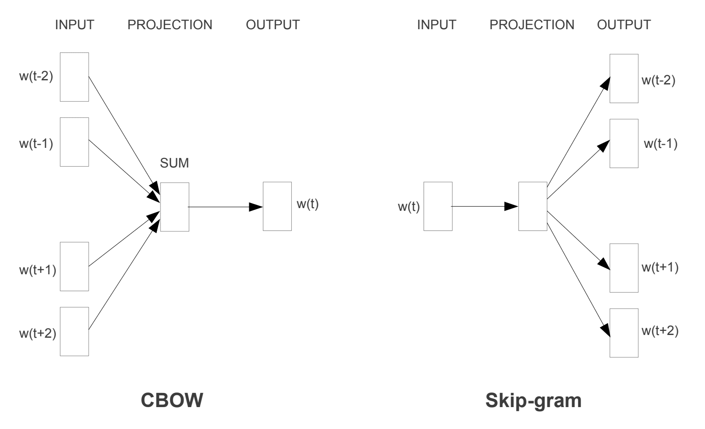
Continuous Bag-of-Words vs Skip-Gram

Slide 6
Glove
Developed by Tomas Mikolov, et al. at Google in 2013
Low space and time complexity
Relies on local usage context
This is the hyperparameter of this model

Slide 7
Past work comperition
Modified CNN
Meaningful first layer
Band pass filter (freq) by sinc functions (time)
Regular CNN Pipeline
Ravanelli, M., & Bengio, Y. (2018, December). Speaker recognition from raw waveform with sincnet. In 2018 IEEE Spoken Language Technology Workshop (SLT)

Slide 8
Future work
Initial results
Hyperparameter tuning via cross validation
Data filtering rules – maximizing number of samples with small data variance
Split long audio files with long silence periods
Up sampling the data of the third surgeon (“AM”)

Slide 9
Questions?

