Slide 1
Incompressible MHD spectral code

Slide 2
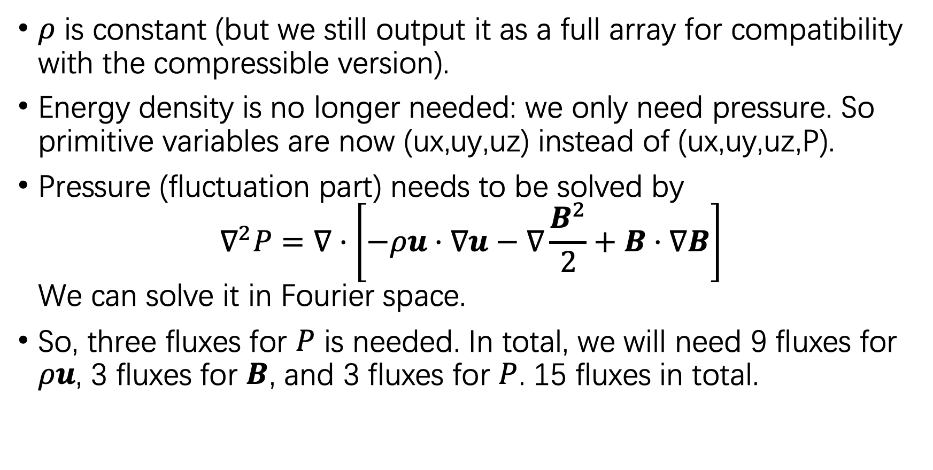
Variables
$ρ$ is constant (but we still output it as a full array for compatibility with the compressible version).
Energy density is no longer needed: we only need pressure. So primitive variables are now (ux,uy,uz) instead of (ux,uy,uz,P).
Pressure (fluctuation part) needs to be solved by $∇^{2}P=∇⋅\left[−ρu⋅∇u−∇\frac{B^{2}}{2}+B⋅∇B\right]$ We can solve it in Fourier space.
So, three fluxes for $P$ is needed. In total, we will need 9 fluxes for $ρu$, 3 fluxes for $B$, and 3 fluxes for $P$. 15 fluxes in total.

Slide 3
Notes
A uniform background pressure needs to be set.
The pressure needs to be updated independently before advancing velocity and magnetic field.

