Slide 1
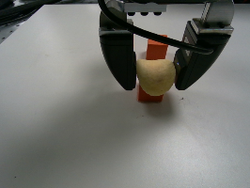
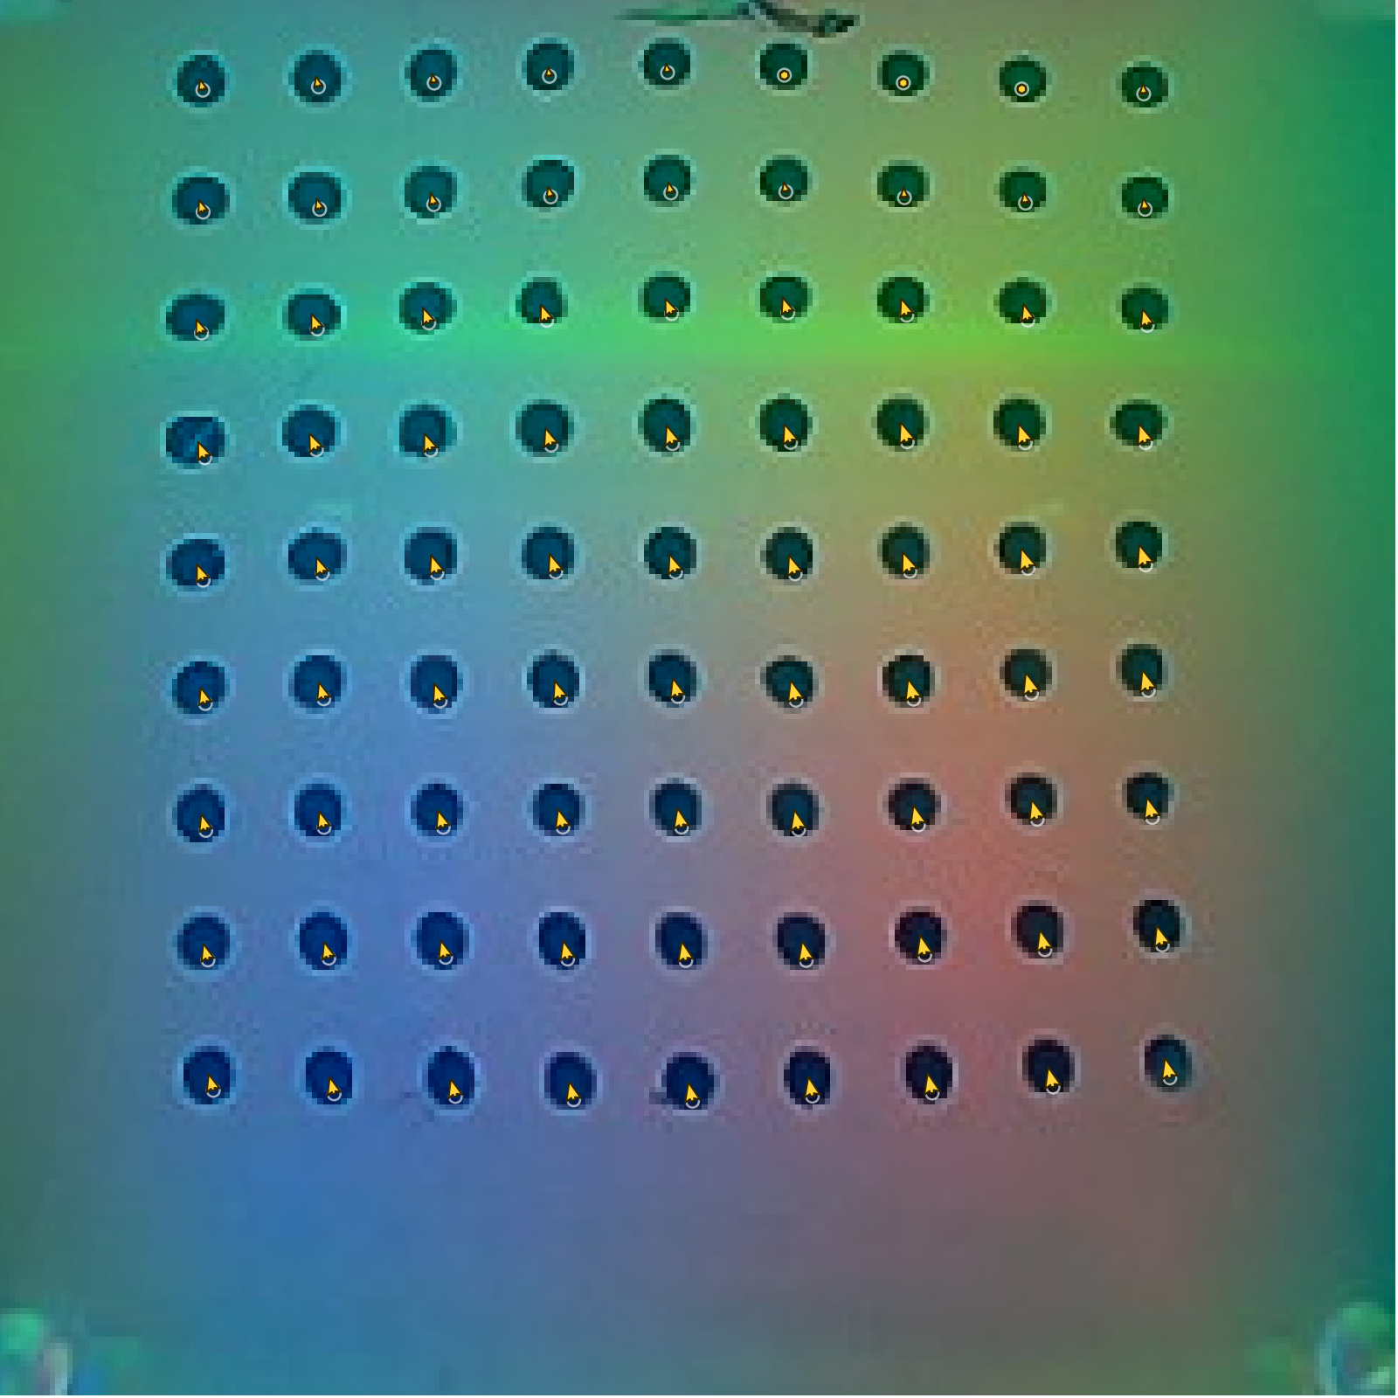
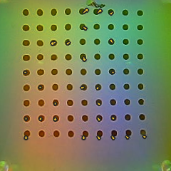
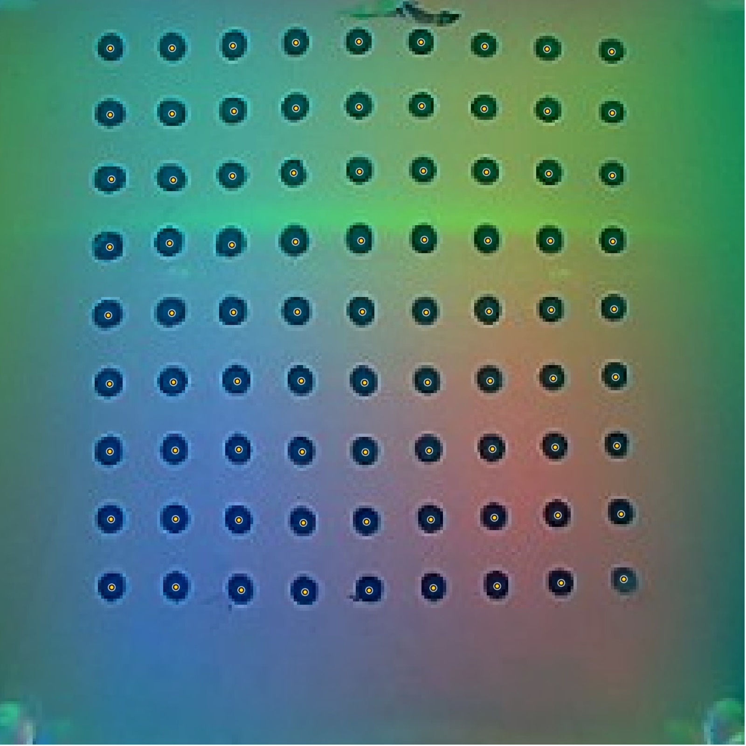
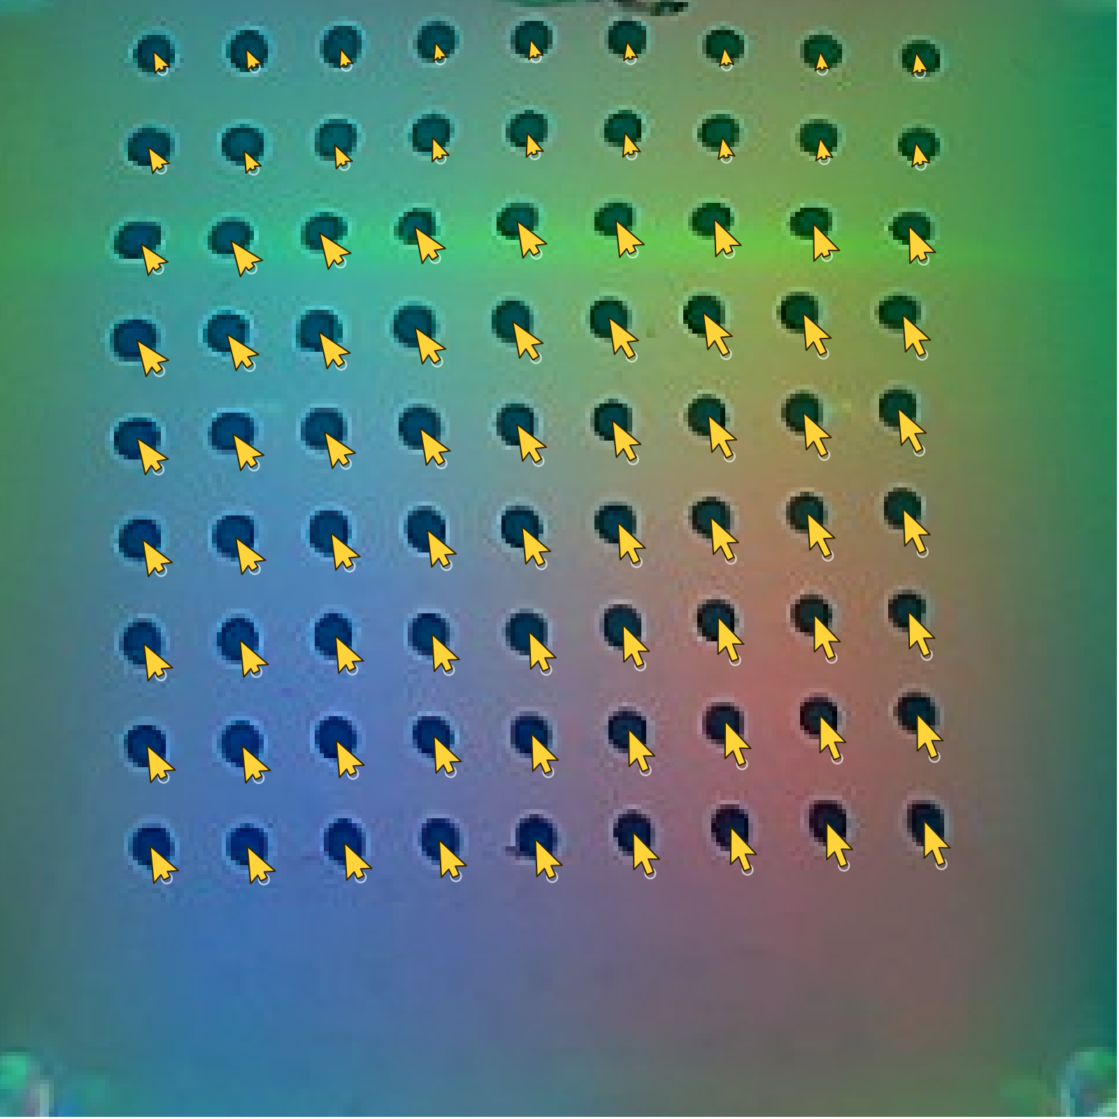
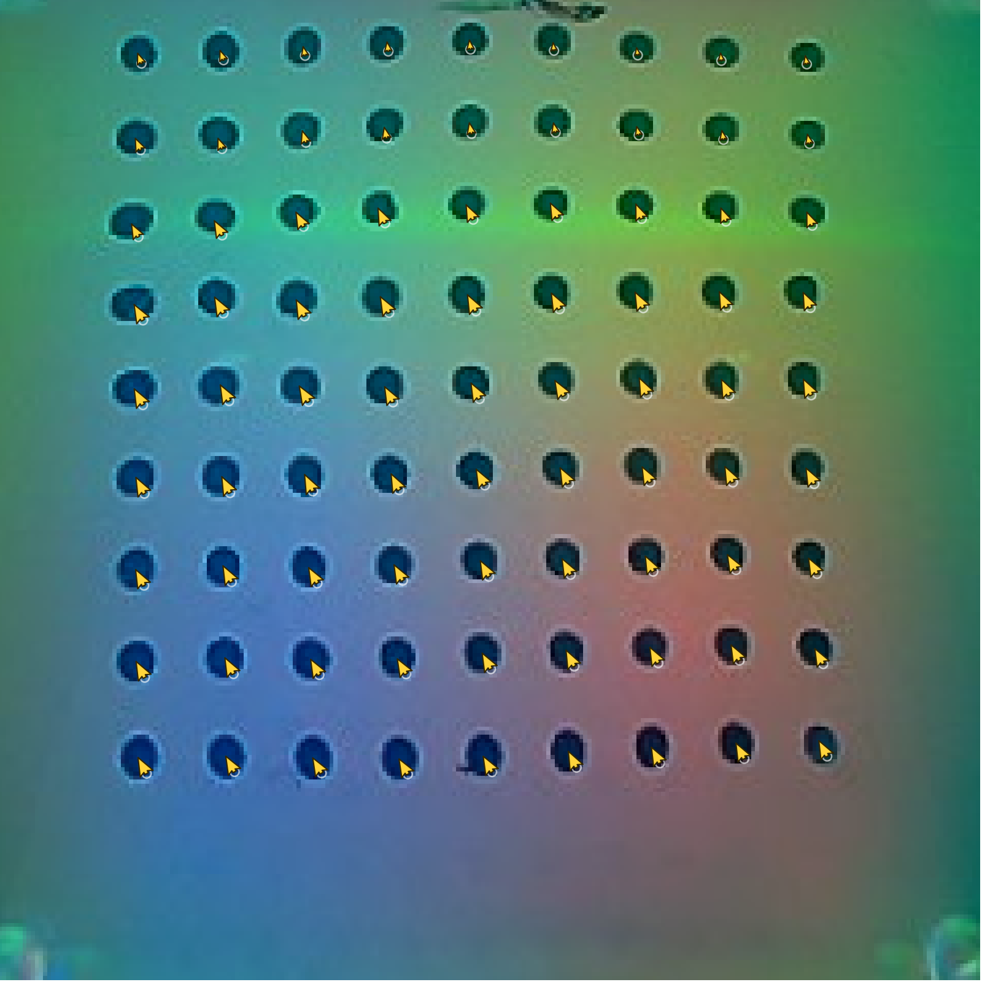
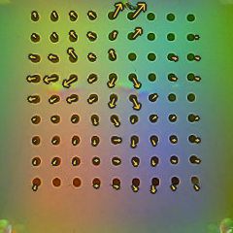
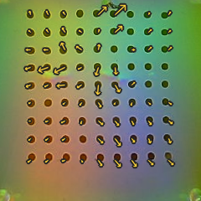
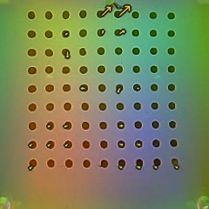
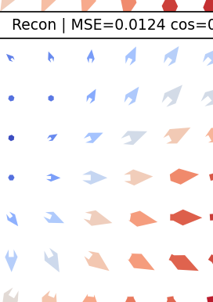
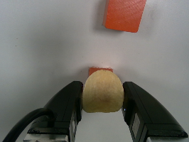
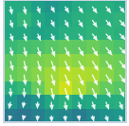
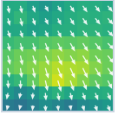
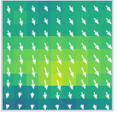
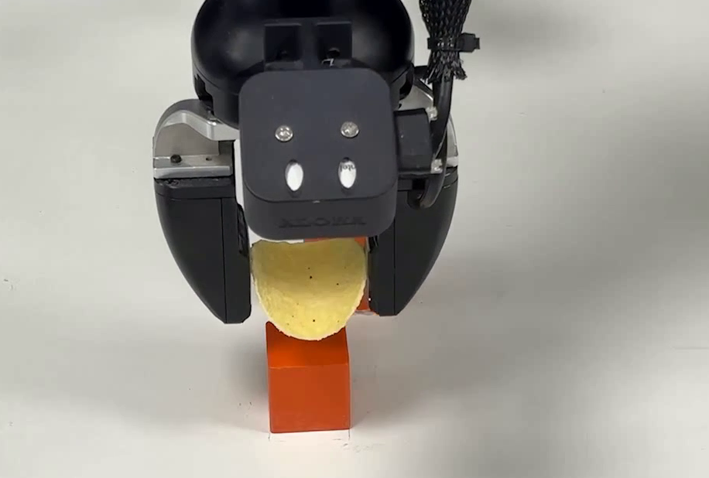
OFFLINE MODEL LEARNING
(a) TacVAE Pretraining
(b) Action-Conditioned Tactile Foresight
(c) Contact-Quality Scorer
Global
Wrist
Future queries
Future tactile latents
Deployment z_t
+
-
-
-
-
Visual Encoder
...
Tactile Encoder
mu
Marker Decoder
...
~
t+1
t+H
stable
dropout
low force
excess
slip
log var
Foresight Transformer
Spatial latent
Marker Decoder
aligned action
Marker history
Recon.
Contact-Quality Scorer
stable contact
TacVAE
Obs. context
Decoded contact evolution
predicted touch
Action cross-attention
parallel future
failure risk
Touch
Projection
Actions
Action Embedding
Robot state
INFERENCE-TIME PREDICTIVE GUIDANCE
Frozen modules; guidance updates only the selected action state.
predicted tactile future
current context
clean action estimate
Denoiser
Foresight
Scorer
low quality
quality gradient
guided update
...
...
initial noise
selected late state
updated state
continued frozen denoising
final guided action
execute & replan

