Slide 1
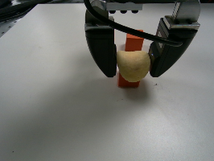
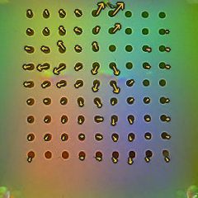
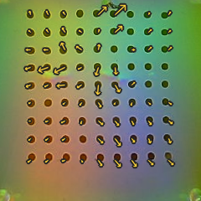
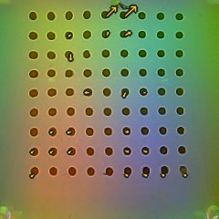
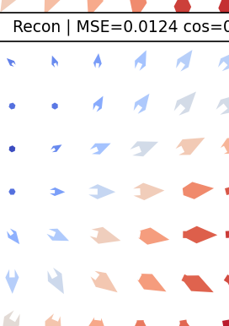
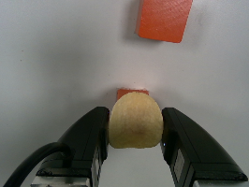
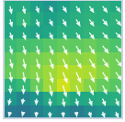
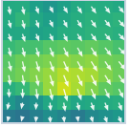
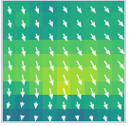
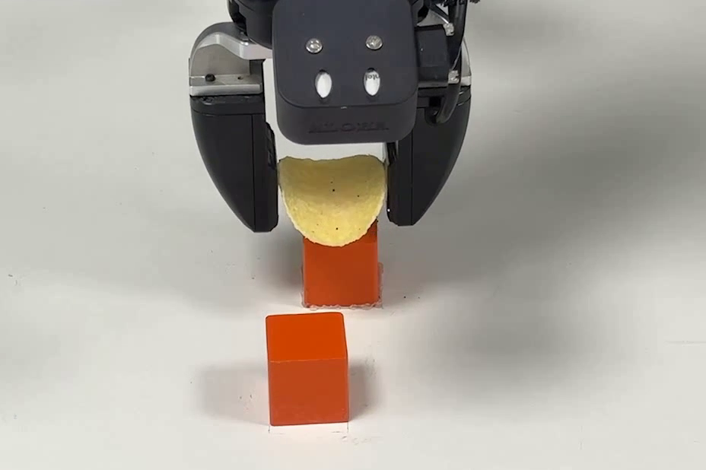
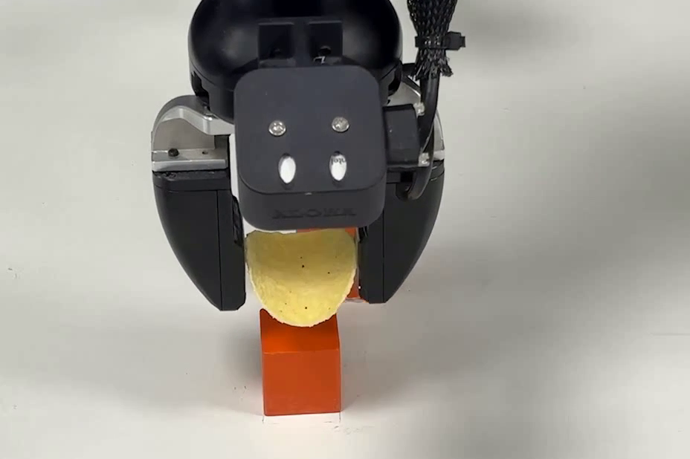
OFFLINE MODEL LEARNING
(a) TacVAE Pretraining
(b) Action-Conditioned Tactile Foresight
(c) Contact-Quality Scorer
Global
Wrist
Future queries
Future tactile latents
Deployment z_t
+
-
!
~
x
Visual Encoder
...
Tactile Encoder
mu
Marker Decoder
...
~
t+1
t+H
stable
dropout
excess
slip
jam
log var
Foresight Transformer
Spatial latent
Marker Decoder
Aligned trajectories
Marker history
Recon.
Contact-Quality Scorer
stable
TacVAE
Obs. context
Decoded contact evolution
failure risk
Action cross-attention
parallel future
Touch
Projection
Actions
Action Embedding
Robot state
INFERENCE-TIME PREDICTIVE GUIDANCE
Frozen models; only the action sample is updated.
Predicted tactile future
Obs. context
Clean action estimate
Denoiser
Foresight
Scorer
low quality
guided update
quality gradient
...
...
initial noise
selected late state xᵏ
updated state x̃ᵏ
continue frozen denoising
final guided action
execute & replan

Slide 2
