Slide 1

Unit 10
Improving Intercultural Communication

Slide 2

Learning Objectives
In this unit, you are to know:
1. the definition and importance of IC competence;
2. potential problems in IC;
3. ways to improve IC competence.

Slide 3
Procedures
Warm-up
1
Text Study
2
Practice
3
3
Assignments
4
4

Slide 4

I. Warm-up
What does the case symbolize？

Slide 5
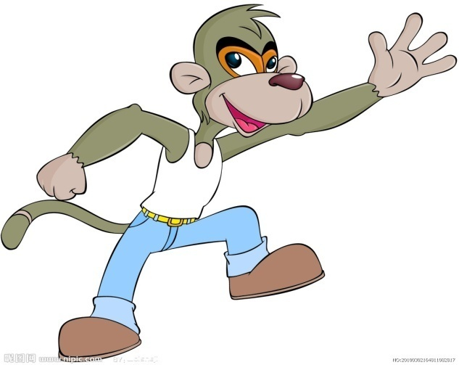
Analysis
The case symbolizes human being’s ethnocentrism
in intercultural communication.
ethnocentrism

Slide 6
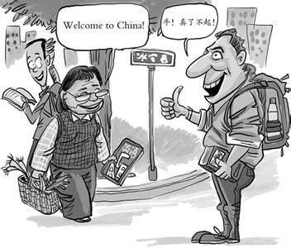
II. Text Study
Go over textbooks from pages 154 to 161 and learn
about how to improve IC competence

Slide 7
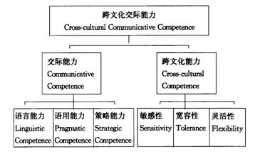
2.1. Intercultural Communicative Competence
The term intercultural(cross-cultural) communicative competence
involves the competence of effective communication in intercultural context.
It produces behaviors that are both appropriate and effective; and it requires
sufficient knowledge, suitable motivations, and skilled actions.
To be effective in intercultural communication, one needs not only communicative
competence (skills) but also intercultural competence.

Slide 8
2.2.Potential Problems in intercultural communicative competence
1. Ethnocentrism
2. Stereotypes
3. Culture Shock
4. Prejudice

Slide 9
2.2.1. Ethnocentrism
All cultures have the tendency to use the categories of one’s own culture to evaluate
the actions of others.
Ethnocentrism means：
1)The view of things in which one’s own group is the center of everything, and all
Others are scaled and rated with reference to it.——William G. Sumner)
2) A habitual disposition to judge foreign peoples or groups by the standards and
practices of one’s own culture of ethnic group; a tendency toward viewing alien cultures
with disfavor and a resulting sense of inherent superiority ——the Webster’s Third New
International Dictionary
Ethnocentrism refers to the belief that one’s culture is better. Or: A belief in the
superiority of one’s own ethnic group.
Negative impact of ethnocentrism:
If people believe that their culture is the only true culture, they will discriminate against
people who manifest cultural norms that fail to correspond to their values and behaviors.

Slide 10
Various forms of ethnocentric attitude（1）
My culture should be the model for other cultures.
I have little respect for the values and customs of other cultures.
Most people would be happier if they lived like people in my culture.
People in my culture have the best lifestyles.
I do not cooperate with people who are different.
I do not trust people who are different.
I dislike interacting with people from different cultures.

Slide 11
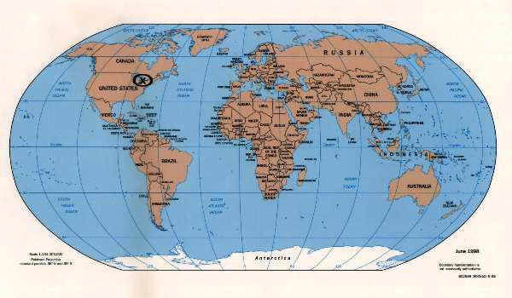
Ethnocentrism (2)
Western map of the world

Slide 12
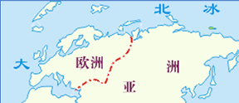
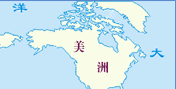
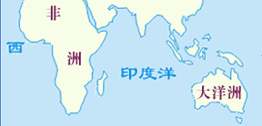
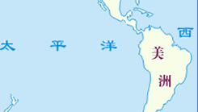
Ethnocentrism (3)
Chinese map of the world

Slide 13
Ethnocentrism (4)
Other possible manifestations:
古代中国之所以叫做“华夏”(华,光华也,荣华也；夏,大也)，因为这是大国之号…我们的国号叫中国， … 从名称上看都来源于中国的地理中心观念—天下中央之国。 非华夏文化之国被古代中国称作蛮夷， 表现出大国对外来文化的蔑视
Besides the name of “the United States”, the country has another name “America”; people of this country call themselves “Americans”.
We call a group of primitives in North America Eskimos; this name, originally used by certain Indians to the south of the Eskimos, means “Eaters of Raw Flesh.” However, the Eskimos’ own name for themselves is not Eskimos but Inupik, meaning “Real People”. By their name they provide a contrast between themselves and other groups; the latter might be “people” but are never “real”.
Negative impact on intercultural communication:
Ethnocentric judgments usually involve invidious (歧视的) comparisons that ennoble one’s culture while degrading those of others

Slide 14
2.2.2.Stereotyping
Stereotypes are a form of generalization about some group of people, or a means
of organizing images into fixed and simple categories that are used to stand for the
entire collection of people——Walter Lippmann
Stereotyping is a complex form of categorization that mentally organizes our
experiences and guides our behavior toward a particular group of people.
Human beings have a psychological need to categorize and classify. They acquire
them :
from our parents, relatives and friends;
through limited personal contact;
by the mass media.
…

Slide 15
Stereotype
Stereotypes are the perceptions or beliefs we
hold about groups or individuals based on
previously formed opinions and attitudes.

Slide 16
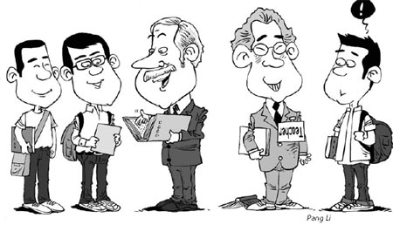
The negative of stereotypes
Stereotypes fail to specify individual characteristics. They assume that all members of a
group have exactly the same traits. They are oversimplified, over generalized, and/ or
exaggerated.
Stereotypes are based on half-truths, distortions, and often untrue premises; but often
taken as “truth”. Stereotype inaccuracy can lead to errors in interpretations about the
behaviors of others.
Stereotypes can also lead to errors in interpretations about the future behaviors of others.

Slide 17
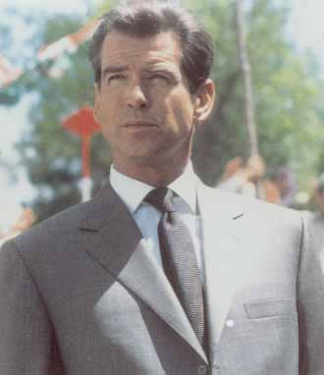
Chapter 7 Intercultural
Communication Barriers
The conservative and gentlemen-like English

Slide 18

Chapter 7 Intercultural
Communication Barriers
The demonstrative and talkative Italians

Slide 19
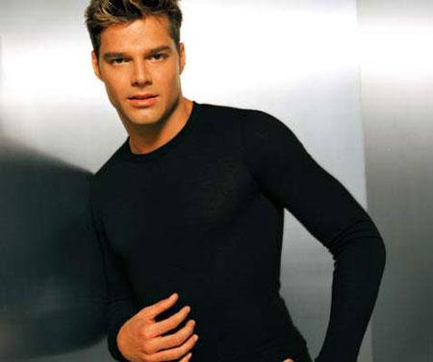
Chapter 7 Intercultural
Communication Barriers
The music-loving, masculine Latinos

Slide 20
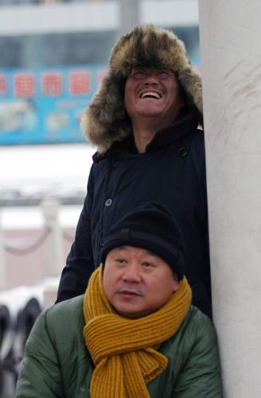
Chapter 7 Intercultural
Communication Barriers
Stereotyped Chinese northerners

Slide 21
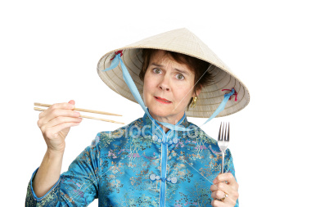
2.2.3. Culture Shock
After WWII, the United States sent waves of middle-class Americans out across
the globe: military and diplomatic personnel, business people, missionaries, Peace
Corps and other aid workers, exchange students, academics, engineers, scientists. The term "Culture Shock" is coined in the 1950's to explain some of the difficulties
these people had adjusting to life abroad. It focuses on the experience of expatriates
and elites, rather than the more rigorous cultural adjustments that refugees,
immigrants, and subjugated peoples face.
The term was first introduced by the anthropologist Oberg.
A popular term for the disorientation, confusion, and emotional reactions that
arise when people live in another culture.
They are troublesome feelings such as depression, loneliness, confusion,
inadequacy, hostility, frustration and tension caused by the loss of familiar cues
from the home culture (Linell Davis).
The term has been translated into Chinese as “文化休克”、“文化震荡” or “文
化冲突”.
Culture shock experiences 4 stages:
1. Honeymoon 2. Crisis
3. Recovering 4. Adjustment

Slide 22
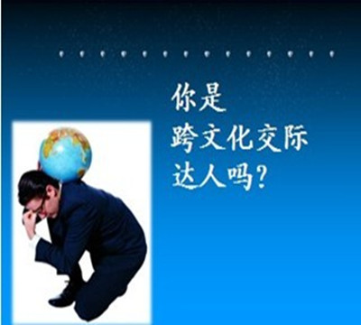
Possible Consequences of culture Shock
For people who constantly encounter in other cultures—
The anxiety period might be brief and include only a bit of “homesickness.”
For many other people—
Culture shock can mean depression, serious physical reactions (such as headaches or body pains), anger, aggression toward the new culture, and even total withdrawal.
All these reactions would obviously hamper intercultural communication.

Slide 23
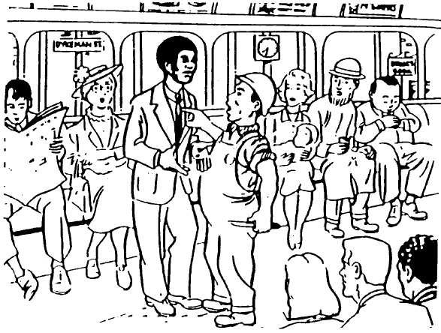
2.2.4.Prejudice
Stereotypes that include negative feelings and attitudes toward a group are prejudices.
Prejudice refers to negative attitudes towards other people that are based on faulty and
inflexible stereotypes. It is an unfair, biased, or intolerant attitude towards another group of
people—— Lusting & Koester
Prejudice refers to the irrational (非理性的) dislike, suspicion, or hatred of a particular
group, race, religion, or sexual orientation.
Strong prejudices are sometimes described as racism, sexism, ageism and extreme
nationalism.
Mr. Bias is a director of a small private company. He is interviewing candidates for the
position of assistant manager. He selects a bright and ambitious applicant.
Later, he discovers that this applicant is from the country of Levadel (a fictitious nation). Since he thinks that all Levadelians are stupid and lazy, he decides to select someone else
for the position.
What do you think of Mr. Bias’ decision?
Do you have ant prejudices against some people?

Slide 24
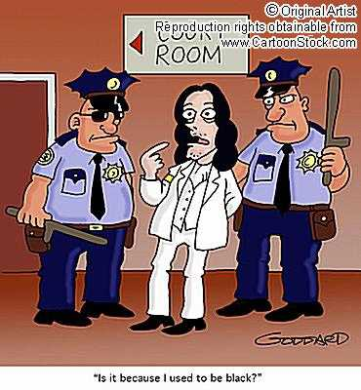
Racism is the belief that race accounts for differences in human character or ability and that a particular race is superior to others.
Racism is any policy, practice, belief, or attitude that attributes characteristics or status to individuals based on their race.
Racism

Slide 25
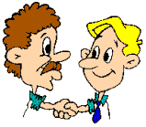
2.3.Ways to Improve Intercultural Communicative Competence
1. Knowing about our own culture
2. Knowing about foreign culture
3. Applying empathy
4. Developing adaptability

Slide 26

Knowing Ourselves
We are products of our culture--that culture helps control communication.
1. Knowing our attitudes
2. Identify those attitudes, prejudices, and opinions that we all carry around and
that bias the way the world appears to us.
3. Knowing our likes, dislikes, and degrees of personal ethnocentrism enables
us to place them out in the open so that we can detect the ways in which these
attitudes influence communication
4. Knowing our communication style
1) Do I seem at ease or tense?
2) Do I often change the subject without taking the other person into
consideration?
3) Do I deprecate（轻视）the statements of others?
4) Do I smile often?
5) Do I interrupt repeatedly?
6) Do I show sympathy when someone has a problem?
7) Do my actions tend to lower the other person’s self-estem?
8) Do I use a pleasant tone of voice when I talk to people?
...

Slide 27
Empathy
Empathy – being able to see things from the point of view of others or to see oneself in the other fellow’s situation.将自身投入到他人的境遇中，体验他人的感受，获得与他人相近的情感体验。
To improve empathy:
1. We have to remind ourselves to pay attention to the spontaneous emotional expressions of others and the situation where the interaction takes place.
2. As empathy is a reciprocal act, both parties have to be expressive so as to achieve understanding.
3. Empathy can be enhanced through awareness of specific behaviors that members of a particular culture or co-culture might find impertinent （无礼的） or insulting.
4. We have to remember that empathy can be increased if you resist the tendency to interpret the other’s verbal and nonverbal actions from your culture’s orientation.
Do you think we need empathy when we have intracultural communication?
Key words for improving empathy: understanding, respect, tolerance, openness, control…

Slide 28

Adaptability
Cultural modification of an individual, group, or people by adapting to or borrowing traits from another culture.

Slide 29
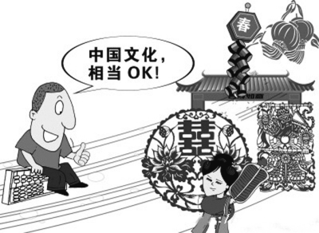
The adaptation process
Excitement about the new situation
Confusion when faced with the hidden aspects of culture
Frustration when old ways of dealing with situations fail to work
Growing effectiveness as new skills are acquired
Appreciation as new skills and attitudes enable the person to live more fully in
the new situation
Increased ability to deal with new and novel situations
---- Linell Davis

Slide 30
Develop culture awareness
We have to adapt to this changing world. Being able to communicate with people from other cultures is one aspect of this adaptation. Humans are capable of this through learning.
Successful intercultural communication demands cultural fluency as well as linguistic fluency.
To increase our cultural fluency, we should be aware of and sensitive to different values, beliefs, attitudes and assumptions in diverse aspects of life as well as culturally different modes of behavior.

Slide 31

III. Practice
.

Slide 32
3.1. Description Completion
Regional stereotypes
Complete the following descriptions of people of some places in China:
1) ________ 人精明。
2） ———— 人豪放。
3） ———— 人小气。
4） ———— 人会做生意。
5） ———— 人实在。
possible answer:
1) 上海 2) 东北 3) 城里 4) 潮州 5) 北京
Intercultural stereotypes
Complete the following descriptions of Westerners:
1) ________ are romantic.
2） ———— are cold and reserved.
3） ———— get on well with you quickly and forget you just as quickly.
4） ———— are logical and philosophical.
possible answer:
1) French 2) British 3) Americans 4) Germans
What you just did is stereotyping people.

Slide 33
3.2. Q’s & A’s
A. One Japanese student in America said: “On my way to school, a girl whom I don’t know smiled at me several times. I was a little surprised.” Why was he surprised?
B. A South Korean student in America wrote: “We went to visit an American friend. When we saw him, he opened the window and said to us: ‘I’m sorry, I don’t have time. I have to work at my studies.’ Then he closed his window.” Why was he confused?
C. An Arab student in America said: “When I was walking on the campus the first day, many people smiled at me, which made me quite ashamed. I hurried to the bathroom to see if anything was wrong with my clothes. Now I’m used to all the smiles.” Why did he first feel ashamed?
D. When Andrew Eggman was staying in Australia some 20 years ago, he had dinner with a local family. When the hostess asked his wife to have more, she said “I’m stuffed”. Immediately the host and hostess became quiet and wordless. Why?
Possible answer for B: He should have made an appointment .
Explanation for D: “I’m stuffed” ---
AmE: “I’m full.” Austrial English: (1) “I’m pregnant.” (2) “I have too much sex.”

Slide 34
3.3.Identifying problems When East Meets West
Wang Ming has invited a foreign friend, Lisa, to his home for a meal. Unfortunately,
the occasion gets off to a rather bumpy start.
Wang: Hi! Lisa, welcome! Come in, come in.
Lisa: Thank you for your invitation. It’s a lovely room and very warm in here.
Wang: My room is very small and untidy. Please sit down and have a cup of tea. You must be
tired after the long walk here.
Lisa: What a strange thing to say—you room is perfectly clean and tidy! And as for the walk, I’m very strong, you know. I usually walk for at least half an hour every day. Do you
think walking is a good way to keep fit?
Wang: Yes, I do. Dinner is ready. Please sit at the table.
Lisa: Wow! So many dishes—eight! They look very tasty.
Wang: I’m sorry that I’m not a very good cook. Here are only a few cold dishes. Please try this
fish, though I’m not very good at cooking fish, I’m afraid.
Lisa: This is delicious.
(Later on in the meal, just before they finish the cold dishes, eight hot dishes
are placed on the table.)
Lisa: Another eight!
Wang: You know, the figure ‘eight’ is a lucky number in China. So there are two sets of eight
dishes for the most distinguished guests.
Lisa: If I had known earlier I would have left some room for the second eight. But I’m
completely full. I’m terribly sorry, but I’m afraid I couldn’t eat another mouthful.

Slide 35
Questions
What remarks made by Wang shortly after Lisa”s arrival seemed to surprise her? How did she react?
Lisa was surprised by Wang’s remarks denigrating（贬低，轻视） his flat. For Westerners compliments should be accepted and appreciated. Culture value probably reflected in Wang’s remarks: Chinese often negate (i.e. deny) compliments in order to appear modest.
She also seemed surprised and perhaps a little by his remark about her being tired after her walk. Possible reason for Wang: We Chinese often show our concern by saying something like: “You must be tired. Have a good rest.” Westerners’ possible reaction: Some Westerners are sensitive about such comments, taking them as implying that they are not strong enough and so easily get tired. Here Lisa obviously took it amiss (i.e. in a mistaken way) as suggesting that she was old and weak.
Did Lisa think the meal unusual?
Yes. Eight courses for one meal are too many by western standards. A western meal normally serves one main course plus a starter and sweets or desserts.
Avoiding misunderstandings

Slide 36
Avoiding Misunderstandings
Now try to act out the conversation between Wang and Lisa,
avoiding such misunderstandings and embarrassment as much
as possible by using appropriate English and explain customs
which may be unfamiliar to foreign visitors.
Wang: Hi! Lisa, welcome! Come in, please.
Lisa: Thank you for your invitation. It’s a lovely room and very warm in here.
Wang: Thank you. Please sit and have a cup of tea. It’s quite cold outside
today. How long did it take you to come here? Was it difficult to find
my place? Did you find the map I drew useful?
Lisa: It was very useful. It only took 20 minutes to get here. I enjoyed the
walk. Winter in Beijing is very beautiful.
Wang: Lisa, dinner is ready. Please sit here facing the door. According to the Chinese custom, this is the seat for the most distinguished guest.
Lisa: Thank you. I feel most honoured. Wow! So many dishes—eight! They
look very tasty.

Slide 37

IV. Assignments

Slide 38

1. Stereotype the following people
College professors
Teenagers
Bankers
People from Northern China
Fat people
Millionaire
Mother
American old people

Slide 39
2.Compare the images of the following people and see whether they are true or not
广东男人：
有经济实力较务实
广东省的脱光率占全国12.75%，作为全国脱光率最高的省份，世纪佳缘情感专家张佳芮分析，广东男
性头脑灵活、富于冒险，对空头理论不感兴趣，人人都为了赚钱忙忙碌碌。所以很多广东男性都具备一定的
经济实力，而这正是维持恋爱婚姻的必要因素之一。
张佳芮说，广东男性性情温和，感情细腻，做事不温不火，给别人留有余地，这尤其深得女性的赞赏。
北京男人：
会侃大山也是本事
根数据分析，北京男性的脱光成功率在全国排名第二。世纪佳缘情感专家分析，一直以来，北京男人给
人的感觉是能“侃”。在这个工作生活压力巨大的社会里，面对自己的爱人要么闭口不说，要么说话很官方，
这会使大多数人觉得无趣。而跟北京男性一起生活就不会感到无趣。海阔天空的聊天让你high得忘了东西南
北，再加上包装精巧的甜言蜜语，潜台词里的恭维更哄得你心花暗放。其实这也是一种本事，能说会道也是
一门艺术。
上海男人：
细心也是一种美德
在所有外地人的心目中，上海男性的标准形象是“小气、琐碎、矫情、娘娘腔”。可是在世纪佳缘脱光
成功率全国排行榜上，上海男性可是排名第三。据说能从口袋里同时掏出手帕和纸巾的男性肯定是上海的。
这一点在女性中间非常受欢迎。所以，把自己收拾得一尘不染兼香喷喷的男性肯定是上海男性。
现在很多女性苦恼自己男朋友/老公不肯陪自己逛街，而上海男性就肯做小男人陪自己的女人逛街，并
且帮女友/太太拎包；一家子出门，上海男性肯抱着小孩让太太坐着；他们懂得哄老婆，肯在每个月仅有的
零用钱里卡出一部分买首饰礼物。这样的男性怎么可能愁脱不了光。——《羊城晚报》2013年11月11日

Slide 40
3. Compare the images of the following people and see whether they are true or not .
Culture | Image
English | conservative, reserved, polite, proper, formal
French | arrogant（傲慢的, 自大的）, rude, chauvinistic（沙文主义的）, romantics, gourmets（能精选品评美食、美酒的人）, cultural, artistic
Italians | demonstrative, talkative, emotional, romantics, bold, artistic
Latin Americans | manana attitude, macho（男子气的）, music lovers, touchers

Slide 41
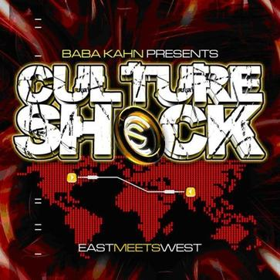
4.Read the following letters written by Li Li studying in the USA to her grandmother
in Shanghai(extracted) and see what the life of a new Chinese student in USA would
be like and how he or she would feel about it?

Slide 42
Letter 1
September 6
Dear grandmother,
…I love it in America and everyone is wonderful with me. I have a really nice roommate, Gabriela, who is from Mexco and has been here for three years already. She is very kind and helpful to me…
Oh, Grandmother, Americans do everything with machines. Can you imagine – they get coffee, food – even money from a machine. And they are so friendly they smile at you even when they don’t know you. Strangers at bus stops talk to one another about personal things like what you’re studying or what year you are in school.
I like my classes very much – especially my cross-cultural communication class… my cross-cultural teacher, Miss joy, is very nice and always helps us and gives us advice. And this is a most beautiful city with lots of new things to try out and places to visit. And everything is so modern and new…
Your granddaughter,
Li Li

Slide 43
Letter 2
November 20
Dear Grandmother,
I’m afraid I made a serious mistake in coming here. After all back home, I had a good job and now everyone will be ahead of me. To tell you the truth, I can’t remember now why I thought it would be so great to come to America to study. And the Americans, now that I know them better, I discover that I don’t like them very much at all. In fact, the longer I am here the more proud I am to be Chinese. It’s easier to be with other Chinese. We understand one another.
The other Chinese told me I was just a baby chick and would soon find out about the Americans. And they were right – they are only interested in
themselves and in making money. They are very impolite. And they’re not as advanced as we have been told. The professors don’t know how to teach at all. They’re more interested in being our friends than in teaching. Sometimes, I wonder what I’m missing.
Your disappointed granddaughter
Li Li

Slide 44
Letter 3
January 9
Dear Grandmother:
The new semester has started. I’m in the same dorm room and am very happy that Gabriela and I are roommates again. I’m also helping new students to adjust. I give them a tour of the campus and show them which books to buy. It seems strange to think that only a few months ago I was like them. I feel like I have come very far in a short time.
Last night I cooked Chinese food for some of my old classmates. I think that we will always have a special relationship with one another. I think,
Grandmother, that I have finally arrived in America. I have not lost my Chinese roots. In fact, they’re stronger than ever.
Respectfully, your granddaughter,
LiLi

Slide 45
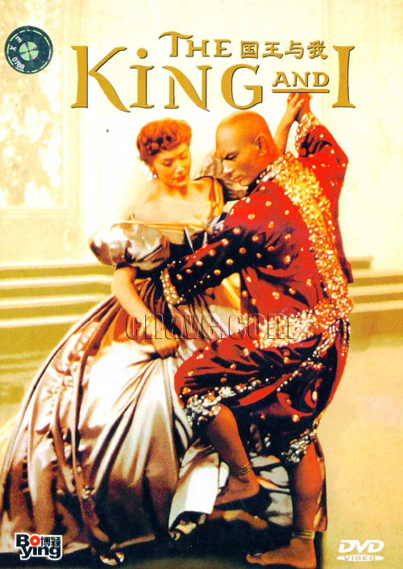
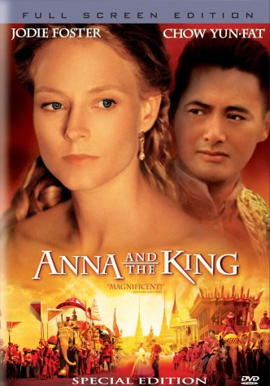
5. See part of the film The King and I (or the new version Anna and the King) in
which the King, prince and the concubines of Siam think their country is
superior than other countries even the very strongest country England in the
seventeenth century（Ethnocentrism）

Slide 46


