Slide 1
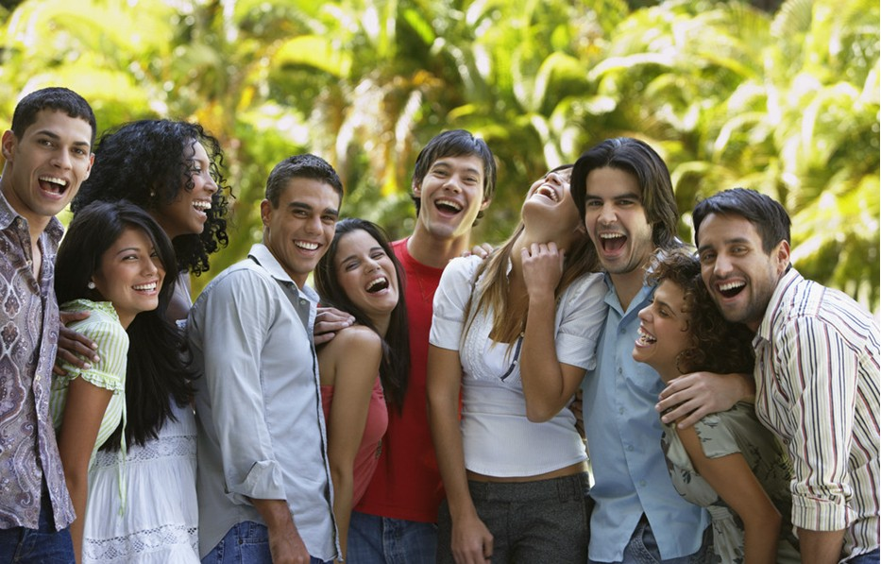
Unit 2
Communication, Culture and Language

Slide 2
Learning Objectives
In this unit, you are to know:
1.the definition, components, levels and characteristics of communication;
2.the definition, classifications and characteristics of culture, and
high context culture 高语境文化 & low context culture 低语境文化;
3.the definition, functions, characteristics and structure of language
4.the relationship between communication, culture and language

Slide 3
Procedures
Warm-up
1
Text Study
2
Assignments
3
3

Slide 4

I. Warm-up
Case Analysis
What do you want?
Why can’t the Chinese policeman and his British superior understand each other?

Slide 5

Analysis
The case shows the misunderstanding caused by high-context culture and low- context culture.
misunderstanding conflict

Slide 6
II. Text Study
Go over textbooks from pages 10 to 23 and try to answer the following questions.
1. What is the definition, components, levels or characteristics of communication?
2. What is the definition, classifications or characteristics of culture?
3.What is high-context culture or low-context culture?
4. What is the definition, functions, characteristics and structure of language?
5. What is the relationship between language, culture and communication?

Slide 7

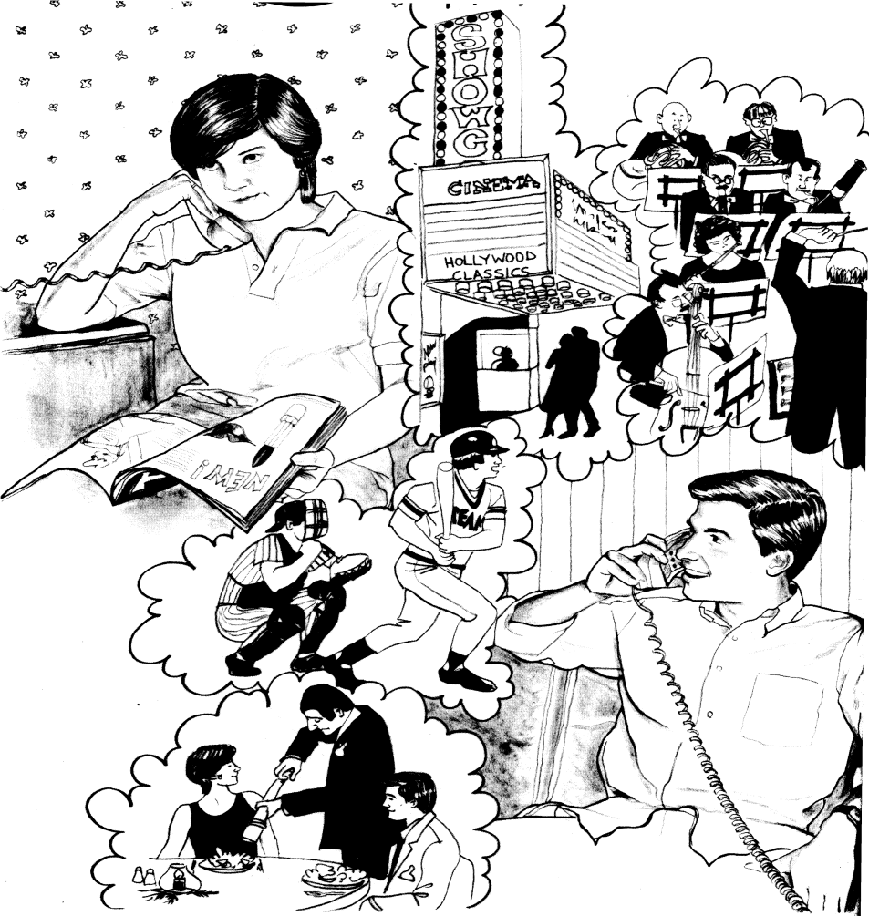
2.1. Communication

Slide 8
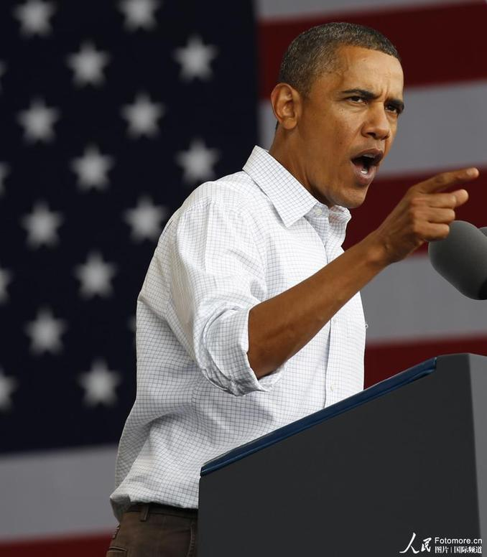

2.I.1. Definition
Up to now there are as many as over 100 definitions of communication.
Communication refers to the share or exchange of information, ideas, and feelings with symbol. It is the basis of all human contact.

Slide 9
2.1.2. Components (1)
1)source/sender
2)message
3)encoding
4)channel/medium
5)receiver
6)decoding
7)noise
8)context

Slide 10
2.1.2. Components (2)
1) Participants (sender/encoding, receiver/decoding)
2) Context (physical, social, interpersonal setting)
3) Messages (signal that triggers responses)
4) Channel/method
5) Noise
(1) external noise (sounds, voices , annoying ring, an overcrowded room or a smelly cigar)
(2) internal noise:
-physiological noise (illness, disabilities)
-psychological noise (egoism; hostility; preoccupation; fear; etc)
-semantic noise (caused by different languages, different understanding of messages delivered)
6) Feedback

Slide 11
Interactive Model of Communication
decoding
encoding
message / channel
Sender
Receiver
Sender
Receiver
noise
encoding
decoding
message / channel
Feedback is essential to good communication

Slide 12

2.1.3. Levels
(1) International communication 国家交流
(2) Interracial communication 种族交流
(3) Inter-ethnic communication 民族交流
(4) inter-regional communication 地区交流
(5) intracultural communication 相同文化间交流

Slide 13
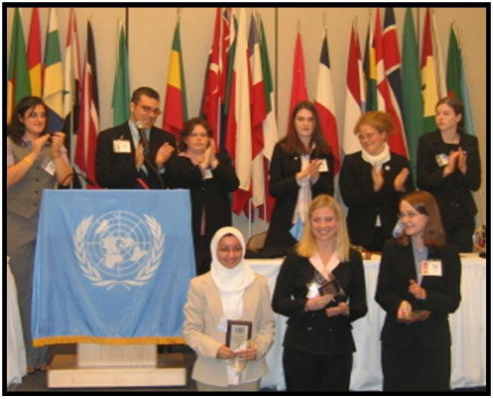
(1) International communication 国家交流

Slide 14
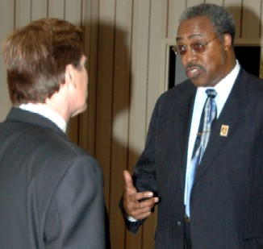
(2) Interracial communication. 种族交流

Slide 15
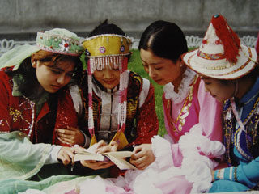
(3) Inter-ethnic communication 民族交流

Slide 16
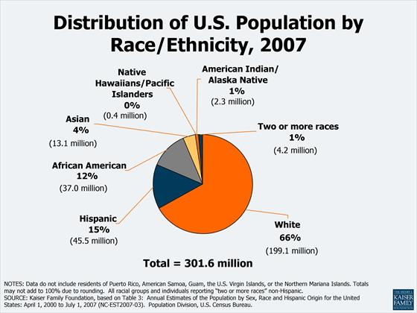
Inter-ethnic communication in U.S.

Slide 17
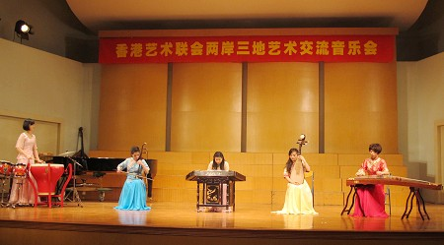
(4) inter-regional communication 地区交流

Slide 18

(5) intracultural communication 相同文化间交流

Slide 19
1.If a Japanese Prime Minister communicates with an American President, what kind of communication is it?
International communication, because this is communication between two countries, between two nations.
2. If an Afro-American interacts with a White American, what kind of communication is it?
Interracial communication. (In the USA, we know there're Afro-Americans and White Americans. )

Slide 20
3. If a Tibetan communicates with a Han in China, what kind of communication is it?
Inter-ethnic communication because they are from different ethnic groups.
4. If a northerner interacts with a southerner in China, what kind of communication is it?
inter-regional communication.

Slide 21

2.1.4. Characteristics
By analyzing the characteristics of communication, we can
have a better understanding of how communication actually
works.
Generally, communication has the following characteristics:

Slide 22
Characteristics of Communication
1.Communication is symbolic（符号式的）
2.Communication is dynamic（动态的）
3.Communication is interpretive（解释性的）
4.Communication is contextual（场景性的）
5.Communication is irreversible（不可逆的）
6.Communication involves shared meanings（共有意义）

Slide 23
Symbols are central to the communication process
because they represent the shared meanings that are
communicated. A symbol may be a word, action, or
object that stand for a unit of meaning.

Slide 24
When people communicate, they interact with each
other. When they don’t like one idea, they can replace
it with another. They sometimes even can change the
topics in the middle of a sentence.

Slide 25
When people communicate, they must interpret the
symbolic behaviors of others and assign significance
to some of those behaviors in order to create a
meaningful account of the other’s actions.

Slide 26
Communication takes place within a certain setting or
situation. The situation includes the actual location of the
interactants: indoors or outdoors, public or private, warm or
cold, etc. and the social settings: the types of social relationships
that exist between senders and receivers: teacher-student,
employer-employee, parent-child, etc.

Slide 27
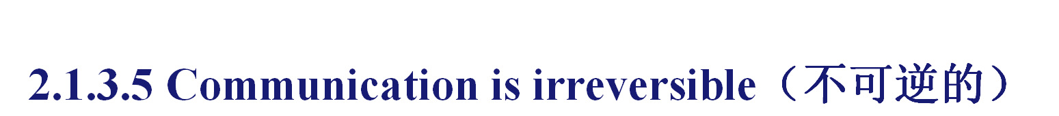
As the old proverb says, “You can’t stand in the
same stream twice,” once the information has been sent
and received by others, it can not be taken back. Even
if people can experience a similar event, it can not be
an identical one.

Slide 28
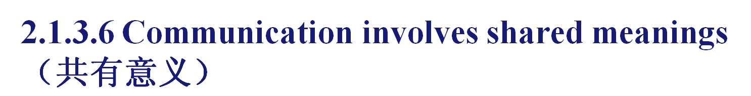
Meanings are invented by participants in
the communication that form the context
for common interpretations.

Slide 29
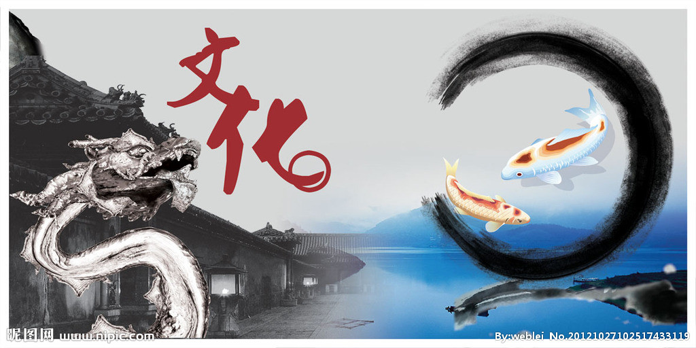
2.2.Culture

Slide 30
2.2.1. Definition
(1)…that complex whole which includes knowledge, belief, art, morals, law,
custom, and any other capabilities and habits acquired by man as a member of
society——Edward Taylor, 1871 (first use of this term)
(2)Culture consists of patterns, explicit and implicit, of and for behavior acquired
and transmitted by symbols, constituting the distinctive achievement of human
groups, including their embodiment in artifacts; the essential core of culture consists
of traditional (i.e. historically derived and selected) ideas and especially their
attached values; culture systems may, on the one hand, be considered as products of
action, on the other as conditioning elements of further action—— Kroeber and
Kluckhohn (1952) Culture: A Critical Review of Concepts and Definitions (listing
more than 300 definitions).

Slide 31
(3)We define culture as “the total accumulation of beliefs, customs, values, behaviors,
institutions and communication patterns that are shared, learned and passed down through
the generations in an identifiable group of people—— ( Hall, 1983)
（4）Culture may be defined as what a society does and thinks. —— Sapir萨皮尔 （美国人类学家）
（5）Culture is that which binds men together.—— Ruth Benedict
（6）Culture is a system of shared beliefs, values, customs, behaviors, and artifacts that the member
of a society use to cope with their world and with one another, and that are transmitted from generation
to generation through learning.———Bates and Plog
（7）We define culture as the deposit of knowledge, experience, beliefs, values, actions, attitudes,
meanings, hierarchies, religion, notions of time, roles, spatial relations, concepts of the universe, and
artifacts acquired by a group of people in the course of generations through individual and group
striving.———Samovar et al
To put it simply, cultures can be defined as the total way of life that a large group of people share.

Slide 32
2.2.2. Classifications (1)
Culture can be classified into different types/layers
from different angles:
1.Material and Nonmaterial
2.Big Culture/Big C and Small Culture/Small C
3.Dominant Culture and Sub-culture

Slide 33
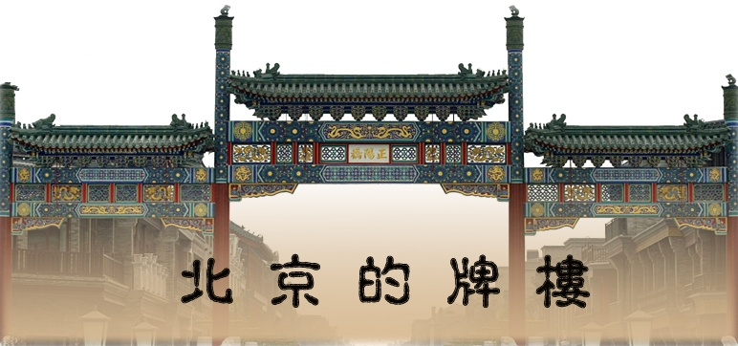
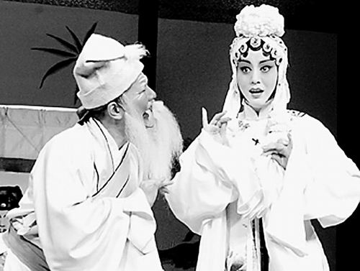
Material culture and Nonmaterial culture

Slide 34
Big Culture/Big C and Small Culture/Small C
Big Culture or Big C refers to intellectual and artistic activity, and such works produced by it as education, institution, literature, art, music,etc. ; Small Culture/Small C refers to the way of life of the given people who share values, customs, norms, etc.

Slide 35
Dominant Culture/Mainstream Culture and Sub-culture
From the point of influence, culture can be classified into
dominant culture/mainstream culture主流文化and sub-culture
非主流文化（亚文化）. The former refers to the culture that is
shared by most people and exerts greater influence. The
latter refers to the groups or social communities exhibiting
communication characteristics, values and practices that are
quite different from the other groups, communities and the
dominant culture. Sub-cultures is based on race, ethnic
background, sex, etc In the U.S. for example, there are
Chinese Americans, native Americans, women, youth, etc.

Slide 36
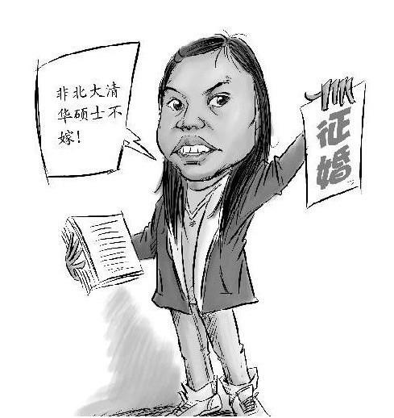
Dominant Culture
让高雅文化成为主流

Slide 37
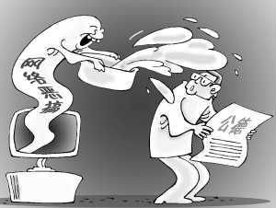
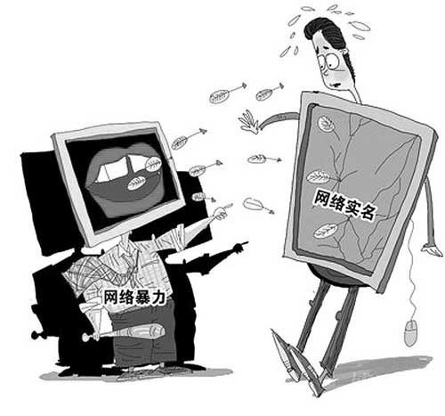
Dominant Culture
网络需要扶持主流文化

Slide 38
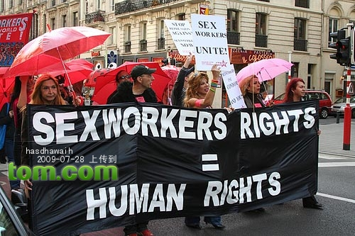

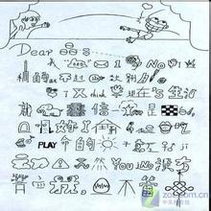
Sub-cultures

Slide 39
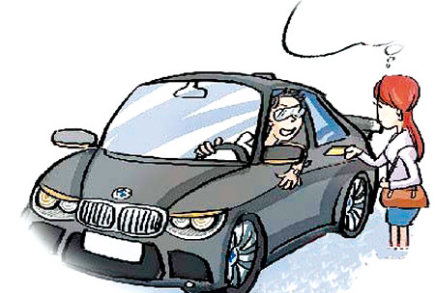
sub-culture— example 1
It was my first visit to Chongqing, southwest China. I felt
uneasy when I asked the way to some place. In my hometown in the
North, directions are given in terms of East, West, North and South.
We may easily find the way when local people there tell you
whether the place is in the direction of North or South; while in
Chongqing the local people tell you the way in terms of direction on
the right, or on the left, to which we Northerners are quite
unfamiliar. And I guess people from Chongqing may meet the same
problem as I had when they were in the North.

Slide 40

sub-culture—example 2
古时候有个不学无术的人，好不容易用钱买了个县官，却不会说“官话”，上任之后，照例要去拜访顶头上司---知府，在闲聊中知府问：
“贵县风土怎么样？”
“并没有大风，更少尘土。”
“百姓怎样？”
“白杏只有两棵，红杏不少。”
“我问的是黎庶！”
“梨树很多，结的果实很小。”
知府动气了：“我不是问什么梨树，我是问你的小民！”
县官见知府生气，急忙站起来回答到：“卑职的小名叫狗儿。”

Slide 41

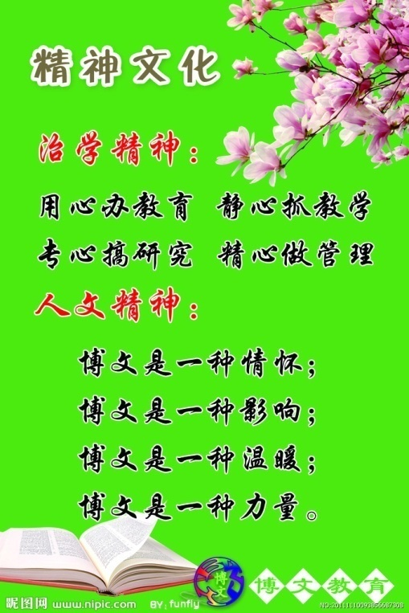
2.2.2 Classifications (2)
material culture
institutional culture
spiritual culture

Slide 42
几乎所有文化学或文化哲学研究者在某种意义上都会同意把文化
的构成最粗略地划分为物质文化,制度文化和精神文化,因为这种划分
能够最大限度地涵盖整个文化世界.
物质文化: 满足人的需要的各种文化产品,变化频繁.
制度文化: 以物质文化为基础,主要满足人的更深层次的需求,内涵
丰富,包括与人类的个体生存活动和群体社会活动密切相关的各种制
度,如经济制度, 政治制度, 法律制度, 商品交换制度, 教育制度, 家庭
婚姻制度, 公共管理制度, 等等.
精神文化: 一种创造性的自由的需要. 最深层次. 最具有内在性,
最能体现文化的超越性和创造性的本质特征. 以意识, 观念, 心理, 理
论等形态而存在.（衣俊卿, 文化哲学十五讲, 北京大学出版社,
2004.10. P52-P57 ）

Slide 43
2.2.3. Characteristics
Although there may not be a universally accepted
definition of culture, there are a number of characteristics
of culture, on the basis of which most people agree to
describe its essence.

Slide 44
Characteristics of culture (1)
Culture is human-specific
Culture is varied
Culture is learned
Culture is dynamic
Most of culture is invisible
Culture is a symbol system
Culture is integrated
Culture is ethnocentric

Slide 45


Characteristics of Culture (2)
varied
ethnocentric
learned
human-specific
dynamic
CULTURE IS…
symbolic
unconscious
integrated

Slide 46
2.2.3.1. Culture is human-specific
As one of the important marks that discriminate
human-beings from animals, culture is created by
human-beings. It exists only in the human society.
Anything out of human society does not have
culture. Culture is not only the result of human-
beings’ social practice but also develops with
human-beings.

Slide 47
2.2.3.2. Culture is varied
Each nation or society in the world has its own characteristics
of culture. Such characteristics may manifest themselves in
the form of cultural values, thinking patterns, means of
communication, language, literature, religion, social customs and
interactions, etc. Variety of culture is the essential characteristic of
human beings and the important driving power of the advancement of
human civilization as well. Identifying their own culture and
respecting other national culture, people should seek common ground
while they maintain difference, learning from each other to
promote the prosperity and progress of human beings.

Slide 48
2.2.3.3.Culture is learned
Culture is not something that we are born with, but rather learned.
they are acquired through the process of learning or interacting with the
individual’s environment.
The process of cultural acquisition is called enculturation. The
learning environment includes the family, neighborhood, schools, social
groups, physical surroundings etc. If the environment is different, the
culture that each individual learns or acquires will be different too.

Slide 49
2.2.3.3.Culture is learned
Culture is learned consciously or unconsciously:
(enculturation)
**through Proverbs, Folktales, Myths, and legends
**through Art
e.g. Beijing Opera
**through Mass Media

Slide 50
2.2.3.4.Culture is dynamic
Though culture is persistent and enduring, it is not
static. Any great inventions and process of mankind will
bring about changes in people’s ideas, way of life, mode
of behavior etc. and these changes often take place on
the superficial levels of a culture, while the deep
structures, i.e. ideological perceptions, values and value
orientations, world views and beliefs, are likely to stay
or change slowly. .

Slide 51
2.2.3.5.Most of Culture is Invisible
Some aspects of culture are easily observable but
most aspects of culture are hidden, like the part of the
iceberg under water. The ways of dressing, talking, and
working are readily noticeable, but the ideas and
motivations underlying these superficial behaviors are
generally unrecognized. The study of culture should
involve not only the learning of the explicit rules but
also those implicit beliefs, values attitudes that relate to
them.

Slide 52
Culture as an iceberg
way of doing things(10%)
Behaviour
Traditions
Artefacts – buildings, clothes, art etc.
explicit
tacit
Beliefs
Attitudes
Perceptions
Values
way of thinking
(90%)

Slide 53
2.2.3.6.Culture is ethnocentric
All cultures display some signs of ethnocentrism（民
族中心主义）. It is the belief that one’s culture is
superior to foreign culture, that “we are right” and “they
are wrong”. Ethnocentrism is usually learned at the
unconscious level.

Slide 54
2.2.3.7.Culture Is a Symbol System
The members of a culture communicate
with verbal, nonverbal, or iconic（徽章）
symbols. With these symbols, it is possible for us
to learn from cumulative（累积的）, shared
experience, and to pass culture on from
individual to individual, group to group, and
generation to generation.

Slide 55
2.2.3.8.Culture is integrated
The elements are closely linked as if in a
complex chain like system. “You touch a culture
in one place and everything else is affected.”
Values are the core of the system.

Slide 56
Linell Davis: five metaphors
(to be more easily understood)
Culture is like an iceberg
some is visible (history, literature, customs), most is invisible (feelings and attitudes);
Culture is our software
physical selves as the hardware, become human when programmed with the software of culture;
Culture is like the water a fish swims in
notice everything except the water;
Culture is the story we tell ourselves about ourselves
people tell stories to tell who they are and stories also change to adapt to changing circumstances;
Culture is the grammar of our behavior
people learn their cultural grammar unconsciously and apply them automatically in order to behave appropriately in any society.

Slide 57
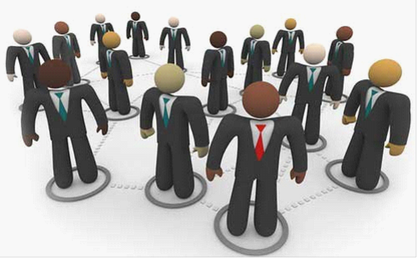
2.2.4 High Context Cultures & Low Context Cultures

Slide 58
High-context Culture
In high-context messages, meaning is not
necessarily contained in words. Information is
provided through gestures, the use of space, and
even silence. Meaning is also conveyed through
status (age, sex, education, family background,
title, and affiliation).
Examples of high-context cultures include
Chinese, Japanese, Middle Easterners, etc.

Slide 59
Low-context Culture
In low-context messages, the majority of
the information is vested in the explicit code.
Examples of low-context cultures include
English, North American, German, etc.

Slide 60
High-Context Cultures
Japanese
Chinese
Korean
African American
Native American
Arab
Greek
Latin
Italian
English
French
American
Scandinavian
German
German-Swiss
Low-Context Cultures

Slide 61
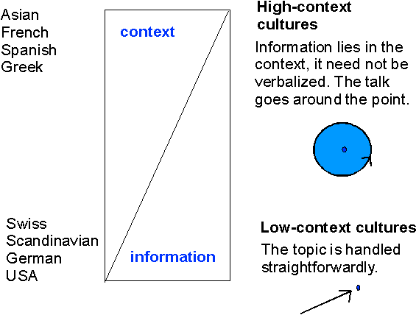
High Context Cultures & Low Context Cultures

Slide 62

2.3.Language

Slide 63
2.3.1 Definition
人类特有的一种符号系统，当它作用于人与人的关系的
时候，它是表达相互反应的中介；当它作用于人和客观世界
的关系的时候，它是认知事物的工具；当它作用于文化的时
侯，它是文化信息的载体和容器。— （许国璋: 1991）
A language is a symbolic code of communication
consisting of a set of sounds (phonetics) with understood
meanings and a set of rules (grammar) for constructing
messages.

Slide 64
2.3.2.Importance/functions
(1)Although not all communication is linguistic, language is by
far the most powerful and versatile medium of communication.-----
John Gumperty
(2) Language permits us to remember the past, deal with the
present, and anticipate and plan for the future. — (Samovar: 1998)
(3) We don't just communicate with language but language is an
important part of communication.
(4) With language, people can transmit information, exchange
ideas and feelings.
(5) 人类区别于动物的最大特征是创造和使用语言的能力。

Slide 65
2.3.3 Structure
1. phonology
2. Morphology
3. Semantics
4. Syntax
5. discourse

Slide 66
2.3.4. Characteristics
1) Systematic
Language is rule-governed. Its speaker has to speak according to rules.
E.g. The dog feeding is he;
Sdylithgt
2) Arbitrary
There is no logical relationship between words and the objects, action or
concepts .
“ a rose by any other name smells just as sweet. 名称有什么关系呢？玫
瑰不叫玫瑰，依然芳香如故。” ——Shakespeare

Slide 67
3)Symbolic
Language is a set of symbols in that words are
arbitrarily associated with objects, actions and ideas
through convention. They are only symbols.
E.g. Dog refers to the animal that can bark.
4) Human-specific
Only human beings possess what can be called
language.
5) Communicative
Communication is the primary function of language. It
is the most effective way of communication.

Slide 68
2.4.Relationship between Language, Culture and Communication
Language, culture and communication are inseparable. A
metaphor can best manifest their relationship:
Communication is swimming action, language is the swimming
skill, and culture is water. Without language, communication
would remain to a very limited degree (in very shallow（浅的）
water); without culture, there would be no communication at all.
Language is not only a channel of culture but also a means of
communication. We have to use a language to communicate with
people from different cultural backgrounds. But language alone
can not ensure effective communication. People must acquire
cultural competence to make effective communication.

Slide 69

Assignments
Review Unit 2 according to the outline given below.

Slide 70

1. communication definition of communication
types of communication
models of communication
characteristics of communication
2. culture definition of culture
characteristics of culture
3. language definition of language
relationships of language, culture and
communication

Slide 71
Assignments
1. Log Writing: My First Intercultural Communication Experience (optional);
2. Read the following speech and make a comment on it from the point of intercultural communication.

Slide 72
第三届“21世纪杯”全国英语演讲比赛冠军梁励敏关于中西多元文化的英语演讲稿。
梁励敏，生于浙江杭州，毕业于北京外国语大学，获英语语言文学硕士学位，研究生期间专攻方向为美国社会研究。2002年进入中央电视台英语频道采访组工作，所采写的新闻获得2003年全国新闻彩虹奖二等奖。
专家点评:引用文学大师的诗句作为开场白，与结束语首尾呼应，颇有感染力。东西方文化的融合表现得十分鲜明，意味深长，是篇优秀的演讲。

Slide 73
Crossing the Sea
穿越海洋
Good afternoon, ladies and gentlemen. The title of my speech today is "Crossing the Sea".
女士们、先生们，晚上好。今天，我演讲的题目是:《穿越海洋》。
An English poet by the name of Rudyard Kipling once wrote in his poem "We and They":
英国诗人罗得雅德.吉卜林曾写过一首诗，名叫《我们与他们》，其中写道:
"All the people like us are We
像我们的人是我们
And everyone else is They
其余的人是他们
We live over the sea
我们生活在海这边
While They live over the way
他们生活在路那边
We eat pork and beef with horn-handled knives
我们用牛角柄的刀叉吃猪牛肉
They who gobble their rice off a leaf
Are horrified out of their lives."
吞吃粽叶包饭的他们吓得要死。

Slide 74
When these lines first caught my eyes, I was shocked-how could two peoples remain so isolated and ignorant of each other in the past? Today's society, of course, is an entirely different picture. Those people who used to eat with cowhorn-handled knives might be very skillful in using chopsticks, and those people who used to gobble their rice might be as well have taken to fish and chips.
第一次读到这首诗，我很震惊——过去两个民族何以如此疏离、彼此陌生?当然今日的社会呈现出完全不同的情景:那些过去吃米饭的人们也开始喜欢吃鱼和薯条。
Indeed, just take China as an example: Our modern life has been influenced by Western style of living in so many ways that it's no longer surprising to see teenagers going crazy about rock-and-roll, whole families dining out at McDonald's and even rather elderly people dressed in Apple Jeans.
的确如此，就拿中国来说，西方的生活方式已经广泛地影响了我们的现代生活，以致对于年轻人对摇滚乐着迷，全家去吃麦当劳，老年人穿苹果牌牛仔裤，大家都已习以为常。
However, these are only some expressions of the cultural changes taking place in our society today. What is really going on is a subtle but significant restructuring of the nation's mentality. Just look around.
然而，这不过是我们当今社会中所发生的文化变迁的表面现象而已，真正发生的却是我们的民族心理开始了微妙而又有重大意义的重建，大家只要看看周围就会清楚。

Slide 75
How many college graduates are ready to compete aggressively for every job opportunity, whereas not long ago they were asked just to sit idle and wait for whatever was to be assigned to them by the government?
不久以前，大学生还只是束手空坐，等待政府给他们分配工作;如今，又有多少大学生正在做充分准备，为争取任何工作机会而激烈角逐?
How many young people are now eager to seek for an independent life whereas only two decades ago they would rely totally on their parents to arrange for their future? Ask anyone who participates in today's speech contest. Who has not come with a will to fight and who has not come determined to achieve self-fulfillment in winning the game? And I'm quite certain that if Confucius had lived to see today's China, he would have been horrified to see young lovers kissing each other in public places in an unreserved expression of their passion.
20年前年轻人还完全依靠父母为他们安排未来，今天又有多少年轻人在急切地寻求一种独立的生活?试问今天参加演讲比赛的诸位，谁不是带着志在一搏的心情来到这里?谁不是铁下心来赢得这场比赛以实现自我?如今年轻人毫无顾忌地宣泄情感当众亲吻，我确信，倘若孔子在世，他必被吓坏。
It is therefore evident that we as descendants of an ancient Eastern civilization are already living under strong inf1uence of the Western culture. But it is not only in China that we find the incorporation of the two cultures.
很明显，我们这些东方古老文明的后裔们早已生活在西方文化的强烈影响之下，然而出现这种异质文化合流的现象不止是在中国。

Slide 76
Take the United States as an example: During the 1980s,in face of the overwhelming competition from Japan, many American companies such as the Ford began to adopt a teamwork management from their rivals, the essence of which, lay at the very core of Eastern culture.
以美国为例，20世纪80年代，面对来自日本的强大竞争压力，许多美国公司如福特公司开始采用对手的集体合作管理方式，而这种方式正是东方文化核心之精华。
Take the Chinese acupuncture as another example: This traditional treatment of diseases is finally finding its way to the West and hence the underlying notion that illness is resulted from the imbalance between Yin and Yang within the body -- an idea which would strike any Westerner as incredible in the past!
再以中华针灸为例，这种传统的医疗方法以及这种疗法的依据——即人体阴阳失调导致疾病最终得到西方社会的承认，而在过去，西方人还认为这是无稽之谈。
Ladies and Gentlemen, we live in a great epoch when the global integration of economy and the information revolution have brought cultures of the world closer than ever before. We live in a particular era when countries, East and West, find themselves in need of readjusting their traditional values. We live, at the same time, at a critical juncture of our evolution because such problems as ethnic conflicts and regional unrest are increasingly posing a threat to the peace and happiness of the whole human race. To cope with such an era and to embrace an even brighter future, we need to learn to live more harmoniously in a world community which is becoming smaller and smaller.
女士们，先生们，我们恰逢一个伟大的时代:全球经济一体化、信息革命使得世界各种文化联系比以往更加紧密; 我们恰逢一个特殊的年代:无论是东方国家还是西方国家都意识到自身急需调整传统价值。与此同时，我们正生活在发展的关键时刻:种族冲突，地区动荡正越来越威胁着整个人类的和平与幸福。如何对待这一时代，拥抱更加灿烂的未来，我们需要学会在越来越小的世界大家庭中更加和睦地生活

Slide 77
My dear fellow students, our command of the English language renders it possible for us to gain an insight into Western culture while retaining our own cultural identity.
亲爱的同学们，我们掌握英语，得以了解西方文化，与此同时，又不失本民族的文化特征。
Therefore, it is our sacred responsibility to promote the cultural exchanges and hence the mutual understanding between China and the rest of the world.
因此，促进中国与世界的文化交流与相互理解是我们神圣的责任。
It is my happiest dream that the new generation of Chinese will not only grow up drinking Coca-Cola and watching Hollywood, but also be blessed with the far-reaching benefits of multiple cultures; benefits that our forefathers had never, ever dreamed of.
我有一个美好的梦想，我梦想中国的年轻一代不仅仅在喝可口可乐、看好莱坞影片中成长，而且还受益于我们的父辈所从未梦想过的多元文化所带来的深远影响。
To end my speech, I would like to quote Rudyard Kipling again:
最后，再次以罗得雅德?吉卜林的诗作为我此次演讲的结尾:
"All the people like us are We
像我们的人是我们
And everyone else is They
其余的人是他们
But once you cross over the sea
然而一旦你们穿洋越海
You will end by looking on We
就不会再把我们
As only a sort of They"
看做仅仅是他们。
Thank you.
谢谢。

Slide 78


