Slide 1
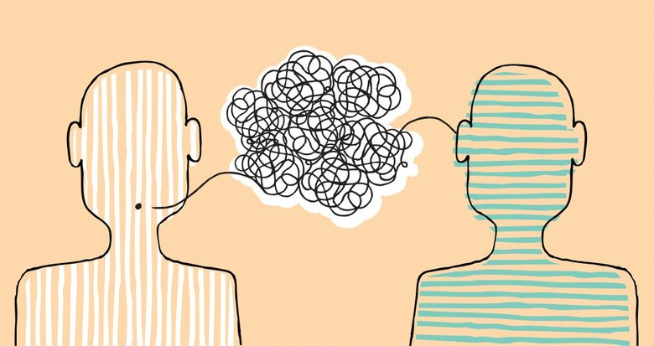
Unit 5
Thinking Patterns in the East and West

Slide 2
Learning Objectives
In this unit, you are to know:
1.Thinking patterns (modes of thinking) in the East and West
2. Linguistic differences resulting from thinking patterns
in English and Chinese
3. Discourse patterns in English and Chinese

Slide 3
Procedures
Warm-up
1
Text Study
2
Practice
3
3
Assignments
4
4

Slide 4
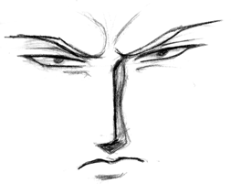
I. Warm-up
Case: Tal’s Confusion
Why did Tal feel confused with his tutorials’evaluation?

Slide 5

Analysis
The case reflects the differences in thinking
patterns between different cultures.
misunderstanding conflict

Slide 6
II. Text Study
Go over textbooks from pages 59 to 67 and try to answer the following questions.
1. In what way did the East and West think differently?
2. What are the Linguistic differences resulting from thinking patterns in the East and West?
3.How different are the discourse patterns in the East and West?

Slide 7
2.1.Thinking patterns in the East and West
Thinking patterns are the set thinking tendencies思维定势They are the reflections of cultural
and psychological properties of nations, and are shaped in a certain historical, social and
geographical environments. Thinking patterns have much impact on human’s behavior or use
of language.
The ancient Greek and Chinese philosophies respectively played a vital role in the formation
of different thinking patterns in the east and west. The differences in traditional thinking patterns
can roughly be summarized as the following:
Chinese pattern | Western pattern
synthesis (holistic)综合型 (整体型) | analytical分析型
concrete (in images)具体型(形象型) | abstract抽象型
illogicaI 无逻辑性 | logical逻辑性
intuitional直觉型 | rational理性型
vague模糊性 | precise精确性
tortuous (circular) 圆型 | straight (linear)线型
inductive归纳型 | deductive演绎型
subjective主观性 | objective客观性

Slide 8
2.1.1. Synthesis vs. Analysis
Generally speaking, people in the East are inclined to believe in
holism（一元的）while people in the West tend to be dualistic （二元的）
in their outlook.
Accordingly, with regards to modes of thinking, people in the East are
likely to synthesize elements into a unit, with the emphasis on the “whole”
of things while people in the West tend to dissect things into parts and
analyze their relationships in order to understand them properly. Their
emphasis is upon the parts rather than upon the whole of things.
As a result of synthetic thinking, people in the East tend to be good at
gaining intuitive（直观） insight and thinking in terms of images（形象思
维）and as a result of analytical thinking, people in the West tend to be
good at classification and categorization, and thus they prefer making use
of concepts for logical judgment and reasoning.

Slide 9
Examples
1) Medicine
Traditional Chinese Medicine (TCM中医) regards human body as an organic whole, taking the connections of all parts of the body into consideration; Western medicine（西医）divides human bodies into different parts and treat them accordingly. Just see:
(1) the layout of a TCM clinic and a Western hospital.
(2) how a TCM doctor and a Western doctor treats a patient.

Slide 10
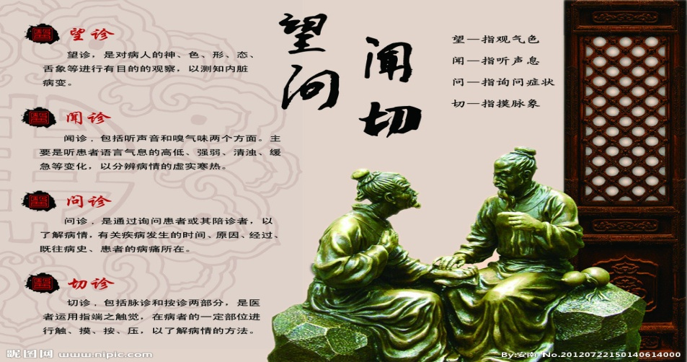

A TCM doctor treats a patient by looking at his complexion and the
coating on his tongue, feeling his pulse and eliciting his complaint in order
to form a correct judgment of his general physical condition.
In a Western hospital, patients have to go to different departments to
get treated. A doctor treats his patients by examining parts of the body
through tests (detailed analysis) and X-rays before making a diagnosis

Slide 11
Traditional Chinese Medicine (TCM) and Western medicine
Traditional Chinese Medicine | Western medicine·
It regards the human body as a part of nature, bring it back to balance. | It regards the human body as an object that can be studied and controlled.
It looks at the body as an organic whole. | It divides the human body into different parts and treats them accordingly.
It considers the connections of different parts of the body. | Patients have to go to different departments to get treated.
A patient suffering from headache may get some foot treatment. | A lot of tests /analyses (e.g. blood tests，CT, X-ray, NMR核磁共振) done before decision made.

Slide 12
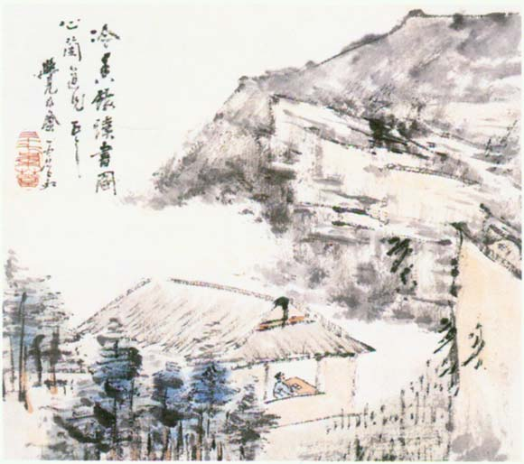
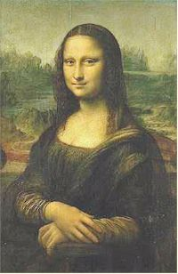
2) Paintings
A Chinese painting can be a synthesis of different art forms: calligraphy, painting, poetry and stamps while in the west, painting is painting and poetry is poetry; in Chinese painting, the eye of the viewer is assumed to move across the surface of the painting while in the western painting, there is only one focal point, one spot from which the viewer looks at the painting.
1、人融于自然与人的突出
(中国画注重人与自然和谐，
多山水画，有人也不突出。
西方注重人的独立、自由、
自主、平等。故绘画中人物
形象非常突出醒目)；
2、神韵与写实
（主观感悟与客观精神）；
3、多样（画、诗、印章）
与单一

Slide 13
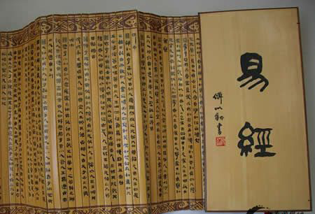
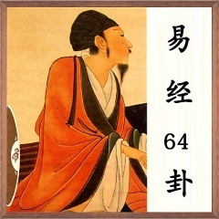
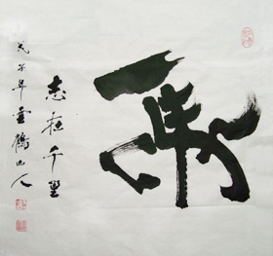
2.1.2. Concrete vs. Abstract
Concrete thinking ( thinking in image ) refers to the thinking pattern by which people make
an understanding of something abstract through analysis, generalization, analogy,
association or metaphor.
Chinese people traditionally prefer this kind of thinking pattern which can be found in
some classics. The ideas, e.g. the sixty four divinatory symbols(64卦), in Book of Changes《
易经》, are expressed with the help of images; Chinese calligraphy is also the art of images
of concrete thinking.

Slide 14
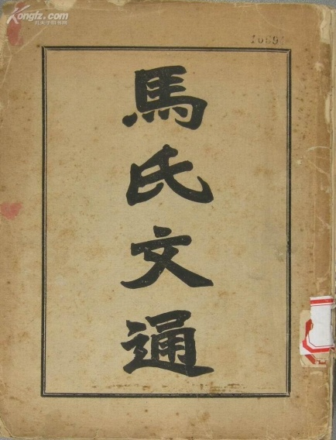

2.1.2. Concrete vs. Abstract
Abstract thinking refers to the thinking pattern by which people make an understanding of something abstract with the help of concepts, judgments, categorization, systematization or reasoning. The westerners traditionally prefer this kind of thinking pattern which can be found in some classics. The difference can also be exemplified by the history of English and Chinese grammar. The history of English grammar is much longer than that of Chinese.
The first English grammar ( The Concise English Grammar by William Bullokar ) appeared in 1586 while the first Chinese grammar （马建忠 《马氏文通》) did not appear until 1898.

Slide 15
2.1.3. Vague (Intuitional, Illogical) vs. Precise (Rational, Logical)
The Chinese people traditionally regard universe as a vague unity. In their
eyes, since the object for thinking is not clear, the subject for thinking is
naturally not clear, either, so their thinking patterns tend to be vague, intuitional
and illogical. In contrast, the westerners strive for science and ration, they
stress the strictness, clearness and precision of thinking activity, so their
thinking patterns tend to be precise, rational and logical.

Slide 16
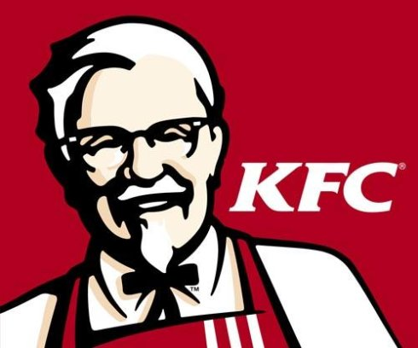
Examples
1) Cooking
To a great extent, roughness and experience is characteristic of Chinese cooking. A Chinese recipe
will roughly tell you: a little oil, a little salt, or monosodium glutamate味精etc. is needed, you have no idea
exactly how much each of the ingredients is. A Chinese usually senses how much by their experience and
cooks delicious dishes. an apprentice learns cooking not by following recipes with precise quantitative
descriptions, but by intuitively acquiring his master’s technique after repeated imitations. While western
style of cooking is relatively more precise and scientific: how much water, salt, sugar and how many other
ingredients are exactly needed for a certain dish. Besides, how many minutes and how strong the heat
does the food need to be cooked are usually clearly stated. Take the famous KFC as an example, the
preparation for ingredients, the addition of seasoning and the time needed for making KFC are all
controlled by computers, the accuracy is to the degree of kilograms or seconds. That is why KFC all over
the world taste the same.
Look at the following description of how to prepare a piece of meat loaf in English:
1 Ib. ground beef碎牛肉
1 chopped onion
1 chopped green pepper
1 egg
1/2 cup tomato catsup番茄酱
1 tablespoon mustard芥末
1 cup broken crackers碎饼干
Place in a greased loaf pan and bake at 350°
for 1 hour. (like a chemical lab)

Slide 17
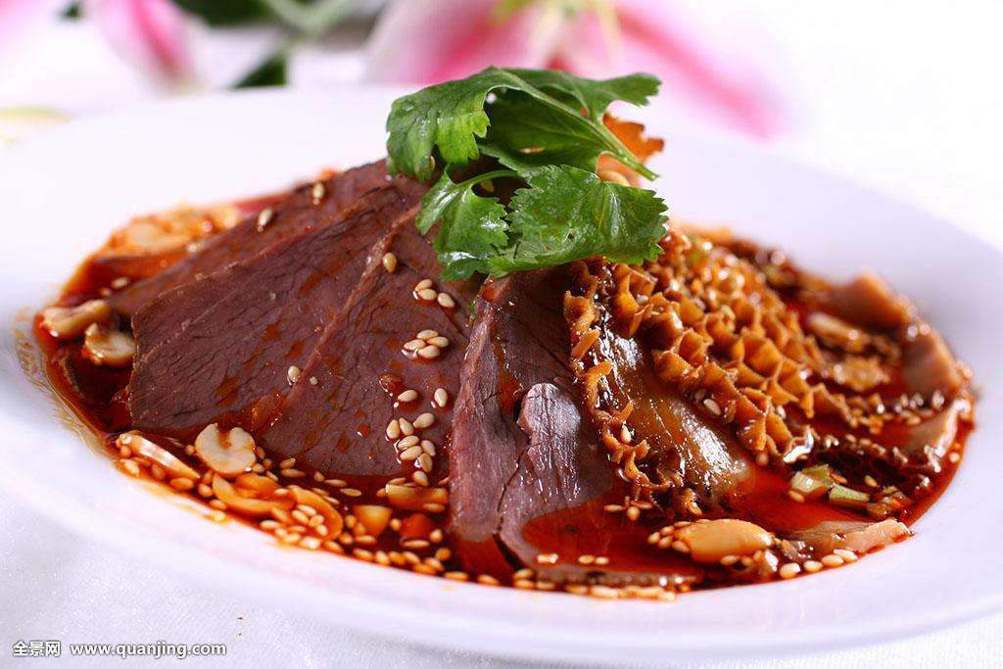

Examples
1) Cooking
Such characteristics can also be reflected in Chinese and Western menus:
Chinese menus:
老少平安(Peace to Young and Old) ; 全家福(Happy Family); 麻婆豆腐(Mapo Bean Curd) ; 叫花子鸡
(Beggars Chicken); 金钱肉(Gold Coin Pork); 狮子头(Lion‘ s Head); 夫妻肺片（Pork Lungs in Chili
Sauce）; 宫保鸡丁（Kung Pao Chicken）
Western menus:
fried calf ribs( 炸小牛排) ; roasted saddle of mutton( 烤羊里脊) ; breast of deer( 鹿脯) ; shark fin( 鱼翅) ;ham and sausage( 火腿香肠) ; Black pepper pork steak( 黑椒猪排) ; French goose liver( 法式鹅肝) ; Scotland mutton chop( 苏格兰羊排) ;Australian fresh shellfish( 澳洲鲜贝); Honeyed banana( 蜜汁香蕉) ; Vegetable salad( 蔬菜色拉)

Slide 18
Examples
2) communicative styles
Sometimes the exact meanings in Chinese can only be acquired from
context, e.g. in the question“你吃了吗Have you eaten?”, people can only
know what “ 饭” really refers to: “早饭breakfast”, “午饭lunch” or “晚饭dinner”
from context, but in English there is a specific word for each of them.
In the forms of addressing regarding titles, the Chinese people usually omit
“ 副(vice/associate/deputy/assistant)” , but in English, they have to be supplied.

Slide 19
Examples
2) communicative styles
The following versions are easy for Chinese people to understand, but
difficult for English-speaking people, as they think these versions are
grammatically (logically) wrong.
救火;
晒太阳；
打扫卫生；
在家养病;
这锅饭能吃十个人;
“你吃饭怎么办？”, “好办，吃食堂。” ；
一匹马骑两个人;
一间屋住三个人”
昨晚我盖了两条被子;
哎，你想死我了;
我差一点没跟他结婚;
中国队大胜美国队”
-- 中国队赢
中国队大败美国队
-- 中国队赢

Slide 20
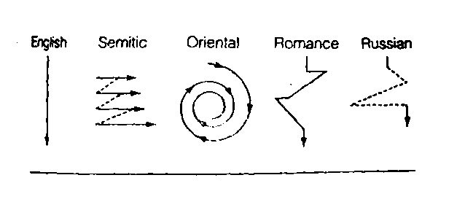
2.1.4.Tortuous vs. Straight
Kalpan (1970) concluded that the problem-solving approaches and thinking
patterns of English-speakers from the United States were more linear and direct
than that of the Semitic, Asian, Romance language, or Russian speakers. The
Semitic individuals solved problems using a combination of tangential and semi-
direct approaches, Asians employed a circular approach, Romance cultures used
a more consistently circuitous approach, and Russians employed a combination
of direct ad circuitous approaches.
The Chinese people have been accustomed to the harmony and unity of the
world, esp. that between the nature and the humans, and tend to adopt both
sides of a matter, thus establishing a tortuous thinking pattern. But in the Western
philosophy, it has been a lasting convention to pursue alternate contrast in its
reasoning, thus establishing a straightforward thinking pattern.

Slide 21
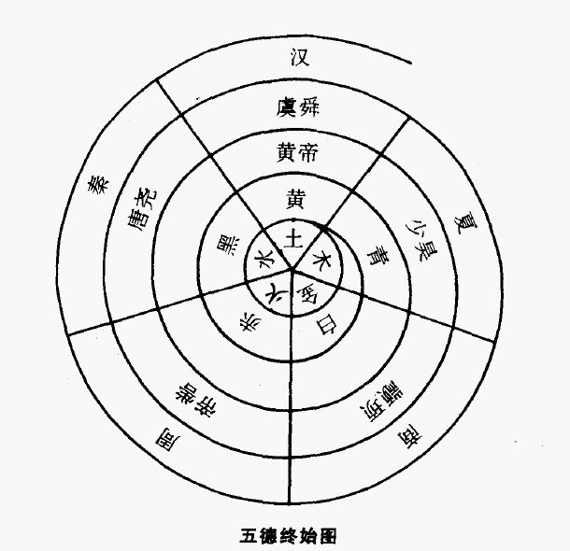
Examples
1) Concept of time
To the Chinese people, time is circular, just as the changing of Yin and Yang(阴阳的互相转化); Taiji Diagram(太极图)is circular; it is something separate, several events may happen at once, so people may do different things at the same time. With this idea, the Chinese people use time more freely and elastically, they are not so punctual. While the westerners think that time is linear. They regards time as a direct line with both beginning and ending that can be divided (past, present and future) but can not be repeated. They emphasize schedules, segmentation, and promptness. They are punctual (refer to pages.135-136 in your textbooks).
2) communicative styles
(refer to high & low context culture on pages.23-24 in your textbooks).

Slide 22
2.1.5.Inductive vs. Deductive
Traditionally, Chinese people tended to summarize or make an induction of
their experience or insight to form vague theories, concepts or categories on the
basis of practice or intuition. Such concepts or categories, like holy words or
maxims, without clear definition or careful deduction, seldom became a scientific
system.
While in the past, Aristotle, the ancient Greek philosopher, stressed deduction.
He regarded it as an advanced way of thinking to deduce the unknown. Nowadays, to the westerners. deduction has become not only a means
of forming theoretical systems, but also a usual thinking pattern.

Slide 23
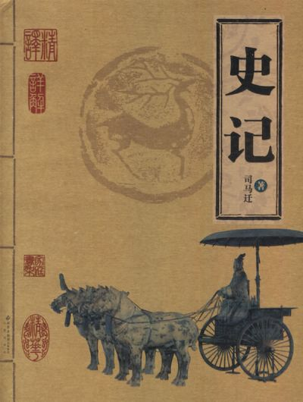
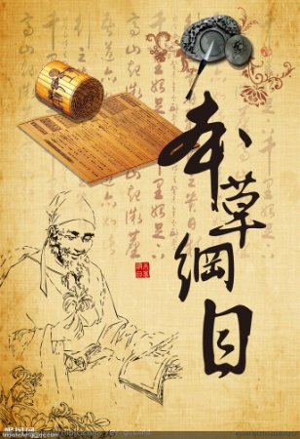
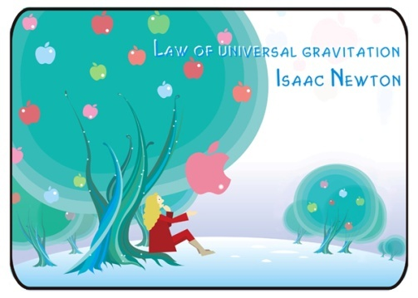

Examples
Many of the famous Chinese theories, such as “道”, “气”, “理”, “心”, “阴
阳”, “经络”, etc. were formed inductively;
A lot of great works in Chinese history were also written in this way: 《史记》in
literature,《齐民要术》in agriculture, 《本草纲目》in medicine, 《梦溪笔谈》in
science, 《天工开物》in technology.
Many of the famous Western theories, such as those put forward by Aristotle,
Euclid, Newton or Einstein were formed deductively:

Slide 24
2.1.6.Subjective vs. Objective
Subjectivity is the characteristic of intuition. Chinese people stress more on
subjective thinking. They follow “ Oneness Between Man and Nature” and tend to
describe something from their own point of view, thus, “somebody” is often used
as the subject of a sentence.
Westerners follow “Dividedness Between Man and Nature”. They stress
more on objective thinking and tend to describe something calmly and factually.
As a result, more often, either “something” is often used as the subject of a
sentence or passive voice is used.

Slide 25
The analysis above, however, is a very rough generalization. We can never carry it to the extreme. In fact, both of the peoples in the east and west understand and recognize the world in a similar way. The only difference is that different people possess different(high or low) degrees of thinking pattern, not that there is one kind of thinking pattern in one culture and there is none in the other.
上述中西思维方式的不同特征是从总体的、相对的角度而言的, 这些差异多属相对的此强彼弱而非绝对的此有彼无。

Slide 26
2.2. English and Chinese Differences Resulting from Thinking Patterns
in the East and West
Language and thinking are closely related to each other. Language is the main carrier of thinking and the main manifestation of thinking as well. Language changes with thinking patterns. The above-mentioned characteristics of thinking patterns of Chinese people and English-speaking people can also be reflected in their languages.
English language reveals a tendency of being analytical, logical, accurate and abstract while Chinese language reveals synthesis, intuition, simplicity and concreteness.

Slide 27
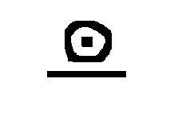

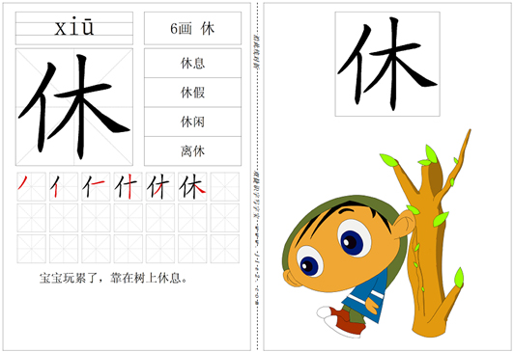
2.2.1 Difference in the Formation of English Words and Chinese Characters
As an alphabetic language, English words are formed by only 26 letters. There is
generally a certain relationship between the shapes and pronunciation of words while there
is no relationship between the shapes and the meanings of words. This reflects the
abstractness of English language.
Chinese characters originated from pictograph(象形文字),which directly developed from
primitive picture-drawings during Yangshao Culture (仰韶文化) over 6,000 years ago.There
may be a certain relationship between the shapes and the meanings of characters,
though there is no direct relationship between the shapes and the pronunciation of
characters. This reflects the concreteness of Chinese language.
Take “旦morning”, “明brightness” and “休rest” as examples. “旦” is just like the sun
over the horizon; “明” reflects both the sun and the moon shine brightly “休” is just
like a man leaning on the tree to take a rest. Yet you can see no relationship between the
shapes and meanings of “ morning”, “ brightness” and “ rest”.

Slide 28
汉字的构字特点是东方民族偏重具象思维的结果。中国传统思维习惯将特定的思想寄寓
于具体的物象之中 ,用形象的方式来表达抽象的事物。这种具象思维反映在造字心理上 ,就是
注重图像性 ,以象形、会意、指事、形声等方法使汉字达到、形 、义的统一。
英语文字是西方民族抽象思维的结果。西方传统思维常以客观和冷静的科学态度对待客
观世界,以逻辑和理性探索自然规律 ,通过对事物整体加以分析来达到透过事物的现象把握事
物本质和规律的目的。这种思维具有较强的抽象性。英语的字母文字不是对自然现象的模拟,
而是抽去了具体物象的形象,与其传递的信息之间没有内在的联系。字母符号是理性的规定 ,
不像汉字那样直观形象。
会意字“旦”下面的一横代表地平线 ,上面的“日 ”是“太阳 ”的象形 ,整个字表示太
阳从地平线上升起 ,意即“早晨”,而其英语对等语“morning”的形与意却没有这种内在联。再如“明”、“休”、“人”、“木”、 “水”、“火”等字的构成。

Slide 29
5.2.2 Difference in the Use of Abstract Nouns and Concrete Nouns
In the diction of words, English language prefers abstraction, generalization and vagueness while Chinese language tends to be concrete, clear and picturesque. As a result, abstract nouns instead of concrete nouns are usually used in English, and abstract nouns are widely used in Chinese.

Slide 30
cf:
1. He had surfaced with less visibility in the policy decisions.
在决策过程中,他已经不那么抛头露面了。
2. This is the day for our two peoples to rise to the heights of greatness which build a new and better world ( R. Nixon )
现在该是我们两国人民为缔造一个崭新的、更加美好的世界而攀登这一伟大境界高峰的时了。
3. She wondered whether her outspokenness might be a liability to Franklin (“ The Glory and Dream”)
她怀疑自己那么心直口快,是否会成为弗兰克林的包袱。
4. He waited for her arrival with a frenzied agitation.
他等着她来, 急得像热锅上的蚂蚁一样。
5. With his tardiness, we were sorely perplexed.
他老是磨磨蹭蹭, 我们都拿他没办法。
6. There has been too much violence in that region.
那个地区发生了许多暴力事件。.

Slide 31
5.2.3 Difference in the Use of articles (a/an) and 量词 (Classifier)
An article, which is used before a noun to limit it or make it clearer, is a
characteristically part of speech in English. In the following situation in English, “a”
is always used, e.g. a man, a horse, a book, a room, a door, a mountain, to make a
trip to Beijing, etc. It reflects the abstractness of English.
A classifier, which is used to measure the number of something or action, is a
characteristically part of speech in Chinese. It is usually used customarily, In the
similar situation in English above, different classifiers are used: 一个人, 一匹马, 一
本书, 一间房, 一扇门,一座山,去趟北京,etc. It reflects the concreteness of Chinese.

Slide 32
5.2.4 Difference in Word Orders
1. English tends to follow the order: small- big, less important-more important, simple - complex, specific-general, partial–holistic while Chinese usually follows the reverse order. These characteristics can be found in the expression of time, place, locations, names, etc.
1) Mr. Qian Zhongshu died at 7:38, on the morning of 19 Dec, 1998, at the age of 88.
钱 钟 书 先生于1998年12 月19 日上午7 时38分因病在北京逝世, 享年88岁。
2) She lives at 12 Nanjing Road , Jing’an District, Shanghai ,China.
她住在中国上海市静安区南京路 12 号。
3) Japan lies to the east of China
日本位于中国的东方
4) Barack Hussein Obama
巴拉克 侯赛因 奥巴马;
Donald John Trump
唐纳德 约翰 特朗普
(given name- father name- family name)
王向东、王向明
陈继业、陈继先
(family name-generation name-given name)

Slide 33
5.2.4 Difference in Word Orders
2. When the parallel compositions exist, English language often follows such logical order as: from the small to the big, from the simple to the complex, yet in such cases, Chinese just follows the opposite order:
e. g.
young and old老少 | food and shelter衣食
iron and steel钢铁 | life and death死活
agriculture and industry工农业 | heal the wounded, rescue the dying救死扶伤

Slide 34
5.2.4 Difference in Word Orders
3. When it comes to many modifiers in a sentence, English usually follows the rule: the more essential the modifier is, the nearer it is to the word modified, yet it is just the opposite in Chinese. In Chinese, the most essential modifier usually appears first.
限定词 | 描绘性 观点性 | 大小 长短 高低 | 形状 | 温度 新旧 年龄 | 颜色 | 国籍 地区 出处 种类 | 材料 物质 用途 类别 | 名词
a | nice | large | green |  |  |  |  | carpet
these | dear |  |  | old |  | French | Writing | desk
the |  | big | round | old |  |  | wooden | table
a |  |  |  | Middle-aged- | Black-haired | English |  | woman

Slide 35
5.2.5 Difference in Sentence Structure
1. Hypotaxis形合法in English vs. Parataxis意合法in Chinese
Hypotaxis means the sentences is organized with the dependent or subordinate
construction or relationship of clauses arranged with connectives. English is the
language in which the logical meaning of a group of sentences is usually conveyed
through external method, such as inserting relatives, connectives or prepositions in
between (overt cohesion显性连贯).
Parataxis means that clauses are normally arranged one after the other without
connectives showing the relationship between them. Chinese is the language in
which the logical meaning of a group of sentences is usually conveyed through the
context (covert cohesion隐性连贯) instead of inserting connectives in between.
Such characteristic can better be seen from the following simile:
English is like a tree with a trunk and some branches attached to it, the trunk
being like the main clause and the branches being the subordinate clauses and
dependent phrases; Chinese sentence is like a clump of bamboo, each shoot growing
independently, the text is organized by the understatement.
Thus, English prefers tree-like sentences to achieve conciseness while Chinese
usually prefers bamboo-like sentences to achieve preciseness.

Slide 36
5.2.5 Difference in Sentence Structure
1) Hypotaxis形合法in English vs. Parataxis意合法in Chinese
E.G
Strike while the iron is hot. 趁热打铁。
When I try to understand what it is that prevents so many Americans from being as happy as one might expect, it seems to me that there are two causes, of which one goes much deeper than the other.
为什么如此众多的美国人不能如想象中那样幸福呢？我认为原因有二，而两者之间又有深浅之分。
(3) The isolation of the rural world, because of distance and the lack of transport facilities, is compounded by the paucity of the information media.
由于距离远，又缺乏交通工具， 使农村社会与外界隔绝， 而这种隔绝，又由于通讯工具不足而变得更加严重。
(4) 坐吃山空。
If you only sit and eat and do nothing, even a fortune as big as a mountain will vanish.
(5)不进则退
He who does not advance falls backwards.
(6) 人不犯我,我不犯人
We will not attack unless we are attacked

Slide 37
1)Parataxis意合法in Chinese and hypotaxis形合法in English
汉语注重隐性连贯 covert coherence ,偏重意合 parataxis （依据语义），因而语言简
约、含蓄、模糊,语序灵活 ,中短句较多 ,语法富于弹性(elasticity) , 但形散而神聚。例如 ,马
致远的诗句“枯藤老树昏鸦 ,小桥流水人家 ,古道西风瘦马 ”全部由名词排列而成 ,名词之间
没有英语式的语法成分 ,句子可谓“残缺不全 ”。然而 ,它所勾勒的意境 与其所反映的作者
的心境 ,汉语读者完全能领悟出来。英语句子注重显性接应 overt cohesion ，偏重形合
hypotaxis（依据形态规则）,常借助语言手段，包括词汇手段和形态手段实现。用这种显性
语法造出来的句子往往结构复杂、形式冗长。
例如 ,《孙子兵法 》中有“知彼知己 ,百战不殆;不知彼而知己 ,一胜一负;不知彼不知己,
每战必殆 ”。句式凝练 ,但语义明晰，说汉语的人完全能“悟 ”出此诗中省略的结构关系 ,即：
若 知彼 而又 知己 ,则每战不殆; 若不知彼而知己, 则 一胜一负 ……。然而 ,英语重形合的句
法特点要求其译文必须补出这些连接词 ,而且要加上表示虚指的主语“you”以遵循主谓一致
的原则:
You can fight a hundred battles without defeat if you know the enemy as well as
yourself. You will win one battle and lose one battle if you know yourself but leave
yourself in the dark about the enemy. You will lose every battle if you leave both the
enemy and yourself in the dark. 刘宓庆 ,1991。

Slide 38
2)Regular Pyramid-like sentence/Stress-beginning sentence in English vs.
Inverted Pyramid-like sentence/Stress-ending sentence in Chinese
Western thinking is likely to be deductive wile Chinese thinking is inductive.
Therefore, in an English sentence, the shorter elements usually go before longer
ones and the whole sentence looks like a pyramid; the stress usually stands at
the beginning.
The arrangement of a Chinese sentence seems quite the opposite, where the
longer elements are often put at the beginning of a sentence; the stress usually
stands at the ending. So it looks like an inverted pyramid or triangle.

Slide 39
2) Regular Pyramid-like sentence/Weight-beginning sentence in English vs.
Inverted Pyramid-like sentence/Weight-ending sentence in Chinese
E.G
(1) It was a keen disappointment when I had to postpone the visit which I intended to pay to China in January.
我本打算在今年一月访问中国，后来不得不推迟，这令我非常失望。
(2) The time has come when ordinary people can use electronic computers both in the office and at home
普通人在办公室和家庭里使用电子计算机的时代已经到来
(3) Mr. Smith was arrested when he himself was not aware that crime he had committed.
史密斯先生自己还不知道犯了什么罪，人家就把他逮捕了。
(4) Everybody here has a chance to study unless he doesn’t want to. 除非自己不愿意学，这里的每个人都有学习的机会。
(5) I can’t go to school because I have got a high fever.我发高烧了，不能上学。
Such phenomenon is also known as “peacock tail in English” and “lion head in Chinese”
英语头短尾长, 前重心；汉语头长尾短后重心。

Slide 40
3) Passive Voice in English vs. Active Voice in Chinese
Passive voice is widely used in English, especially in scientific English or news
report . While Chinese often use active voice instead of passive voice. Even in
the passive voice in Chinese, verb form does not change, only such words as
“被”, “受”,“给”,“让”, or “叫”,“由”,“挨”, “为”, etc. are added before verbs.
The meeting has been successfully held. 会开得很成功。
The Great Hall of the People was built in 1959. 人民大会堂是1959年建成的。
It is well known that the earth goes round the sun. 众所周知，地球绕着太阳转。
The resistance can be determined provided that the voltage and currents are known.只要知道电压和电流，就能确定电阻。
He has been fired by the company. 他被（让/叫/给）公司开除了。
And it is imagined by many that the operations of the common mind can by no means be
compared with these processes，and that they have to be required by a sort of special
training.许多人认为，普通人的思维活动根本无法与科学家的思维活动相比，认为这些思维活动必须经过某种专门训练才能把握。
The passive voice in English “is imagined”, “be compared”, and “be required” has been
translated into active voice: “认为”, “相比” and “掌握”.

Slide 41
2.3. Discourse Patterns in English and Chinese
Discourse refers to linguistic structure above the sentence level. It involves written and
spoken forms which include letters, jokes, stories, speeches, arguments, instructions,
conversations, interviews, business negation, etc. Chinese and English have different styles of
discourse as a result of different thinking patterns.
Writing in English has often been characterized as basing almost entirely on a
deductive thought pattern such as that characteristic of Aristotelian logic, in which
one properly begins with a general topic sentence and then systematically restricts
its meaning by presenting more specific details at several levels of generality —
proceeding from the most general to the least general, Norton 1987）

Slide 42
2.3. Discourse patterns in the East and West
There are some essential differences both in English and Chinese discourse
conventions and strategies:
1) In most cases, English discourse develops in the way of “Linear”. The topic
sentence comes first and then follows the supporting detailed information, while the
Chinese discourse develops in the way of “Spiral”. Detailed information comes first
and then follows the generalization.
2) English discourse develops in the way of “analytic”, it goes from small to big,
from inside to outside, from near to far. While the Chinese discourse develops in the
way of “synthetic”. It goes: from “general to specific, from big to small, from outside to
inside, from far to near,
3) English discourse focuses more on the process of analysis while Chinese
discourse focuses more on the outcome, and displays relevant phenomena instead.
4) English discourse develops in the way of anticlimax (逆潮式). Result (Topic)
appears before reasons to attract listeners’ or readers’ attention. While Chinese
discourse develops in the way of climaxing（逐渐达到高潮）. It is organized as:
“Because A, Because B, Because C, Therefore/So” or “If… then…”, “ Although…
yet…”.
5) English discourse gives much consideration to cohesion, Sentences are
connected with the help of such ties as connectives（that, which, when, where, etc.)
or prepositions (in, on, at, of, etc.) While Chinese discourse pay less attention to
cohesion. The discourse is tied together by its semantic meanings..

Slide 43
Essential differences in Chinese and English discourses
English | Chinese
Linear直线式 | Spiral迂回式
Analytic分析型 | Synthetic综合型
Process of analysis/ Problem solving解决问题式 | Outcome重结果
Anti-climax逆潮式 | Climax渐进式
Lexical ties词汇连结 | Semantic ties/time and space sequence语义连结/时空顺序

Slide 44
Examples
1) Soccer is a difficult sport. A player must be able to run steadily without rest.
Sometimes a player must hit the ball with his or her head. Players must be willing
to bang into and be banged into by others. They must put up with aching feet and
sore muscle. (result first and reason second)
足球运动员必须能不停地奔跑，有时得用头顶球，撞别人或被别人撞，必须忍受双脚和
肌肉的疼痛，所以说，足球运动是一项难度很大的体育运动。(先理由后结果)
2) May 24, 2014
Dear Professor Smith，
I am sorry to inform you that I shall be unable to attend classes today. I have
got a severe headache on account of the flu, and have to lie in bed to rest. I have
asked Jenny to hand in my assignments. I also herewith submit a medical
certificate issued by our clinic.Your kind permission will be greatly appreciated.
Yours respectfully,
Tom
(result first and reason second)
亲爱的史密斯教授：
我患了重感冒，头疼得厉害，只能躺床休息，故今天不能到课，实为抱歉。我已请简妮
帮我交了作业。特附上医务室假条一张，请准假为盼。(先理由后结果)
学生汤姆
二零一四年五月二十四日

Slide 45
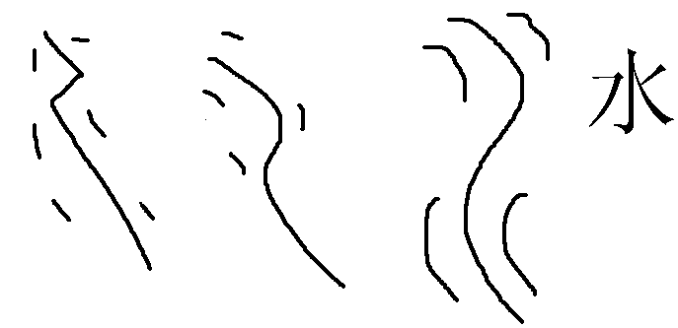
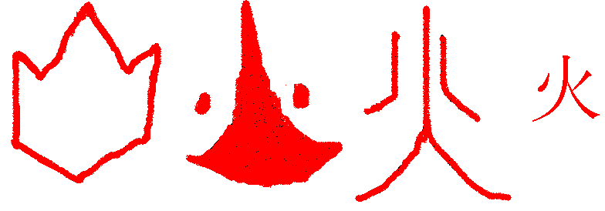
III. Practice
1. How do the Chinese characters“人(person)”，“雨(rain)”， “水(water)” and “火(fire)” reflect the Chinese people and English people’ s patterns of thinking?
Chinese pattern of thinking: concrete, thinking in image
Western pattern of thinking: abstract

Slide 46
2. How does the following case reflect the thinking difference
in China and Western world?
中方代表团到了德国以后，德国接待的主人问今天晚上你们喜欢吃西餐，还是去中餐馆吃中餐？我们有的代表团的答覆往往是「随便」，「客随主便」。翻译成英文是「up to you」，德文是「Wie Sie wollen」他们对这样的答覆难以理解，他们说一听到「随便」这个词就头疼，不知道怎么弄好，不好操作。我们思维方式深处，认为客随主便是礼貌的表现，是对主人的尊重，可西方人不这样看，这就是区别。再反过来看看，欧洲的代表团到中国来，你问他今天干什么，他一定不会说随便，一定会明确表明自己的愿望。今天就吃西餐，或者就吃中餐——卢秋田 （中国驻德国大使）
Chinese pattern of thinking: vague; Western pattern of thinking: precise

Slide 47

IV. Assignments

