Slide 1
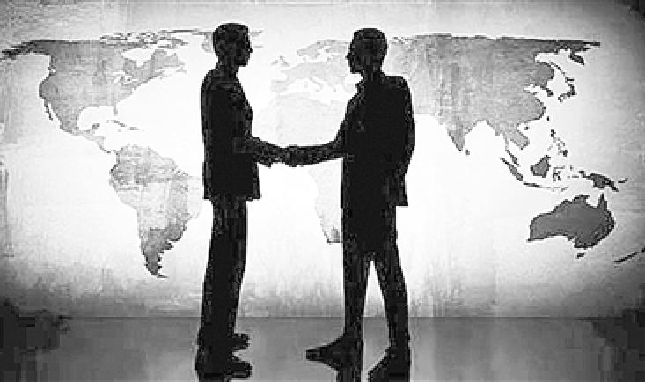
Unit 1
An Introduction
to Intercultural Communication

Slide 2
Learning Objectives
something general about IC;
some requirements for this course.

Slide 3
Contents
What is Intercultural Communication?
Why should we study it?
What does this discipline study?
What are we going to do?

Slide 4
Procedures
Warm-up
1
Text Study
2
Course Requirements
3
3
Assignments
4
4

Slide 5

I. Warm-up
Case 1 Have You Had Your Lunch?
How could you explain the reason that Mary was puzzled?

Slide 6

Analysis
The case shows the misunderstanding caused by verbal communication.
misunderstanding conflict

Slide 7
I. Warm-up
Case 2 A British Professor’s Posture
How could you explain the reason that the British professor was demanded to be sent home by the students?

Slide 8
Analysis
The case shows the misunderstanding caused by non-verbal communication.
misunderstanding conflict

Slide 9
II. Text Study
Go over textbooks from pages 3 to 6 and answer the following questions.
1. What is Intercultural Communication?
2. What does IC study?
3. How does IC develop?
4. What is the relationship between IC and other disciplines?
5. Why should we study IC?
6. How should we study IC?

Slide 10
2.1. What is intercultural communication/IC?
This term refers to both a phenomenon and a discipline.
phenomenon : communication between people from different cultural backgrounds;
discipline: a field of study that looks at how people from different cultural backgrounds endeavor to communicate.
It is both old and new.
It is both easy and difficult.
IC is regarded as an interdisciplinary field

Slide 11
Old and new
As a social phenomenon, IC is nothing new. The history of human beings is also the history of IC as there exists IC as long as there is communication between individuals with different cultures.
Take “Silk Road” in Chinese history as an example, peoples in Asia, Africa and Europe interacted with each other through the “Road”. Today we interact with each other over the Internet.

Slide 12

Old and new
Intercultural Communication, as a relatively newly developed discipline, started in America between 1950s and 1960s, and and was marked by The Silent Language (1959), a classic (经典) in IC studies by Edward Hall who is believed as the founder of IC.
. This is very natural as US is a country of immigrants who are from Europe, Africa, Asia and some other continents with different cultures and social customs. Cultural problems will undoubtedly arise in the process of communication (In 1960s, in America, the ethics, especially the blacks fought for their rights and tried to maintain their own cultures, consequently, there appeared multicultural dimensions in this country. It was unavoidable to deal with different cultural values or customs.) The phenomenon certainly attracted sociologists or anthropologists attention. Besides, America communicated with other countries more and more frequently. Americans went abroad and at the same time, many foreigners, including travellers, immigrants and overseas students , came to America every year,. It became necessary to develop these people’s cross-cultural competence. “It is time Americans learned how to communicate effectively with foreign nationals” (Edward Hall,1959)

Slide 13

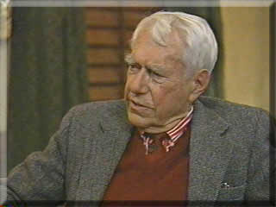
Classics by Edward T. Hall
1959 -The Silent Language
1966 - The Hidden Dimension
1976 -Beyond Culture

Slide 14




Still in Print and Influencing the field

Slide 15

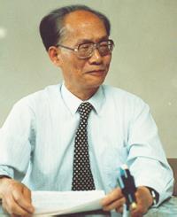

Old and new
The history of IC in China is comparatively shorter. In the early 1980s, scholars began to notice the field with focus mainly on foreign language teaching and the relationship between culture and language. e.g. Culturally-loaded Words and English Language Teaching(许国璋.)

Slide 16




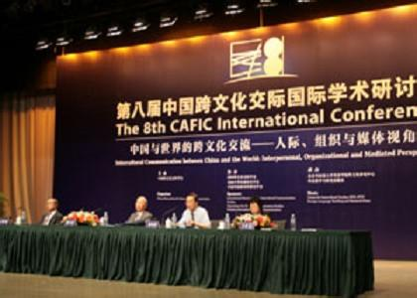
Old and new
In the later years, especially these years, IC has witnessed a dramatic development in China, many books and journals have been published and more and more college students have been choosing IC as their optional subject.

Slide 17
Easy and difficult
Intercultural communication as a phenomenon is really universal.
Anyone can communicate with those who are from different cultural backgrounds in one way or another, but the problem is whether the communication is effective or not.

Slide 18
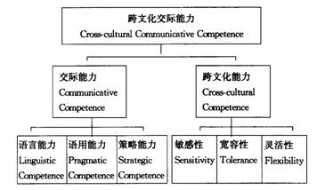
Easy and difficult
Language alone does not guarantee effective communication. Cultural factors contribute. Examples.

Slide 19
Example1
When an American teacher asked one Chinese freshman to answer a question, she answered: “I don’t know.” To her surprise, the teacher said: “As an adult, you should at least have some idea about a question, no matter how difficult it is.” How do you understand it?

Slide 20
“I don’t know why I could not say “I don’t know.” It was always safe for me to say that in my Chinese classes. After I had several more American teachers I began to realize that Chinese teachers concentrate on the results of learning and teaching, while American teachers generally emphasize the process.
Traditionally Chinese teachers expect the students’ answers to be correct, while American teachers welcome any answers because all answers are the fruit of the student’s thinking. That is why a Chinese teacher prefers the decent “I don’t know” to a wrong answer, while an American teacher feels annoyed by it.”

Slide 21
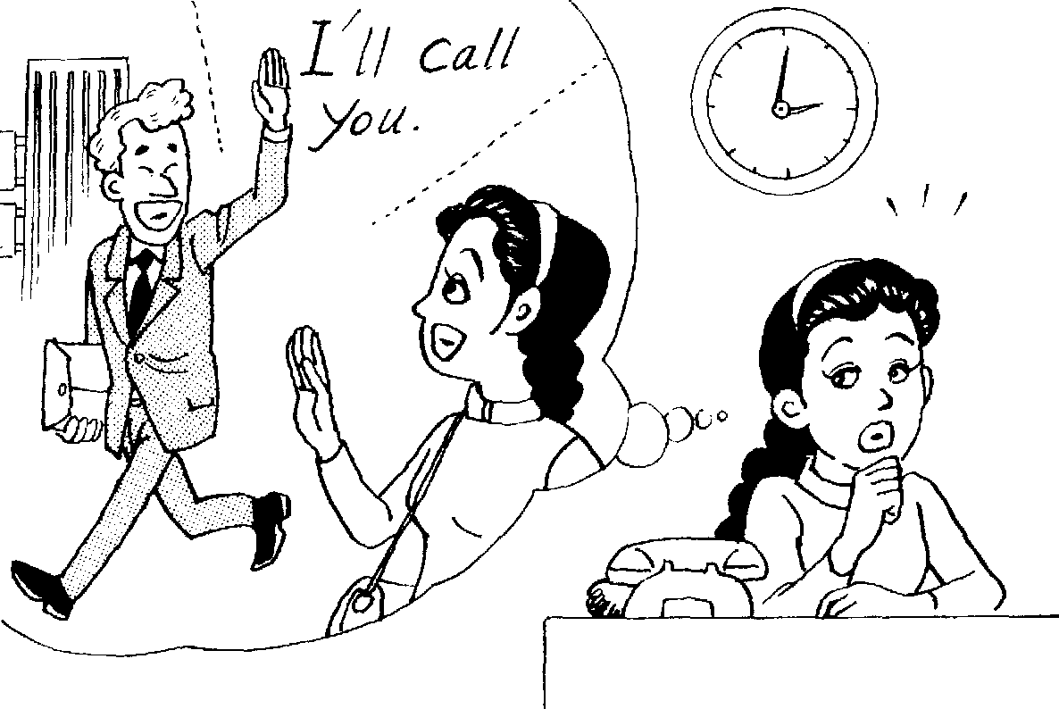
Example 2
1. Let’s get together soon.
2. I haven’t seen you for a long time. You must come round for dinner sometime.
3. It’s good seeing you. I’ll invite you to tea later.
Don't mean it when they say "I'll call you" or "Let's meet for dinner".
Americans may use these expressions to simply close a conversation, or say goodbye. They may not actually mean to call the other person, nor are they necessarily offering an invitation to dinner.

Slide 22

Example 3
There has been a very famous brand of battery in China: White Elephant. Suppose this product is to be exported to the UK or the USA, it’s very likely to fail without changing its brand name. Why?
White elephant: Something useless and expensive to maintain in English.

Slide 23
Example 4
One cold winter day in a Chinese city, Wang Lin on his way to the library met an American Professor who knew very little about China. After greeting him, Wang said: “It’s rather cold. You’d better put on more clothes.” But the professor didn’t appear happy on hearing this.
U.S people like to be independent

Slide 24
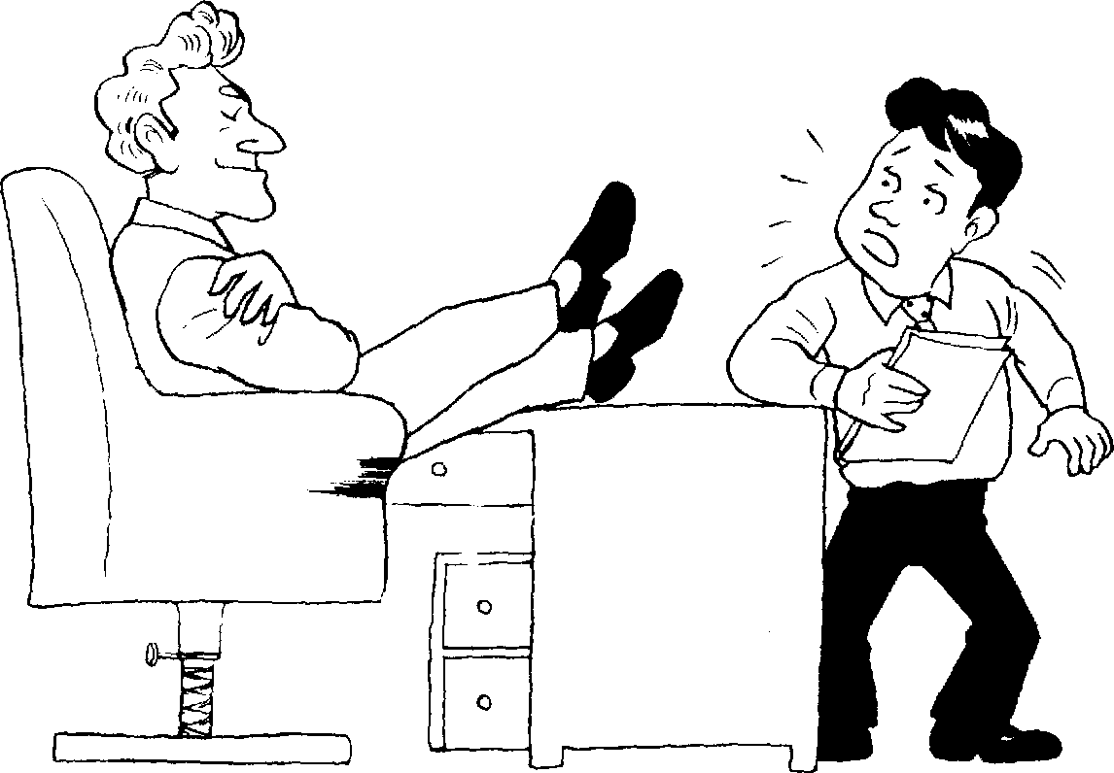
Example5
Put their feet up on a desk or chair in public places, including the classroom.
Some Americans will display informality in public, including classrooms, by putting their feet up on chairs, or even on a desk. Do you sometimes put feet up on a chair or desk in a public place?
No

Slide 25
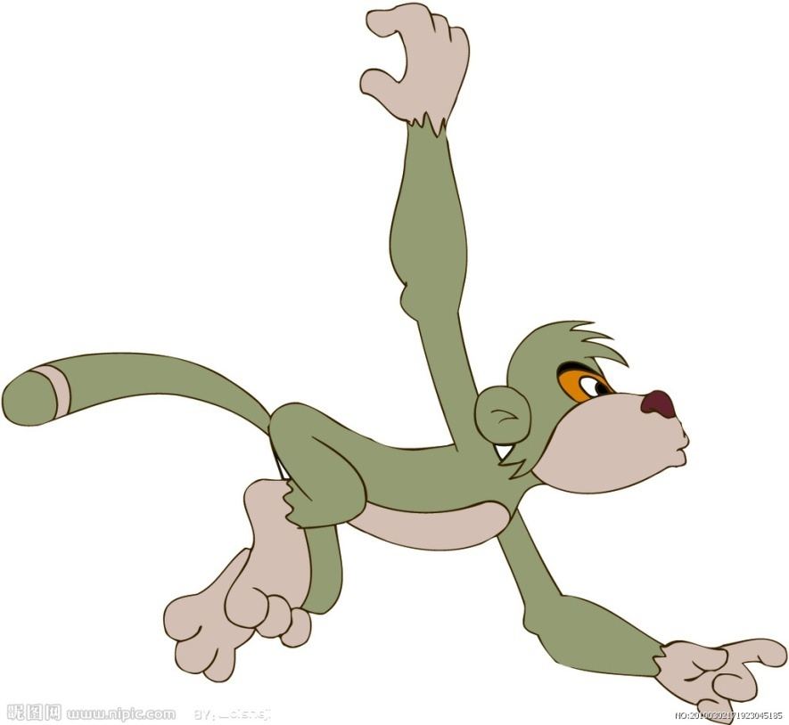
Easy and difficult
And we usually judge people from other cultures with our own cultural rules. So problems may arise. A story:

Slide 26
Story
Once upon a time a monkey decided to leave the forest and explore the great, wide world. He traveled to the city and saw many strange and wonderful things but finally he decided to return home. Back in the forest his friends gathered around. “What did you see?” they cried.
“I saw many buildings made of concrete and glass. Buildings were so high that they touched the sky,” he said. And all his friends imagined branches scratching the sky. “The buildings were full of people walking on two legs and carrying briefcases,” he said. All his friends could almost see people running along the branches with their tails wrapped firmly around their briefcases.

Slide 27
Easy and difficult
This requires better understanding of ourselves and others, and competence to communicate with them more effectively. To make it effective, two kinds of fluency is involved: English fluency, and communicative fluency.
So:
1. To learn a foreign language without learning its culture is to very good way to make yourself a language fluent ___.
2. You will not know your own culture until you ___.
3. Communication is ___ a business.
fool
communicate with another.
risky

Slide 28
2.2. What does IC study?
The Scope/Contents of IC
There is a large field of IC, but generally it mainly covers the following scopes or contents:
(1) intercultural communication theories, such as theories concerning culture, communication, language, cultural values, culture shock, etc.
(2) pragmatic rules;
(3)verbal communication,
(4) non-verbal communication,
(5) social customs, such as festivals, religion, marriage, foods and drinks, etc.
(6) interpersonal relationship, conversation topics, making friends, gifts-giving/gifts-taking, etc.
(7) business negotiation
(8) intercultural communication competence

Slide 29

In a word, the contents for IC in this course will focus on “what”, “why” and “how”, that is what are the cultural differences between different peoples, why are there such differences, and how to deal with these differences.

Slide 30
2.3.What disciplines is IC related to ?
Psychology, Sociology,
Anthropology
App. Ling. history Education geography religion Media
Culture Studies
Law, Politics, Economics

Slide 31
2.4. Why should we study IC?
It is often thought that people can communicate with
foreigners effectively if they have listening, speaking, reading
and writing abilities in a foreign language.
But actually, it is not the case. Quite often, one polite
behavior in a culture may be impolite or even rude in another
culture.
So it is more important to know “how to say” than” “what to
say” in cross-cultural communication. The study of IC will help
us:

Slide 32
(1) to take positive and understanding attitudes towards other cultures
Cultures are different.
Through studying IC, we can gain insight into other cultures.
It helps broaden our horizon and open our minds do different perspectives and experiences.
It helps awaken our cultural sensitivity, the reflection and unlearning of ethnocentrism and help the cultivation of an open attitude and the general development of intercultural personalities.

Slide 33
(2) to understand Chinese culture better from new perspectives
Through studying IC, we can compare Chinese culture with other different cultures from all-round dimensions in a world background, and to know what is there in our culture, how can we adapt to different cultures, and how can we learn and assimilate all the great cultural achievements of other countries to enrich our national culture.

Slide 34

(3) to make effective cross-cultural communication in a global environment
As the result of the formation of “Global Village”, today’s world is becoming smaller, people are becoming more closely connected with each other. They are facing the reality of cross-cultural communication in a global environment. They need to deal with international economic relationship, they need to solve environmental issues including overfishing, global warming, deforestation, endangered species, waste disposal, and air and water pollution, they need to share ideas and information more freely ……to achieve these purposes, people need to develop their cross-cultural communicative competences.

Slide 35
2.5. How to Study IC?
        There are many approaches to studying foreign culture, which depend on different goals, but generally, these approaches may roughly fall into two categories: intellectual approach and experiential approach.
        There is no doubt that for English language learners, the best way to study English culture is to experience it. It is better through experiencing English culture that we can really understand the target culture and find out how native speakers use their language.

Slide 36
However, it is impossible for most of the English language learners to go directly to the target countries (English-speaking countries) to learn about the target culture.
Thus intellectual knowledge indirectly gained through classroom training, reading newspapers and magazines, watching movies and TV or going to the internet, etc. are the alternatives to learn about the social and cultural milieu of the English language.
If we can learn conscientiously, we can still have a good chance of learning about the target culture.
Such specific methods as comparison, analysis, discussion or imitation can be employed in studying IC.

Slide 37
III. Course Requirements
——What are we going to do in this class?
3.1.Teaching Plan for IC
第一周（2学时）Unit 1 An Introduction to Intercultural Communication (IC)
第二周（2学时）Unit 2 Communication, Culture and Language
第三-四周（4学时）Unit 3 Language and Culture
第五-六周（4学时）Unit 4 Cultural Values
第五-六周（4学时）Unit 5 Thinking Patterns in the East and West
第七-八周（4学时）Unit 6 Verbal Communication
第九-十周（4学时）Unit7 Nonverbal Communication
第十一-十二周（4学时）Unit 8 Social Customs and Interactions
第十三-十四周（4学时）Unit 9 Intercultural Business Negotiation
第十五周（2学时）Unit 10 Improving Intercultural Communication Competence
第十六周（2学时）Revision
第十七周 Examination

Slide 38

3.2.Text Book

Slide 39
3.3.Suggested Reading Books
1. Larry A. Samovar, Richard E. Porter, Lisa A. Stefani, 2000, Communication Between Cultures, Beijing: Foreign Language Teaching and Research Press. （跨文化交际学的 “Bible”）
2.《跨文化交际学概论》胡文仲, 外语教学与研究出版社，1999,
（短小精练，高度概括）
3. Doing Culture: Cross-Cultural communication in Action, Davis, Linell., (《中西文化之鉴》 ), 外语教学与研究出版社，2010
（老外的亲身经历，有丰富的第一手案例）
4. 《跨文化交际学》，贾玉新，上海外语教育出版社2003
5. 《跨文化交际英语教程》，许力生，上海外语教育出版社，2004
6.《跨文化非语言交际》，杜学增，外语教学与研究出版社，1999,
…

Slide 40
3.4.Suggested Video Materials
Gua Sha ( The Treatment / Guasha Treatment)
刮痧
Crash 撞车
Outsourced 世界是平的
The Joy Luck Club 喜福会
Babel 通天塔
Terminal 幸福终点站
Mulan 花木兰
Pushing Hands 推手
The Wedding Banquet 喜宴
Drink Eat Man Woman 饮食男女
Anna and the King安娜与国王
Family Album in USA(走遍美国)
Friends(六人行/老友记）
Good Luck Charlie(查莉成长日记)
…

Slide 41

3.5.Course Assessment
Final Examination（50%）+ attendance & performance（50%）
Attendance: 10% (Absence from one class session with no permission results in losing one point. Any student who misses more than one third of the class sessions will not be permitted to take the final exam.)
Performance : 40 % (It includes contribution in questions and answers, pair work, group work ,class discussion, written assignments, etc.)

Slide 42
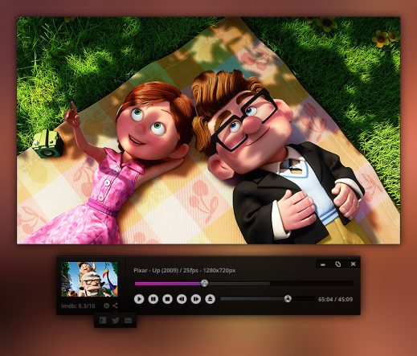

3.6.Teaching Methodology
Video Viewing and Analysis
PowerPoint Interactive Lectures
Critical Incidents (Case Studies)
Problem Analysis and –Solving
Pair and Group Discussions
Experiential Activities
Written Feedback

Slide 43
3.7. five points about this course
1. No culture is superior to another.
2. In this global village, we are alike, we are different; appreciate similarities, accept differences.
3. Nothing is extreme, especially when we study Intercultural Communication.
4.The focus is mainly on the cultures in China and English-speaking countries, especially in America.
5. We are to do both “learning about culture” and “doing culture.”

Slide 44

IV. Assignments
1. Discuss part of the questions in Ex.I;
2. Analyze some of the cases in Ex.III;
3. Get on the Internet and locate some intercultural-related websites.
…

